Slide 1
Remember Who You Are
Acts 4:8-14

Slide 2
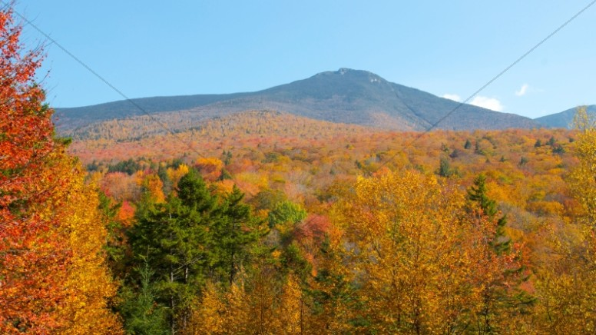
When tempted to sin…
Remember Who You Are…

Slide 3
Don’t Forget!!!!!

Slide 4
Acts 4:8-14
⁸ Then Peter, filled with the Holy Ghost, said unto them, Ye rulers of the people, and elders of Israel,
⁹ If we this day be examined of the good deed done to the impotent man, by what means he is made whole;
¹⁰ Be it known unto you all, and to all the people of Israel, that by the name of Jesus Christ of Nazareth, whom ye crucified, whom God raised from the dead, even by him doth this man stand here before you whole.
¹¹ This is the stone which was set at nought of you builders, which is become the head of the corner.

Slide 5
¹² Neither is there salvation in any other: for there is none other name under heaven given among men, whereby we must be saved.
¹³ Now when they saw the boldness of Peter and John, and perceived that they were unlearned and ignorant men, they marvelled; and they took knowledge of them, that they had been with Jesus.
¹⁴ And beholding the man which was healed standing with them, they could say nothing against it.

Slide 6

Remember Who You Are…

Slide 7
What a wonderful explanation:
They noted that these Apostles had been with Jesus.
It makes a difference to be known that you have been With Jesus!

Slide 8
^{Phil. 1: 19} For I know that this shall turn to my salvation through your prayer, and the supply of the Spirit of Jesus Christ,
²⁰ According to my earnest expectation and my hope, that in nothing I shall be ashamed, but that with all boldness, as always, so now also Christ shall be magnified in my body, whether it be by life, or by death.
²¹ For to me to live is Christ, and to die is gain.
²² But if I live in the flesh, this is the fruit of my labour: yet what I shall choose I wot not.
²³ For I am in a strait betwixt two, having a desire to depart, and to be with Christ; which is far better:
²⁴ Nevertheless to abide in the flesh is more needful for you.

Slide 9
²⁵ And having this confidence, I know that I shall abide and continue with you all for your furtherance and joy of faith;²⁶ That your rejoicing may be more abundant in Jesus Christ for me by my coming to you again.
²⁷ Only let your conversation be as it becometh the gospel of Christ: that whether I come and see you, or else be absent, I may hear of your affairs, that ye stand fast in one spirit, with one mind striving together for the faith of the gospel;²⁸ And in nothing terrified by your adversaries: which is to them an evident token of perdition, but to you of salvation, and that of God. ²⁹ For unto you it is given in the behalf of Christ, not only to believe on him, but also to suffer for his sake;³⁰ Having the same conflict which ye saw in me, and now hear to be in me.

Slide 10
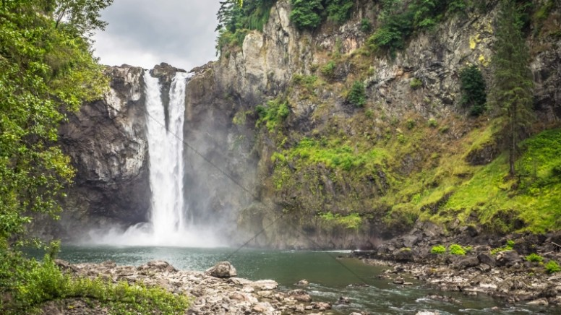
Remember Who You Are

Slide 11
My Mother loved to have her picture made With her family. We all have some precious picture albums .And each one is assortment of pictures of loved ones. Pictures Of people who are or have been close to our family. We have pictures of husbands/wives/ children at different ages and with different ones. We have pictures of church members Who have been a big part of our lives..
We love to take time, get the boxes down , and sort through
Our pictures. There is a story that relates to our inner circle
Of days gone by, that brings to our minds some pleasant and
Enduring experiences. Pictures with names reminds me of
who we are; it reminds Me who I am. It connects me with my
past and gives me hope forThe future.

Slide 12
Picture of Mom and Me

Slide 13
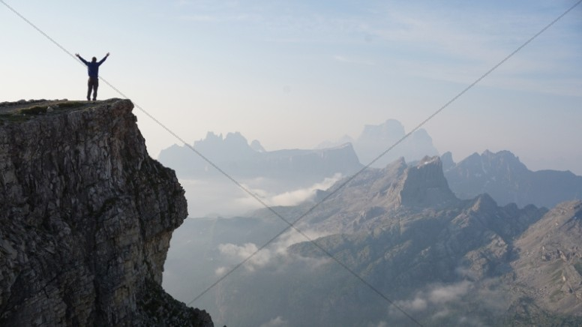
Remember Who you Are ..

Slide 14
When God brought the final plague upon Egypt, He wanted
the Egyptians to see that He put a difference between them
and the children of Israel. Israel were GOD’S PEOPLE!
There are many people who go through life without a good sense of who they are.
In order to get where we all want to go, we must never forget who we are

Slide 15
I. Remember who we are: People made by God from dust. Gen. 2:7 And the Lord God formed man of the dust of the ground, and breathed into his nostrils the breath of life; and man became a living soul
Ecclesiastes 12:7 Then shall the dust return to the earth as it was: and the spirit shall return unto God who gave it.
Psalms 103:13–16). Like as a father pitieth his children, so the Lord pitieth them that fear him.¹⁴ For he knoweth our frame; he remembereth that we are dust.¹⁵ As for man, his days are as grass: as a flower of the field, so he flourisheth.¹⁶ For the wind passeth over it, and it is gone; and the place thereof shall know it no more.

Slide 16
2. Remember what He tells us. Remember who you are!
2 Tim.2:15;
2 Tim. 3:16-17
Heb. 4:12
Psalm 119:104-105
Prov. 30:5-6
Heb. 10:19-20 Having therefore, brethren, boldness to enter into the holiest by the blood of Jesus,
²⁰ By a new and living way, which he hath consecrated for us, through the veil, that is to say, his flesh;

Slide 17
Remember How He wants us to live. Remember WHO you are! Rom. 12:1,2
Col. 3:1,2
Phil. 1:27
Titus 2:11-14 ¹¹ For the grace of God that bringeth salvation hath appeared to all men,
¹² Teaching us that, denying ungodliness and worldly lusts, we should live soberly, righteously, and godly, in this present world;
¹³ Looking for that blessed hope, and the glorious appearing of the great God and our Saviour Jesus Christ;
¹⁴ Who gave himself for us, that he might redeem us from all iniquity, and purify unto himself a peculiar people, zealous of good works

Slide 18
Phil. 4:13
¹³ I can do all things through Christ which strengtheneth me.
Quit the can’t’s … On with the Can’s

Slide 19
Quit the can’t’s : Flee from the evil

Slide 20
^{I Cor. 10: 5} But with many of them God was not well pleased: for they were overthrown in the wilderness.
⁶ Now these things were our examples, to the intent we should not lust after evil things, as they also lusted. (Quit lusting!)
⁷ Neither be ye idolaters, as were some of them; as it is written, The people sat down to eat and drink, and rose up to play.(Quit Idolatry!)
⁸ Neither let us commit fornication, as some of them committed, and fell in one day three and twenty thousand.(Quit fornication!)
⁹ Neither let us tempt Christ, as some of them also tempted, and were destroyed of serpents. (Quit tempting Christ!)
¹⁰ Neither murmur ye, as some of them also murmured, and were destroyed of the destroyer.(Quit complaining , murmuring!)
¹¹ Now all these things happened unto them for examples: and they are written for our admonition, upon whom the ends of the world are come.

Slide 21
On With the CAN’S …
Matt. 7:12 ¹² Therefore all things whatsoever ye would that men should do to you, do ye even so to them: for this is the law and the prophets..
a)If others won’t speak to you, you CAN
speak to them
b)You can do unto others as you would
have them do unto you.

Slide 22
You can love God with all your heart,mind,soul and body.
Matt. 22:36
You can put God first in your life. Matt. 6:33
You can be faithful to God. Rev. 2:10
You can be separate from the world. I John 2:15-17
You can be kind. Eph. 4:32
You can be a true disciple of Christ. John 8:31-32
You can be a light in the world. Matt. 5:14, 16
You can keep on keeping on till your journey is
over. 2 Tim. 4:7-8
REMEMBER..WHO YOU ARE!

Slide 23
1 John 4:17¹⁷ Herein is our love made perfect, that we may
have boldness in the day of judgment: because
as he is, so are we in this world
He will NEVER leave us. Heb. 13:5-6; Prov. 3:5-6

Slide 24
3. Remember who you are:
So your last days
Will be better than your first ones.

Slide 25
Psalm 145:18 The Lord is nigh unto all them
that call upon him, to all that call upon him in truth.
Song: Remember Who you are
In His image God created you
In new birth He gave you life anew.
And His matchless love you now proclaim
You must live to glorify His name.

Slide 26
Christian remember who you are today
As you follow Him along the way.
Though the way seems dark and the journey far
Strength comes when you remember who you are.
You were bought at such an awful price
Christ redeemed you by His sacrifice
You obeyed Him and were free from sin
Peace and hope and joy and love within.
Let your light be bright and ever true
Live so others will see Christ in you
In your life a sermon sinners see,
What the Christian life is meant to be

Slide 27
The 11th Hour. Matt. 20:1 For the kingdom of heaven is like unto a man that is an householder, which went out early in the morning to hire labourers into his vineyard.² And when he had agreed with the labourers for a penny a day, he sent them into his vineyard.³ And he went out about the third hour, and saw others standing idle in the marketplace,⁴ And said unto them; Go ye also into the vineyard, and whatsoever is right I will give you. And they went their way.
⁵ Again he went out about the sixth and ninth hour, and did likewise.
⁶ And about the eleventh hour he went out, and found others standing idle, and saith unto them, Why stand ye here all the day idle?
⁷ They say unto him, Because no man hath hired us. He saith unto them, Go ye also into the vineyard; and whatsoever is right, that shall ye receive

Slide 28
2 Cor. 4:14-18 ¹⁴ Knowing that he which raised up the Lord Jesus shall raise up us also by Jesus, and shall present us with you.
¹⁵ For all things are for your sakes, that the abundant grace might through the thanksgiving of many redound to the glory of God.
¹⁶ For which cause we faint not; but though our outward man perish, yet the inward man is renewed day by day.
¹⁷ For our light affliction, which is but for a moment, worketh for us a far more exceeding and eternal weight of glory;
¹⁸ While we look not at the things which are seen, but at the things which are not seen: for the things which are seen are temporal; but the things which are not seen are eternal.

Slide 29
2 Corinthians 5:1-12
1 For we know that if our earthly house of this tabernacle were dissolved, we have a building of God, an house not made with hands, eternal in the heavens.
² For in this we groan, earnestly desiring to be clothed upon with our house which is from heaven:
³ If so be that being clothed we shall not be found naked.
⁴ For we that are in this tabernacle do groan, being burdened: not for that we would be unclothed, but clothed upon, that mortality might be swallowed up of life.
⁵ Now he that hath wrought us for the selfsame thing is God, who also hath given unto us the earnest of the Spirit.

Slide 30
⁶ Therefore we are always confident, knowing that, whilst we are at home in the body, we are absent from the Lord:
⁷ (For we walk by faith, not by sight:)
⁸ We are confident, I say, and willing rather to be absent from the body, and to be present with the Lord.
⁹ Wherefore we labour, that, whether present or absent, we may be accepted of him.
¹⁰ For we must all appear before the judgment seat of Christ; that every one may receive the things done in his body, according to that he hath done, whether it be good or bad.
¹¹ Knowing therefore the terror of the Lord, we persuade men; but we are made manifest unto God; and I trust also are made manifest in your consciences.

Slide 31
1 Corinthians 4:14-16¹⁴ I write not these things to shame you, but as my beloved sons I warn you.
¹⁵ For though ye have ten thousand instructors in Christ, yet have ye not many fathers: for in Christ Jesus I have begotten you through the gospel.
¹⁶ Wherefore I beseech you, be ye followers of me.

Slide 32
For some , We are almost Home!
..Life is like a vapor James 4:13-14
..Going Home…Life is as a flower. I Pet. 1:22-25
“Come, ye blessed of my Father, inherit
the kingdom prepared for you from the
foundation of the world.” (Matt. 25:31-46)
Remember Who You Are…

Slide 33
Remember How He wants us to live. Remember WHO you are! Rom. 12:1,2
Col. 3:1,2
Phil. 1:27
Titus 2:11-14 ¹¹ For the grace of God that bringeth salvation hath appeared to all men,
¹² Teaching us that, denying ungodliness and worldly lusts, we should live soberly, righteously, and godly, in this present world;
¹³ Looking for that blessed hope, and the glorious appearing of the great God and our Saviour Jesus Christ;
¹⁴ Who gave himself for us, that he might redeem us from all iniquity, and purify unto himself a peculiar people, zealous of good works

Slide 34
Acts 17:24-31 God that made the world and all things therein, seeing that he is Lord of heaven and earth, dwelleth not in temples made with hands;²⁵ Neither is worshipped with men's hands, as though he needed any thing, seeing he giveth to all life, and breath, and all things;²⁶ And hath made of one blood all nations of men for to dwell on all the face of the earth, and hath determined the times before appointed, and the bounds of their habitation;²⁷ That they should seek the Lord, if haply they might feel after him, and find him, though he be not far from every one of us:

Slide 35
²⁸ For in him we live, and move, and have our being; as certain also of your own poets have said, For we are also his offspring.²⁹ Forasmuch then as we are the offspring of God, we ought not to think that the Godhead is like unto gold, or silver, or stone, graven by art and man's device.³⁰ And the times of this ignorance God winked at; but now commandeth all men every where to repent:³¹ Because he hath appointed a day, in the which he will judge the world in righteousness by that man whom he hath ordained; whereof he hath given assurance unto all men, in that he hath raised him from the dead.

Slide 36
Rom.12:5
So, we, who are many, are one body
In Christ and individually members one of another.,

Slide 37
Matthew 5:14-16
¹⁴ Ye are the light of the world.
A city that is set on an hill cannot be hid.
¹⁵ Neither do men light a candle, and put it under a bushel, but on a candlestick; and it giveth light unto all that are in the house.
¹⁶ Let your light so shine before men, that they may see your good works, and glorify your Father which is in heaven.

Slide 38
If you are a Christian, then you are a child of God
Spiritually.
…Why are you here? To glorify God.. I Pet. 4:11
…What made you special? God hath chosen us.
The awful price Christ paid:
Redeemed you by His blood Rom. 5:8-9
…How are you suppose to live? “Live for Jesus, O
My brother” Phil. 1:27

Slide 39
Others Remembered who they were….
Paul…remembered who he was I Tim. 1:15
Joseph..remembered who he was Gen. 39:8-9
But he refused, and said unto his master's wife, Behold, my master wotteth not what is with me in the house, and he hath committed all that he hath to my hand;
⁹ There is none greater in this house than I; neither hath he kept back any thing from me but thee, because thou art his wife: how then can I do this great wickedness, and sin against God?

Slide 40
Like the woman who had been taken in the very
act of
Adultery . listen to what Jesus told her:
John 8:5-11

Slide 41
^{Her} Accusers said:
⁵ Now Moses in the law commanded us, that such should be stoned: but what sayest thou?
⁶ This they said, tempting him, that they might have to accuse him. But Jesus stooped down, and with his finger wrote on the ground, as though he heard them not.
⁷ So when they continued asking him, he lifted up himself, and said unto them, He that is without sin among you, let him first cast a stone at her.
⁸ And again he stooped down, and wrote on the ground.

Slide 42
⁹ And they which heard it, being convicted by their own conscience, went out one by one, beginning at the eldest, even unto the last: and Jesus was left alone, and the woman standing in the midst.
¹⁰ When Jesus had lifted up himself, and saw none but the woman, he said unto her, Woman, where are those thine accusers? hath no man condemned thee?
¹¹ She said, No man, Lord. And Jesus said unto her, Neither do I condemn thee: go, and sin no more.
Remember who you are!

Slide 43
<Like the woman who was a poor widow .…but gave all that she had Mark 12:41-44 And Jesus sat over against the treasury, and beheld how the people cast money into the treasury: and many that were rich cast in much.
⁴² And there came a certain poor widow, and she threw in two mites, which make a farthing(2 small coins worth a penny NASV) .
⁴³ And he called unto him his disciples, and saith unto them, Verily I say unto you, That this poor widow hath cast more in, than all they which have cast into the treasury:
⁴⁴ For all they did cast in of their abundance; but she of her want did cast in all that she had, even all her living.
Remember Who You Are!!

Slide 44
<Like the publican in Luke 18:13 “God be merciful to me
A (the) sinner”.
<Like the apostle Peter, Who DENIED the Lord, 3 times,
‘go out and weep bitterly…and change’ Lk.22:61-62
⁶¹ And the Lord turned, and looked upon Peter. And Peter remembered the word of the Lord, how he had said unto him, Before the cock crow, thou shalt deny me thrice.
⁶² And Peter went out, and wept bitterly

Slide 45
< Like Mary, who set at ‘Jesus feet’ and listened to
Jesus…” (Lk.10:39) Go and learn God’s truth” 2 Tim.2 :15
Remember who you are:
1. Don’t smoke, don’t do drugs, don’t drink whiskey,
Don’t’ engage in lustful dancing, keep your mouth
Speaking things that honor God, not the things that
Bring dishonor
2. Don’t lie, don’t steal, don’t speak gossipy about
Your friends and neighbors.
3. Count your blessings..
REMEMBER WHO YOU ARE!!

Slide 46
No matter what life may hold
And no matter what others around you
May do or say,
Remember—always remember—
WHO YOU ARE…

Slide 47
I AM A SINNER SAVED BY GRACE. Eph. 2:8-10
I AM A Redeemed ONE- I Pet. 1:18
I AM A FOLLOWER OF JESUS CHRIST . Matt. 16:24
I AM A THANKFUL CHRISTIAN ..Acts 11:26; Acts 26:28; I Pet. 4:16
I AM A DISCIPLE OF THE KING JESUS. Acts 11:26
I AM A PERSON ON MY WAY TO HEAVEN. Lk.9:62
I AM A WHAT I AM BECAUSE OF JESUS MY LORD! I Tim 1:15

Slide 48
We cannot disappoint Him. We dare not take
Him for granted. We will not turn from Him.
And we will be faithful. “
Lord, you can count
On me!”
REMEMBER WHO YOU ARE!!

Slide 49
Don’t allow any circumstances in life to make
you forget who you are.
C. No matter what life may hold and
no matter what others around you
may do or say, remember––always remember––who you are!

Slide 50
Is your name written there?
Has your name been blotted out of the book?
It’s up to you…You make the final decision…we
Pray for you, we urge you to live for Jesus, but
It is all left up to you for your decision.
May God help you to make the right decision
This morning! Remember who you are!

