Slide 1
STICKING WITH THE WORD OF GOD
O'Neal Church of Christ June 15th 2017

Slide 2
In the world we live in today people have all types of thoughts on how we should live and the types of paths we take.
Tonight I want to look at some biblical characters who Stuck with Gods word and how it benefited them.
I hope we can look with open hearts and make application from these examples of how sticking with God’s word can help us have a better relationship with Christ and hope of eternal life.

Slide 3
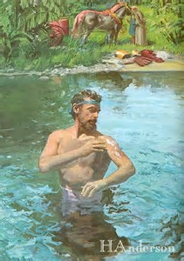
Naaman 2nd Kings 5:1, 8-14
-vs 14 According to the saying of the man of God
-He first thought of other ways to be cleansed…. then he decided to go with God’s way.

Slide 4
Making Application to Naaman….
-Many today try other ways for salvation…..
Reciting the Sinners Prayer
Once Saved Always Saved
Predestination
Laying on of Healing Hands (Television Schemes)
Many more ways that are not the Lord’s way
Baptism not necessary
Acts 2:37-38 John 3:5 Galatians 3:27
Let’s stick with God’s word on salvation and not alter it.

Slide 5
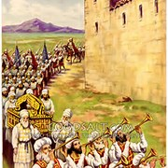
The Walls of Jericho Joshua 6:2-5, 10,15-16
-vs 2 The LORD SAID
-Joshua stuck with the Word of God and it paid off
-Joshua never changed, became innovative, or strayed from what God had commanded

Slide 6
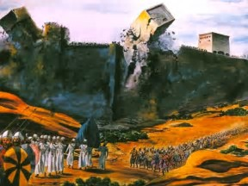
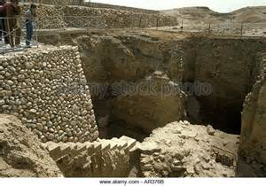
Making application to the walls of Jericho……
-Many today don’t stick with God’s word as Joshua did
They do things like
Add Musical Instruments to worship
Only partake in the Lord’s supper sometimes
(but give EVERY Sunday)
Worship the creature rather than the creator
Make human creeds
Add and Take from God’s word (Rev 22:18-19)
Plus much more
Matthew 15:8-9 Matthew 7:21-23 Leviticus 10:1-2
Let’s Stick with God’s Word and not alter it.

Slide 7
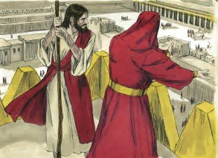
3. Jesus Christ Matthew 4:1-4,7,10
-Jesus kept repeating “IT IS WRITTEN”
-Do you do the same when making your decisions on salvation, how to worship, and how to live?
-Can we say regarding the direction of our lives and our decisions, we do or do not do this or that because “IT IS WRITTEN”?

Slide 8

Making application to Jesus Christ sticking to the Word of God……..
-We need to study to show ourselves approved to know what is written 2nd Timothy 2:15
-All Scripture is important because it is the breathe of God 2nd Timothy 3:16-17
-Always putting God’s will first, as should we Mark 14:36
We should always stick to Gods word when it comes to
Putting God First Matthew 6:33
Raising our children Deuteronomy 6:6-9
Choosing a job
Choosing recreation
Giving God our best at all times

Slide 9
Conclusion
-Are you sticking to the word of God in a world who will go every which way the wind takes them?
-Are your reasons for sticking with the word of God due to an engrained faith in God?
-Stick with the word of God and in the end it will pay off.

