Slide 1
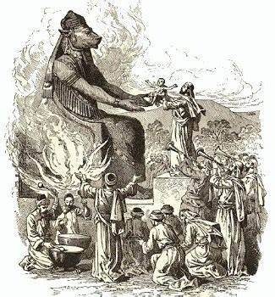
Sacrificing our Children to Idols

Slide 2
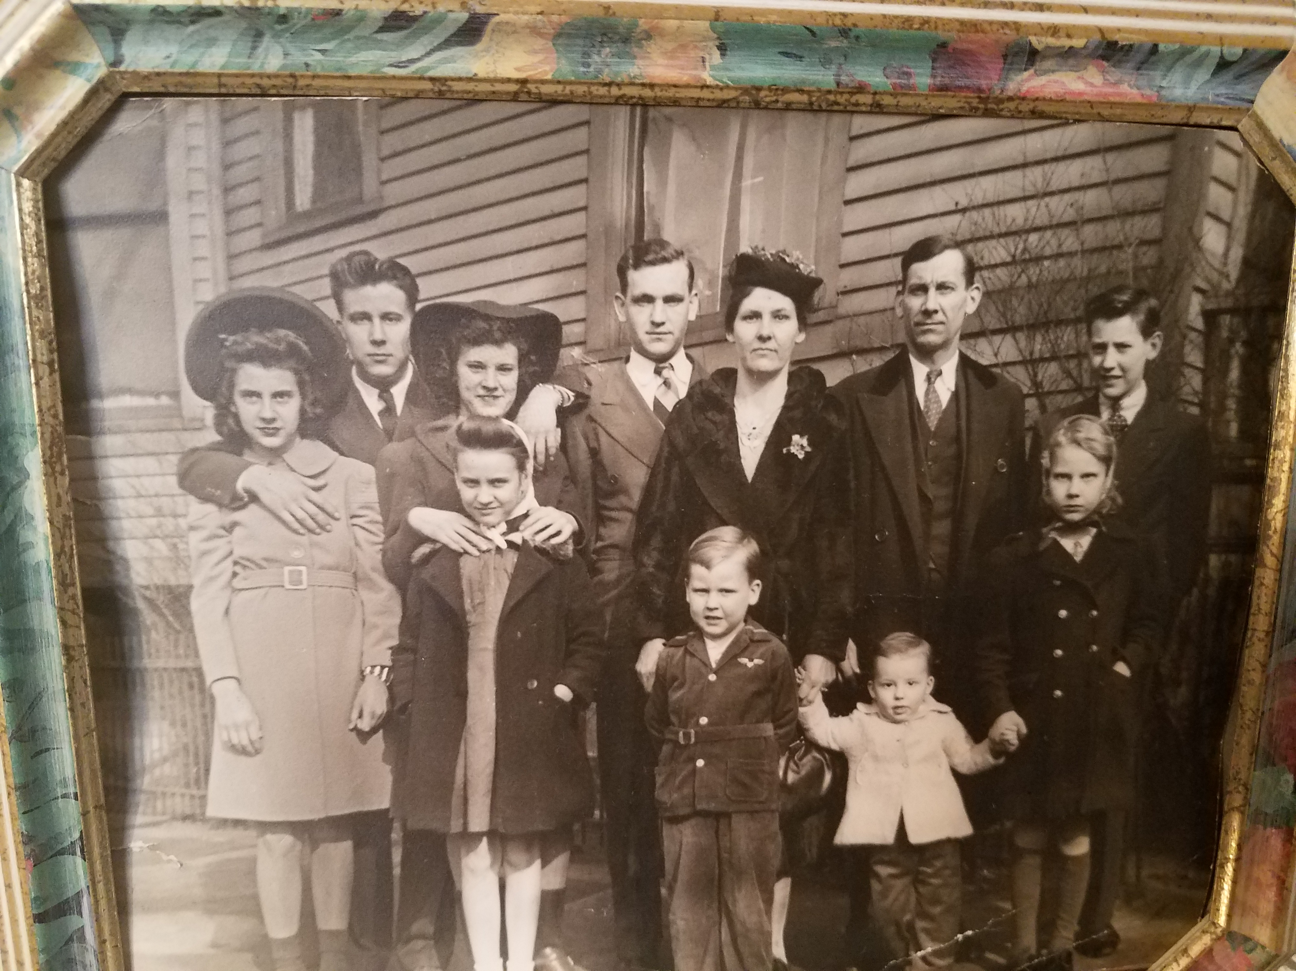

Slide 3
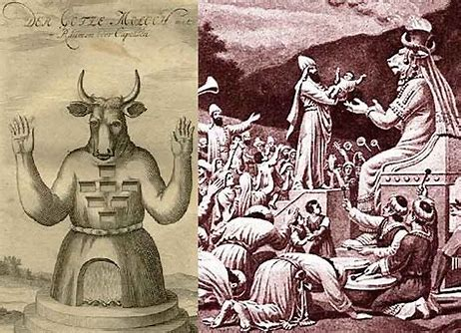
-Practiced Among God’s O.T. People
-Before Israel entered Canaan, God warned them about the abominable practices of the heathen nations they would displace.
-Particularly, the practice of child sacrificing (Lev 18:21)
-Israel ignored Him (2 Kings 16:2-3)

Slide 4
Leviticus 18:21 ²¹"'Do not give any of your children to be sacrificed to Molek, for you must not profane the name of your God. I am the LORD.
2 Kings 16:2-3 ²Ahaz was twenty years old when he became king, and he reigned in Jerusalem sixteen years. Unlike David his father, he did not do what was right in the eyes of the LORD his God. ³He followed the ways of the kings of Israel and even sacrificed his son in the fire, engaging in the detestable practices of the nations the LORD had driven out before the Israelites.

Slide 5
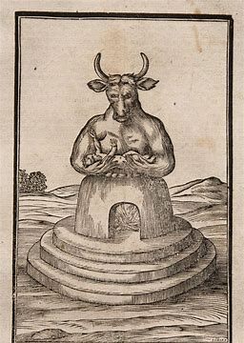
-Practiced Among God’s O.T. People
-Through one His greatest prophets, Jehovah tells us just how bad He felt about this practice.
(Jer 32:30-35)

Slide 6
Jeremiah 32:30-35 ³⁰"The people of Israel and Judah have done nothing but evil in my sight from their youth; indeed, the people of Israel have done nothing but arouse my anger with what their hands have made, declares the LORD. ³¹From the day it was built until now, this city has so aroused my anger and wrath that I must remove it from my sight. ³²The people of Israel and Judah have provoked me by all the evil they have done-they, their kings and officials, their priests and prophets, the people of Judah and those living in Jerusalem. ³³They turned their backs to me and not their faces; though I taught them again and again, they would not listen or respond to discipline. ³⁴They set up their vile images in the house that bears my Name and defiled it. ³⁵They built high places for Baal in the Valley of Ben Hinnom to sacrifice their sons and daughters to Molek, though I never commanded-nor did it enter my mind-that they should do such a detestable thing and so make Judah sin.

Slide 7
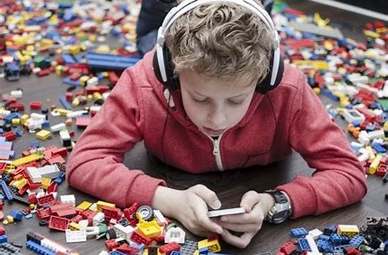
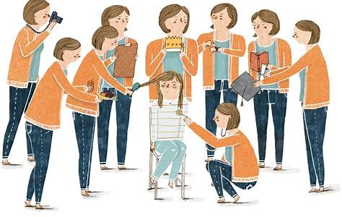
-Unfortunately it is Practiced Among God’s N.T. People
-We are not through offering up our children to idols.
-We’ve only substituted our modern-day “gods” for the ancient idol Molech.

Slide 8

Sacrificing Our Children to Idols………..
1. The “GOD OF APATHY”
  Too many children no longer care about ethics, manners, respect, responsibility.
  Even worse, many children of Christians do not care about the Lord, His word, or His church
  If we as parents do not care, our children will not care.
  The Bible teaches diligence, not negligence.
  (Rom 12:10-11 Heb 6:9-12 2 Pet 1:5)

Slide 9

Sacrificing Our Children to Idols………..
2. The “GOD OF MATERIALISM”
  Many raise children in an environment where money & possessions take center stage.
  This example sends the wrong message to our children. (Lk 12:15)
  Such raising sends the wrong message to our children
  Earthly treasures take precedence over heavenly ones. (Mt 6:19-21)
  “Spiritual poverty” will come.
  (Lk 12:21) (1 Tim 6:6-10)

Slide 10

Sacrificing Our Children to Idols………..
3. The “GOD OF PLEASURE”
  This begins as many children observe their parents’ obsessions with secular activities.
  The problem is not a healthy pursuit of such innocent interests
  The problem is allowing such activities to crowd God out of our hearts (Lk 8:11, 14)
  Loving pleasure over loving God is a sure sign of sin. (2nd Tim 3:4)
  Many parents encourage their children to be very active in such activities…unfortunately, to the exclusion of their spiritual training.
  This is not the Lord’s plan for us. (Mt 6:33)

Slide 11

Conclusion
-God only gives us our children for a short while…then, we must give them up.
-We cringe at the idea of child sacrifice.
-How much more should we cringe when our children are offered up to our own modern-day idols??
-Therefore we are exhorted to “train” and “teach”. (Prov 22:6)
-To do this takes time, effort, love!
-If we sacrifice our children to modern-day idols, Jeremiah’s ancient words have a relevant haunting ring. (Jer 32:30-35)

Slide 13


Conclusion
-Are you raising your children in a way that they know God is first?
-Are do have the cares, riches, and pleasures of this world chocked out the Lord in your lives?

