Slide 1
Judges 15:20 (NKJV)
20 And he judged Israel twenty years in the days of the Philistines.

Slide 2
Samson and the Nazarite Vow

Slide 3
A Nazarite from the womb
Judges 13:5 (NKJV)
5 For behold, you shall conceive and bear a son. And no razor shall come upon his head, for the child shall be a Nazirite to God from the womb; and he shall begin to deliver Israel out of the hand of the Philistines.”
Judges 13:24-25 (NKJV)
24 So the woman bore a son and called his name Samson; and the child grew, and the Lord blessed him. 25 And the Spirit of the Lord began to move upon him at Mahaneh Dan between Zorah and Eshtaol.

Slide 4
Numbers 6:1-21 (NKJV)
The Law of the Nazirite
6 Then the Lord spoke to Moses, saying, 2 “Speak to the children of Israel, and say to them: ‘When either a man or woman consecrates an offering to take the vow of a Nazirite, to separate himself to the Lord, 3 he shall separate himself from wine and similar drink; he shall drink neither vinegar made from wine nor vinegar made from similar drink; neither shall he drink any grape juice, nor eat fresh grapes or raisins. 4 All the days of his separation he shall eat nothing that is produced by the grapevine, from seed to skin.
5 ‘All the days of the vow of his separation no razor shall come upon his head; until the days are fulfilled for which he separated himself to the Lord, he shall be holy. Then he shall let the locks of the hair of his head grow. 6 All the days that he separates himself to the Lord he shall not go near a dead body. 7 He shall not make himself unclean even for his father or his mother, for his brother or his sister, when they die, because his separation to God is on his head. 8 All the days of his separation he shall be holy to the Lord.
9 ‘And if anyone dies very suddenly beside him, and he defiles his consecrated head, then he shall shave his head on the day of his cleansing; on the seventh day he shall shave it. 10 Then on the eighth day he shall bring two turtledoves or two young pigeons to the priest, to the door of the tabernacle of meeting; 11 and the priest shall offer one as a sin offering and the other as a burnt offering, and make atonement for him, because he sinned in regard to the corpse; and he shall sanctify his head that same day. 12 He shall consecrate to the Lord the days of his separation, and bring a male lamb in its first year as a trespass offering; but the former days shall be lost, because his separation was defiled.
13 ‘Now this is the law of the Nazirite: When the days of his separation are fulfilled, he shall be brought to the door of the tabernacle of meeting. 14 And he shall present his offering to the Lord: one male lamb in its first year without blemish as a burnt offering, one ewe lamb in its first year without blemish as a sin offering, one ram without blemish as a peace offering, 15 a basket of unleavened bread, cakes of fine flour mixed with oil, unleavened wafers anointed with oil, and their grain offering with their drink offerings.
16 Then the priest shall bring them before the Lord and offer his sin offering and his burnt offering; 17 and he shall offer the ram as a sacrifice of a peace offering to the Lord, with the basket of unleavened bread; the priest shall also offer its grain offering and its drink offering. 18 Then the Nazirite shall shave his consecrated head at the door of the tabernacle of meeting, and shall take the hair from his consecrated head and put it on the fire which is under the sacrifice of the peace offering.
19 ‘And the priest shall take the boiled shoulder of the ram, one unleavened cake from the basket, and one unleavened wafer, and put them upon the hands of the Nazirite after he has shaved his consecrated hair, 20 and the priest shall wave them as a wave offering before the Lord; they are holy for the priest, together with the breast of the wave offering and the thigh of the heave offering. After that the Nazirite may drink wine.’
21 “This is the law of the Nazirite who vows to the Lord the offering for his separation, and besides that, whatever else his hand is able to provide; according to the vow which he takes, so he must do according to the law of his separation.”

Slide 5
Timnah, a city of vineyards, a women of the enemy
Judges 14:1-3 (NKJV)
14 Now Samson went down to Timnah, and saw a woman in Timnah of the daughters of the Philistines. 2 So he went up and told his father and mother, saying, “I have seen a woman in Timnah of the daughters of the Philistines; now therefore, get her for me as a wife.”
3 Then his father and mother said to him, “Is there no woman among the daughters of your brethren, or among all my people, that you must go and get a wife from the uncircumcised Philistines?”
And Samson said to his father, “Get her for me, for she pleases me well.”

Slide 6
Judges 14:5-6
5 So Samson went down to Timnah with his father and mother, and came to the vineyards of Timnah. Now to his surprise, a young lion came roaring against him. 6 And the Spirit of the Lord came mightily upon him, and he tore the lion apart as one would have torn apart a young goat, though he had nothing in his hand. But he did not tell his father or his mother what he had done.

Slide 7
Judges 14:8-10 (NKJV)
8 After some time, when he returned to get her, he turned aside to see the carcass of the lion. And behold, a swarm of bees and honey were in the carcass of the lion. 9 He took some of it in his hands and went along, eating. When he came to his father and mother, he gave some to them, and they also ate. But he did not tell them that he had taken the honey out of the carcass of the lion. 10 So his father went down to the woman. And Samson gave a feast there, for young men used to do so.

Slide 8
Judges 14:19 (NKJV)
19 Then the Spirit of the Lord came upon him mightily, and he went down to Ashkelon and killed thirty of their men, took their apparel, and gave the changes of clothing to those who had explained the riddle. So his anger was aroused, and he went back up to his father’s house.

Slide 9
Judges 15:4 (NKJV)
4 Then Samson went and caught three hundred foxes; and he took torches, turned the foxes tail to tail, and put a torch between each pair of tails.

Slide 10
Judges 15:7 (NKJV)
7 Samson said to them, “Since you would do a thing like this, I will surely take revenge on you, and after that I will cease.”

Slide 11
Judges 15:11-14 (NKJV)
11 Then three thousand men of Judah went down to the cleft of the rock of Etam, and said to Samson, “Do you not know that the Philistines rule over us? What is this you have done to us?” And he said to them, “As they did to me, so I have done to them.” 12 But they said to him, “We have come down to arrest you, that we may deliver you into the hand of the Philistines.” Then Samson said to them, “Swear to me that you will not kill me yourselves.” 13 So they spoke to him, saying, “No, but we will tie you securely and deliver you into their hand; but we will surely not kill you.” And they bound him with two new ropes and brought him up from the rock. 14 When he came to Lehi, the Philistines came shouting against him. Then the Spirit of the Lord came mightily upon him; and the ropes that were on his arms became like flax that is burned with fire, and his bonds broke loose from his hands.

Slide 12
Judges 16:1-4 (NKJV)
16 Now Samson went to Gaza and saw a harlot there, and went in to her. 2 When the Gazites were told, “Samson has come here!” they surrounded the place and lay in wait for him all night at the gate of the city. They were quiet all night, saying, “In the morning, when it is daylight, we will kill him.” 3 And Samson lay low till midnight; then he arose at midnight, took hold of the doors of the gate of the city and the two gateposts, pulled them up, bar and all, put them on his shoulders, and carried them to the top of the hill that faces Hebron. 4 Afterward it happened that he loved a woman in the Valley of Sorek, whose name was Delilah.

Slide 13
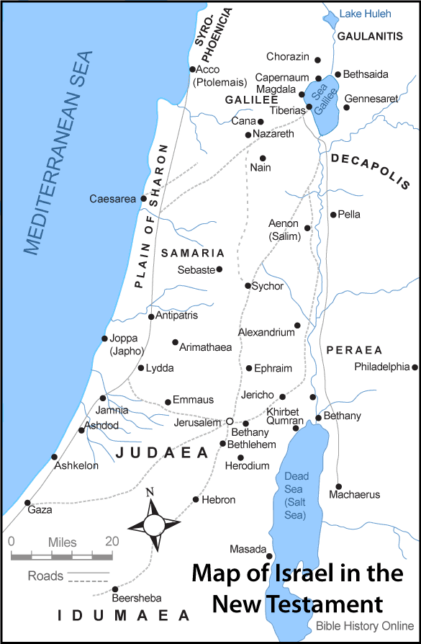

Slide 14
Judges 16:9 (NKJV)
9 Now men were lying in wait, staying with her in the room. And she said to him, “The Philistines are upon you, Samson!” But he broke the bowstrings as a strand of yarn breaks when it touches fire. So the secret of his strength was not known.

Slide 15
Judges 16:12 (NKJV)
12 Therefore Delilah took new ropes and bound him with them, and said to him, “The Philistines are upon you, Samson!” And men were lying in wait, staying in the room. But he broke them off his arms like a thread.

Slide 16
Judges 16:13-14 (NKJV)
13 Delilah said to Samson, “Until now you have mocked me and told me lies. Tell me what you may be bound with.”
And he said to her, “If you weave the seven locks of my head into the web of the loom”—
14 So she wove it tightly with the batten of the loom, and said to him, “The Philistines are upon you, Samson!” But he awoke from his sleep, and pulled out the batten and the web from the loom.

Slide 17
Judges 16:15-17 (NKJV)
15 Then she said to him, “How can you say, ‘I love you,’ when your heart is not with me? You have mocked me these three times, and have not told me where your great strength lies.” 16 And it came to pass, when she pestered him daily with her words and pressed him, so that his soul was vexed to death, 17 that he told her all his heart, and said to her, “No razor has ever come upon my head, for I have been a Nazirite to God from my mother’s womb. If I am shaven, then my strength will leave me, and I shall become weak, and be like any other man.”

Slide 18
Judges 16:20 (NKJV)
20 And she said, “The Philistines are upon you, Samson!” So he awoke from his sleep, and said, “I will go out as before, at other times, and shake myself free!” But he did not know that the Lord had departed from him.

Slide 19
Judges 16:30 (NKJV)
30 Then Samson said, “Let me die with the Philistines!” And he pushed with all his might, and the temple fell on the lords and all the people who were in it. So the dead that he killed at his death were more than he had killed in his life.

Slide 20
Philippians 4:13 (NKJV)
13 I can do all things through Christ who strengthens me.

Slide 21
Romans 12:1-2 (NKJV)
12 I beseech you therefore, brethren, by the mercies of God, that you present your bodies a living sacrifice, holy, acceptable to God, which is your reasonable service. 2 And do not be conformed to this world, but be transformed by the renewing of your mind, that you may prove what is that good and acceptable and perfect will of God.

Slide 22
Hebrews 11:32-34 (NKJV)
32 And what more shall I say? For the time would fail me to tell of Gideon and Barak and Samson and Jephthah, also of David and Samuel and the prophets: 33 who through faith subdued kingdoms, worked righteousness, obtained promises, stopped the mouths of lions, 34 quenched the violence of fire, escaped the edge of the sword, out of weakness were made strong, became valiant in battle, turned to flight the armies of the aliens.

