Slide 1

Join us at
O’Neal Church of Christ
Vacation Bible School
June 10-14
7pm each evening
Notes:
Good evening! It is so good to see everyone here tonight. If you are visiting, thank you for coming our way. You are our special guests. Make plans to come back each night this week for our VBS. Our teachers have been working tirelessly to prepare for this week for our kids.
Tonight’s lesson will come from James 1:1-5.

Slide 2
James 1:1-5
1 James, a servant of God and of the Lord Jesus Christ, to the twelve tribes which are scattered abroad, greeting.
2 My brethren, count it all joy when ye fall into divers temptations;
3 Knowing this, that the trying of your faith worketh patience.
4 But let patience have her perfect work, that ye may be perfect and entire, wanting nothing.
5 If any of you lack wisdom, let him ask of God, that giveth to all men liberally, and upbraideth not; and it shall be given him.
Notes:
Read James 1:1-5.
Is that how you feel?
When troubles of any kind come your way, do you consider it an opportunity for great joy? Do you consider that when your faith is tested, you have a chance to grow?
What do you and I do when trouble comes our way? What do you and I do when our faith is tested?

Slide 3

Where/Who do you go to for advice?
James 1:5
If any of you lack wisdom, let him ask of God, that giveth to all men liberally, and upbraideth not; and it shall be given him.
Notes:
Often times we seek advice.
Where do you go for advice?
Who do you go to for advice?
Do we often forget verse 5?
Do we need wisdom to get through this life? Yes, we sure do! Let us never forget to seek God’s counsel.
I’ve asked but he didn’t answer. Did he not answer or did he not answer the way you thought he should?

Slide 4
Seeking Godly Advice in an
Ungodly World
Notes:
So tonight, we will discuss Seeking Godly Advice in an Ungodly World.

Slide 5

Advice
Not Found in Scripture
Do what makes you happy.
Create the life you want.
Love yourself first.
Follow your heart.
Notes:
Have you ever heard this advice given? At first hearing this type of advice, it sounds good, but when you think on what the advice is saying, take a step back and then you realize that it isn’t good advice at all—especially for someone who is a Christian.
Yet this is advice that is posted on items. You can buy merchandise with these sayings.
This is advice the world gives. Although the advice has good intentions, the advice could lead to destructive habits.
This advice is all about self! Serving what you want. Doing what makes you happy or doing what you think is right, even sometimes at the expense of others.
Is this what God wants for His children?

Slide 6
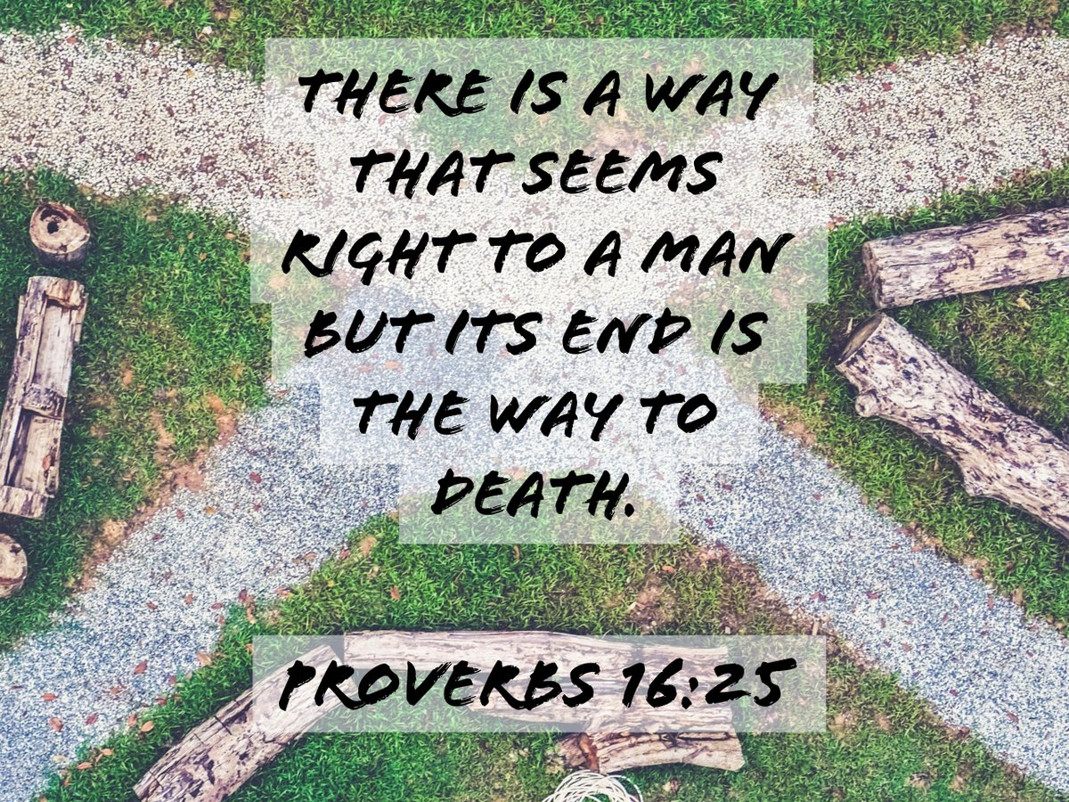
Notes:
Proverbs 16:25 King James Version (KJV)
25 There is a way that seemeth right unto a man, but the end thereof are the ways of death.

Slide 7

Notes:
What advice would the world give to parents? Christians?

Slide 8

Notes:
What advice would the world give to parents? Christians?

Slide 9

Notes:
What advice would the world give to parents? Christians?

Slide 10
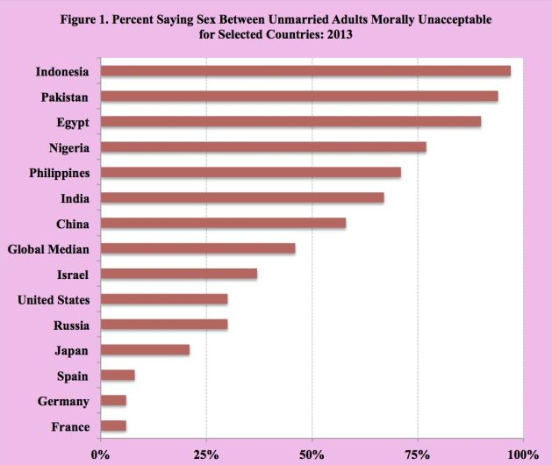
Notes:
This chart was taken 2013 and shows the percent of people who feel that having premarital relations is morally unacceptable.
At one time the US was almost universal. It has declined to just about 25% today.
What advice would the world give to parents? Christians?

Slide 11
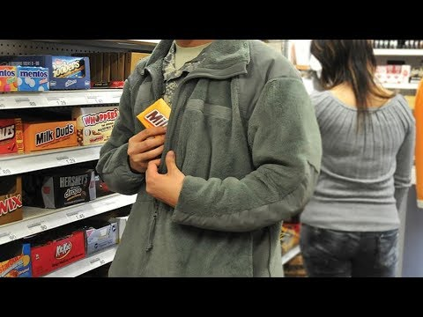
Notes:
What advice would the world give to parents? Christians?

Slide 12

Notes:
What advice would the world give to parents? Christians?

Slide 13

Notes:
What advice would the world give to parents? Christians?

Slide 14


Notes:
What advice would the world give?
It doesn’t matter who you hang around with. My friends don’t have any effect on me.
This may be the biggest factor determining if you participate in any of the things we’ve mentioned so far.

Slide 15


1 Peter 2:9
But ye are a chosen generation, a royal priesthood, an holy nation, a peculiar people; that ye should shew forth the praises of him who hath called you out of darkness into his marvellous light;

Slide 16

We are called to…
Offer yourself a living sacrifice. Rom. 12:1
Seek first the kingdom of God. Matthew 6:33
Love the Lord your God with all your heart, soul, mind, and strength. Luke 10:27
Deny yourself, take up your cross, and follow Christ. Luke 9:23
Notes:
Romans 12:1 I beseech you therefore, brethren, by the mercies of God, that ye present your bodies a living sacrifice, holy, acceptable unto God, which is your reasonable service.
Matthew 6:33 But seek ye first the kingdom of God, and his righteousness; and all these things shall be added unto you
Luke 10:27 And he answering said, Thou shalt love the Lord thy God with all thy heart, and with all thy soul, and with all thy strength, and with all thy mind; and thy neighbour as thyself.
Luke 9:23 And he said to them all, If any man will come after me, let him deny himself, and take up his cross daily, and follow me.
How does that list sound to you?
Not as fun, is it? That isn’t a list that the world wants said about them. That’s a boring list.
Being called different is like being called limited edition. Meaning you’re something people don’t see that often. Remember that!

Slide 17

Notes:
Living for Christ is the only way to truly live. You’ll get all kinds of advice that contradicts this, but all that advice is a lie.
Galatians 2:20 I am crucified with Christ: nevertheless I live; yet not I, but Christ liveth in me: and the life which I now live in the flesh I live by the faith of the Son of God, who loved me, and gave himself for me.

Slide 18
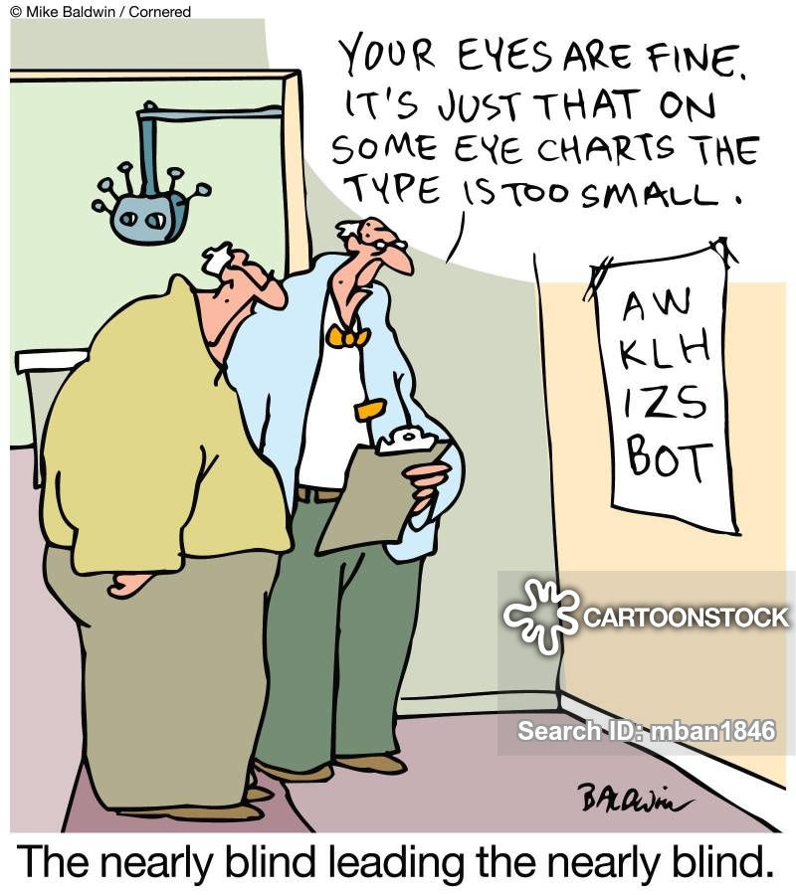

Notes:
You will receive bad advice from many sources in your lifetime. Sadly, sometimes that bad advice comes from those who are considered believers. I’ve seen brothers and sisters in Christ encourage ungodly behaviors. I’ve seen young Christians participate in those ungodly behaviors.
Only one life to live, right? That’s exactly right! Only 1, so don’t mess it up!
If the advice is contrary to what God wants for His children, then seek advice elsewhere.

Slide 19
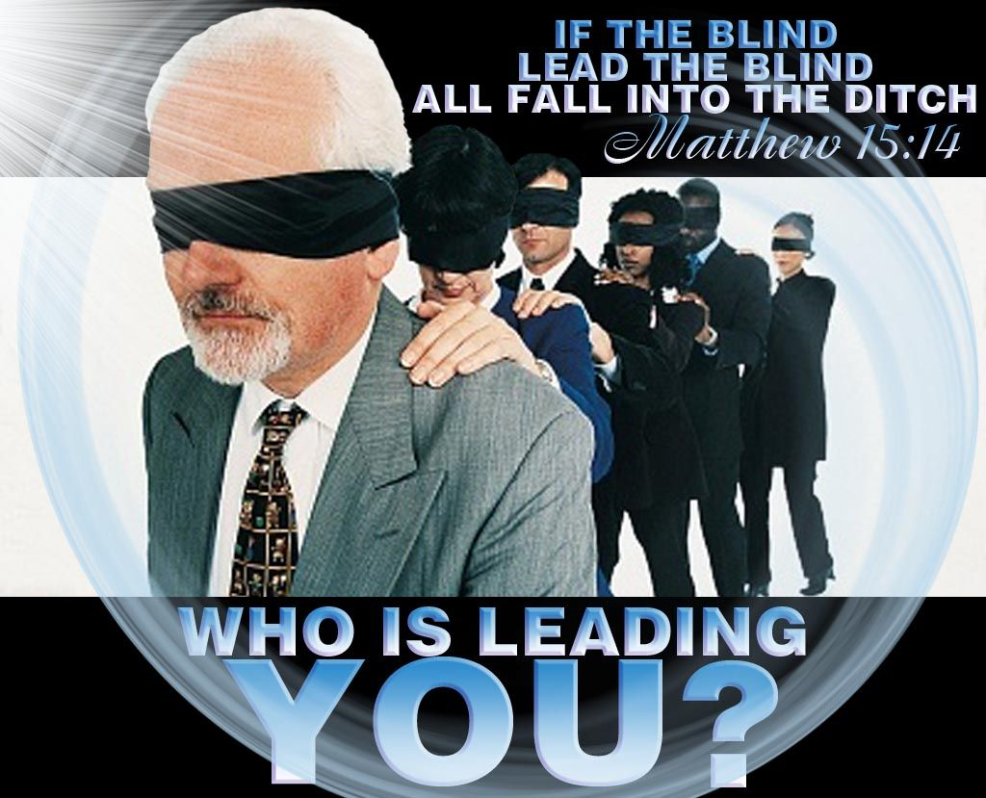
Notes:
Matthew 15:13-14 But he answered and said, Every plant, which my heavenly Father hath not planted, shall be rooted up. 14 Let them alone: they be blind leaders of the blind. And if the blind lead the blind, both shall fall into the ditch.
Who is leading you? Is it yourself? Are you taking ungodly advice? Where will that lead you?

Slide 20
Listen to Counsel
Isaiah 30:1-2
Woe to the rebellious children, saith the Lord, that take counsel, but not of me; and that cover with a covering, but not of my spirit, that they may add sin to sin:
That walk to go down into Egypt, and have not asked at my mouth; to strengthen themselves in the strength of Pharaoh, and to trust in the shadow of Egypt!
Proverbs 19:20
Listen to counsel and receive instruction, That you may be wise in your latter days.

Slide 21
Buy the Truth
Proverbs 23:23
23 Buy the truth, and sell it not; also wisdom, and instruction, and understanding.
*It doesn’t matter the cost!
Matthew 13:45-46
45 Again, the kingdom of heaven is like unto a merchant man, seeking goodly pearls:
46 Who, when he had found one pearl of great price, went and sold all that he had, and bought it.

Slide 22
Deny Self
Matthew 16:24-26
24 Then said Jesus unto his disciples, If any man will come after me, let him deny himself, and take up his cross, and follow me.
25 For whosoever will save his life shall lose it: and whosoever will lose his life for my sake shall find it.
26 For what is a man profited, if he shall gain the whole world, and lose his own soul? or what shall a man give in exchange for his soul?
Notes:
What wrong advice are you willing to take?

Slide 23
Treasure my Commands
Proverbs 2:1-9
My child, listen to what I say, and treasure my commands.
Tune your ears to wisdom, and concentrate on understanding.
Cry out for insight, and ask for understanding.
Search for them as you would for silver; seek them like hidden treasures.
Then you will understand what it means to fear the Lord, and you will gain knowledge of God.
For the Lord grants wisdom! From his mouth come knowledge and understanding.
He grants a treasure of common sense to the honest. He is a shield to those who walk with integrity.
He guards the paths of the just and protects those who are faithful to him.
Then you will understand what is right, just, and fair, and you will find the right way to go.
Notes:
NLT
Psalm 1:1-3 King James Version (KJV)
1 Blessed is the man that walketh not in the counsel of the ungodly, nor standeth in the way of sinners, nor sitteth in the seat of the scornful.
2 But his delight is in the law of the Lord; and in his law doth he meditate day and night.
3 And he shall be like a tree planted by the rivers of water, that bringeth forth his fruit in his season; his leaf also shall not wither; and whatsoever he doeth shall prosper.

Slide 24
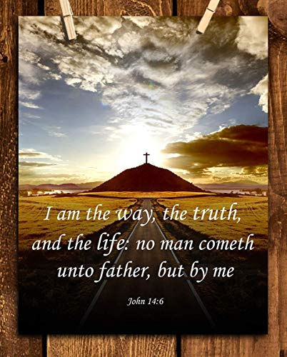
Notes:
John 14:6

