Slide 1
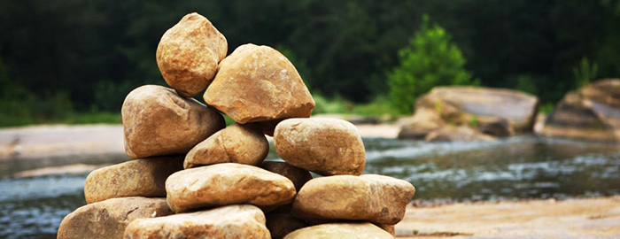
What Mean Ye these Stones? Joshua 4:1-7)

Slide 2
Joshua 4:1-7 When all the nation had finished passing over the Jordan, the LORD said to Joshua,
“Take twelve men from the people, from each tribe a man, and command them, saying, ‘Take twelve stones from here out of the midst of the Jordan, from the very place where the priests' feet stood firmly, and bring them over with you and lay them down in the place where you lodge tonight.’”

Slide 3
Then Joshua called the twelve men from the people of Israel, whom he had appointed, a man from each tribe. And Joshua said to them, “Pass on before the ark of the LORD your God into the midst of the Jordan, and take up each of you a stone upon his shoulder, according to the number of the tribes of the people of Israel, that this may be a sign among you.
When your children ask in time to come, ‘What do those stones mean to you?’ then you shall tell them that the waters of the Jordan were cut off before the ark of the covenant of the LORD.
When it passed over the Jordan, the waters of the Jordan were cut off. So these stones shall be to the people of Israel a memorial forever.” (Joshua 4:1-7)

Slide 4
Is It Really Too Much to ask of us?
1 John 5:3 For this is the love of God, that we keep His commandments. And His commandments are not burdensome.
Mt. 11:28 Come to Me, all you who labor and are heavy laden, and I will give you rest.
29 Take My yoke upon you and learn from Me, for I am gentle and lowly in heart, and you will find rest for your souls.
30 For My yoke is easy and My burden is light.
John 14:15 If you love Me, keep My commandments.

Slide 5
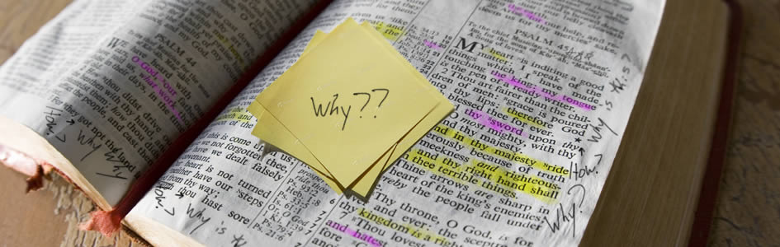
Ready With An Answer I Pet. 3:15
1 Peter 3:15

Slide 6
What Mean Ye these Stones? Joshua 4:1-7)

Slide 7
#1 Remember What God hath done
It was GOD who parted the waters
For the children to walk across the
Jordan on dry land!

Slide 8
We need to teach our children that it is GOD who
Hath blessed us so much in our lives.
What they have, what they have been given…
ALL from a loving and kind Father who loved us.
James 1:17 Every good blessing..
Our lives, our homes, our families…all from God.
Eccl.12:13-14 Teach them to FEAR GOD.
(Fear:
A wholesome dread of displeasing God!)

Slide 9
#2 . Every Generation must be taught.

Slide 10
^{Deut. 6:6-15} And these words, which I command thee this day, shall be in thine heart:
⁷ And thou shalt teach them diligently unto thy children, and shalt talk of them when thou sittest in thine house, and when thou walkest by the way, and when thou liest down, and when thou risest up.
⁸ And thou shalt bind them for a sign upon thine hand, and they shall be as frontlets between thine eyes.
⁹ And thou shalt write them upon the posts of thy house, and on thy gates.
¹⁰ And it shall be, when the Lord thy God shall have brought thee into the land which he sware unto thy fathers, to Abraham, to Isaac, and to Jacob, to give thee great and goodly cities, which thou buildedst not,

Slide 11
¹¹ And houses full of all good things, which thou filledst not, and wells digged, which thou diggedst not, vineyards and olive trees, which thou plantedst not; when thou shalt have eaten and be full;
¹² Then beware lest thou forget the Lord, which brought thee forth out of the land of Egypt, from the house of bondage.
¹³ Thou shalt fear the Lord thy God, and serve him, and shalt swear by his name.
¹⁴ Ye shall not go after other gods, of the gods of the people which are round about you;
¹⁵ (For the Lord thy God is a jealous God among you) lest the anger of the Lord thy God be kindled against thee, and destroy thee from off the face of the earth

Slide 12
Teach your children today…

Slide 13
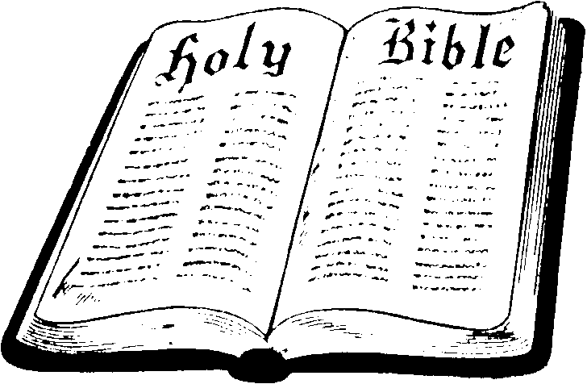
Is It Too Much To Faithfully Worship God?
23 But the hour is coming, and now is, when the true worshipers will worship the Father in spirit and truth; for the Father is seeking such to worship Him.
24 God is Spirit, and those who worship Him must worship in spirit and truth (Jn. 4).
“Spirit” involves the heart of the worshipper.
“Truth” is the Word of God which authorizes the act.
Pray (1 Cor. 14:15)
Give (1 Cor. 16:1-2)
Partake of Lord’s Supper (Acts 20:7)
Preach Word (Acts 2:42)
Sing (Eph. 5:19)

Slide 14
What does Prayer mean to you…? I Thess. 5:17; Acts 2:42;
I will lift up my eyes unto the Lord, from which cometh my strength…Psalm 121:1
Brethren…pray for us. I Thess.5:25
Pray without ceasing. I Thess. 5:17
Pray in the morning, noon time and evening Daniel 6:10
If I could hear my Mother pray again!!

Slide 15
Praying for protection…from the powerful hurricanes…tornadoes…
Praying for God’s help. “Help me Lord…. Just like Peter, we begin
To sink….
Just a little talk with Jesus makes it right…
Ere you left your room this morning, did you think to pray?
I am praying for you.

Slide 16
What will we tell our children when they ask:
What does the table of the Lord with Bread and The Fruit of the Vine mean and Why are you partaking of it?
1. This is what Jesus told us to do each First day of each week.
Acts 20:7; Acts 2:42;
2. Paul reminded the Corinthians the need to come together
To eat the Lord’s Supper. I Cor. 11:23-24

Slide 17
What do these hymns mean to you?
Eph. 5:19; Col. 3:16; I Cor. 14:15
“in a land where we will never grow old…”
“As the life of a flower…”
“Rock of Ages…”
“Amazing Grace ..”

Slide 18
#3 Conviction vs.
Convenience
1. Matt. 6:33 God is #1
2. Matt. 5:16
3. Jude 3

Slide 19
What does the Bible mean to you? Why must
We abide in its truth? John 17:17; Rom. 10:17
Look at all the other books in the world…
Why is the Bible still the best seller of all?”
It is an inspired book of God. 2 Tim. 3:16-17
We are not to add to its words or take away from
its words. Prov. 30:5,6; I Pet. 4:11
We must live by it. Matt. 4:4

Slide 20
What does the Family mean to you?
What mean you this Marriage Certificate?
A new law…. Heb. 13:4 “No preacher needed!”
Matt. 19:9;
Rom. 7:1 marriage is a bond …a promise…and
A completion of a man and woman…joined by God.
not woman with woman
not man with man
It takes a ‘him’ and a ‘her’ …God’s order of procreation.

Slide 21
"What do the poor, the hurting, and the lost mean to you?"
Those twelve stones were more than a memorial. They represented a tremendous teaching opportunity--a tangible bridge full of meaning from one generation to the next. "What do those stones mean to you?"
The next generation continues to notice, learn, and ask questions. "What does ___ mean to you?" Are you ready for that question? Ready or not, you are giving an answer. Does the answer you would like to give harmonize with your daily habits? Will you live in such a way that you can unashamedly, easily, and naturally point the next generation to the God worth remembering and serving today?

Slide 22
#4 All of us have a past but look what God’s people
Have for their future. What is before us!
2 Tim. 4:7-8 Paul. Wouldn’t you love to live like
Paul and have a future forthcoming like his.!
James 4:17
I Tim. 1:15

Slide 23
What mean you this stone…plan …the gospel plan of salvation?
Matt. 7:21-23 Doing what He tells us to do to be saved.
Hear Rom. 10:17
Believe John 8:24
Repent Acts 2:38
Confess Matt. 10:32,33
Be Baptized…. I Pet. 3:21
Live faithfully., I Cor. 15:58

Slide 24
What Mean Ye these Stones? Joshua 4:1-7)

