Slide 1

What’s Your BIG Problem?
Notes:
Our biggest problem is sin. The problem is that most people do not know what their problem is, and therefore they do not appreciate how Jesus helps them overcome it, and how His help alleviates every other problem one might have.

Slide 2

According to a 2014 Pew Survey:
“When looking for answers to questions about right and wrong, more Americans say they turn to practical experience and common sense (45%) than to any other source of guidance. The next most common source of guidance is religious beliefs and teachings (33%), while far fewer turn to philosophy and reason (11%) or scientific information (9%).”

Slide 3
Millennials reported the following as the 10 most critical problems in the world:
10. Lack of economic opportunity and unemployment (12.1%)
9. Safety / security / well being (14.1%)
8. Lack of education (15.9%)
7. Food and water security (18.2%)
6. Government accountability and transparency/corruption (22.7%)
5. Religious conflicts (23.9%)
4. Poverty (29.2%)
3. Income inequality (30.8%)
2. Large scale conflict/wars (38.9%)
1. Climate change/destruction of nature (48.8%)
World Economic Forum Global Shapers Survey 2017

Slide 4
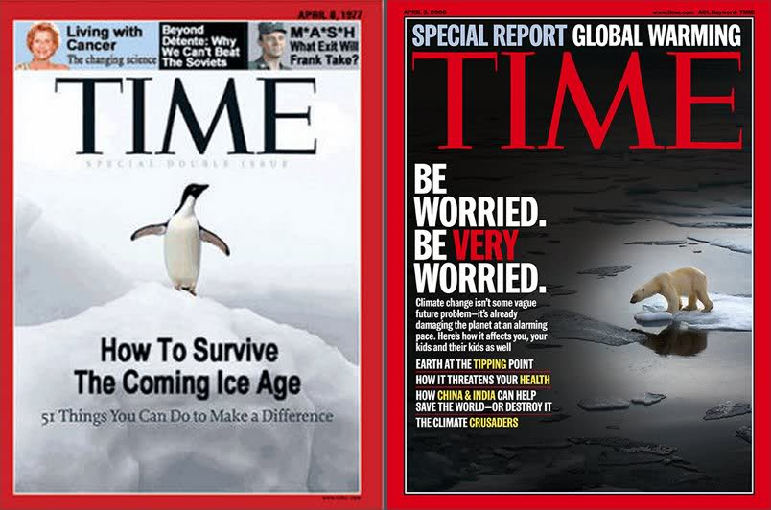

Slide 5
Your BIG Problem is Sin! John 9:39-41 1 John 1:8
It separates us from God (Isaiah 59:1-2; Romans 3:23; 6:23; 5:12)
It enslaves (John 8:34; Proverbs 5:22)
It makes us miserable (Psalms 38:3)
It dooms us for eternity (Mark 9:43-44)

Slide 6
Solving the Problem of Sin!
Sin is lawlessness (1 John 3:4-6)
Jesus came to solve the problem (Matthew 1:21; John 1:29; Luke 24:46-47)
The gospel of Christ encourages repentance and provides remission! (Acts 3:19; 11:18; 1 Peter 2:24; 3:18; 1 John 2:2; 3:5; 1 Tim. 1:15)

