Slide 1
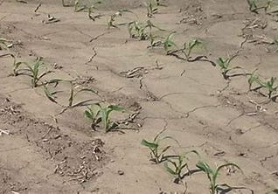
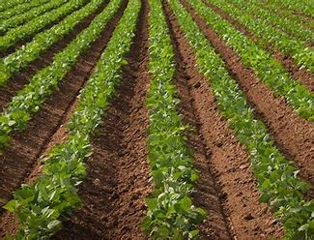
Soil of O’Neal
Are we Growing and Bearing Fruit?

Slide 2
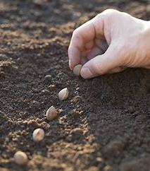
The parable of the sower! Matthew 13:1-9
Luke 8:4-15

Slide 3

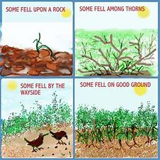

Slide 4
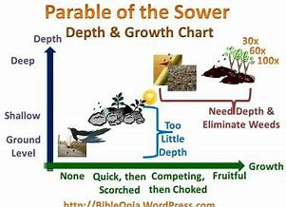

Slide 5
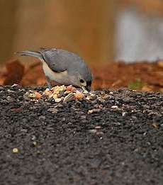
1. The first type of soil is the “way side”. (Luke 8:5)
Does this represent you and your growth and development since hearing the word of God? Is this how the word of God and your heart have mixed?

Slide 6
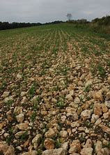
2. The second type of soil is the “Rocky” soil. Luke 8:6
Does this describe the way the word of God has mixed with your heart? You Obeyed his word and you started growing as Christian should and just like that your faith withered away because of lack of moisture and growth?

Slide 7
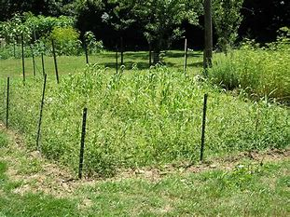
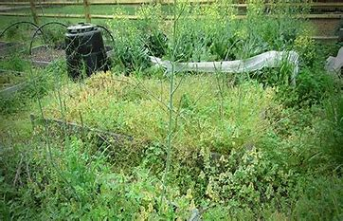
3. The third type of soil is the “Thorny soil”. Luke 8:7
Does this describe the way the word of God has mixed with your heart? You obeyed, were faithful, growing, attending services, studying, sharing his word, and looking fruitful in all ways, and then ……………the weeds of life, cares of this world, your jobs, friends, bad fortune, problems with health, etc….came into your life and out weighed your faith. This is the story of the soil of many. Many who have been in Church their whole life and are blind to the thorns choking out the BEST CHRISTIAN THEY COULD BE!

Slide 8
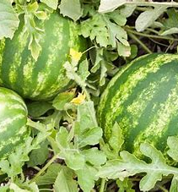
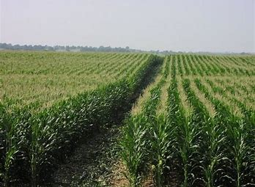
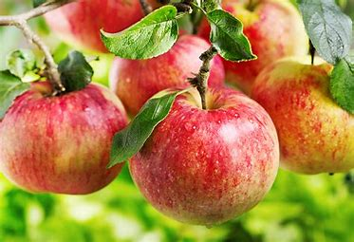
4. The fourth type of ground is the “good ground”! Luke 8:8
This is what God wants of us!
Do exemplify good soil that when mixed with Gods word produces great things in our lives, homes, and communities as God has planned for us?

Slide 9
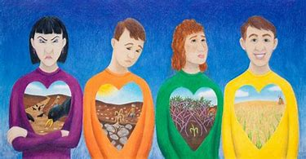
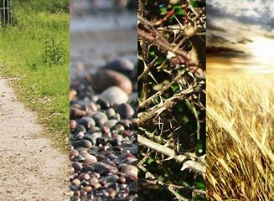
Conclusion
Which type of soil are we seeing here at Piney Grove?
Luke 8:10-15

