Slide 1
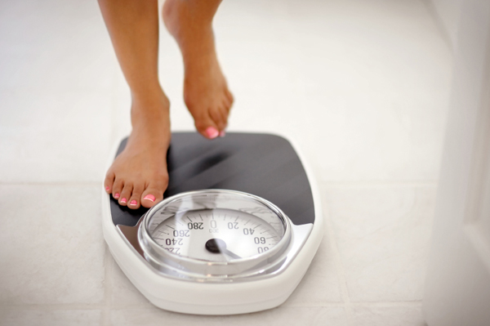
Stepping on the Spiritual Scales

Slide 2

To grow closer to God
James 4:8 – Come near to God and He will come near to you. Wash your hands, you sinners, and purify your hearts, you double-minded.

Slide 3
To grow in knowledge of God’s word
Not simply to read the bible, but to meditate on the scriptures.
To study with an open mind with a sincere desire to know the Will of God.
2 Tim. 2:15 – Study to shew thyself approved unto God, a workman that needeth not to be ashamed, rightly dividing the word of truth.
Matt. 5:6 – Blessed are they which do hunger and thirst after righteousness: for they shall be filled.

Slide 4
To grow in knowledge of God’s word
Study without any agenda other that wanting to know God and His Will.
Be open and willing to change your mind if God’s Word dictates something different that what you previously thought or believed.
2 Tim. 3:16-17 – All scripture is given by the inspiration of God, and if profitable for doctrine, for reproof, for correction, for instruction in righteousness: That the man of God may be perfect, thoroughly furnished unto all good works.

Slide 5
To Be more diligent in prayer
Col. 4:2 – Devote yourselves to prayer, being watchful and thankful.
1 Thes. 5:16-18 – Rejoice always, pray continually, give thanks in all circumstances; for this is God’s will for you in Christ Jesus.
Psalm 145:18 – The Lord is near to all who call on Him, to all who call on Him in truth.
Who is your best friend at this point in your life?
How close would you be to them if you talked to them as much as you currently talk to God in prayer?

Slide 6
Plant & Water the seed of god
Mark 16:15 – “Go into all the world and preach the gospel to all creation. Whoever believes and is baptized will be saved, but whoever does not believe will be condemned.”
Matt 28:19-20 – Therefore go and make disciples of all nations, baptizing them in the name of the Father and of the Son and of the Holy Spirit, and teaching them to obey everything I have commanded you. And surely I am with you always, to the very end of the age.”
Matt 9:37-38 – Then he said to his disciples, “The harvest is plentiful but the workers are few. Ask the Lord of the harvest, therefore, to send out workers into his harvest field.”

Slide 7
Plant & Water the seed of god
1 Cor. 3:3-8 - Brothers and sisters, I could not address you as people who live by the Spirit but as people who are still worldly, mere infants in Christ. I gave you milk, not solid food, for you were not yet ready for it. Indeed, you are still not ready. You are still worldly. For since there is jealousy and quarreling among you, are you not worldly? Are you not acting like mere humans? For when one says, “I follow Paul,” and another, “I follow Apollos,” are you not mere human beings? What, after all, is Apollos? And what is Paul? Only servants, through whom you came to believe as the Lord has assigned to each his task.

Slide 8
Plant & Water the seed of god
I planted the seed, Apollos watered it, but God has been making it grow. So neither the one who plants nor the one who waters is anything, but only God, who makes things grow. The one who plants and the one who waters have one purpose, and they will each be rewarded according to their own labor. For we are co-workers in God’s service; you are God’s field, God’s building.
Romans 10:10-17 - For it is with your heart that you believe and are justified, and it is with your mouth that you profess your faith and are saved. As Scripture says, “Anyone who believes in him will never be put to shame.” For there is no difference between Jew and Gentile—the same Lord

Slide 9
Plant & Water the seed of god
is Lord of all and richly blesses all who call on him, for, “Everyone who calls on the name of the Lord will be saved.” How, then, can they call on the one they have not believed in? And how can they believe in the one of whom they have not heard? And how can they hear without someone preaching to them? And how can anyone preach unless they are sent? As it is written: “How beautiful are the feet of those who bring good news!” But not all the Israelites accepted the good news. For Isaiah says, “Lord, who has believed our message?” Consequently, faith comes from hearing the message, and the message is heard through the word about Christ.

Slide 10
To become more involved
Are you using the talents that God has given to you?
There’s a tremendous emphasis in the Bible on using the gifts and the talents God has given you. God has made an investment in your life and He expects a return on it.
1 Peter 4:10 - Each of you should use whatever gift you have received to serve others, as faithful stewards of God’s grace in its various forms.

Slide 11
To change requires sacrifice
1 Cor. 9:24-27 – Do you not know that in a race all the runners run, but only one gets the prize? Run in such a way to get the prize. Everyone who competes in the games goes into strict training. They do it to get a crown that will not last, but we do it to get a crown that will last forever. Therefore I do not run like someone running aimlessly; I do not fight like a boxer beating the air. No, I strike a blow to my body and make it my slave so that after I have preached to other, I myself may not be disqualified for the prize.

Slide 12
To change requires sacrifice
What do you think Paul and other 1st century Christians sacrificed for the sake of God?
Public Ridicule
Imprisonment
Family Disownment
Beatings, Beheaded, Crucifixions
Clothed in furs of beast and tore apart by dogs
Set on fire to provide light at night for entertainment

Slide 13
To change requires sacrifice
To lose weight you have to sacrifice your current diet and be disciplined in eating healthy.
You will have to sacrifice time and relaxation for exercise.
What will you sacrifice for God?

