Slide 2

Stirring Up to Remembrance
Notes:
What if that was your last invitation? Your last opportunity to make your life right? Your last chance to confess your sins? Your last chance to obey the gospel and be buried with your Savior in baptism?
What if?
This life is not certain, but HIS life is. If we are in Him, then our life is certain too.
I can’t help but think of the song, My Hope is Built on Nothing Less (438)

Slide 3
My Hope is Built on Nothing Less
My hope is built on nothing less
Than Jesus blood & righteousness;
I dare not trust the sweetest frame,
But wholly lean on Jesus’ name.
When darkness veils His lovely face,
I rest on His unchanging grace;
In every high and stormy gale,
My anchor holds within the veil.
His oath, His covenant, His blood,
Support me in the whelming flood;
When all around my soul gives way,
He then is all my hope and stay.
When He shall come with trumpet sound,
Oh, may I then in Him be found;
Dressed in His righteousness, alone,
Faultless to stand before the throne.
CHORUS:
On Christ, the solid Rock, I stand;
All other ground is sinking sand,
All other ground is sinking sand.

Slide 4
2 Peter 1:12-13 KJV
12 Wherefore I will not be negligent to put you always in remembrance of these things, though ye know them, and be established in the present truth.
13 Yea, I think it meet, as long as I am in this tabernacle, to stir you up by putting you in remembrance;
Notes:
Peter knew the importance of that HOPE. He knew the importance of REMEMBERING JESUS!
He wrote to the brethren in 2 Peter 1:12-13….

Slide 5
2 Peter 1:12-13 NIV
12 So I will always remind you of these things, even though you know them and are firmly established in the truth you now have.
13 I think it is right to refresh your memory as long as I live in the tent of this body,

Slide 6

Notes:
What did Peter want them to remember?

Slide 7
2 Peter 1:3-4
³ According as his divine power hath given unto us all things that pertain unto life and godliness, through the knowledge of him that hath called us to glory and virtue:
⁴ Whereby are given unto us exceeding great and precious promises: that by these ye might be partakers of the divine nature, having escaped the corruption that is in the world through lust.

Slide 8
Remember What?
1. Jesus gave us all things that pertain to life and godliness.
2. We have been given exceeding great and precious promises.
3. We are able to escape the corruption of the world.
Notes:
What did Peter want them to remember?

Slide 10
2 Peter 1:5-7
⁵ And beside this, giving all diligence, add to your faith virtue; and to virtue knowledge;
⁶ And to knowledge temperance; and to temperance patience; and to patience godliness;
⁷ And to godliness brotherly kindness; and to brotherly kindness charity.

Slide 11
2 Peter 1:8-9
⁸ For if these things be in you, and abound, they make you that ye shall neither be barren nor unfruitful in the knowledge of our Lord Jesus Christ.
⁹ But he that lacketh these things is blind, and cannot see afar off, and hath forgotten that he was purged from his old sins.

Slide 12
Remember What?
1. Remember how to be fruitful—effective and productive.
2. Remember that you have been cleansed.
Notes:
What did Peter want them to remember?

Slide 14
2 Peter 1:10-11
¹⁰ Wherefore the rather, brethren, give diligence to make your calling and election sure: for if ye do these things, ye shall never fall:
¹¹ For so an entrance shall be ministered unto you abundantly into the everlasting kingdom of our Lord and Saviour Jesus Christ.

Slide 15
Remember What?
1. You are God’s chosen people.
2. The Great Welcome Home awaits those who are His!
Notes:
What did Peter want them to remember?

Slide 17


Slide 18
2 Peter 1:12-15
12 So I will always remind you of these things, even though you know them and are firmly established in the truth you now have.
13 I think it is right to refresh your memory as long as I live in the tent of this body,
14 Knowing that shortly I must put off this my tabernacle, even as our Lord Jesus Christ hath shewed me.
15 Moreover I will endeavour that ye may be able after my decease to have these things always in remembrance.

Slide 19
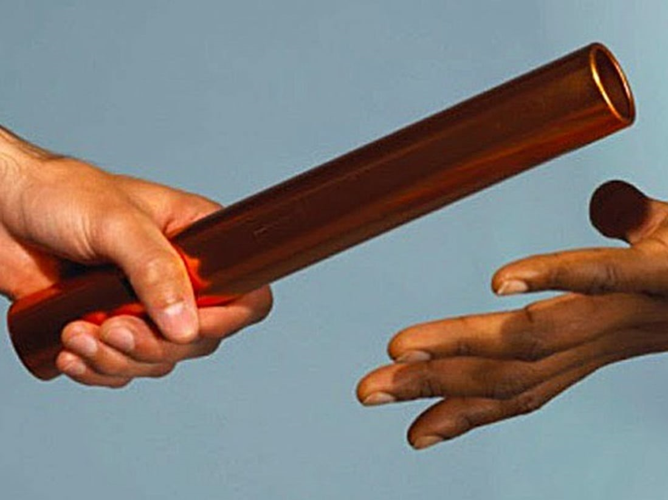
Notes:
When we die, what do we want our kids to remember?
What do we want our brethren to remember?
What do we want God to remember?

Slide 20
The Church
1 Timothy 3:15
But if I tarry long, that thou mayest know how thou oughtest to behave thyself in the house of God, which is the church of the living God, the pillar and ground of the truth.

Slide 21
The Church is Competing with…
The Pollutions of the World: Sin
Temptations
Selfishness
Lack of Concern for the Truth
Lack of Love for the Truth: Priorities Wrong
Wrong Heart—Where is your heart? Purpose behind actions?
_________________________________________
Satan’s Devices
Notes:
2 Corinthians 2:11 ¹¹ Lest Satan should get an advantage of us: for we are not ignorant of his devices.

Slide 22
The Church is Competing with…
Concerts
Motivational Messages-Little Scripture
Free Food
Movie Nights
Ballgames
Work/Extra-curricular activities
Homework
Early Bedtimes

Slide 23
Someone said….
“We just sit here.”
Is that what we do? If so, are we really worshipping in spirit and in truth?

Slide 24
John 4:22-24
22 Ye worship ye know not what: we know what we worship: for salvation is of the Jews.
23 But the hour cometh, and now is, when the true worshippers shall worship the Father in spirit and in truth: for the Father seeketh such to worship him.
24 God is a Spirit: and they that worship him must worship him in spirit and in truth.
Notes:
In John 4:22-24, Jesus talking to the Samaritan woman at the well—she concludes that He is a prophet. She tells Him that her fathers worshipped in the mountains, but He says they should worship in Jerusalem. Jesus responds…….
We don’t need anything new to be stirred up spiritually. We need the Gospel. We need the Truth. We need to worship in spirit and in truth.

Slide 26
2 Peter 3:1
1 This second epistle, beloved, I now write unto you; in both which I stir up your pure minds by way of remembrance:
2 That ye may be mindful of the words which were spoken before by the holy prophets, and of the commandment of us the apostles of the Lord and Saviour:
³ Knowing this first, that there shall come in the last days scoffers, walking after their own lusts,

Slide 27
The Bible
2 Timothy 3:16-17
16 All scripture is given by inspiration of God, and is profitable for doctrine, for reproof, for correction, for instruction in righteousness:
17 That the man of God may be perfect, thoroughly furnished unto all good works.
Notes:
⁶ All Scripture is given by God.
And all Scripture is useful for teaching and
for showing people what is wrong in their lives.
It is useful for correcting faults and
teaching the right way to live.
¹⁷ Using the Scriptures, those who serve God will be prepared and
will have everything they need to do every good work.

Slide 28
The Bible
2 Peter 1:20-21
20 Knowing this first, that no prophecy of the scripture is of any private interpretation.
21 For the prophecy came not in old time by the will of man: but holy men of God spake as they were moved by the Holy Ghost.
Notes:
It’s not just some clever stories invented by people.
It’s God’s Words written down by men who were moved/guided by the Holy Spirit.

Slide 30
The Sacrifice
Hebrews 10:1-4
¹ For the law having a shadow of good things to come, and not the very image of the things, can never with those sacrifices which they offered year by year continually make the comers thereunto perfect.
² For then would they not have ceased to be offered? because that the worshippers once purged should have had no more conscience of sins.
³ But in those sacrifices there is a remembrance again made of sins every year.
⁴ For it is not possible that the blood of bulls and of goats should take away sins.

Slide 31
The Sacrifice
Hebrews 9:22
²² And almost all things are by the law purged with blood; and without shedding of blood is no remission.

Slide 32
The Sacrifice
Hebrews 10:9-12
⁹ Then said he, Lo, I come to do thy will, O God. He taketh away the first, that he may establish the second.
¹⁰ By the which will we are sanctified through the offering of the body of Jesus Christ once for all.
¹¹ And every priest standeth daily ministering and offering oftentimes the same sacrifices, which can never take away sins:
¹² But this man, after he had offered one sacrifice for sins for ever, sat down on the right hand of God;

Slide 33
The Sacrifice
Hebrews 10:16-18
¹⁶ This is the covenant that I will make with them after those days, saith the Lord, I will put my laws into their hearts, and in their minds will I write them;
¹⁷ And their sins and iniquities will I remember no more.
¹⁸ Now where remission of these is, there is no more offering for sin.

Slide 35
Remission of Sins
Acts 2:38
³⁸ Then Peter said unto them, Repent, and be baptized every one of you in the name of Jesus Christ for the remission of sins, and ye shall receive the gift of the Holy Ghost.
Notes:
The remission is found in the watery grave of baptism.
It’s found in the blood of Jesus Christ.
It’s found in Jesus.

Slide 36
Baptized into His Death
Romans 6:3-4
³ Know ye not, that so many of us as were baptized into Jesus Christ were baptized into his death?
⁴ Therefore we are buried with him by baptism into death: that like as Christ was raised up from the dead by the glory of the Father, even so we also should walk in newness of life.

Slide 37
Baptized into His Death
Romans 6:5-7
⁵ For if we have been planted together in the likeness of his death, we shall be also in the likeness of his resurrection:
⁶ Knowing this, that our old man is crucified with him, that the body of sin might be destroyed, that henceforth we should not serve sin.
⁷ For he that is dead is freed from sin.

Slide 39
Put on Christ
Galatians 3:27
27 For as many of you as have been baptized into Christ have put on Christ.

Slide 40
When you put on Christ, you become a CHRISTIAN

Slide 41
When you become a CHRISTIAN
Notes:
Others should see CHRIST in you.

Slide 42
If you are not a CHRISTIAN
Notes:
Others should see CHRIST in you.

Slide 44
I
Am
Nothing
Notes:
Others should see CHRIST in you.

Slide 46
Hold Fast
Hebrews 10:23
23 Let us hold fast the profession of our faith without wavering; (for he is faithful that promised;)

Slide 47
Stirring Up to Remembrance

