Slide 2


Success
What makes a person successful

Slide 3
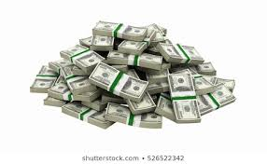
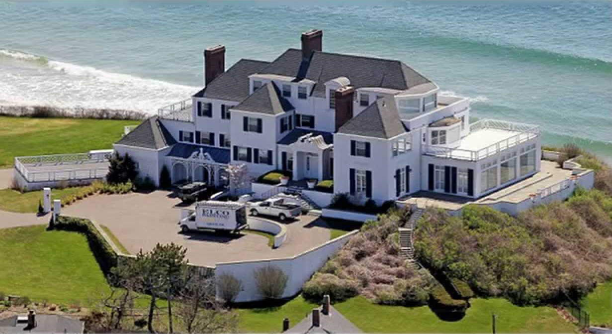

What is Success?

Slide 4

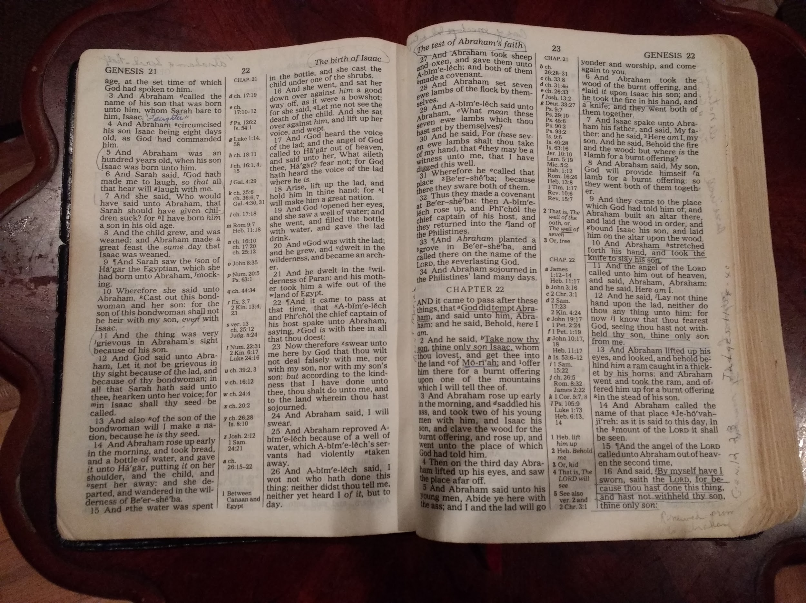

Can success be…..
Family?
Friends?
Spiritual success?

Slide 5
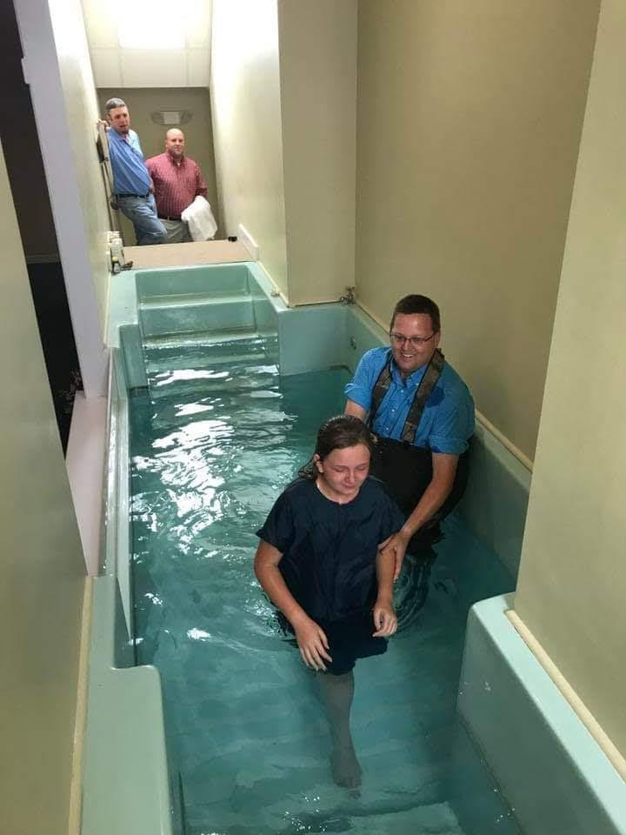
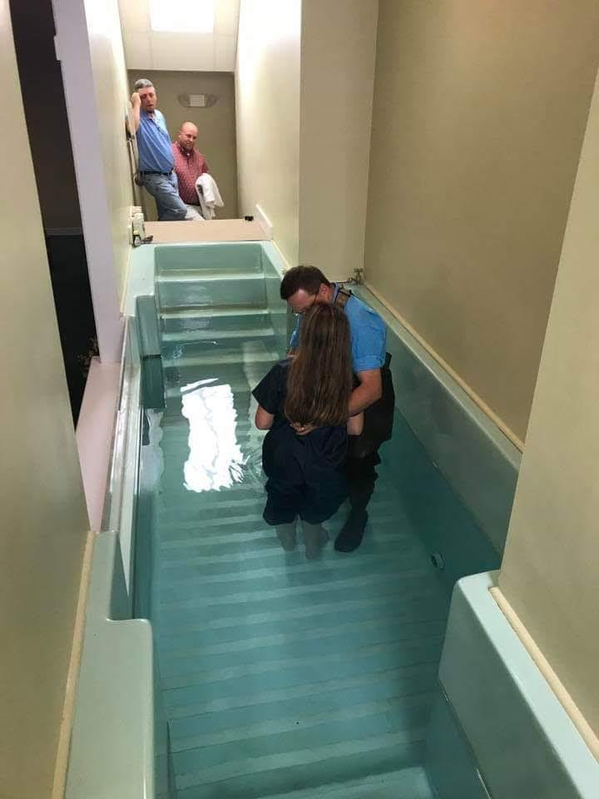
Is this success?

Slide 6
Maybe success isn’t measured in dollars?
Maybe success can be spiritual.

Slide 7
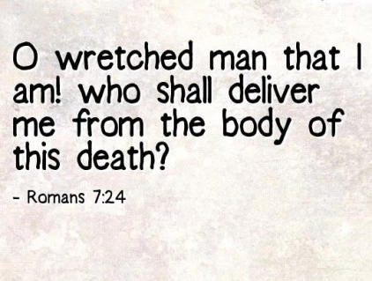

Who can we look to, as a pattern of spiritual success?
A loved one who has passed away?
Paul?
Abraham?
Joseph?
Moses?

Slide 8
Moses
Rose from slave to a member of the royal family.
Freed an entire nation from the most powerful nation in the ancient world.
Stood against the most powerful ruler on earth.
Defeated the most powerful army of the ancient world.
5 excuses on the way to success

Slide 9
Exodus 3:7-8… & 10-11
The Lord said, “I have surely seen the affliction of My people who are in Egypt, and have given heed to their cry because of their taskmasters, for I am aware of their sufferings. So I have come down to deliver them from the power of the Egyptians, and to bring them up from that land to a good and spacious land, to a land flowing with milk and honey…
Therefore, come now, and I will send you to Pharaoh, so that you may bring My people, the sons of Israel, out of Egypt.” But Moses said to God, “Who am I, that I should go to Pharaoh, and that I should bring the sons of Israel out of Egypt?”

Slide 10

The first excuse
Who am I that I should...?

Slide 11
Do we ever use that excuse?
I am not good enough to teach…
I can’t sing.
I wouldn’t make a good elder, deacon, teacher, song leader…
No one will miss me tonight.
Have you ever offered God this same excuse?

Slide 12
God’s answer: 3:12
I will be with you and this will be a sign that I have sent you: when you have brought the people out of Egypt you will serve God on this mountain.
God replied, “I will be with you. And you will know that I am the one who sent you, when you worship me on this mountain after you have led my people out of Egypt.” CEV

Slide 13
Stop relying on YOU
Then Amos replied to Amaziah, “I am not a prophet, nor am I the son of a prophet; for I am a herdsman and a grower of sycamore figs. But the Lord took me from following the flock and the Lord said to me, ‘Go prophesy to My people Israel.’
Amos 7:14-15

Slide 14
Exodus 3:13
Then Moses said, “When I come to the children of Israel and say to them the God your fathers has sent me, and they say what is His name? What shall I say to them?”
I don’t know enough to… Teach, preach, study with others.
I could never be an elder, deacon, leader in the church.
I don't know enough to…

Slide 15
God’s answer: Exodus 3:13-14, 15...
“And God said to Moses, “I AM WHO I AM.” You will say to the children of Israel I AM has sent me to you”
God, furthermore, said to Moses, “Thus you shall say to the sons of Israel, ‘The Lord, the God of your fathers, the God of Abraham, the God of Isaac, and the God of Jacob, has sent me to you.’

Slide 16
We also, go on God’s authority
And He said to them, “Go into all the world and preach the gospel to all creation. He who has believed and has been baptized shall be saved; but he who has disbelieved shall be condemned. Mark 16:15
I planted, Apollos watered, but God was causing the growth. So then neither the one who plants nor the one who waters is anything, but God who causes the growth.
I Corinthians 3:6-7

Slide 17
Exodus 4:1
Then Moses said, “Suppose they will not listen or believe me; suppose they say, “The Lord has not appeared to you.”
They won’t believe…
They won’t listen…
You can’t talk to those people…
You just have to have faith and they never will…

Slide 18
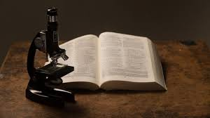
God’s answer: Exodus 4:2-8
“Then it will be, if they do not believe you or listen to the message of the first sign that they may believe the message of the second sign.”
In the beginning God created the heavens and the earth.
Genesis 1:1

Slide 19
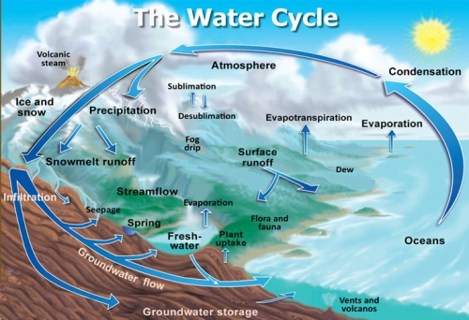
The Hydrologic cycle
He who calls for the waters of the sea And pours them out on the face of the earth, The Lord is His name. Amos 9:6
For He draws up the drops of water, They distill rain from the mist, Job 36:27
All the rivers flow into the sea Yet the sea is not full. To the place where the rivers flow, There they flow again. Ecclesiastes 1:7

Slide 20
Exodus 4:10
Then Moses said to the Lord, “Please, Lord, I have never been eloquent, neither recently nor in time past, nor since You have spoken to Your servant; for I am slow of speech and slow of tongue.”
I don’t have the ability to…

Slide 21
God’s answer: Exodus 4:11-12
The Lord said to him, “Who has made man’s mouth? Or who makes him mute or deaf, or seeing or blind? Is it not I, the Lord? Now then go, and I, even I, will be with your mouth, and teach you what you are to say.”
Now the word of the Lord came to me saying, “Before I formed you in the womb I knew you, And before you were born I consecrated you; I have appointed you a prophet to the nations.” Jeremiah 1:4-5

Slide 22

Exodus 4:13
But he said, “Please, Lord, now send the message by whomever You will.”
I don’t have time to…
I don’t think I could ever…
I could never be...

Slide 23
Then the anger of the Lord burned against Moses...
Exodus 4:14

Slide 24

Success is a product of...
Hard work and the right choices?

Slide 25
Success is a direct result of
Which over time compound on each other to make a tremendous difference in our lives.
--Darren Hardy, Publisher of Success Magazine
Is Spiritual success any different?
small seemingly insignificant choices…

Slide 26

Moses keys to success…
He trusted God. Exodus 4: 18
He made the right choices: Hebrews 11:24-28
He used the tools God had given him and continually improved : Exodus 4:27-28

Slide 27

God knows that you can be a success.
For You formed my inward parts; You wove me in my mother’s womb. I will give thanks to You, for I am fearfully and wonderfully made; Wonderful are Your works, And my soul knows it very well. My frame was not hidden from You, When I was made in secret, And skillfully wrought in the depths of the earth; Your eyes have seen my unformed substance; And in Your book were all written The days that were ordained for me, When as yet there was not one of them. Psalms 139: 13-16

Slide 28
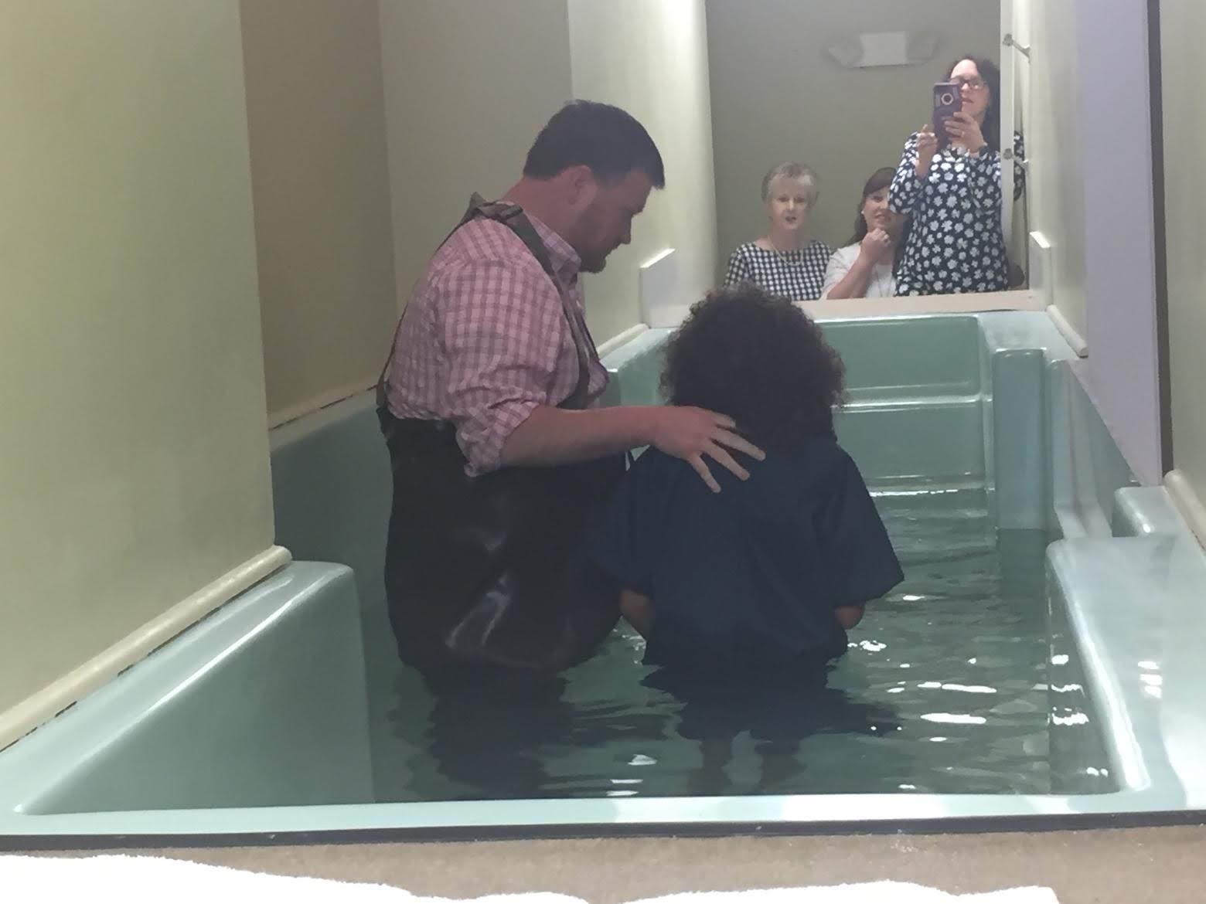
Maybe success isn’t measured in dollars?

Slide 29


Maybe it is measured in water and blood
Revelation 1:5 & Acts 22:16

