Slide 1
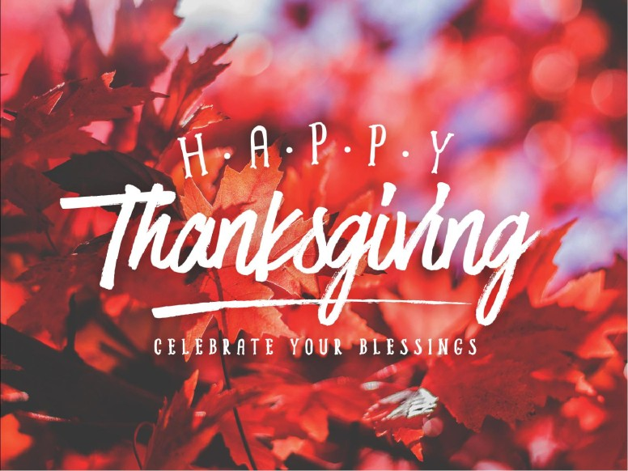
2019
Oneal church of Christ, Athens, Al. Nov. 24, 2019

Slide 2
Psalm 100:1-5
100 Make a joyful noise unto the Lord, all ye lands.
² Serve the Lord with gladness: come before his presence with singing.
³ Know ye that the Lord he is God:
it is he that hath made us, and not we ourselves;
we are his people, and the sheep of his pasture.
⁴ Enter into his gates with thanksgiving,
and into his courts with praise:
be thankful unto him, and bless his name.
⁵ For the Lord is good; his mercy is everlasting;
and his truth endureth to all generations.

Slide 3
^{Psalm 100: 4} Enter into his gates with thanksgiving,
and into his courts with praise:
be thankful unto him, and bless his name.

Slide 4
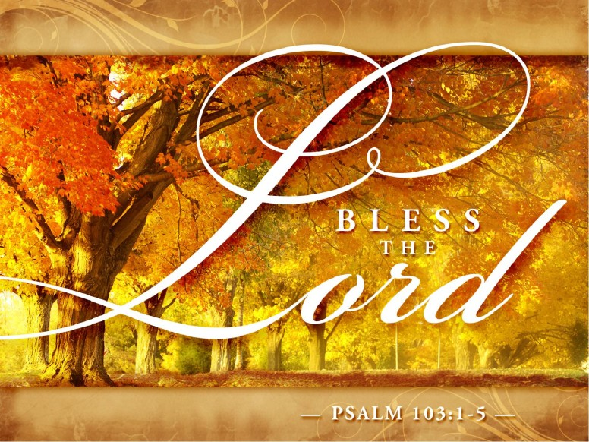

Slide 5
Psalm 103:1-5
103 Bless the Lord, O my soul: and all that is within me, bless his holy name.
² Bless the Lord, O my soul, and forget not all his benefits:
³ Who forgiveth all thine iniquities; who healeth all thy diseases;
⁴ Who redeemeth thy life from destruction; who crowneth thee with lovingkindness and tender mercies;
⁵ Who satisfieth thy mouth with good things; so that thy youth is renewed like the eagle's

Slide 6
#1
What shall we do?
Give thanks

Slide 7


Slide 8
I Thess. 5:14-18
¹⁴ Now we exhort you, brethren, warn them that are unruly, comfort the feebleminded, support the weak, be patient toward all men.
¹⁵ See that none render evil for evil unto any man; but ever follow that which is good, both among yourselves, and to all men.
¹⁶ Rejoice evermore.
¹⁷ Pray without ceasing.
¹⁸ In every thing give thanks: for this is the will of God in Christ Jesus concerning you.

Slide 9
#2
To Whom Shall we Give Thanks?

Slide 10


Slide 11
Isaiah 41:10
¹⁰ Fear thou not;
for I am with thee: be not dismayed;
for I am thy God:
I will strengthen thee; yea, I will help thee; yea, I will uphold thee with the right hand of my righteousness
..Phil. 4:13 “I can do all things through
Christ which strengtheneth me.”
..Phil. 4:19 ¹⁹ But my God shall supply all your need according to his riches in glory by Christ Jesus.

Slide 12
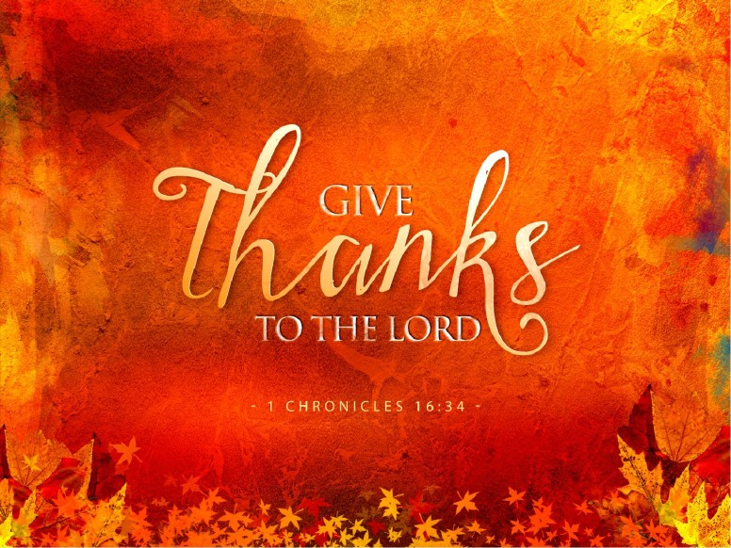

Slide 13
I Chron. 16:34
³⁴ O give thanks unto the Lord;
for he is good; for his mercy endureth for ever.

Slide 14
Psalm 18:49
Therefore will I give thanks unto thee, O Lord, among the heathen, and sing praises unto thy name

Slide 15
Psalm 92:1
It is a good thing to give thanks unto the Lord, and to sing praises unto thy name, O Most High:

Slide 16
Psalm 30:12
To the end that my glory may sing praise to thee,
and not be silent. O Lord my God,
I will give thanks unto thee for ever

Slide 17
#3
What shall we give thanks to God for?
Everything.

Slide 19
Psalm 103:1-5
103 Bless the Lord, O my soul: and all that is within me, bless his holy name.
² Bless the Lord, O my soul, and forget not all his benefits:
³ Who forgiveth all thine iniquities; who healeth all thy diseases;
⁴ Who redeemeth thy life from destruction; who crowneth thee with lovingkindness and tender mercies;
⁵ Who satisfieth thy mouth with good things; so that thy youth is renewed like the eagle's

Slide 20
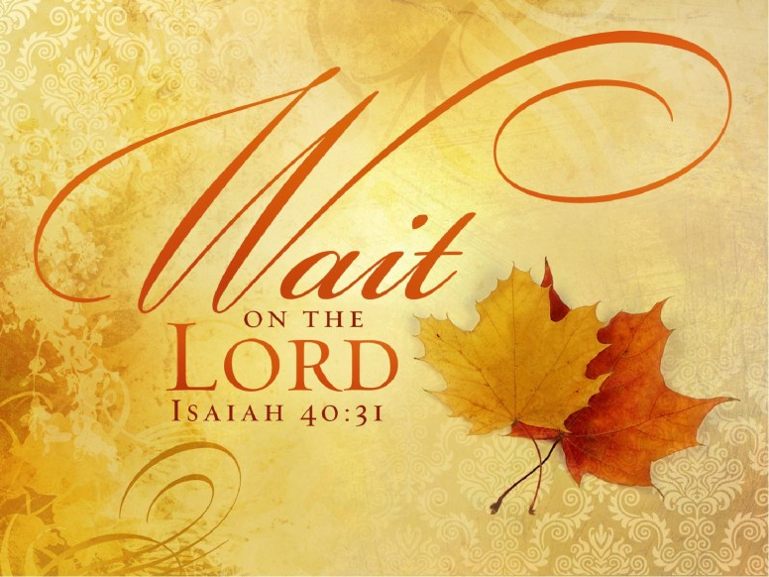

Slide 21
Isaiah 40:31
³¹ But they that wait upon the Lord
shall renew their strength;
they shall mount up with wings as eagles;
they shall run, and not be weary;
and they shall walk, and not faint.

Slide 22


Slide 23
Phil. 4:8
Finally, brethren, whatsoever things are true,
whatsoever things are honest,
whatsoever things are just,
whatsoever things are pure,
whatsoever things are lovely,
whatsoever things are of good report;
if there be any virtue,
and if there be any praise,
think on these things.

Slide 24
What To Be Thankful For?
· As we just stated:
The Lord’s benefits (Psalm 103:1-5)

Slide 25
·
For God’s goodness and mercy
(I Chronicles 16:34)
³⁴ O give thanks unto the Lord; for he is good;
for his mercy endureth for ever.

Slide 26
For wisdom from above (Daniel 2:23)
²³ I thank thee, and praise thee, O thou God of my fathers, who hast given me wisdom and might, and hast made known unto me now what we desired of thee: for thou hast now made known unto us the king's matter.

Slide 27
· For Christians , For the church!
(I Thessalonians 1:2)
² We give thanks to God always for you all,
making mention of you in our prayers;

Slide 28
For salvation through Christ
2 Cor. 9:15
¹⁵ Thanks be unto God for his unspeakable gift.

Slide 29
·
For the Word of God which changes lives
I Thess. 2:13 ¹³ For this cause also thank we God without ceasing, because, when ye received the word of God which ye heard of us, ye received it not as the word of men, but as it is in truth, the word of God, which effectually worketh also in you that believe.

Slide 30
For answered prayer (John 11:41)
⁴¹ Then they took away the stone from the place
where the dead was laid. And Jesus lifted up his eyes,
and said, Father, I thank thee that thou hast heard me.

Slide 31
·
For victory (I Corinthians 15:57)
⁵⁷ But thanks be to God,
which giveth us the victory
through our Lord Jesus Christ.

Slide 32
The Word tells us the following:
(Psalm 140:13) “Surely the righteous shall give thanks to Your name; The upright shall dwell in Your presence.” NKJV

Slide 33
#4 WHEN?
I Thess. 5:17 Pray without ceasing
Daniel 6:10 ¹⁰ Now when Daniel knew that the writing was signed, he went into his house; and his windows being open in his chamber toward Jerusalem, he kneeled upon his knees three times a day, and prayed, and gave thanks before his God, as he did aforetime.
Pray: Morning, Noon and Night!!!

Slide 34
BE THANKFUL TO GOD THAT
YOU AND I CAN BE SAVED!
He is calling you home.
Heb. 5:8-9

Slide 35
2019
Oneal church of Christ, Athens, Al. Nov. 24, 2019

Slide 38
What shall we do?
Give thanks
For what shall we thank God?
Everything
Why should we give thanks to God?
For God is Good and all we have is from Him. Jas. 1:17
When should we give thanks to God?
Morning, Noon and Night…all times.

Slide 39
Why should we give thanks to God?
Because He is good.

Slide 40
When should we give thanks to God?
Morning, Noon and Night.
Daniel prayed and gave thanks…Dan 6:10
Pray without ceasing. I Thess. 5:17

Slide 41
Isaiah 40:31
³¹ But they that wait upon the Lord
shall renew their strength;
they shall mount up with wings as eagles;
they shall run, and not be weary;
and they shall walk, and not faint.

Slide 43
Phil. 4:8
Finally, brethren, whatsoever things are true,
whatsoever things are honest,
whatsoever things are just,
whatsoever things are pure,
whatsoever things are lovely,
whatsoever things are of good report;
if there be any virtue,
and if there be any praise,
think on these things.

Slide 44


Slide 45
Prov. 3:5-6
⁵ Trust in the Lord with all thine heart;
and lean not unto thine own understanding.
⁶ In all thy ways acknowledge him,
and he shall direct
thy paths.

Slide 46


Slide 47
Be Thankful for the church of Christ
A)Purchased with the blood of Christ. Acts 20:28
B)People are being added to it by the Lord. Acts 2:47
C)It is the house of God, the family of God. I Tim.3:15
D)Jesus promises to receive it to himself.

Slide 48
Today, on this Thanksgiving Sunday, let
Us give thanks unto our Creator
1. For our creation.
2. For His blessings that flow to us daily Eph.1:3;James 1:17
3. For each other. Family, Friends, Brethren.
4. For all of our sins being forgiven in Jesus Christ.

Slide 49
Why?

Slide 50
Quit worrying…
Stop it.

Slide 51


Slide 52
Col. 4:2Colossians
² Continue in prayer,
and watch in the same
with thanksgiving
Let us pray right now…

Slide 53
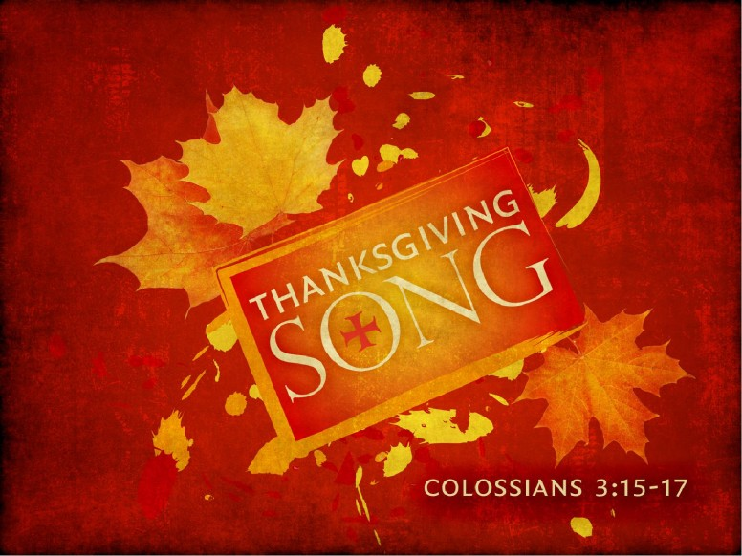

Slide 54
Col. 3:15-17
¹⁵ And let the peace of God rule in your hearts, to the which also ye are called in one body; and be ye thankful.
¹⁶ Let the word of Christ dwell in you richly in all wisdom; teaching and admonishing one another in psalms and hymns and spiritual songs, singing with grace in your hearts to the Lord.
¹⁷ And whatsoever ye do in word or deed, do all in the name of the Lord Jesus, giving thanks to God and the Father by him.

Slide 56
Why?

Slide 57


Slide 58
Today, on this Thanksgiving Sunday, let
Us give thanks unto our Creator
1. For our creation.
2. For His blessings that flow to us daily Eph.1:3;James 1:17
3. For each other. Family, Friends, Brethren.
4. For all of our sins being forgiven in Jesus Christ.

Slide 59
Our Prayer today is for all of you in this
Audience who need to be converted,
Who need to make their lives restored to
The loving God, and Father through confession of
Faults and being restored to the Lord.

Slide 61
First National Thanksgiving Proclamation
Whereas, it is the duty of all nations to acknowledge the providence of Almighty God, to obey His will, to be grateful for His benefits, and humbly to implore His protection and favor. Whereas, both the houses of Congress have, by their joint committee, requested me
“to recommend to the people of the United States a day of public thanksgiving and prayer, to be observed to acknowledging with grateful hearts the many and signal favors of Almighty God, especially by affording them an opportunity peaceably to establish a form of government for their safety and happiness!”
Now therefore, I do recommend next, to be devoted by the people of the state to the service of that great and glorious being, who is the beneficent Author of all the good that was, that is, or that will be, that we may then all unite in rendering unto Him our sincere and humble thanks for His kind care and protection of the people of this country. George Washington
Our aim today is to follow the instruction of I Thessalonians 5:18 “in everything give thanks; for this is the will of God in Christ Jesus for you.” NKJV

Slide 62
. What Does Thanksgiving Look Like?
· It is seen as a spiritual sacrifice, an offering to Jehovah. (Psalm 116:17) Note also Leviticus 7:12.
· It is seen as a duty, under obligation because of the multitude of blessings. (II Thessalonians 2:13)
· Thanksgiving should be a regular part of our prayer. (Ephesians 1:16) Be thankful every chance you get. (Philippians 1:3-4, Psalm 34:1)
· It is done through the name of Christ. (Ephesians 5:20)
· God wants His people to be thankful. (I Thessalonians 5:18, Philippians 4:6)
· Those pictured in heaven fell on their faces to worship and thank God. (Revelation 7:11-12)
· Those associated with the peace of God were called to be thankful. (Colossians 3:15

Slide 63
II. What To Be Thankful For?
· The Lord’s benefits (Psalm 103:1-5)
· For God’s goodness and mercy (I Chronicles 16:34)
For wisdom from above (Daniel 2:23)
· For Christians (I Thessalonians 1:2)
· For salvation through Christ (II Corinthians 9:15)
· For the Word of God which changes lives (I Thessalonians 2:13)
· For answered prayer (John 11:41)
· For victory (I Corinthians 15:57)
The Word tells us the following:
(Psalm 140:13) “Surely the righteous shall give thanks to Your name; The upright shall dwell in Your presence.” NKJV

Slide 64
O Give Thanks Unto the
Lord God
Psalm 100:1-5

Slide 65
We will never forget!!
Our brothers and sisters who have
Left us.
We shall press onward, looking forward
To meeting the Lord with all
His saints.

Slide 66
1 Make a joyful noise unto the Lord, all ye lands.
² Serve the Lord with gladness: come before his presence with singing.
³ Know ye that the Lord he is God: it is he that hath made us, and not we ourselves; we are his people, and the sheep of his pasture.
⁴ Enter into his gates with thanksgiving, and into his courts with praise: be thankful unto him, and bless his name.
⁵ For the Lord is good; his mercy is everlasting; and his truth endureth to all generations.

Slide 67
Psalm 18:49
Therefore will I give thanks unto thee, O Lord, among the heathen, and sing praises unto thy name

Slide 68
Psalm 92:1
It is a good thing to give thanks unto the Lord, and to sing praises unto thy name, O Most High:

Slide 69
Psalm 30:12
To the end that my glory may sing praise to thee,
and not be silent. O Lord my God,
I will give thanks unto thee for ever

Slide 70
Psalm 105:1
O give thanks unto the Lord;
call upon his name:
make known his deeds among the people.

Slide 71
Psalm 106:47
Save us, O Lord our God, and gather us from
among the heathen, to give thanks unto
thy holy name, and to triumph in thy praise.

Slide 72
Psalm 136:1
O give thanks unto the Lord;
for he is good:
for his mercy endureth for ever.

Slide 73
1 Thessalonians 5:18
In every thing give thanks:
for this is the will of God in
Christ Jesus concerning you.

Slide 74
Isa. 55:6-11
⁶ Seek ye the Lord while he may be found, call ye upon him while he is near:
⁷ Let the wicked forsake his way, and the unrighteous man his thoughts: and let him return unto the Lord, and he will have mercy upon him; and to our God, for he will abundantly pardon.

Slide 75
⁸ For my thoughts are not your thoughts, neither are your ways my ways, saith the Lord.
⁹ For as the heavens are higher than the earth, so are my ways higher than your ways, and my thoughts than your thoughts.
¹⁰ For as the rain cometh down, and the snow from heaven, and returneth not thither, but watereth the earth, and maketh it bring forth and bud, that it may give seed to the sower, and bread to the eater:
¹¹ So shall my word be that goeth forth out of my mouth: it shall not return unto me void, but it shall accomplish that which I please, and it shall prosper in the thing whereto I sent it

Slide 76
1. Give God thanks for the glorious invitation
To be forgiven Isa. 55:6-7

Slide 77
2. Give God thanks for the Glorious Ways of God.
Isa. 55:8-9

Slide 78
3. Give God thanks for the
glorious
Operation of the word of God. Isa. 55:10-11

Slide 79
1. Give God thanks for the glorious invitation
To be forgiven Isa. 55:6-7

Slide 80
Isa. 55:6-11
⁶ Seek ye the Lord while he may be found, call ye upon him while he is near:
⁷ Let the wicked forsake his way, and the unrighteous man his thoughts: and let him return unto the Lord, and he will have mercy upon him; and to our God, for he will abundantly pardon.

Slide 81
2. Give God thanks for the Glorious Ways of God.
Isa. 55:8-9

Slide 82
The Great Difference between God and Man
Thoughts
My Thoughts
Your Thoughts
Ways
My Ways
Your Ways

Slide 83
Demonstration of God’s Goodness
For as the rain cometh down,
And the snow from heaven,
And returneth not again
But Watereth the earth
That it may bring forth seed to the sower
And bread to the eater

Slide 84
3. Give God thanks for the
glorious
Operation of the word of God. Isa. 55:10-11

Slide 85
So…shall my word be that goeth forth out of my mouth
The word that goeth forth out of God’s mouth….
Don’t Add it, don’t take away from it.
Prov. 30:5-6
Rev. 22:18-19
2 John 9
Matt. 4:4

Slide 86
It shall prosper in the thing that I sent it.
There is never a time when it does not do what He says it will do.
Ill. 2 Tim. 4:2-4
Jude 3

Slide 87
Guaranteed promise:
1. It shall accomplish that which I please
God’s truth is astonishing…what it can do.
a.Make you free. John 8:32; no longer a
slave. Rom. 6:16-18..
God be thanked, you were the servants of sin, but have obeyed from the heart that form of doctrine delivered unto you. Being then made free from sin, you became the servants of righteousness.

Slide 88
The power in God’s word…we give thanks

Slide 89
The grace given us in Jesus Christ…we give God thanks

Slide 90
The circumstances that we have in Jesus, makes us humble with thanks

Slide 91
The outcome of our lives…We give God thanks

Slide 92
The people who God has given us to touch our lives, we give God thanks..
Paul was so thankful for Timothy
The Philippians (church who sent once and
again unto his necessities)
Peter reminds us of those ‘precious’ to us…
The Thessalonians are given the assurance that “God
Will bring them with His Son”…

Slide 93
People we have lost in the last 2years
We will never forget them!!
Fred Robertson (former Elder)
Charles Tucker (former Elder)
Bobby Chittam(former Deacon)
Charlie Christopher(former Elder)
Jimmy Hargrave(faithful brother)
And a host of others…

Slide 94
Today we give thanks to God for all those who have lived among us and are gone…
We remember them.

Slide 95
O Give Thanks
Above all,
We stand with assurance of hope that God will bring
Them with His Son Jesus Christ
We shall see our loved ones again.
They shall not come back to us,
But we shall go to them… As David said about his son that
Had died.

Slide 96
Are you in Christ Jesus?
Husbands,
Wives,
Children
Grandchildren
Great grandchildren
Parents

Slide 97
HIS WORD WILL ACCOMPLISH THAT WHICH
HE PLEASES

Slide 98
His Word will prosper in the thing whereto He sent it.

Slide 99
O Give Thanks Unto the
Lord God
Isa 55:6-11

