Slide 1
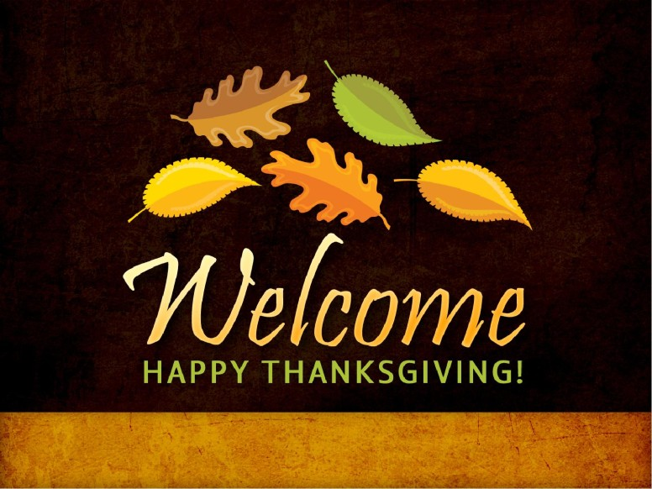

Slide 2
Thanksgiving 2018

Slide 3
Psalm 136:1-9
136 O give thanks unto the Lord; for he is good: for his mercy endureth for ever. 1. He is good.
² O give thanks unto the God of gods: for his mercy endureth for ever. 2. He is the God of gods
³ O give thanks to the Lord of lords: for his mercy endureth for ever. 3. He is the Lord of lords.
⁴ To him who alone doeth great wonders: for his mercy endureth for ever. 4. He alone doeth great wonders

Slide 4
⁵ To him that by wisdom made the heavens: for his mercy endureth for ever. 5. He made the heavens by wisdom
⁶ To him that stretched out the earth above the waters: for his mercy endureth for ever. 6. He stretched out the earth above the waters.
⁷ To him that made great lights: for his mercy endureth for ever: 7. He made great lights
⁸ The sun to rule by day: for his mercy endureth for ever:
8. He made the sun to rule by day
⁹ The moon and stars to rule by night: for his mercy endureth for ever. 9. He made the moon and stars to rule by night

Slide 5


Slide 6


Slide 7
Psalm 139:1-6 Let us be thankful that God knows us!!
O lord, thou hast searched me, and known me. (He knows us!)
^{What does God know about us?2} Thou knowest my downsitting and mine uprising, thou understandest my thought afar off.
³ Thou compassest my path and my lying down, and art acquainted with all my ways. (God is acquainted with all our ways)
⁴ For there is not a word in my tongue, but, lo, O Lord, thou knowest it altogether. (God is aware of every word in our tongue)
⁵ Thou hast beset me behind and before, and laid thine hand upon me.(God has beset us behind and before)
⁶ Such knowledge is too wonderful for me; it is high, I cannot attain unto it.

Slide 8


Slide 9
What are some things for which we should
Give God thanks!!

Slide 10
1. The Lord’s Benefits. Psalm 103:1-5
1 Bless the Lord, O my soul: and all that is within me, bless his holy name.
² Bless the Lord, O my soul, and forget not all his benefits:
³ Who (1) forgiveth all thine iniquities;
(2) who healeth all thy diseases; (3) ⁴ Who redeemeth thy life from destruction;(4) who crowneth thee with lovingkindness and tender mercies;
⁵ Who (5)satisfieth thy mouth with good things; so that thy youth is renewed like the eagle's.
Dear God…We truly thank you for all these benefits!!

Slide 11
2. For God’s goodness and mercy!!
1 Chronicles 16:34 ³⁴ O give thanks unto the Lord; for he is good; for his mercy endureth for ever.

Slide 12
3. For Wisdom from above. Daniel 2:23
²³ I thank thee, and praise thee, O thou God of my fathers, who hast given me wisdom and might, and hast made known unto me now what we desired of thee: for thou hast now made known unto us the king's matter.
Isa. 26:3

Slide 13


Slide 14
1 Chronicles 29:13
Now therefore, our God, we thank thee, and praise thy glorious name.

Slide 15
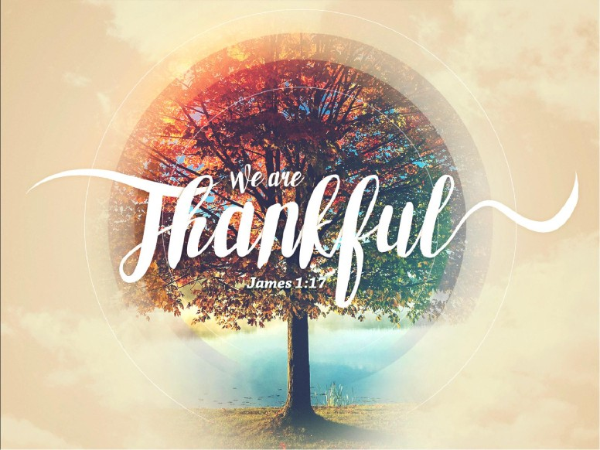

Slide 16
^{James 1:17} Every good gift and every perfect gift is from above, and cometh down from the Father of lights, with whom is no variableness, neither shadow of turning.

Slide 17


Slide 18
Colossians 3:15
¹⁵ And let the peace of God rule in your hearts, to the which also ye are called in one body; and be ye thankful.

Slide 19


Slide 20
4. For Other Christians. Our spiritual
Family. I Thess. 1:2
We give thanks to God always for you all, making mention of you in our prayers;
We are the family of God. I Tim. 3:15
The church of Christ. Rom. 16:16

Slide 21
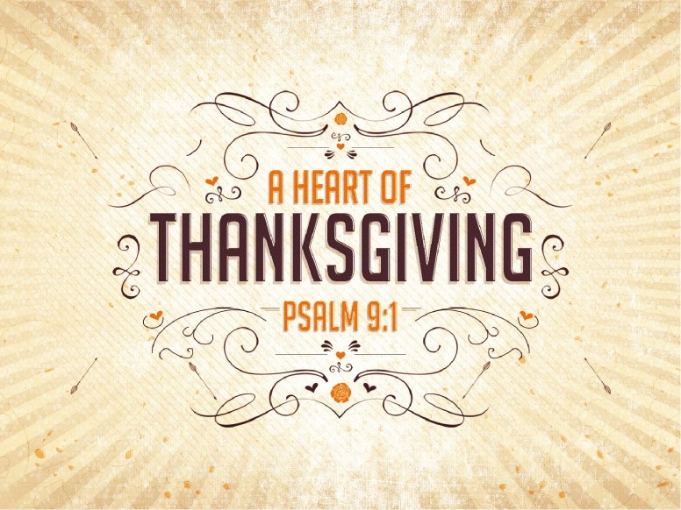

Slide 22
Psalm 9:1 I will praise thee, O Lord, with my whole heart; I will shew forth all thy marvellous works.

Slide 23
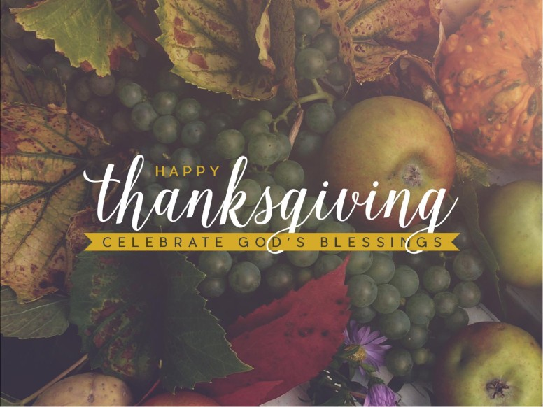

Slide 24
5. For our Physical Family.
We are so grateful for the support that God
Teaches us to give to our immediate families.
I Tim. 5:4 ⁴ But if any widow have children or nephews, let them learn first to shew piety at home, and to requite their parents: for that is good and acceptable before God.
⁸ But if any provide not for his own, and specially for those of his own house, he hath denied the faith, and is worse than an infidel.
Welcome home Children!!

Slide 25
6. For Salvation through Jesus Christ.
Acts 4:12 ..no other name by which we can be saved
Rom.5:8,9..no other justification except in Jesus Christ
John 1:29..no other Lamb by which His blood saves us
John 14:6 .no other way…JESUS IS THE ONLY WAY
And …LET US THANK GOD FOR HIM!! Today ..and forever

Slide 26

7. For the Word of God which changes lives. (I Thess.2:13)
1 Thessalonians 2:13 ¹³ For this cause also thank we God without ceasing, because, when ye received the word of God which ye heard of us, ye received it not as the word of men, but as it is in truth, the word of God, which effectually worketh also in you that believe.

Slide 27
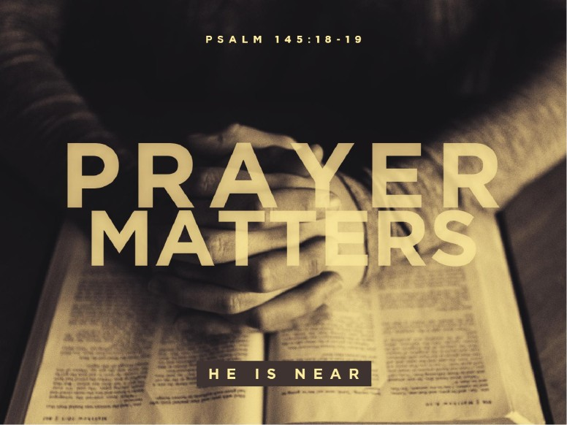
8. For answered prayer. (John 11:41) ⁴¹ Then they took away the stone from the place where the dead was laid. And Jesus lifted up his eyes, and said, Father, I thank thee that thou hast heard me.

Slide 28

9. For being in America!!
God Bless the USA..

Slide 29
First National Thanksgiving Proclamation
Whereas, it is the duty of all nations to acknowledge the providence of Almighty God, to obey His will, to be grateful for His benefits, and humbly to implore His protection and favor. Whereas, both the houses of Congress have, by their joint committee, requested me
“to recommend to the people of the United States a day of public thanksgiving and prayer, to be observed to acknowledging with grateful hearts the many and signal favors of Almighty God, especially by affording them an opportunity peaceably to establish a form of government for their safety and happiness!”

Slide 30
Now therefore, I do recommend next, to be devoted by the people of the state to the service of that great and glorious being, who is the beneficent Author of all the good that was, that is, or that will be, that we may then all unite in rendering unto Him our sincere and humble thanks for His kind care and protection of the people of this country.
George Washington
Our aim today is to follow the instruction of I Thessalonians 5:18 “in everything give thanks; for this is the will of God in Christ Jesus for you.” NKJV

Slide 31


