Slide 1
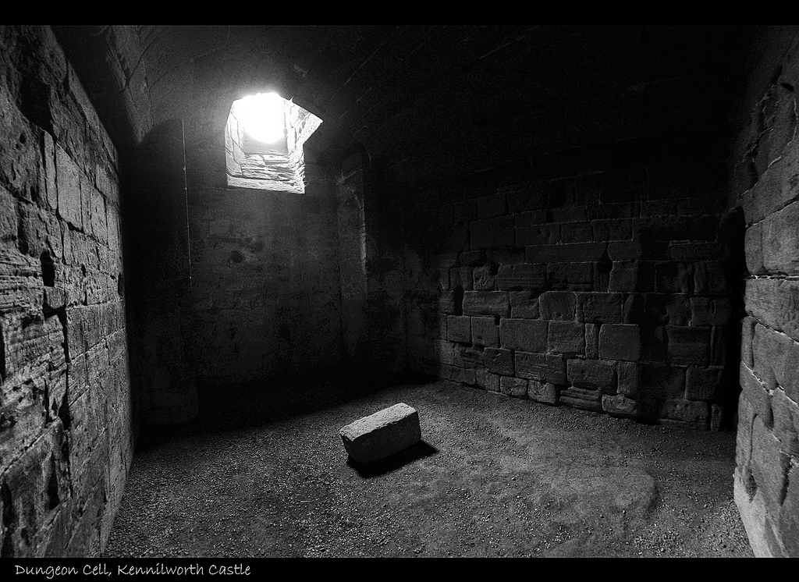

Nobody Cares
GOD
Notes:
Years ago a Frenchman incurred the displeasure of Napoleon and was put into a dungeon. It seemed to be forsaken by his friends and forgotten by everyone in the outside world. In loneliness and despair he took a stone and scratched on the wall of his cell, “Nobody cares.”
One day a green shoot came through the cracks in the stones on the floor of the dungeon and began to reach up toward the long window at the top of the cell. He
watered it each day and it grew up to be beautiful blue flower.
He then crossed out the words previously written on the wall and above them scratched, “God cares.”
Yes, God cares. He cares for you and He cares for me.

Slide 2
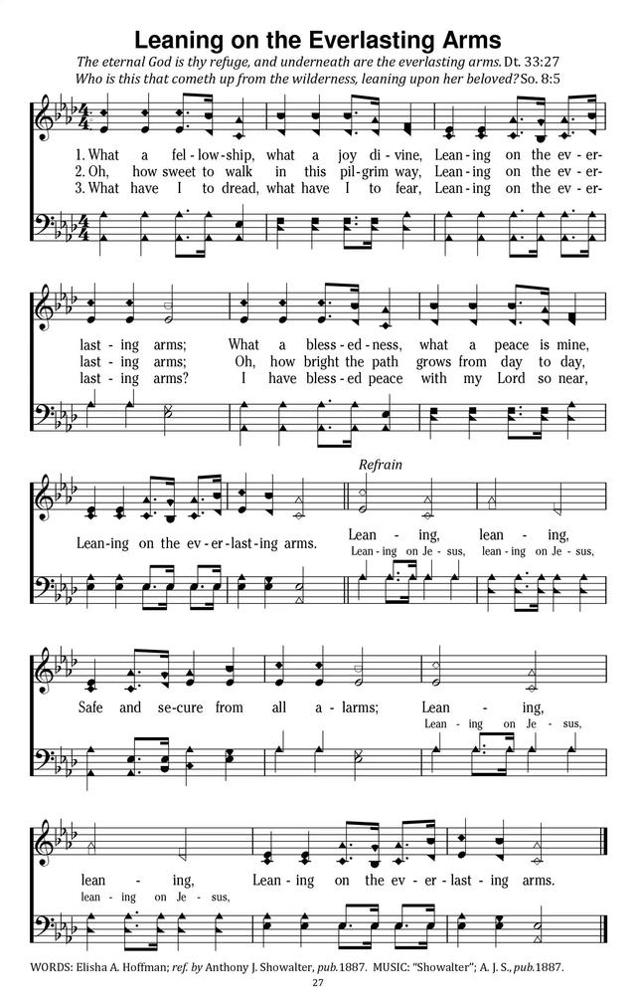
Notes:
I want to thank Will for leading us in Leaning on the Everlasting Arms.
What comforting words are based on Moses’ statement found in Deuteronomy 33:27.
Deuteronomy 33:27
²⁷ The eternal God is thy refuge, and underneath are the everlasting arms: and he shall thrust out the enemy from before thee; and shall say, Destroy them.
It is wonderful to know God is eternal! He always been and always will be.
B. It is even more wonderful to know God is our refuge and we can always lean upon His everlasting arms.

Slide 3

Notes:
But sometimes we are like a man
There is a well-worn story about a man who was walking along a narrow path, not paying much attention to where he was going and slipped over the edge of a cliff.
As he fell, he grabbed a branch growing from the side of the cliff. Realizing that he couldn’t hang on for long, he called out for help.
He yelled, “Is there anybody up there?” When a voice answered, the man said, “Who’s that?”
The voice replied, “It’s God, do you trust me?”
The man said, “I trust you completely, Lord.”
God replied, “Good. Let go of the branch.”
After a long pause the man cried out, “Is there anybody else up there?”

Slide 4
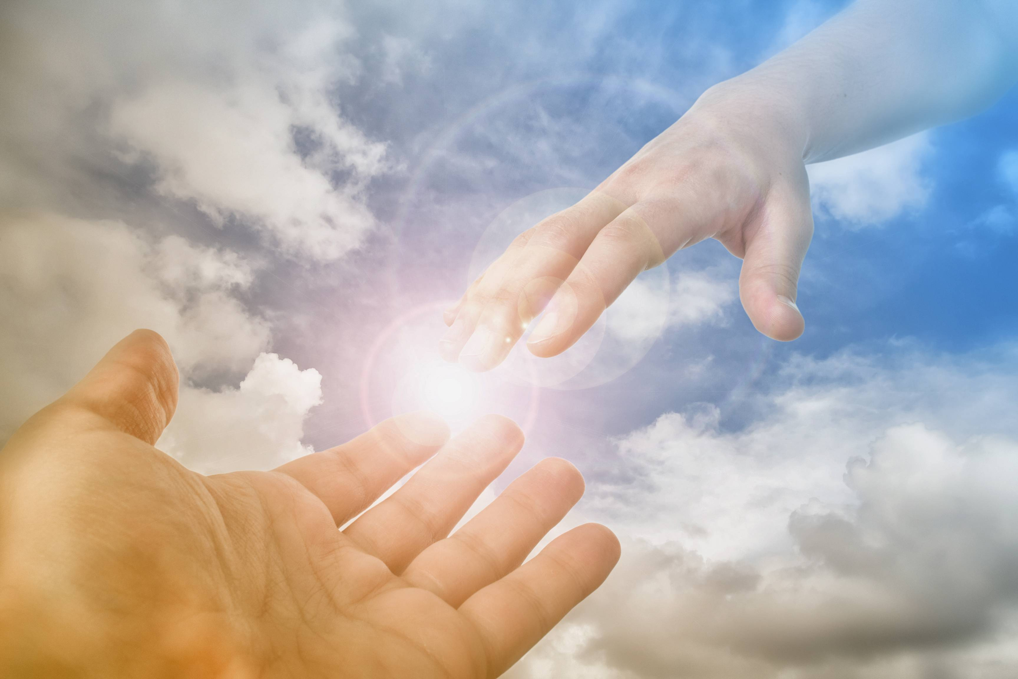
The Everlasting Arms of God
Notes:
Far too many times we react like the man on side of the cliff. We see no hope. We want answers, but when we receive them, they really aren’t what we want to hear.
We find ourselves saying we trust Him, but do we really trust in the Everlasting Arms of God?

Slide 5
Arms of Salvation
1. Paul exclaimed
Rom. 6:23
For the wages of sin is death; but the gift of God is eternal life through Jesus Christ our Lord.
Tit. 2:11
¹¹ For the grace of God that bringeth salvation hath appeared to all men,
Notes:
The “everlasting arms” are arms of salvation.
God’s arms are gracious, saving arms.
B. All men had fallen into sin and stood condemned, but God’s arms reached down from heaven to earth to bring salvation to all who will accept His grace.
Paul exclaimed….

Slide 6
Ephesians 2:1-9
¹And you hath he quickened, who were dead in trespasses and sins;
² Wherein in time past ye walked according to the course of this world, according to the prince of the power of the air, the spirit that now worketh in the children of disobedience:
³ Among whom also we all had our conversation in times past in the lusts of our flesh, fulfilling the desires of the flesh and of the mind; and were by nature the children of wrath, even as others.
Notes:
2. Paul wrote. (Eph. 2:1-9).
2. Paul declared we were dead in our trespasses and sins.

Slide 7
Ephesians 2:1-9
⁴ But God, who is rich in mercy, for his great love wherewith he loved us,
⁵ Even when we were dead in sins, hath quickened us together with Christ, (by grace ye are saved;)
⁶ And hath raised us up together, and made us sit together in heavenly places in Christ Jesus:
Notes:
3. God’s grace has been manifested through the atoning death of Jesus Christ. On the cross Jesus shed His blood for those lost in the filthy mire of sin.

Slide 8
Ephesians 2:1-9
⁷ That in the ages to come he might shew the exceeding riches of his grace in his kindness toward us through Christ Jesus.
⁸ For by grace are ye saved through faith; and that not of yourselves: it is the gift of God:
⁹ Not of works, lest any man should boast.
Notes:
3. God’s grace has been manifested through the atoning death of Jesus Christ. On the cross Jesus shed His blood for those lost in the filthy mire of sin.

Slide 9
Jesus Said…
Jn. 8:24 I said therefore unto you, that ye shall die in your sins: for if ye believe not that I am he, ye shall die in your sins.
Lk. 13:3 I tell you, Nay: but, except ye repent, ye shall all likewise perish.
Mk. 16:16 He that believeth and is baptized shall be saved; but he that believeth not shall be damned.

Slide 10
Arms of Salvation
Notes:
B. If we will but put our faith in the Lord Jesus Christ, believe Him to be the Messiah, the Son of the Living God, and trust Him completely for salvation; if we will sincerely repent and renounce all the sins we have committed; if we will then obey our Lord’s command to be baptized for the remission of sins, we shall be saved
2. The everlasting arms of God will reach down and save us when we obey these simple conditions of the gospel.

Slide 11
Arms of Strength
1. Leaning on the everlasting arms of God, we can say with the psalmist.
Psalms 46:1
God is our refuge and strength, a very present help in trouble.
Psalms 121:1-2
I will lift up mine eyes unto the hills, from whence cometh my help. ² My help cometh from the Lord, which made heaven and earth.
Notes:
The “everlasting arms” of God are arms of strength.
A. After saving us, God gives us strength to live the Christian life.

Slide 12
Arms of Strength
Isaiah 40:28-31
²⁸ Hast thou not known? hast thou not heard, that the everlasting God, the Lord, the Creator of the ends of the earth, fainteth not, neither is weary? there is no searching of his understanding.
²⁹ He giveth power to the faint; and to them that have no might he increaseth strength.
³⁰ Even the youths shall faint and be weary, and the young men shall utterly fall:
Notes:
2. Leaning on the everlasting arms of God, we can say in the triumphant words of Isaiah the prophet….

Slide 13
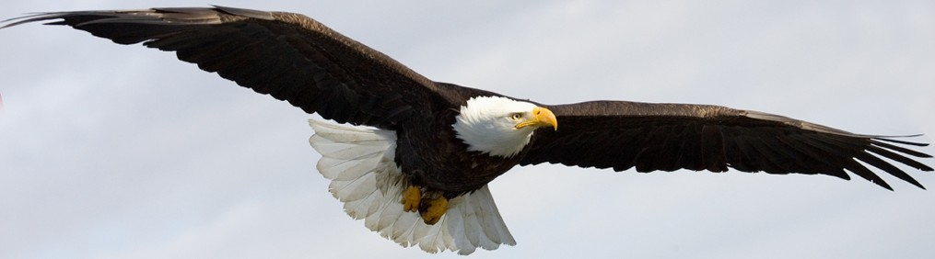
Arms of Strength
Isaiah 40:31
³¹ But they that wait upon the Lord shall renew their strength; they shall mount up with wings as eagles; they shall run, and not be weary; and they shall walk, and not faint.

Slide 14
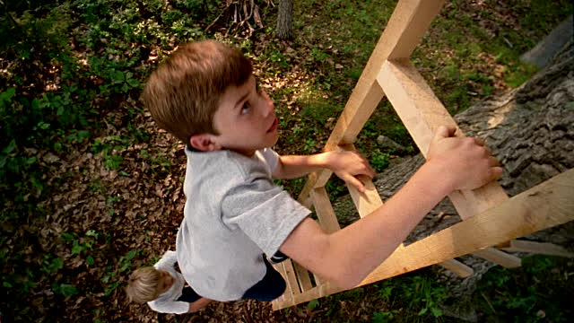
Arms of Strength
Notes:
B. Once a man on the top of his house gave his small son permission to climb the ladder to the place where he was standing. The little boy started up the ladder, but when he was halfway up, he looked down to the ground. He became frightened and began to cry.
The father then said, “Son, don’t look down, look up at me, and keep climbing.” The boy looked up to his father, the fear left him, and he climbed safely to the top.
C. Oh, that is what we need to do. When troubles and trials and temptations gather around us, we need to look up to God and He will reach forth His everlasting arms and help us.

Slide 15
Arms of Strength
Notes:
3. Leaning on the everlasting arms of God, we can also say with Paul. (2 Tim. 1:12).
¹² For the which cause I also suffer these things: nevertheless I am not ashamed: for I know whom I have believed, and am persuaded that he is able to keep that which I have committed unto him against that day.

Slide 16
Arms of Love
Jeremiah 31:3
I have loved thee with an everlasting love
Romans 5:8
But God commendeth his love toward us, in that, while we were yet sinners, Christ died for us.
1 Jn. 4:10
Herein is love, not that we loved God, but that he loved us, and sent his Son to be the propitiation for our sins.
Notes:
The “everlasting arms” of God are arms of love.
A. God is love.
1. God, through Jeremiah the prophet, said. (Jere. 31:3). ³ The Lord hath appeared of old unto me, saying, Yea, I have loved thee with an everlasting love: therefore with lovingkindness have I drawn thee.
2. Paul wrote. (Rom. 5:8). But God commendeth his love toward us, in that, while we were yet sinners, Christ died for us.
3. John wrote. (1 Jn. 4:10). Herein is love, not that we loved God, but that he loved us, and sent his Son to be the propitiation for our sins.

Slide 17
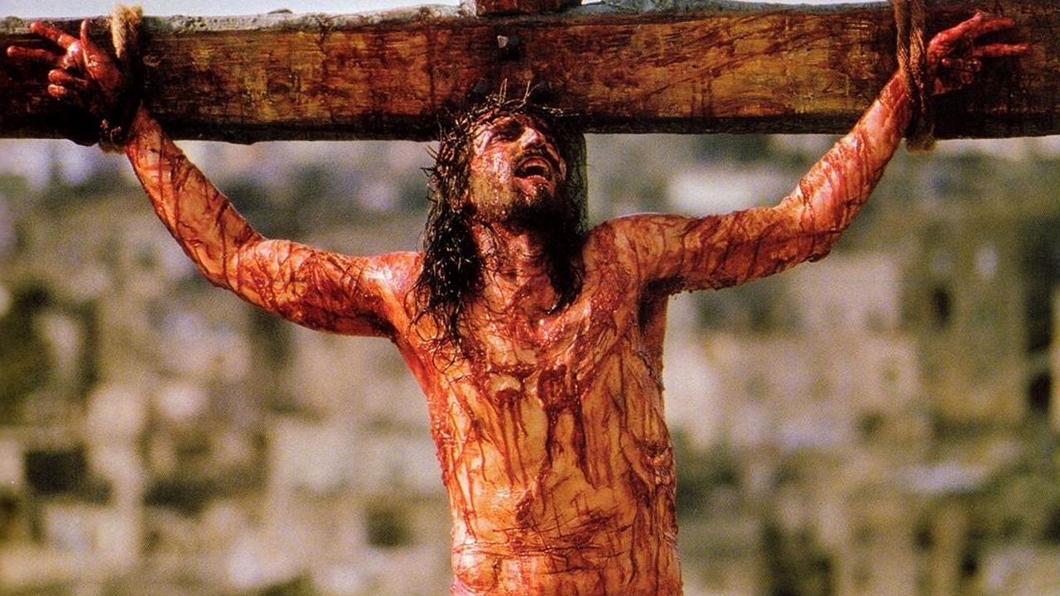
How Much Do You Love Us?
Notes:
B. God has always loved man.
He has manifested this love to man through a multitude of blessings showered upon him.
2 The climax of the divine love was when God sent Jesus to the world to be our Savior. God sent His Son to die on a cruel cross to die for us transgressions.
Christ was the propitiation for us sins. God can justly save us because Jesus paid the price for us.
3. God loved us by giving His only Son for us. We can be assured, therefore, that God who loved us that much will always love us.
4. If our faith and trust are in God, we may say in the words of Paul. (Rom. 8:37-39).

Slide 18
Romans 8:37-39
³⁷ Nay, in all these things we are more than conquerors through him that loved us.
³⁸ For I am persuaded, that neither death, nor life, nor angels, nor principalities, nor powers, nor things present, nor things to come,
³⁹ Nor height, nor depth, nor any other creature, shall be able to separate us from the love of God, which is in Christ Jesus our Lord.

Slide 19
Arms of Love
Notes:
C. We ought to love, honor, and serve God! “We love Him because He first loved us.” (1 Jn. 4:19).
1. Because God loved us, we ought to love God with all our heart, mind, soul, and strength is our greatest duty.
2. Because God loved us, we ought to obey God and conform to His will in every detail of our lives.

Slide 20
Arms of Guidance
Psalms 23:1-4
¹ The Lord is my shepherd; I shall not want.
² He maketh me to lie down in green pastures: he leadeth me beside the still waters.
³ He restoreth my soul: he leadeth me in the paths of righteousness for his name's sake.
⁴ Yea, though I walk through the valley of the shadow of death, I will fear no evil: for thou art with me; thy rod and thy staff they comfort me.
Notes:
The “everlasting arms” of God are arms of guidance.
A. As the father takes his son by the hand to lead him through the darkness of night, so the everlasting arms lead us in this world.
B. We may therefore say, in the immortal words of David. (Psa. 23:1-4).
C. Yes, God will lead us where we need to go.
1. He may lead us by the still waters and green pastures; and, at other times, in the valleys of darkness, where the shadows and danger lurk.
2. But we are assured that our Good Shepherd will always lead us in paths of righteousness, never in the paths of unrighteousness! Where He leads is where we ought to go! We should follow God’s guidance in all things.

Slide 21
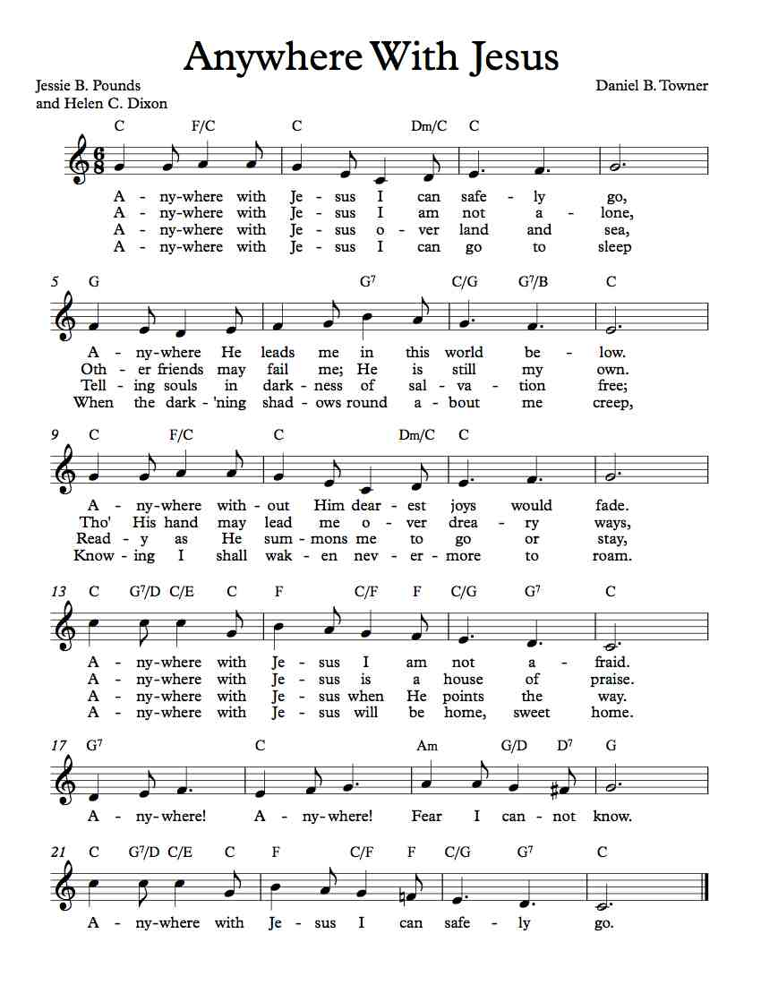

Slide 22
Arms of Guidance

Slide 23
Arms of Rest
1 Kings 8:56-57
⁵⁶ Blessed be the Lord, that hath given rest unto his people Israel, according to all that he promised: there hath not failed one word of all his good promise, which he promised by the hand of Moses his servant.
⁵⁷ The Lord our God be with us, as he was with our fathers: let him not leave us, nor forsake us:
Notes:
The “everlasting arms” of God are also arms of rest.
A. Solomon uttered these words to Israel.
1KI 8:56 "Blessed be the Lord, who has given rest to His people Israel, according to all that He promised; not one word has failed of all His good promise, which He promised through Moses His servant.
1KI 8:57 "May the Lord our God be with us, as He was with our fathers; may He not leave us or forsake us,
These words were spoken to fleshly Israel, but they are also true of spiritual Israel - the church. God will not break His promise, but will give us sweet rest.
The psalmist exhorted us to “rest in the Lord”. (Psa. 37:7).
Psalm 37:7
⁷ Rest in the Lord, and wait patiently for him: fret not thyself because of him who prospereth in his way, because of the man who bringeth wicked devices to pass.

Slide 24
Arms of Rest
Matthew 11:28-30
²⁸ Come unto me, all ye that labour and are heavy laden, and I will give you rest.
²⁹ Take my yoke upon you, and learn of me; for I am meek and lowly in heart: and ye shall find rest unto your souls.
³⁰ For my yoke is easy, and my burden is light.

Slide 25
Arms of Rest
Revelation 14:13
¹³ And I heard a voice from heaven saying unto me, Write, Blessed are the dead which die in the Lord from henceforth: Yea, saith the Spirit, that they may rest from their labours; and their works do follow them.

Slide 26
Arms of Rest
Notes:
B. Amid all the trials, sorrow, tragedies, heartaches and troubles in life, we may go to the everlasting arms of God and there find sweet rest from all our labors.
C. And we have the blessed assurance that, if faithful to God in this life, we may enter into the eternal rest with Him in heaven. There we will enjoy sweet rest and sing of His marvelous grace forever.

Slide 27
The Everlasting Arms of God
Notes:
In the Everlasting Arms of God, we will find
Salvation
Strength
Love
Guidance
Rest
His arm is always extended, but it’s up to you and me to take it.
What will you answer be?

