Slide 1

Notes:
What comes to mind when you see this word?
Maybe other words like scared, frightened, terrified
Maybe things like spiders, snakes, heights, small spaces, storms, the dark, flying, death
Maybe you are thinking about a movie
Maybe when your mom says or use to say, Just wait until your dad gets home
Maybe when your mom or teacher gave you THE LOOK
Maybe a knock on the door in the middle of the night
What do you fear?
Whom do you fear?

Slide 2

Notes:
Yet there might be some in the audience tonight who says, I have no fear.
I would say that most of us in here tonight have a fear of something in this life.

Slide 3

Notes:
That leaves us with a question….
Whom shall I fear? Should I even have fears?

Slide 4
Romans 3:9 What then? are we better than they? No, in no wise: for we have before proved both Jews and Gentiles, that they are all under sin;
10 As it is written, There is none righteous, no, not one:
11 There is none that understandeth, there is none that seeketh after God.
12 They are all gone out of the way, they are together become unprofitable; there is none that doeth good, no, not one.
13 Their throat is an open sepulchre; with their tongues they have used deceit; the poison of asps is under their lips:
14 Whose mouth is full of cursing and bitterness:
15 Their feet are swift to shed blood:
16 Destruction and misery are in their ways:
17 And the way of peace have they not known:
18 There is no fear of God before their eyes.
Notes:
In Romans chapter 3 we see a description of the Jews and the Gentiles.
Read.
Does this sound familiar to the world we know today?
Why do people do the evil things they do? Remember my last sermon on Seeking Godly Advice in an Ungodly Word?
Why are people involving themselves with alcohol, smoking, drugs, premarital and extra-marital relations, stealing, cursing, lying, choosing of inappropriate friends?
Just like the Jews & Gentiles mentioned in Romans 3—There is no fear of God before their eyes.

Slide 5


Slide 6


Slide 7


Slide 8
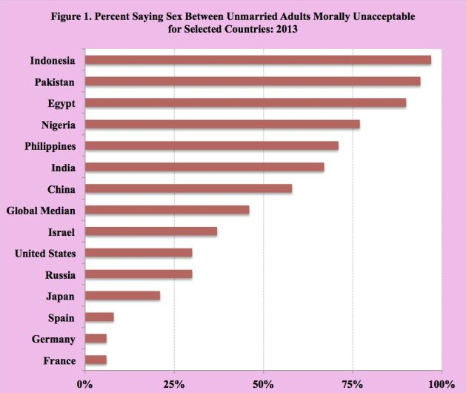
Notes:
Premarital relations
Extra-marital relations

Slide 9
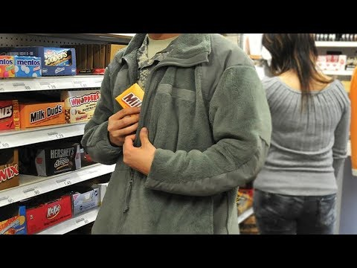

Slide 10


Slide 11

Notes:
What advice would the world give to parents? Christians?

Slide 12



Slide 13

1 Peter 2:9
But ye are a chosen generation, a royal priesthood, an holy nation, a peculiar people; that ye should shew forth the praises of him who hath called you out of darkness into his marvellous light;
Notes:
It’s fear that causes us to go along with the crowd. It’s a lack of fear that causes us to not stand out and be different from the world.

Slide 14

Notes:
So it boils down to this question….
Do you fear God or Man?
So let’s let the wisest man to ever live give us insight on the answer to that question.

Slide 15
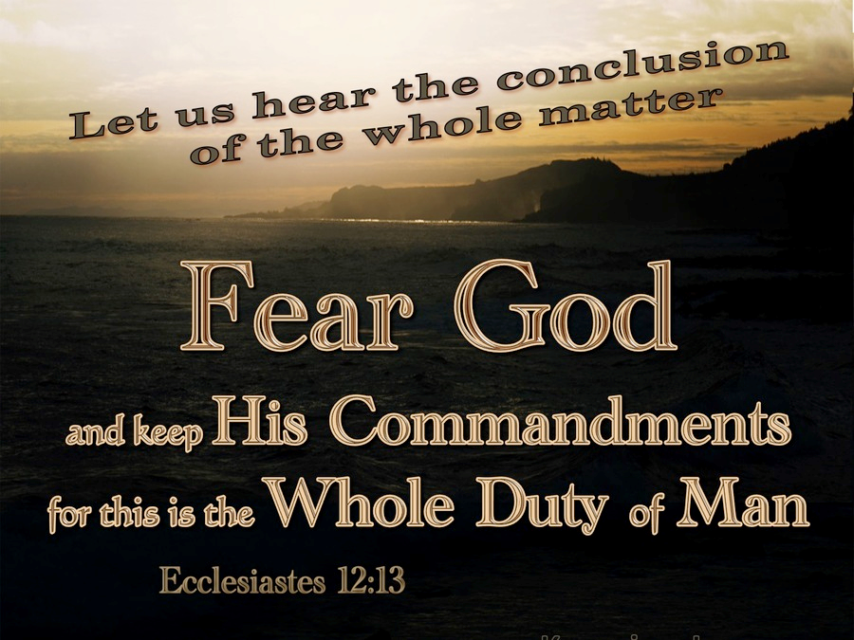
Notes:
Better yet, let’s let the one who lived a sinless life shed some light on the answer to the question “Whom shall I fear?”

Slide 16
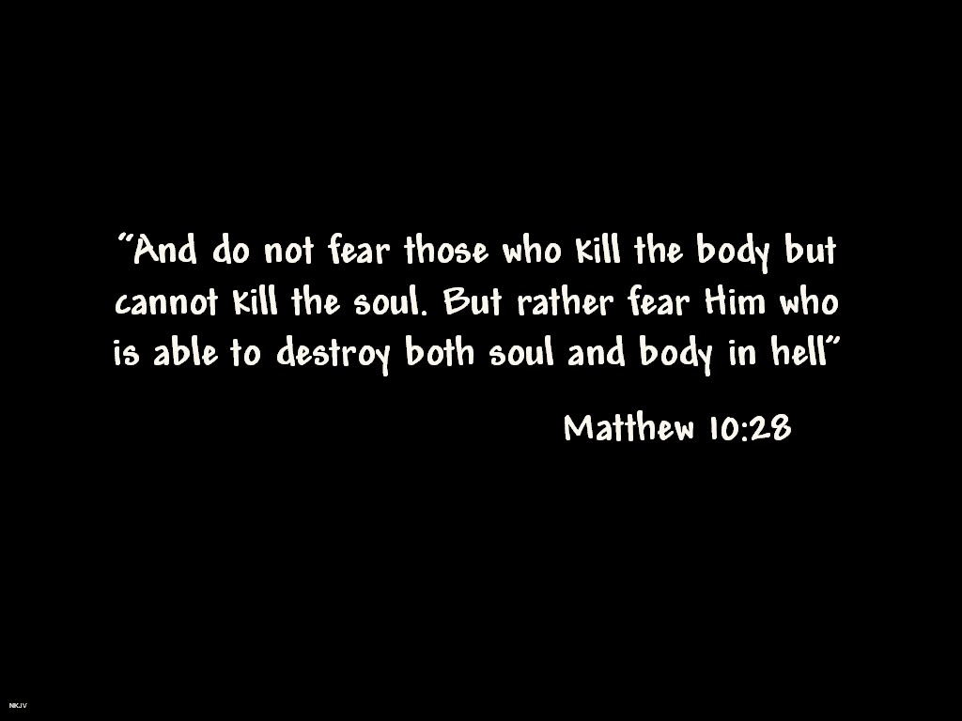

Slide 17
Definition
Two Distinct Definitions of Fear:
  Terrified (filled with terror, trembling)
  Awe-filled (reverential awe)
Fear of God can then be:
  Terrified of divine judgment for one’s personal offenses against a holy God
  Filled with a reverence for God who is sovereign and a savior.
Notes:
So what is the fear of God?

Slide 18
Actions of God-Fearing People
Actions or attitudes of those who fear God consist of:
  serving God (Deut 6:13; 10:20; 1 Sam 12:24).
  obeying His commandments (Deut 31:13; 1 Sam 12:14).
  exhibiting wisdom (Ps 111:10; Prov 9:10; 15:33).
  living in a special, covenant relationship with God (Ps 25:14; 103:17–18).
Notes:
Deuteronomy 6:13: Fear the Lord your God, serve him only and take your oaths in his name.
Deuteronomy 10:20 Fear the Lordyour God and serve him. Hold fast to him and take your oaths in his name
1 Samuel 12:24 But be sure to fear the Lord and serve him faithfully with all your heart; consider what great things he has done for you
Deuteronomy 31:13 Their children, who do not know this law, must hear it and learn to fear the Lordyour God as long as you live in the land you are crossing the Jordan to possess
1 Samuel 12:14 If you fear the Lord and serve and obey him and do not rebelagainst his commands, and if both you and the king who reigns over you follow the Lord your God—good!
Ps 111:10: The fear of the Lord is the beginning of wisdom; all who follow his precepts have good understanding. To him belongs eternal praise.
Proverbs 9:10 The fear of the Lord is the beginning of wisdom, and knowledge of the Holy One is understanding.
Proverbs 15:33 Wisdom’s instruction is to fear the Lord, and humility comes before honor
Psalm 25:14: The Lord confides in those who fear him; he makes his covenant known to them.
Psalm 103:17-18 But from everlasting to everlasting the Lord’s love is with those who fear him, and his righteousness with their children’s children—with those who keep his covenant and remember to obey his precepts.

Slide 19
Actions of God-Fearing People
  being in awe and reverence of Him (Ps 33:8; Mal 2:5).
  trusting Him (Ps 40:3; 115:11).
  hating and avoiding evil (Prov 8:13; 16:6).
  worshiping Him (Rev 14:7).
Deuteronomy 10:12-13: And now, O Israel, what does the Lord your God ask of you but to fear the Lord your God, to walk in all his ways, to love him, to serve the Lord your God with all your heart and with all your soul, and to observe the Lord’s commands and decrees” (NIV)
Notes:
Psalm 33:8: Let all the earth fear the Lord; let all the people of the world revere him.
Malachi 2:5 My covenant was with him, a covenant of life and peace, and I gave them to him; this called for reverence and he revered me and stood in awe of my name
Psalm 40:3: He put a new song in my mouth, a hymn of praise to our God. Many will see and fear the Lord and put their trust in him.
Psalm 115:11 You who fear him, trust in the Lord—he is their help and shield.
Proverbs 8:13 To fear the Lord is to hate evil; I hate pride and arrogance, evil behavior and perverse speech
Proverbs 16:6 : Through love and faithfulness sin is atoned for; through the fear of the Lord evil is avoided.
Revelation 14:7: He said in a loud voice, “Fear God and give him glory, because the hour of his judgment has come. Worship him who made the heavens, the earth, the sea and the springs of water.”

Slide 20
Terror vs. Reverence
The fear of God is a fundamental quality for those who have knowledge of who He is.
A personal knowledge of God makes the difference between terror and awe.
Example: Sailors from the book of Jonah. Terrified vs. reverent

Slide 21
Jonah 1:3-16
³ But Jonah ran away from the Lord and headed for Tarshish. He went down to Joppa, where he found a ship bound for that port. After paying the fare, he went aboard and sailed for Tarshish to flee from the Lord.
⁴ Then the Lord sent a great wind on the sea, and such a violent storm arose that the ship threatened to break up. ⁵ All the sailors were afraid and each cried out to his own god. And they threw the cargo into the sea to lighten the ship.
But Jonah had gone below deck, where he lay down and fell into a deep sleep. ⁶ The captain went to him and said, “How can you sleep? Get up and call on your god! Maybe he will take notice of us so that we will not perish.”
⁷ Then the sailors said to each other, “Come, let us cast lots to find out who is responsible for this calamity.” They cast lots and the lot fell on Jonah. ⁸ So they asked him, “Tell us, who is responsible for making all this trouble for us? What kind of work do you do? Where do you come from? What is your country? From what people are you?”

Slide 22
Jonah 1:3-16
⁹ He answered, “I am a Hebrew and I worship the Lord, the God of heaven, who made the sea and the dry land.”
¹⁰ This terrified them and they asked, “What have you done?” (They knew he was running away from the Lord, because he had already told them so.)
¹¹ The sea was getting rougher and rougher. So they asked him, “What should we do to you to make the sea calm down for us?”
¹² “Pick me up and throw me into the sea,” he replied, “and it will become calm. I know that it is my fault that this great storm has come upon you.”
¹³ Instead, the men did their best to row back to land. But they could not, for the sea grew even wilder than before.¹⁴ Then they cried out to the Lord, “Please, Lord, do not let us die for taking this man’s life. Do not hold us accountable for killing an innocent man, for you, Lord, have done as you pleased.” ¹⁵ Then they took Jonah and threw him overboard, and the raging sea grew calm. ¹⁶ At this the men greatly feared the Lord, and they offered a sacrifice to the Lord and made vows to him.

Slide 23
Terror vs. Reverence
Sailors know a little about the Lord after this.
Fear of God produces results as can seen by sailors
When the Law was given to Israel through Moses, the command to fear the Lord also was coupled with it
When the Law was given to Israel, many times it was: Don’t do [enter sin here]; but fear the Lord
Notes:
Deuteronomy 5:29: Oh, that their hearts would be inclined to fear me and keep all my commands always, so that it might go well with them and their children forever
Deutteronmy 6:24: The Lord commanded us to obey all these decrees and to fear the Lord our God, so that we might always prosper and be kept alive, as is the case today
Deuteronomy 10:20: Fear the Lord your God and serve him. Hold fast to him and take your oaths in his name
Leviticus 19:14: Do not curse the deaf or put a stumbling block in front of the blind, but fear your God. I am the Lord
Leviticus 25:17 Do not take advantage of each other, but fear your God. I am the Lord your God
Leviticus 25:36: Do not take interest or any profit from them, but fear your God, so that they may continue to live among you
Leviticus 25:43: Do not rule over them ruthlessly, but fear your God.

Slide 24
Examples of God-Fearing People
After Abraham has obeyed God’s command by showing his willingness to sacrifice his son Isaac, an angel of the Lord declares to him, “Now I know that you fear God, because you have not withheld from me your son” (Gen 22:12 NIV).
Joseph, a man of integrity, attempts to put to rest his brothers’ fears with the comment, “I fear God” (Gen 42:18).
God twice describes Job as “blameless and upright, a man who fears God and shuns evil” (Job 1:8; 2:3 NIV).
Paul makes the statement that “we know what it is to fear the Lord” (2 Cor 5:11 NIV)
Notes:
Genesis 42:18: On the third day, Joseph said to them, “Do this and you will live, for I fear God
Job 1:8 Then the Lord said to Satan, “Have you considered my servant Job? There is no one on earth like him; he is blameless and upright, a man who fears God and shuns evil
2 Corinthians 5:11: Since, then, we know what it is to fear the Lord, we try to persuade others. What we are is plain to God, and I hope it is also plain to your conscience

Slide 25
Examples of God-Fearing
People
Luke 12:5 But I will show you whom you should fear: Fear him who, after the killing of the body, has power to throw you into hell. Yes, I tell you, fear him. NIV
The fear of God marks the beginning of the way to salvation through Christ, as we see when Peter visits Cornelius’ house and declares that God “accepts men from every nation who fear him and do what is right” (Acts 10:35 NIV).
About the early church we read, “Encouraged by the Holy Spirit, it grew in numbers, living in the fear of the Lord” (Acts 9:31 NIV).
Notes:
In the NT the fear of God is a significant part of the gospel. In the face of threats that His followers face in this world, Jesus instructed his disciples to fear God (Lk 12:5), again in the context of judgment.

Slide 26
Examples of God-Fearing
Honour all men. Love the brotherhood. Fear God. Honour the king. (1 Peter 2:17)
Therefore, since we have these promises, dear friends, let us purify ourselves from everything that contaminates body and spirit, perfecting holiness out of reverence (fear KJV) for God. (2 Cor 7:1)
Therefore, since we are receiving a kingdom that cannot be shaken, let us be thankful, and so worship God acceptably with reverence and awe (godly fear KJV), (Heb. 12:28, 29)
Notes:
Why?? Because according to verse 29—God is a consuming fire.

Slide 27
Consequences for not Fearing God
Pharaoh and the plagues
  Exodus 9:30
Pharaoh and Exodus
  After releasing Israel, Pharaoh pursues them – even after all the plagues
  Army is destroyed as a result
Malachi 3:5 – God promises to bring judgment on those who don’t fear
Compare to Malachi 3:16-17 God promises to preserve those who do fear
Notes:
Exodus 9:29: Moses replied, “When I have gone out of the city, I will spread out my hands in prayer to the Lord. The thunder will stop and there will be no more hail, so you may know that the earth is the Lord’s. But I know that you and your officials still do not fear the Lord God.
Malachi 3:5: So I will come to put you on trial. I will be quick to testify against sorcerers, adulterers and perjurers, against those who defraud laborers of their wages, who oppress the widows and the fatherless, and deprive the foreigners among you of justice, but do not fear me,” says the Lord Almighty
Malachi 3:16-17: Then those who feared the Lord talked with each other, and the Lord listened and heard. A scroll of remembrance was written in his presence concerning those who feared the Lord and honored his name. “On the day when I act,” says the Lord Almighty, “they will be my treasured possession. I will spare them, just as a father has compassion and spares his son who serves him.

Slide 28
Consequences of Fearing God
God will bring blessing upon them (Ps 115:13) (Favor)
He will confide in them (Ps 25:14). (Knowledge and guidance)
They will avoid evil (Prov 16:6), (Consequences of living in a sin-filled world)
God will have mercy upon them (Lk 1:50). (Compassion)
Those who fear God will gain…
  life (Prov 19:23),
  knowledge (Prov 1:7)
  wisdom (Prov 9:10).
The wisdom that begins with the fear of God is closely related to knowledge and obedience (Ps 111:10). The fear of God is a fundamental quality of people who know and obey God.
Notes:
Psalm 115:13: he will bless those who fear the Lord— small and great alike
Psalm 25:14: The Lord confides in those who fear him; he makes his covenant known to them
Proverbs 16:6: Through love and faithfulness sin is atoned for; through the fear of the Lord evil is avoided
Luke 1:50: His mercy extends to those who fear him, from generation to generation.
Proverbs 19:23: The fear of the Lord leads to life; then one rests content, untouched by trouble.
Proverbs 1:7: The fear of the Lord is the beginning of knowledge, but fools[a] despise wisdom and instruction.
Proverbs 9:10: The fear of the Lord is the beginning of wisdom, and knowledge of the Holy One is understanding
Psalms 111:10: The fear of the Lord is the beginning of wisdom; all who follow his precepts have good understanding. To him belongs eternal praise

Slide 29
How Can I Fear the Lord?
Prayer—Jeremiah 32:38-41; Psalm 86:11
Exposure to the Word of God—Deuteronomy 4:10; Proverbs 2:1-10
Respect for authority—John 5:19, 14:31, 12:49-50
Realization of their sinful, needy condition—Proverbs 3:7
Recognition of the presence of God
Understanding their need for God—Acts 17:24-25
Notes:
Jeremiah 32:38-41: They will be my people, and I will be their God. 39 I will give them singleness of heart and action, so that they will always fear me and that all will then go well for them and for their children after them. 40 I will make an everlasting covenant with them: I will never stop doing good to them, and I will inspire them to fear me, so that they will never turn away from me. 41 I will rejoice in doing them good and will assuredly plant them in this land with all my heart and soul.
Psalm 86:11: Teach me your way, Lord, that I may rely on your faithfulness; give me an undivided heart, that I may fear your name.
Deuteronomy 4:10: Remember the day you stood before the Lord your God at Horeb, when he said to me, “Assemble the people before me to hear my words so that they may learn to revere me as long as they live in the land and may teach them to their children
Proverbs 2:1-10: My son, if you accept my words
and store up my commands within you,
2 turning your ear to wisdom
and applying your heart to understanding—
3 indeed, if you call out for insight
and cry aloud for understanding,
4 and if you look for it as for silver
and search for it as for hidden treasure,
5 then you will understand the fear of the Lord
and find the knowledge of God.
6 For the Lord gives wisdom;
from his mouth come knowledge and understanding.
7 He holds success in store for the upright,
he is a shield to those whose walk is blameless,
8 for he guards the course of the just
and protects the way of his faithful ones.
9 Then you will understand what is right and just
and fair—every good path.
10 For wisdom will enter your heart,
and knowledge will be pleasant to your soul
John 5:19: Jesus gave them this answer: “Very truly I tell you, the Son can do nothing by himself; he can do only what he sees his Father doing, because whatever the Father does the Son also does
John 14:31: but he comes so that the world may learn that I love the Father and do exactly what my Father has commanded me.
John 12: 49-50: For I did not speak on my own, but the Father who sent me commanded me to say all that I have spoken. 50 I know that his command leads to eternal life. So whatever I say is just what the Father has told me to say
Proverbs 3:7: Do not be wise in your own eyes; fear the Lord and shun evil.
Acts 17:24-25: “The God who made the world and everything in it is the Lord of heaven and earth and does not live in temples built by human hands. 25 And he is not served by human hands, as if he needed anything. Rather, he himself gives everyone life and breath and everything else.

Slide 30
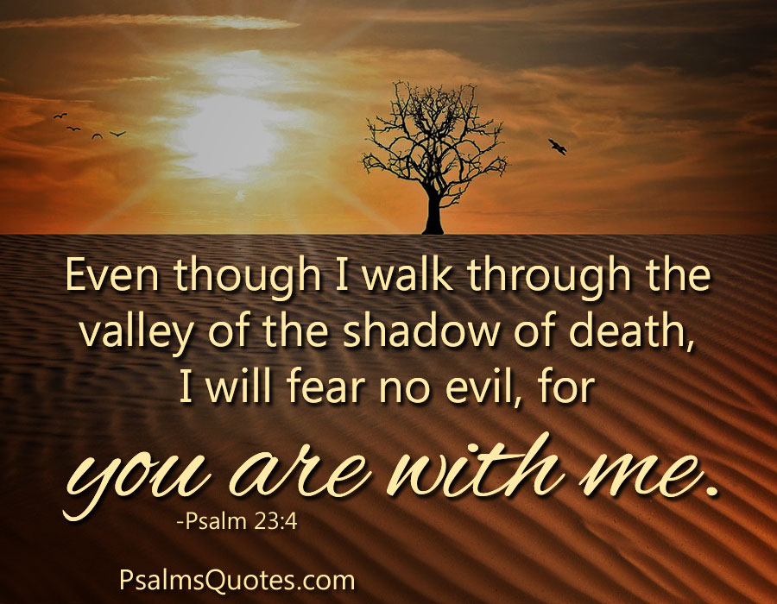

Slide 31
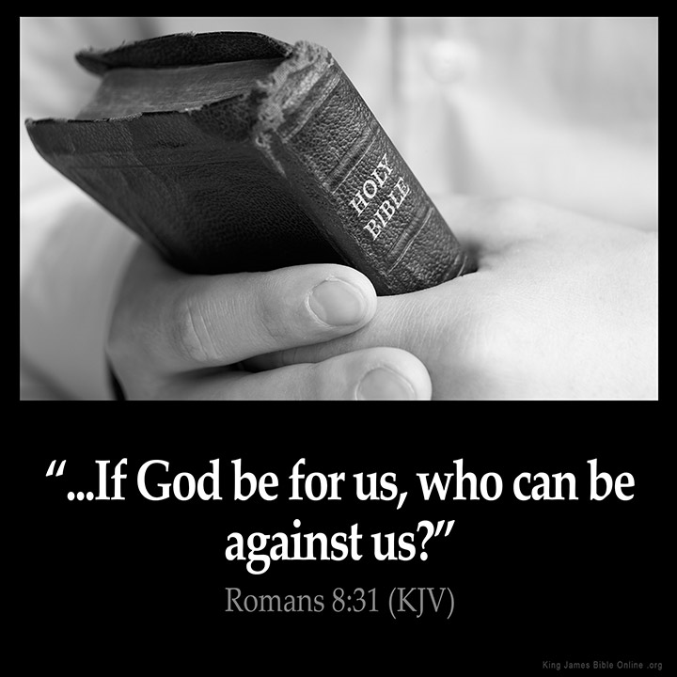

Slide 32


