Slide 2
Martha Mendez
Laura Mendez
Kelli Gooch
Samuel Appleton
Addie Mae Taylor
Anna Beth Burns
Connor McElyea
Luke Hasting
Harley Pugh
Katie Lee Helums
Dylan Carter
Mackenzie Tribble

Slide 3
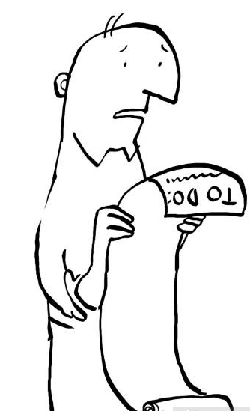

Slide 4
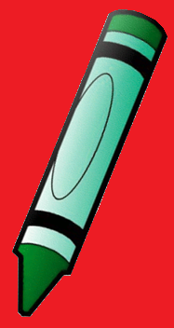
The Honey-DOs of Hebrews
The “Let Us” statements of Hebrews

Slide 5
“Let Us”…. Lay aside every weight Heb. 12:1-2
Hebrews 12:1-2 (NKJV)
12 Therefore we also, since we are surrounded by so great a cloud of witnesses, let us lay aside every weight, and the sin which so easily ensnares us, and let us run with endurance the race that is set before us, 2 looking unto Jesus, the author and finisher of our faith, who for the joy that was set before Him endured the cross, despising the shame, and has sat down at the right hand of the throne of God.

Slide 6
“Let Us”…. Lay aside every weight Heb. 12:1-2
1 John 2:15-17 (NKJV)
15 Do not love the world or the things in the world. If anyone loves the world, the love of the Father is not in him. 16 For all that is in the world—the lust of the flesh, the lust of the eyes, and the pride of life—is not of the Father but is of the world. 17 And the world is passing away, and the lust of it; but he who does the will of God abides forever.

Slide 7
“Let Us”…. Run with endurance Heb. 12:1-2
Hebrews 12:1-2 (NKJV)
12 Therefore we also, since we are surrounded by so great a cloud of witnesses, let us lay aside every weight, and the sin which so easily ensnares us, and let us run with endurance the race that is set before us, 2 looking unto Jesus, the author and finisher of our faith, who for the joy that was set before Him endured the cross, despising the shame, and has sat down at the right hand of the throne of God.

Slide 8
“Let Us”…. Run with endurance Heb. 12:1-2
Hebrews 10:35-36 (NKJV)
35 Therefore do not cast away your confidence, which has great reward. 36 For you have need of endurance, so that after you have done the will of God, you may receive the promise:

Slide 9
“Let Us”…. Run with endurance Heb. 12:1-2
1 Corinthians 9:25-27 (NKJV)
25 And everyone who competes for the prize is temperate in all things. Now they do it to obtain a perishable crown, but we for an imperishable crown. 26 Therefore I run thus: not with uncertainty. Thus I fight: not as one who beats the air. 27 But I discipline my body and bring it into subjection, lest, when I have preached to others, I myself should become disqualified.

Slide 10
“Let Us”…. Look unto Jesus Heb. 12:1-2
Hebrews 12:1-2 (NKJV)
12 Therefore we also, since we are surrounded by so great a cloud of witnesses, let us lay aside every weight, and the sin which so easily ensnares us, and let us run with endurance the race that is set before us, 2 looking unto Jesus, the author and finisher of our faith, who for the joy that was set before Him endured the cross, despising the shame, and has sat down at the right hand of the throne of God.

Slide 11
“Let Us”…. Look unto Jesus Heb. 12:1-2
Philippians 3:13-14 (NKJV)
13 Brethren, I do not count myself to have apprehended; but one thing I do, forgetting those things which are behind and reaching forward to those things which are ahead, 14 I press toward the goal for the prize of the upward call of God in Christ Jesus.

Slide 12
“Let Us”…. Look unto Jesus Heb. 12:1-2
Luke 9:62 (NKJV)
62 But Jesus said to him, “No one, having put his hand to the plow, and looking back, is fit for the kingdom of God.”

Slide 13
“Let Us”…. Draw Near to God Heb. 10:22
Hebrews 10:22 (NKJV)
22 let us draw near with a true heart in full assurance of faith, having our hearts sprinkled from an evil conscience and our bodies washed with pure water.

Slide 14
“Let Us”…. Draw Near to God Heb. 10:22
Hebrews 6:11 (NKJV)
¹¹ And we desire that each one of you show the same diligence to the full assurance of hope until the end,

Slide 15
Acts 22:16 (NKJV)
¹⁶ And now why are you waiting? Arise and be baptized, and wash away your sins, calling on the name of the Lord.’

Slide 16
Acts 2:38 (NKJV)
³⁸ Then Peter said to them, “Repent, and let every one of you be baptized in the name of Jesus Christ for the remission of sins; and you shall receive the gift of the Holy Spirit.

