Slide 2
Majesty
Page 951
1 verse

Slide 3
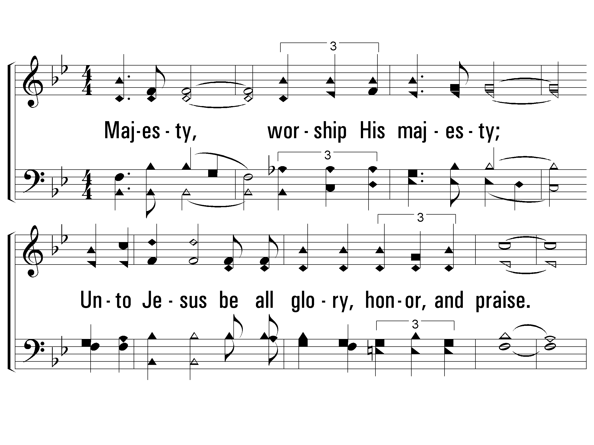
1 - Majesty
Majesty, worship His majesty;
Unto Jesus be all glory, honor, and praise.
Majesty, kingdom authority
Flow from His throne unto His own,
His anthem raise.
So exalt, lift up on high the name of Jesus;
Magnify, come glorify Christ Jesus the King.
Majesty, worship His majesty;
Jesus, who died, now glorified,
King of all kings.
Words and Music by: Jack Hayford / Arr.: Eugene Thomas
Copyright © 1980 by Rocksmith Music (ASCAP) (Admin. by Brentwood-Benson Music Publishing, Inc.)
All rights reserved. Used by permission.
© 2001 The Paperless Hymnal™

Slide 4
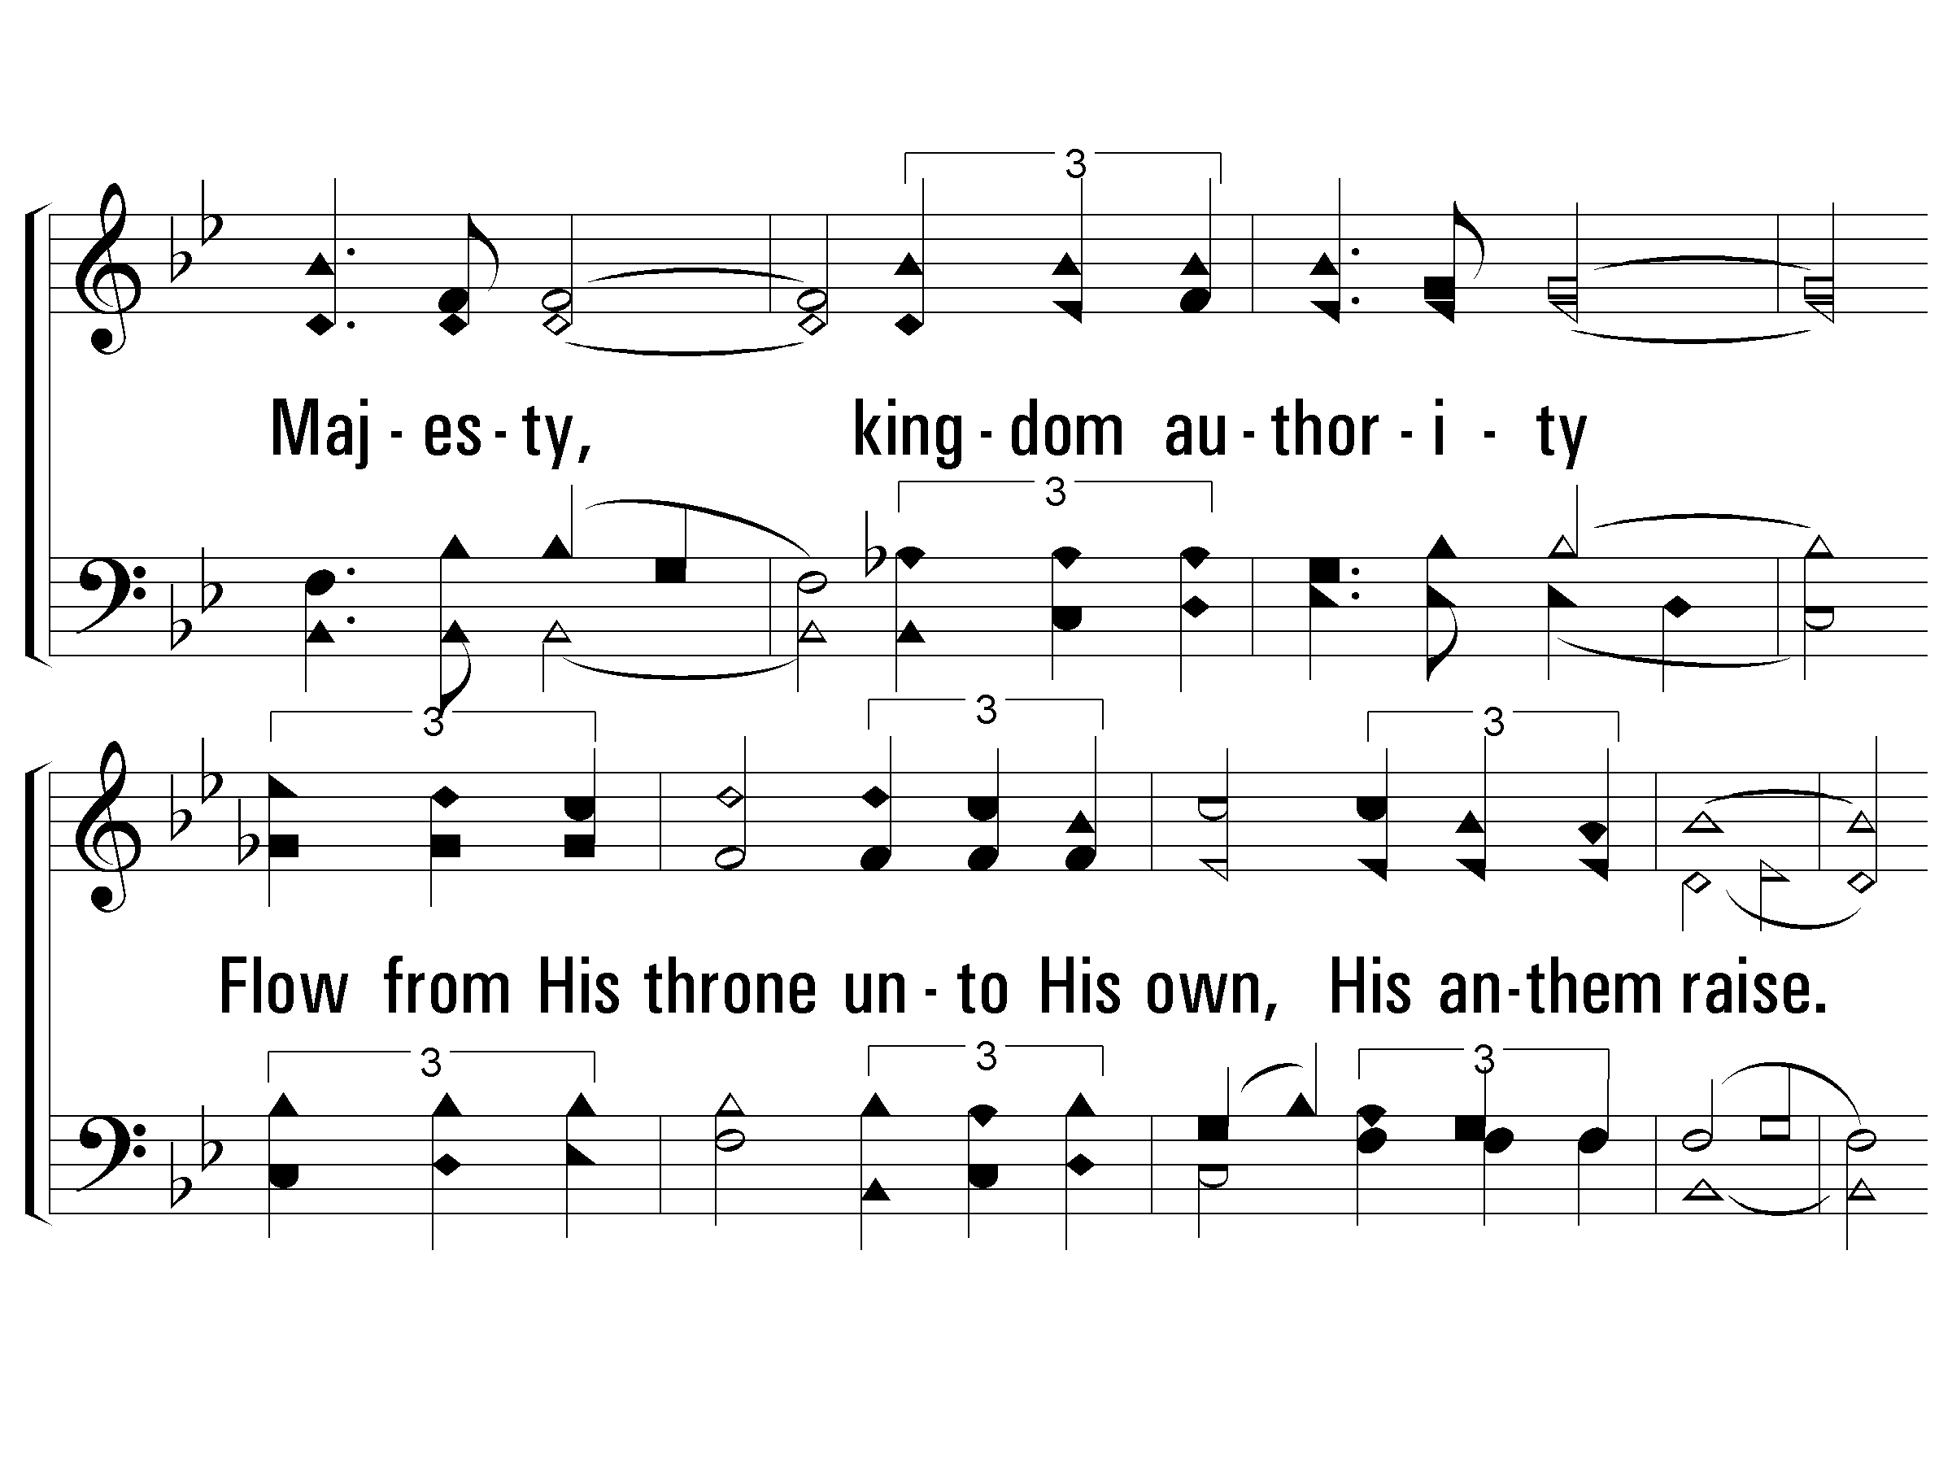
1 - Majesty
© 2001 The Paperless Hymnal™

Slide 5
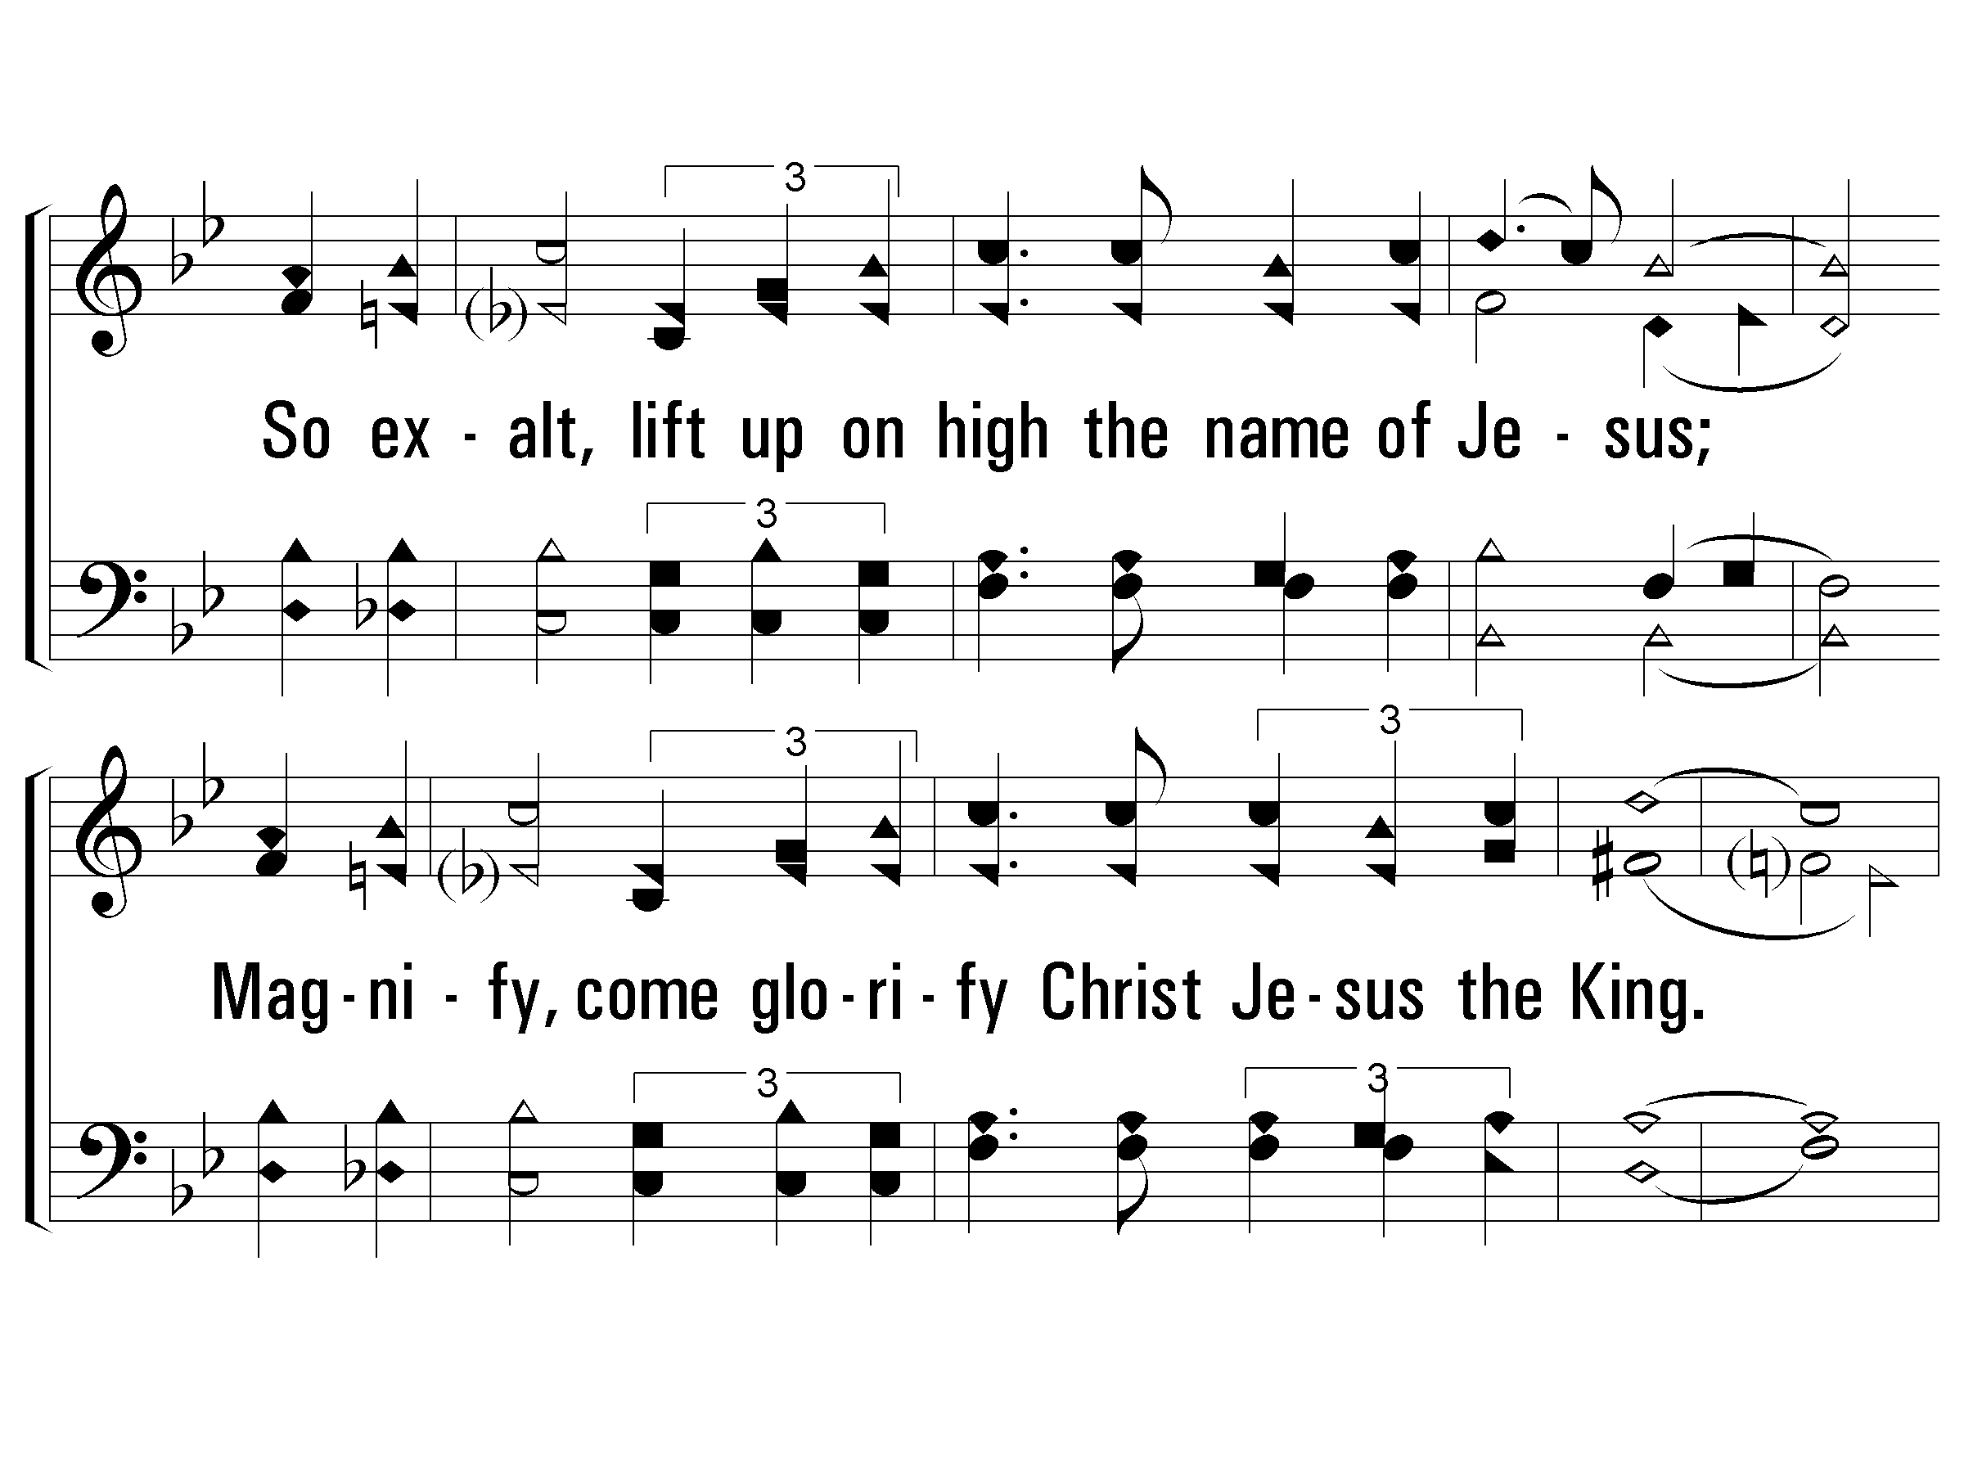
c - Majesty
© 2001 The Paperless Hymnal™

Slide 6
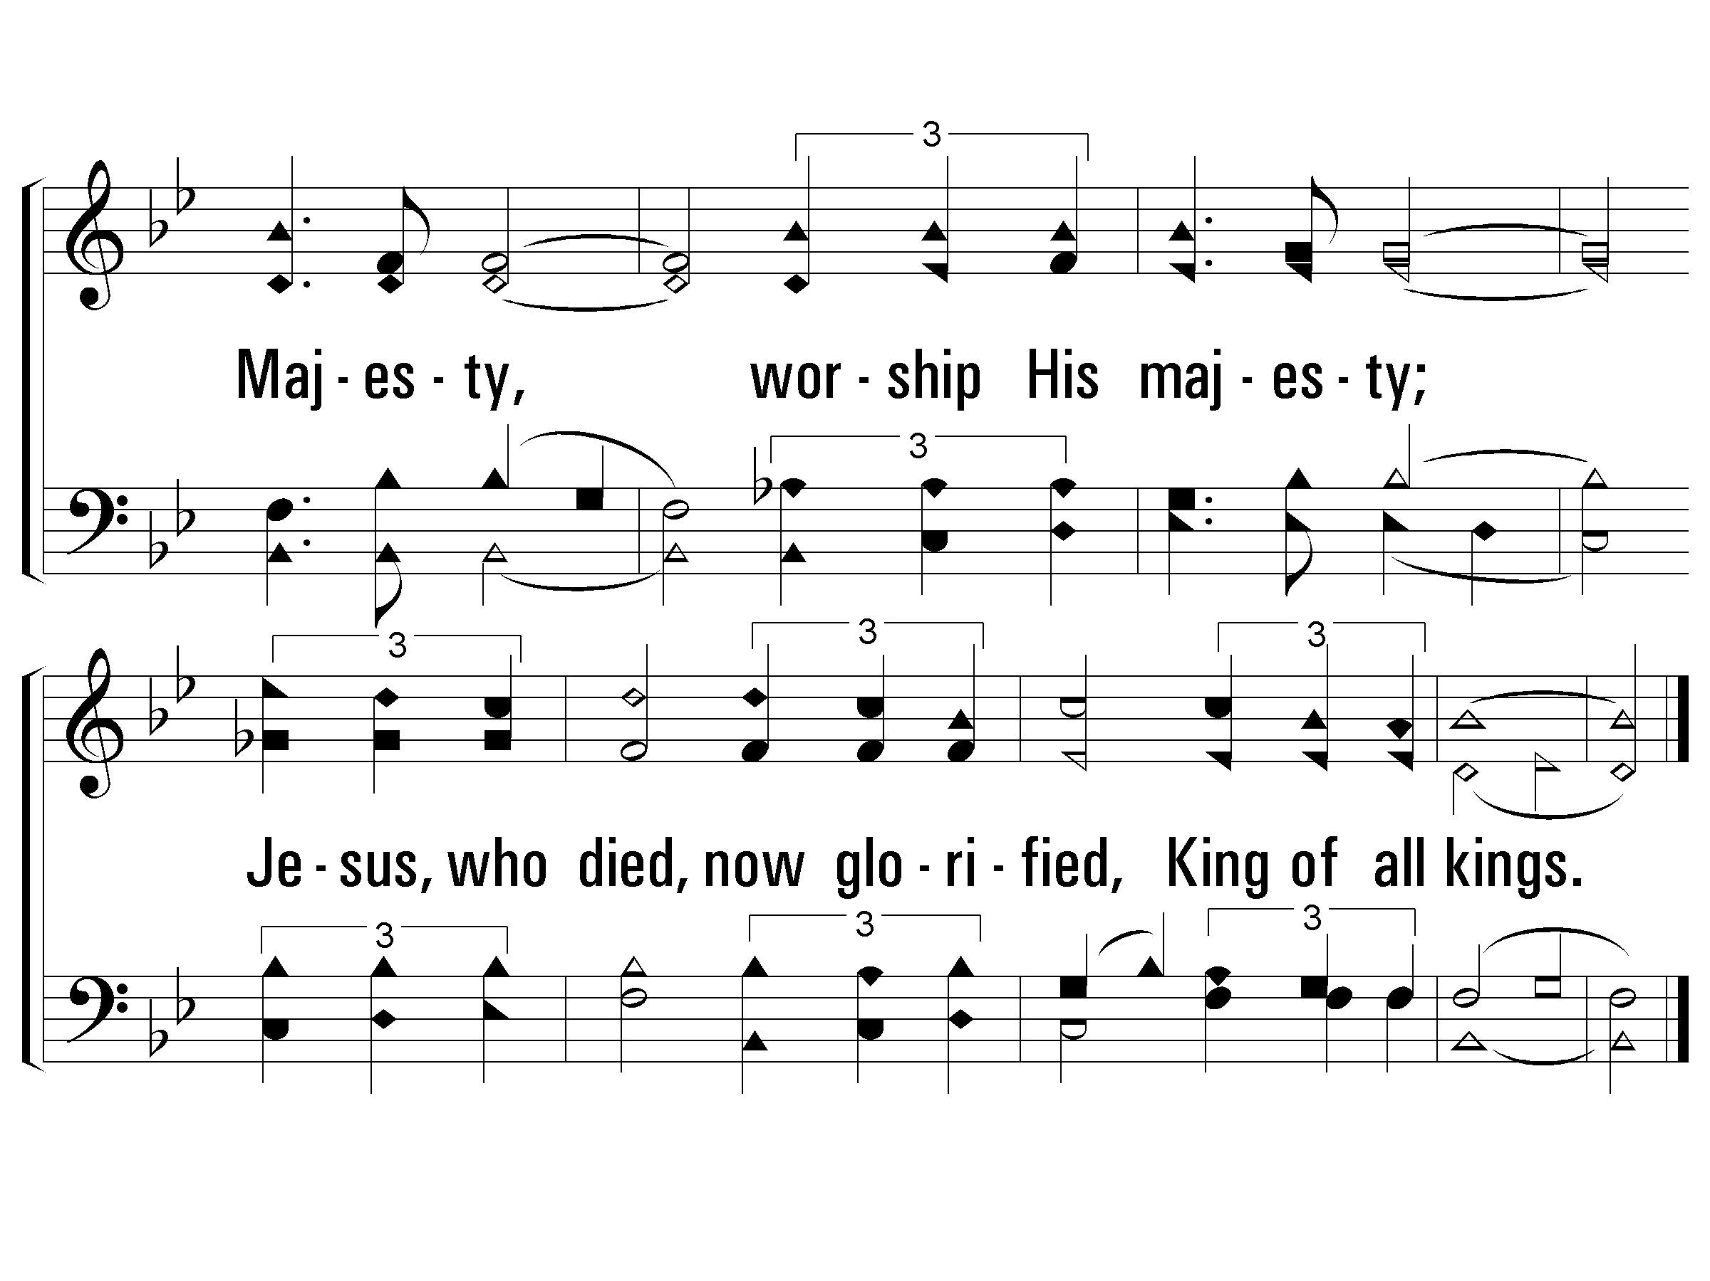
c - Majesty
© 2001 The Paperless Hymnal™

Slide 7
c - Majesty
© 2001 The Paperless Hymnal™

Slide 8
c - Majesty
© 2001 The Paperless Hymnal™

Slide 10
Hosanna
Page 934
Both verses

Slide 11
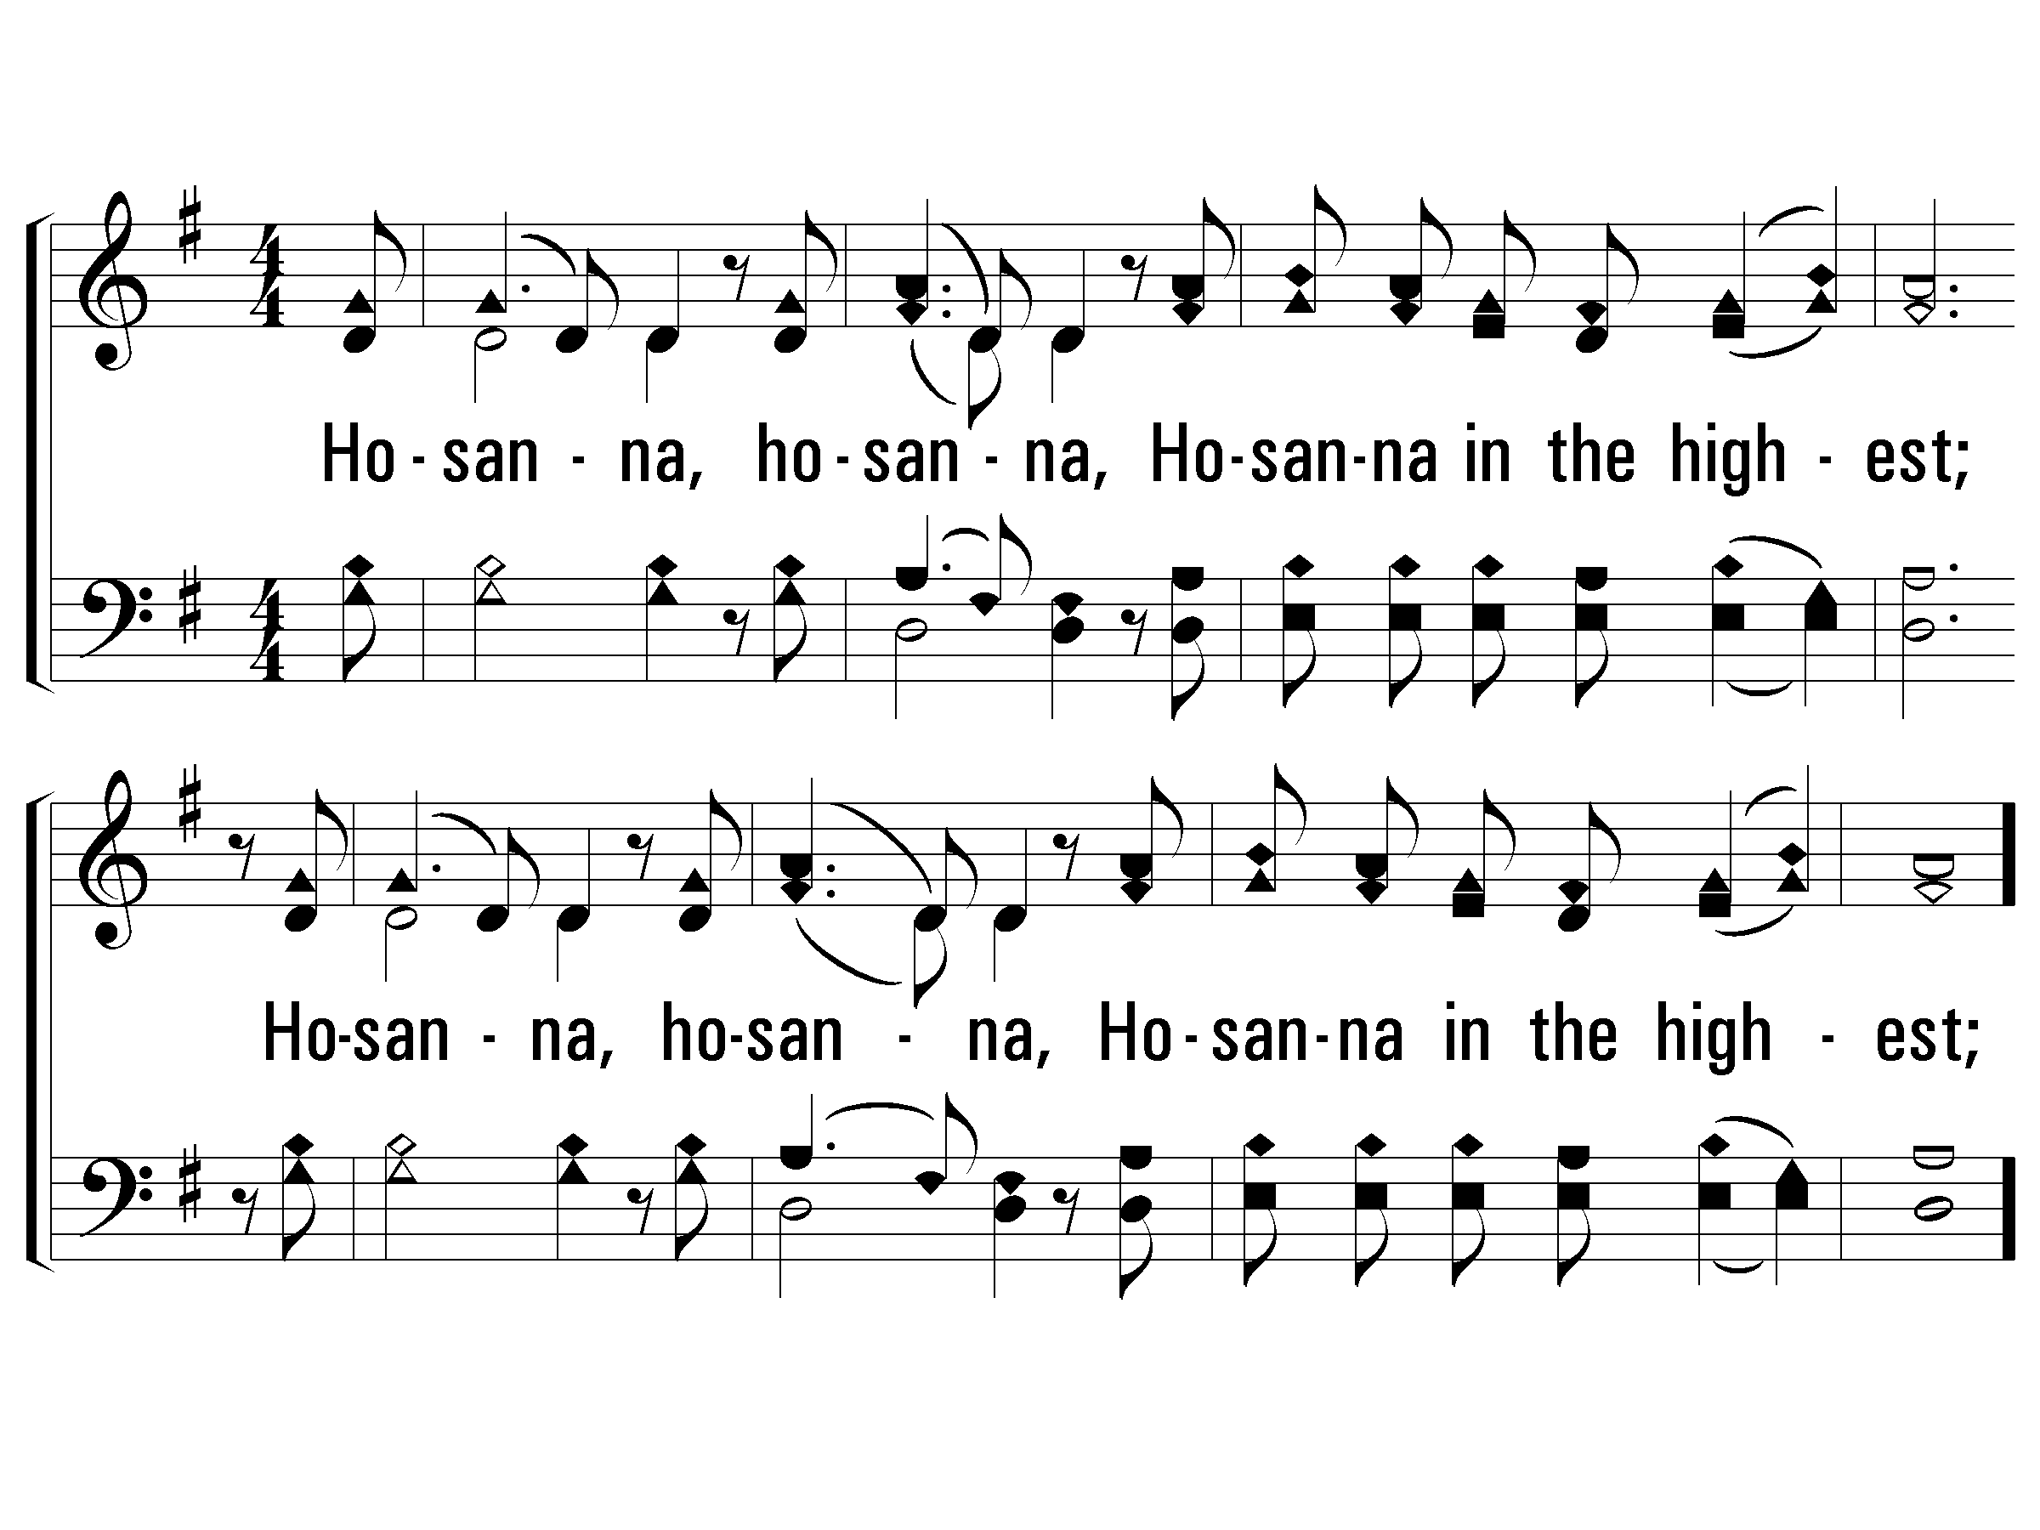
1 - Hosanna
934
Hosanna, hosanna,
Hosanna in the highest;
Hosanna, hosanna,
Hosanna in the highest;
Lord, we lift up Your name,
With hearts full of praise;
Be exalted, O Lord, my God,
Hosanna in the highest.
Words & Music: Carl Tuttle / Arr.: Reid Lancaster
Copyright © 1985 by Mercy Publishing
© 2008 The Paperless Hymnal®

Slide 12
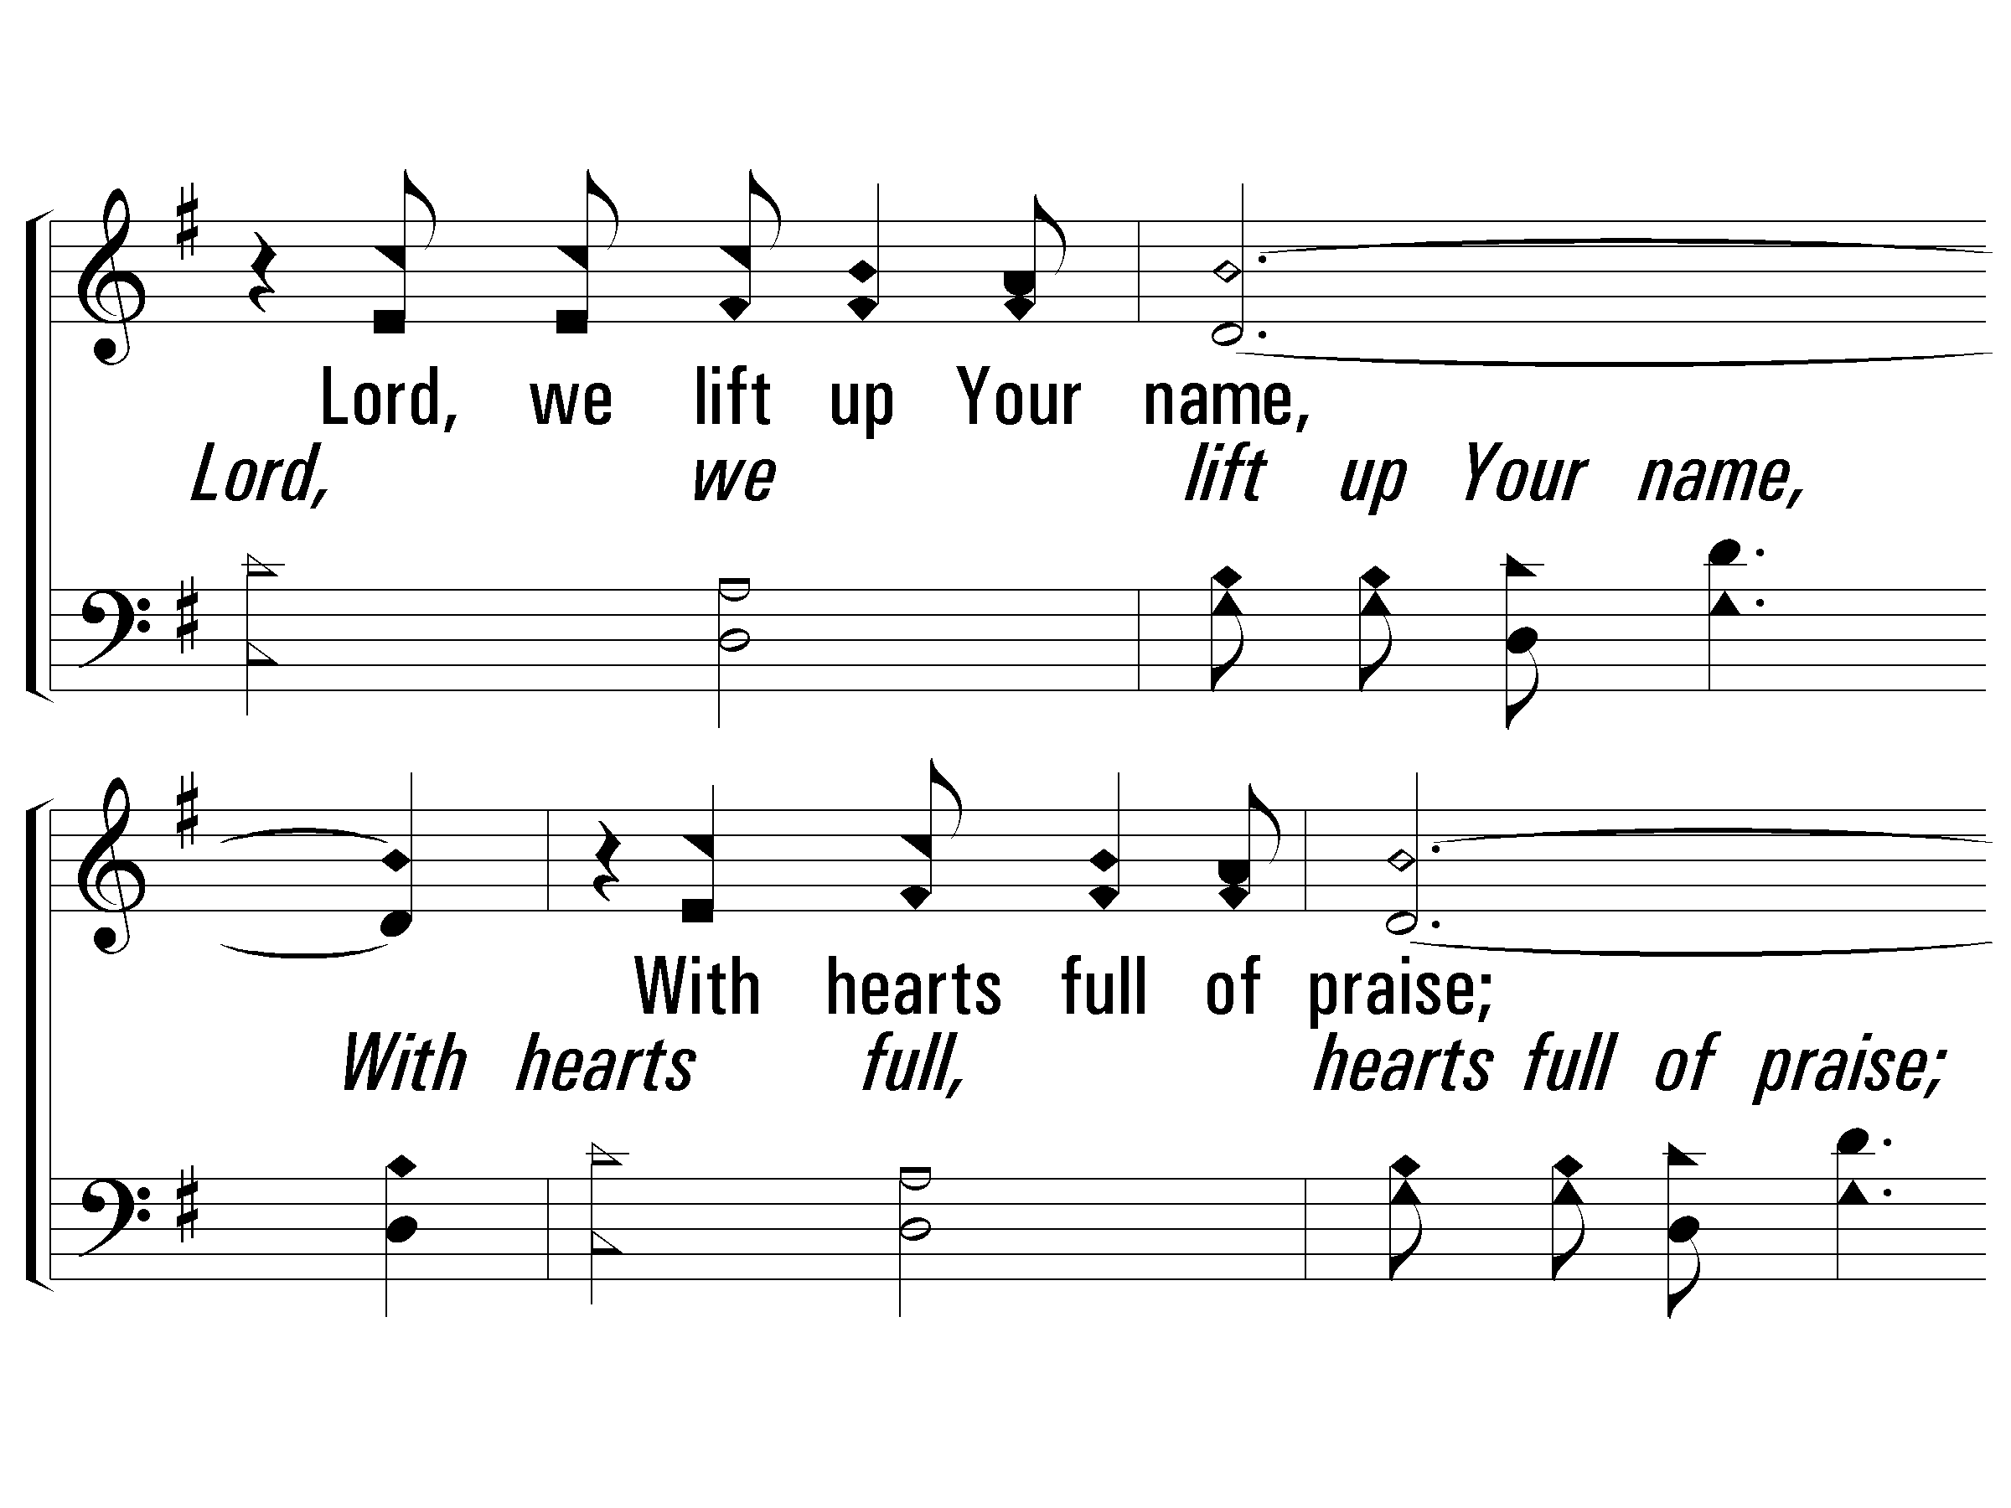
c - Hosanna
934
© 2008 The Paperless Hymnal®

Slide 13
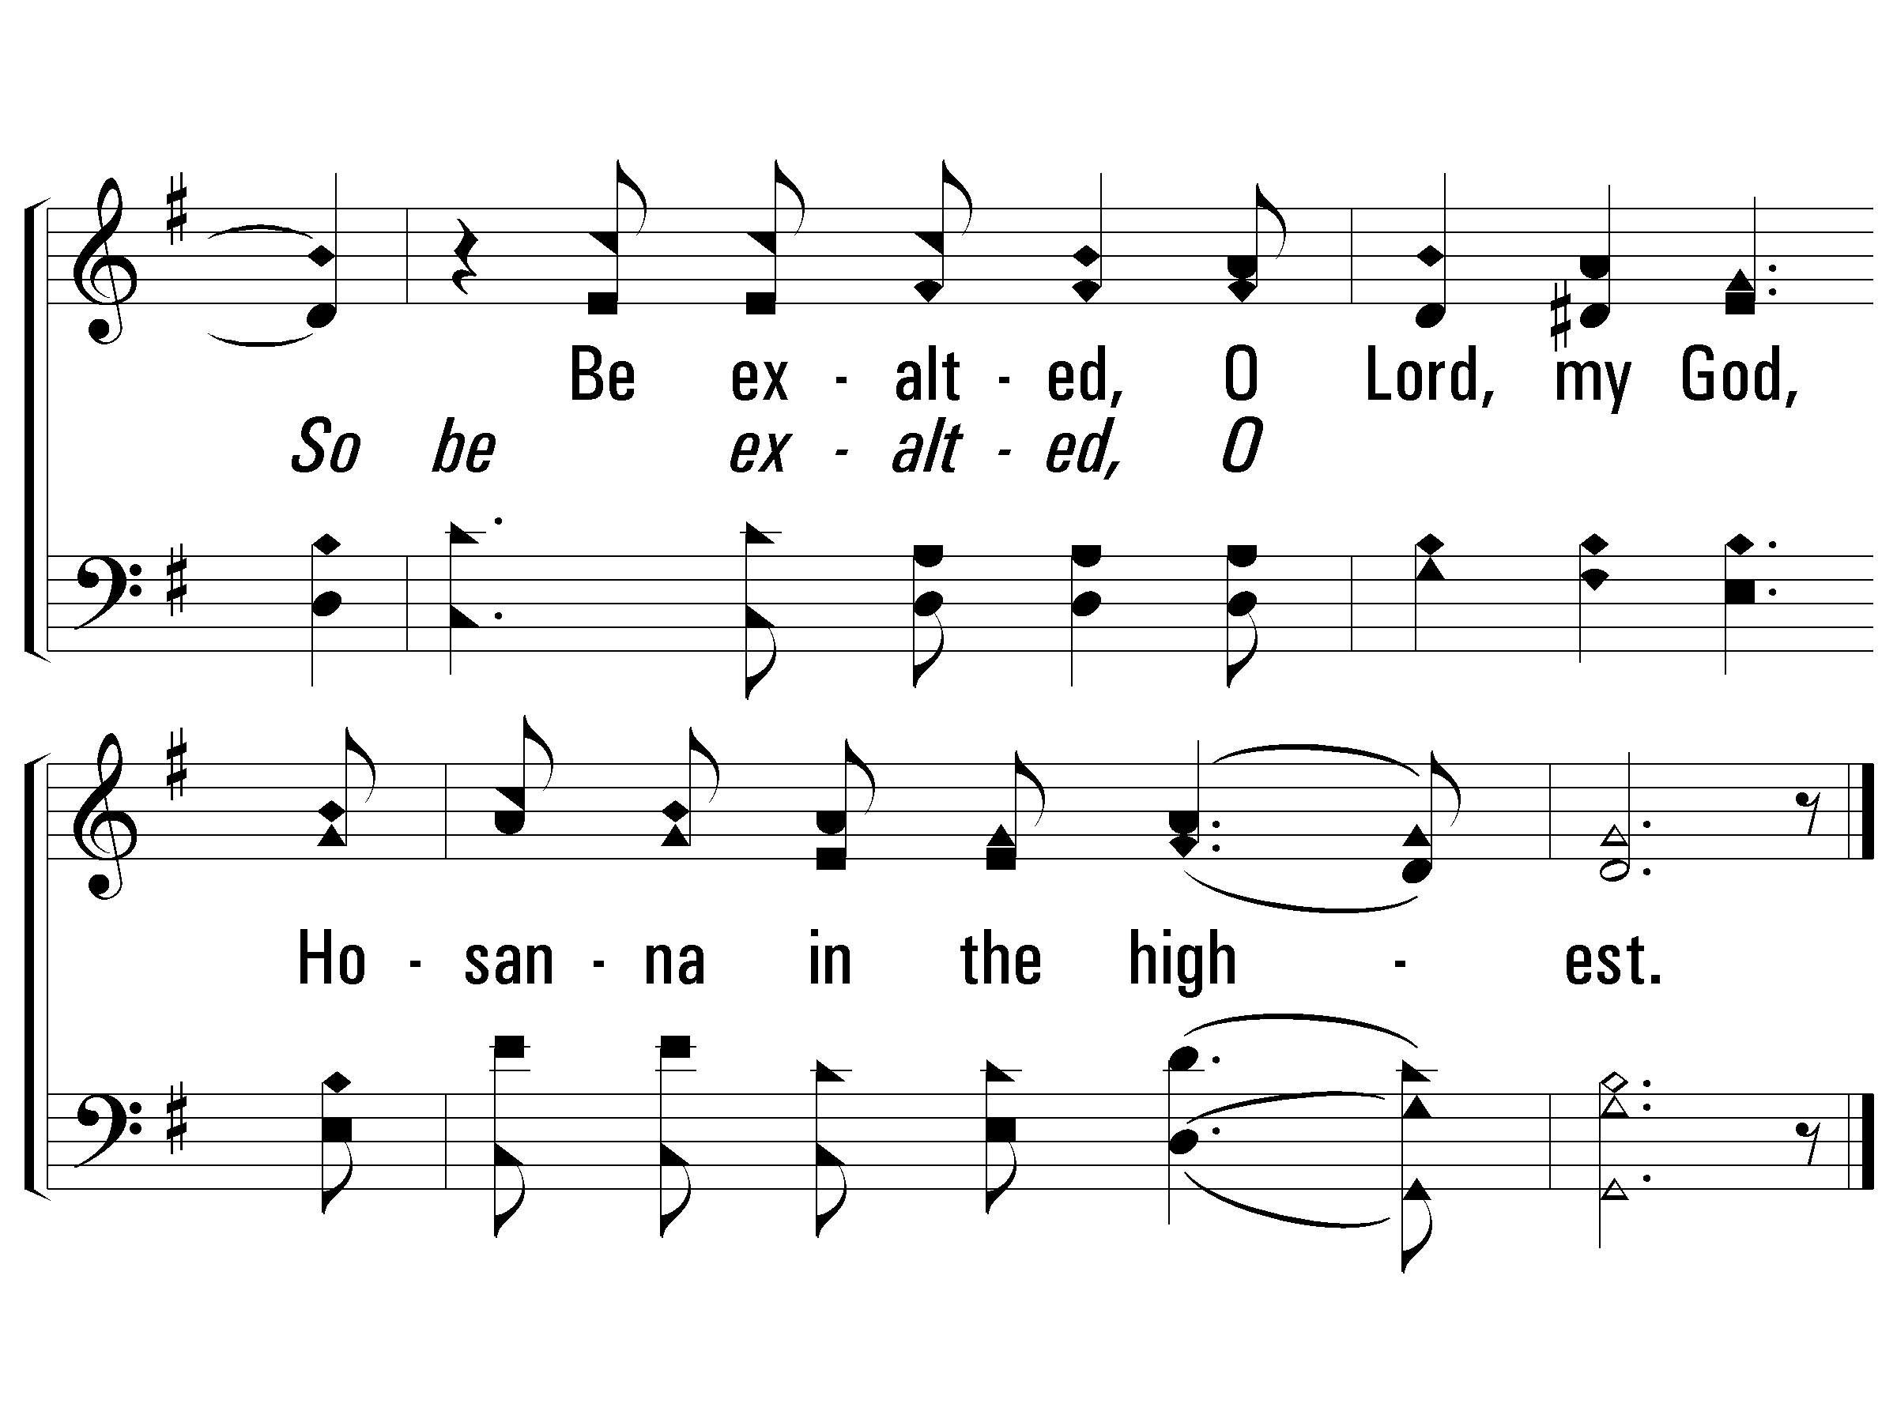
c - Hosanna
934
© 2008 The Paperless Hymnal®

Slide 14
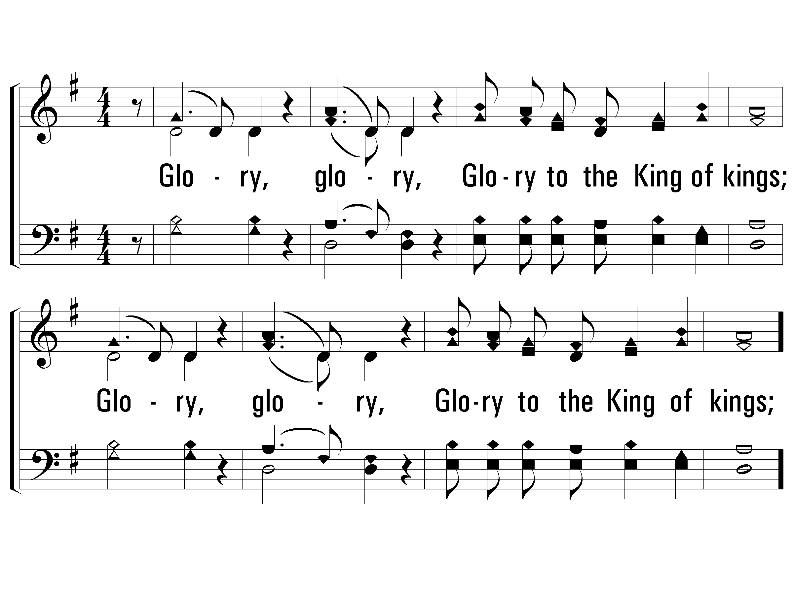
2 - Hosanna
934
Glory, glory,
Glory to the King of kings;
Glory, glory,
Glory to the King of kings;
Words & Music: Carl Tuttle / Arr.: Reid Lancaster
Copyright © 1985 by Mercy Publishing
© 2008 The Paperless Hymnal®

Slide 15
c - Hosanna
934
© 2008 The Paperless Hymnal®

Slide 16
c - Hosanna
934
© 2008 The Paperless Hymnal®

Slide 17
The Life of Christ

Slide 18
God’s Plan
Isaiah 45:18 (NKJV)
18 For thus says the Lord, Who created the heavens, Who is God, Who formed the earth and made it, Who has established it, Who did not create it in vain, Who formed it to be inhabited: “I am the Lord, and there is no other.

Slide 19
God’s Plan
Deuteronomy 7:9 (NKJV)
9 “Therefore know that the Lord your God, He is God, the faithful God who keeps covenant and mercy for a thousand generations with those who love Him and keep His commandments;

Slide 20
How Great Thou Art
Page 226
Verses 1, 3 & 4
Buzz Lovell

Slide 21
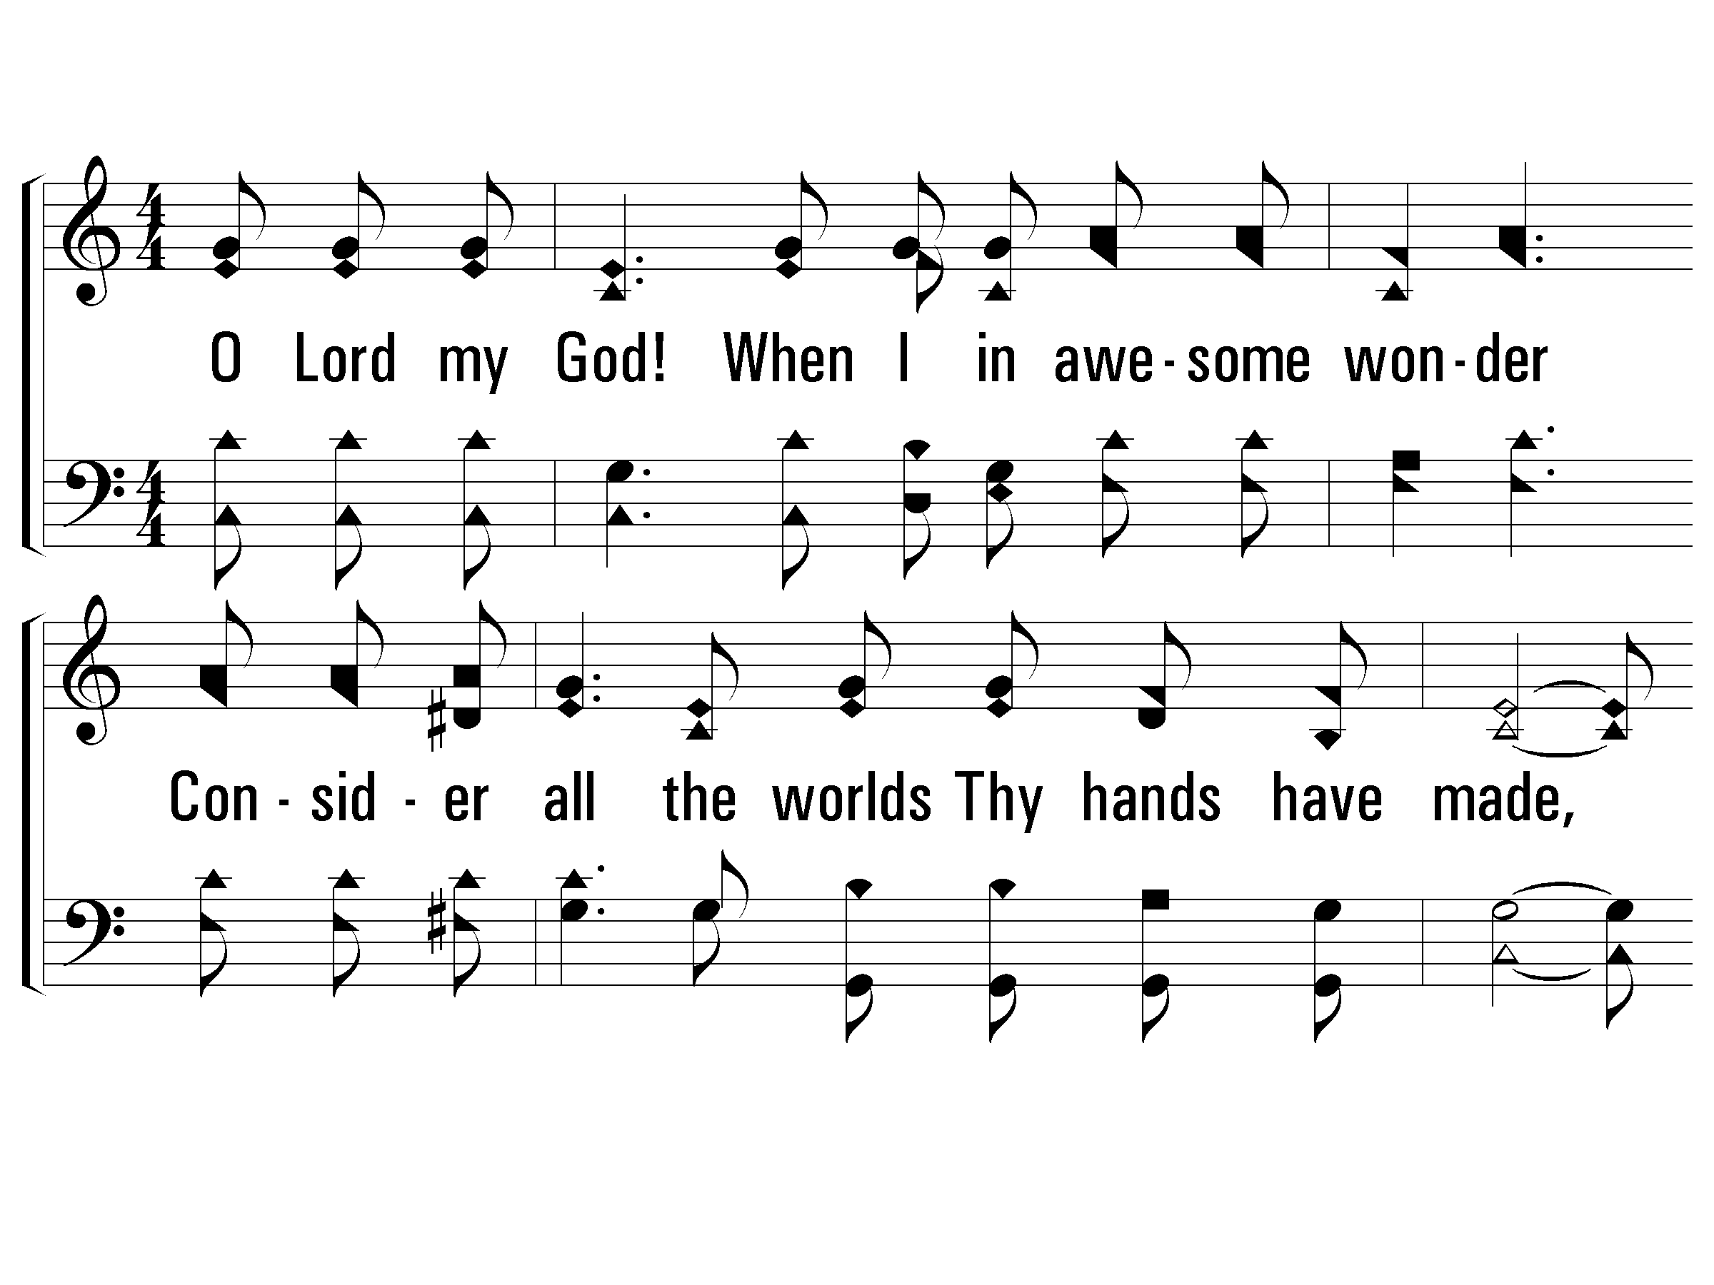
1 – How Great Thou Art
1.
O Lord my God! When I in awesome wonder
Consider all the worlds Thy hands have made,
I see the stars, I hear the rolling thunder,
Thy power throughout the universe displayed.
Words by: Carl Boberg / Tr.: Stuart K. Hine
Music by: Swedish Folk melody, Arrangement by: Stuart K. Hine
Copyright © 1953 by Stuart K. Hine. Assigned to Manna Music, Inc., 35255 Brooten Road, Pacific City, OR 97135.
All Rights Reserved. Used by Permission.
© 2001 The Paperless Hymnal™

Slide 22
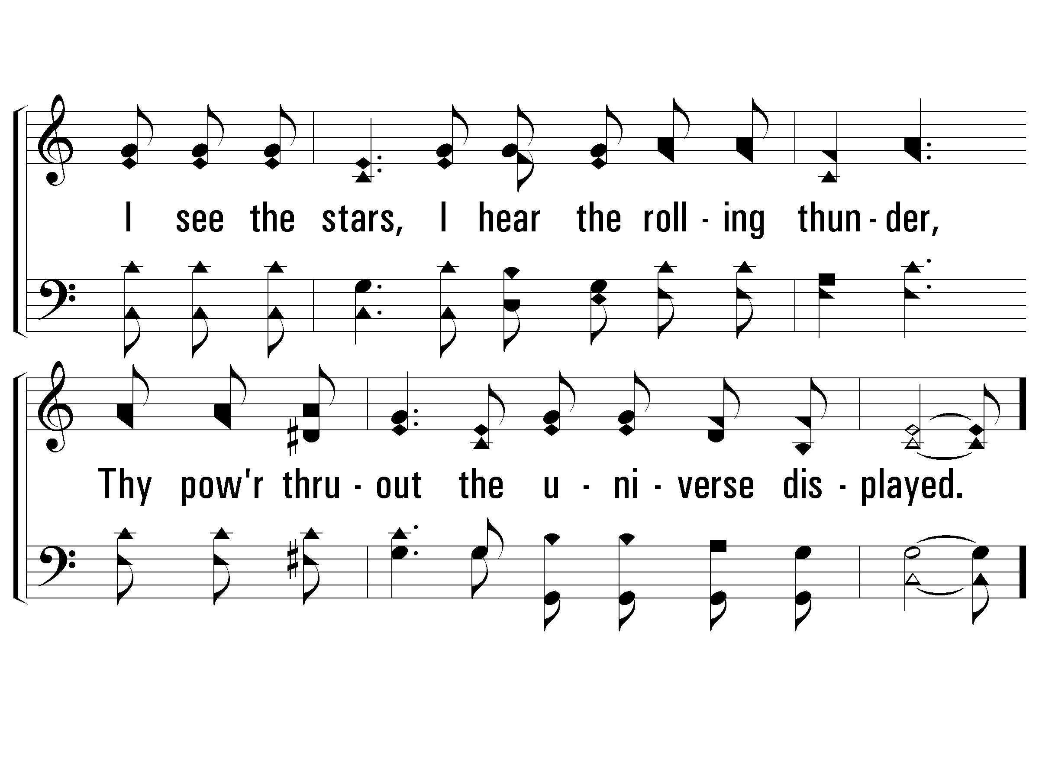
1 – How Great Thou Art
© 2001 The Paperless Hymnal™

Slide 23
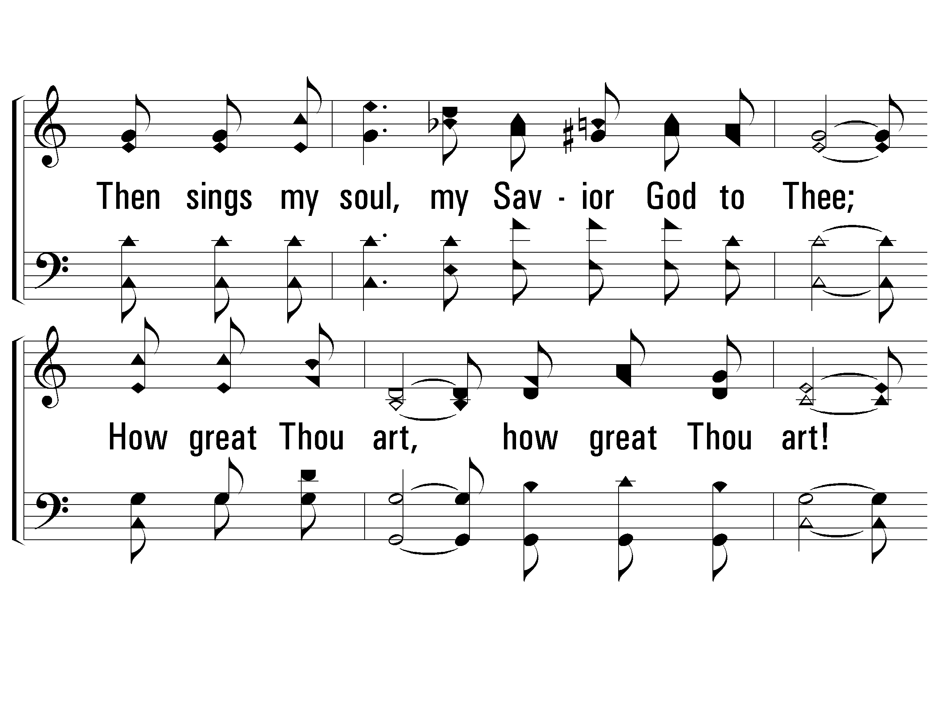
c – How Great Thou Art
Then sings my soul, my Savior God to Thee;
How great Thou art, how great Thou art!
Then sings my soul, my Savior God to Thee;
How great Thou art, how great Thou art!
© 2001 The Paperless Hymnal™

Slide 24
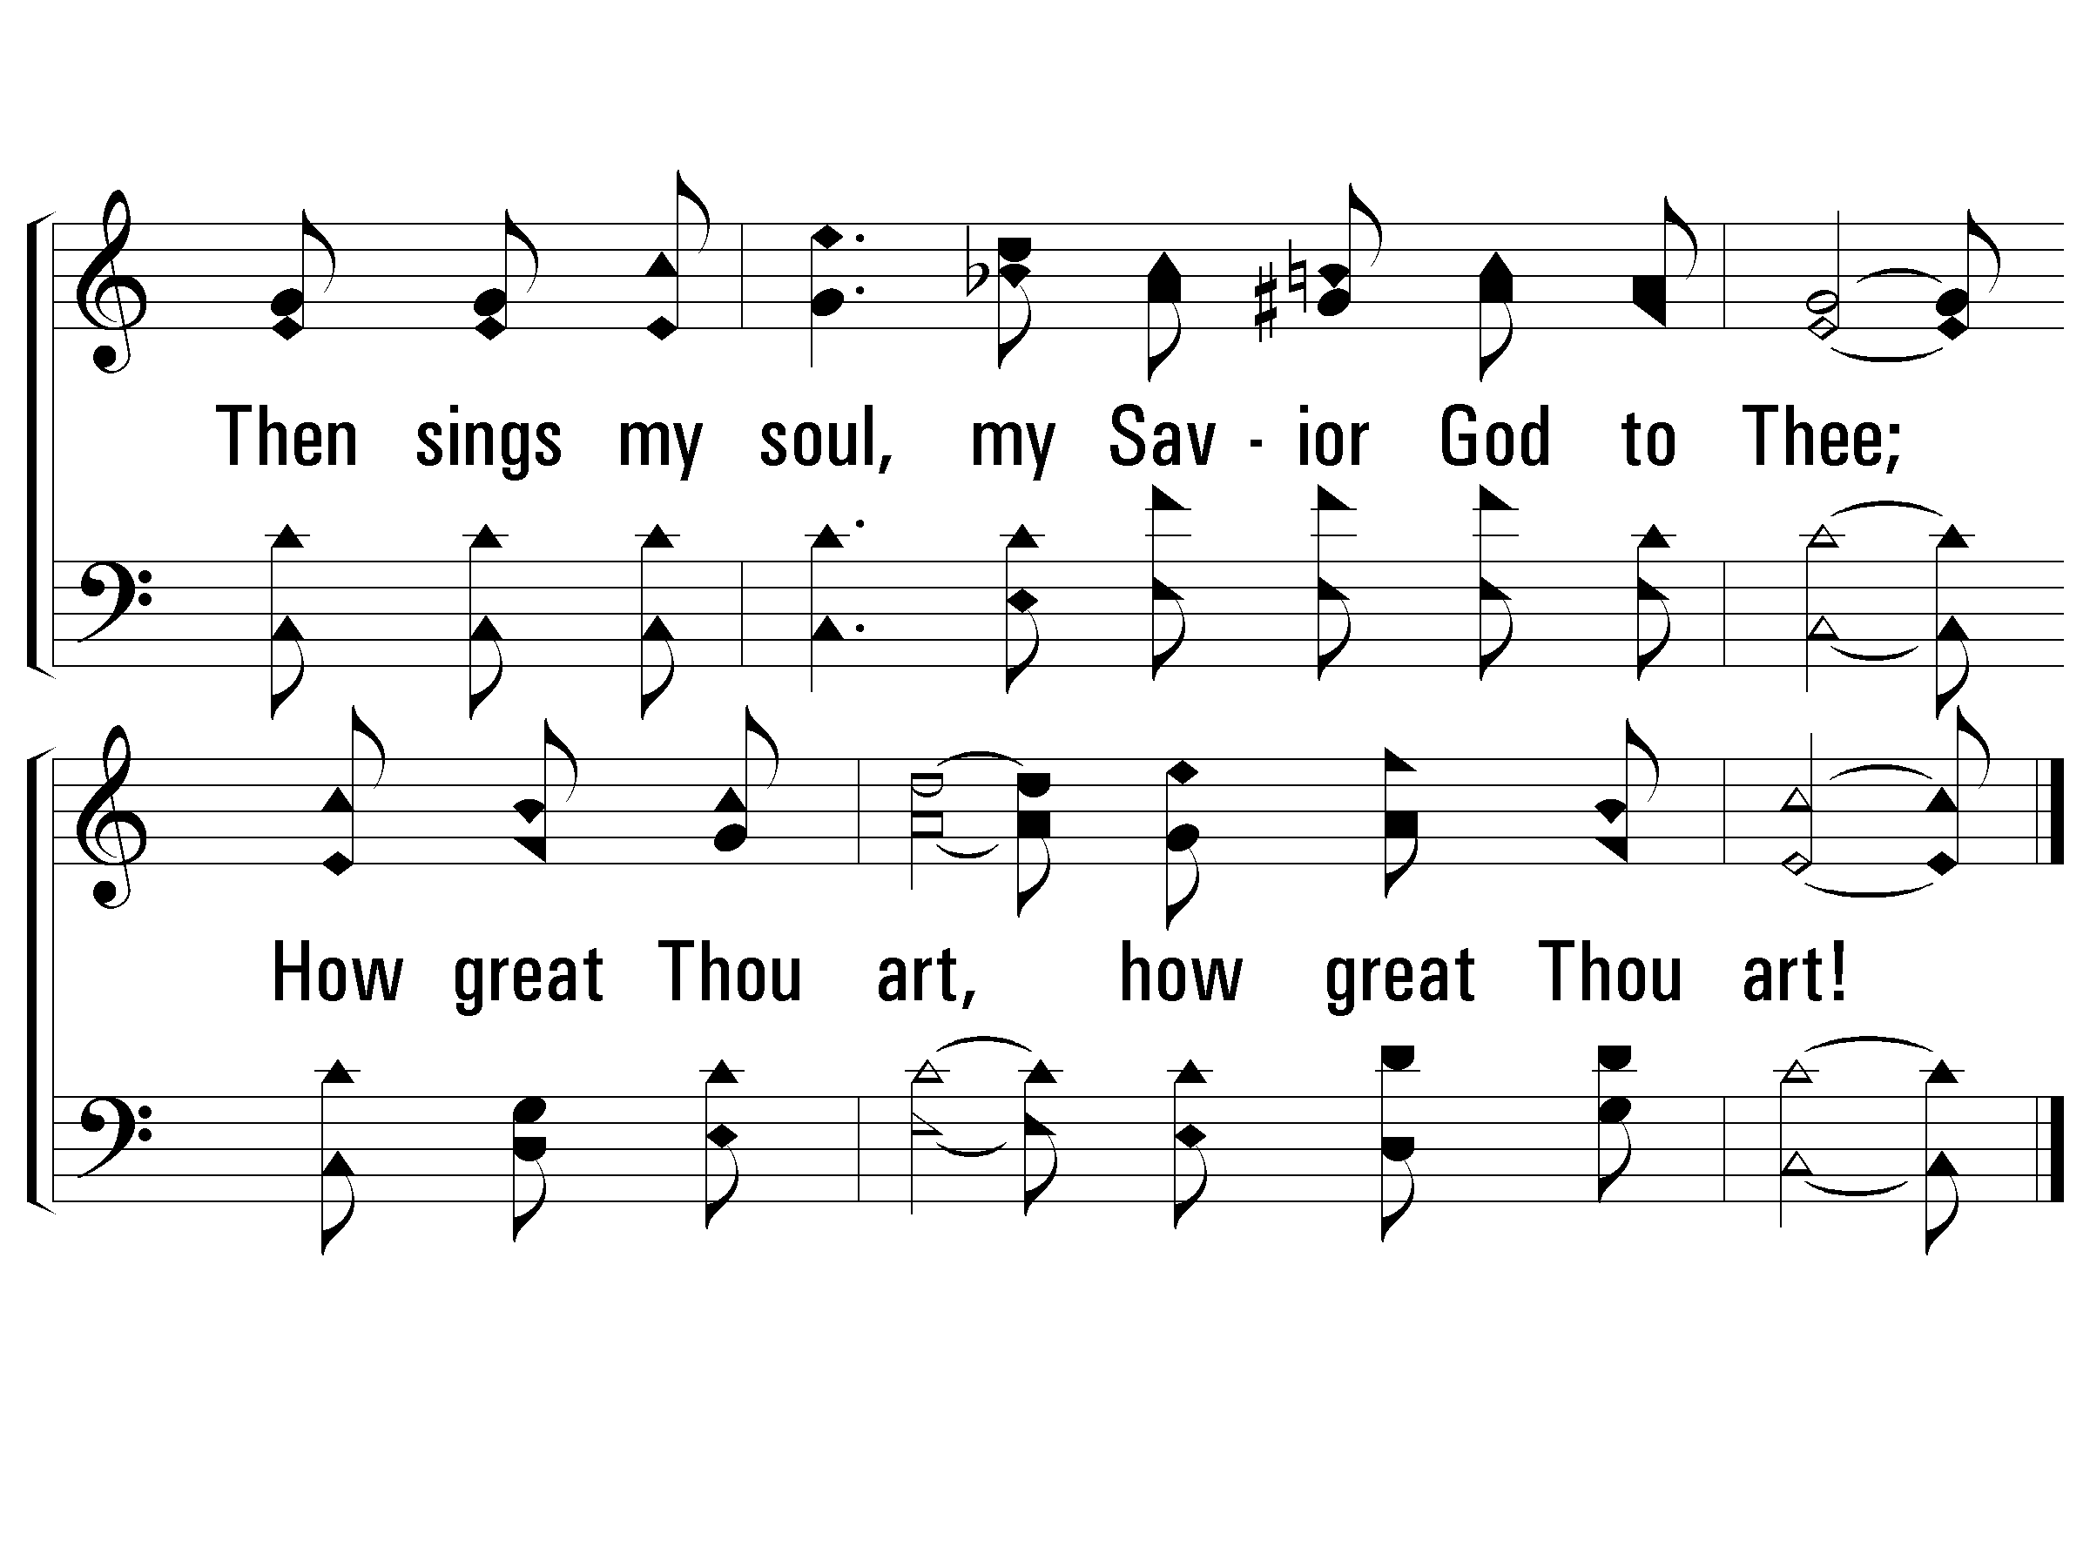
c – How Great Thou Art
© 2001 The Paperless Hymnal™

Slide 25
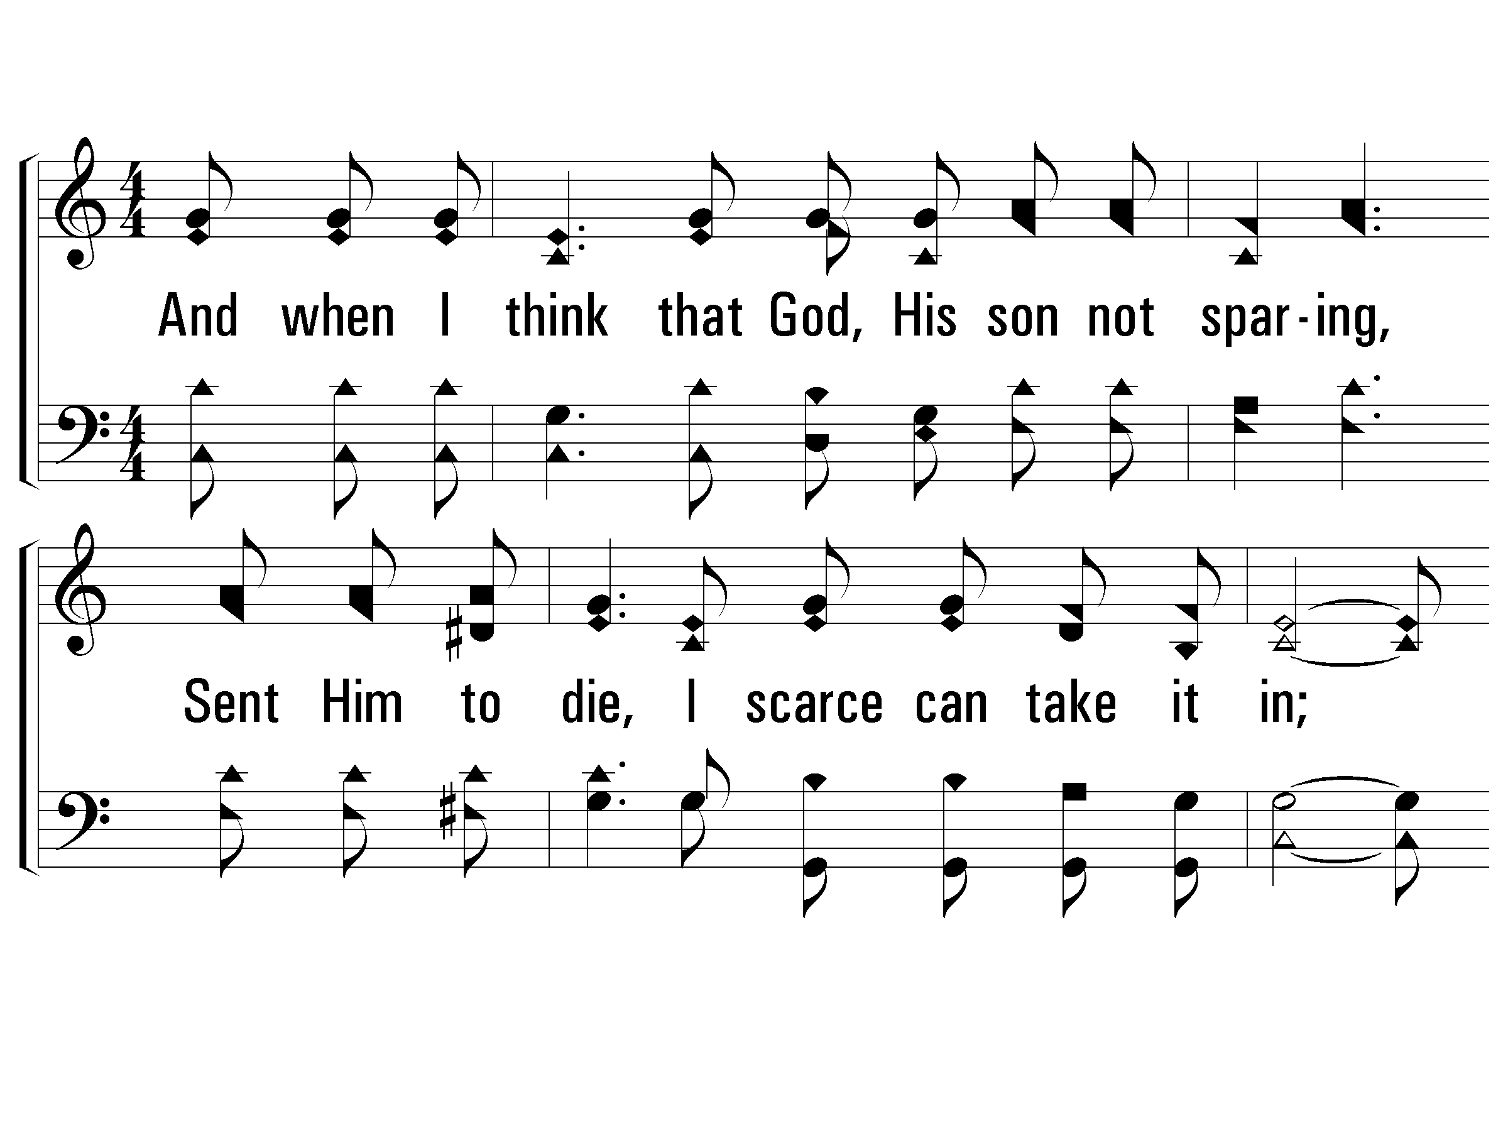
3 – How Great Thou Art
3.
And when I think that God, His son not sparing,
Sent Him to die, I scarce can take it in;
That on the cross, my burden gladly bearing,
He bled and died to take away my sin;
Words by: Stuart K. Hine
Music by: Swedish Folk melody, Arrangement by: Stuart K. Hine
Copyright © 1953 by Stuart K. Hine. Assigned to Manna Music, Inc., 35255 Brooten Road, Pacific City, OR 97135.
All Rights Reserved. Used by Permission.
© 2001 The Paperless Hymnal™

Slide 26
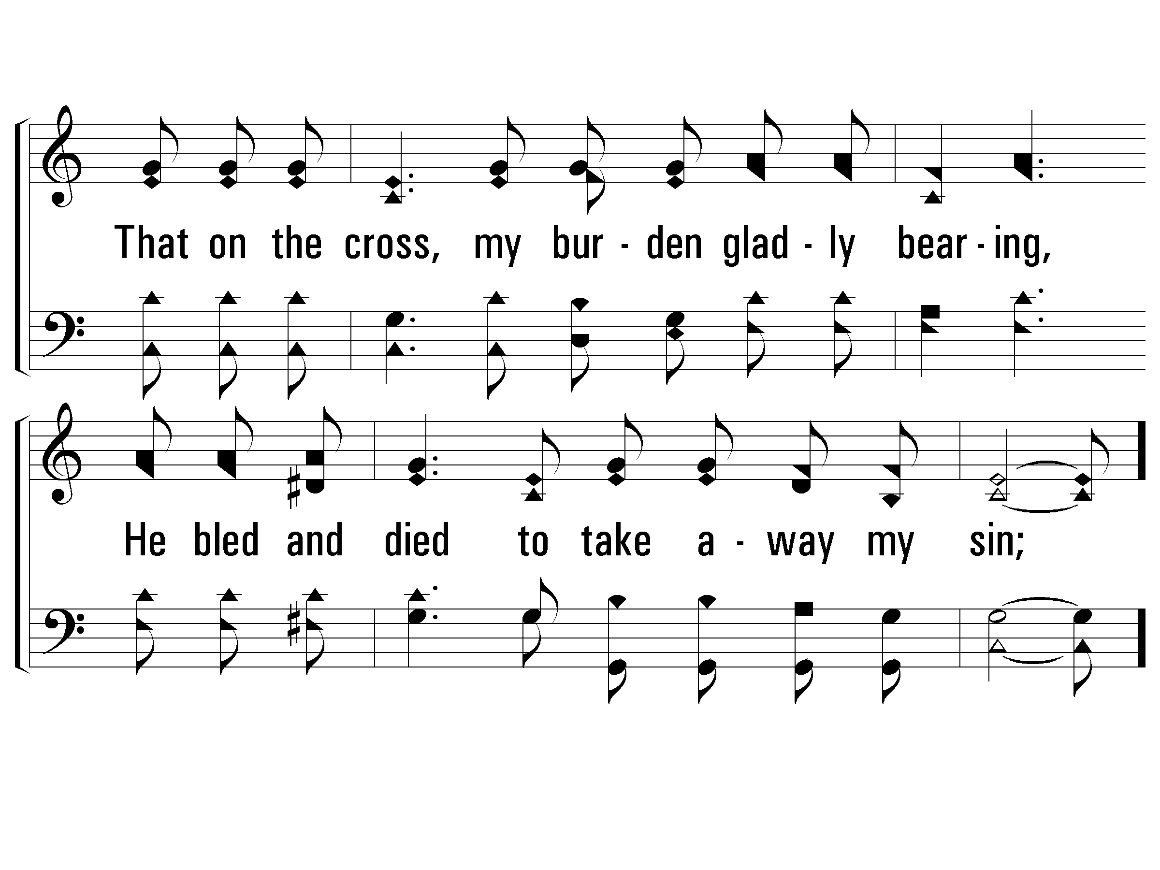
3 – How Great Thou Art
© 2001 The Paperless Hymnal™

Slide 27
c – How Great Thou Art
Then sings my soul, my Savior God to Thee;
How great Thou art, how great Thou art!
Then sings my soul, my Savior God to Thee;
How great Thou art, how great Thou art!
© 2001 The Paperless Hymnal™

Slide 28
c – How Great Thou Art
© 2001 The Paperless Hymnal™

Slide 29
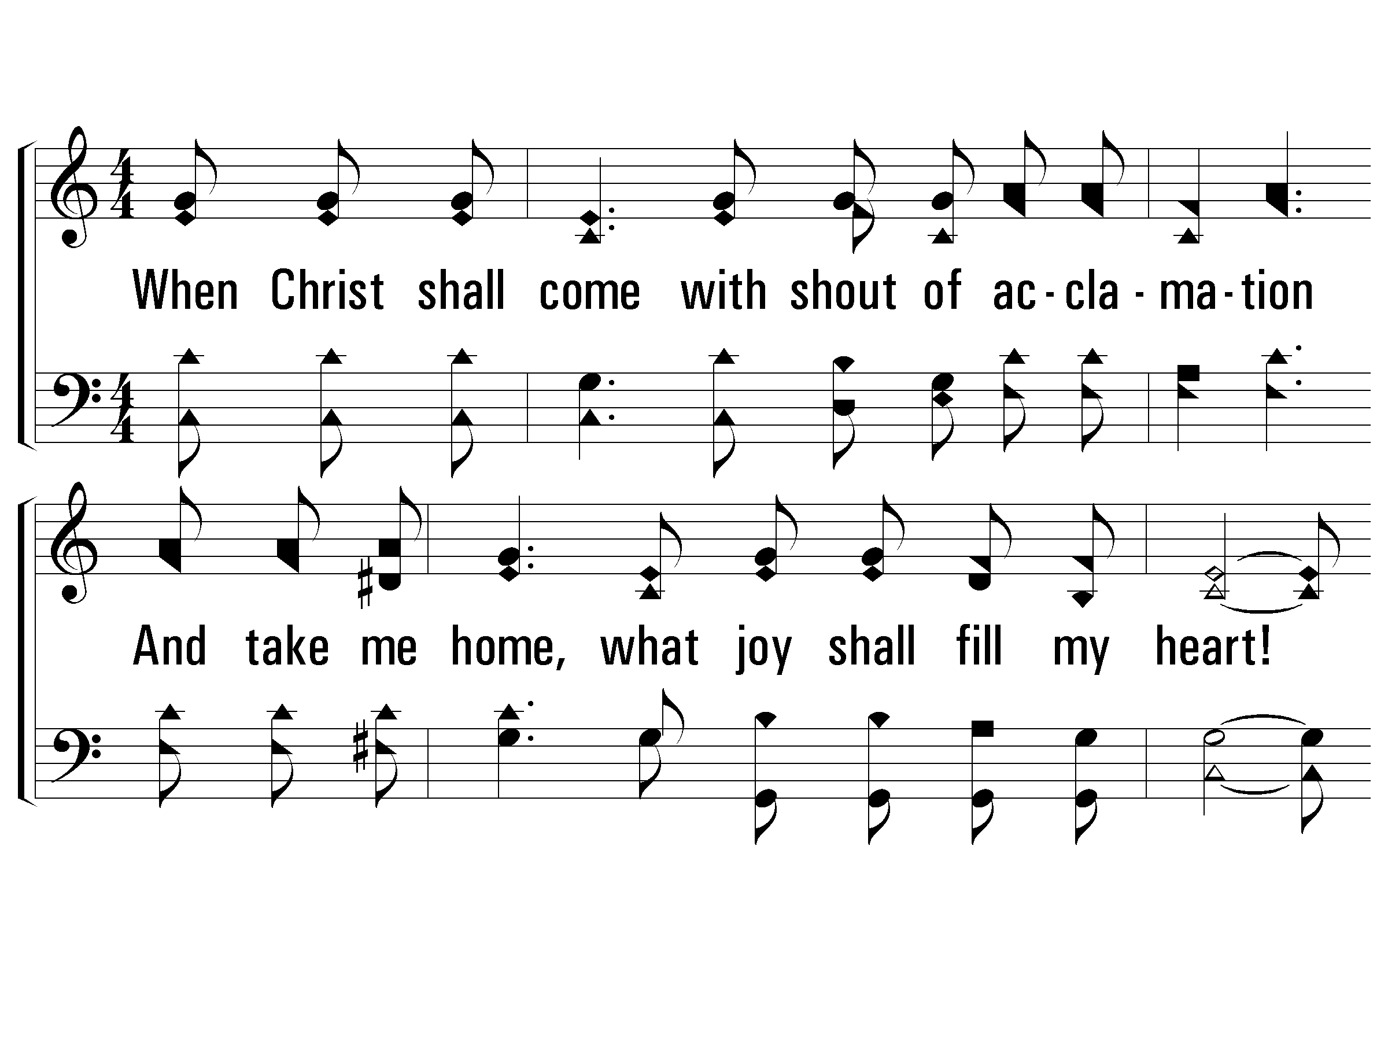
4 – How Great Thou Art
4.
When Christ shall come with shout of acclamation
And take me home, what joy shall fill my heart!
Then I shall bow in humble adoration
And there proclaim, my God, how great Thou art!
Words by: Stuart K. Hine
Music by: Swedish Folk melody, Arrangement by: Stuart K. Hine
Copyright © 1953 by Stuart K. Hine. Assigned to Manna Music, Inc., 35255 Brooten Road, Pacific City, OR 97135.
All Rights Reserved. Used by Permission.
© 2001 The Paperless Hymnal™

Slide 30
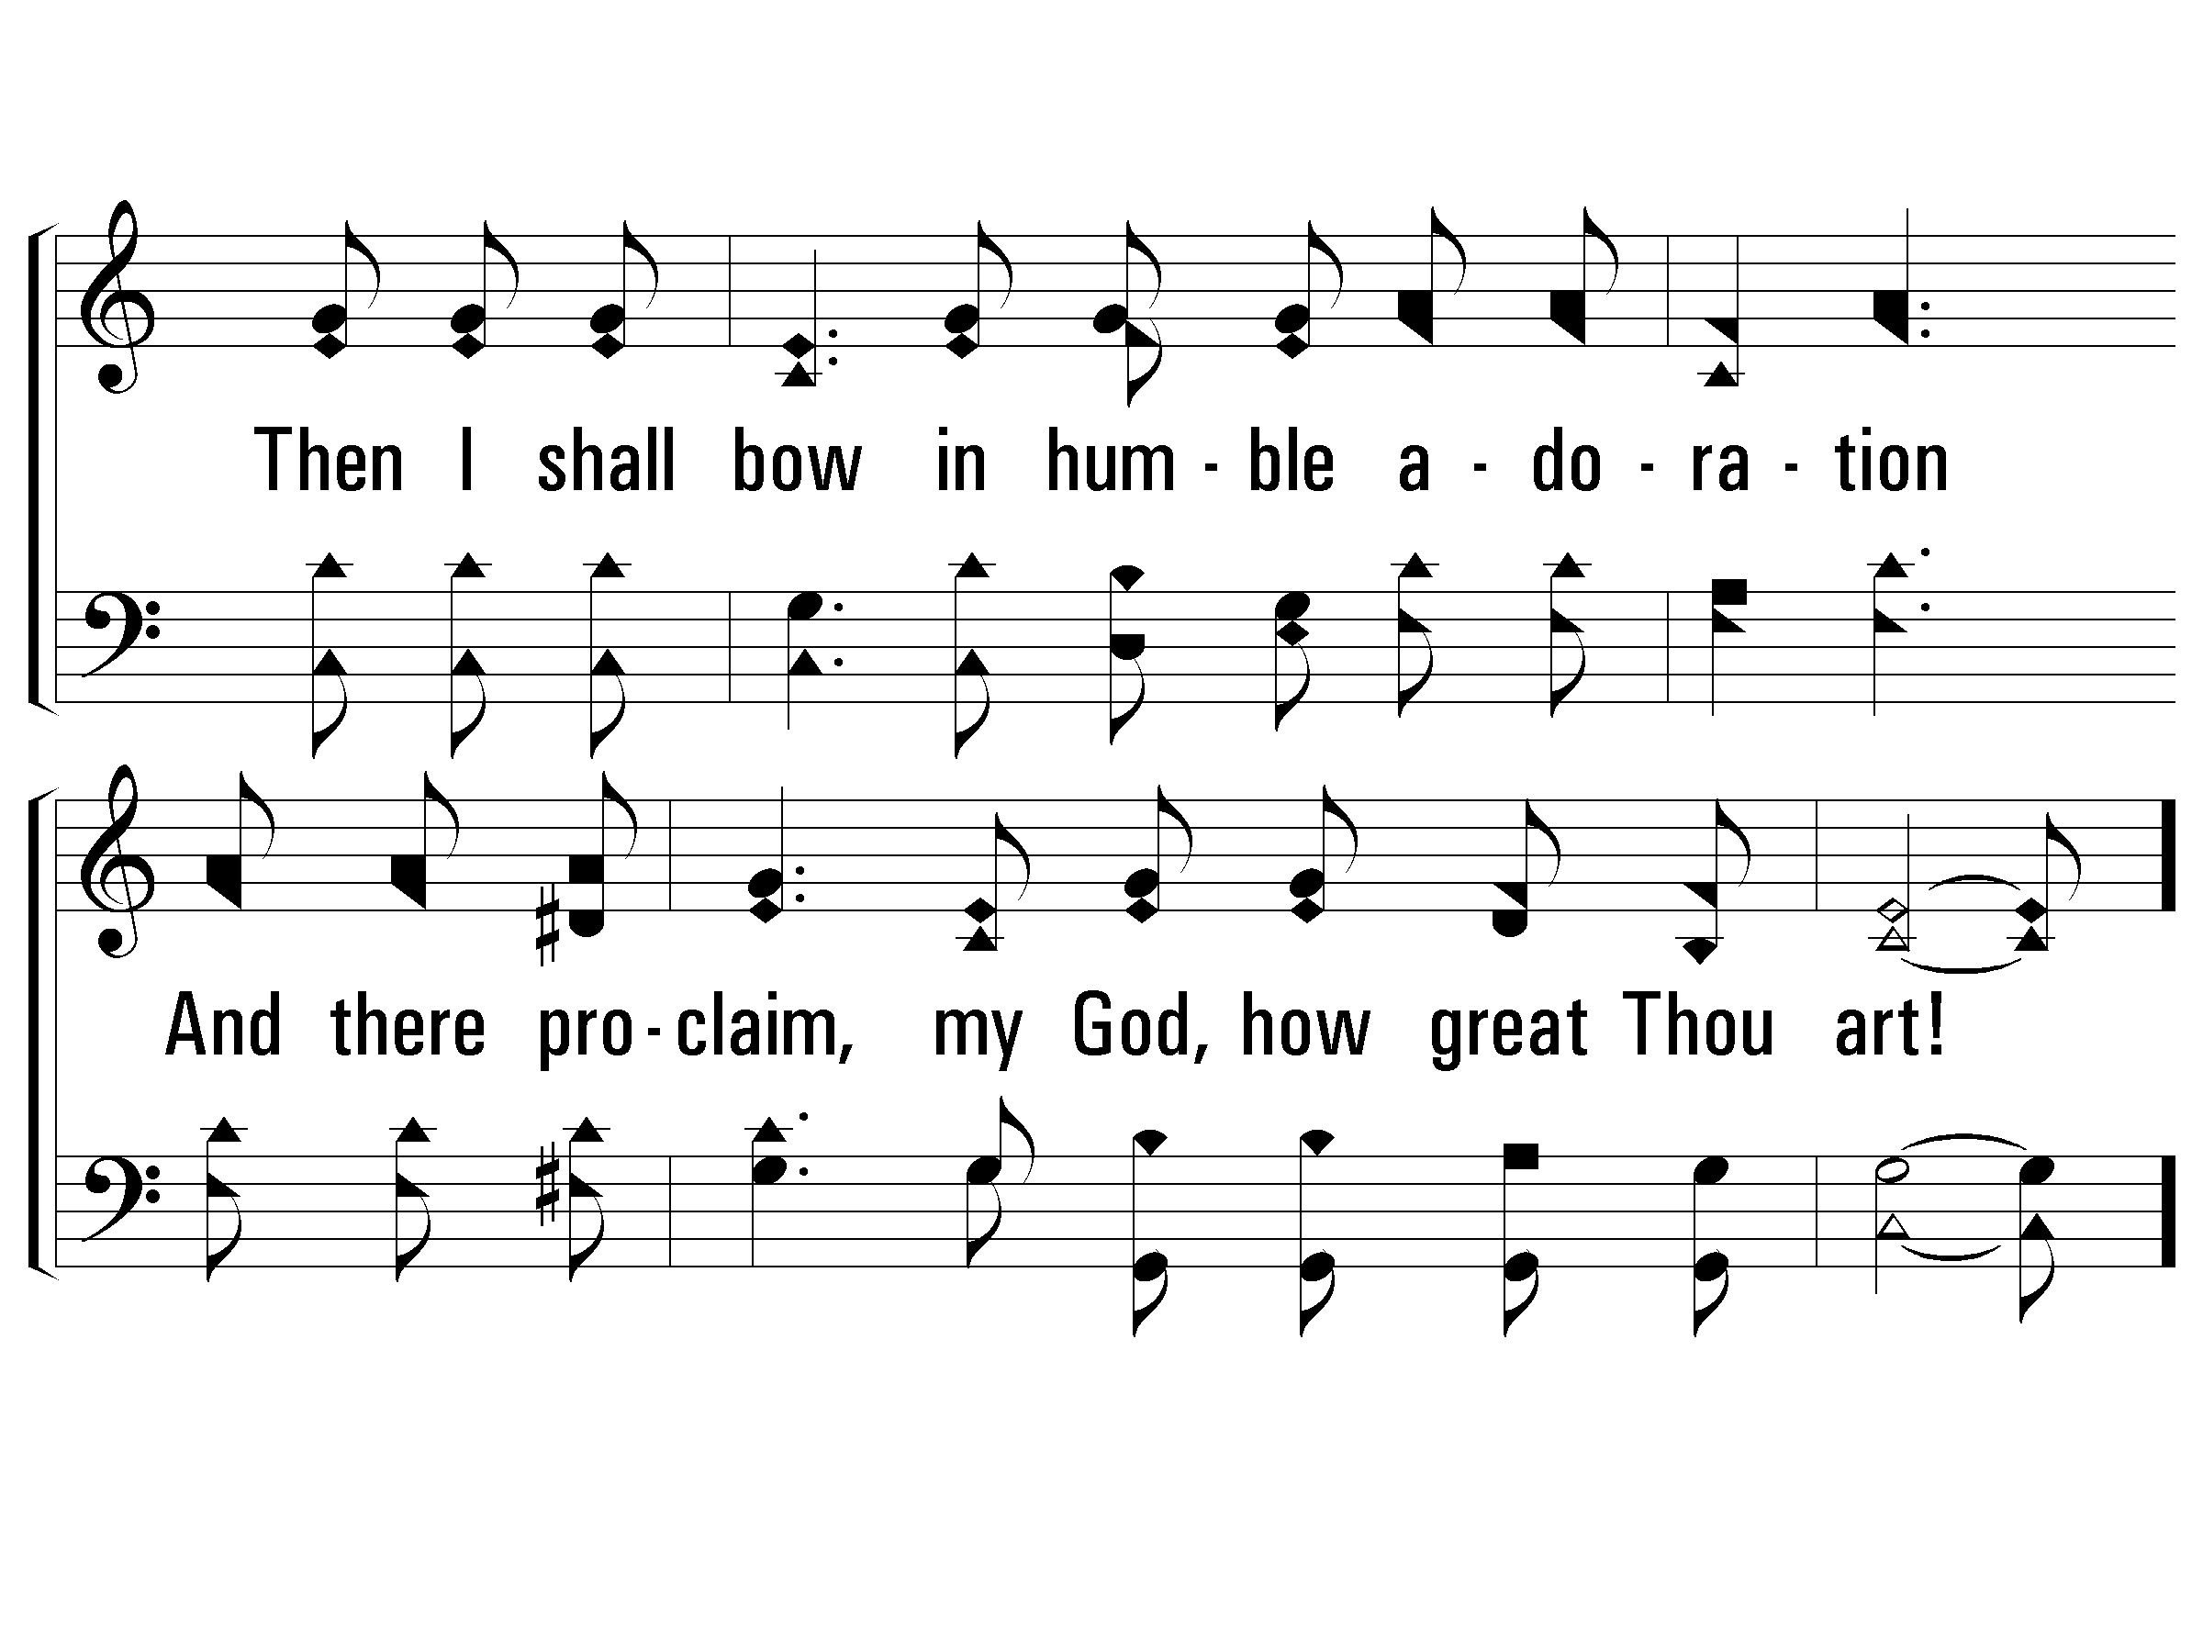
4 – How Great Thou Art
© 2001 The Paperless Hymnal™

Slide 31
c – How Great Thou Art
Then sings my soul, my Savior God to Thee;
How great Thou art, how great Thou art!
Then sings my soul, my Savior God to Thee;
How great Thou art, how great Thou art!
© 2001 The Paperless Hymnal™

Slide 32
c – How Great Thou Art
© 2001 The Paperless Hymnal™

Slide 33
Christ’s Life
John 14:6 (NKJV)
6 Jesus said to him, “I am the way, the truth, and the life. No one comes to the Father except through Me.

Slide 34
Christ’s Life
1 John 4:7-10 (NKJV)
7 Beloved, let us love one another, for love is of God; and everyone who loves is born of God and knows God. 8 He who does not love does not know God, for God is love. 9 In this the love of God was manifested toward us, that God has sent His only begotten Son into the world, that we might live through Him. 10 In this is love, not that we loved God, but that He loved us and sent His Son to be the propitiation for our sins.

Slide 35
What Is Love
Page 62 supp.
Verses 1 & 3
Will Lovell

Slide 36
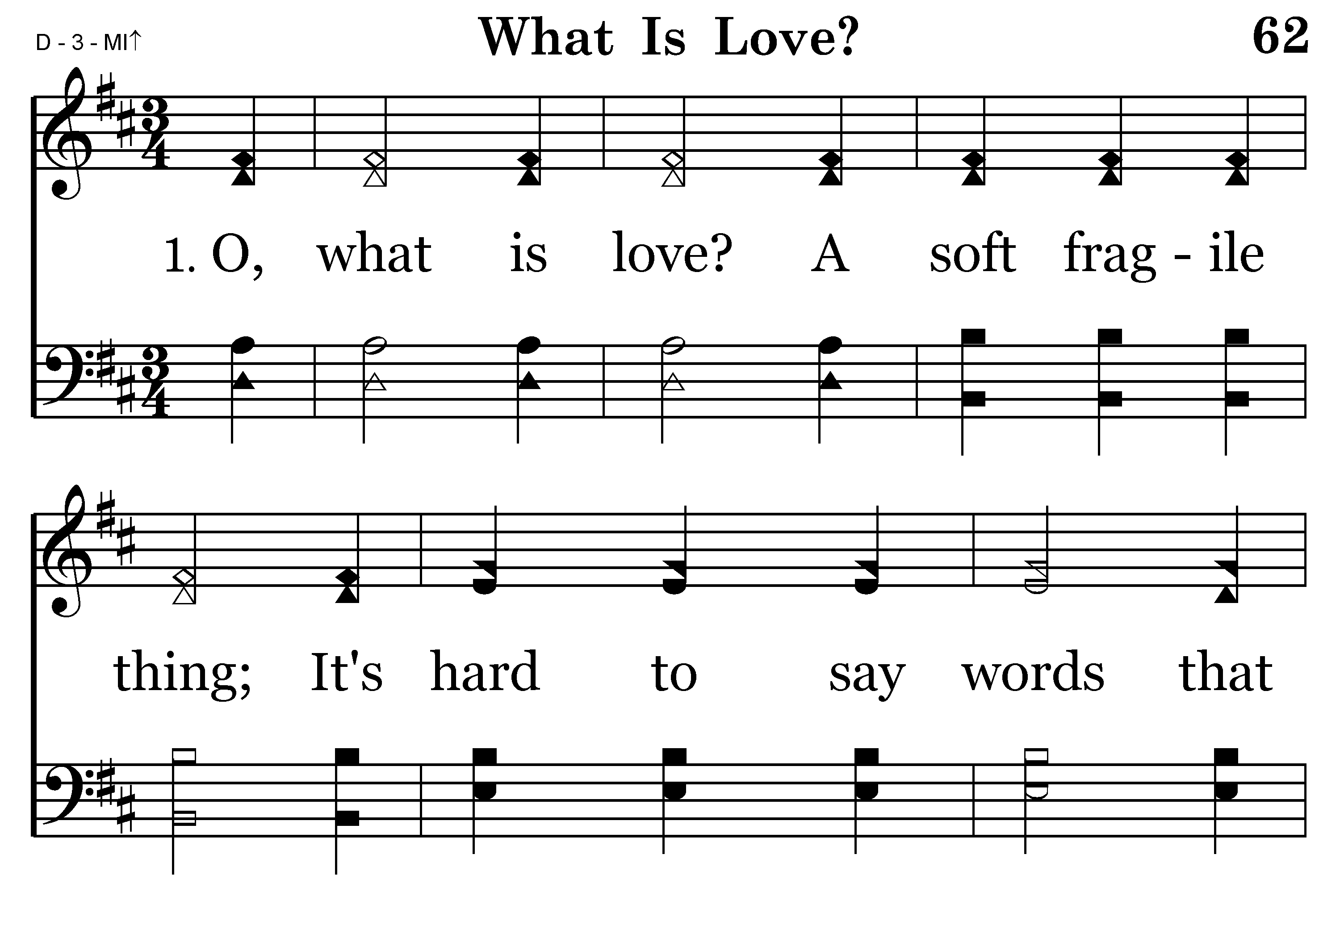
062 - What Is Love - 1.1

Slide 37
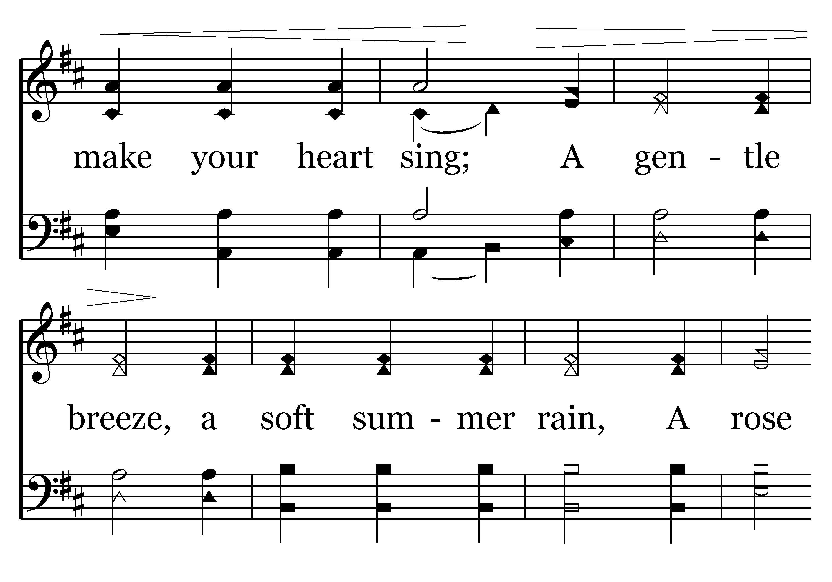
062 - What Is Love - 1.2

Slide 38
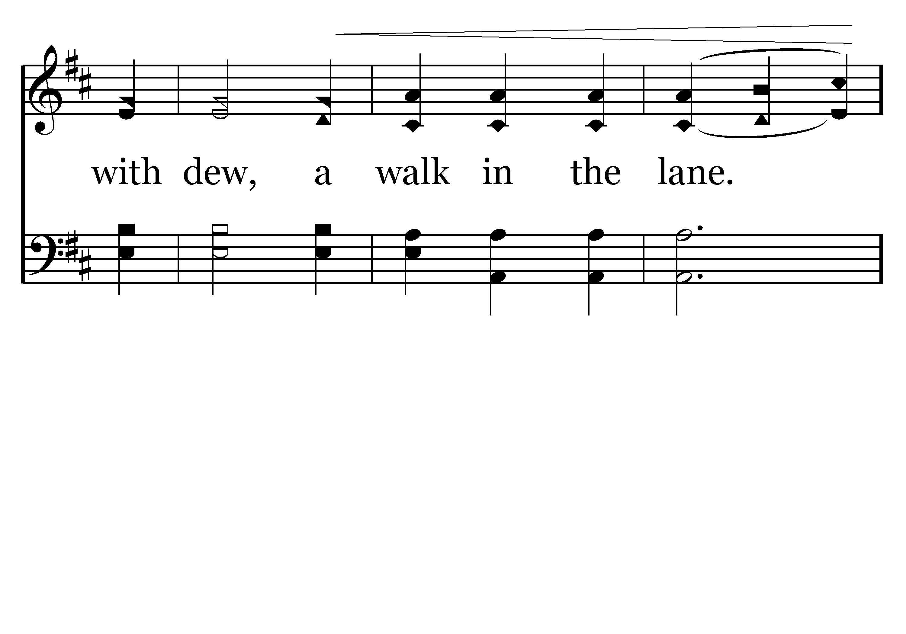
062 - What Is Love - 1.3

Slide 39
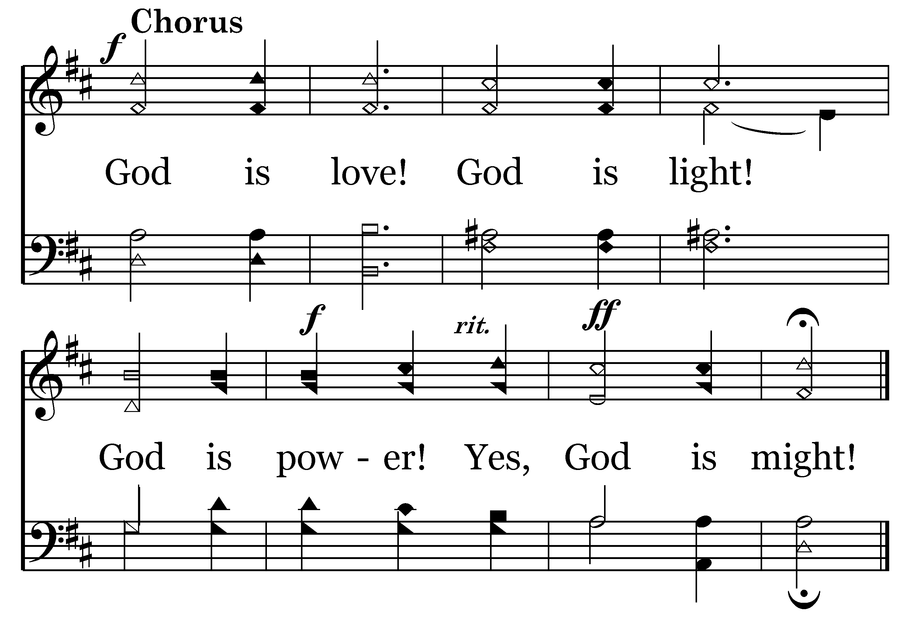
062 - What Is Love - C.1
End of Verse 1

Slide 40
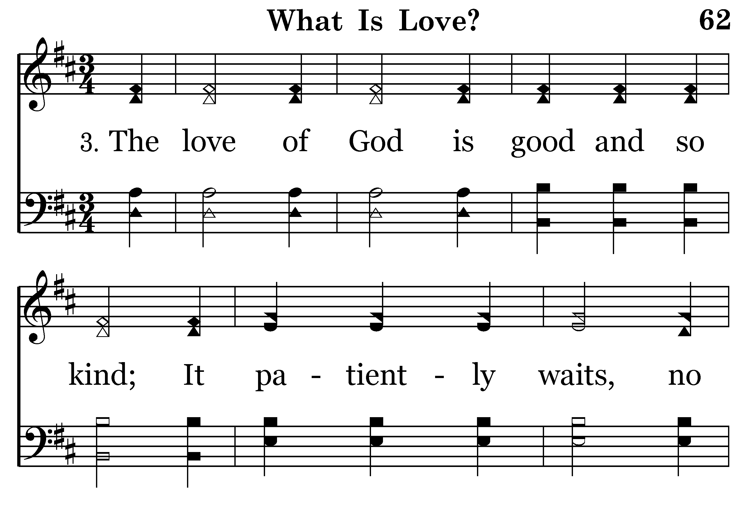
062 - What Is Love - 3.1

Slide 41
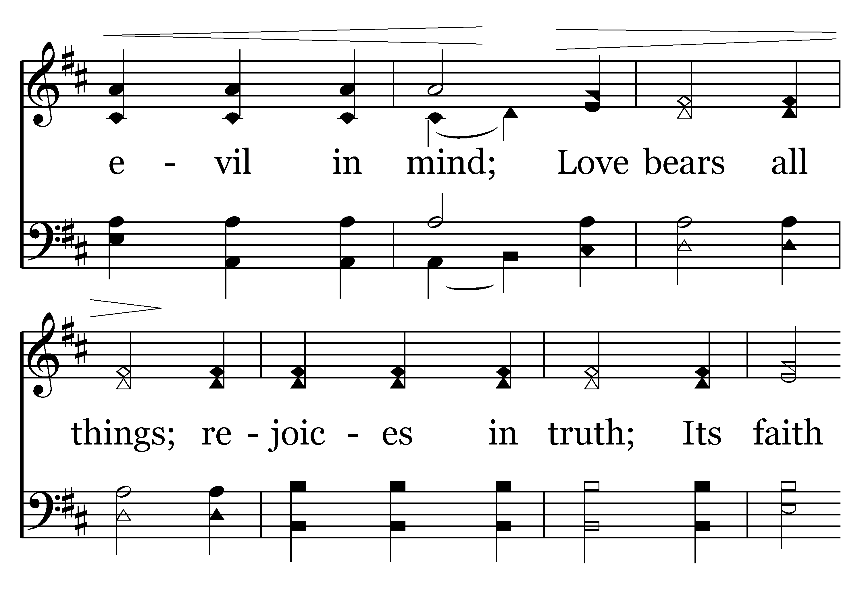
062 - What Is Love - 3.2

Slide 42
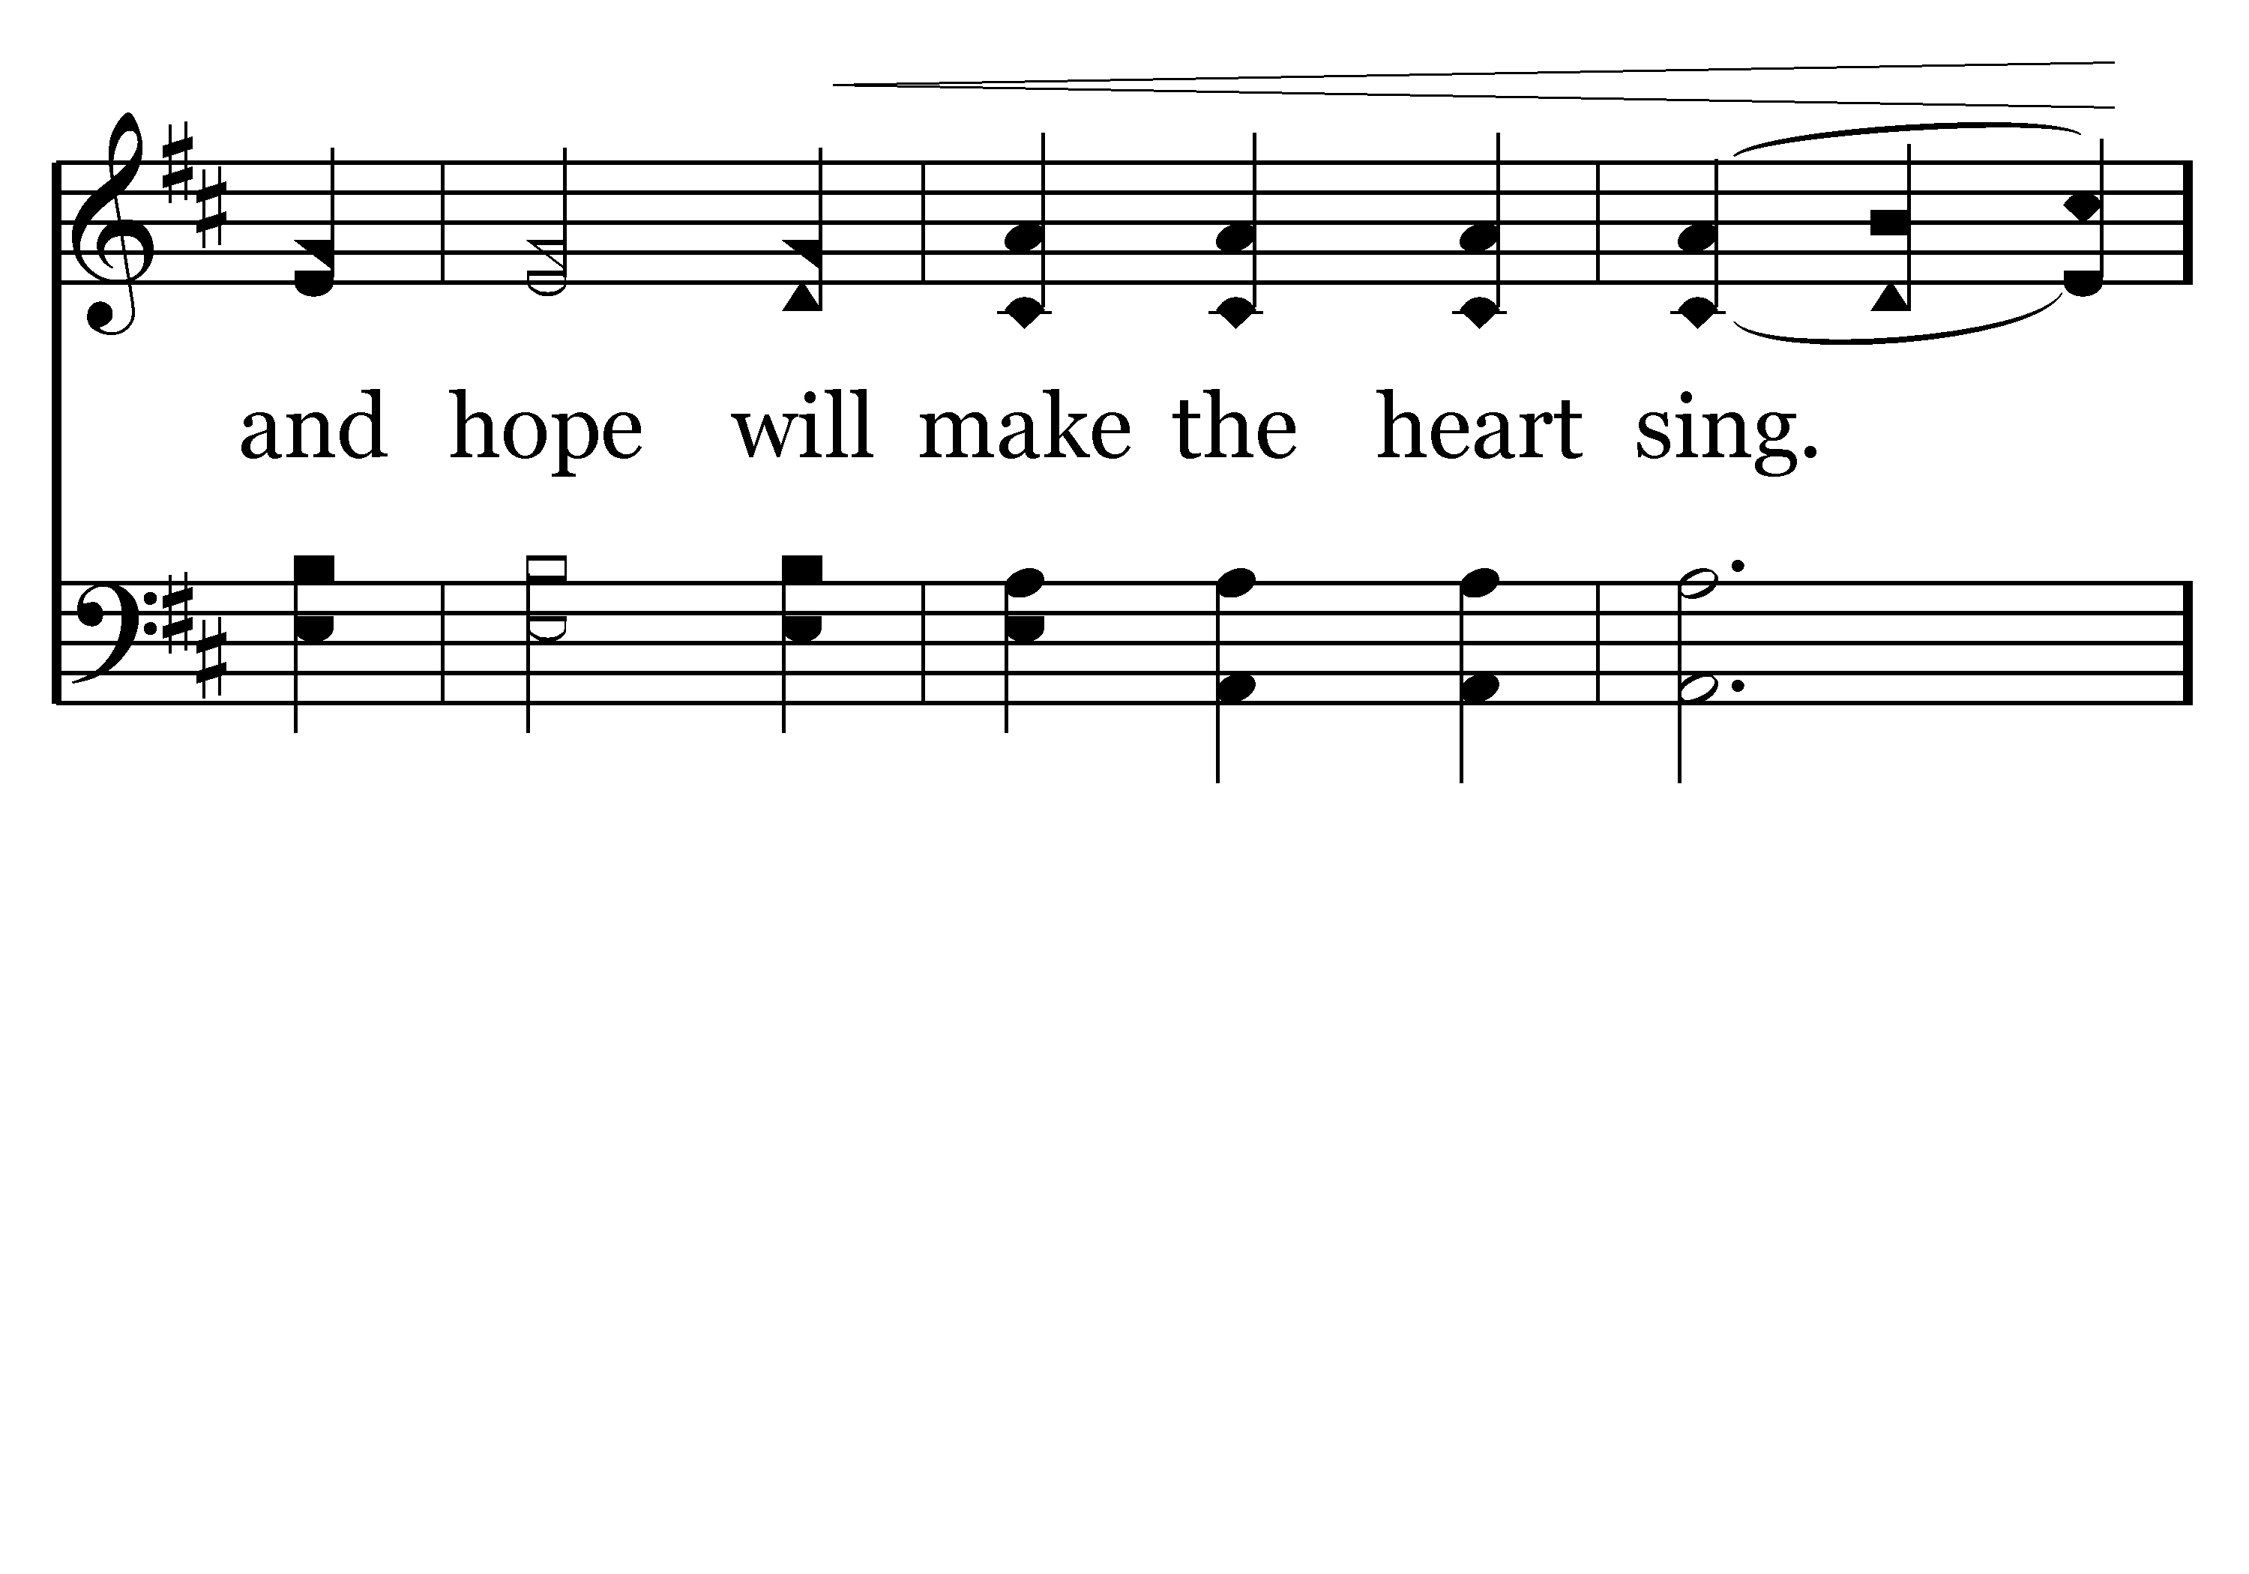
062 - What Is Love - 3.3

Slide 43
062 - What Is Love - C.1
End of Song

Slide 44
A Beautiful Prayer
Page 2
All 3 verses
Stuart Wilson

Slide 45
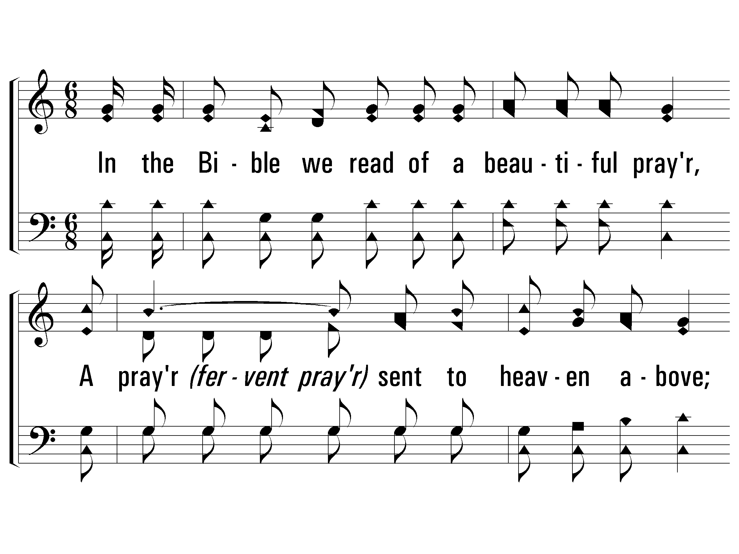
1 - A Beautiful Prayer
1.
In the Bible we read of a beautiful prayer,
A prayer sent to heaven above;
It was prayed by a heart that was laden with care
And filled with such wonderful love.
Words & Music: Luther G. Presley
Copyright © 1937 by Stamps-Baxter Music
© 2007 The Paperless Hymnal®

Slide 46
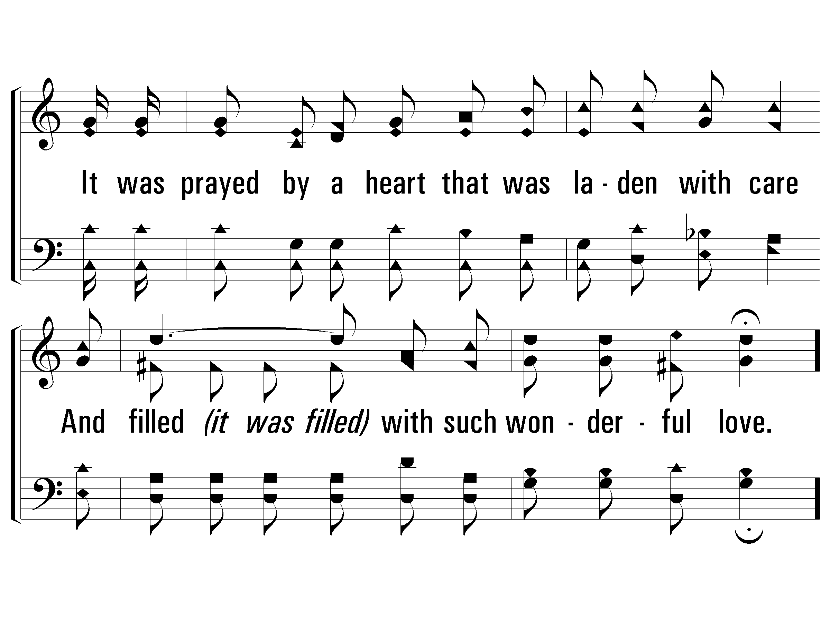
1 - A Beautiful Prayer
© 2007 The Paperless Hymnal®

Slide 47
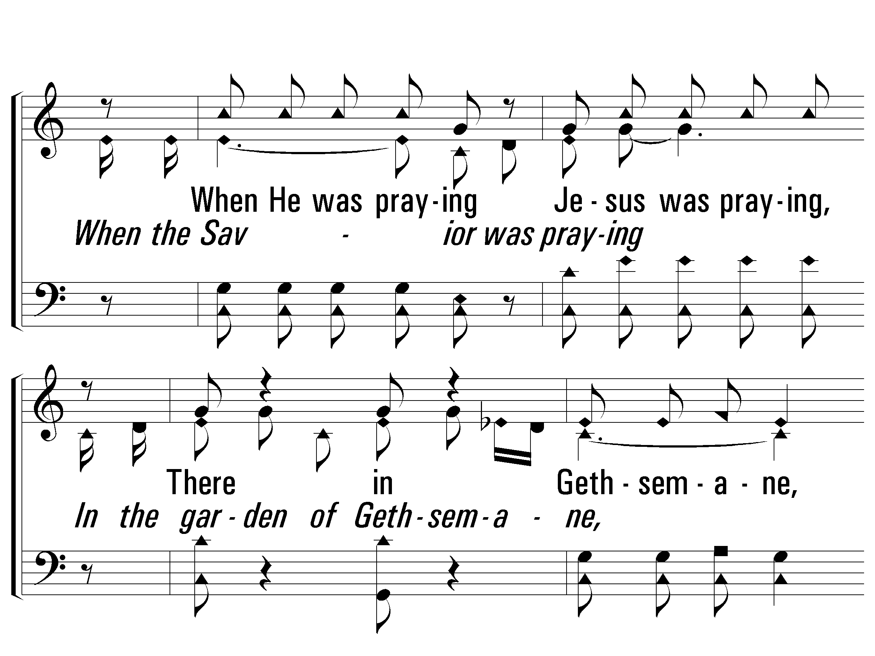
c - A Beautiful Prayer
When the Savior was praying
In the garden of Gethsemane,
He said, "loving Father,
If you will let this cup pass from me;"
I know He was thinking
Of the anguish death would bring to His own,
How was deep was His sorrow
When Jesus was praying alone.
© 2007 The Paperless Hymnal®

Slide 48
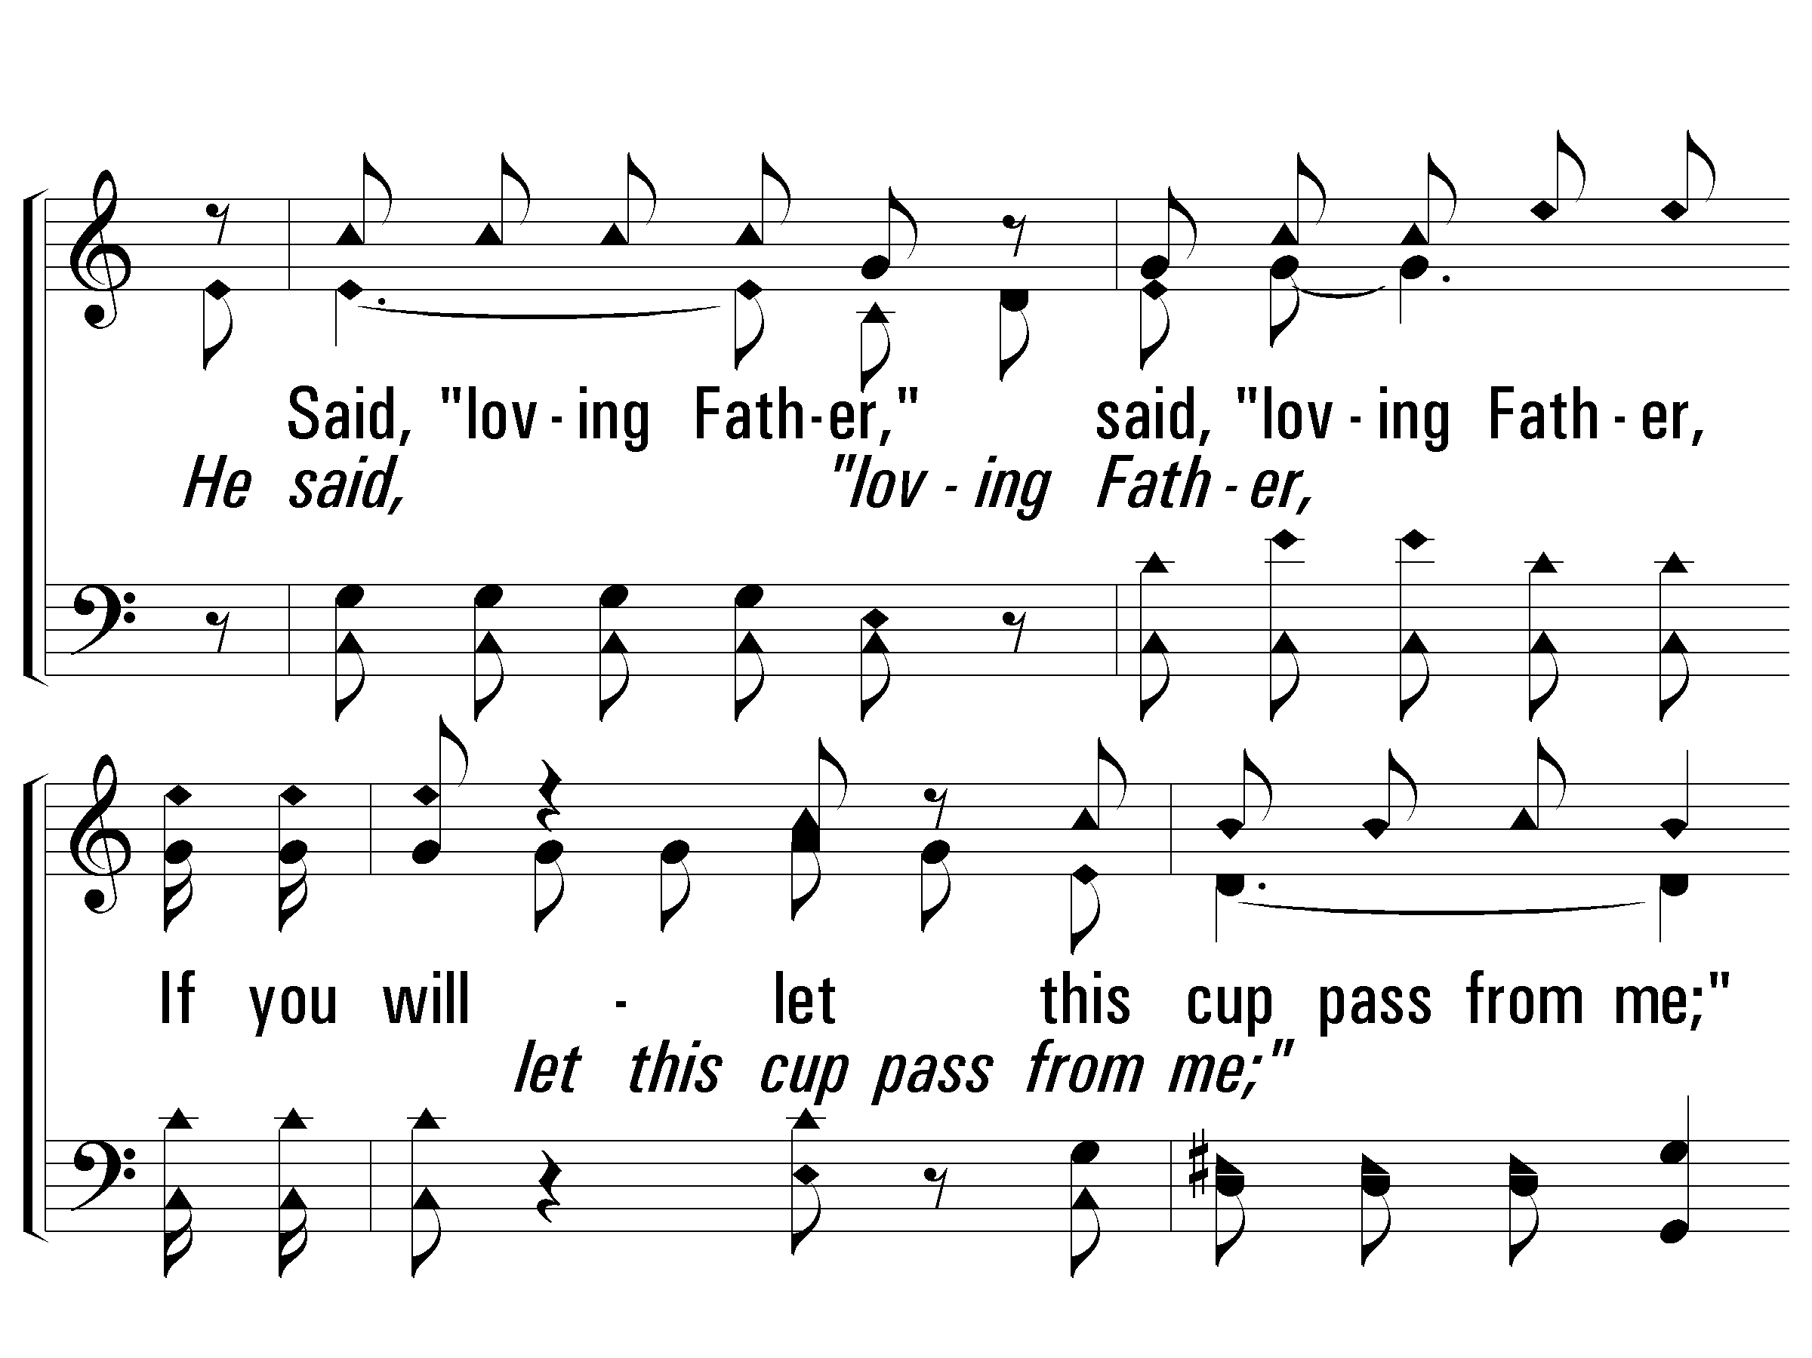
c - A Beautiful Prayer
© 2007 The Paperless Hymnal®

Slide 49
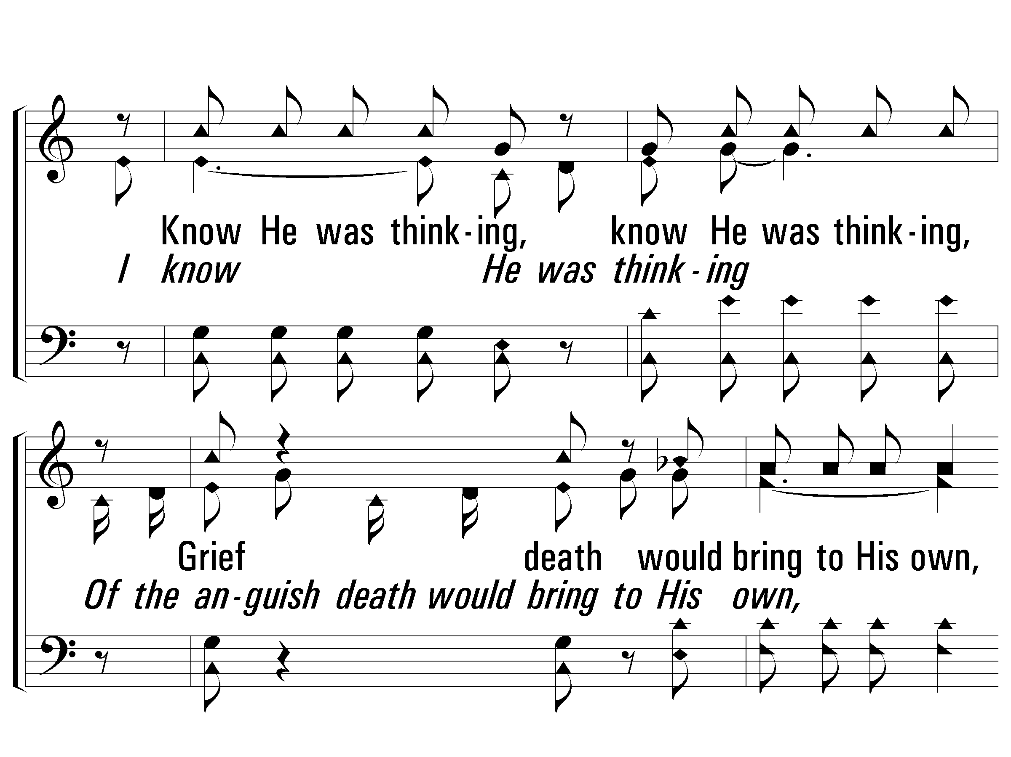
c - A Beautiful Prayer
© 2007 The Paperless Hymnal®

Slide 50
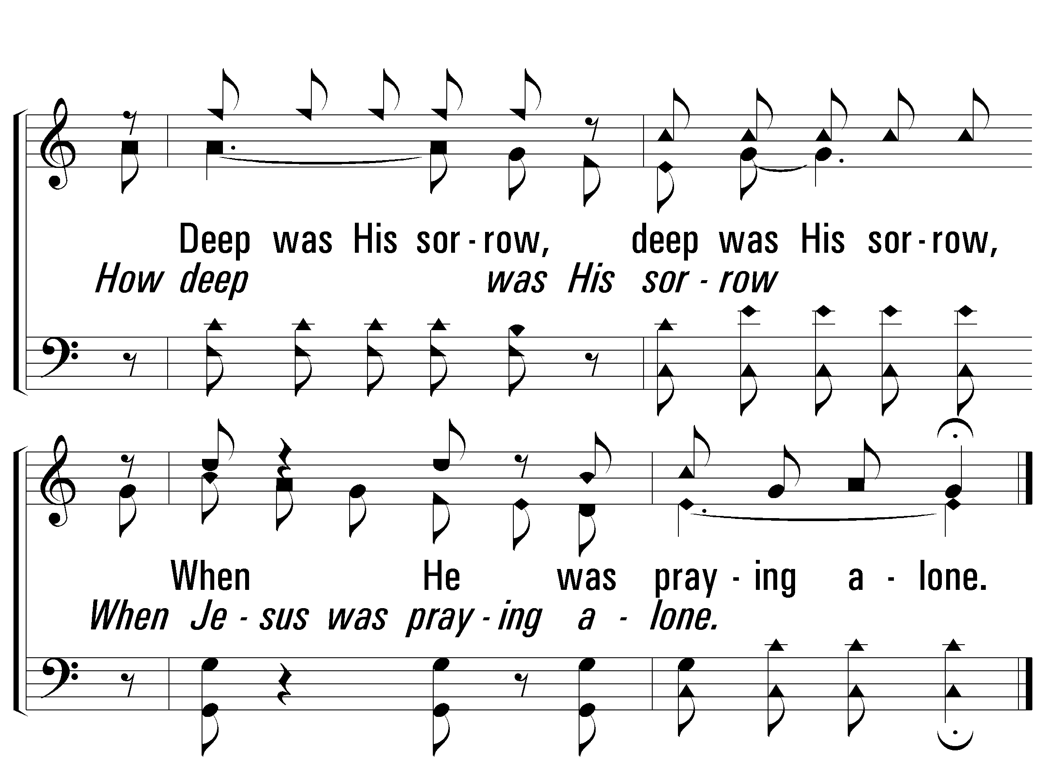
c - A Beautiful Prayer
© 2007 The Paperless Hymnal®

Slide 51
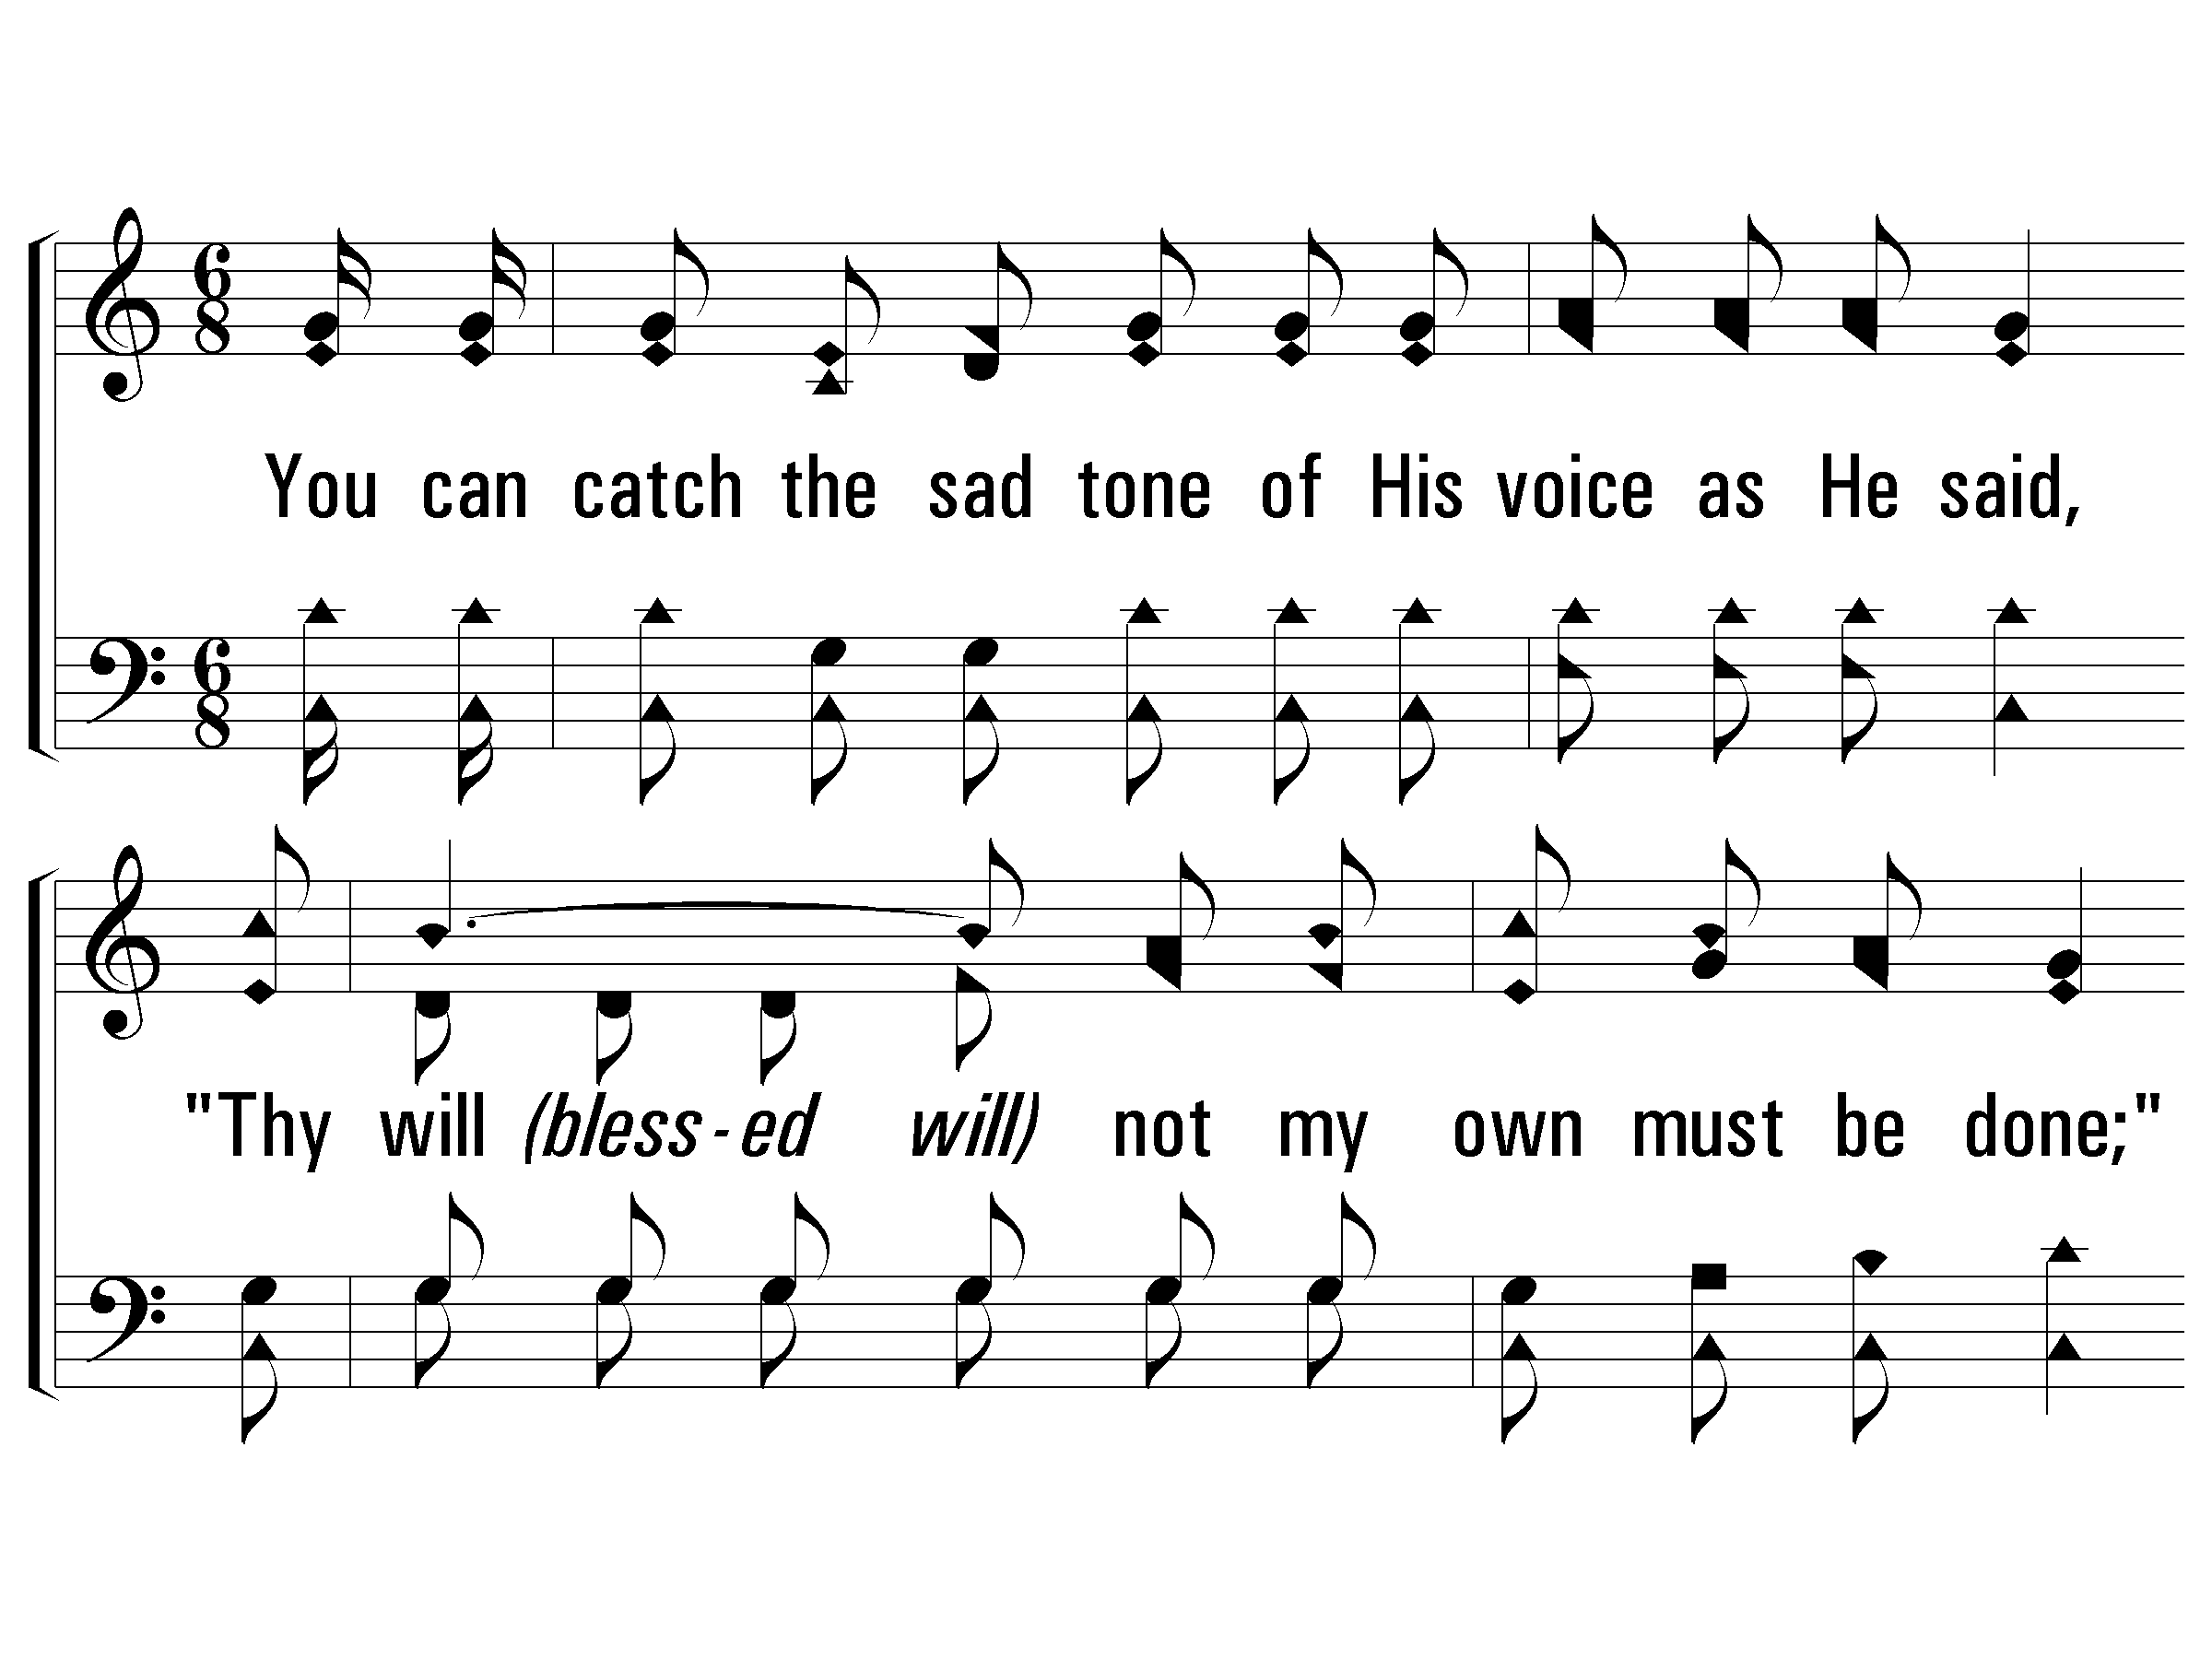
2 - A Beautiful Prayer
2.
You can catch the sad tone of His voice as He said,
"Thy will not my own must be done;"
As a lamb to the slaughter He soon must be led
To die as the Crucified One.
Words & Music: Luther G. Presley
Copyright © 1937 by Stamps-Baxter Music
© 2007 The Paperless Hymnal®

Slide 52
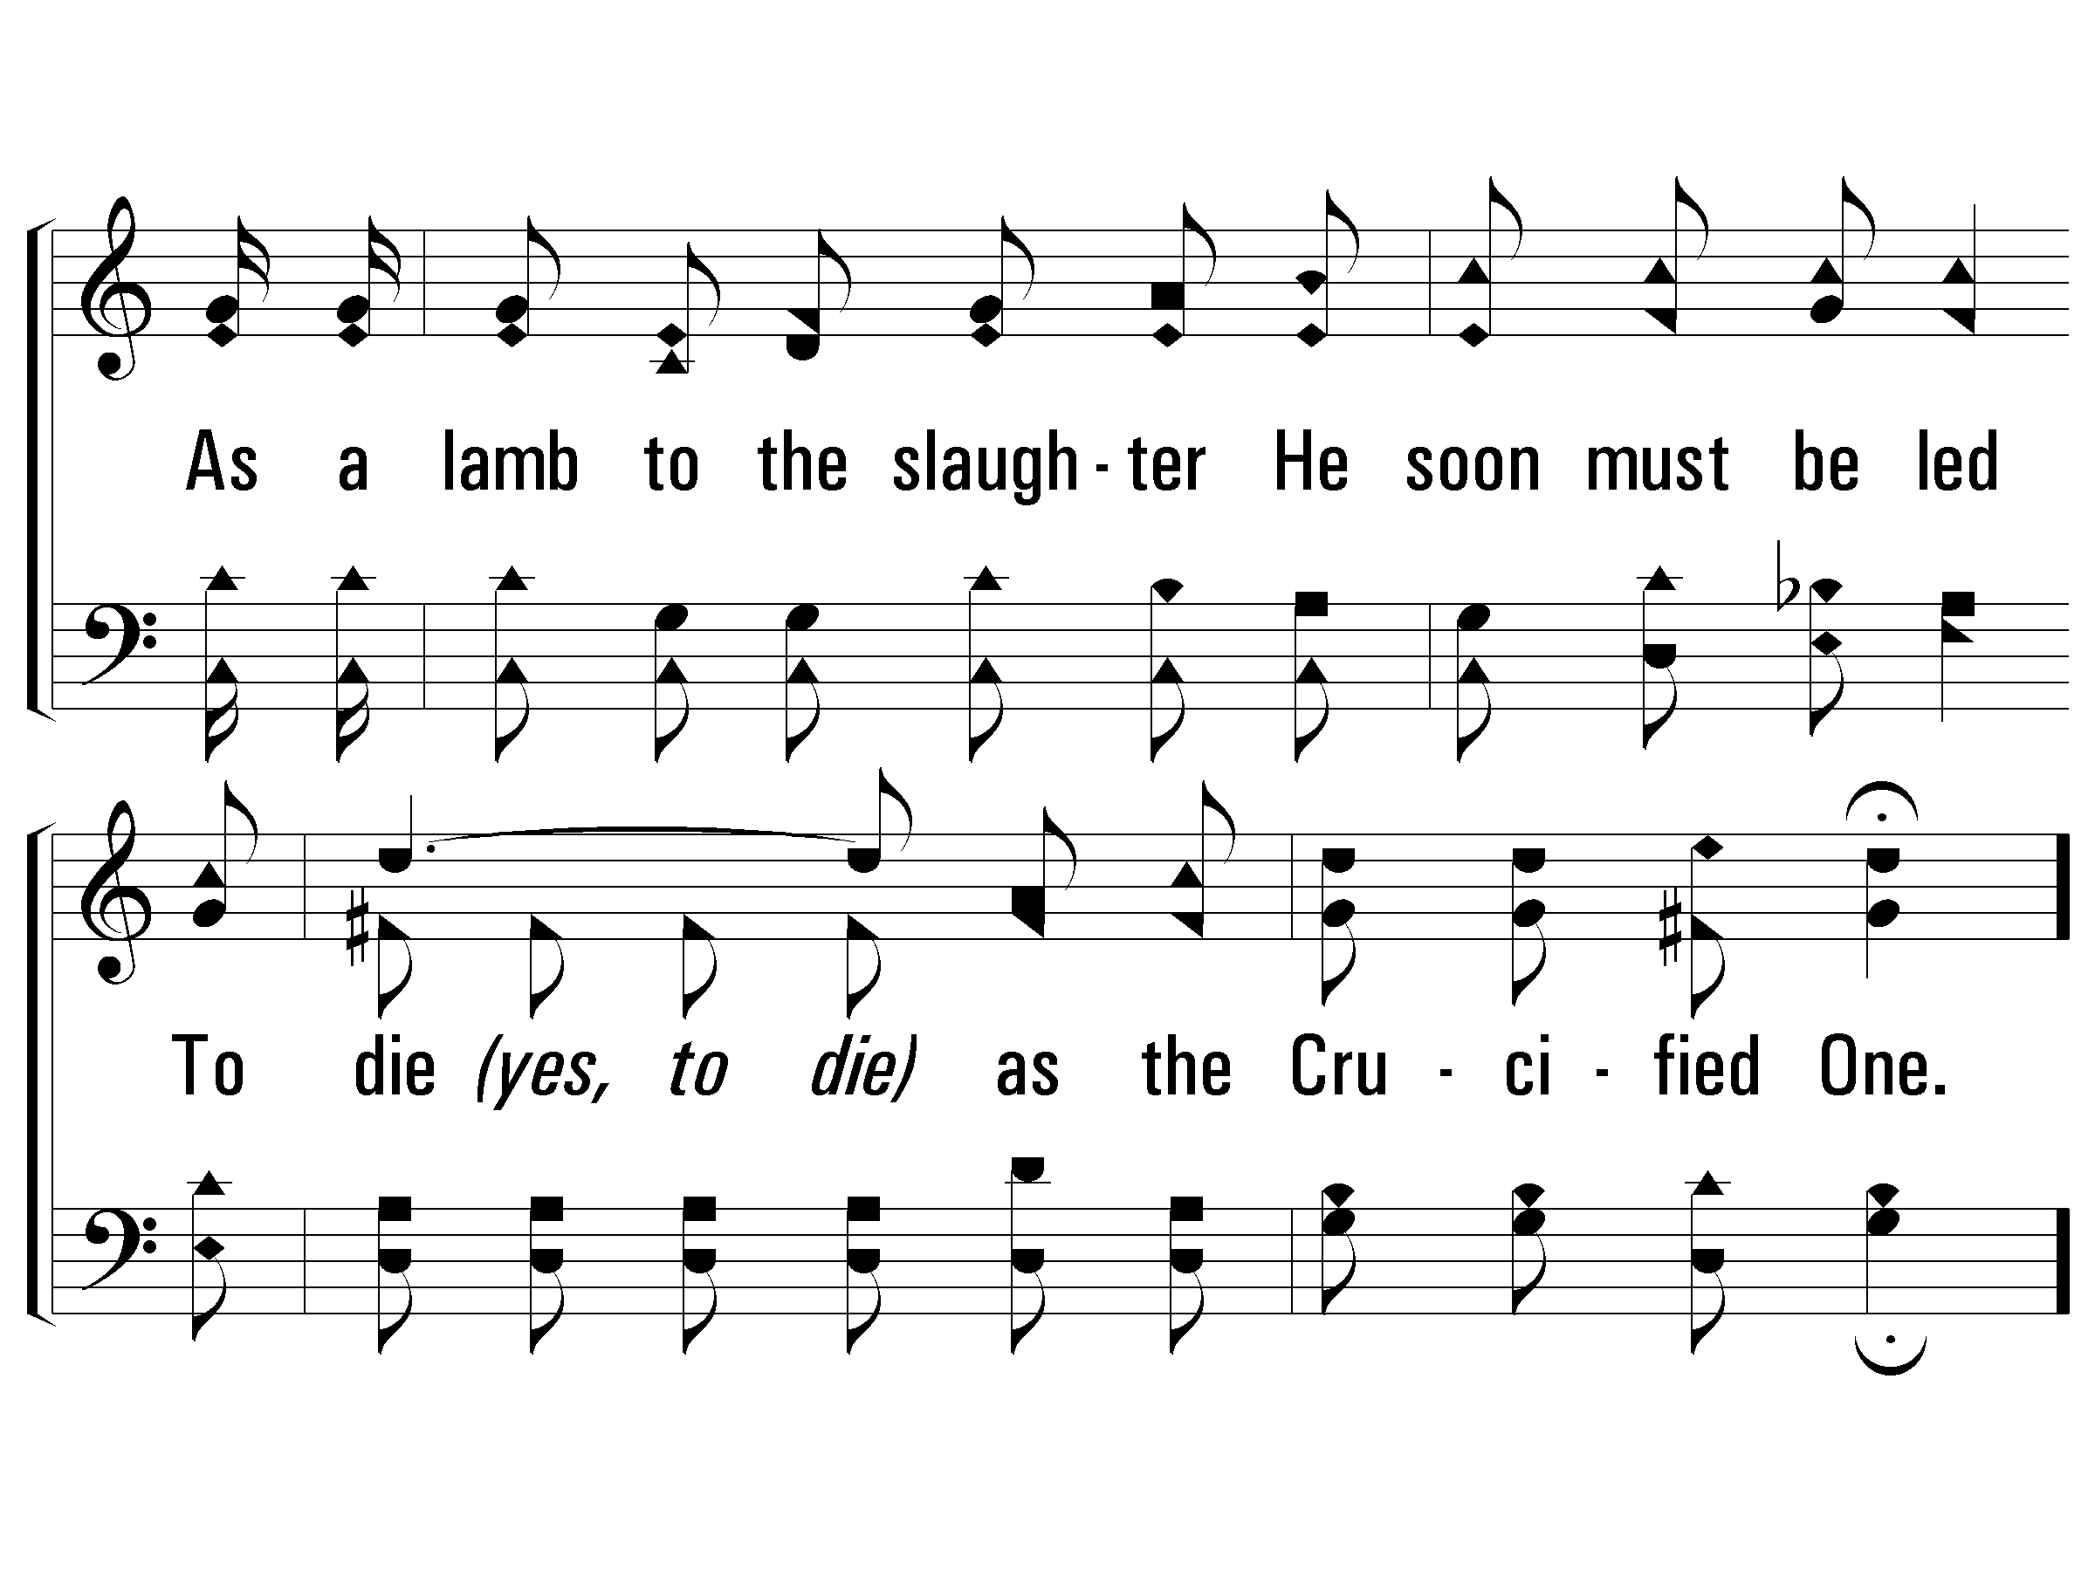
2 - A Beautiful Prayer
© 2007 The Paperless Hymnal®

Slide 53
c - A Beautiful Prayer
When the Savior was praying
In the garden of Gethsemane,
He said, "loving Father,
If you will let this cup pass from me;"
I know He was thinking
Of the anguish death would bring to His own,
How was deep was His sorrow
When Jesus was praying alone.
© 2007 The Paperless Hymnal®

Slide 54
c - A Beautiful Prayer
© 2007 The Paperless Hymnal®

Slide 55
c - A Beautiful Prayer
© 2007 The Paperless Hymnal®

Slide 56
c - A Beautiful Prayer
© 2007 The Paperless Hymnal®

Slide 57
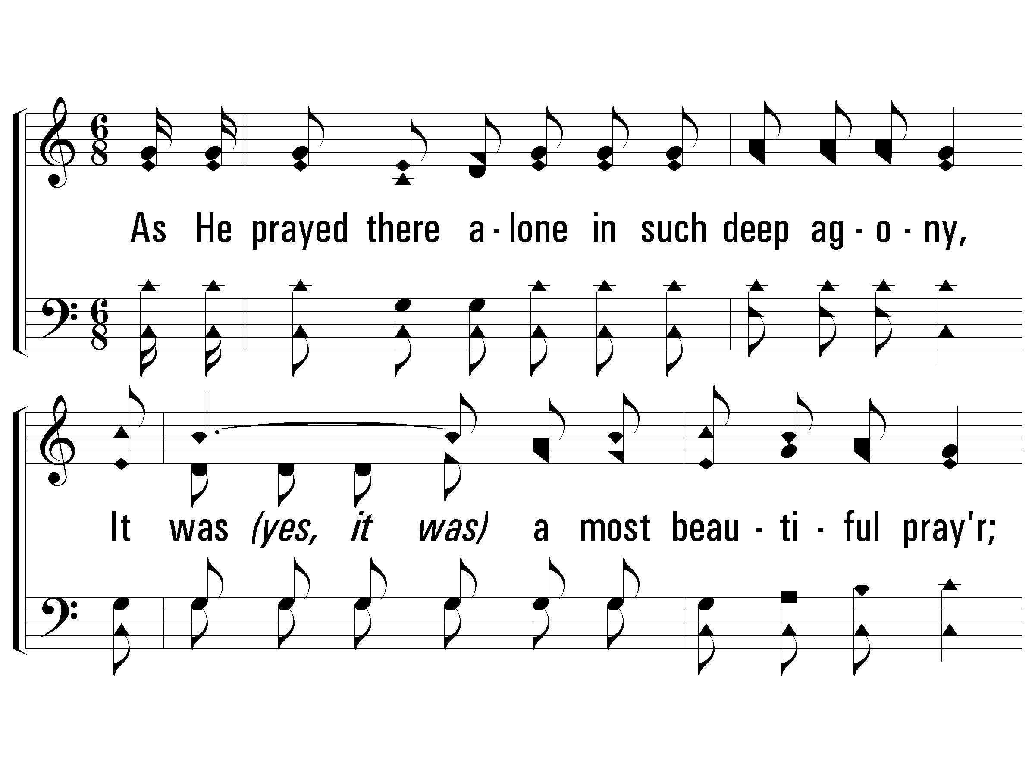
3 - A Beautiful Prayer
3.
As He prayed there alone in such deep agony,
It was a most beautiful prayer;
Just to think His great heart was all broken for me,
That He my great sorrow must share.
Words & Music: Luther G. Presley
Copyright © 1937 by Stamps-Baxter Music
© 2007 The Paperless Hymnal®

Slide 58
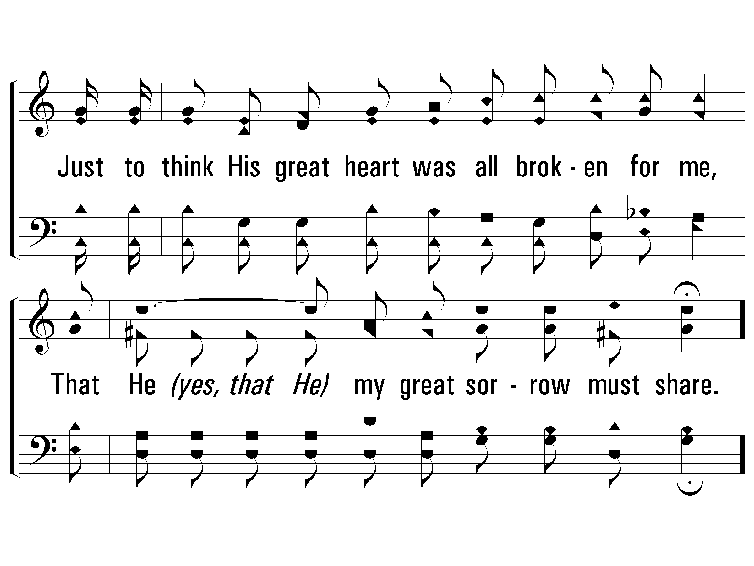
3 - A Beautiful Prayer
© 2007 The Paperless Hymnal®

Slide 59
c - A Beautiful Prayer
When the Savior was praying
In the garden of Gethsemane,
He said, "loving Father,
If you will let this cup pass from me;"
I know He was thinking
Of the anguish death would bring to His own,
How was deep was His sorrow
When Jesus was praying alone.
© 2007 The Paperless Hymnal®

Slide 60
c - A Beautiful Prayer
© 2007 The Paperless Hymnal®

Slide 61
c - A Beautiful Prayer
© 2007 The Paperless Hymnal®

Slide 62
c - A Beautiful Prayer
© 2007 The Paperless Hymnal®

Slide 63
Christ’s Death
Isaiah 53:3-10 (NKJV)
3 He is despised and rejected by men, A Man of sorrows and acquainted with grief. And we hid, as it were, our faces from Him; He was despised, and we did not esteem Him. 4 Surely He has borne our griefs And carried our sorrows; Yet we esteemed Him stricken, Smitten by God, and afflicted. 5 But He was wounded for our transgressions, He was bruised for our iniquities; The chastisement for our peace was upon Him, And by His stripes we are healed. 6 All we like sheep have gone astray; We have turned, every one, to his own way; And the Lord has laid on Him the iniquity of us all.

Slide 64
7 He was oppressed and He was afflicted, Yet He opened not His mouth; He was led as a lamb to the slaughter, And as a sheep before its shearers is silent, So He opened not His mouth. 8 He was taken from prison and from judgment, And who will declare His generation? For He was cut off from the land of the living; For the transgressions of My people He was stricken.9 And they made His grave with the wicked— But with the rich at His death, Because He had done no violence, Nor was any deceit in His mouth. 10 Yet it pleased the Lord to bruise Him; He has put Him to grief. When You make His soul an offering for sin, He shall see His seed, He shall prolong His days, And the pleasure of the Lord shall prosper in His hand.

Slide 65
We Saw Thee Not
Page 726
Verses 1, 2 & 3
Stuart Wilson

Slide 66
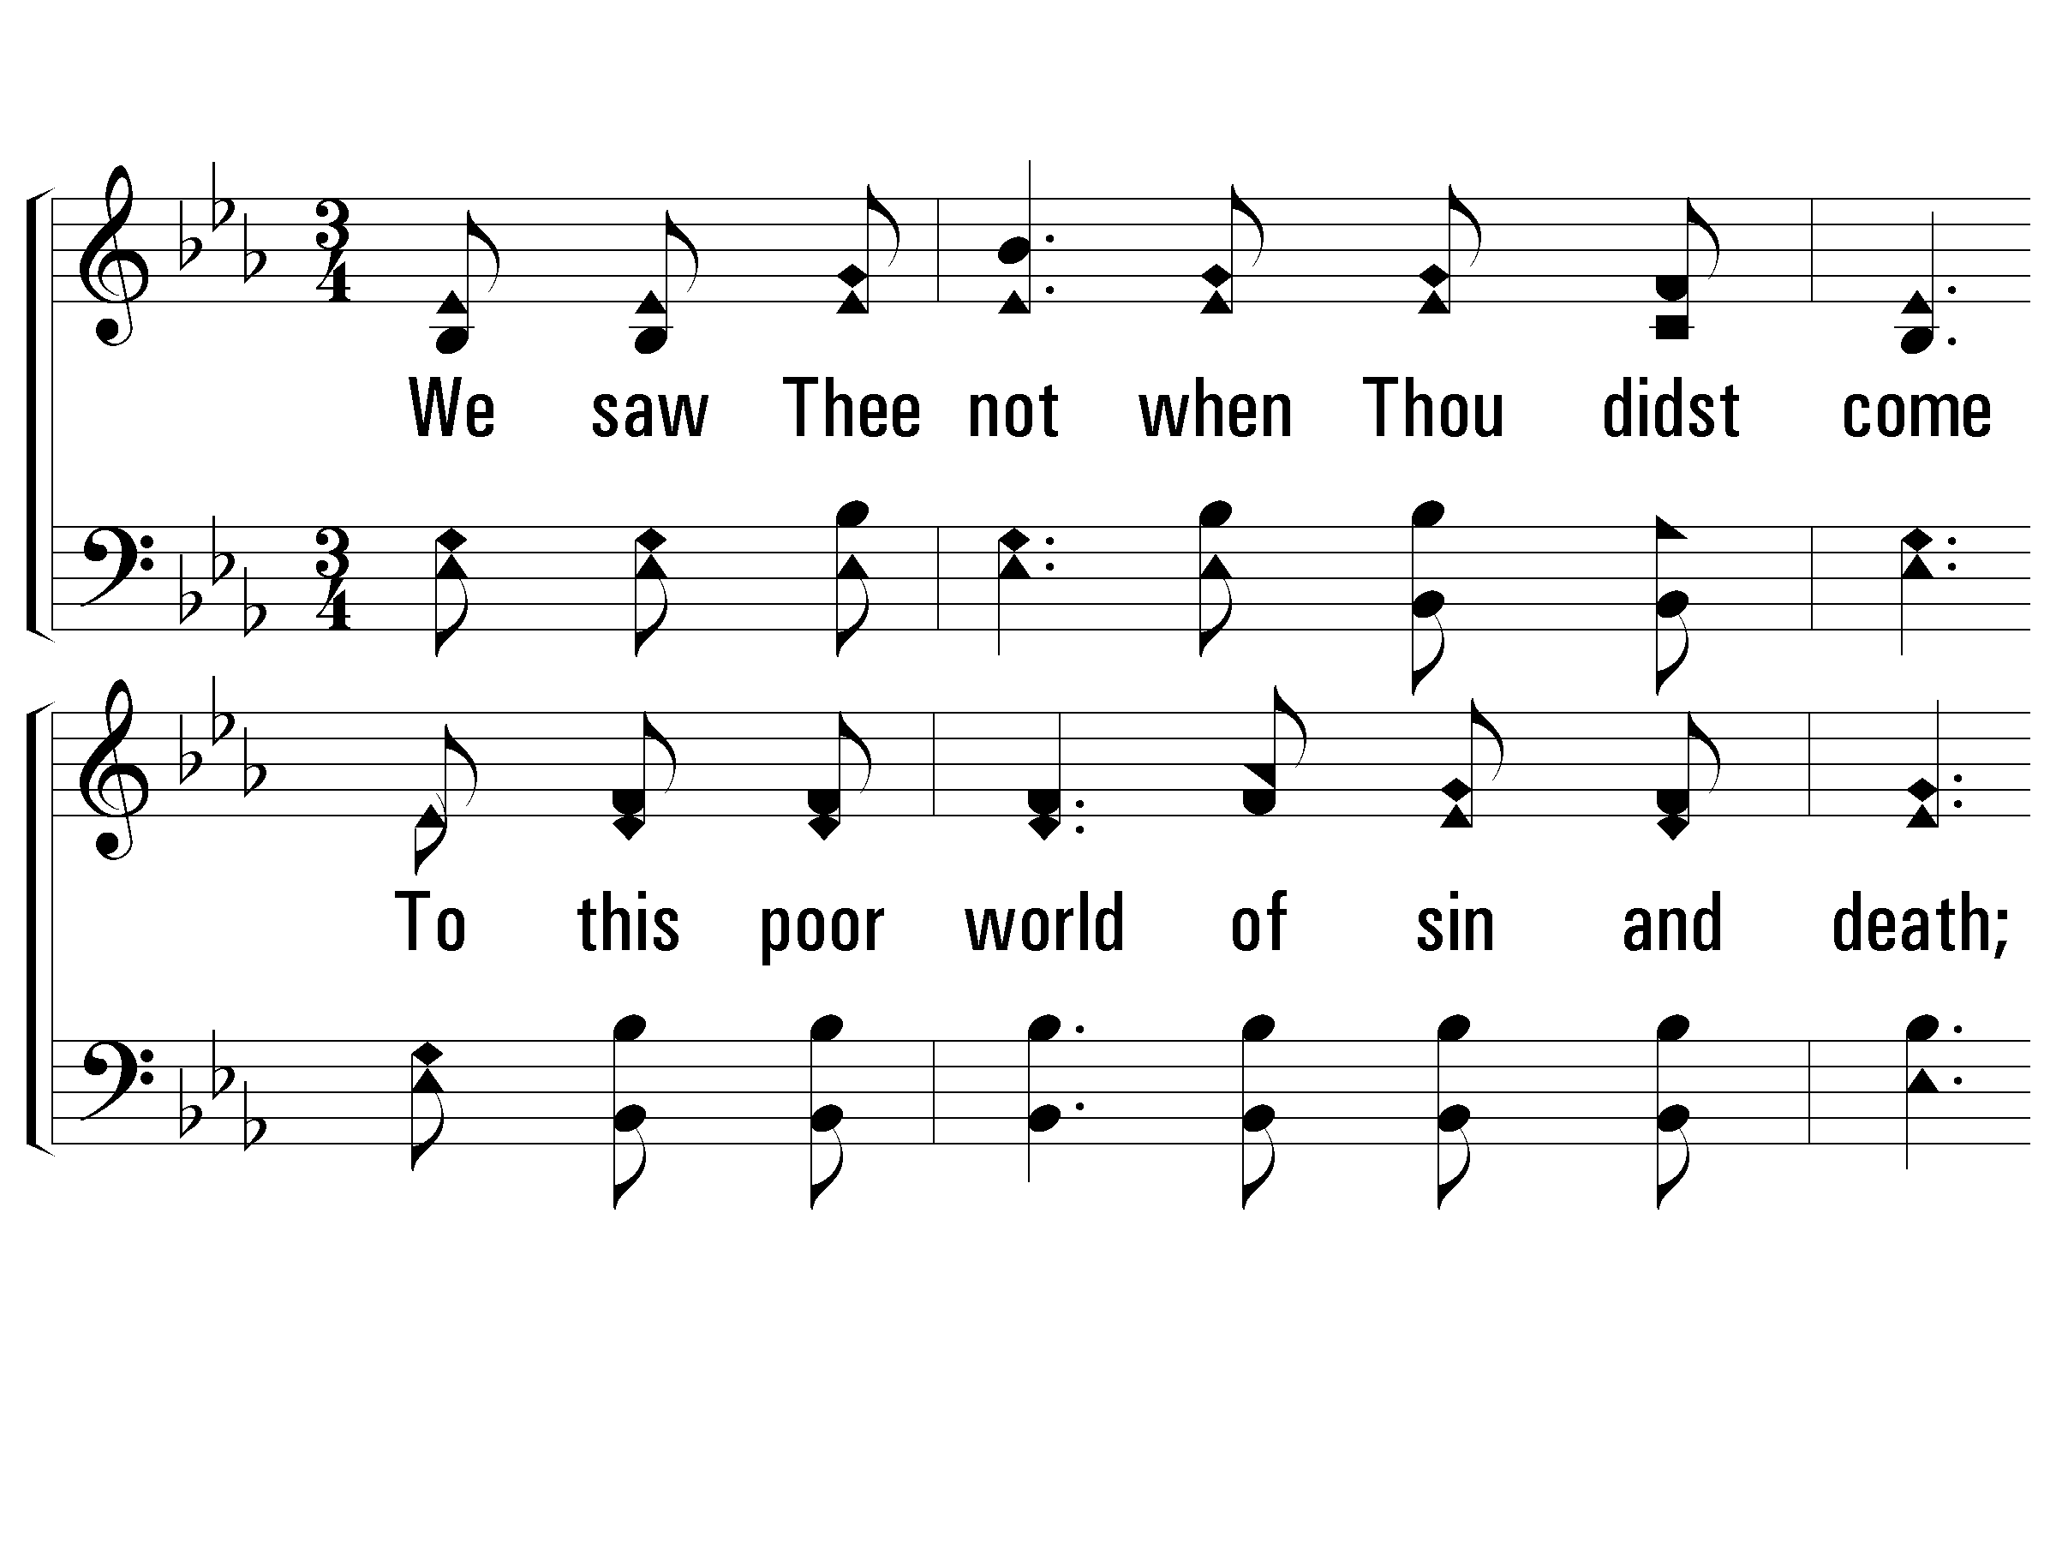
1 – We Saw Thee Not
1.
We saw Thee not when Thou didst come
To this poor world of sin and death;
Nor yet beheld Thy cottage home,
In that despised Nazareth;
But we believe Thy footsteps trod
Its streets and plains, Thou Son of God:
But we believe Thy footsteps trod
Its streets and plains, Thou Son of God.
Words by: Anne Richter
Music by: Knowles Shaw
© 2001 The Paperless Hymnal™

Slide 67
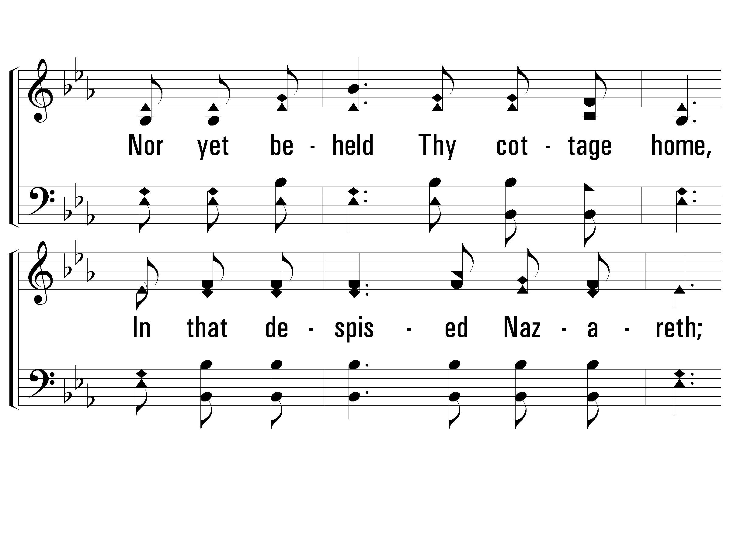
1 – We Saw Thee Not
© 2001 The Paperless Hymnal™

Slide 68
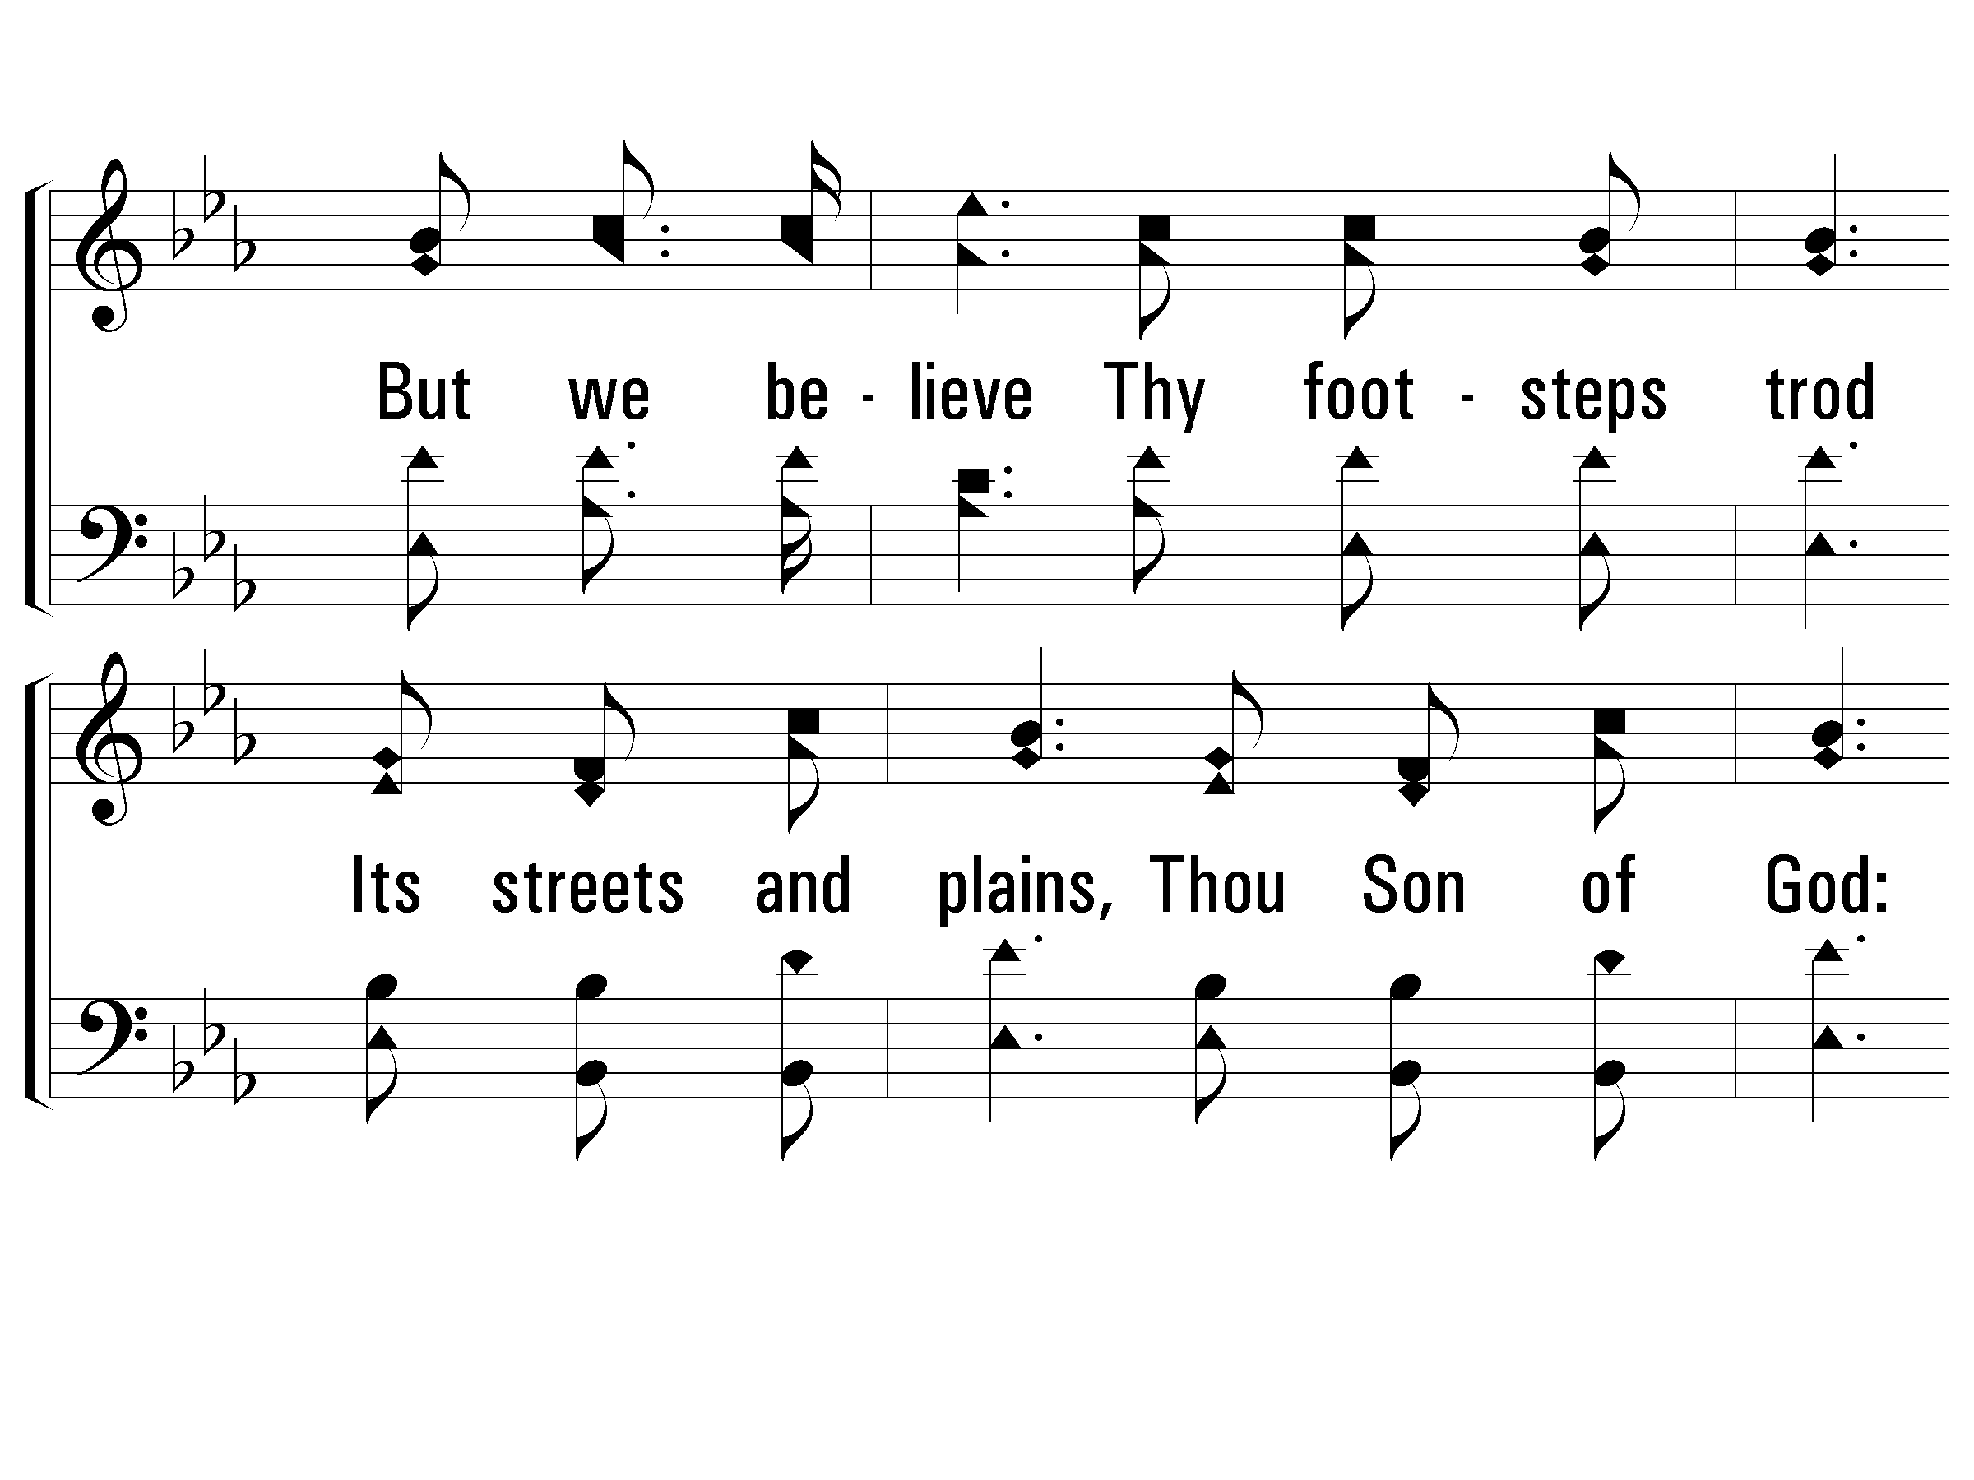
1 – We Saw Thee Not
© 2001 The Paperless Hymnal™

Slide 69
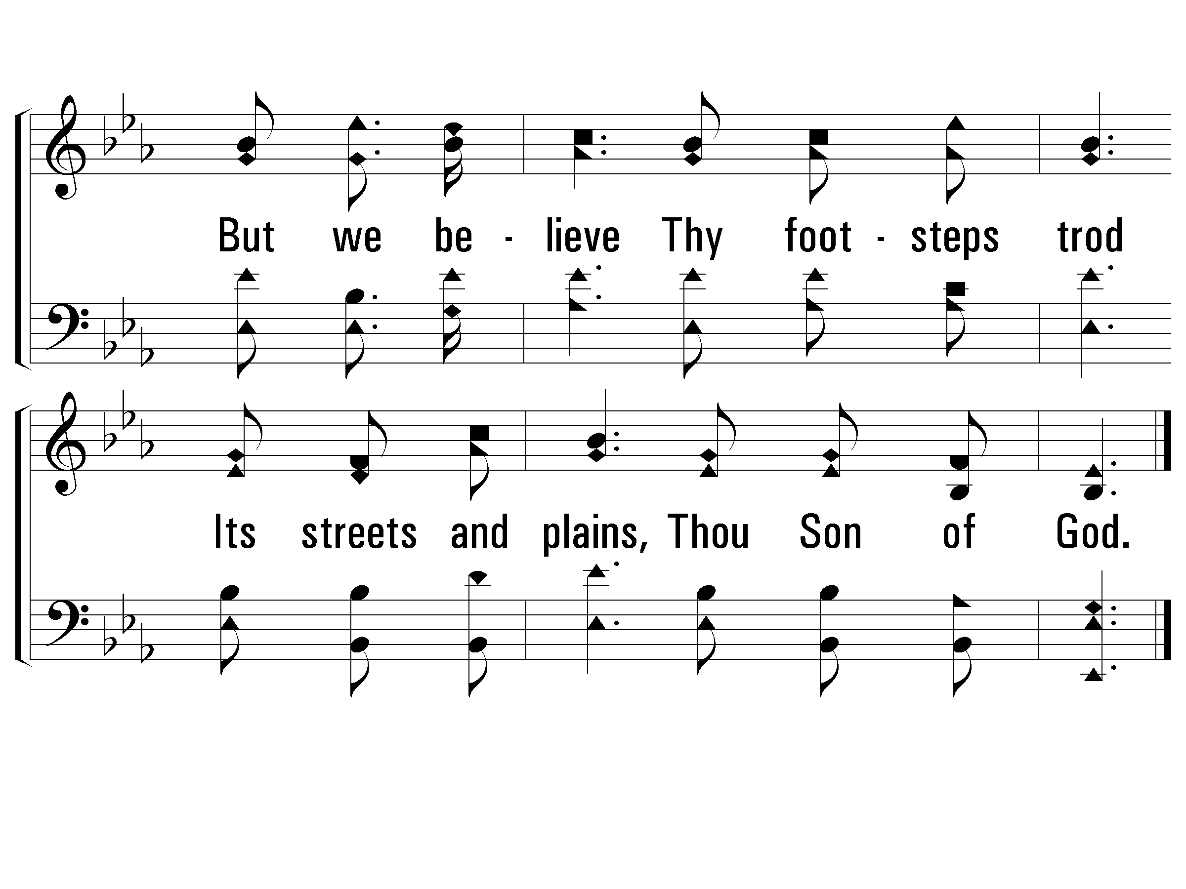
1 – We Saw Thee Not
© 2001 The Paperless Hymnal™

Slide 70
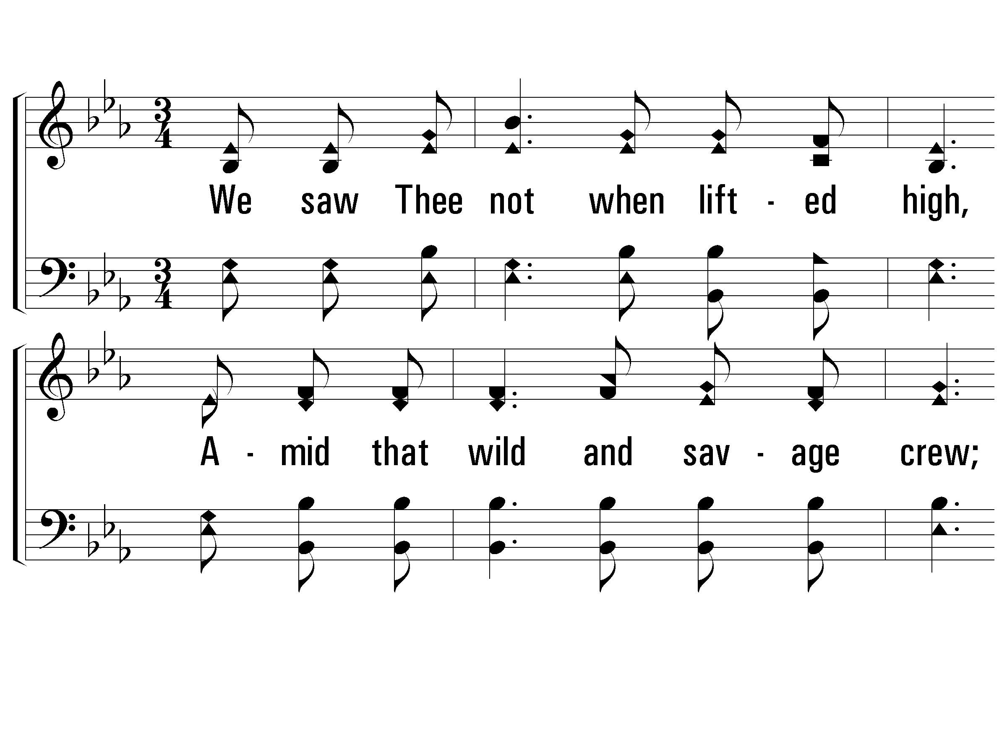
2 – We Saw Thee Not
2.
We saw Thee not when lifted high,
Amid that wild and savage crew;
Nor heard we that imploring cry,
"Forgive, they know not what they do!"
But we believe the deed was done,
That shook the earth and veiled the sun;
But we believe the deed was done,
That shook the earth and veiled the sun.
Words by: Anne Richter
Music by: Knowles Shaw
© 2001 The Paperless Hymnal™

Slide 71
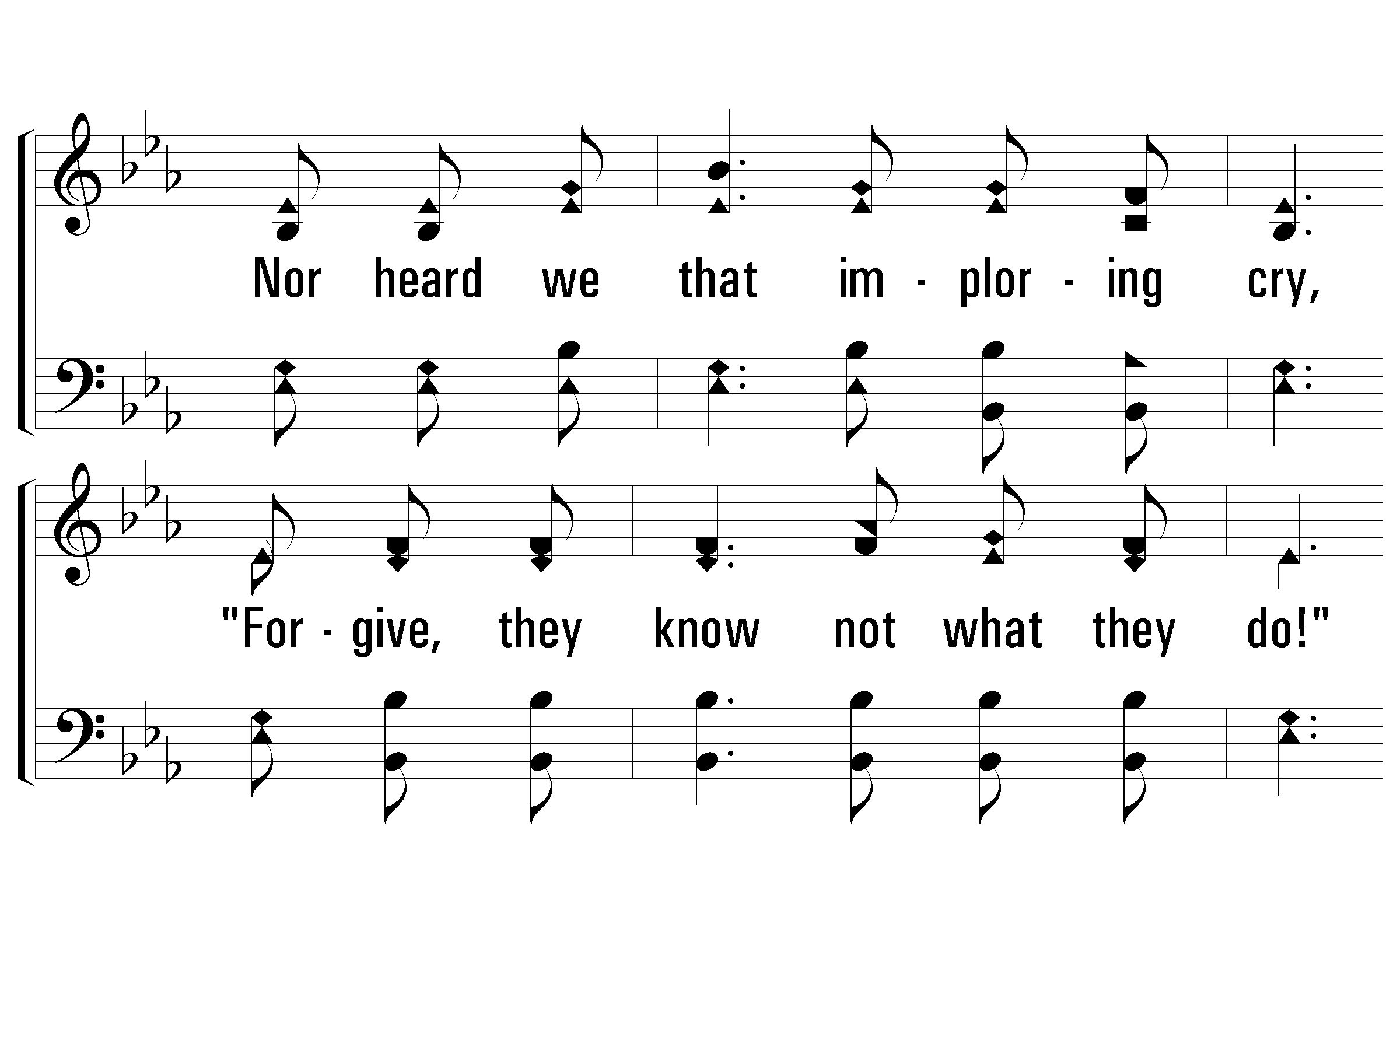
2 – We Saw Thee Not
© 2001 The Paperless Hymnal™

Slide 72
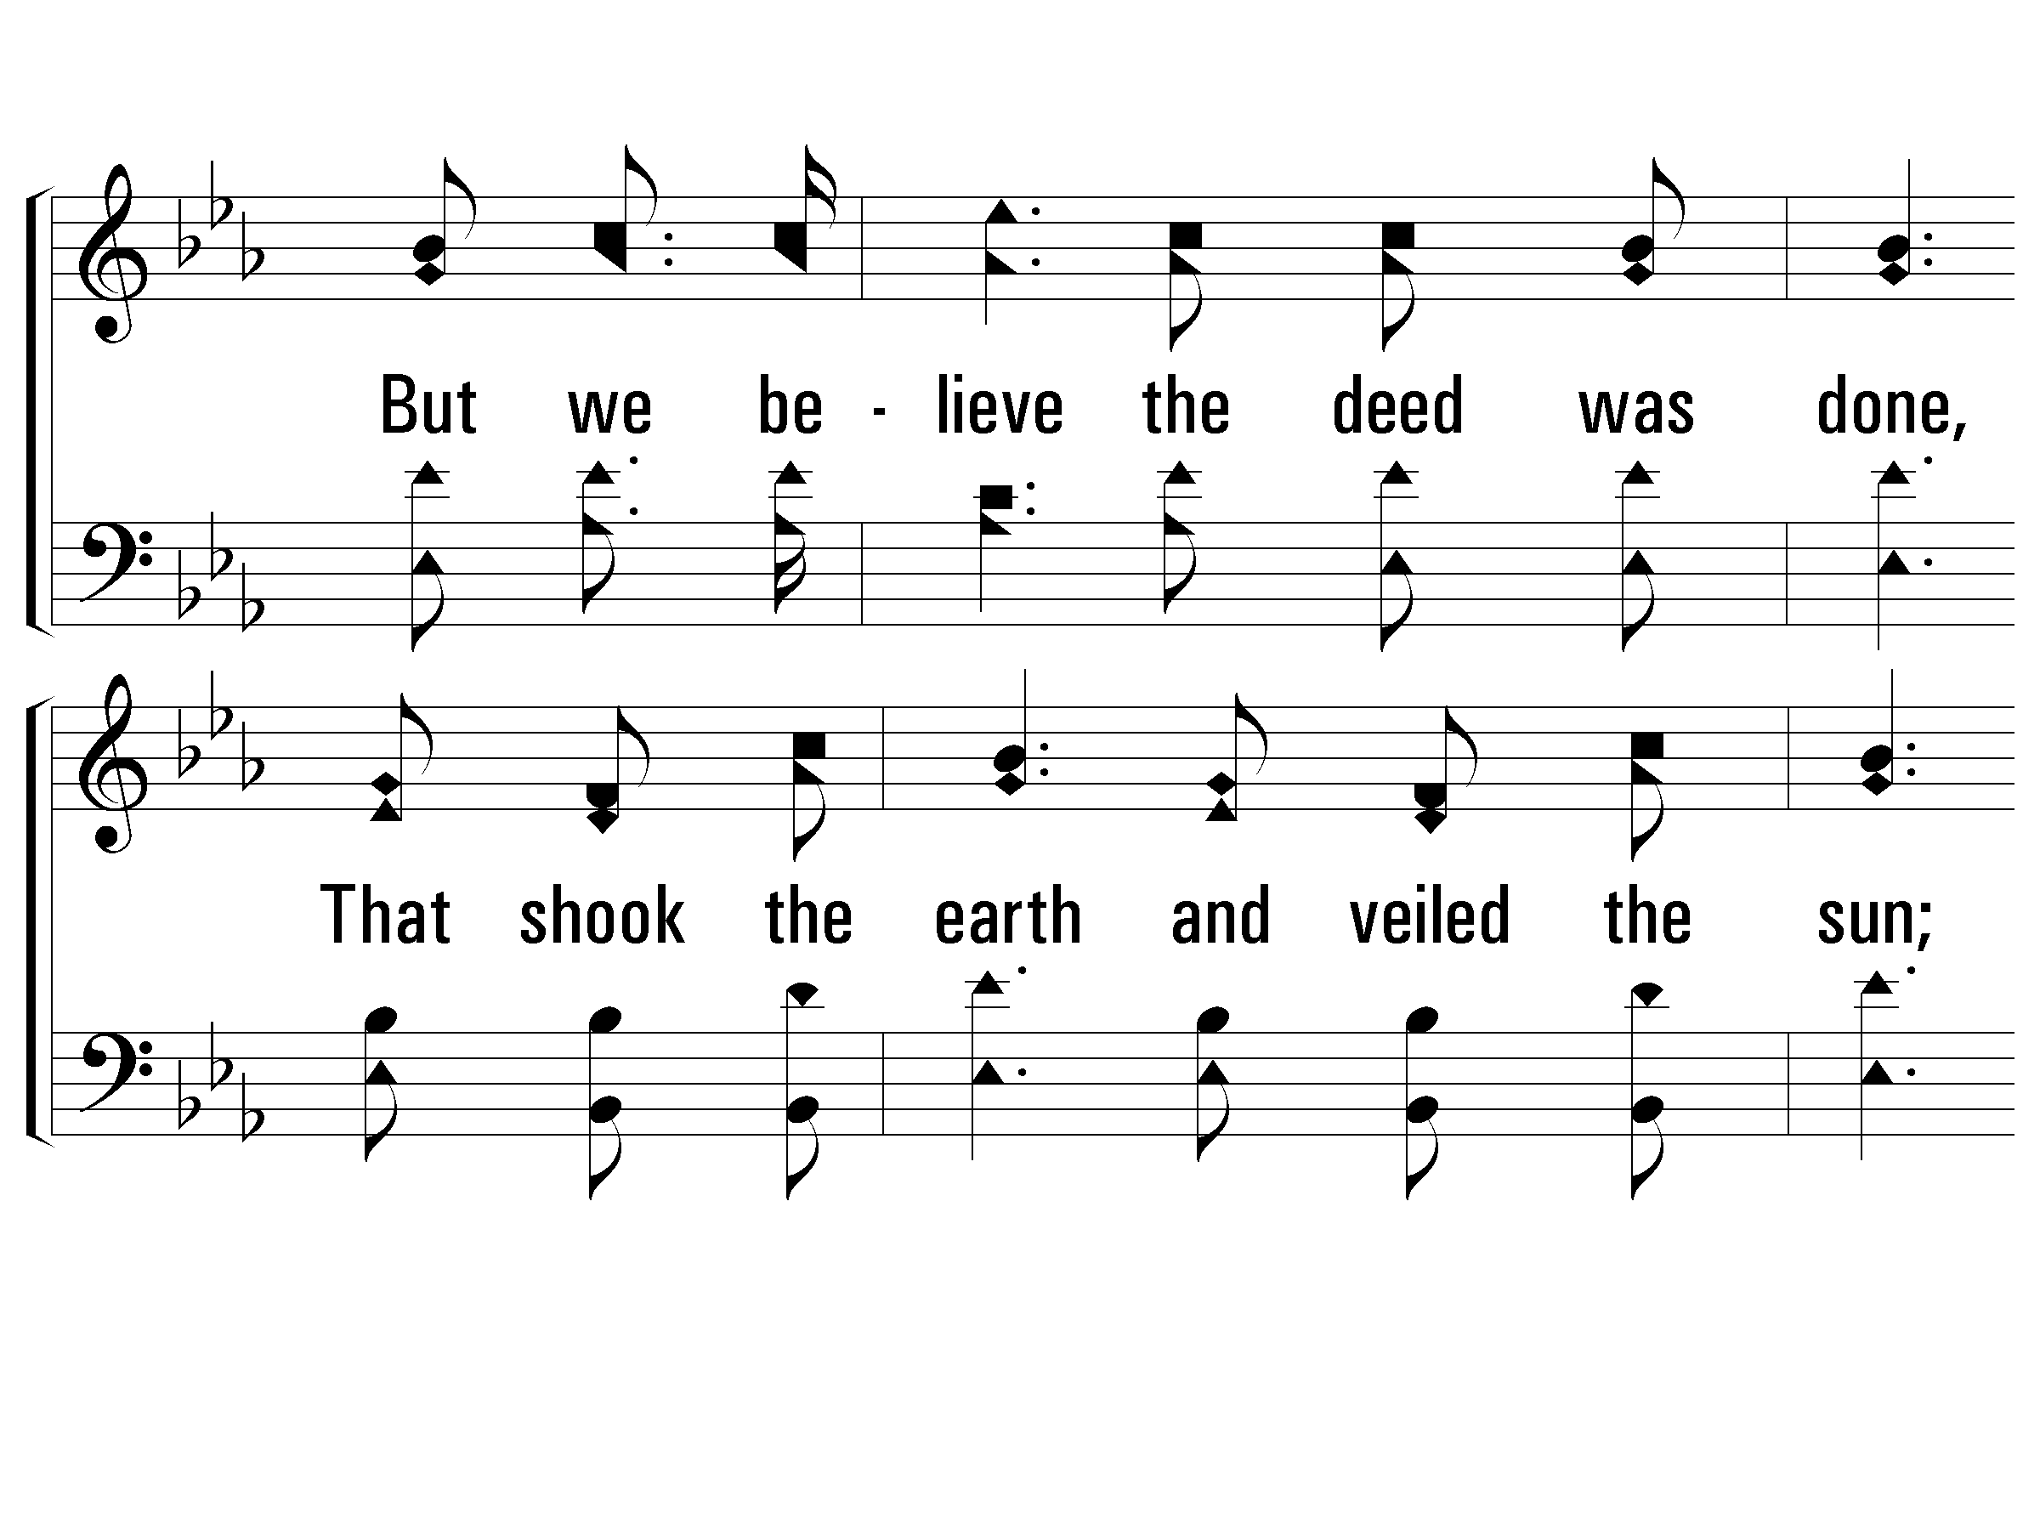
2 – We Saw Thee Not
© 2001 The Paperless Hymnal™

Slide 73
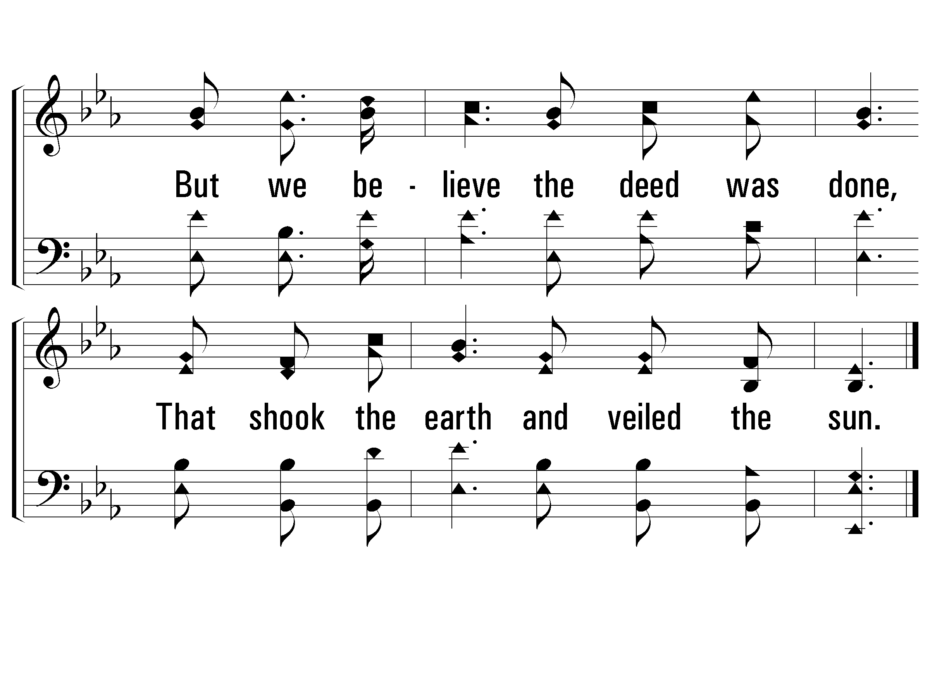
2 – We Saw Thee Not
© 2001 The Paperless Hymnal™

Slide 74
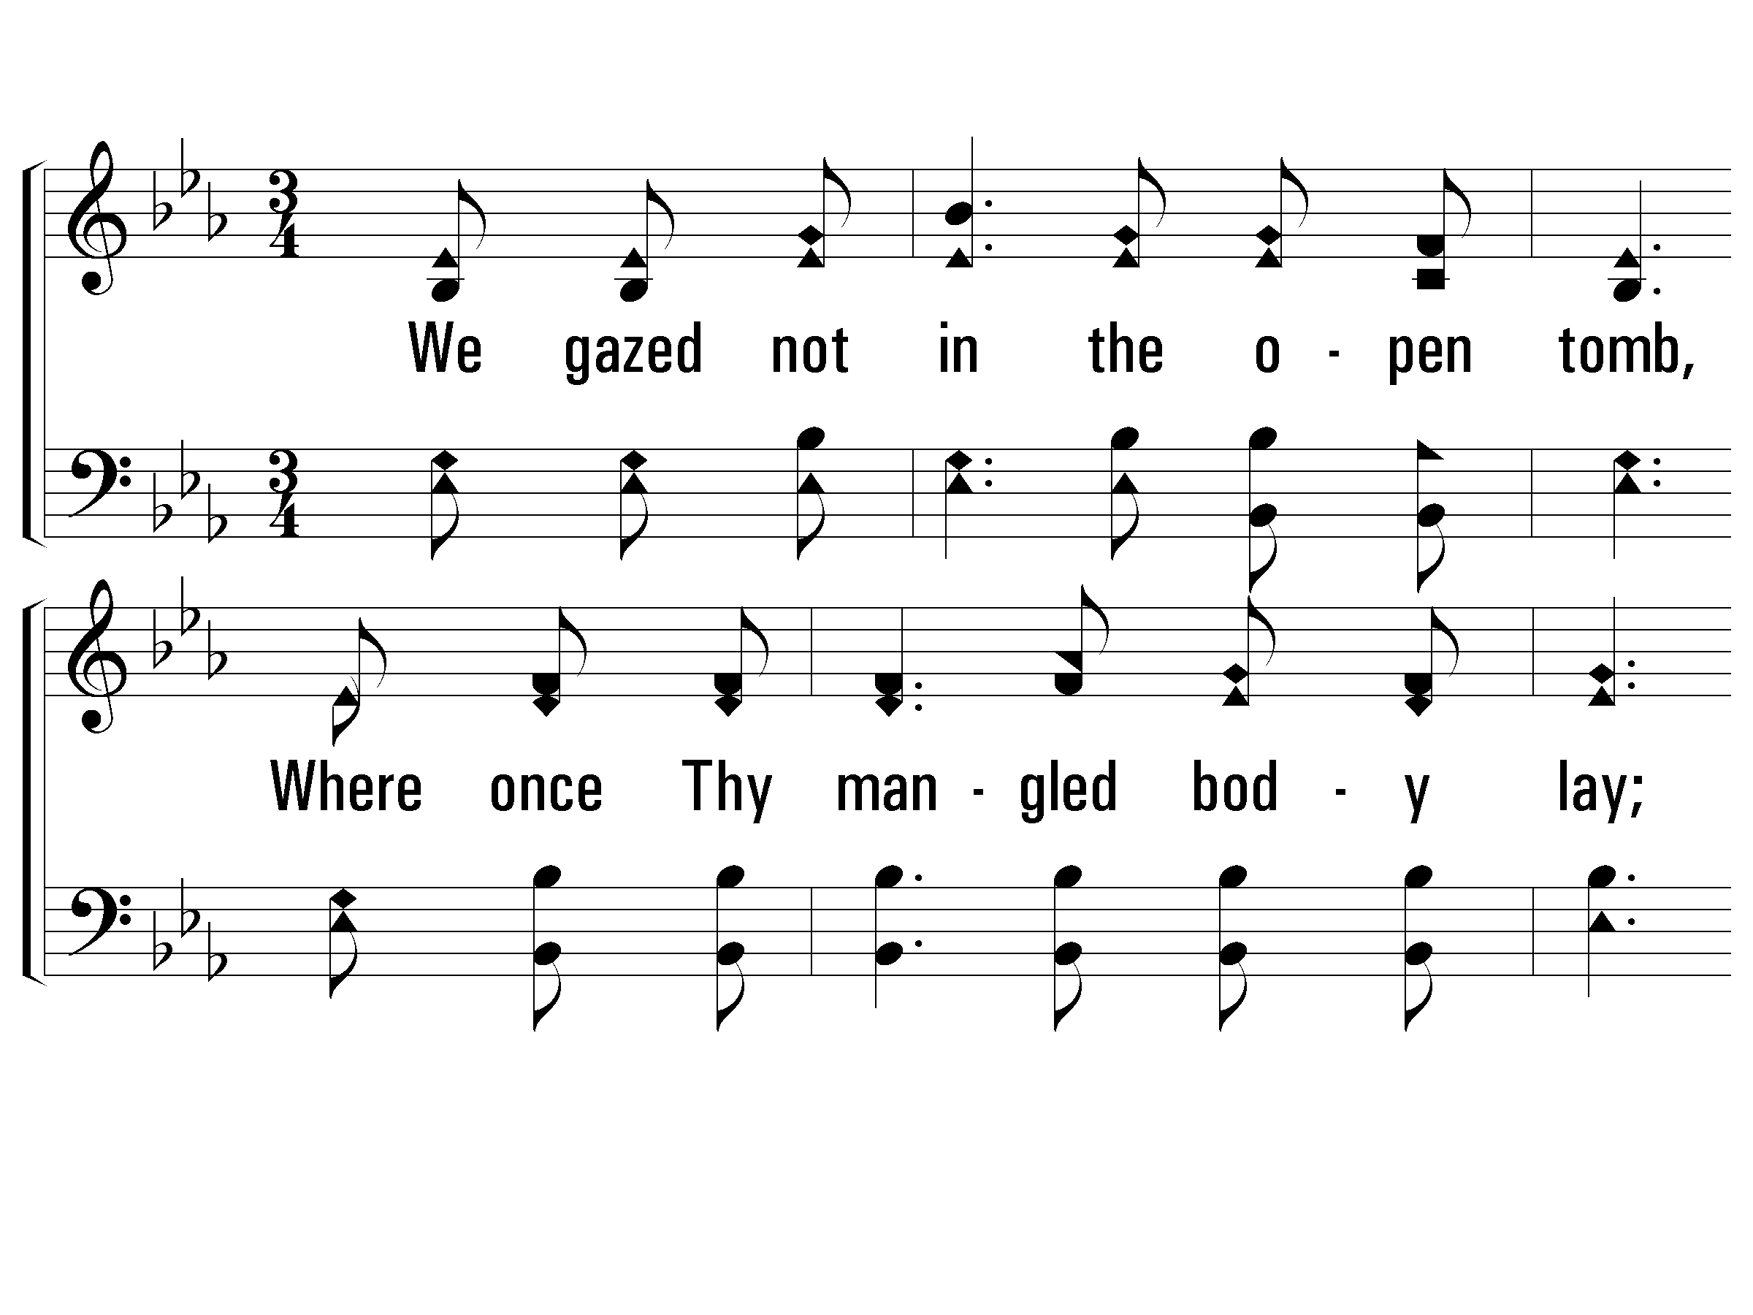
3 – We Saw Thee Not
3.
We gazed not in the open tomb,
Where once Thy mangled body lay;
Nor saw Thee in that "upper room,"
Nor met Thee on the open way;
But we believe that angels said,
"Why seek the living with the dead?"
But we believe that angels said,
"Why seek the living with the dead?"
Words by: Anne Richter
Music by: Knowles Shaw
© 2001 The Paperless Hymnal™

Slide 75
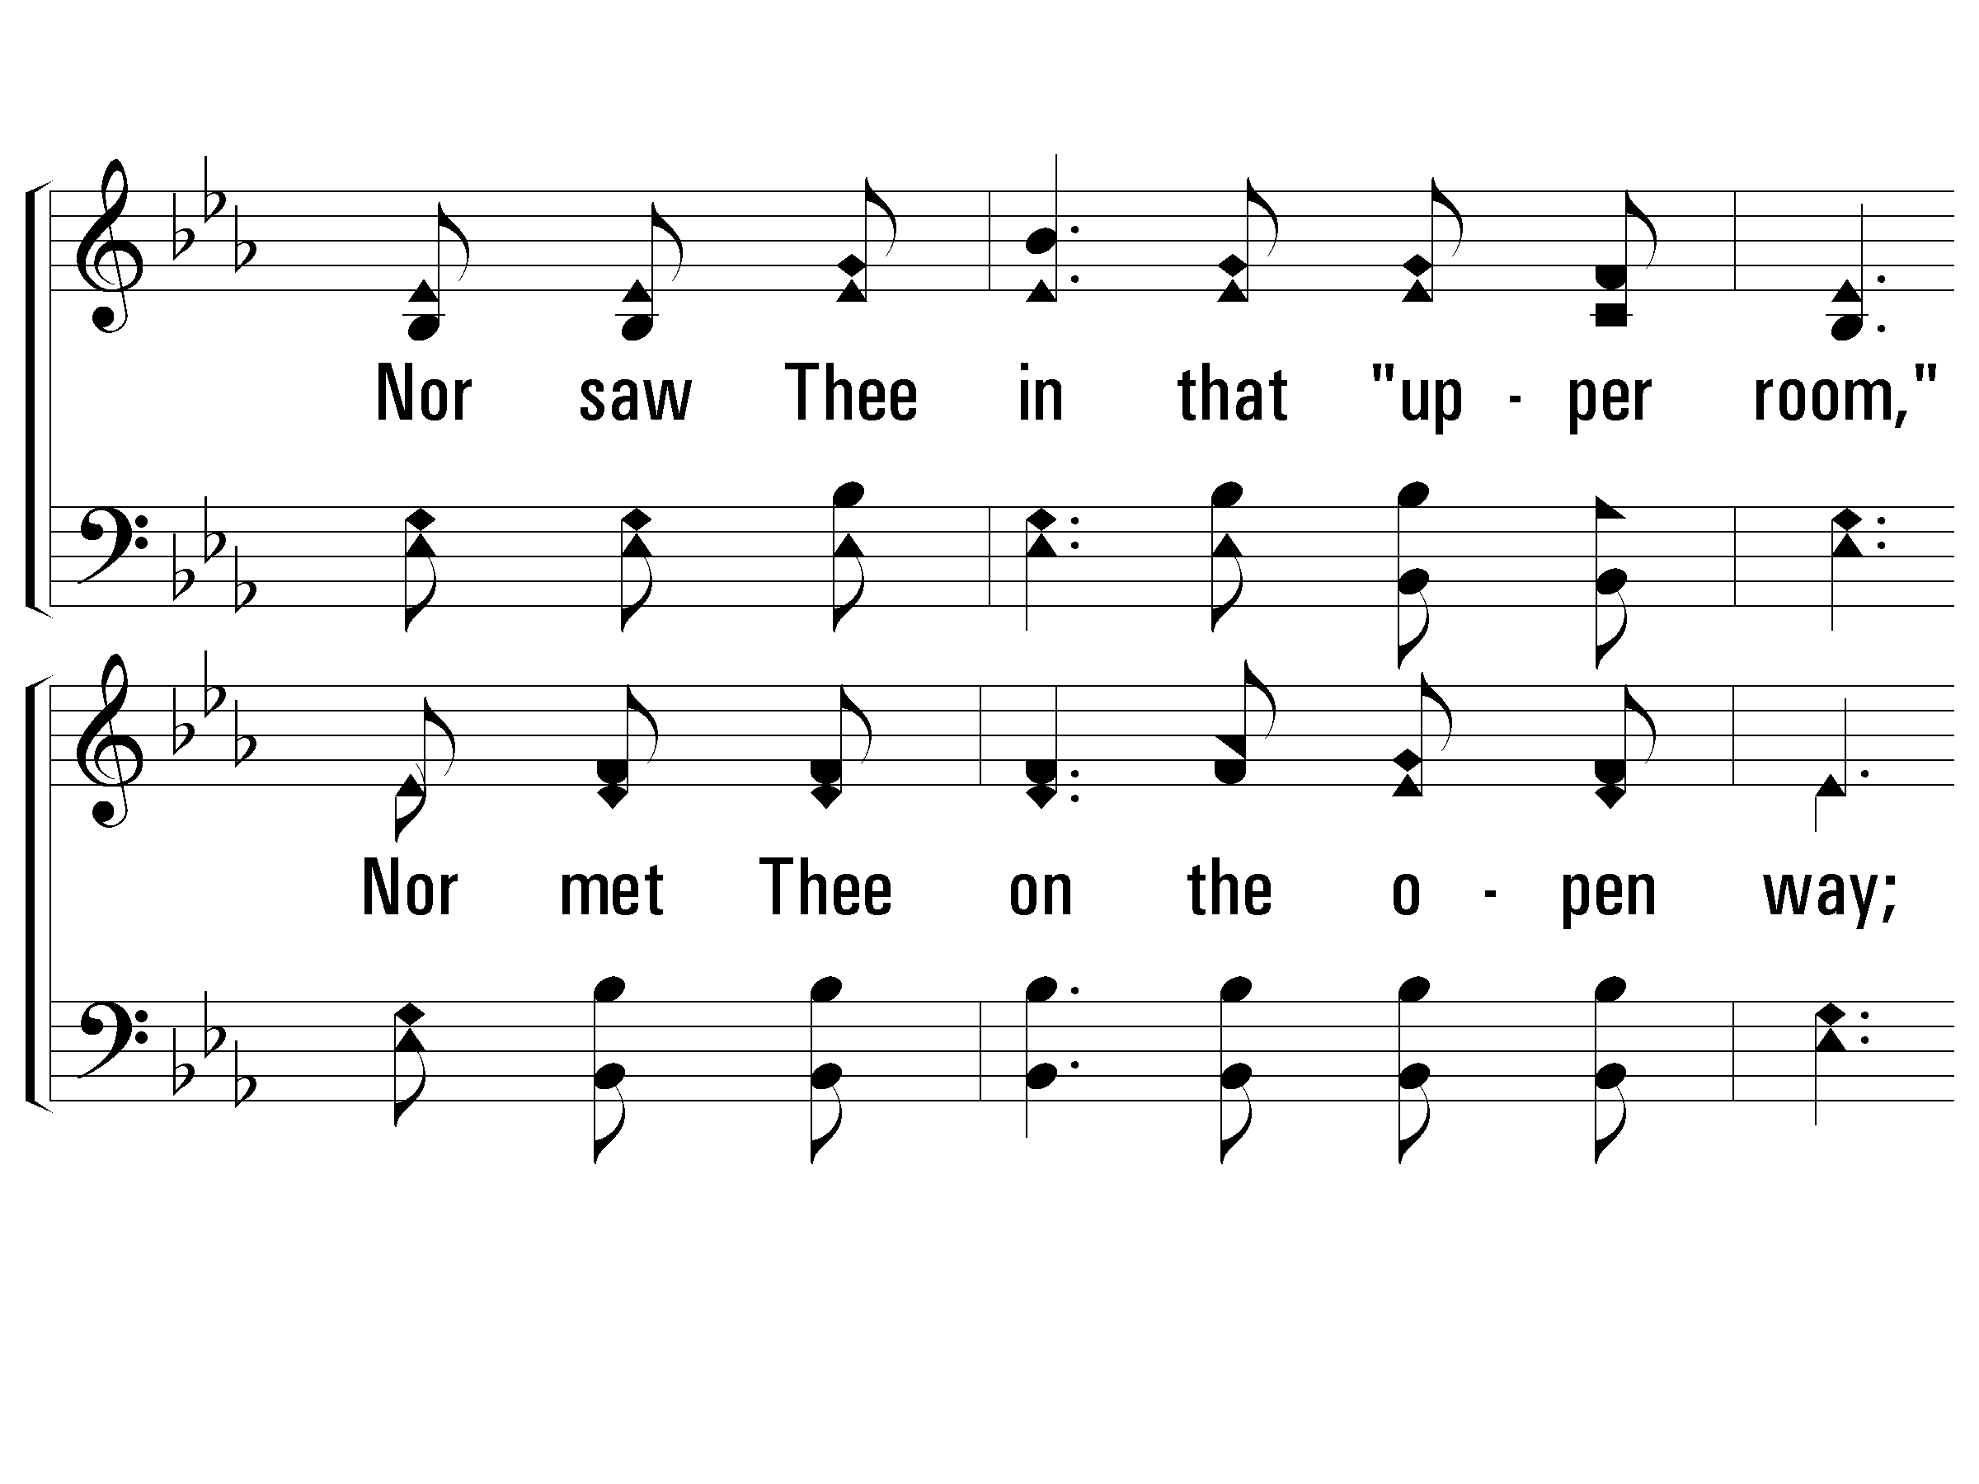
3 – We Saw Thee Not
© 2001 The Paperless Hymnal™

Slide 76
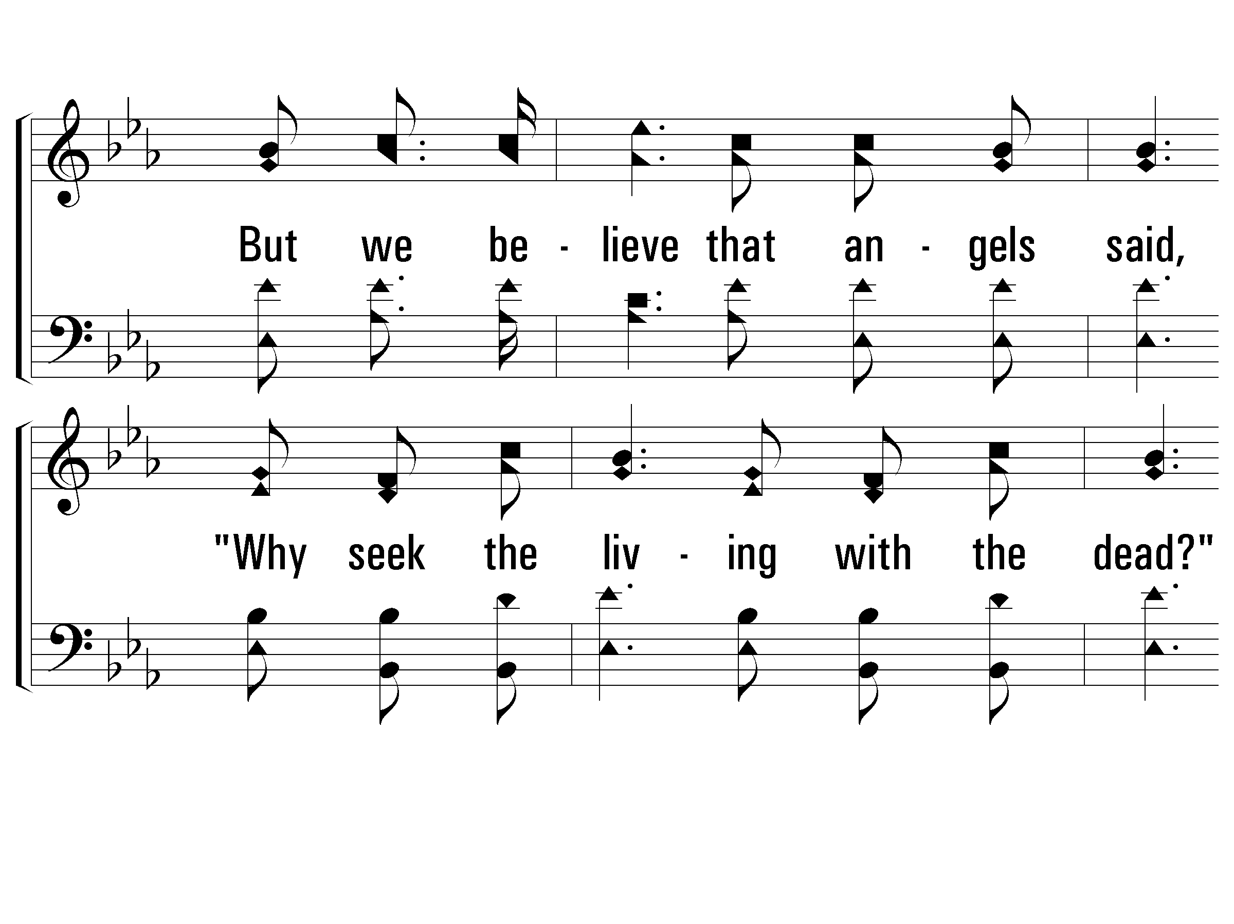
3 – We Saw Thee Not
© 2001 The Paperless Hymnal™

Slide 77
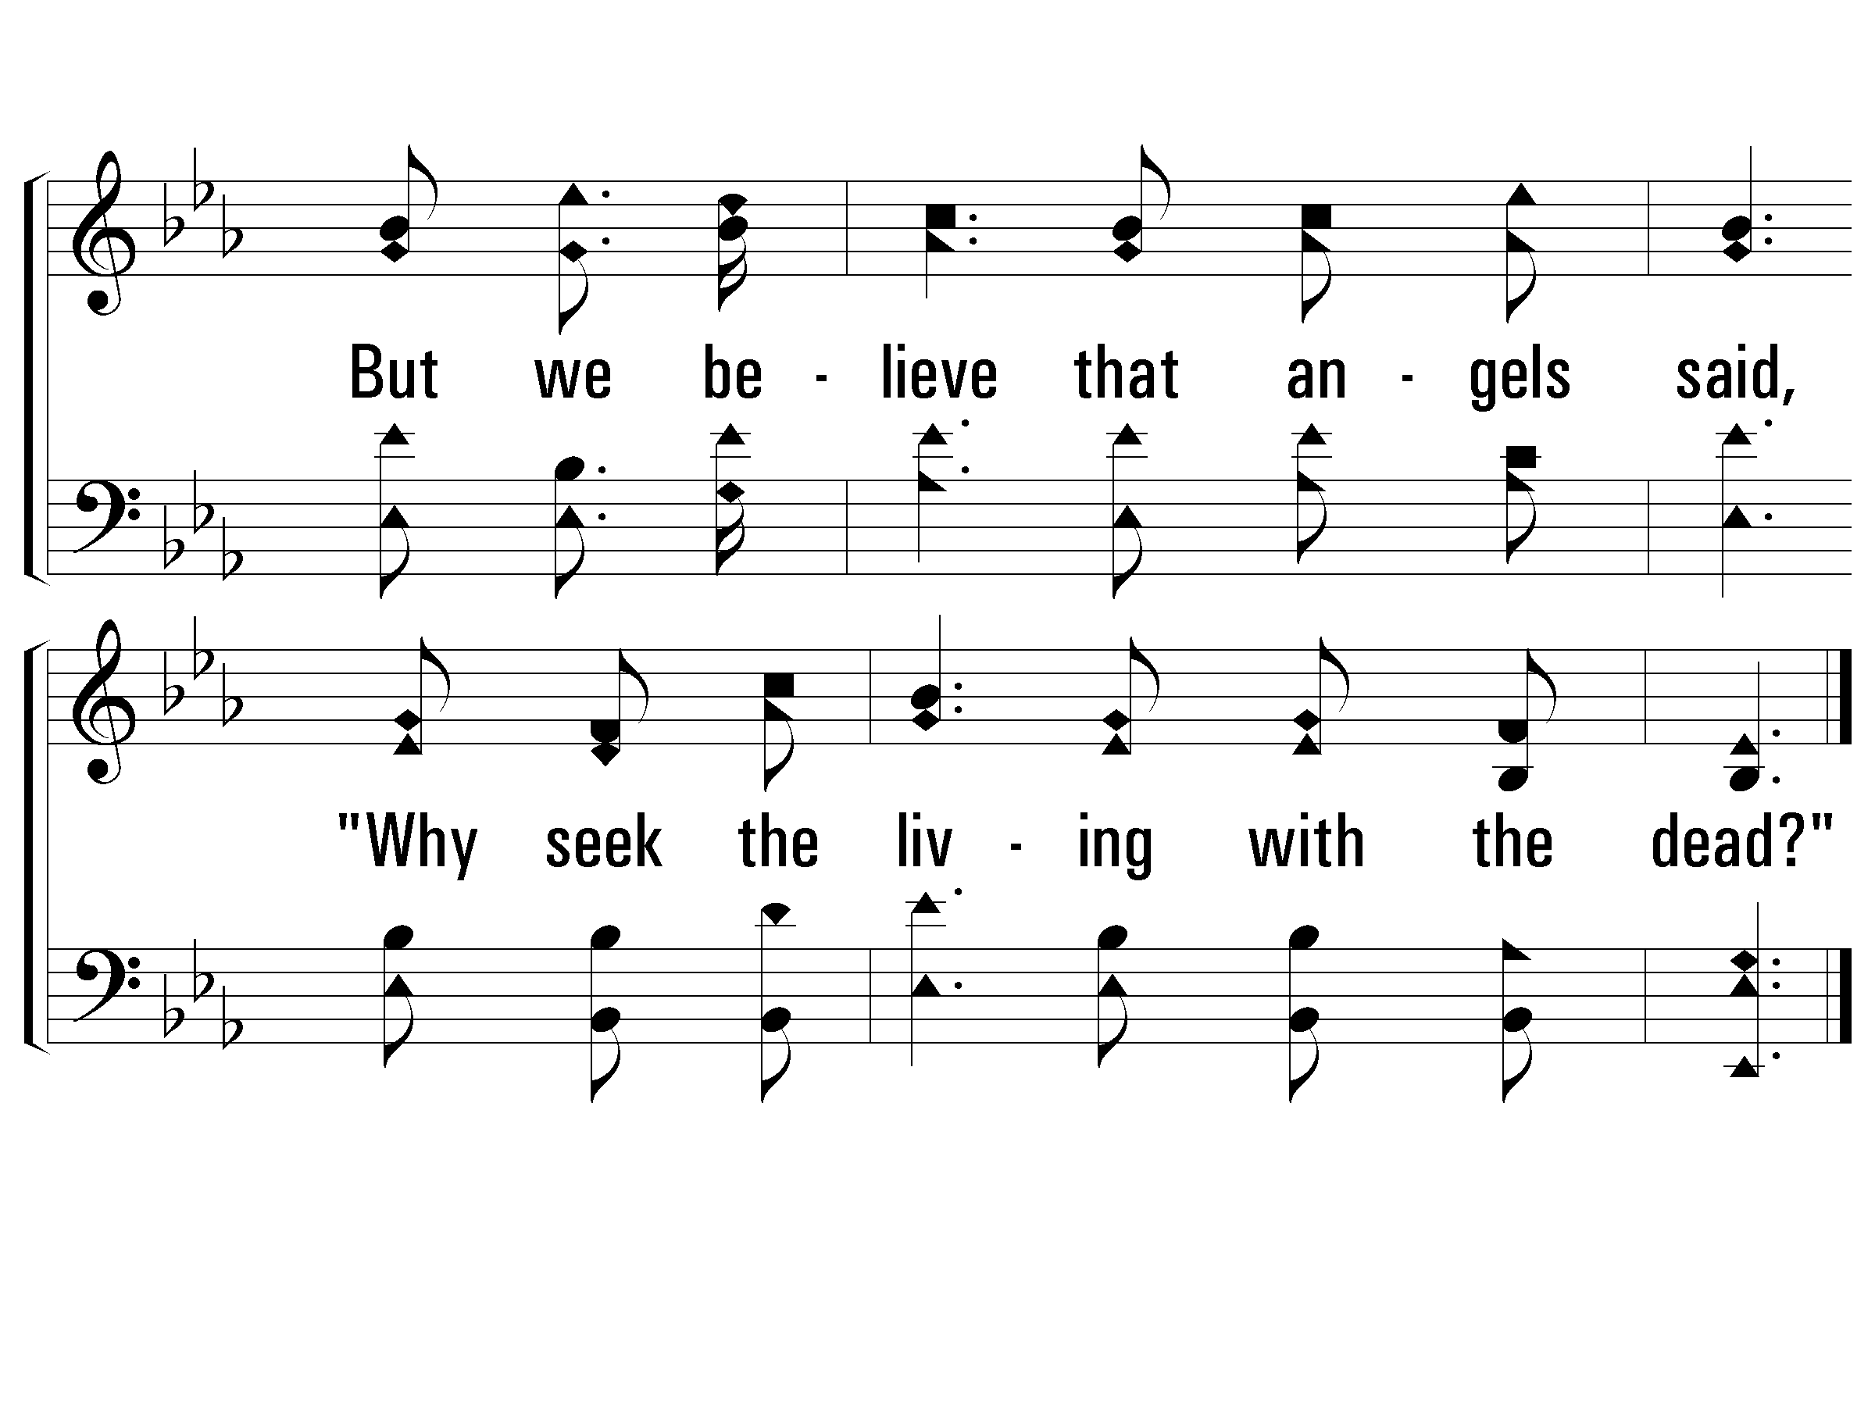
3 – We Saw Thee Not
© 2001 The Paperless Hymnal™

Slide 78
Hallelujah! What a Savior
Page 203
Verses 1, 4 & 5
Will Lovell

Slide 79
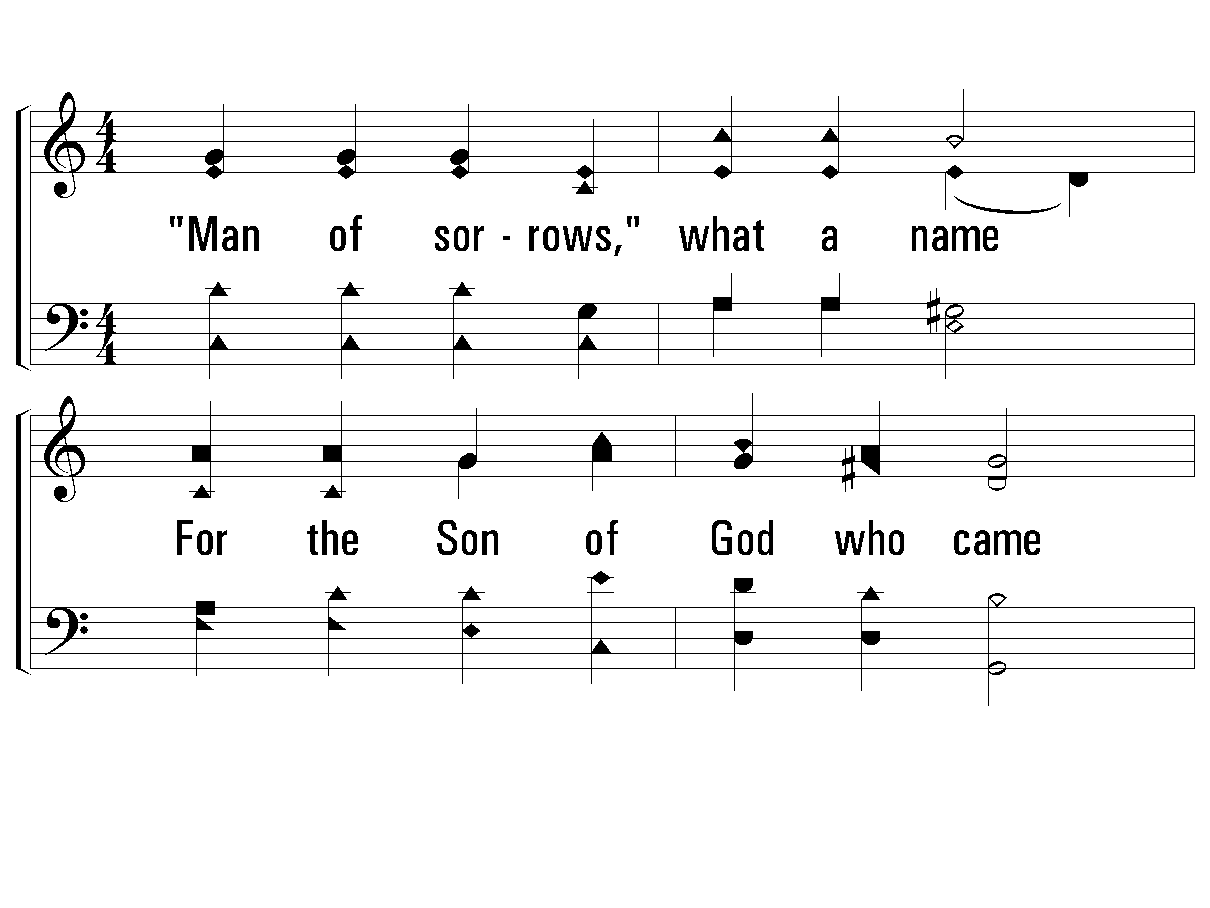
1 - Hallelujah! What a Savior
1.
"Man of sorrows," what a name
For the Son of God who came
Ruined sinners to reclaim!
Hallelujah! What a Savior!
Words & Music: Phillip P. Bliss
© 2001 The Paperless Hymnal™

Slide 80
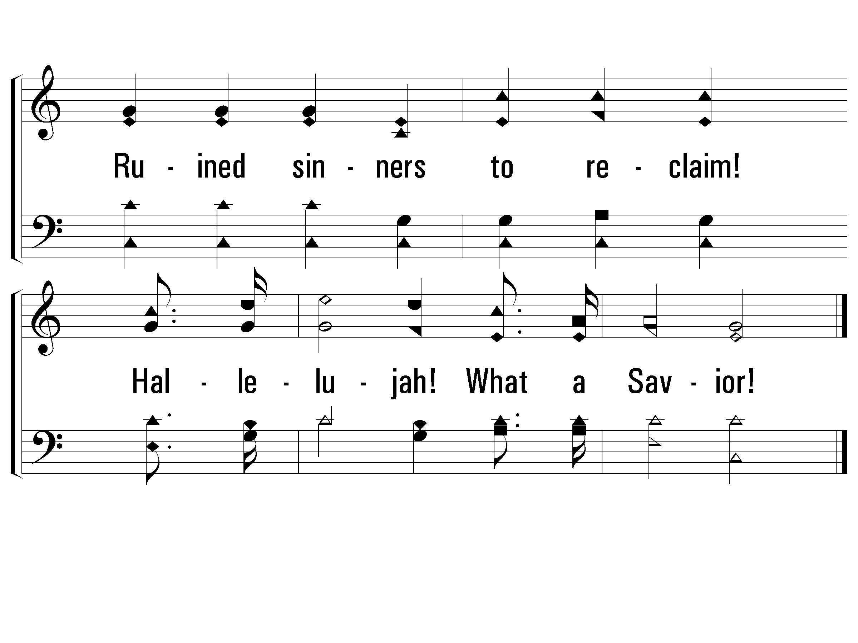
1 - Hallelujah! What a Savior
© 2001 The Paperless Hymnal™

Slide 81
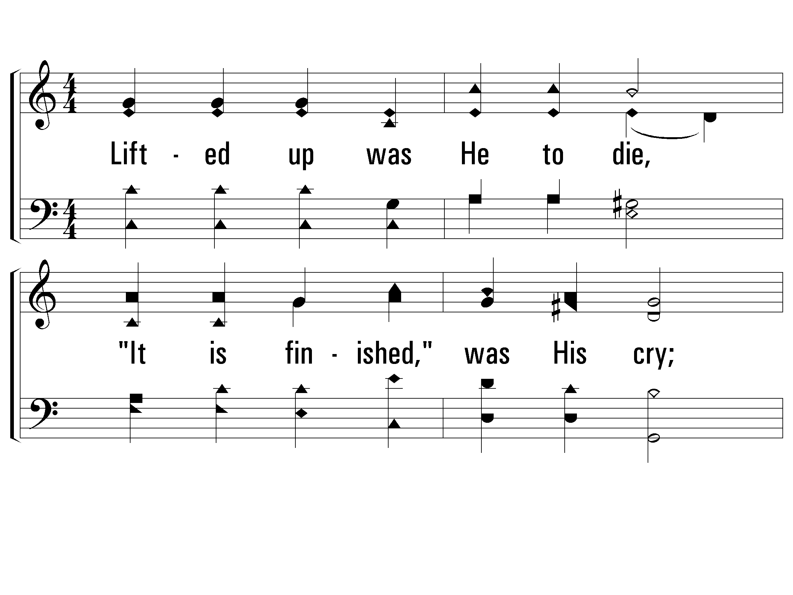
4 - Hallelujah! What a Savior
4.
Lifted up was He to die,
"It is finished," was His cry;
Now in heaven exalted high,
Hallelujah! What a Savior!
Words & Music: Phillip P. Bliss
© 2001 The Paperless Hymnal™

Slide 82
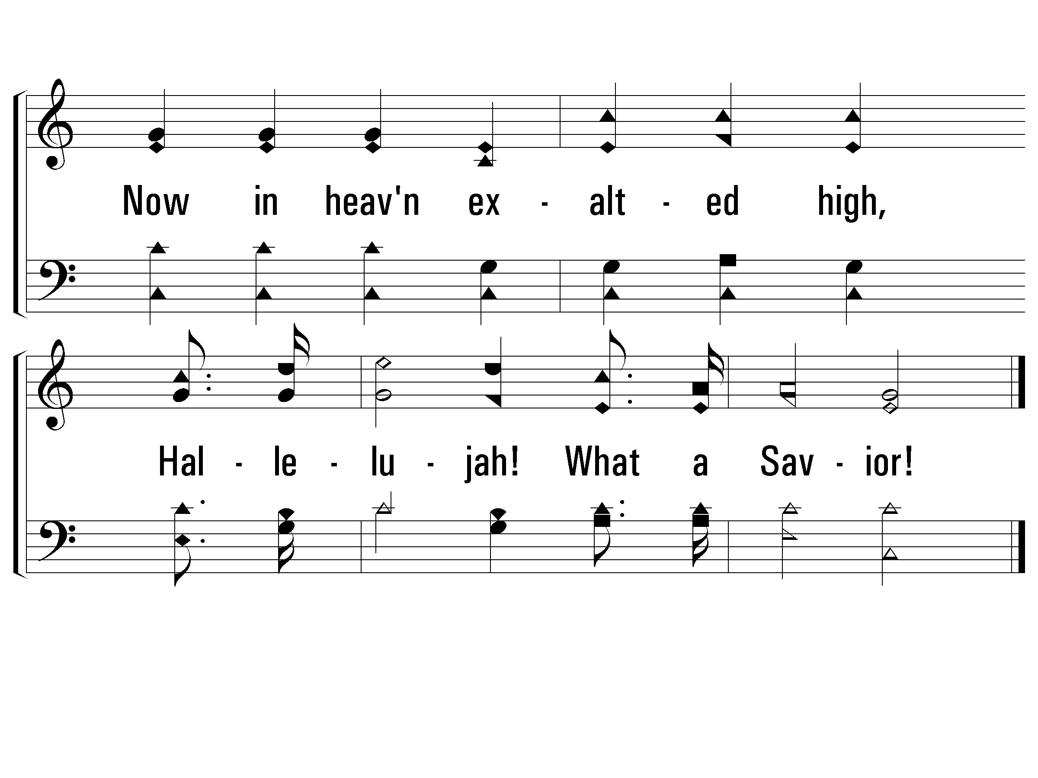
4 - Hallelujah! What a Savior
© 2001 The Paperless Hymnal™

Slide 83
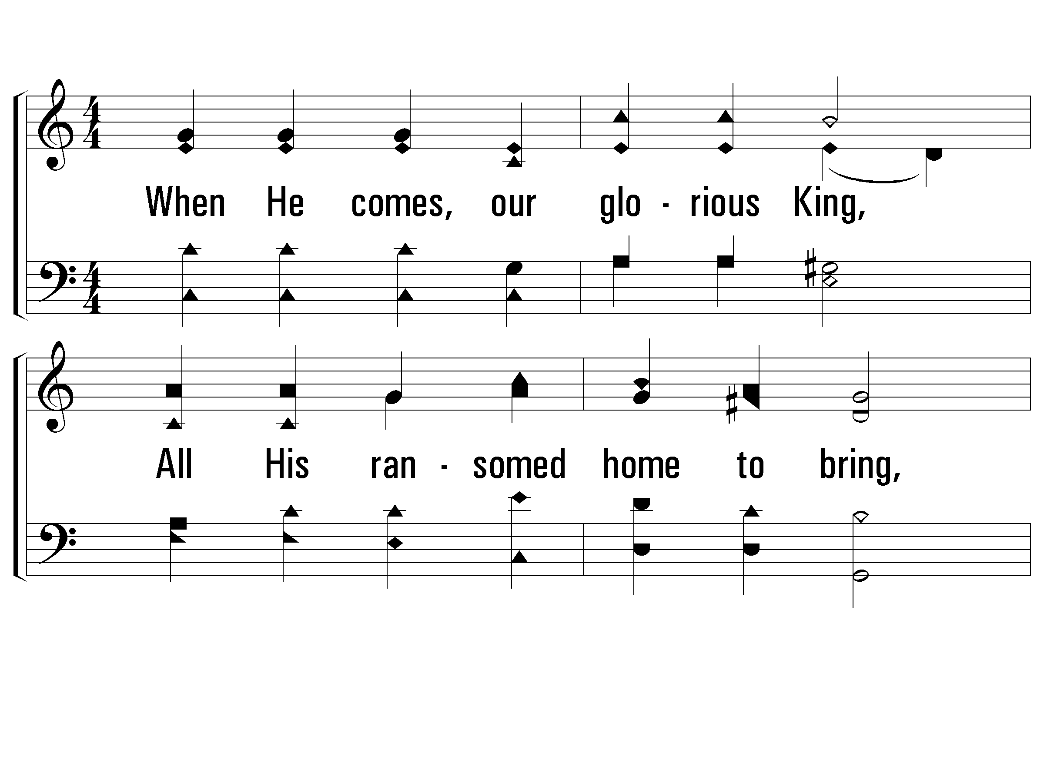
5 - Hallelujah! What a Savior
5.
When He comes, our glorious King,
All His ransomed home to bring,
Then anew this song we'll sing,
Hallelujah! What a Savior!
Words & Music: Phillip P. Bliss
© 2001 The Paperless Hymnal™

Slide 84

5 - Hallelujah! What a Savior
© 2001 The Paperless Hymnal™

Slide 85
He is Risen!
Mark 16:6 (NKJV)
6 But he said to them, “Do not be alarmed. You seek Jesus of Nazareth, who was crucified. He is risen! He is not here. See the place where they laid Him.

Slide 86
Mark 16:14-16 (NKJV)
14 Later He appeared to the eleven as they sat at the table; and He rebuked their unbelief and hardness of heart, because they did not believe those who had seen Him after He had risen. 15 And He said to them, “Go into all the world and preach the gospel to every creature. 16 He who believes and is baptized will be saved; but he who does not believe will be condemned.

Slide 87
Galatians 3:27 (NKJV)
27 For as many of you as were baptized into Christ have put on Christ.
2 Corinthians 13:5 (NKJV)
5 Examine yourselves as to whether you are in the faith. Test yourselves. Do you not know yourselves, that Jesus Christ is in you?—unless indeed you are disqualified.

Slide 88
Do You Know My Jesus
Page 125
All 3 verses

Slide 89

1 - Do You Know My Jesus
1.
Have you a heart that's weary,
Tending a load of care:
Are you a soul that's seeking
Rest from the bur-den you bear?
Words and Music by: William F. Laker and V. B. Ellis
Copyright © 1957 by Lillenas Publishing Company (Administered by The Copyright Company Nashville, TN)
All Rights Reserved. International Copyright Secured. Used By Permission.
© 2001 The Paperless Hymnal™

Slide 90

1 - Do You Know My Jesus
© 2001 The Paperless Hymnal™

Slide 91

c - Do You Know My Jesus
Do you know my Jesus,
Do you know my friend?
Have you heard He loves you,
And that He will abide 'till the end?
© 2001 The Paperless Hymnal™

Slide 92

c - Do You Know My Jesus
© 2001 The Paperless Hymnal™

Slide 93

2 - Do You Know My Jesus
2.
Where is you heart, O pilgrim,
What does your light reveal;
Who hears your call for comfort
When naught but sorrow you feel?
Words and Music by: William F. Laker and V. B. Ellis
Copyright © 1957 by Lillenas Publishing Company (Administered by The Copyright Company Nashville, TN)
All Rights Reserved. International Copyright Secured. Used By Permission.
© 2001 The Paperless Hymnal™

Slide 94

2 - Do You Know My Jesus
© 2001 The Paperless Hymnal™

Slide 95
c - Do You Know My Jesus
Do you know my Jesus,
Do you know my friend?
Have you heard He loves you,
And that He will abide 'till the end?
© 2001 The Paperless Hymnal™

Slide 96
c - Do You Know My Jesus
© 2001 The Paperless Hymnal™

Slide 97

3 - Do You Know My Jesus
3.
Who knows your disappointments,
Who hears each time you cry;
Who understands your heartaches,
Who dries the tears from your eyes?
Words and Music by: William F. Laker and V. B. Ellis
Copyright © 1957 by Lillenas Publishing Company (Administered by The Copyright Company Nashville, TN)
All Rights Reserved. International Copyright Secured. Used By Permission.
© 2001 The Paperless Hymnal™

Slide 98

3 - Do You Know My Jesus
© 2001 The Paperless Hymnal™

Slide 99
c - Do You Know My Jesus
Do you know my Jesus,
Do you know my friend?
Have you heard He loves you,
And that He will abide 'till the end?
© 2001 The Paperless Hymnal™

Slide 100
c - Do You Know My Jesus
© 2001 The Paperless Hymnal™

Slide 102
Take The Name Of Jesus With You
Page 611
1st verse only

Slide 103

1 – Take The Name Of Jesus With You
1.
Take the name of Jesus with you,
Child of sorrow and of woe;
It will joy and comfort give you:
Take it then where’er you go.
Words: Lydia Baxter
Music: William H. Doane
© 2003 The Paperless Hymnal™

Slide 104

1 – Take The Name Of Jesus With You
© 2003 The Paperless Hymnal™

Slide 105

c – Take The Name Of Jesus With You
Precious name,
O how sweet!
Hope of earth and joy of heaven;
Precious name,
O how sweet!
Hope of earth and joy of heaven.
© 2003 The Paperless Hymnal™

Slide 106

c – Take The Name Of Jesus With You
© 2003 The Paperless Hymnal™

