Slide 1

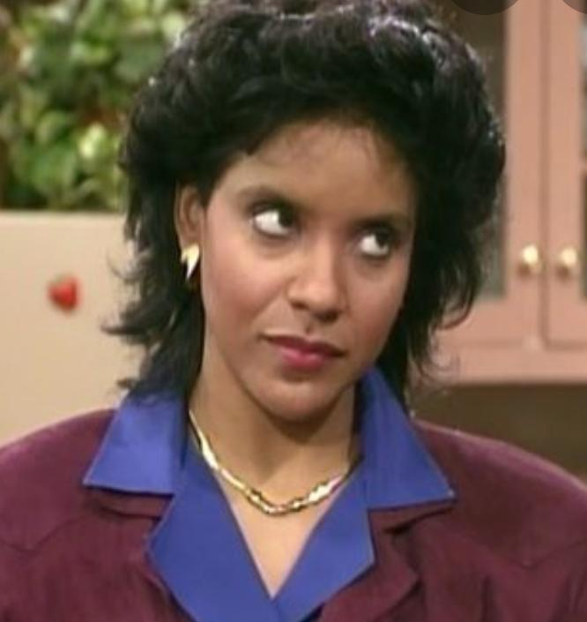
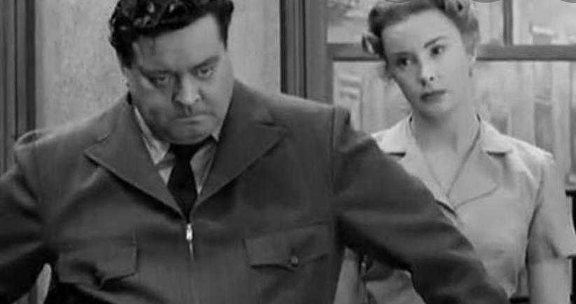

Slide 2
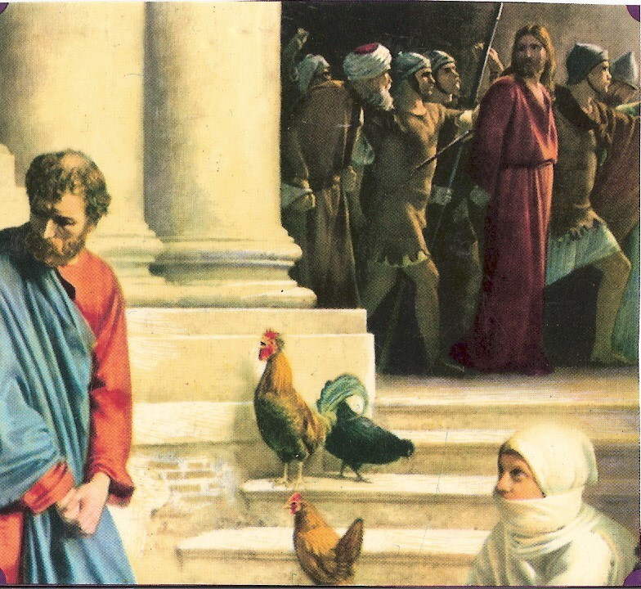
The Look

Slide 3
Missing services
Hebrews 10:24-25
Colossians 3:16
  ¹⁶ Let the word of Christ richly dwell within you, with all wisdom teaching and admonishing one another with psalms and hymns and spiritual songs, singing with thankfulness in your hearts to God.
Matthew 18:20
  ²⁰ For where two or three have gathered together in My name, I am there in their midst.”

Slide 4
Fitting in
Proverbs 13:20
Proverbs 1:10
  “My son, if sinners entice you, Do not consent.”
Romans 12:1-2
Galatians 1:10
  ^{“10}For am I now seeking the favor of men, or of God? Or am I striving to please men? If I were still trying to please men, I would not be a bond-servant of Christ.”

Slide 5
Private time
Proverbs 15:3
  “The eyes of the Lord are in every place, Watching the evil and the good.”
Matthew 6:4
  …”and your Father who sees what is done in secret ”…

Slide 6
Music, movies, tv
Psalm 101:3
  “I will set no worthless thing before my eyes”
Philippians 4:8
1 John 1:7
  but if we walk in the Light as He Himself is in the Light, we have fellowship with one another, and the blood of Jesus His Son cleanses us from all sin.
1 John 2:6
  the one who says he abides in Him ought himself to walk in the same manner as He walked

Slide 7
Not standing up for jesus
Ephesians 6:11-13
I Corinthians 15:58
  Therefore, my beloved brethren, be steadfast, immovable, always abounding in the work of the Lord, knowing that your toil is not in vain in the Lord
Galatians 5:1
  “It was for freedom that Christ set us free; therefore keep standing firm and do not be subject again to a yoke of slavery”
1 Timothy 1:18-19

Slide 8
