Slide 1
The Messenger
Seeing Things from the other viewpoint!

Slide 2
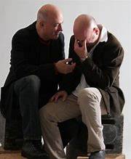
One of the most difficult things to do sometimes is be the messenger!
Why?
Sometimes the message is not easy to deliver.
Sometimes the message is a message of rebuke for something someone is doing wrong.
Sometimes the message is tragic news that no one wants to hear or deliver.

Slide 3
Today we want to consider three things..........
How do we react to the messenger?
Do we carry out our role as the messenger when we should?
How important is it to handle the message correctly?

Slide 4
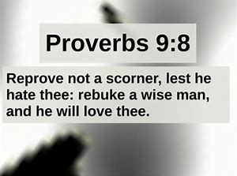
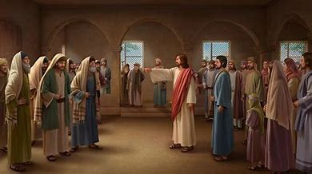
How do we react to the Messenger?
You have heard it said don’t shot the messenger…….yet many times people could care less about the message but rather want to blame the messenger.
2nd Kings 5:8-12
Acts 2:37
Acts 7:54-60

Slide 5
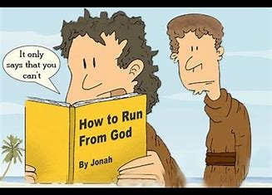
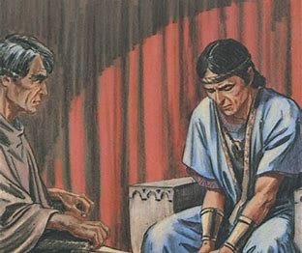
2. Do we carry out our role as the messenger when we should?
Many times we have a duty, obligation, or responsibility to deliver a message from God’s word and we fail because we will not take the time, we are afraid of how the message will be reacted to, or we claim its not our responsibility.
2nd Samuel 12:1-7;13
Jonah 1:1-3
Jude 22-23

Slide 6
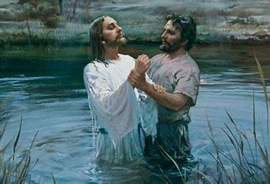
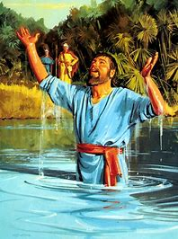
3. How important is it to handle the message correctly?
Our SOUL is at stake…..so whether hearing a message of rebuke, instruction, correction, or delivering a similar message to others its VERY IMPORTANT to handle it correctly!
2nd Kings 5:13-14
Acts 2:41
Jonah 3:3-4;10

Slide 7
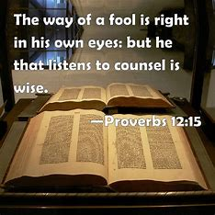
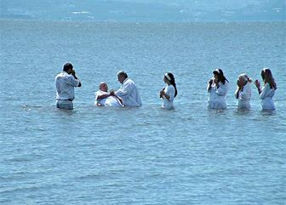
Conclusion
Ever been guilty of shooting the messenger?
Ever been guilty of not delivering the message?
Ever been guilty of not handling the message correctly?
Gods Word is what we will be judged on! Lets handle it correctly and not let anything get in the way of that!

