Slide 2

The Presence of Christ in Your Life

Slide 3
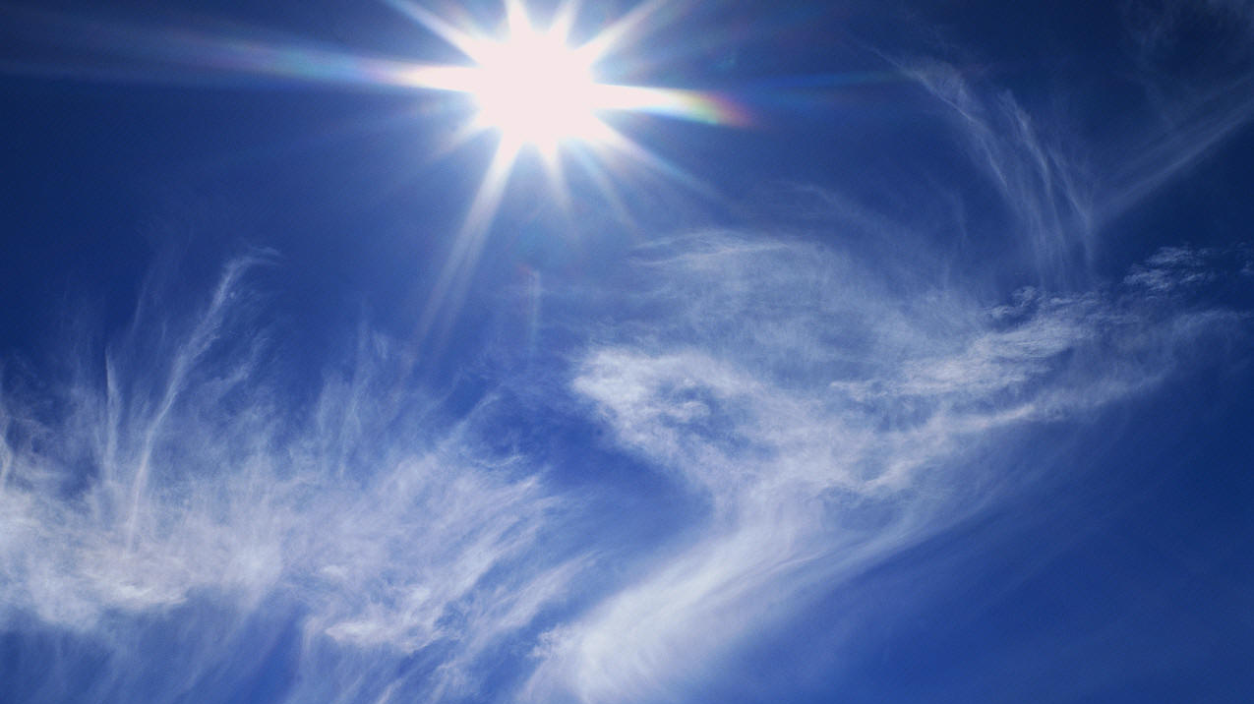


“He Lives”

Slide 4
“He Lives”
“I serve a risen Savior, He’s in the world today. I know that He is living, whatever men may say. I see His hand of mercy; I hear His voice of cheer; And just the time I need Him, He’s always near.”

Slide 5
“He Lives”
“He lives, He lives, Christ Jesus lives today! He walks with me and talks with me along life’s narrow way.
He lives, He lives, salvation to impart! You ask me how I know He lives? He lives within my heart.”

Slide 6
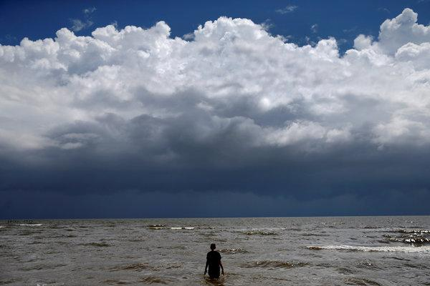
We Survive the Storm Because of the Presence of Christ

Slide 7
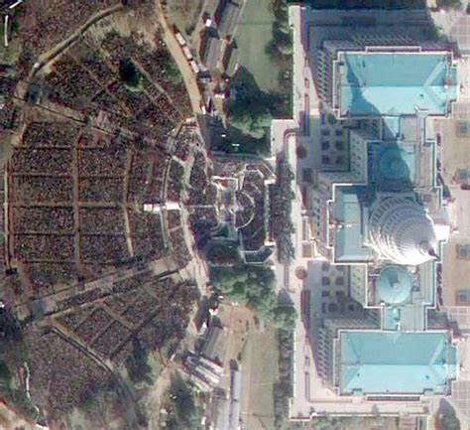
Our Entire Existence is Before Christ

Slide 8
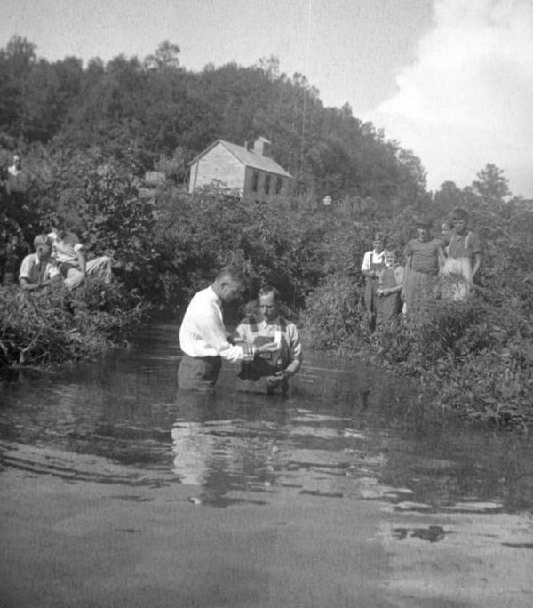
Our New Life is Sustained By His Presence

Slide 9


You Are Special

Slide 11
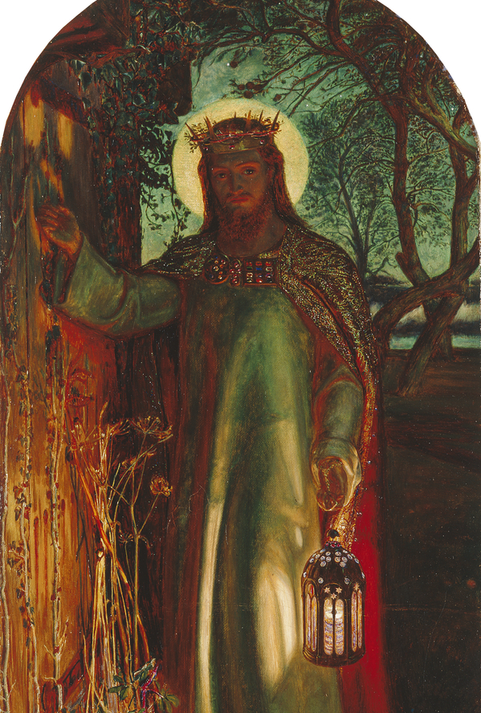

Slide 12
Revelation 3:20-21

Slide 13
Revelation 3:20-21
Behold, I stand at the door and knock. If anyone hears My voice and opens the door, I will come in to him and dine with him, and he with Me. To him who overcomes I will grant to sit with Me on My throne, as I also overcame and sat down with My Father on His throne.

Slide 14
He has shown you, O man, what is good; And what does the LORD require of you But to do justly, To love mercy, And to walk humbly with your God? (Micah 6:8)

