Slide 1
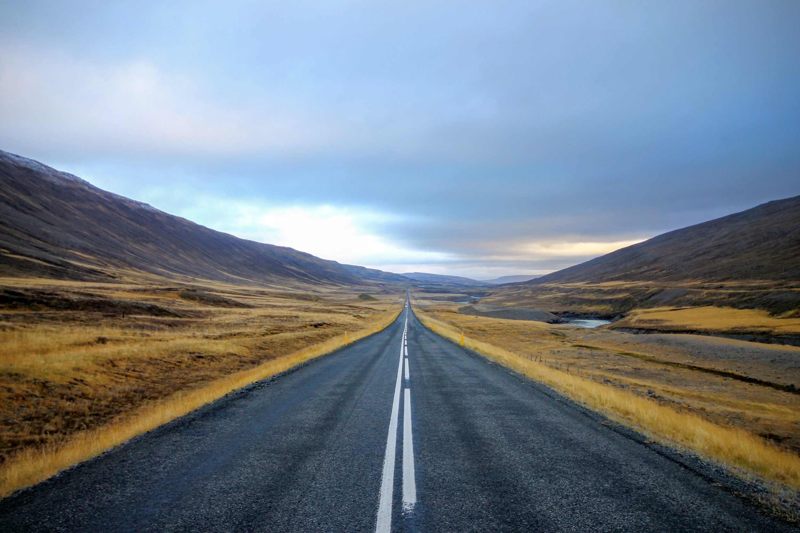
The Road Back to God
Notes:
Good evening! Welcome visitors and thank members.
In our 7th-9th grade boys class, we have been discussing the need for salvation and the necessity of having a Road Back to God.

Slide 2
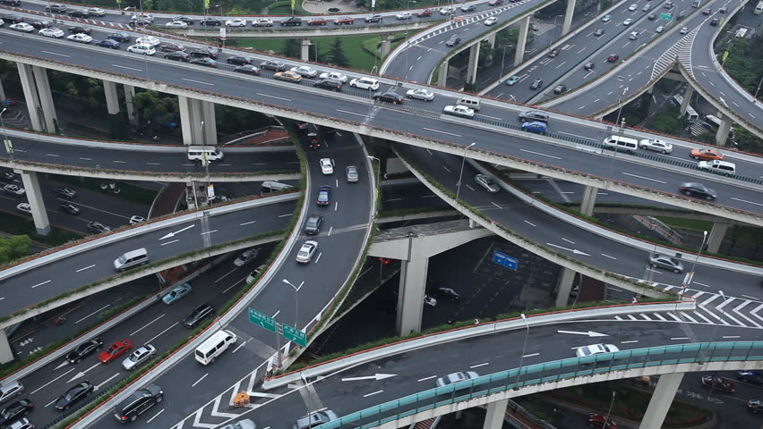
There is a way…
Notes:
The world will tell us there are many roads to God. Just choose the road that makes you feel good. God is a God of love and He wants you to be happy, so do whatever makes you happy.

Slide 3
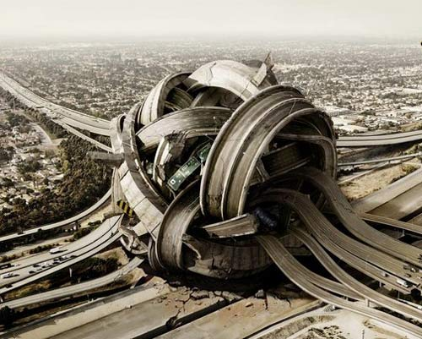
There is a way…
Notes:
This way can be quite confusing to our young members, our middle-aged members and even our older brethren as well.
When we start going away from what God says and from what God wants to what we want…..

Slide 4
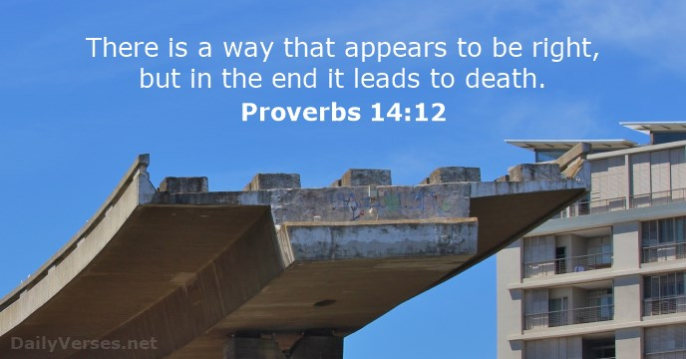
There is a way…
Notes:
When we lead our life by what we think is right, then there is a way…..but it’s not back to God.
Proverbs 14:12
¹² There is a way which seemeth right unto a man, but the end thereof are the ways of death.
We spend so much time with our thoughts and our wants that we fail to go to God’s word—His truth—His wishes—His desires.

Slide 5
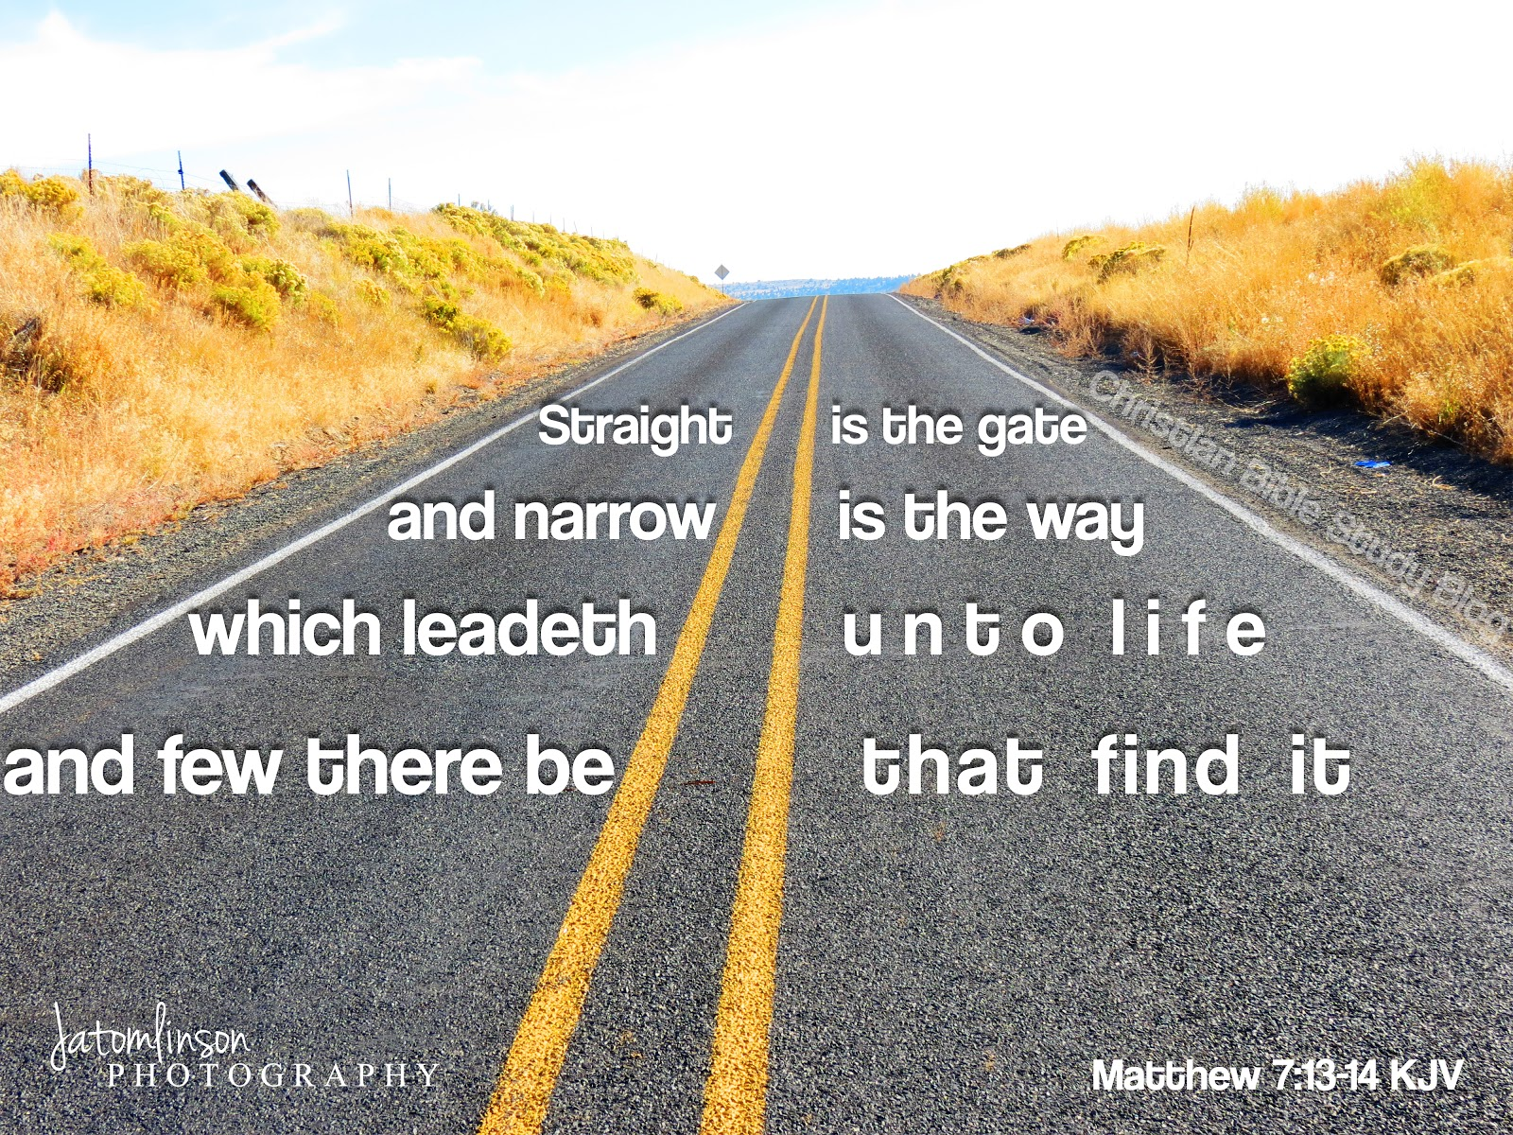
The Straight Road
Notes:
Jesus warns us about the way of destruction and also tells us about His Way in Matthew 7:13-14. Jesus says…..
¹³ Enter ye in at the strait gate: for wide is the gate, and broad is the way, that leadeth to destruction, and many there be which go in thereat:
¹⁴ Because strait is the gate, and narrow is the way, which leadeth unto life, and few there be that find it.
His way is the right way and we must follow Him. That requires us to Trust and Obey.

Slide 6


Slide 7
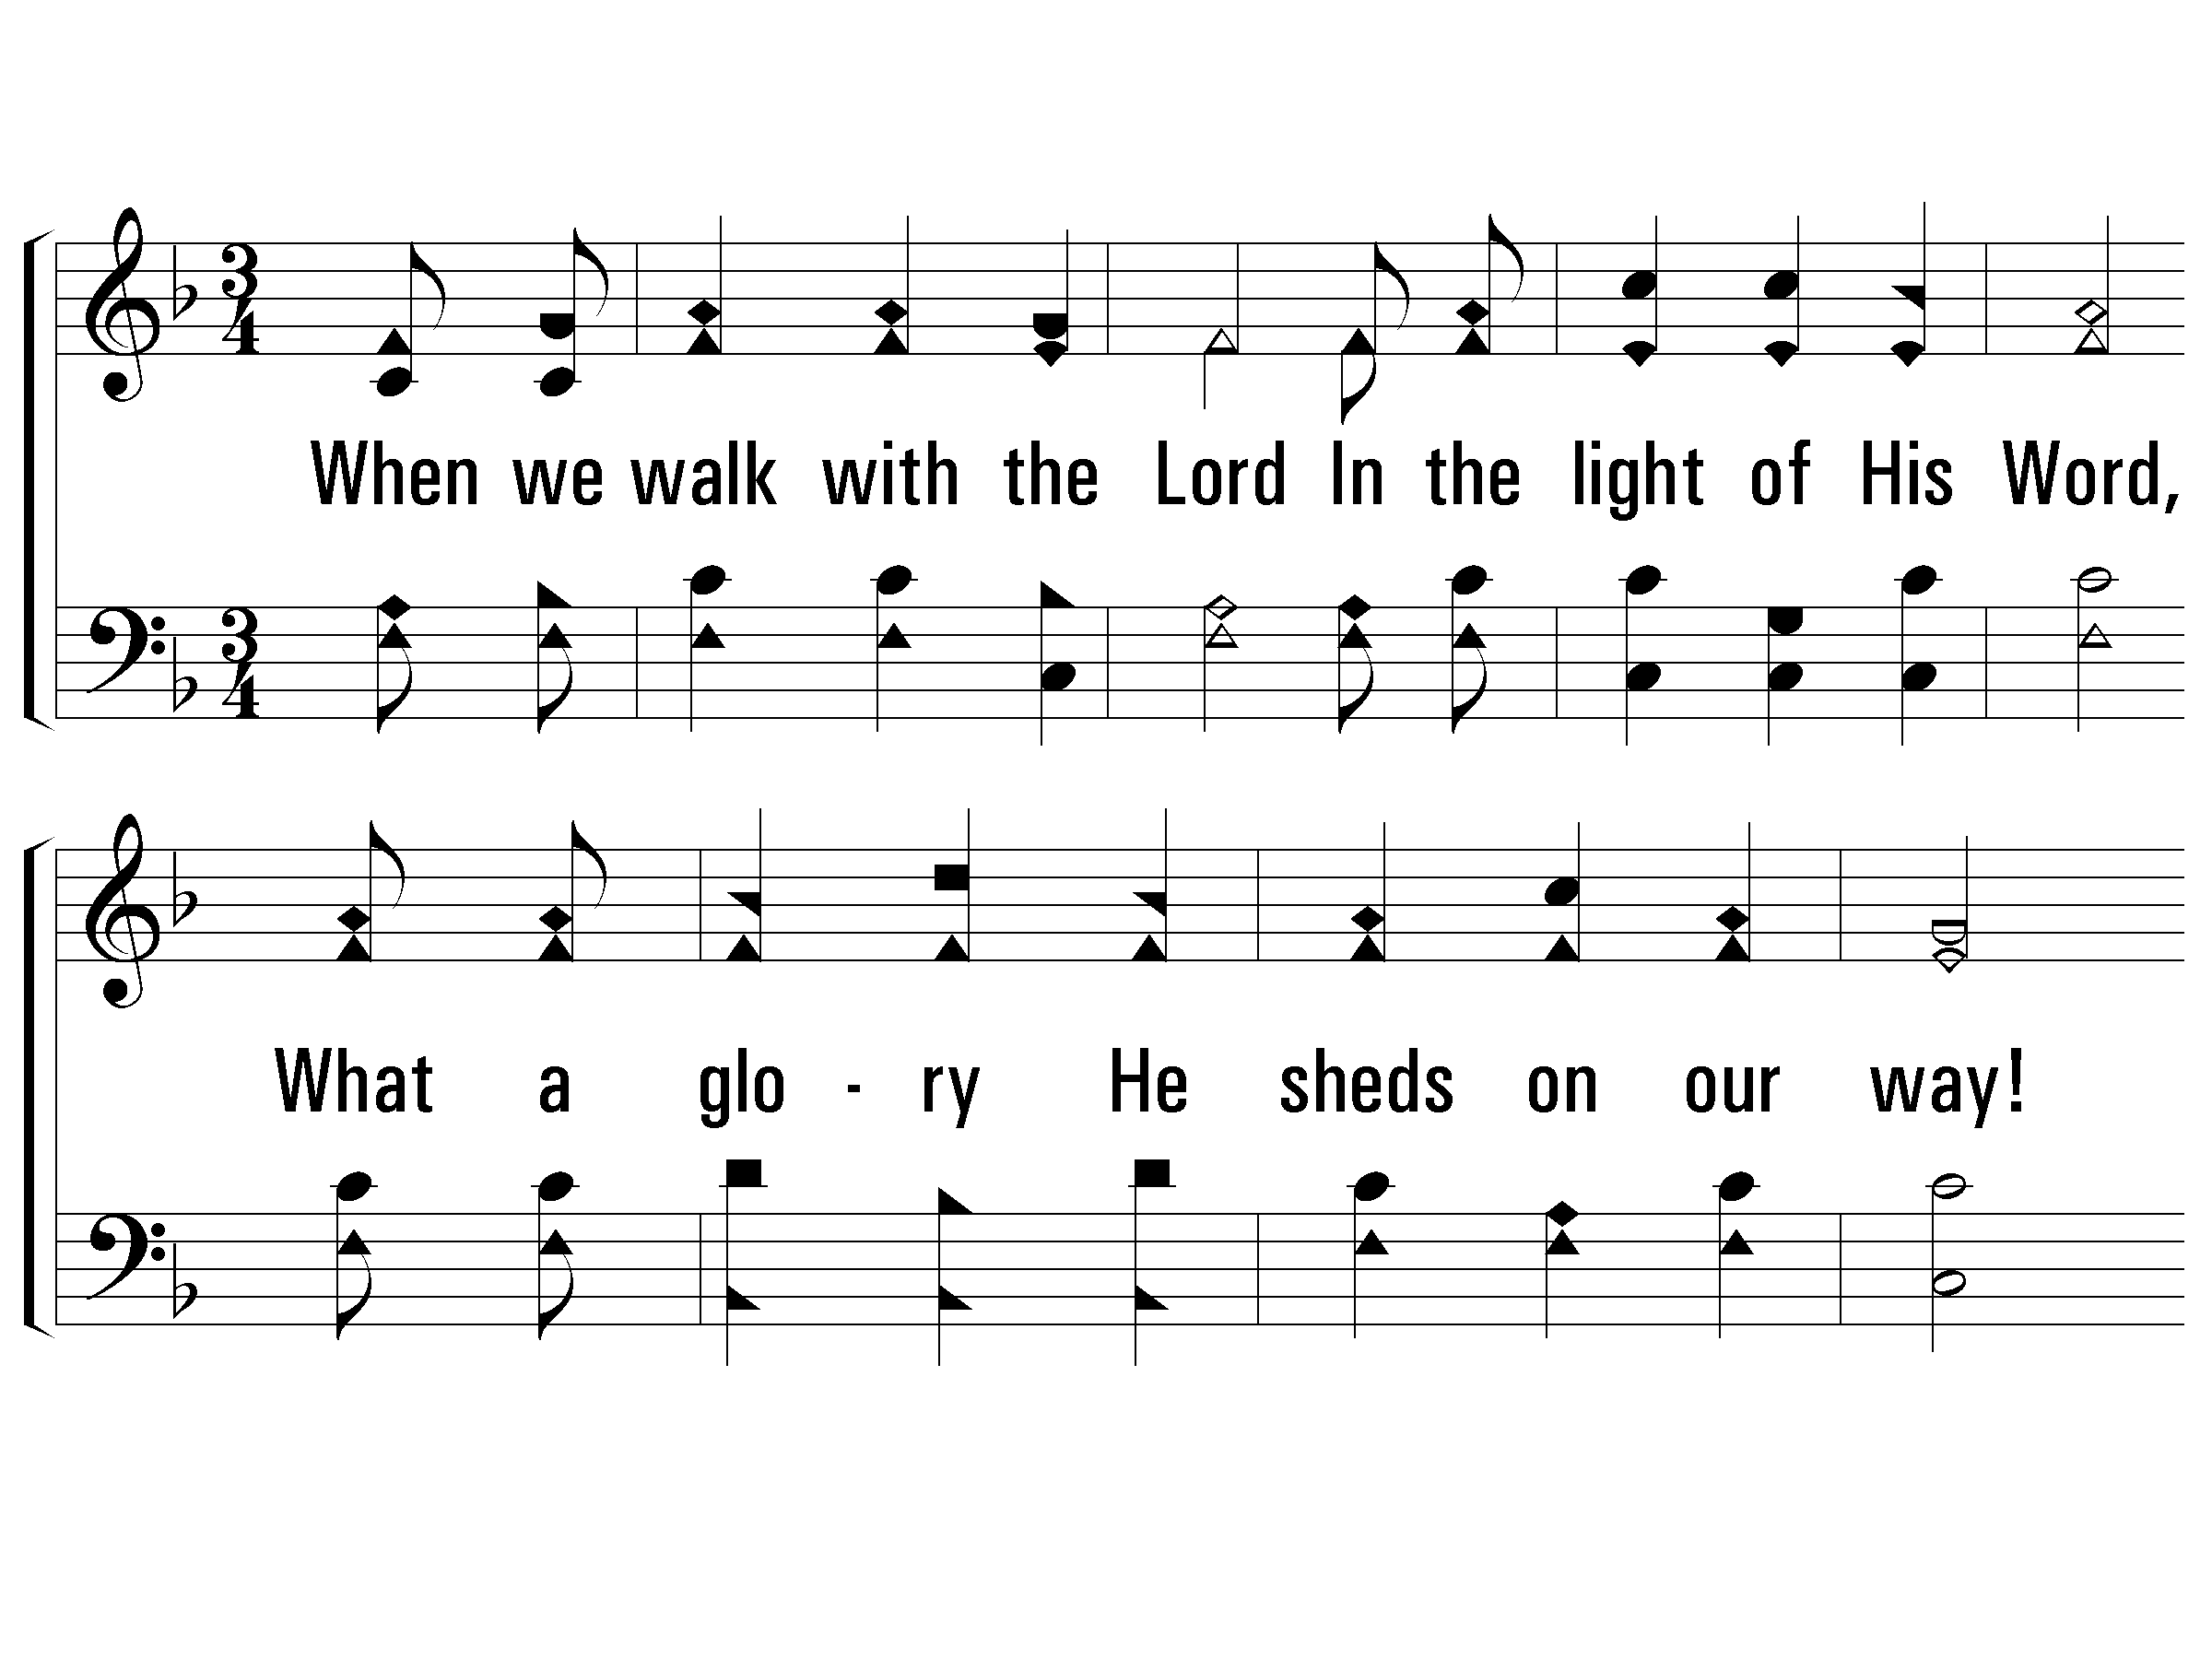
1 – Trust and Obey
714
1.
When we walk with the Lord
In the light of His Word,
What a glory He sheds on our way!
While we do His good will,
He abides with us still,
And with all who will trust and obey.
Words by: J. H. Sammis
Music by: D. B. Towner
© 2001 The Paperless Hymnal™

Slide 8
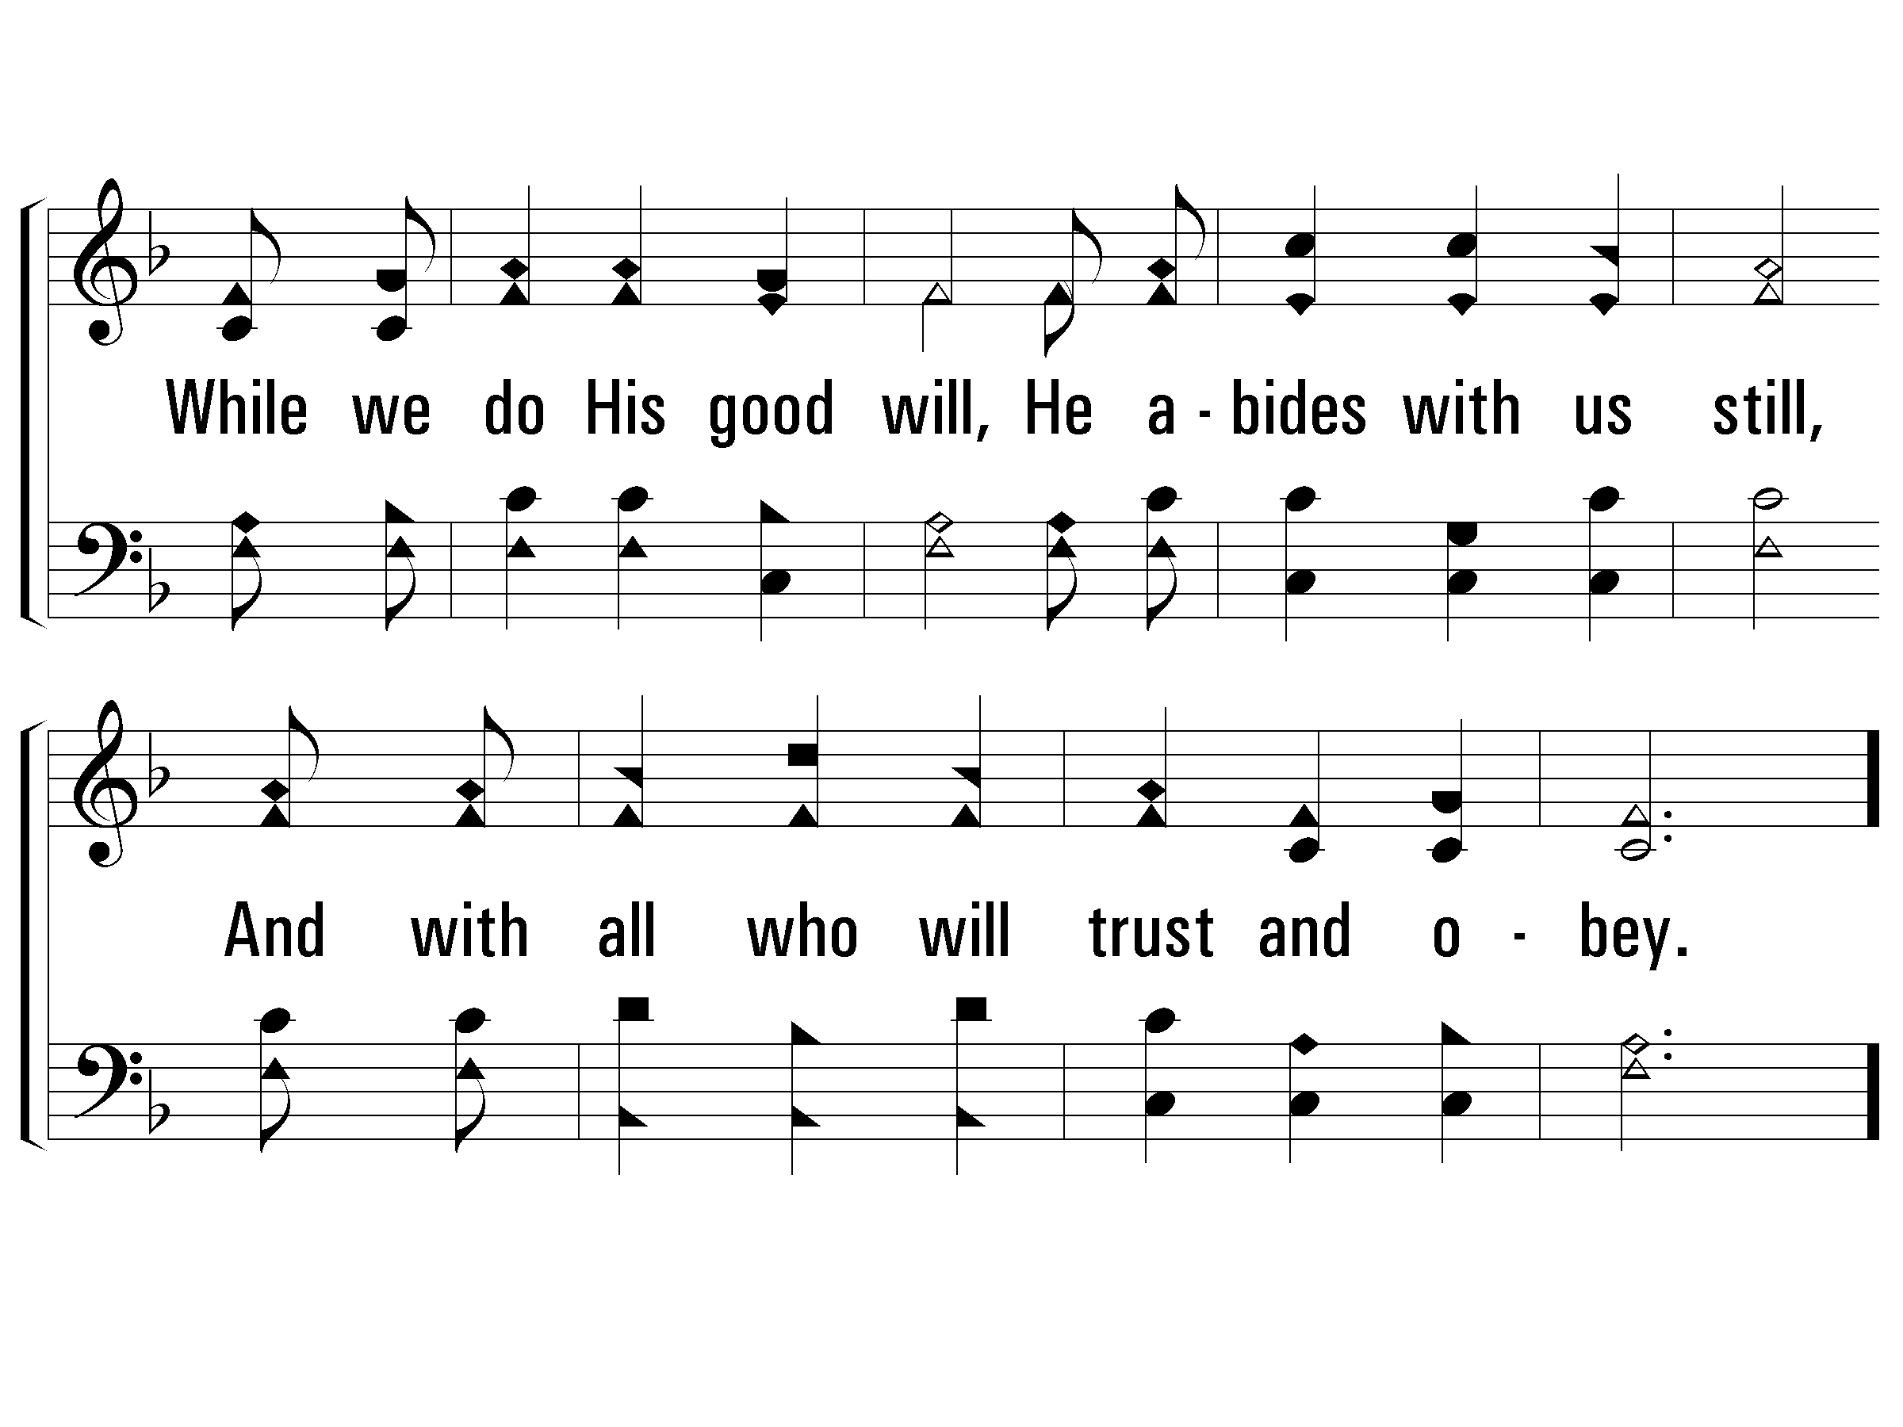
1 – Trust and Obey
714
© 2001 The Paperless Hymnal™

Slide 9
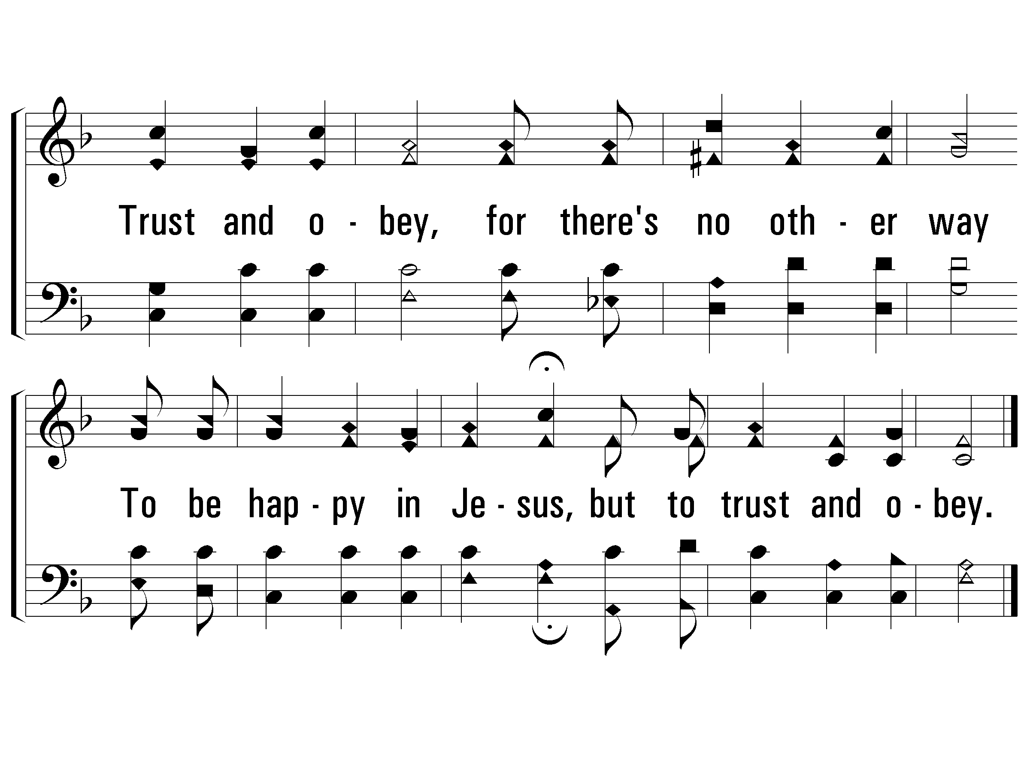
c – Trust and Obey
714
Trust and obey,
for there's no other way
To be happy in Jesus,
but to trust and obey.
© 2001 The Paperless Hymnal™

Slide 10
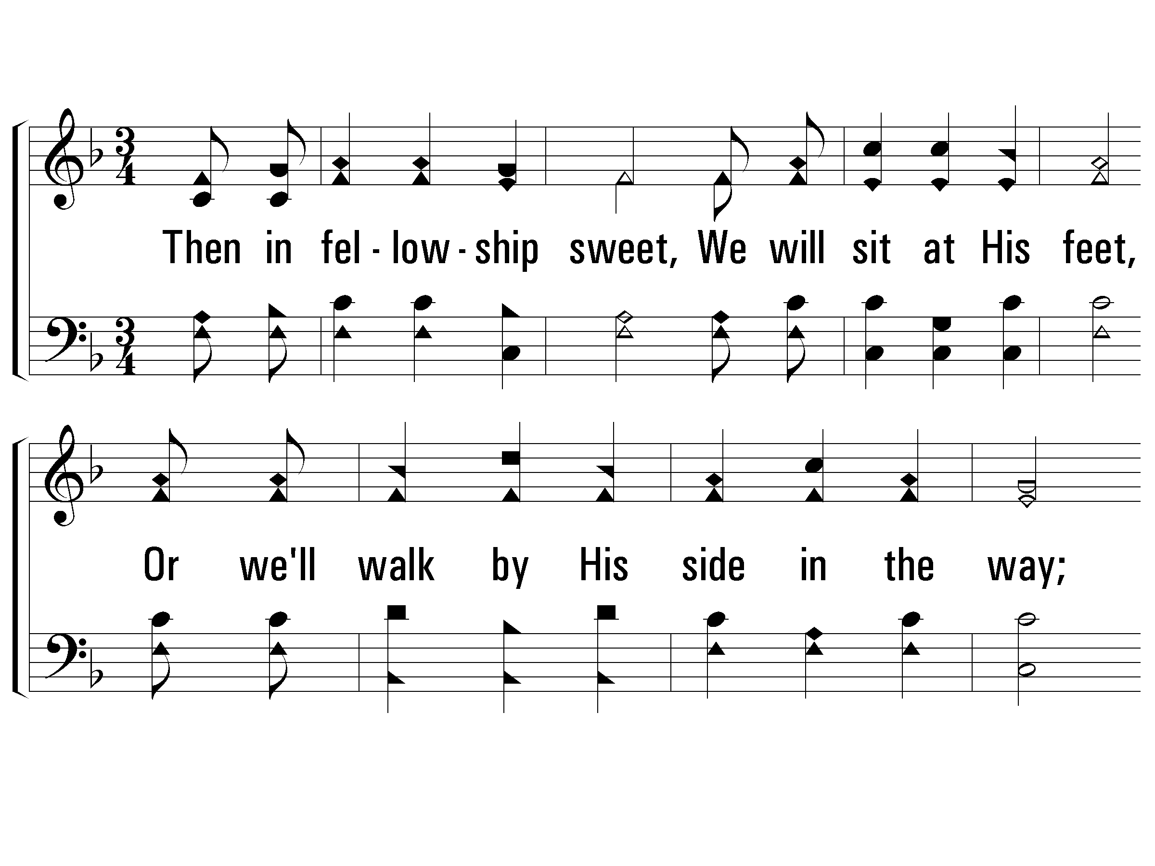
5 – Trust and Obey
714
5.
Then in fellowship sweet,
We will sit at His feet,
Or we'll walk by His side in the way;
What He says we will do,
Where He sends we will go
Never fear, only trust and obey.
Words by: J. H. Sammis
Music by: D. B. Towner
© 2001 The Paperless Hymnal™

Slide 11
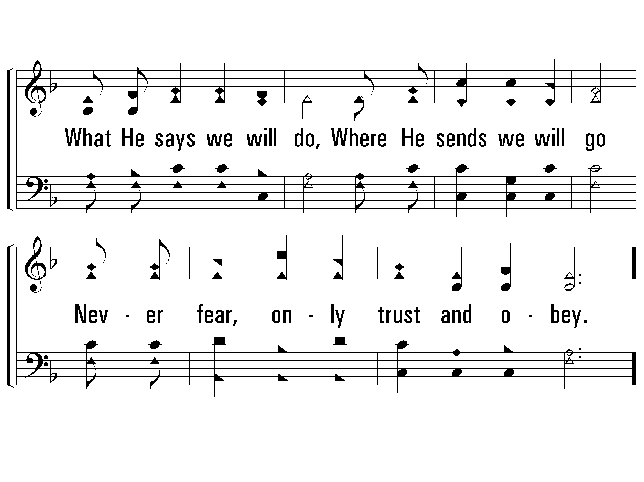
5 – Trust and Obey
714
© 2001 The Paperless Hymnal™

Slide 12
c – Trust and Obey
714
Trust and obey,
for there's no other way
To be happy in Jesus,
but to trust and obey.
© 2001 The Paperless Hymnal™

Slide 13
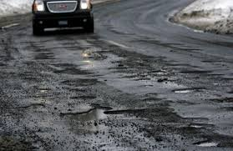
The Bumpy Road
Notes:
Living a life for Christ doesn’t mean that there won’t be bumps in the road. The potholes, detours and bumps are just part of the road.
Remember what the Hebrew writer wrote the Lord in Hebrews 13:5-6:
⁵ Let your conversation be without covetousness; and be content with such things as ye have: for he hath said, I will never leave thee, nor forsake thee.
⁶ So that we may boldly say, The Lord is my helper, and I will not fear what man shall do unto me.
So…..
Stop worrying about the potholes in the road and celebrate the journey.

Slide 14
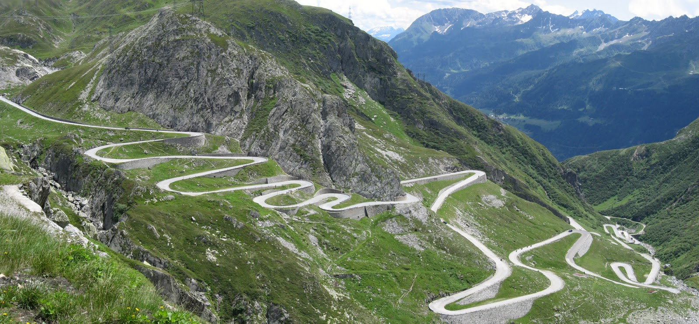
The Curvy Road
Deuteronomy 31:6 Be strong and of a good courage, fear not, nor be afraid of them: for the Lord thy God, he it is that doth go with thee; he will not fail thee, nor forsake thee.
Notes:
Life for a Christian sometimes means a lot of twists and turns—even unknowns about what lies ahead. It’s during these times in our Road to God that we are reminded of what Moses told all of Israel in Deuteronomy 31:6 when he was ending his journey:

Slide 15
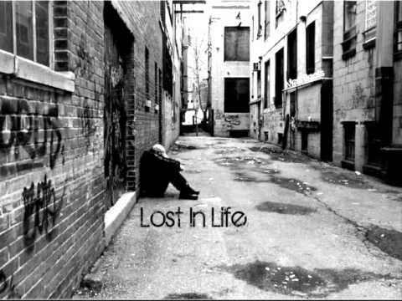

Lost
Notes:
Many times in our life we take the wrong turn, make the wrong choice and find ourselves lost. James said in
James 1:
14 But every man is tempted, when he is drawn away of his own lust, and enticed.
15 Then when lust hath conceived, it bringeth forth sin: and sin, when it is finished, bringeth forth death.
It’s in these brief moments of weakness that a Christian will realize, that he or she has sinned and remember the Road Back to God.
1 John 1:9
9 If we confess our sins, he is faithful and just to forgive us our sins, and to cleanse us from all unrighteousness.

Slide 16
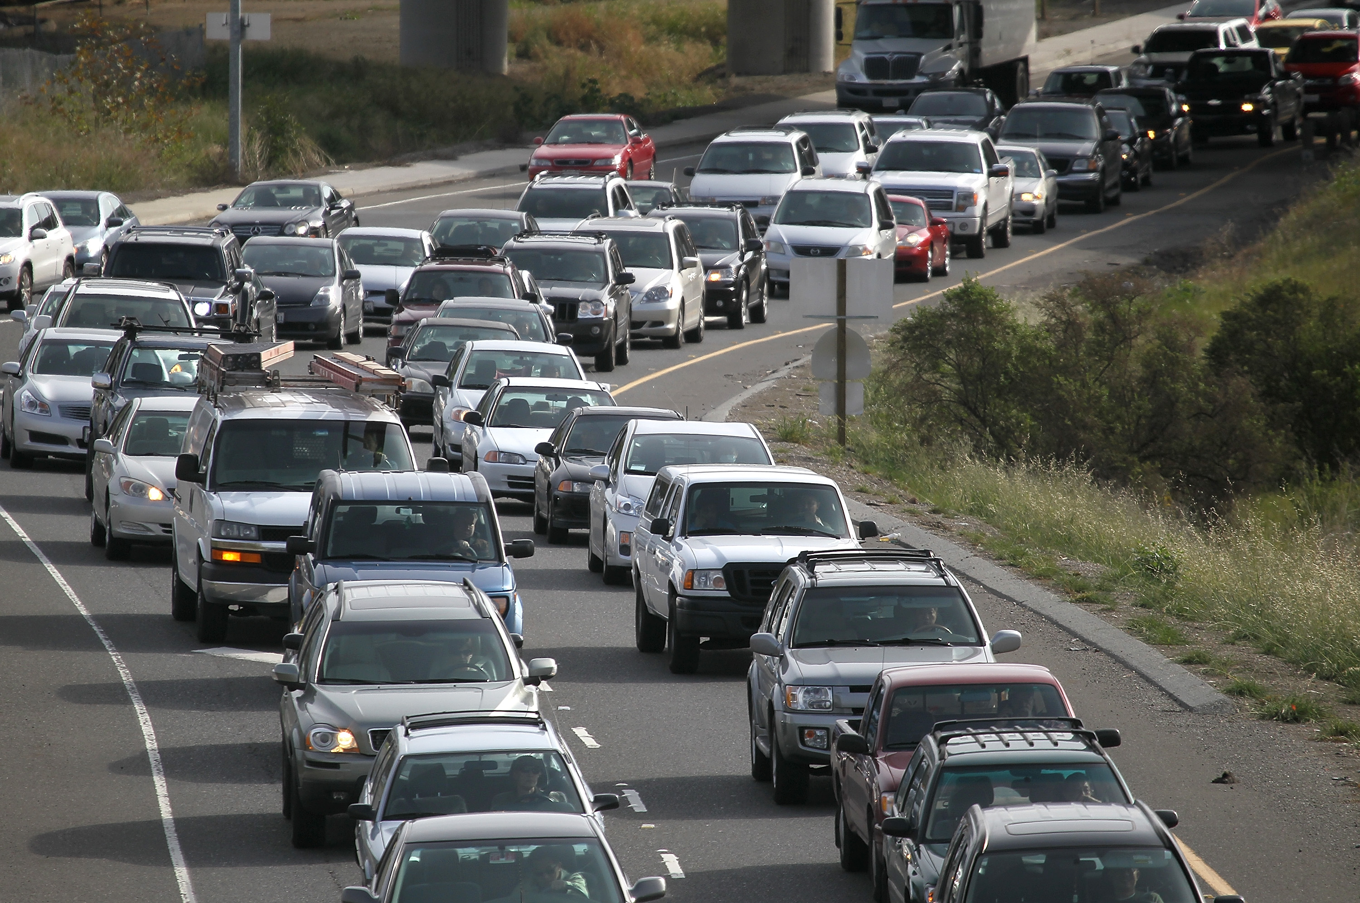
The Traffic Jam
Notes:
But there other times when we continue in sin and find ourselves in a huge Traffic Jam.
It’s in these times in our lives that we begin to question our faith, question our hope, question the way, and even question our salvation.
Our zeal and fire for God begins to dim. Our worship begins to decline as we make excuses and find ourselves skipping. Our prayer life is non-existent. Our conversation becomes ungodly. Our ears and eyes are closed to the truth. We find ourselves in a total grid-lock.
It’s here when we, as Christians, need to get to work.
In Matthew 18, starting in verse 11
11 For the Son of man is come to save that which was lost.
12 How think ye? if a man have an hundred sheep, and one of them be gone astray, doth he not leave the ninety and nine, and goeth into the mountains, and seeketh that which is gone astray?
13 And if so be that he find it, verily I say unto you, he rejoiceth more of that sheep, than of the ninety and nine which went not astray.
14 Even so it is not the will of your Father which is in heaven, that one of these little ones should perish.
15 Moreover if thy brother shall trespass against thee, go and tell him his fault between thee and him alone: if he shall hear thee, thou hast gained thy brother.
16 But if he will not hear thee, then take with thee one or two more, that in the mouth of two or three witnesses every word may be established.
17 And if he shall neglect to hear them, tell it unto the church: but if he neglect to hear the church, let him be unto thee as an heathen man and a publican.

Slide 17
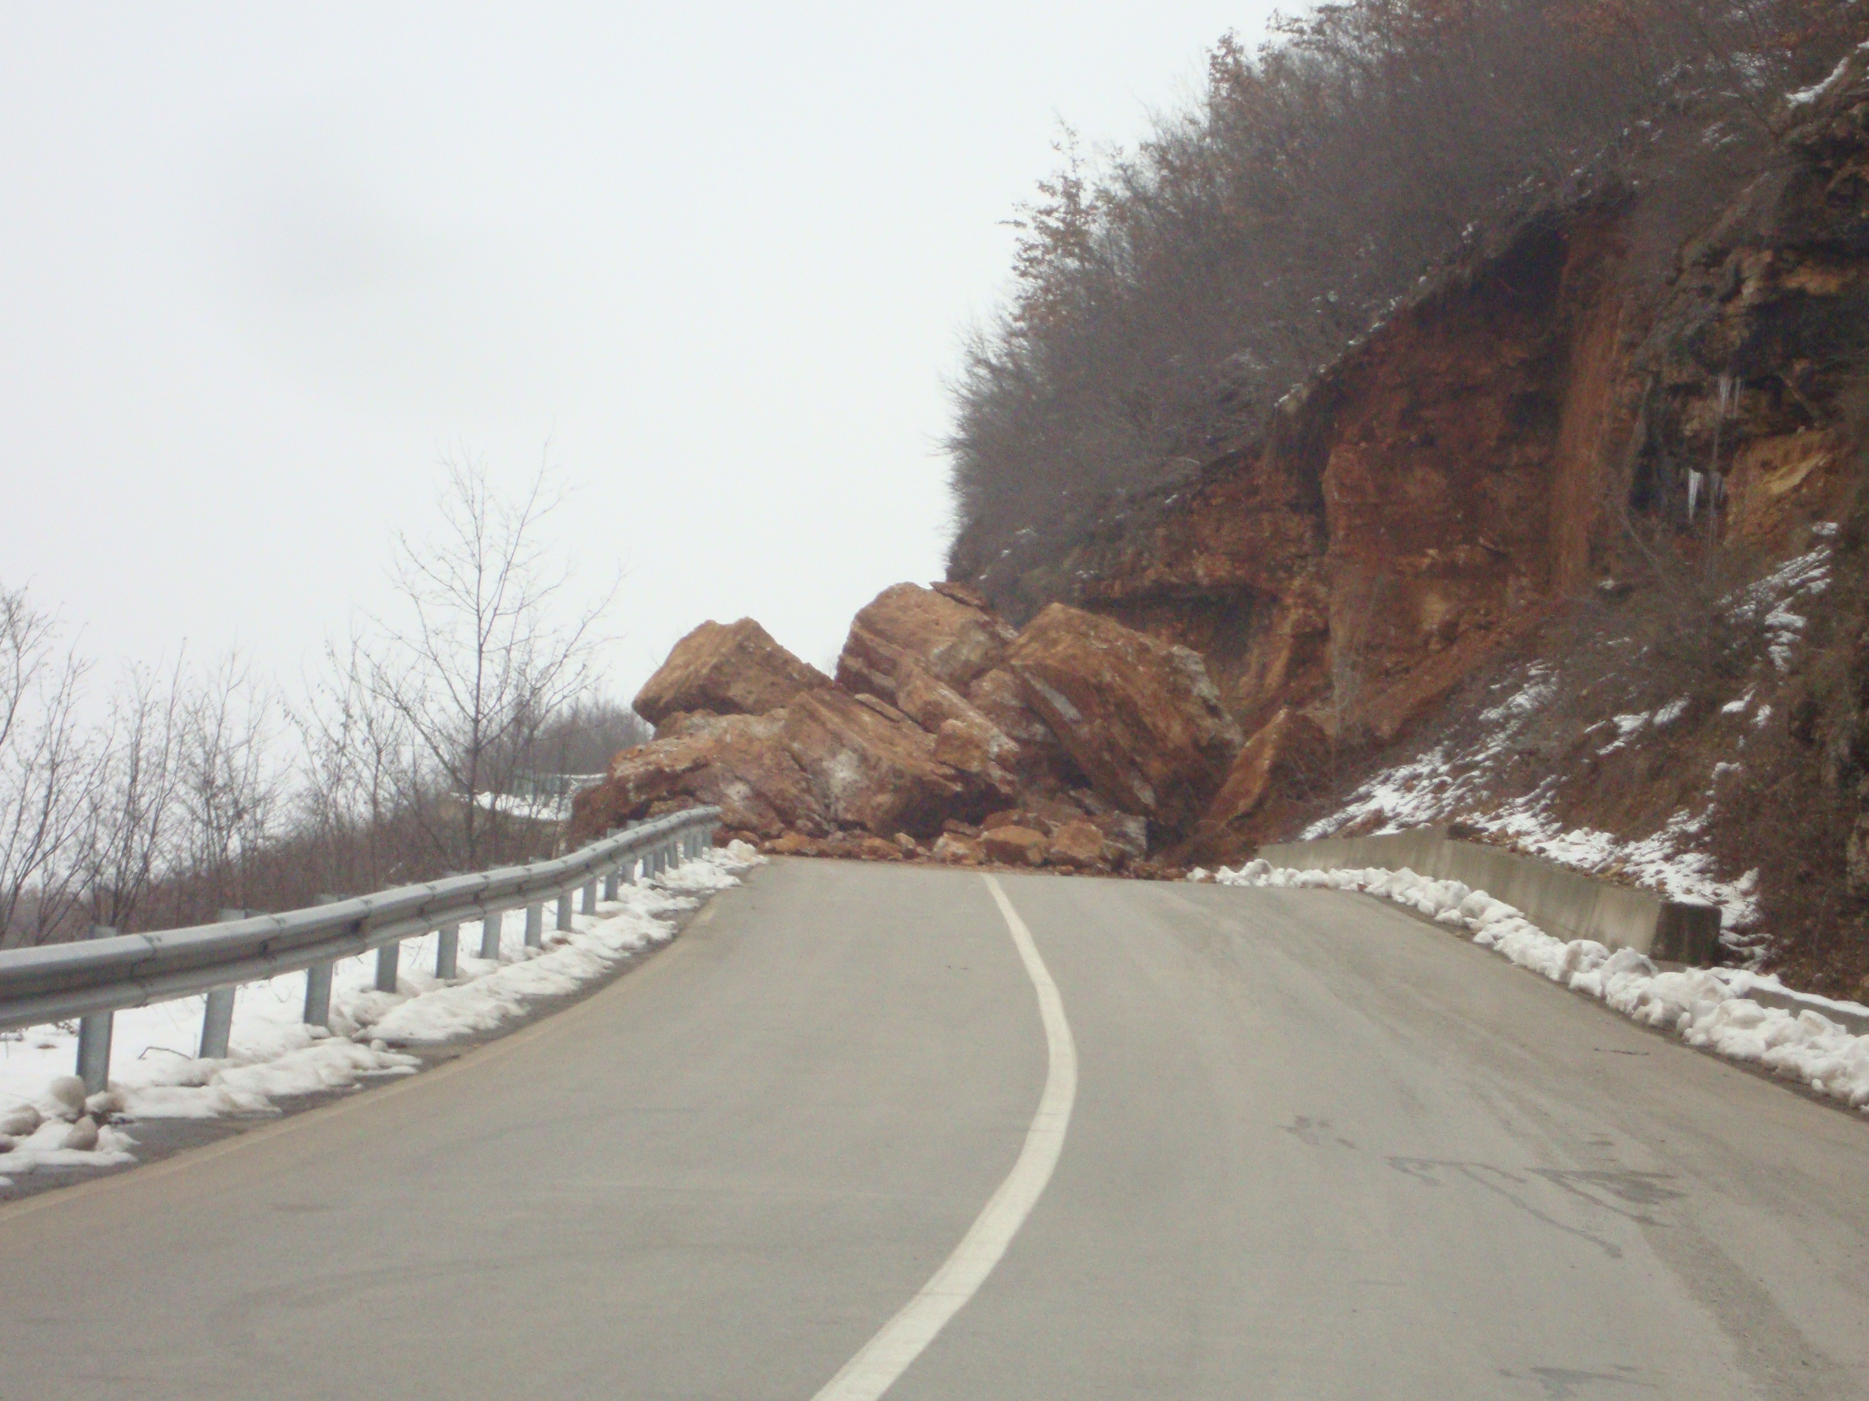
The Stumbling Blocks
Notes:
Let’s not find ourselves being Stumbling Blocks to those on the Road Back to God.
We understand what God says about being a stumbling block.
Matthew 18:7 (NIV)
7 Woe to the world because of the things that cause people to stumble! Such things must come, but woe to the person through whom they come!
In 2 Corinthians 6:3—NIV Paul said,
3 We put no stumbling block in anyone’s path, so that our ministry will not be discredited.
Romans 14:13
13 Let us not therefore judge one another any more: but judge this rather, that no man put a stumblingblock or an occasion to fall in his brother's way.

Slide 18
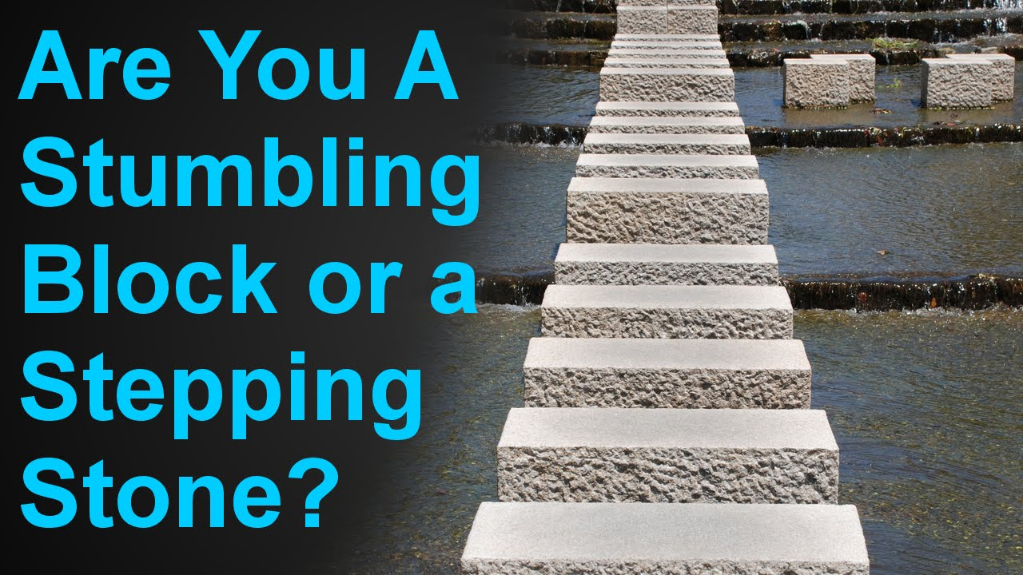
Stepping Stones
Notes:
How often do I need to forgive my brother or sister who continues to go in and out of sin.
Matthew 18:21 Then came Peter to him, and said, Lord, how oft shall my brother sin against me, and I forgive him? till seven times? 22 Jesus saith unto him, I say not unto thee, Until seven times: but, Until seventy times seven.
Instead of being the stumbling block, let’s be the stepping stone for those on the Road Back to God.
Forgive and show compassion
23 Therefore is the kingdom of heaven likened unto a certain king, which would take account of his servants.
OWED A DEBT he couldn’t pay and he begged for mercy…His lord had compassion on him and forgave his debt.

Slide 19
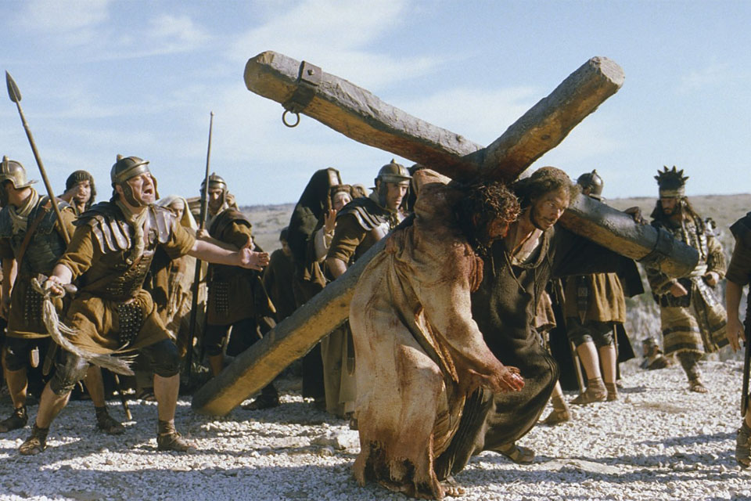
The Road to Calvary
Notes:
Our forgiveness, our Road Back to God is made possible by our Lord and Savior Jesus Christ.
2 Corinthians 5:21
21 For he hath made him to be sin for us, who knew no sin; that we might be made the righteousness of God in him.
Jesus paid the debt that we couldn’t pay. He paid the debt he didn’t owe. He paid our debt with His life.
Jesus Paid a Debt. 859 All verses

Slide 20
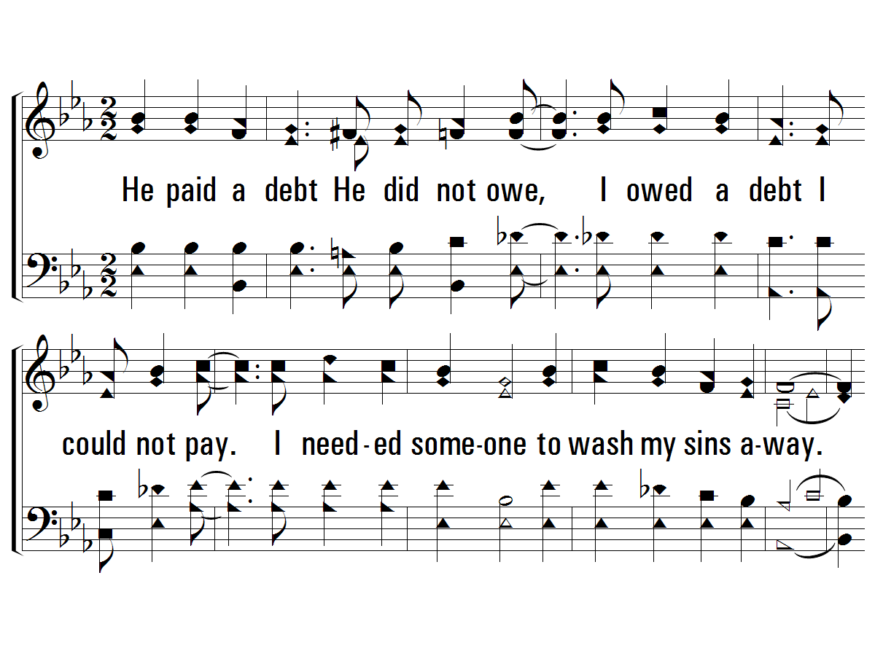
1 - He Paid a Debt
859
1.
He paid a debt He did not owe,
I owed a debt I could not pay.
I needed someone to wash my sins away.
And now I sing a brand new song:
"Amazing Grace."
Christ Jesus paid the debt that I could never pay.
Words by: American Folk Hymn
Music by: American Folk Melody, Arrangement by: Michael R. Greene
Arr. Copyright © 1992 by Song Supplements, Inc. in Praise for the Lord. All rights reserved.
© 2001 The Paperless Hymnal™

Slide 21
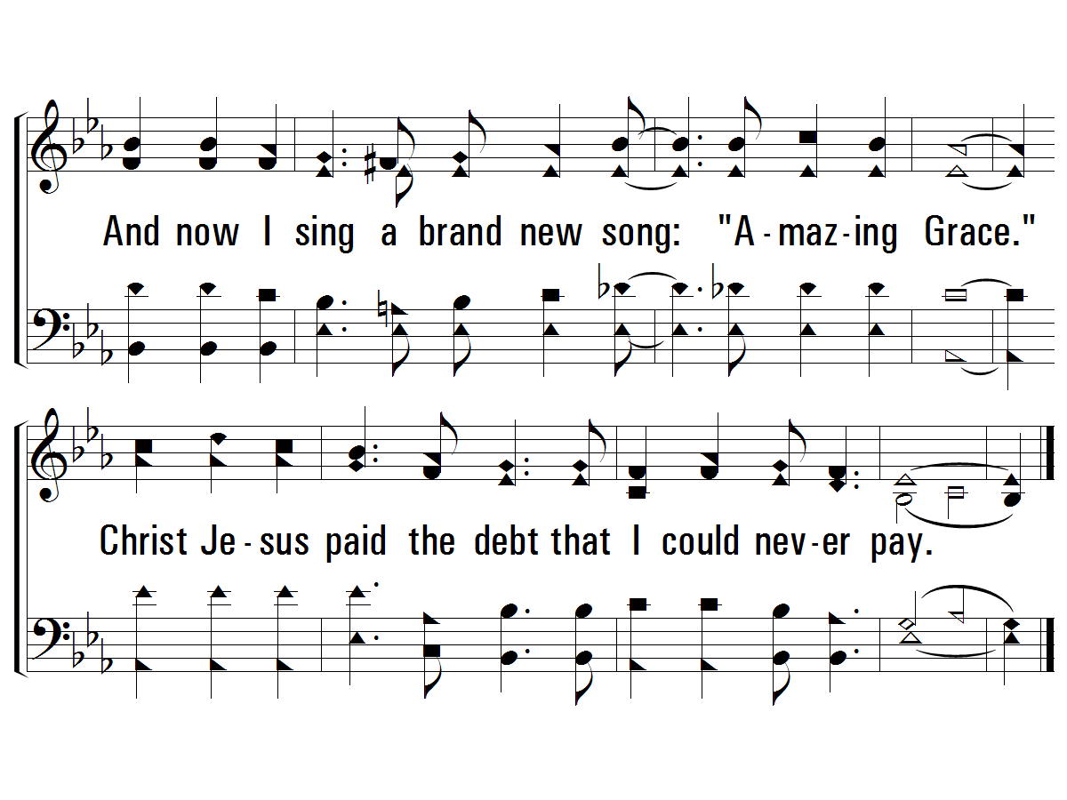
1 - He Paid a Debt
859
© 2001 The Paperless Hymnal™

Slide 22
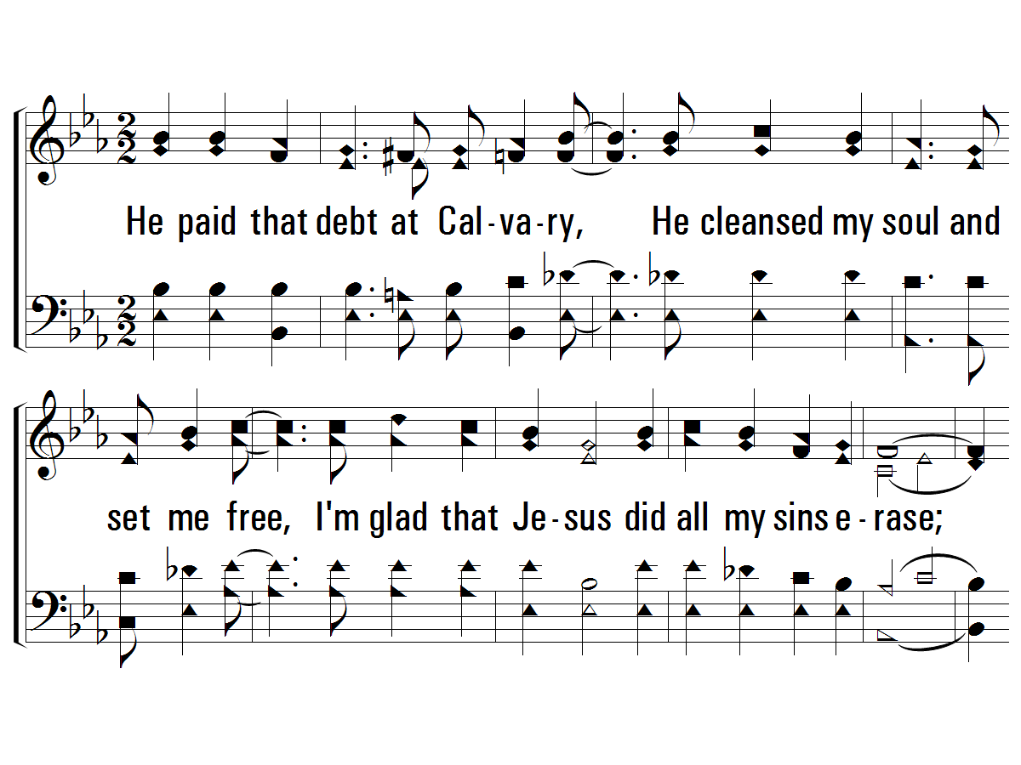
2 - He Paid a Debt
859
2.
He paid that debt at Calvary,
He cleansed my soul and set me free,
I'm glad that Jesus did all my sins erase;
I now can sing a brand new song:
"Amazing Grace."
Christ Jesus paid the debt that I could never pay.
Words by: American Folk Hymn
Music by: American Folk Melody, Arrangement by: Michael R. Greene
Arr. Copyright © 1992 by Song Supplements, Inc. in Praise for the Lord. All rights reserved.
© 2001 The Paperless Hymnal™

Slide 23
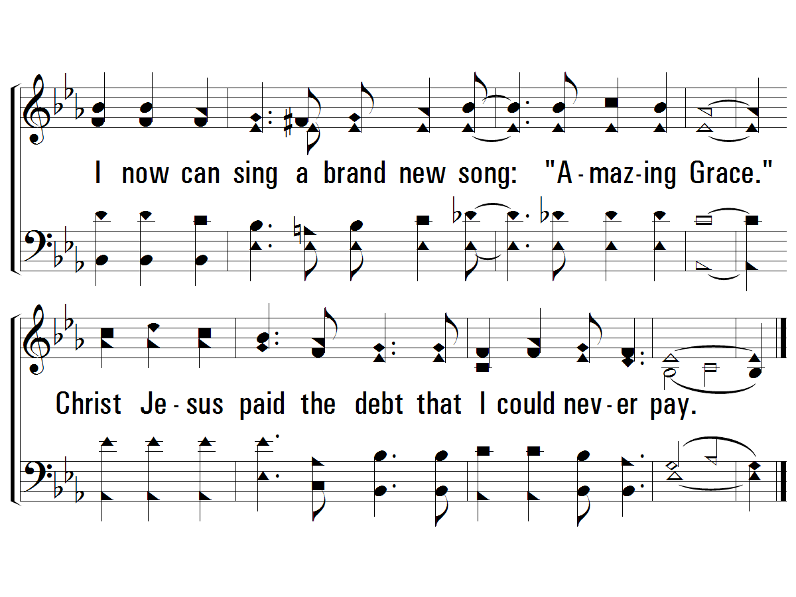
2 - He Paid a Debt
859
© 2001 The Paperless Hymnal™

Slide 24
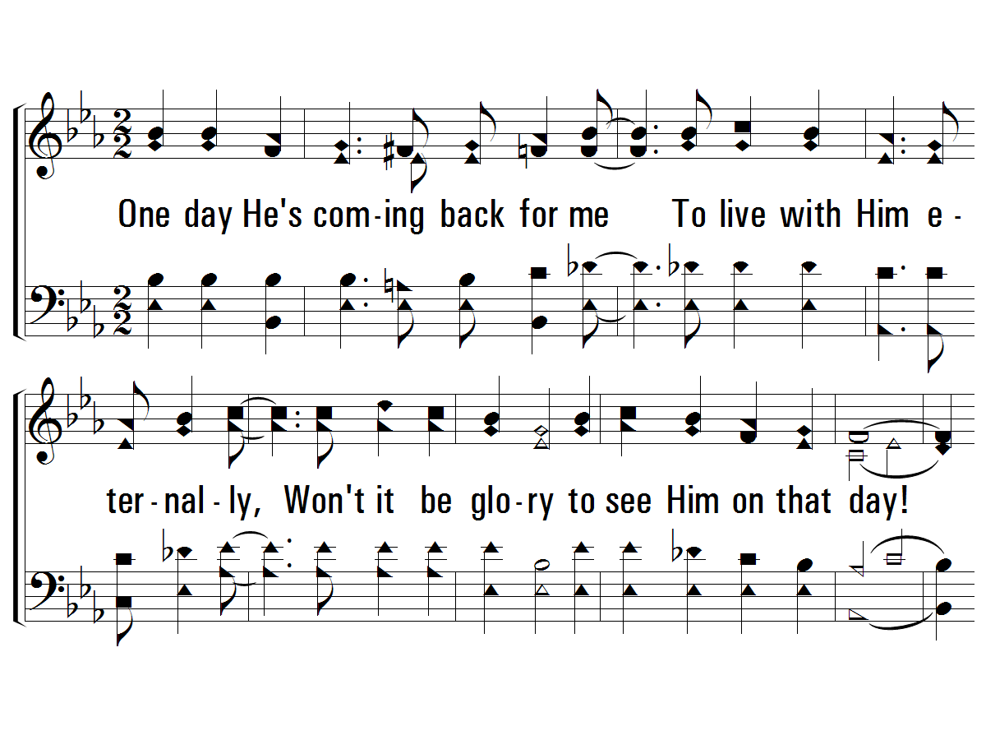
3 - He Paid a Debt
859
3.
One day He's coming back for me
To live with Him eternally,
Won't it be glory to see Him on that day!
I then will sing a brand new song:
"Amazing Grace."
Christ Jesus paid the debt that I could never pay.
Words by: American Folk Hymn
Music by: American Folk Melody, Arrangement by: Michael R. Greene
Arr. Copyright © 1992 by Song Supplements, Inc. in Praise for the Lord. All rights reserved.
© 2001 The Paperless Hymnal™

Slide 25
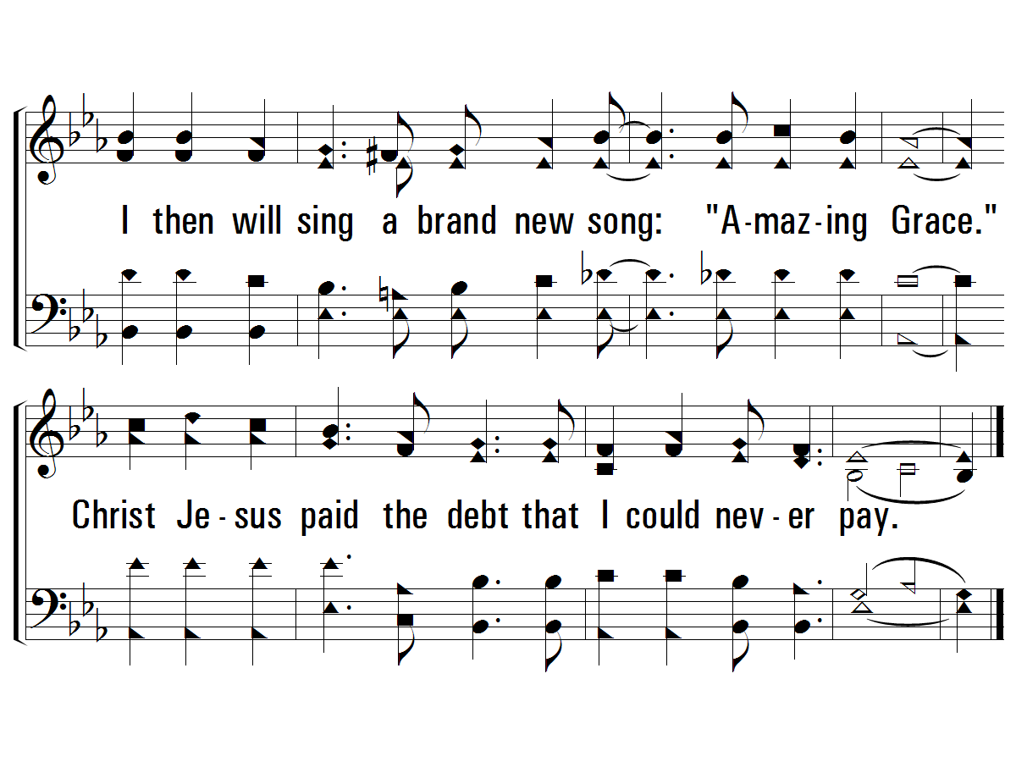
3 - He Paid a Debt
859
© 2001 The Paperless Hymnal™

Slide 26
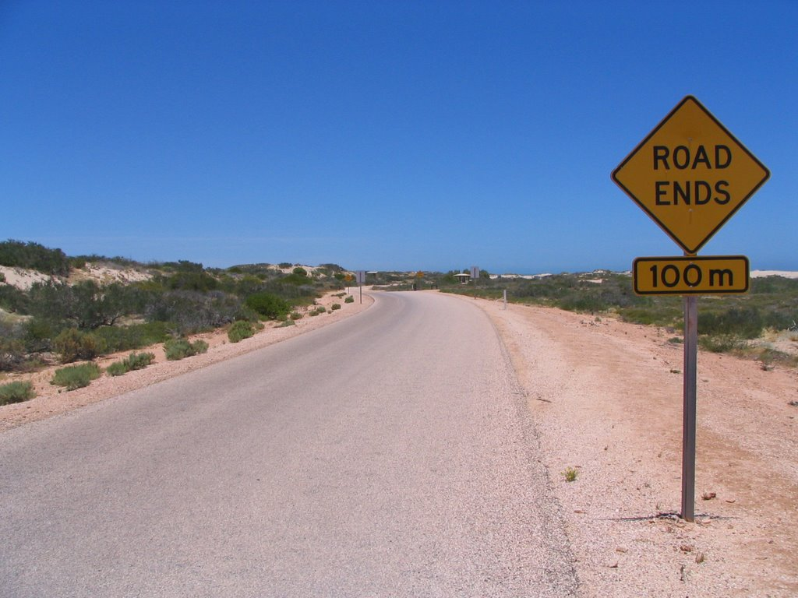
The End of the Road
Notes:
One day He’s coming….coming back to judge the world and take His children home. When our Road ends on this earth, will we be with Him on the Road home?

Slide 27

Start the Road to God
Notes:
If you haven’t started on the Road Home, won’t you start your life as a Christian tonight by Believing in Jesus, Repenting of your ways, Confessing the sweet name of Jesus and being Baptized for the forgiveness of your sins?

Slide 28
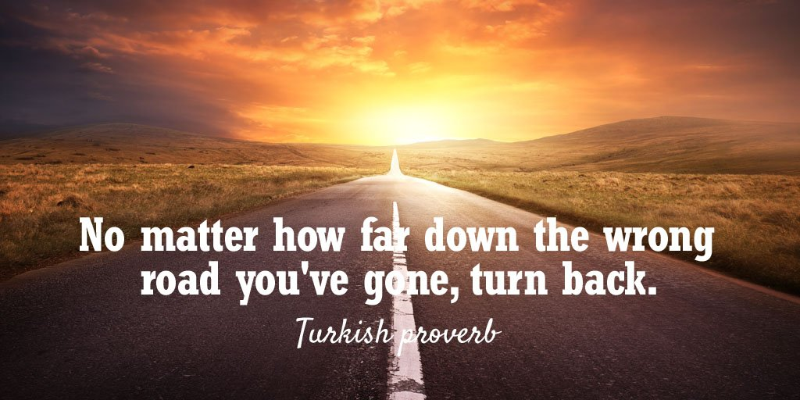
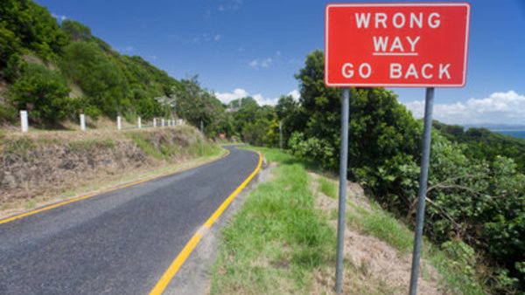
Wrong Road?
Notes:
If you are going down the wrong road and you need to turn back to God. No matter how far down the wrong road you’ve gone, turn back tonight.
He provided us a way—the Way—
Tonight Let Him Have His Way with Thee as we stand and sing.

Slide 29
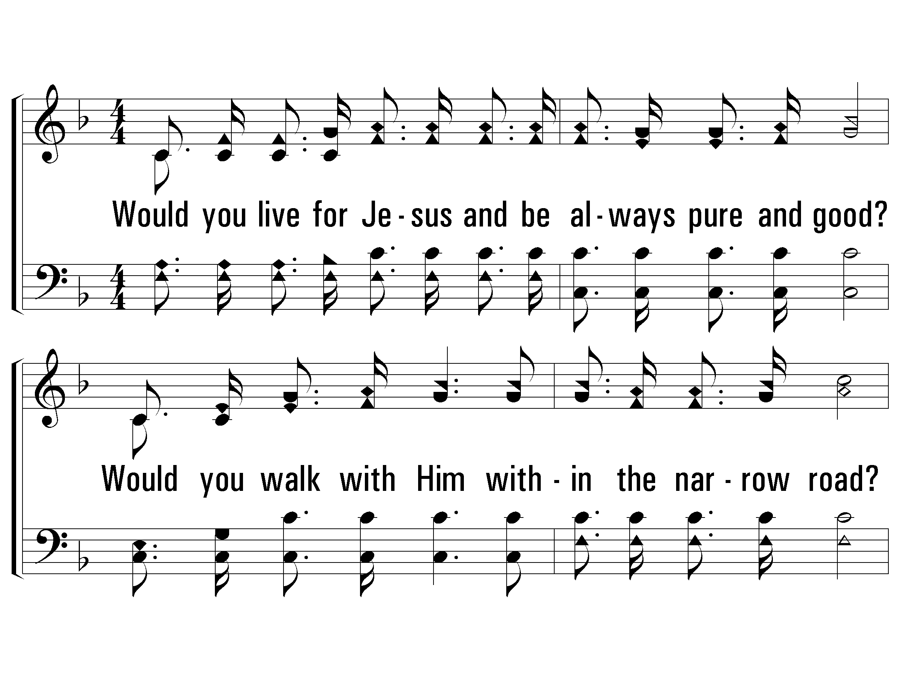
1 - Let Him Have His Way with Thee
389
1.
Would you live for Jesus and be always pure and good?
Would you walk with Him within the narrow road?
Would you have Him bear your burden, carry all your load?
Let Him have His way with thee.
Words & Music: Cyrus S. Nusbaum
© 2008 The Paperless Hymnal®

Slide 30
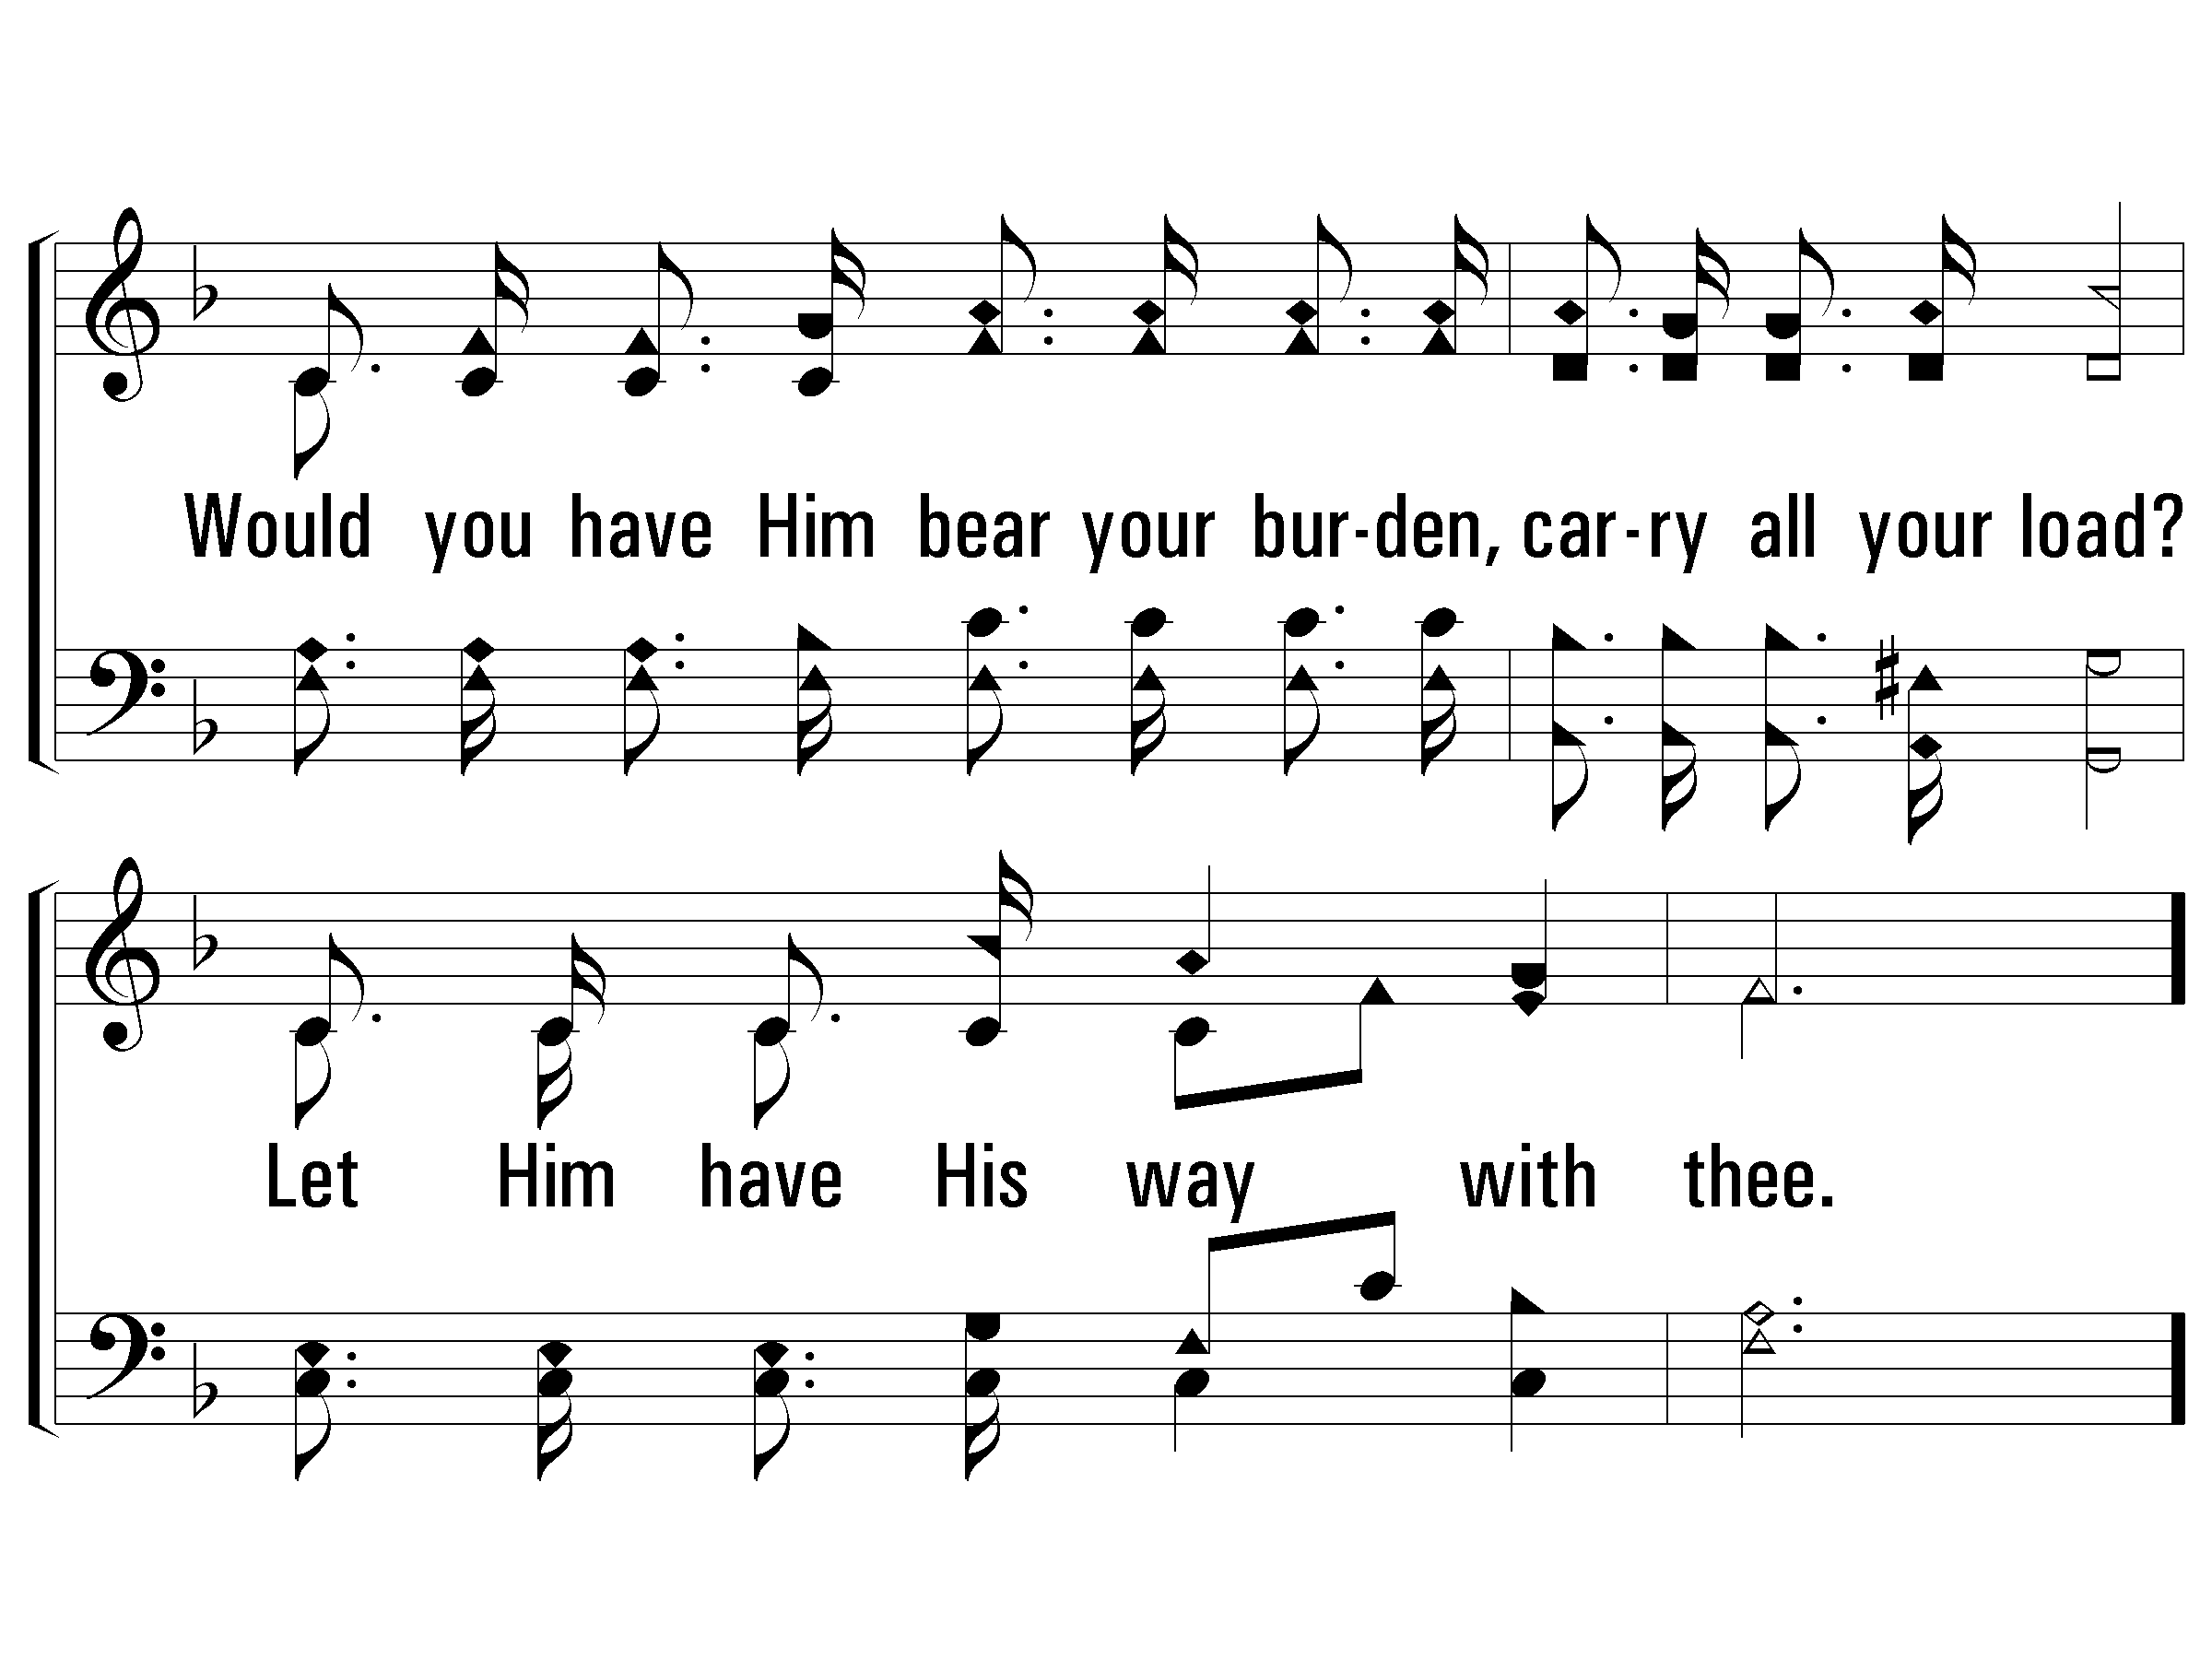
1 - Let Him Have His Way with Thee
389
© 2008 The Paperless Hymnal®

Slide 31
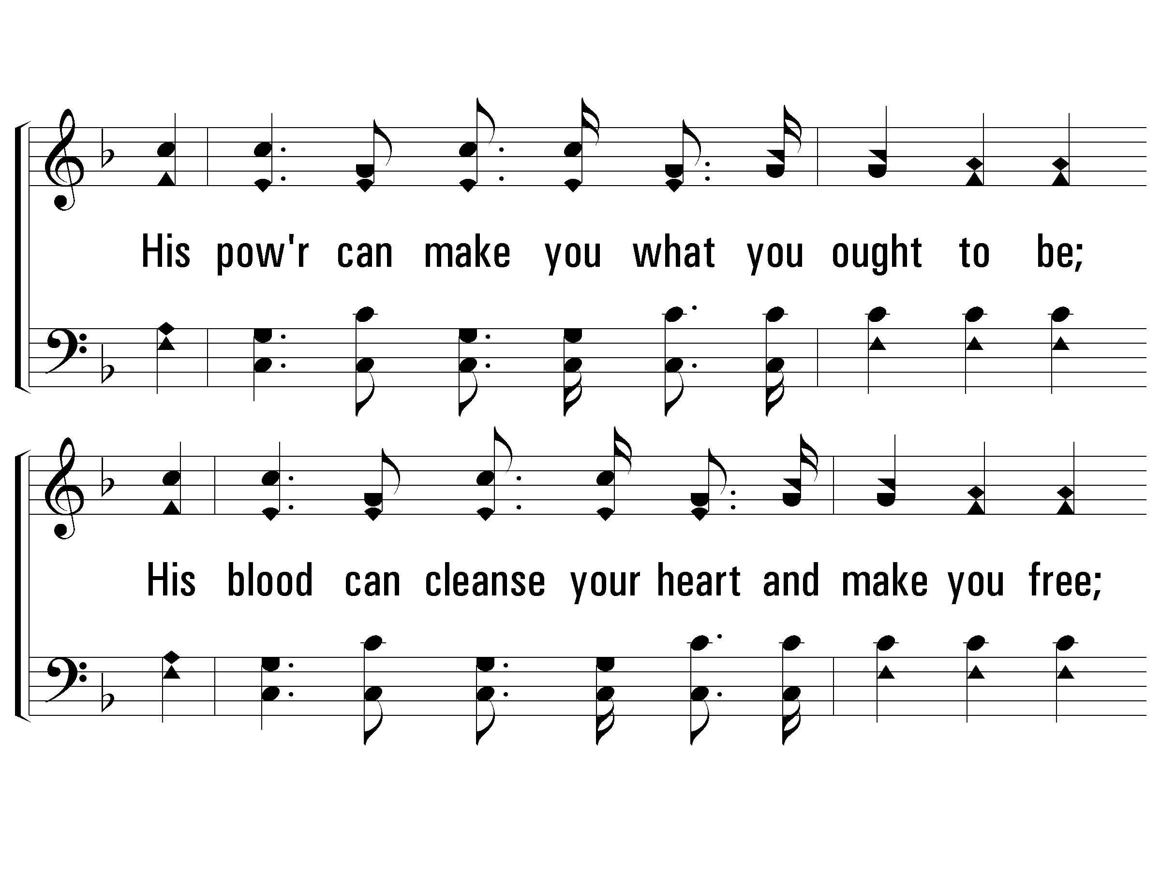
c - Let Him Have His Way with Thee
389
His power can make you what you ought to be;
His blood can cleanse your heart and make you free;
His love can fill your soul, and you will see
'Twas best for Him to have His way with thee.
© 2008 The Paperless Hymnal®

Slide 32
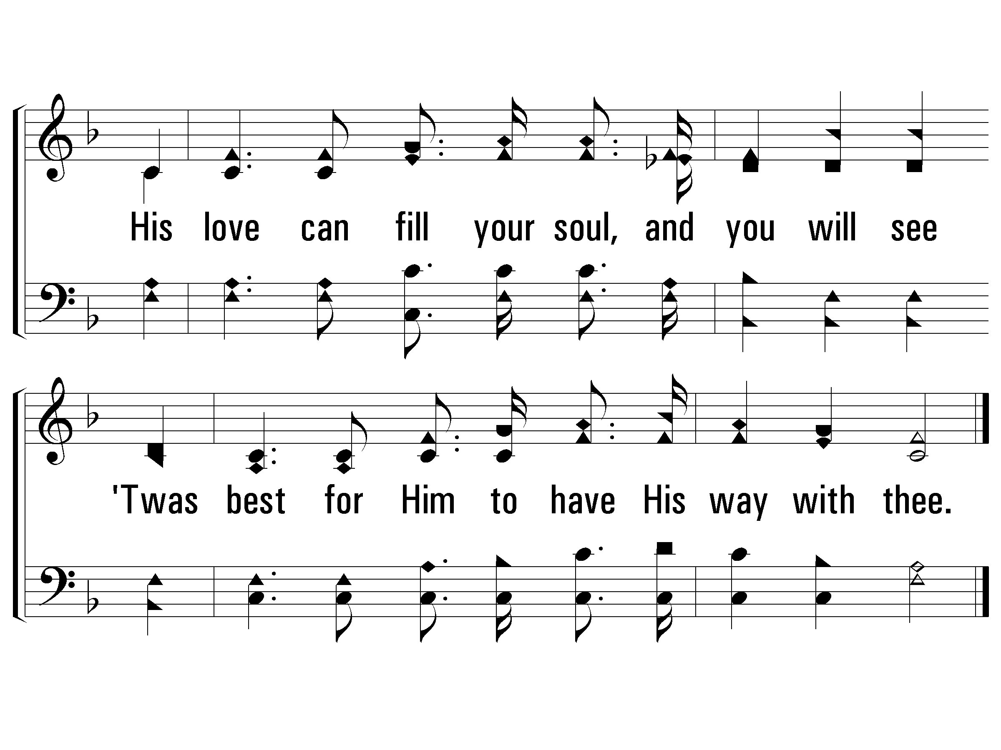
c - Let Him Have His Way with Thee
389
© 2008 The Paperless Hymnal®

Slide 33
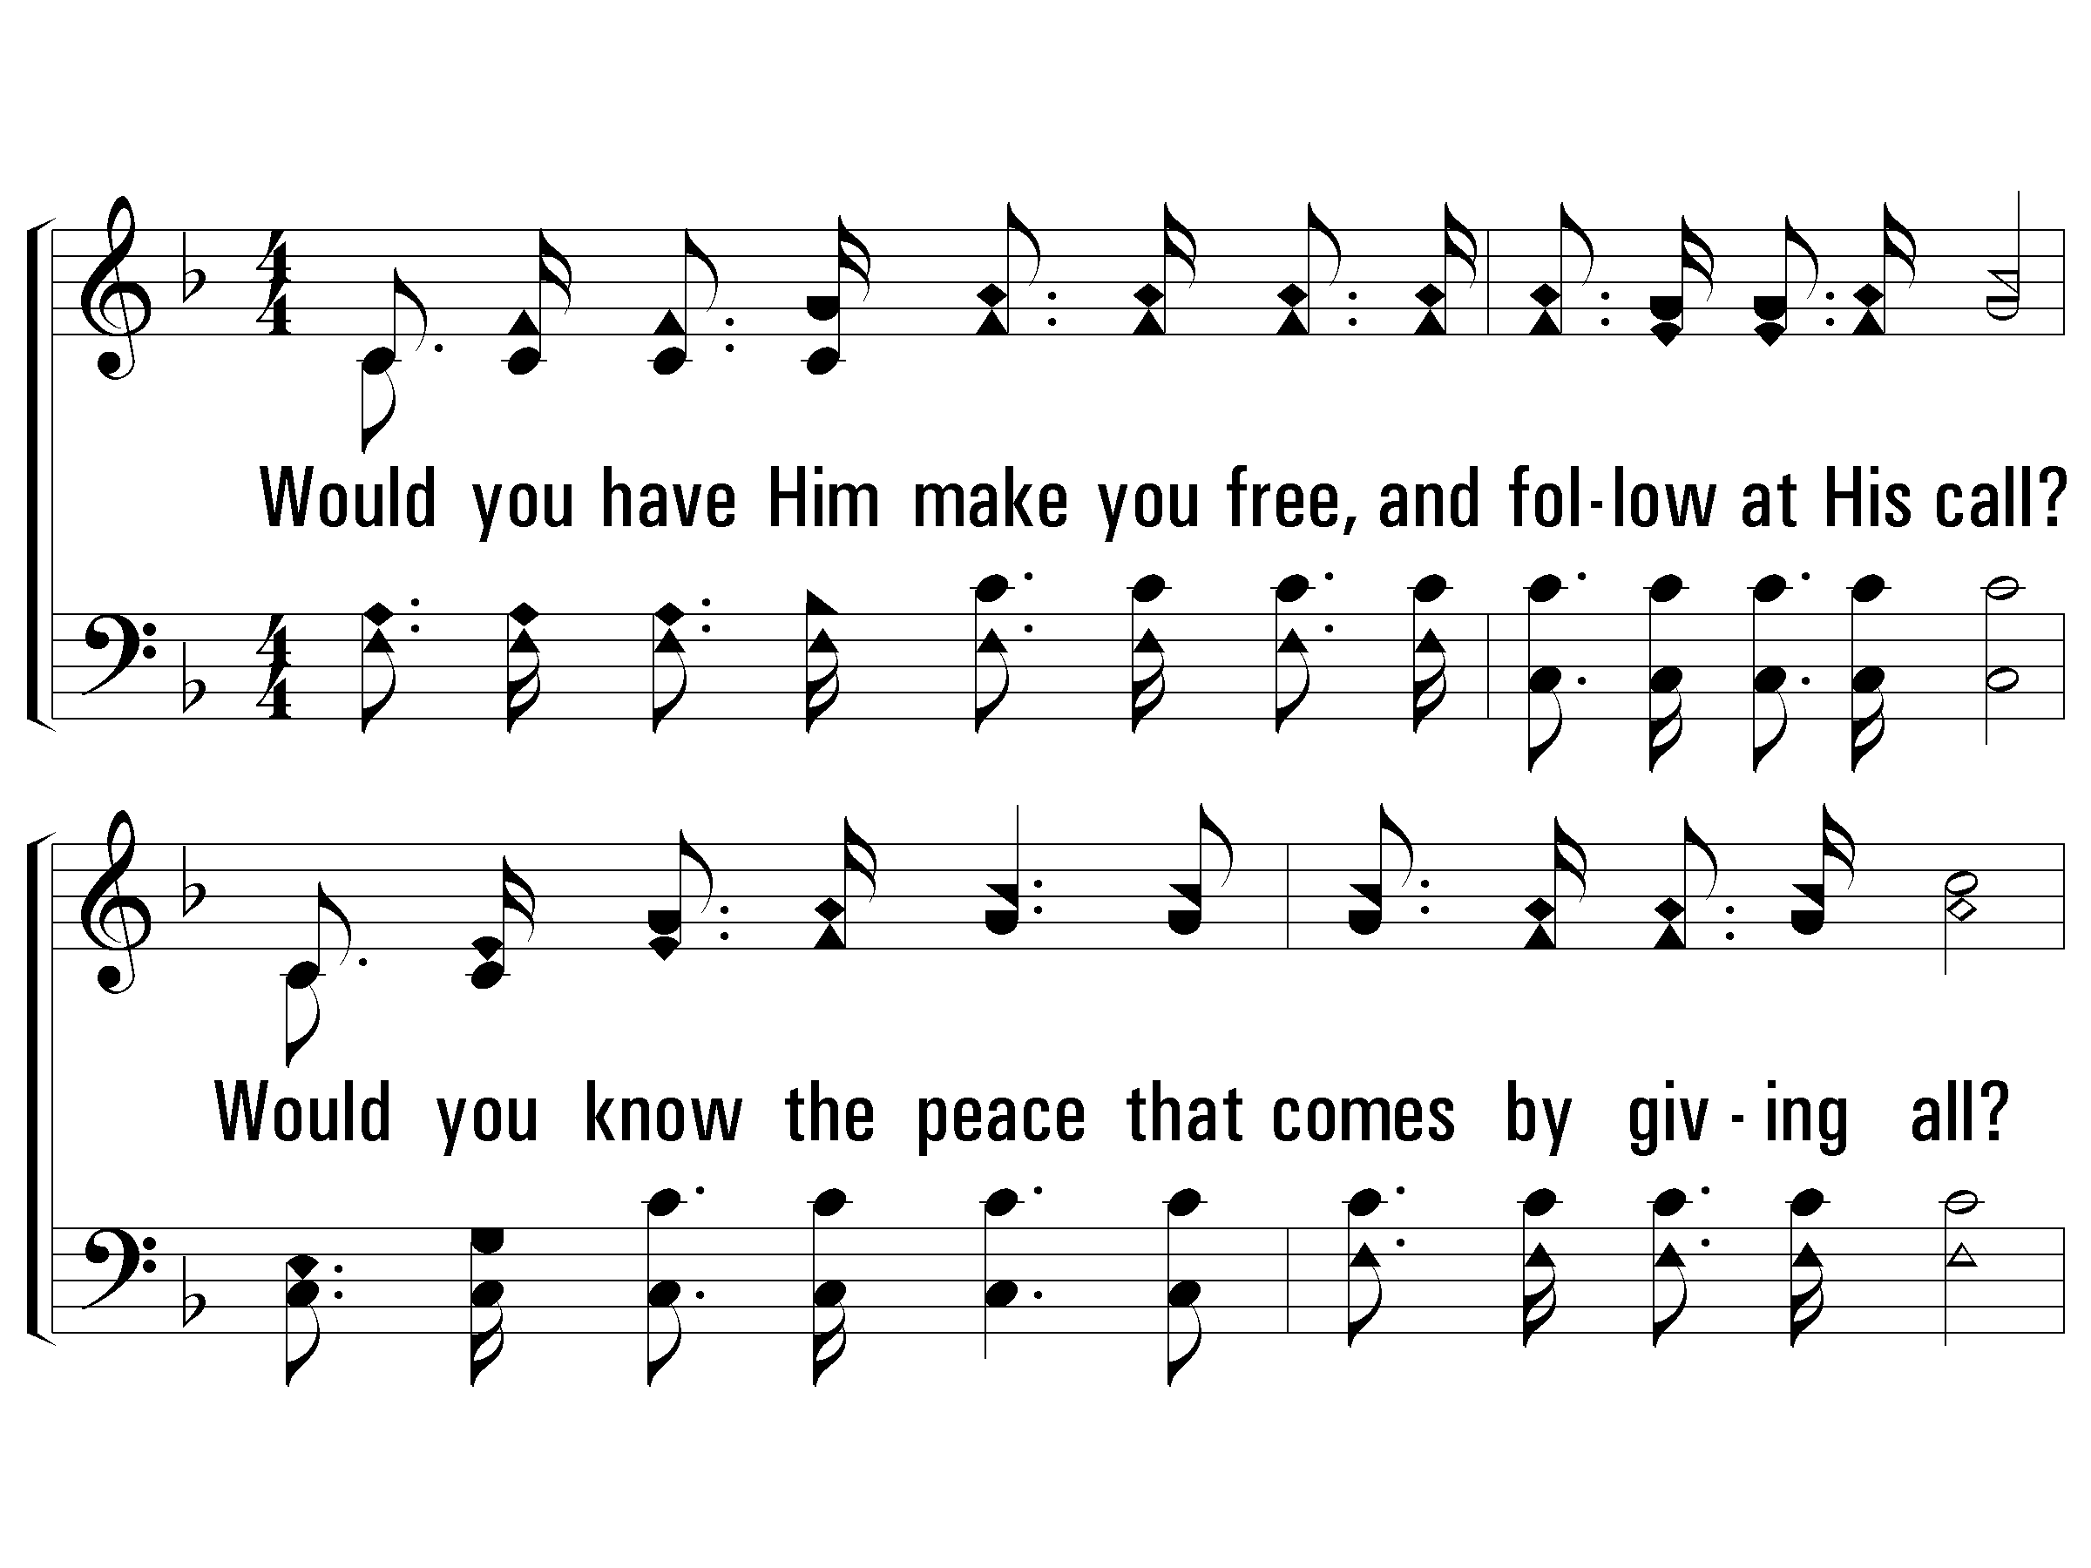
2 - Let Him Have His Way with Thee
389
2.
Would you have Him make you free, and follow at His call?
Would you know the peace that comes by giving all?
Would you have Him save you, so that you need never fall?
Let Him have His way with thee.
Words & Music: Cyrus S. Nusbaum
© 2008 The Paperless Hymnal®

Slide 34
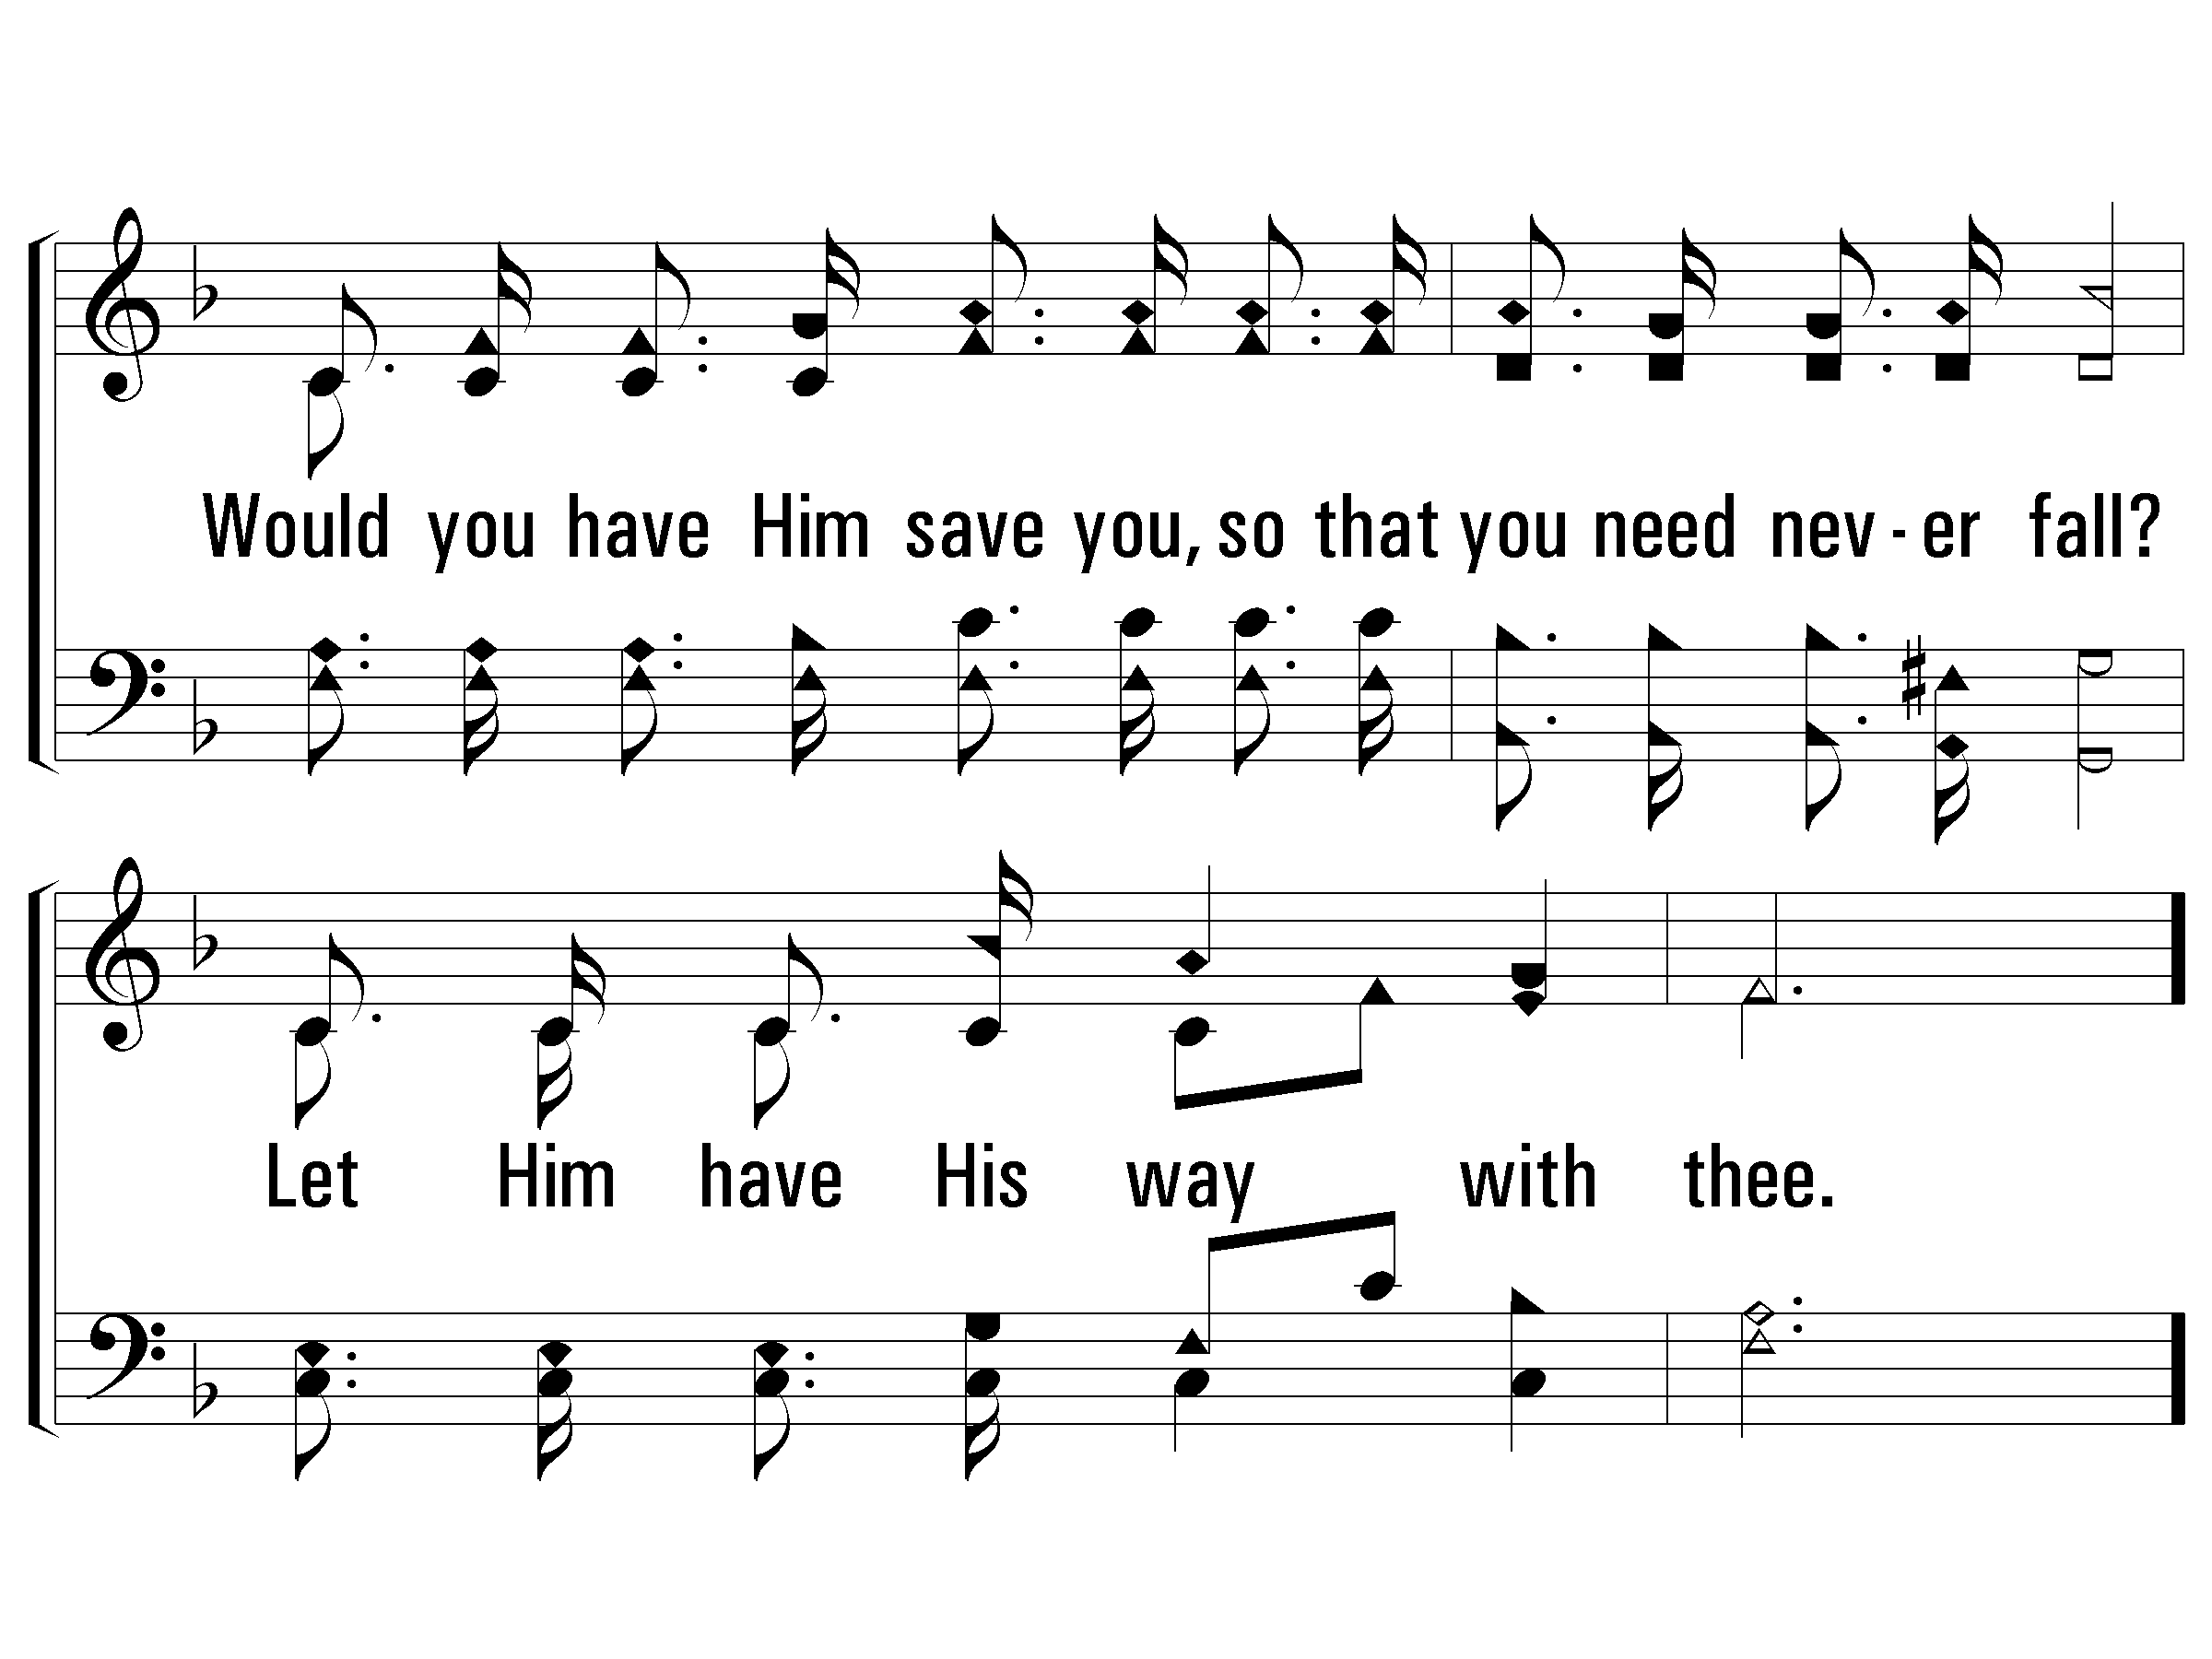
2 - Let Him Have His Way with Thee
389
© 2008 The Paperless Hymnal®

Slide 35
c - Let Him Have His Way with Thee
389
His power can make you what you ought to be;
His blood can cleanse your heart and make you free;
His love can fill your soul, and you will see
'Twas best for Him to have His way with thee.
© 2008 The Paperless Hymnal®

Slide 36
c - Let Him Have His Way with Thee
389
© 2008 The Paperless Hymnal®

Slide 37
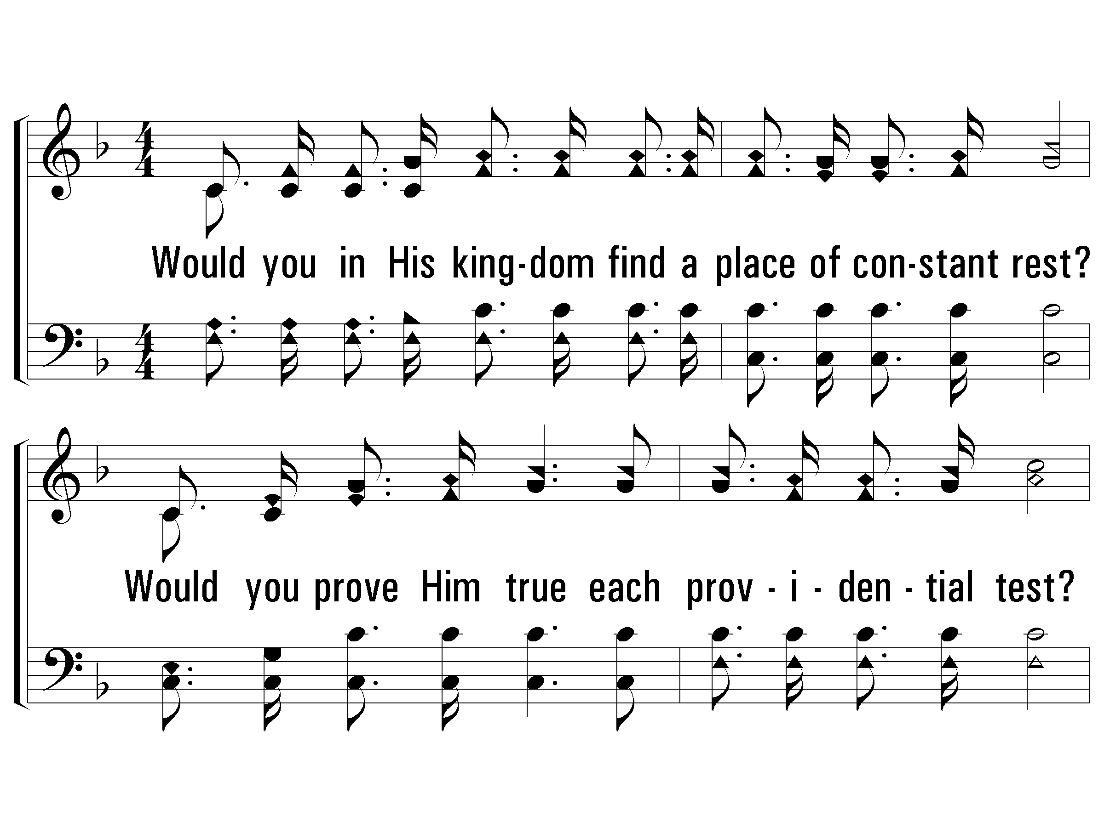
3 - Let Him Have His Way with Thee
389
3.
Would you in His kingdom find a place of constant rest?
Would you prove Him true each providential test?
Would you in His service labor always at your best?
Let Him have His way with thee.
Words & Music: Cyrus S. Nusbaum
© 2008 The Paperless Hymnal®

Slide 38
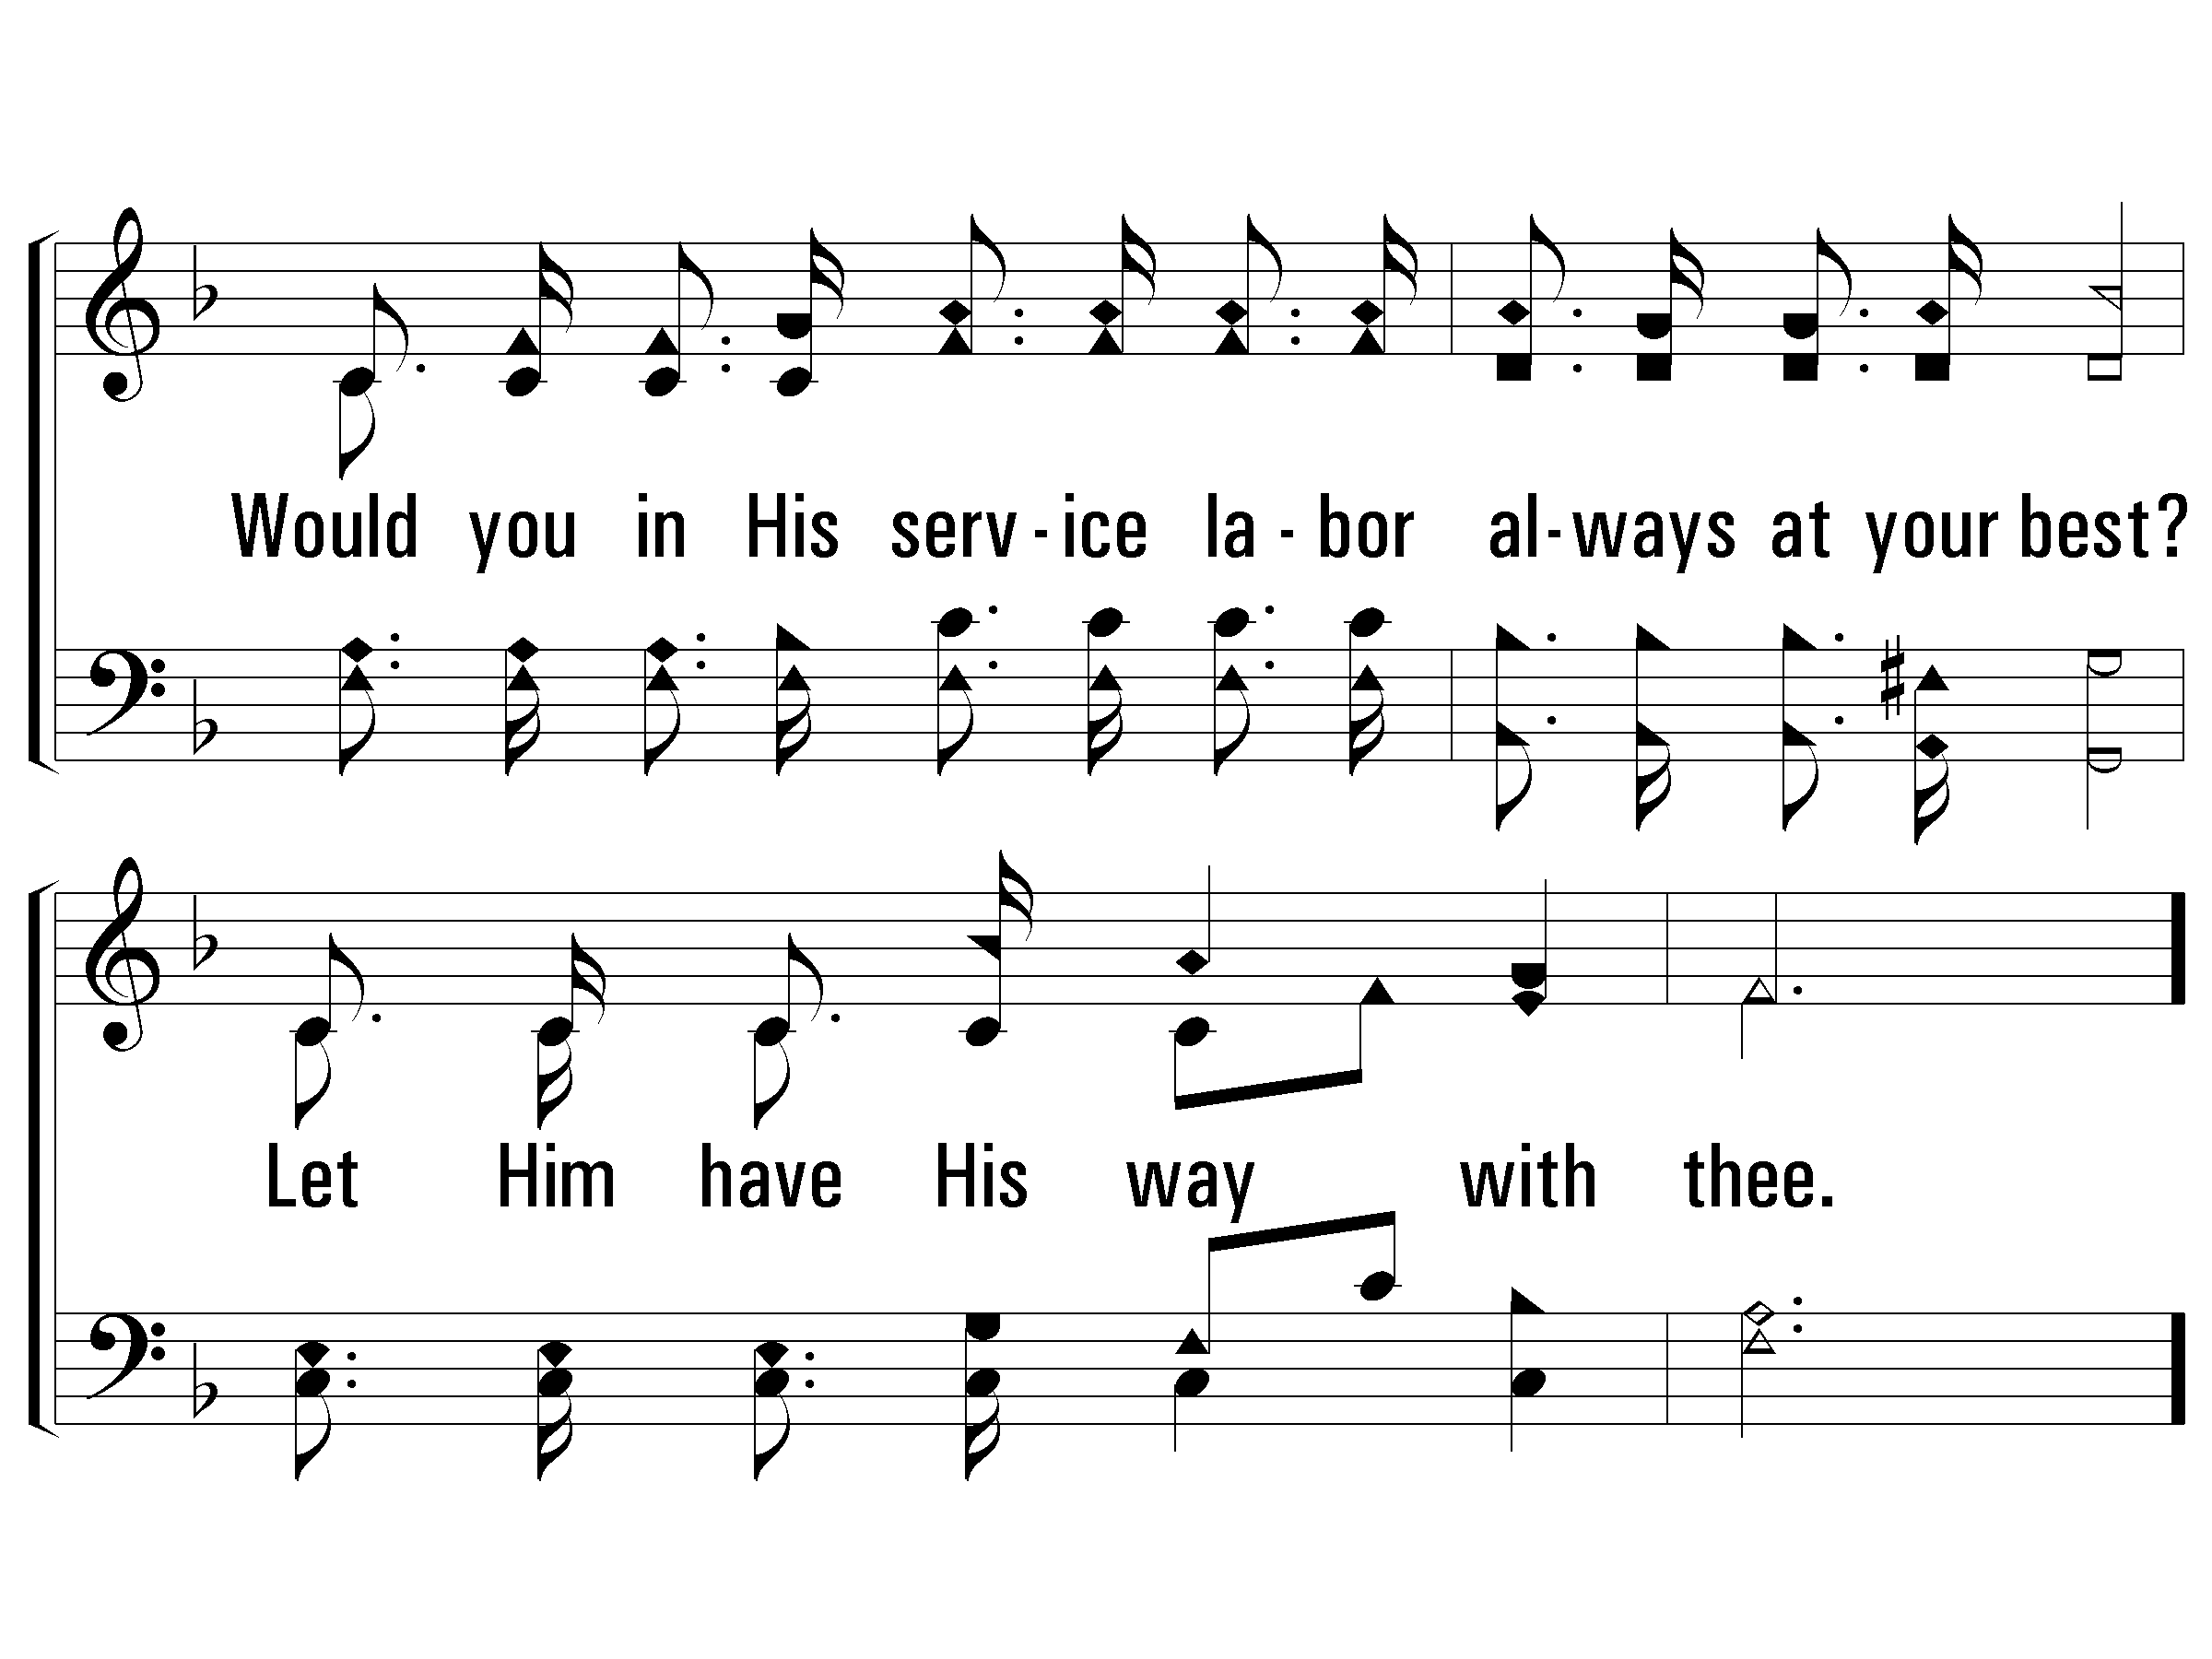
3 - Let Him Have His Way with Thee
389
© 2008 The Paperless Hymnal®

Slide 39
c - Let Him Have His Way with Thee
389
His power can make you what you ought to be;
His blood can cleanse your heart and make you free;
His love can fill your soul, and you will see
'Twas best for Him to have His way with thee.
© 2008 The Paperless Hymnal®

Slide 40
c - Let Him Have His Way with Thee
389
© 2008 The Paperless Hymnal®

