Slide 1
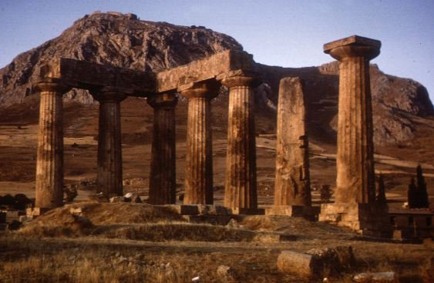
"Now Concerning"—Reply To Their Letter –
Liberty In Christ – 7:1-16:4
“The Risen Christ – Our Hope”
1 Corinthians 15:1-34

Slide 2
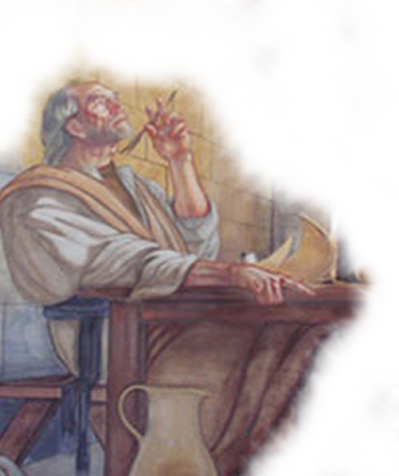
“The Risen Christ – Our Hope” – 1 Corinthians 15:1-58
“The Risen Christ – Our Hope”
1 Corinthians 15:1-58
Answering Questions
First question pertained to marriage – (Chapter 7)
The second question dealt with eating meat offered to idols – (Chapters 8-10)
Chapters 11:2-16:4 deal with a variety of topics, (headship, the Lord’s Supper & miraculous spiritual gifts –
The resurrection – (15:1-58)

Slide 3
“The Risen Christ – Our Hope” – 1 Corinthians 15:1-58
“The Risen Christ – Our Hope”
1 Corinthians 15:1-58
The Problem At Corinth
They had accepted a gospel message that taught the resurrection of Christ. (15:1-4)
What some of them were denying was the bodily resurrection of believers. (15:12-13)
But Paul points out that such a position is contradictory. (15:12-19)
There existed a group of Christians at Corinth, who were enthralled with the "wisdom of this world" (Chapters 1-3)

Slide 4
“The Risen Christ – Our Hope” – 1 Corinthians 15:1-58
“The Risen Christ – Our Hope”
1 Corinthians 15:1-58
The Problem At Corinth
“In the eyes of the Greeks the body was the prison-house of the soul, and death was a release of the soul from its captivity. The resurrection of the body, therefore, was regarded by them as a calamity rather than as a blessing, and so contrary to all sound philosophy as to excite ridicule. (Acts 17:32)” - McGarvey - (p. 145)

Slide 5

“The Risen Christ – Our Hope” – 1 Corinthians 15:1-58
The Gospel Paul Preached (1-11)
1 Corinthians 15:1-11 (NKJV) ¹ Moreover, brethren, I declare to you the gospel which I preached to you, which also you received and in which you stand, ² by which also you are saved, if you hold fast that word which I preached to you--unless you believed in vain. ³ For I delivered to you first of all that which I also received: that Christ died for our sins according to the Scriptures, ⁴ and that He was buried, and that He rose again the third day according to the Scriptures,

Slide 6
“The Risen Christ – Our Hope” – 1 Corinthians 15:1-58
The Gospel Paul Preached (1-11)
1 Corinthians 15:1-11 (NKJV) ⁵ and that He was seen by Cephas, then by the twelve. ⁶ After that He was seen by over five hundred brethren at once, of whom the greater part remain to the present, but some have fallen asleep. ⁷ After that He was seen by James, then by all the apostles. ⁸ Then last of all He was seen by me also, as by one born out of due time. ⁹ For I am the least of the apostles, who am not worthy to be called an apostle, because I persecuted the church of God.

Slide 7
“The Risen Christ – Our Hope” – 1 Corinthians 15:1-58
The Gospel Paul Preached (1-11)
1 Corinthians 15:1-11 (NKJV) ¹⁰ But by the grace of God I am what I am, and His grace toward me was not in vain; but I labored more abundantly than they all, yet not I, but the grace of God which was with me. ¹¹ Therefore, whether it was I or they, so we preach and so you believed.

Slide 8
“The Risen Christ – Our Hope” – 1 Corinthians 15:1-58
The Gospel Paul Preached (1-11)
Facts of The Gospel
They had heard, received and stood in the gospel Paul preached – (1)
They were saved IF they held fast to the truth of the gospel – [They could lose their salvation!! Doctrine matters] (2)
The death, burial and resurrection of Jesus Christ – three facts upon which the gospel of our salvation rests – (3,4)
The resurrection of Jesus witnessed by many – (5-8; Mat 28; Mk 14; Lk 24; etc.)
They had believed these facts – (9-11)

Slide 9
“The Risen Christ – Our Hope” – 1 Corinthians 15:1-58
The Consequences Of A No Resurrection Doctrine: 15:12-19
Contradictory & Illogical
How could “some” deny the general resurrection without denying Christ’s resurrection?– (12,13)
If the dead do not rise – then Jesus was not raised – and the apostles were liars - (14,15)
If the dead do not rise – the gospel is false and they were still lost - (16,17)
Christians who have died have perished – and suffering for Christ is a worthless endeavor!!!! - (18,19)

Slide 10
“The Risen Christ – Our Hope” – 1 Corinthians 15:1-58
Christ's Resurrection A Guarantee Of Our Own: 15:20-34
Christ Is Raised / Therefore
He was the first / in like manner others will follow - (20)
Physical death came by man – by man also came the resurrection – (21; John 1:14; Phil. 2:6-10; Heb 2:9-18)
Physical death came because of Adam’s sin – all die, but by Christ’s life, ALL WILL BE made alive, i.e. resurrected - (21,22; John 5:28,29)
When? Christ has BEEN raised – all others raised at His coming – (23)

Slide 11
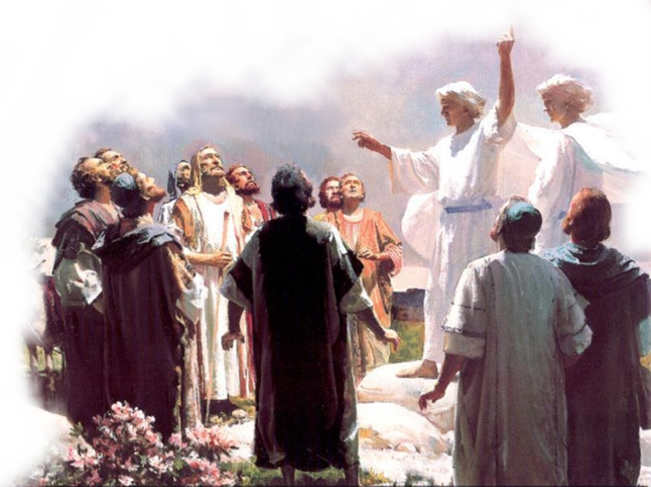
“The Risen Christ – Our Hope” – 1 Corinthians 15:1-58
Christ's Resurrection A Guarantee Of Our Own: 15:20-34
When Will The Dead Be Raised?
At the end – when Jesus comes again - (23,24) – the LAST Trump (15:52 – John 5:28; 1 Thes 4:13-17)
Then Jesus delivers the kingdom back to the Father – [not establish it!] (24,25) –
Marks the defeat of the LAST enemy – DEATH (25,26; 54-57)

Slide 12
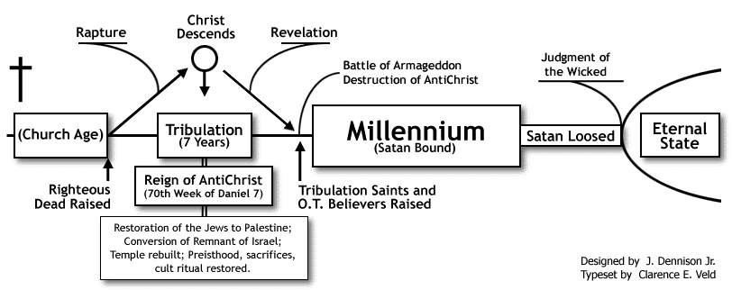


Denies Pre millennialism
http://www.blueletterbible.org/faq/dispre.html

Slide 13
“The Risen Christ – Our Hope” – 1 Corinthians 15:1-58
Christ's Resurrection A Guarantee Of Our Own: 15:20-34
Denies Pre-Millennialism
NO room for two, or three separate resurrections in 1007 years – (John 5:28,29; 2 Thes 1:6-12; 2 Pet 3:10-14)
Jesus is reigning NOW – (25-28; Mark 9:1; Acts 2:25-36; Col. 1:13; Rev 1:5-8; 5:10)
When Jesus returns He will give the kingdom over to the Father – His reign will end when death is defeated – which will occur when the last trump sounds – and all come forth from the grave - (24-28; 52-55; John 5:28,29)

Slide 14
“The Risen Christ – Our Hope” – 1 Corinthians 15:1-58
Christ's Resurrection A Guarantee Of Our Own: 15:20-34
Christ Is Raised / Therefore
We’re baptized unto life, not death - (29)
We suffer for Christ – risking our lives for the cause of Christ? – (30-32; Acts 14:22; Rom 8:18-39; 2 Cor. 4:7-12; 2 Tim 3:12)
We live holy lives, for if the dead are not raised, we might as well live it up - (32)
This doctrine effects our lives – (33)
We should “awake to righteousness and not sin” – (34; 1 John 2:1,2)
Some are ignorant – (34)

Slide 15
“The Risen Christ – Our Hope” – 1 Corinthians 15:1-58
“The Risen Christ – Our Hope”
1 Corinthians 15:1-58
The death, burial and resurrection of Christ are the foundational FACTS of our hope!
We will all be raised and stand before the Lord to be judged! (2 Cor. 5:10)
Have you believed the gospel?
Have you been baptized that you may live with Christ?
Are you living a holy life in view of the resurrection and judgment?

Slide 17
“The Risen Christ – Our Hope” – 1 Corinthians 15:1-58
“The Risen Christ – Our Hope”
1 Corinthians 15:1-58
Charts by Don McClain
Prepared September 18, 2011
Preached September 18, 2011
West 65th Street church of Christ
P.O. Box 190062
Little Rock AR 72219
501-568-1062
Prepared using PPT 2010 –
Email – donmcclain@sbcglobal.net
More PPT & Audio Sermons:
http://w65stchurchofchrist.org/donmaccla/2010SermonPage.html
Note – Many of the transition effects used in this presentation are lost using PPT 2007 Viewer
To view transitions you can download PPT 2010 viewer:
http://www.microsoft.com/downloads/en/details.aspx?displaylang=en&FamilyID=cb9bf144-1076-4615-9951-294eeb832823

Slide 18
John 5:24-30 (NASB95) ²⁴ "Truly, truly, I say to you, he who hears My word, and believes Him who sent Me, has eternal life, and does not come into judgment, but has passed out of death into life. ²⁵ "Truly, truly, I say to you, an hour is coming and now is, when the dead will hear the voice of the Son of God, and those who hear will live.

Slide 19
John 5:24-30 (NASB95) ²⁶ "For just as the Father has life in Himself, even so He gave to the Son also to have life in Himself; ²⁷ and He gave Him authority to execute judgment, because He is the Son of Man. ²⁸ "Do not marvel at this; for an hour is coming, in which all who are in the tombs will hear His voice,

Slide 20
John 5:24-30 (NASB95) ²⁹ and will come forth; those who did the good deeds to a resurrection of life, those who committed the evil deeds to a resurrection of judgment. ³⁰ "I can do nothing on My own initiative. As I hear, I judge; and My judgment is just, because I do not seek My own will, but the will of Him who sent Me.

