Slide 2
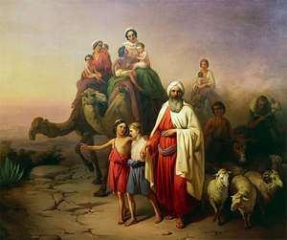
THREE CITIES OF ABRAHAM

Slide 3
3 CITIES OF ABRAHAM
City Behind- UR
Leave
City Beside- SODOM
Live
City Before- HEAVEN
Look

