Slide 1
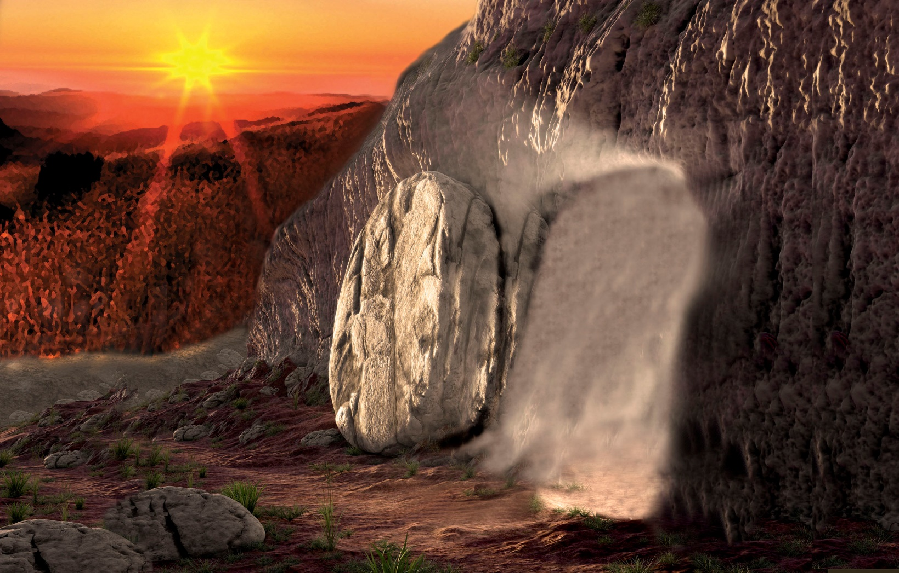

Slide 2
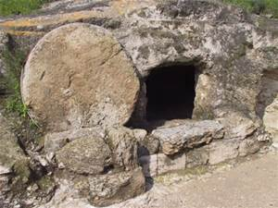

Slide 3
the sepulchre.

Slide 4
THE EMPTY TOMB
John 20:1-10

Slide 5
John 20:1-10
The first day of the week cometh Mary Magdalene early, when it was yet dark, unto the sepulchre, and seeth the stone taken away from the sepulchre.
² Then she runneth, and cometh to Simon Peter, and to the other disciple, whom Jesus loved, and saith unto them, They have taken away the Lord out of the sepulchre, and we know not where they have laid him.
³ Peter therefore went forth, and that other disciple, and came to the sepulchre.
⁴ So they ran both together: and the other disciple did outrun Peter, and came first to the sepulchre.
⁵ And he stooping down, and looking in, saw the linen clothes lying; yet went he not in

Slide 6
⁶ Then cometh Simon Peter following him, and went into the sepulchre, and seeth the linen clothes lie,
⁷ And the napkin, that was about his head, not lying with the linen clothes, but wrapped together in a place by itself.
⁸ Then went in also that other disciple, which came first to the sepulchre, and he saw, and believed.
⁹ For as yet they knew not the scripture, that he must rise again from the dead.
¹⁰ Then the disciples went away again unto their own home

Slide 7
Have you ever looked into an open grave
3 days after a loved one has been buried and
Find that it is open…yet no body!

Slide 8
The Resurrection of Jesus Christ!
So many scriptures in the Bible about
The Resurrection of Jesus Christ from the grave…
And our Resurrection.

Slide 9
Where does the Bible first mention a
Resurrection?

Slide 10
Job 19:25-27 1st mentioned of a resurrection of the body..
²⁵ For I know that my redeemer liveth, and that he shall stand at the latter day upon the earth:
²⁶ And though after my skin worms destroy this body, yet in my flesh shall I see God:
²⁷ Whom I shall see for myself, and mine eyes shall behold, and not another; though my reins be consumed within me.

Slide 11
Job knew he was a sinner who would die.
But he also knew that God would send a redeemer to pay the price for his sins,
enabling him to live again

Slide 12
Other Scriptures

Slide 13
Isa. 26:19
¹⁹ Thy dead men shall live, together with my dead body shall they arise. Awake and sing, ye that dwell in dust: for thy dew is as the dew of herbs, and the earth shall cast out the dead.
Isaiah also spoke of a bodily resurrection in which he would participate.

Slide 14
Daniel 12:1-2
1 And at that time shall Michael stand up, the great prince which standeth for the children of thy people: and there shall be a time of trouble, such as never was since there was a nation even to that same time: and at that time thy people shall be delivered, every one that shall be found written in the book.
² And many of them that sleep in the dust of the earth shall awake, some to everlasting life, and some to shame and everlasting contempt.

Slide 15
John 5:28-29
²⁸ Marvel not at this: for the hour is coming, in the which all that are in the graves shall hear his voice,
²⁹ And shall come forth; they that have done good, unto the resurrection of life; and they that have done evil, unto the resurrection of damnation.

Slide 16
I John 3:2
3 Behold, what manner of love the Father hath bestowed upon us, that we should be called the sons of God: therefore the world knoweth us not, because it knew him not.
² Beloved, now are we the sons of God, and it doth not yet appear what we shall be: but we know that, when he shall appear, we shall be like him; for we shall see him as he is.

Slide 17
Luke 24:36-43
³⁶ And as they thus spake, Jesus himself stood in the midst of them, and saith unto them, Peace be unto you.
³⁷ But they were terrified and affrighted, and supposed that they had seen a spirit.
³⁸ And he said unto them, Why are ye troubled? and why do thoughts arise in your hearts?
³⁹ Behold my hands and my feet, that it is I myself: handle me, and see; for a spirit hath not flesh and bones, as ye see me have.
⁴⁰ And when he had thus spoken, he shewed them his hands and his feet.
⁴¹ And while they yet believed not for joy, and wondered, he said unto them, Have ye here any meat?
⁴² And they gave him a piece of a broiled fish, and of an honeycomb.
⁴³ And he took it, and did eat before them.

Slide 18
For believers, the resurrection from the dead is perhaps the greatest promise the Bible offers.
The idea of eternal life in a state of perpetual bliss goes well beyond amazing for those who read the Scriptures
Most of what we know about the resurrection comes from the New Testament. But from reading about it there we can tell it isn’t exclusively a New Testament idea. As an example, the Sadducees knew about a resurrection, even though they didn’t believe in one (Matt. 22:23).

Slide 19
Paul began by reminding his readers how important the Lord’s resurrection is to believers. In fact it’s so important that our salvation depends on believing in it.
I Cor. 15
1Moreover, brethren, I declare unto you the gospel which I preached unto you, which also ye have received, and wherein ye stand;
² By which also ye are saved, if ye keep in memory what I preached unto you, unless ye have believed in vain.
³ For I delivered unto you first of all that which I also received, how that Christ died for our sins according to the scriptures;
⁴ And that he was buried, and that he rose again the third day according to the scriptures:

Slide 20
⁵ And that he was seen of Cephas, then of the twelve:
⁶ After that, he was seen of above five hundred brethren at once; of whom the greater part remain unto this present, but some are fallen asleep.
⁷ After that, he was seen of James; then of all the apostles.
⁸ And last of all he was seen of me also, as of one born out of due time.
⁹ For I am the least of the apostles, that am not meet to be called an apostle, because I persecuted the church of God.
¹⁰ But by the grace of God I am what I am: and his grace which was bestowed upon me was not in vain; but I laboured more abundantly than they all: yet not I, but the grace of God which was with me.
¹¹ Therefore whether it were I or they, so we preach, and so ye believed.

Slide 21
Romans 10:8-10⁸ But what saith it? The word is nigh thee, even in thy mouth, and in thy heart: that is, the word of faith, which we preach;
⁹ That if thou shalt confess with thy mouth the Lord Jesus, and shalt believe in thine heart that God hath raised him from the dead, thou shalt be saved.
¹⁰ For with the heart man believeth unto righteousness; and with the mouth confession is made unto salvation.
This verse made it official.
Belief in the Lord’s resurrection is a requirement for salvation.

Slide 22
¹² Now if Christ be preached that he rose from the dead, how say some among you that there is no resurrection of the dead?
¹³ But if there be no resurrection of the dead, then is Christ not risen:
¹⁴ And if Christ be not risen, then is our preaching vain, and your faith is also vain.
¹⁵ Yea, and we are found false witnesses of God; because we have testified of God that he raised up Christ: whom he raised not up, if so be that the dead rise not.
¹⁶ For if the dead rise not, then is not Christ raised:
¹⁷ And if Christ be not raised, your faith is vain; ye are yet in your sins.
¹⁸ Then they also which are fallen asleep in Christ are perished.
¹⁹ If in this life only we have hope in Christ, we are of all men most miserable.

Slide 23
²⁰ But now is Christ risen from the dead, and become the firstfruits of them that slept.
²¹ For since by man came death, by man came also the resurrection of the dead.
²² For as in Adam all die, even so in Christ shall all be made alive.
²³ But every man in his own order: Christ the firstfruits; afterward they that are Christ's at his coming.
²⁴ Then cometh the end, when he shall have delivered up the kingdom to God, even the Father; when he shall have put down all rule and all authority and power.
²⁵ For he must reign, till he hath put all enemies under his feet.
²⁶ The last enemy that shall be destroyed is death.
²⁷ For he hath put all things under his feet. But when he saith all things are put under him, it is manifest that he is excepted, which did put all things under him.

Slide 24
²⁸ And when all things shall be subdued unto him, then shall the Son also himself be subject unto him that put all things under him, that God may be all in all.
²⁹ Else what shall they do which are baptized for the dead, if the dead rise not at all? why are they then baptized for the dead?

Slide 25
Why is so much said in the Bible about
Baptism?
1. It is a command of God. Acts 10:48
2. It is the means of getting into Jesus Christ.
Gal.3:27
3. It is a means of getting into the body, the
church. I Cor. 12:13
4. It is to be preached to all so all may be one
in Jesus Christ. 2 Tim.4:2-4; Matt. 28:18-20

Slide 26
What about our body?
“So will it be with the resurrection of the dead. The body that is sown is perishable, it is raised imperishable; it is sown in dishonor, it is raised in glory; it is sown in weakness, it is raised in power; it is sown a natural body, it is raised a spiritual body. If there is a natural body, there is also a spiritual body” (1 Cor. 15:42-44).

Slide 27
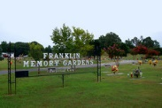

Slide 28
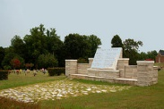

Slide 29
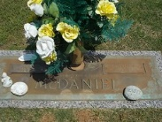

Slide 30
Just as Jesus was raised from the dead, so shall we be.
John 5:28,29
²⁸ Marvel not at this: for the hour is coming, in the which all that are in the graves shall hear his voice,
²⁹ And shall come forth; they that have done good, unto the resurrection of life; and they that have done evil, unto the resurrection of damnation.

Slide 33
No Doubt about Jesus being raised
Up from the Grave.
No Doubt about you and I being
Raised up from the Grave.
Where will you be in eternity?

