Slide 1
Tried by Fire
Malachi 3:3
Notes:
The story is told about a ladies’ Bible study in which the ladies came across the passage in Malachi 3:3.

Slide 2
Malachi 3:3
3 And he shall sit as a refiner and purifier of silver: and he shall purify the sons of Levi, and purge them as gold and silver, that they may offer unto the Lord an offering in righteousness.
Notes:
1 Behold, I will send my messenger, and he shall prepare the way before me: and the Lord, whom ye seek, shall suddenly come to his temple, even the messenger of the covenant, whom ye delight in: behold, he shall come, saith the Lord of hosts.
² But who may abide the day of his coming? and who shall stand when he appeareth? for he is like a refiner's fire, and like fullers' soap:
³ And he shall sit as a refiner and purifier of silver: and he shall purify the sons of Levi, and purge them as gold and silver, that they may offer unto the Lord an offering in righteousness.

Slide 3
The Refining of Silver
1. The refiner breaks up the natural ore.
2. The refiner places unrefined silver into a crucible.
3. The refiner places the crucible in the heated furnace to remove dross.
Notes:
So one of the ladies decided to visit a silversmith and report to the others on what he said about the subject.
She went, but didn’t tell the silversmith the reason for her visit.
While there she asked him to tell her about the process of refining silver.

Slide 4
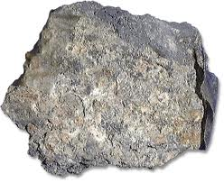

Slide 5
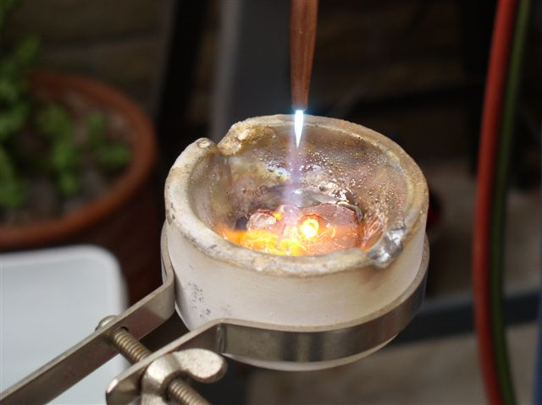

Slide 6
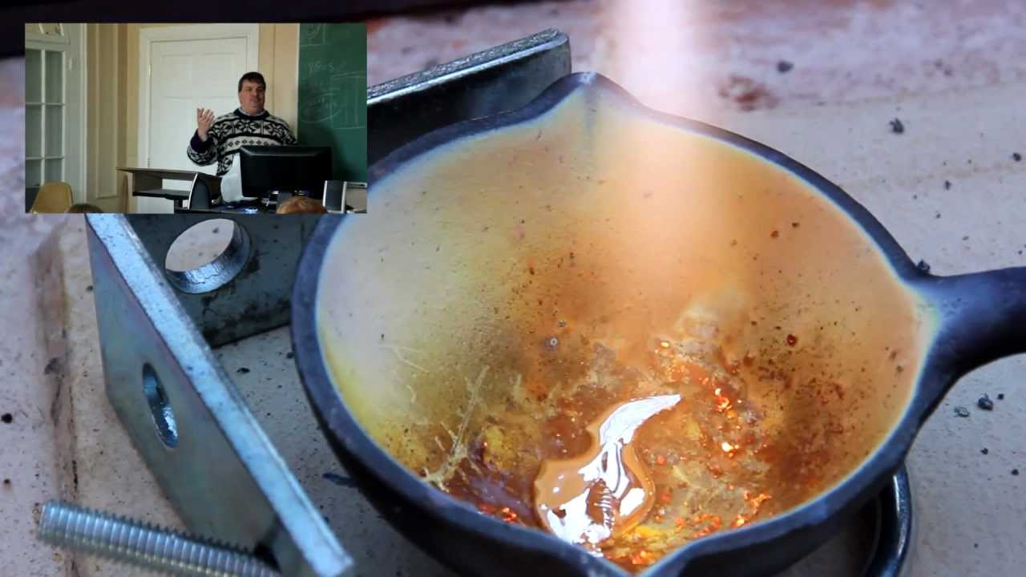

Slide 7
The Refining of Silver
4. The refiner raises the temperature to higher degrees.
5. The refiner continues to remove the impurities until the silver is pure.

Slide 8
The Refiner’s Job
“Oh, yes ma’am. I must sit and watch the furnace constantly, for, if the time necessary for refining is exceeded in the slightest degree, the silver will be injured.”
Notes:
As the lady listened intently on the process of refining silver, she asked, “Sir, do you watch while the work of the refining is going on?’
He replied….

Slide 9
Malachi 3:3
3 And he shall sit as a refiner and purifier of silver: and he shall purify the sons of Levi, and purge them as gold and silver, that they may offer unto the Lord an offering in righteousness.
Notes:
The lady at once saw the beauty and comfort of the statement…Malachi 3:3.
The lady realized God sees it as necessary to put His children into the furnace but His eye is steadily intent on the work of purifying, and His wisdom and love are both engaged in the best manner for us.
Our trials don’t come at random, but are used

Slide 10
“How do you know when the process is finished?”
Notes:
Before the lady left the silversmith, she had one final question to ask:

Slide 11
His Response
“When I can see my image in the silver, the refining process is complete.”
Notes:
“Oh, that’s quite simple!
When I can see my own image in the silver the refining process is complete.”

Slide 12
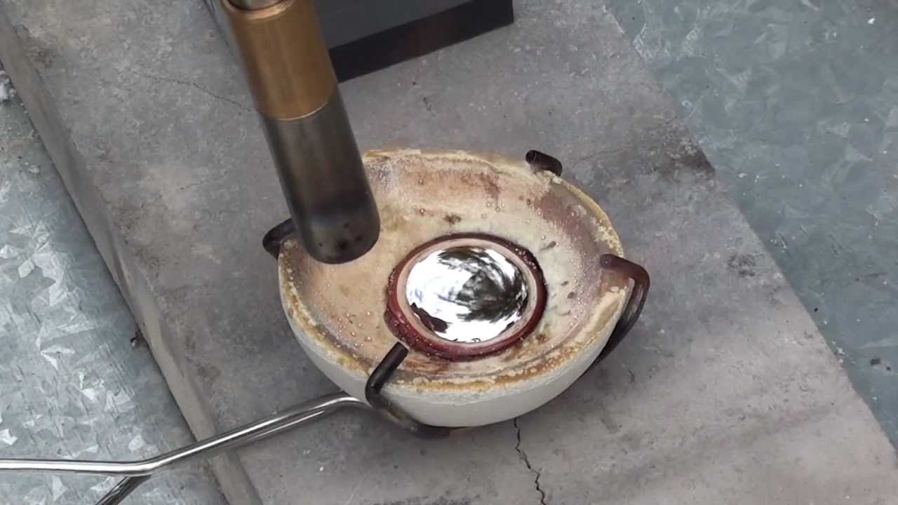

Slide 13
How does this apply to me?

Slide 14
Why do we go through trials?

Slide 15
Why does bad things happen to good people?

Slide 16
The Lesson
God allows us to go through hard times so that we may grow and become smooth and shiny.
Notes:
Children of God—no matter what happens in life—whether good or bad, is for the purpose of making you more Christ like!

Slide 17
Romans 8:28-29
28 And we know that all things work together for good to them that love God, to them who are the called according to his purpose. 29 For whom he did foreknow, he also did predestinate to be conformed to the image of his Son, that he might be the firstborn among many brethren.

Slide 18
His Goal
His goal is for us to become a reflection of Him that not only He can see, but also so others can see Him in us.

Slide 19
1 Peter 4:12-13
12 Beloved, think it not strange concerning the fiery trial which is to try you, as though some strange thing happened unto you:
13 But rejoice, inasmuch as ye are partakers of Christ's sufferings; that, when his glory shall be revealed, ye may be glad also with exceeding joy.
Notes:
Don’t fear the trials and afflictions, instead, choose to focus on the Savior and His purpose.

Slide 20
So how do we become like Him?

Slide 21
The Refining of Us
1. Jeremiah 23:29 Is not my word like as a fire? saith the Lord; and like a hammer that breaketh the rock in pieces?
Notes:
We too must go through the refining process.
Just as the hardened rock must be broken down, so must we. God’s word is like the hammer that breaks us down.
Hebrews 4:12
¹² For the word of God is quick, and powerful, and sharper than any twoedged sword, piercing even to the dividing asunder of soul and spirit, and of the joints and marrow, and is a discerner of the thoughts and intents of the heart.
Isaiah 55:8-11
⁸ For my thoughts are not your thoughts, neither are your ways my ways, saith the Lord.
⁹ For as the heavens are higher than the earth, so are my ways higher than your ways, and my thoughts than your thoughts.
¹⁰ For as the rain cometh down, and the snow from heaven, and returneth not thither, but watereth the earth, and maketh it bring forth and bud, that it may give seed to the sower, and bread to the eater:
¹¹ So shall my word be that goeth forth out of my mouth: it shall not return unto me void, but it shall accomplish that which I please, and it shall prosper in the thing whereto I sent it.

Slide 22
The Refining of Us
2. Proverbs 17:3 The fining pot is for silver, and the furnace for gold: but the Lord trieth the hearts.
Notes:
Just as the furnace is used to purify silver in the crucible, our Refiner uses heat to purify our hearts and cleanse our character.
Proverbs 17:3 says, “The crucible for silver and the furnace for gold, but the Lord tests the heart.”
1 Thessalonians 2:4
⁴ But as we were allowed of God to be put in trust with the gospel, even so we speak; not as pleasing men, but God, which trieth our hearts.

Slide 23
The Refining of Us
3. Proverbs 25:4 The Dross-layer of impurities
Take away the dross from the silver, and there shall come forth a vessel for the finer.
Notes:
The Bible says, “Remove the dross from the silver, and a silversmith can produce a vessel” (Proverbs 25:4)
For us individually, dross represents any wrong motive, wrong attitude, wrong action—anything that keeps us from being all that God wants us to be—anything that isn’t like Christ.
Sin is our dross.
Romans 3:23
²³ For all have sinned, and come short of the glory of God;
Check out the dross of the Corinthian brethren
1 Corinthians 6:9-11
⁹ Know ye not that the unrighteous shall not inherit the kingdom of God? Be not deceived: neither fornicators, nor idolaters, nor adulterers, nor effeminate, nor abusers of themselves with mankind,
¹⁰ Nor thieves, nor covetous, nor drunkards, nor revilers, nor extortioners, shall inherit the kingdom of God.
¹¹ And such were some of you: but ye are washed, but ye are sanctified, but ye are justified in the name of the Lord Jesus, and by the Spirit of our God.
1 Corinthians 6:9-11
Surely you know that people who do wrong will not get to enjoy God’s kingdom. Don’t be fooled. These are the people who will not get to enjoy his kingdom: those who sin sexually, those who worship idols, those who commit adultery, men who let other men use them for sex or who have sex with other men, those who steal, those who are greedy, those who drink too much, those who abuse others with insults, and those who cheat.

Slide 24
The Refining of Us
4. Psalm 12:6 The words of the Lord are pure words: as silver tried in a furnace of earth, purified seven times.
Notes:
Our impurities will rise to the top, but (Psalm 12:6) the words of the Lord are pure words: as silver tried in a furnace of earth, purified seven times..
1 Corinthians 6:9-11
⁹ Know ye not that the unrighteous shall not inherit the kingdom of God? Be not deceived: neither fornicators, nor idolaters, nor adulterers, nor effeminate, nor abusers of themselves with mankind,
¹⁰ Nor thieves, nor covetous, nor drunkards, nor revilers, nor extortioners, shall inherit the kingdom of God.
¹¹ And such were some of you: but ye are washed, but ye are sanctified, but ye are justified in the name of the Lord Jesus, and by the Spirit of our God.
1 Corinthians 6:9-11
Surely you know that people who do wrong will not get to enjoy God’s kingdom. Don’t be fooled. These are the people who will not get to enjoy his kingdom: those who sin sexually, those who worship idols, those who commit adultery, men who let other men use them for sex or who have sex with other men, those who steal, those who are greedy, those who drink too much, those who abuse others with insults, and those who cheat. ¹¹ In the past some of you were like that. ¹¹ In the past some of you were like that. But you were washed clean, you were made holy, and you were made right with God in the name of the Lord Jesus Christ and by the Spirit of our God.
Why do we keep our impurities?
Hebrews 12:1
12 Wherefore seeing we also are compassed about with so great a cloud of witnesses, let us lay aside every weight, and the sin which doth so easily beset us, and let us run with patience the race that is set before us,

Slide 25
The Refining of Us
5. Job 23:10 But he knoweth the way that I take: when he hath tried me, I shall come forth as gold.
Notes:
The Bible says our Refiner sits over the refining process to purify us,
Job 23:10 But he knoweth the way that I take: when he hath tried me, I shall come forth as gold.
Jeremiah 10:23
²³ O Lord, I know that the way of man is not in himself: it is not in man that walketh to direct his steps.
Psalm 119:105
¹⁰⁵ Thy word is a lamp unto my feet, and a light unto my path.
1 John 1:7
⁷ But if we walk in the light, as he is in the light, we have fellowship one with another, and the blood of Jesus Christ his Son cleanseth us from all sin.

Slide 26
Why do we go through trials?

Slide 27
1 Peter 1:6
Wherein ye greatly rejoice, though now for a season, if need be, ye are in heaviness through manifold temptations:

Slide 28
1 Peter 1:7
That the trial of your faith, being much more precious than of gold that perisheth, though it be tried with fire, might be found unto praise and honour and glory at the appearing of Jesus Christ:

Slide 29
1 Peter 1:8
Whom having not seen, ye love; in whom, though now ye see him not, yet believing, ye rejoice with joy unspeakable and full of glory:

Slide 30
“How do you know when the process is finished?”

Slide 31
Look at your Reflection!
Notes:
In spite of building our lives on Jesus Christ, there will be times we go through the fire. But we will be purified, coming out cleaner, brighter, and tested.
Fire purifies what is good.
Jesus knows what is inside us and what is worth saving.
Are we laying up treasures for ourselves? Matthew 6:19-21
Are we making an idol of someone or something? Romans 1:21-25
Are we becoming spiritually arrogant? Pharisee and tax collector Luke 18:9-14
Is our refining processed finished?

Slide 32
Are all the impurities (dross) gone?

Slide 33
Are you 100% pure?
Notes:
That’s what God wants!

Slide 34
Are you 100%- without a doubt- faithful?

Slide 35
JESUS
Notes:
How do you know the refining process is finished….because in your reflection, you will see……JESUS!

Slide 36
If not…
1 John 1:9
If we confess our sins, he is faithful and just to forgive us our sins, and to cleanse us from all unrighteousness.

Slide 37
Are you a Christian?
Notes:
Become one tonight by removing all your dross, by being baptized—just as Ananias told Saul…..
Acts 22:16
¹⁶ And now why tarriest thou? arise, and be baptized, and wash away thy sins, calling on the name of the Lord.
Let God have His way with you as stand and sing!

