Slide 1
We began a small series on Inheritance

Slide 2
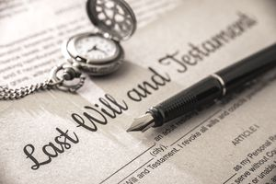
Inheritance
Al talked about our earthly inheritance: What
Guy spoke about attaining our heavenly inheritance: When
Matt spoke about Heaven: Where
Today we will talk about repentance the HOW.

Slide 3
Turning around
A hard look at repentance

Slide 4
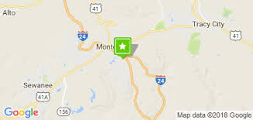
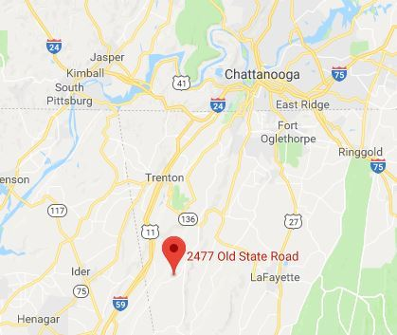

South Pittsburg to Monteagle TN

Slide 5

Getting off the right path can be easy.
-Enter through the narrow gate; for the gate is wide and the way is broad that leads to destruction, and there are many who enter through it. For the gate is small and the way is narrow that leads to life, and there are few who find it. Matthew 7:13-14
-for all have sinned and fall short of the glory of God, Romans 3:23

Slide 6
Sometimes we need a course correction.
Looking at some examples of repentance

Slide 7
Luke 23:33-43
33 When they came to the place called The Skull, there they crucified Him and the criminals, one on the right and the other on the left. But Jesus was saying, “Father, forgive them; for they do not know what they are doing.”...
39 One of the criminals who were hanged there was hurling abuse at Him, saying, “Are You not the Christ? Save Yourself and us!” But the other answered, and rebuking him said, “Do you not even fear God, since you are under the same sentence of condemnation? And we indeed are suffering justly, for we are receiving what we deserve for our deeds; but this man has done nothing wrong.” And he was saying, “Jesus, remember me when You come in Your kingdom!” And He said to him, “Truly I say to you, today you shall be with Me in Paradise.”

Slide 8
Did you hear it?
Repentance is turning around.

Slide 9
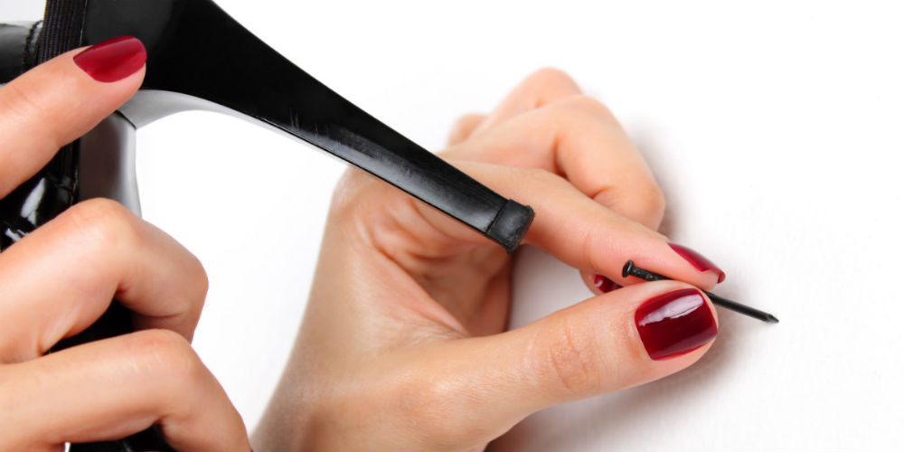
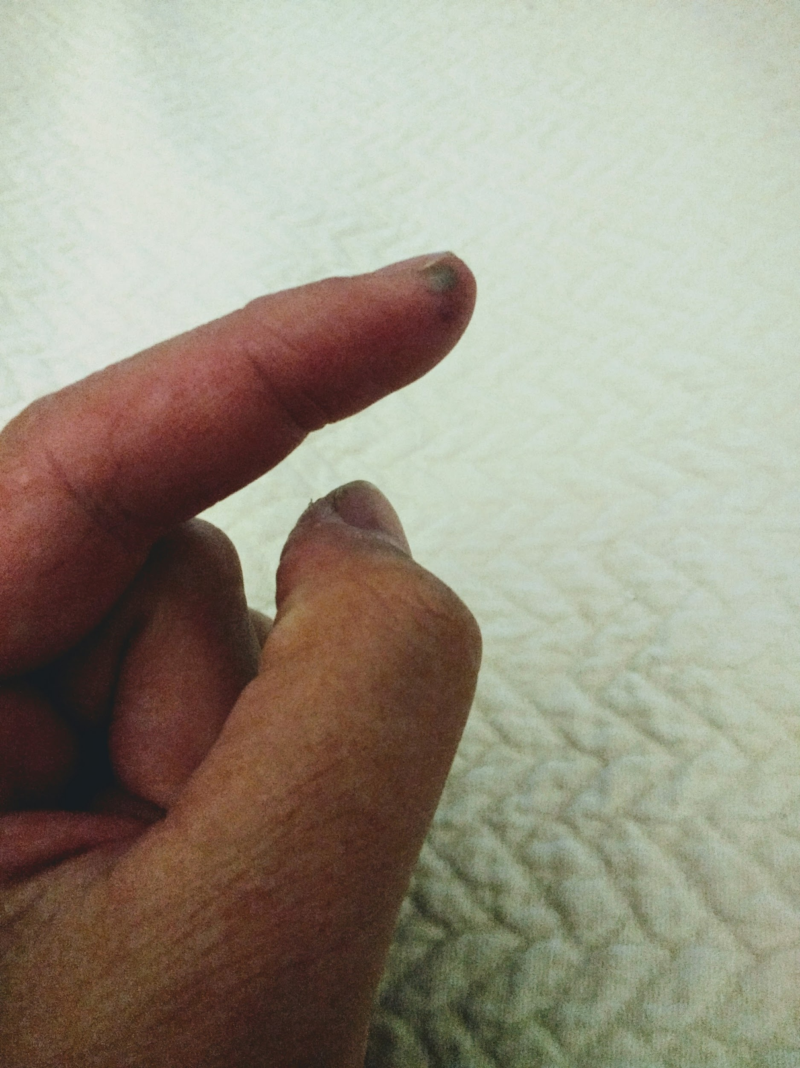
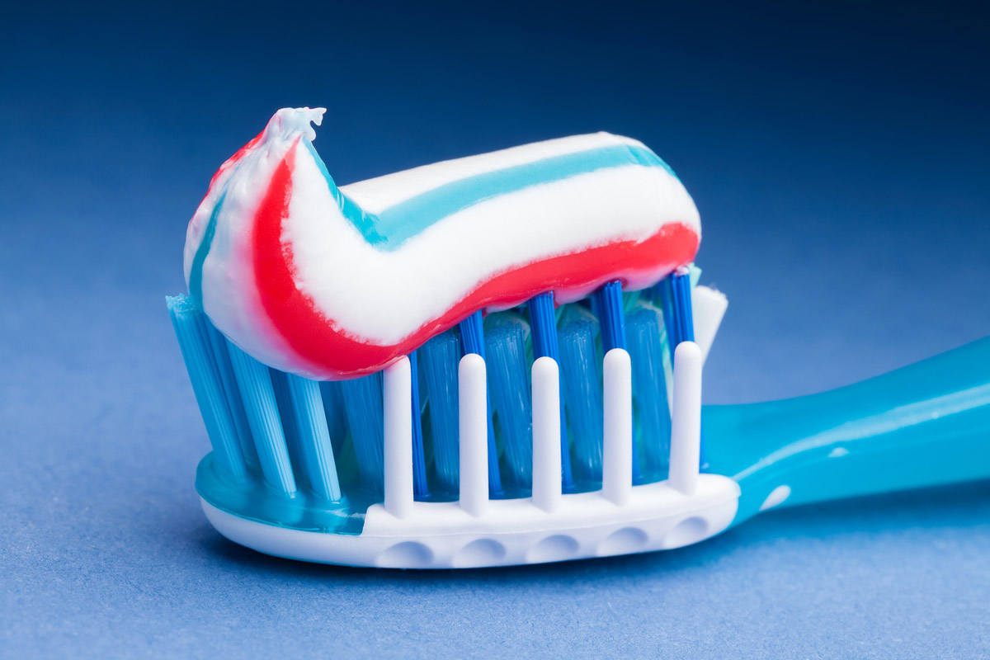
Have you ever used an object for something different than it was intended for?

Slide 10
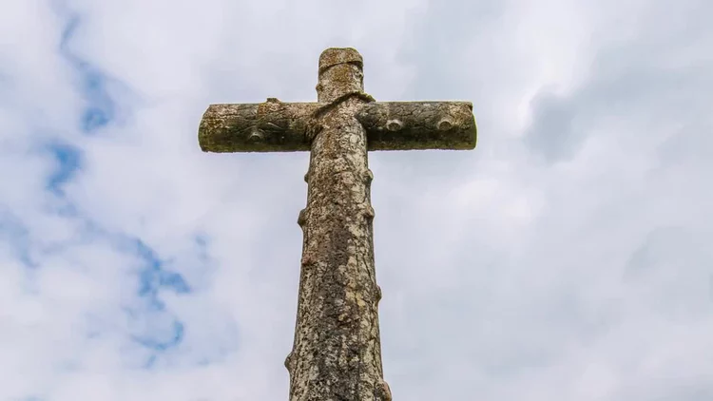

Slide 11
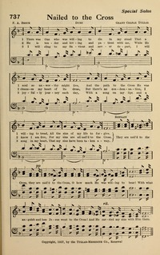
Nailed to the cross
-Words written by Carrie Beck in 1855
-Music written by Grant Tullar in 1869

Slide 12
Repentance = Turning around
Repentance isn’t just about sin its about life.

Slide 13
II Samuel 12:13-15 & 16
Then David said to Nathan, “I have sinned against the Lord.” And Nathan said to David, “The Lord also has taken away your sin; you shall not die. However, because by this deed you have given occasion to the enemies of the Lord to blaspheme, the child also that is born to you shall surely die.” So Nathan went to his house… Then the Lord struck the child that Uriah’s widow bore to David, so that he was very sick.
16 David therefore inquired of God for the child; and David fasted and went and lay all night on the ground.

Slide 14

Did you see it that time?
Repentance is regret.

Slide 15
Psalm 51
Be gracious to me, O God, according to Your lovingkindness;
According to the greatness of Your compassion blot out my transgressions. Wash me thoroughly from my iniquity And cleanse me from my sin. For I know my transgressions, And my sin is ever before me. Against You, You only, I have sinned And done what is evil in Your sight, So that You are justified when You speak And blameless when You judge. Behold, I was brought forth in iniquity, And in sin my mother conceived me. Behold, You desire truth in the innermost being And in the hidden part You will make me know wisdom. Purify me with hyssop, and I shall be clean; Wash me, and I shall be whiter than snow.

Slide 16
Psalm 51
Make me to hear joy and gladness, Let the bones which You have broken rejoice. Hide Your face from my sins And blot out all my iniquities. Create in me a clean heart, O God, And renew a steadfast spirit within me. Do not cast me away from Your presence And do not take Your Holy Spirit from me. Restore to me the joy of Your salvation And sustain me with a willing spirit. Then I will teach transgressors Your ways, And sinners will be converted to You. Deliver me from bloodguiltiness, O God, the God of my salvation; Then my tongue will joyfully sing of Your righteousness. O Lord, open my lips,
That my mouth may declare Your praise.

Slide 17
Psalm 51: 16-17
For You do not delight in sacrifice, otherwise I would give it;
You are not pleased with burnt offering.
The sacrifices of God are a broken spirit;
A broken and a contrite heart,
God makes it so easy for us… All you have to do is say I am sorry and mean it.

Slide 18
John 8:3-11
The scribes and the Pharisees brought a woman caught in adultery, and having set her in the center of the court, they said to Him, “Teacher, this woman has been caught in adultery, in the very act. Now in the Law Moses commanded us to stone such women; what then do You say?” They were saying this, testing Him, so that they might have grounds for accusing Him. But Jesus stooped down and with His finger wrote on the ground. But when they persisted in asking Him, He straightened up, and said to them, “He who is without sin among you, let him be the first to throw a stone at her.” Again He stooped down and wrote on the ground. When they heard it, they began to go out one by one, beginning with the older ones, and He was left alone, and the woman, where she was, in the center of the court. Straightening up, Jesus said to her, “Woman, where are they? Did no one condemn you?” She said, “No one, Lord.” And Jesus said, “I do not condemn you, either. Go. From now on sin no more.”

Slide 19

Did you feel it?
No one my Lord...
Go and sin no more.

Slide 20
Matthew 7:1-3 & 16-20
-“Do not judge so that you will not be judged. For in the way you judge, you will be judged; and by your standard of measure, it will be measured to you. Why do you look at the speck that is in your brother’s eye, but do not notice the log that is in your own eye?
-You will know them by their fruits. Grapes are not gathered from thorn bushes nor figs from thistles, are they? So every good tree bears good fruit, but the bad tree bears bad fruit. A good tree cannot produce bad fruit, nor can a bad tree produce good fruit. Every tree that does not bear good fruit is cut down and thrown into the fire. So then, you will know them by their fruits.

Slide 21
We cannot judge a heart
But we can inspect it’s fruits

Slide 22
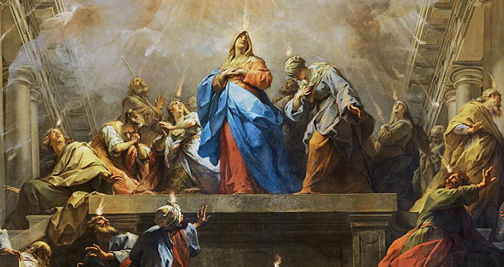
Acts 2:36-38
-Therefore let all the house of Israel know for certain that God has made Him both Lord and Christ—this Jesus whom you crucified. Now when they heard this, they were pierced to the heart, and said to Peter and the rest of the apostles, “Brethren, what shall we do?” Peter said to them, “Repent, and each of you be baptized in the name of Jesus Christ for the forgiveness of your sins; and you will receive the gift of the Holy Spirit.

Slide 23
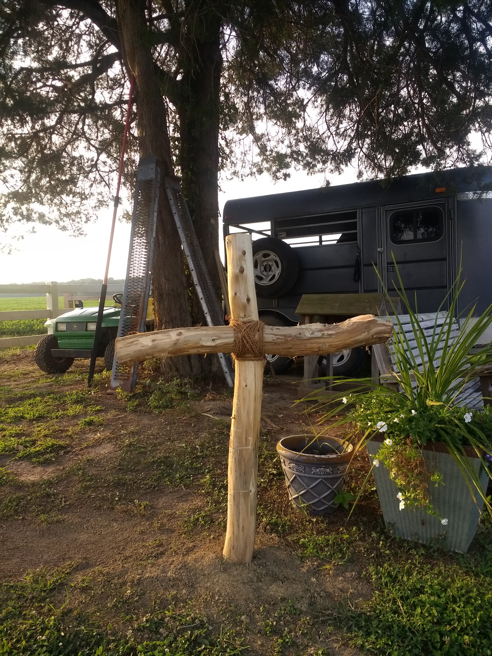
My “Nail it to” cross
I come broken to be mended
I come wounded to be healed
I come desperate to be rescued
I come empty to be filled
I come guilty to be pardoned
By the blood of Christ the lamb
And I am welcomed
With open arms, Praise God!
Just as I am

