Slide 1
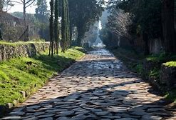

Slide 2
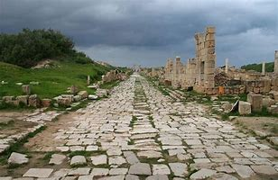

Slide 3
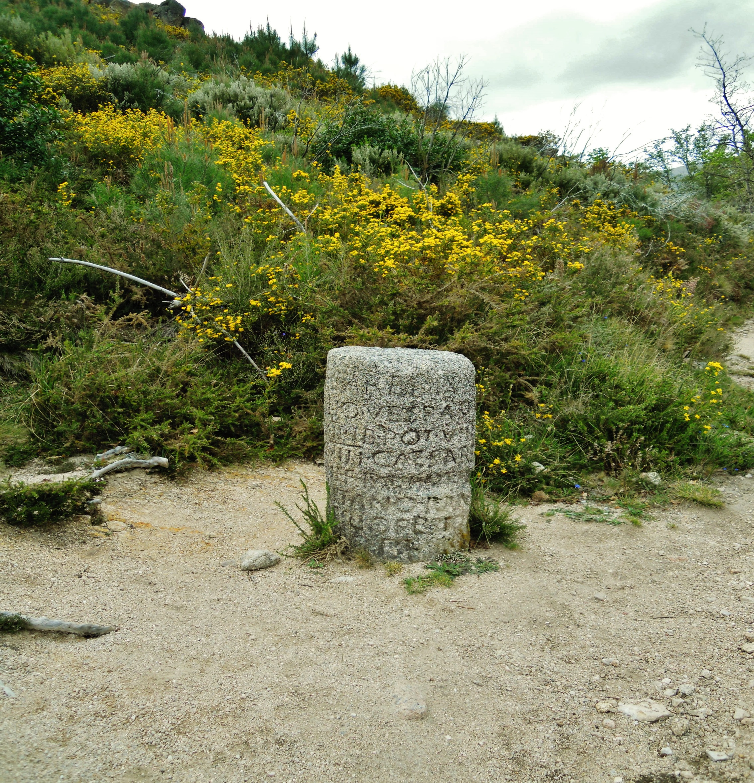

Slide 4
Matthew 5:38-42 (NKJV)
38 “You have heard that it was said, ‘An eye for an eye and a tooth for a tooth.’ 39 But I tell you not to resist an evil person. But whoever slaps you on your right cheek, turn the other to him also. 40 If anyone wants to sue you and take away your tunic, let him have your cloak also. 41 And whoever compels you to go one mile, go with him two. 42 Give to him who asks you, and from him who wants to borrow from you do not turn away.

Slide 5
Matthew 27:32 (NKJV)
32 Now as they came out, they found a man of Cyrene, Simon by name. Him they compelled to bear His cross
Mark 15:21 (NKJV)
21 Then they compelled a certain man, Simon a Cyrenian, the father of Alexander and Rufus, as he was coming out of the country and passing by, to bear His cross.
Luke 23:26 (NKJV)
26 Now as they led Him away, they laid hold of a certain man, Simon a Cyrenian, who was coming from the country, and on him they laid the cross that he might bear it after Jesus.

Slide 6
Two Mile Attitude
Matthew 5:38-42

Slide 7
Hebrews 10:25 (NKJV)
not forsaking the assembling of ourselves together, as is the manner of some, but exhorting one another, and so much more as we see the Day approaching.

Slide 8
Acts of Worship
Teach/Preach – 1 Corinthians 4:17
Sing – Ephesians 5:19
Pray – Acts 12:5
Give/Collection – 1 Corinthians 16:1-2
Lord’s Supper – Acts 20:7

Slide 9
Forgiveness
Matthew 18:21-22 (NKJV)
21 Then Peter came to Him and said, “Lord, how often shall my brother sin against me, and I forgive him? Up to seven times?”
22 Jesus said to him, “I do not say to you, up to seven times, but up to seventy times seven.

Slide 10
Forgiveness
Matthew 6:14-15 (NKJV)
14 “For if you forgive men their trespasses, your heavenly Father will also forgive you. 15 But if you do not forgive men their trespasses, neither will your Father forgive your trespasses

Slide 11
Repentance
Romans 6:1-2 (NKJV)
6 What shall we say then? Shall we continue in sin that grace may abound? 2 Certainly not! How shall we who died to sin live any longer in it?

Slide 12
Repentance
Hebrews 4:16 (NKJV)
16 Let us therefore come boldly to the throne of grace, that we may obtain mercy and find grace to help in time of need.

Slide 13
Spiritual growth
Hebrews 2:1-2 (NKJV)
2 Therefore we must give the more earnest heed to the things we have heard, lest we drift away. 2 For if the word spoken through angels proved steadfast, and every transgression and disobedience received a just reward, 3 how shall we escape if we neglect so great a salvation,

Slide 14
Hebrews 5:12-14 (NKJV)
12 For though by this time you ought to be teachers, you need someone to teach you again the first principles of the oracles of God; and you have come to need milk and not solid food. 13 For everyone who partakes only of milk is unskilled in the word of righteousness, for he is a babe. 14 But solid food belongs to those who are of full age, that is, those who by reason of use have their senses exercised to discern both good and evil.

Slide 15
Example
1 Timothy 4:12 (NKJV)
12 Let no one despise your youth, but be an example to the believers in word, in conduct, in love, in spirit, in faith, in purity.

Slide 16
Effort
2 Corinthians 8:3-4 (NKJV)
3 For I bear witness that according to their ability, yes, and beyond their ability, they were freely willing, 4 imploring us with much urgency that we would receive the gift and the fellowship of the ministering to the saints.

Slide 17
1 Corinthians 15:58 (NKJV)
58 Therefore, my beloved brethren, be steadfast, immovable, always abounding in the work of the Lord, knowing that your labor is not in vain in the Lord.

