Slide 1
T
9
UNITY IN A
DIVIDED AMERICA
Simple Bible answers to
America’s biggest problems

Slide 2
Why do we not have unity in America today?
Because we're not all playing from the same rule book. We can't have unity based on what each person feels.
But we can all have unity in what God says is right.
So what divides us and what does the bible say?
T
17

Slide 3
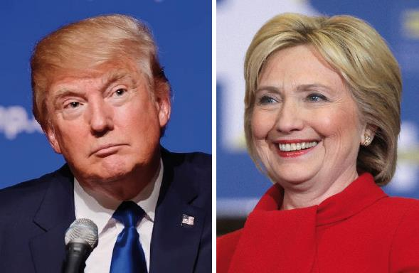
Issues that Divide US
Political Affiliation
E
14

Slide 4
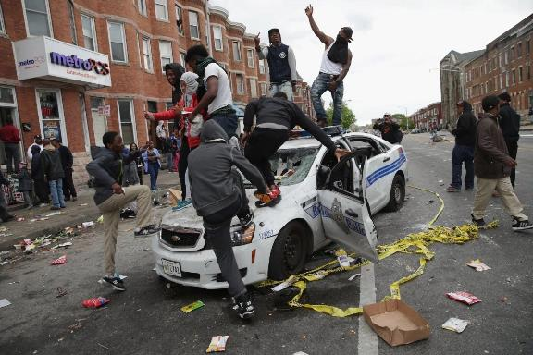
Issues that Divide US
Authority

Slide 5
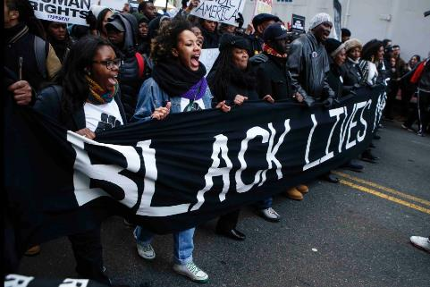
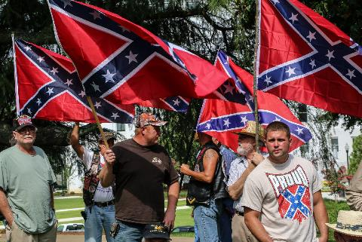
Issues that Divide US
Race & Culture

Slide 6
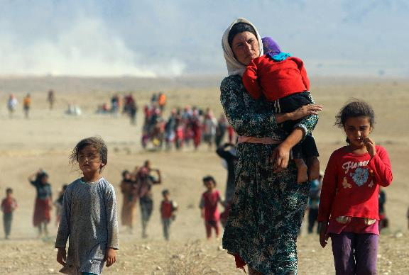
Issues that Divide US
Refugees

Slide 7
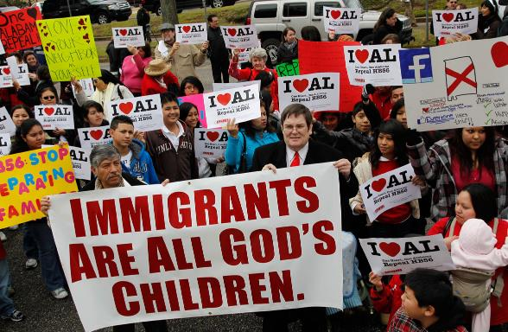
Issues that Divide US
Immigration
A
8

Slide 8
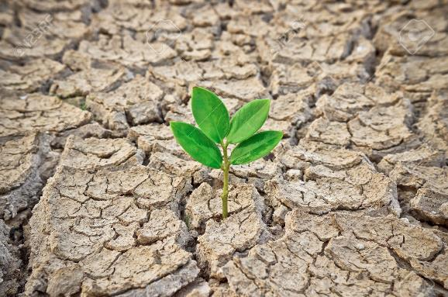
Issues that Divide US
Environmental Care

Slide 9
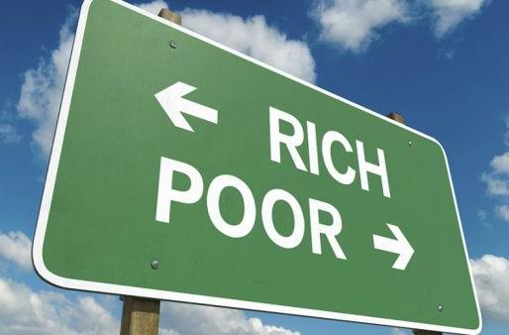
Issues that Divide US
Social Class

Slide 10
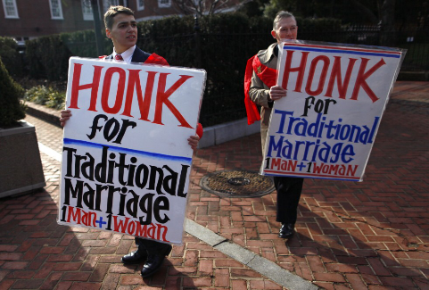
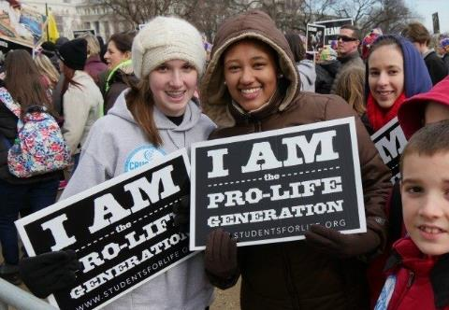
Issues that Divide US
Social Matters
E
22

Slide 11
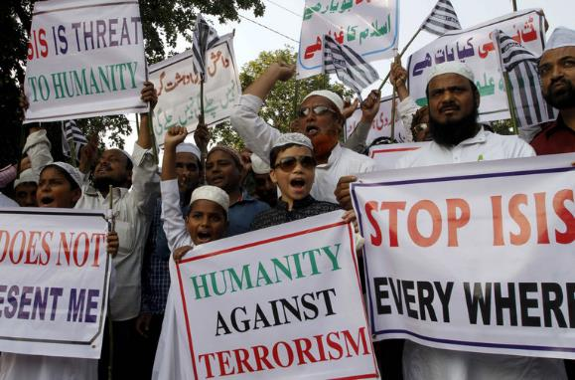
Issues that Divide US
Terrorism

Slide 12
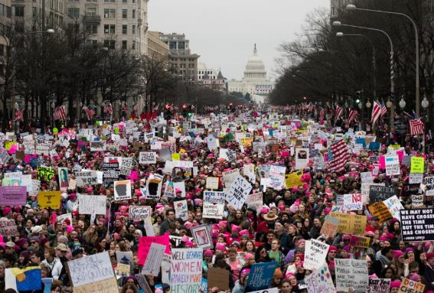
Issues that Divide US
Gender Equality
U
20

Slide 13
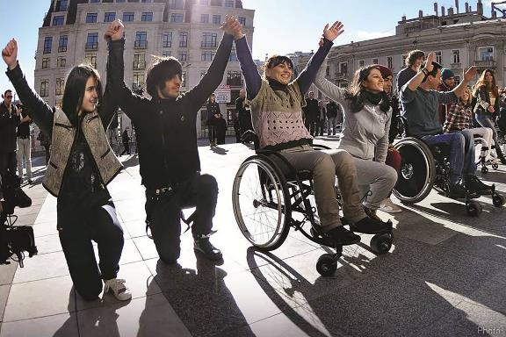
Issues that Divide US
Care for Disabled

Slide 14
What causes these problems?
The Devaluing of Human Life.

Slide 15
Value of Human Life
‭‭All mankind is made in the image of God.
Genesis 1:26 Then God said, “Let us make mankind in our image, in our likeness, so that they may rule over the fish in the sea and the birds in the sky, over the livestock and all the wild animals, and over all the creatures that move along the ground.”
E
18

Slide 16
Value of Human Life
‭‭Mankind is so important that the only reason given for taking a life is to pay the debt for murder.‬‬
Genesis 9:6 “Whoever sheds human blood, by humans shall their blood be shed; for in the image of God has God made mankind.
S
21

Slide 17
Life is Devalued when…
Murder happens.
Abortion happens.
Suicide happens
Self worth and self acceptance are not realized.
S
13

Slide 18
Value of Human Life
So a Christian believes all lives matter?
Yes… We are not to take another’s life…
But we can’t do anything to save a life.
We can make every effort to prolong life, but all will die.
T
10

Slide 19
Value of Human Life
If we prevent every murder, suicide and abortion from ever happening again, we still haven’t brought a single soul the Gospel of Christ.
“Lives” can’t be saved, SOULS CAN!
Matthew 10:28 Do not be afraid of those who kill the body but cannot kill the soul. Rather, be afraid of the One who can destroy both soul and body in hell.
E
3
Mark 16:15 He said to them, “Go into all the world and preach the gospel to all creation. 16 Whoever believes and is baptized will be saved,

Slide 20
What causes these problems?
The Devaluing of Human Life.
Disregard for Another's Rights and Possessions.

Slide 21
Disrespect and Disregard
Disrespect for Authority
  Violence towards Police
  Unnecessary violence by Police
H
12
Romans‬ ‭13:3‬ “For rulers are not a terror to good works, but to evil. Do you want to be unafraid of the authority? Do what is good, and you will have praise from the same.”

Slide 22
Disrespect and Disregard
Disrespect for Laws
  Illegal immigration
Romans‬ ‭13:1-2 “Let every soul be subject to the governing authorities. For there is no authority except from God, and the authorities that exist are appointed by God. Therefore whoever resists the authority resists the ordinance of God, and those who resist will bring judgment on themselves.”
W
7

Slide 23
Disrespect and Disregard
Disregard for Disabled or Elderly
  Welfare Abuser (entitlement of the undeserving)
  Lack of Compassion
H
4
1 John 3:17 If anyone has material possessions and sees a brother or sister in need but has no pity on them, how can the love of God be in that person? 18 Dear children, let us not love with words or speech but with actions and in truth.

Slide 24
Disrespect and Disregard
Disrespect for property (or God’s Creation)
  Lack of environmental concern
  Rallies, marches, and occupy movements that use violence and destruction.
Genesis 2:15 The Lord God took the man and put him in the Garden of Eden to work it and take care of it.
A
6

Slide 25
The Bible addresses all issues of equality and respect
Example: Gender Equality
If the apostle Paul didn’t have an issue working with a man or a woman, why should we?
Acts 18:2 There he met a Jew named Aquila, a native of Pontus, who had recently come from Italy with his wife Priscilla, because Claudius had ordered all Jews to leave Rome. Paul went to see them, 3 and because he was a tentmaker as they were, he stayed and worked with them.
E
19

Slide 26
What causes these problems?
The Devaluing of Human Life.
Disregard for Another's Rights and Possessions.
Partiality of Beliefs (prejudices)

Slide 27
Prejudices
Partialities and Prejudices
C
16
Which would include:
Racial
Social (class)
Political
Religious

Slide 28
Laying Partialities aside for Christ’s cause
Matthew 10:2 These are the names of the twelve apostles: first, Simon (who is called Peter) and his brother Andrew; James son of Zebedee, and his brother John; 3 Philip and Bartholomew; Thomas and Matthew the tax collector; James son of Alphaeus, and Thaddaeus; 4 Simon the Zealot and Judas Iscariot, who betrayed him.
R
2

Slide 29
Laying Partialities aside for Christ’s cause
G
11
Matthew 10:2 These are the names of the twelve apostles: first, Simon (who is called Peter) and his brother Andrew; James son of Zebedee, and his brother John; 3 Philip and Bartholomew; Thomas and Matthew the tax collector; James son of Alphaeus, and Thaddaeus; 4 Simon the Zealot and Judas Iscariot, who betrayed him.
The Zealots objected to Roman rule and violently sought to eliminate it by targeting Romans and Roman supporters.

Slide 30
Laying Partialities aside for Christ’s cause
V
1
Matthew 10:2 These are the names of the twelve apostles: first, Simon (who is called Peter) and his brother Andrew; James son of Zebedee, and his brother John; 3 Philip and Bartholomew; Thomas and Matthew the tax collector; James son of Alphaeus, and Thaddaeus; 4 Simon the Zealot and Judas Iscariot, who betrayed him.
What a wonderful example how Christ can change lives and use anyone to spread the Gospel!

Slide 31
Conclusion
A
5
We could have unity if all had the same standard.
Respecting People in Authority
1 Peter 2:13 For the Lord’s sake, submit to all human authority—whether the king as head of state, 14 or the officials he has appointed. For the king has sent them to punish those who do wrong and to honor those who do right. 15 It is God’s will that your honorable lives should silence those ignorant people who make foolish accusations against you. 16 For you are free, yet you are God’s slaves, so don’t use your freedom as an excuse to do evil. 17 Respect everyone, and love the family of believers. Fear God, and respect the king.

Slide 32
Conclusion
As Christians, we have the greatest cause.
Puzzle Answer
Matthew 5:6 Blessed are those who hunger and thirst for righteousness, for they will be filled.
Matthew 5:13 “You are the salt of the earth. But if the salt loses its saltiness, how can it be made salty again? It is no longer good for anything, except to be thrown out and trampled underfoot.

Slide 34
Is Thy Heart Right With God?
Page 337
All 3 verses

Slide 35
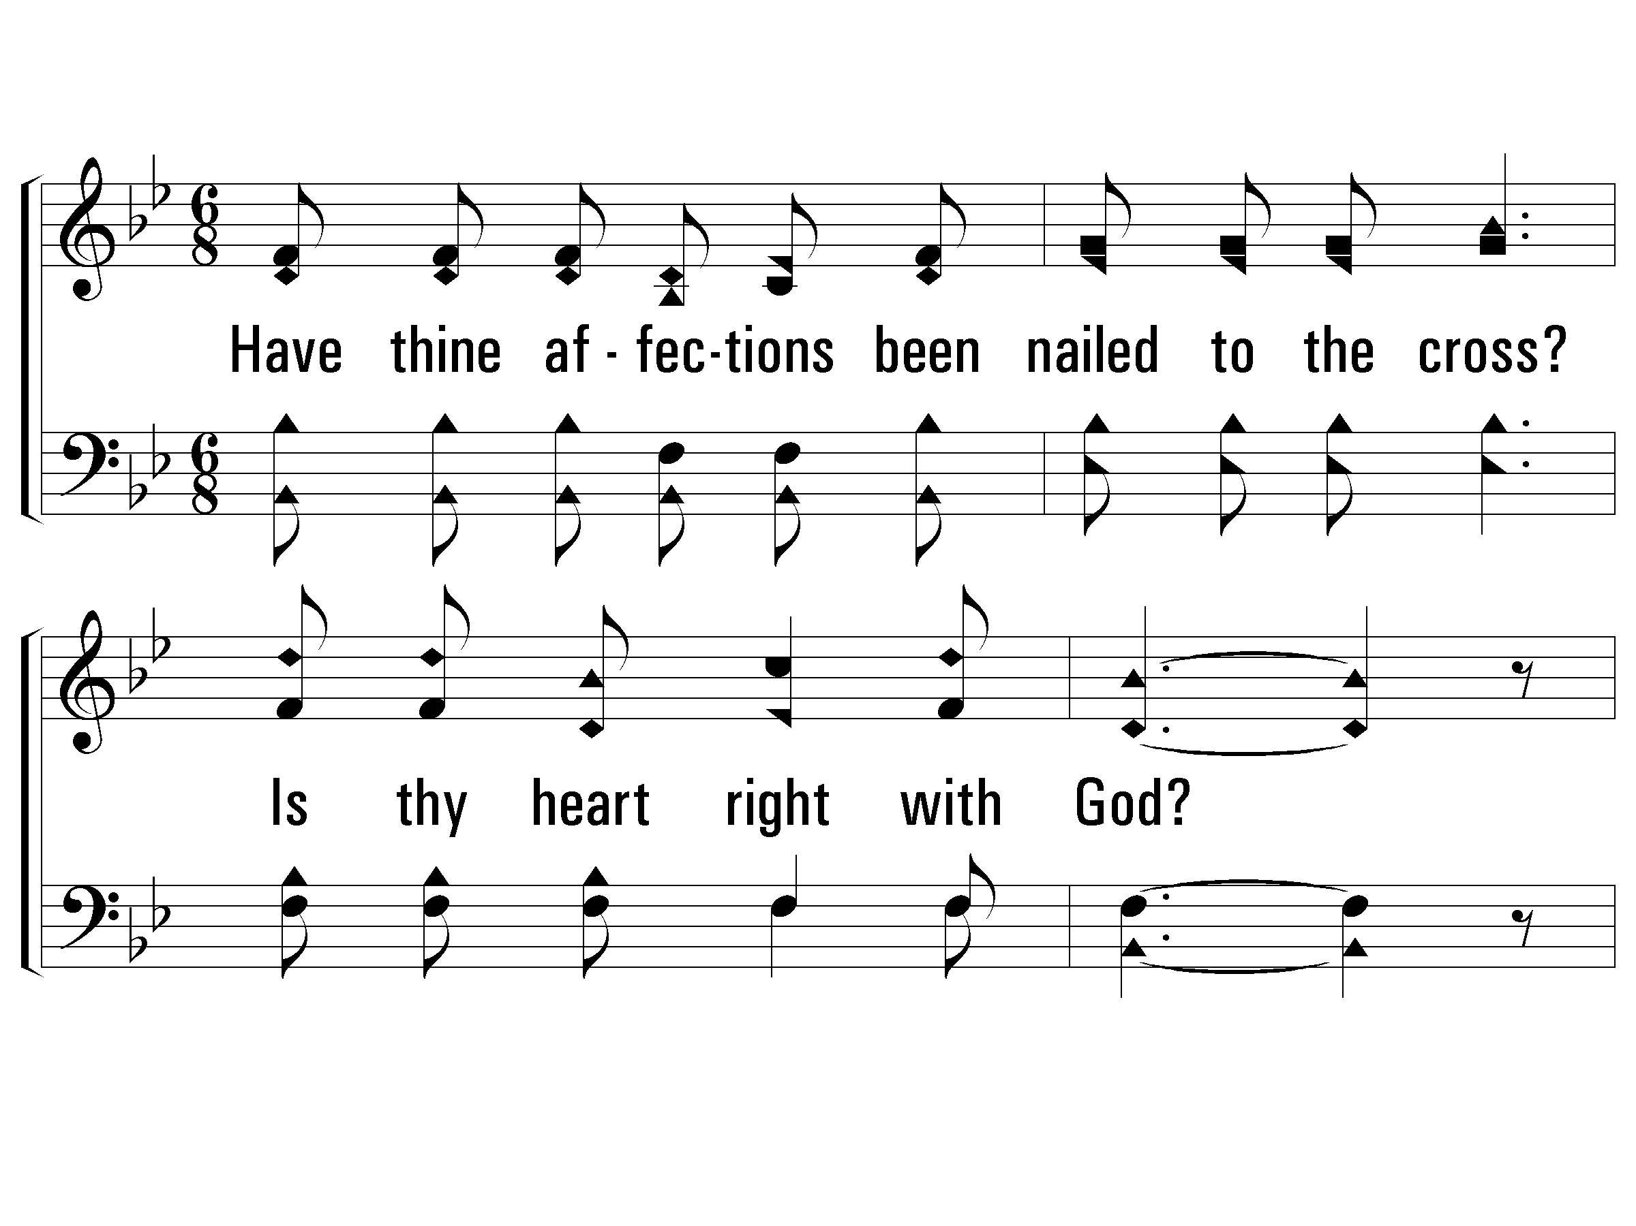
1 – Is Thy Heart Right With God?
1.
Have thine affection been nailed to the cross?
Is thy heart right with God?
Dost thou count all things for Jesus but loss?
Is thy heart right with God?
Words & Music: E. A. Hoffman
© 2002 The Paperless Hymnal™

Slide 36
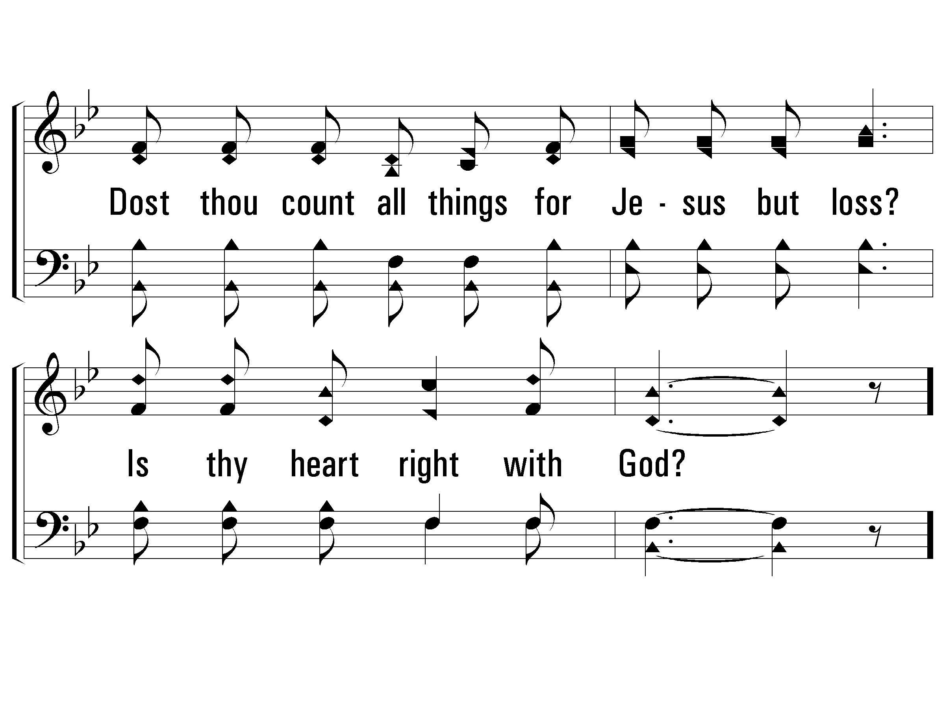
1 – Is Thy Heart Right With God?
© 2002 The Paperless Hymnal™

Slide 37
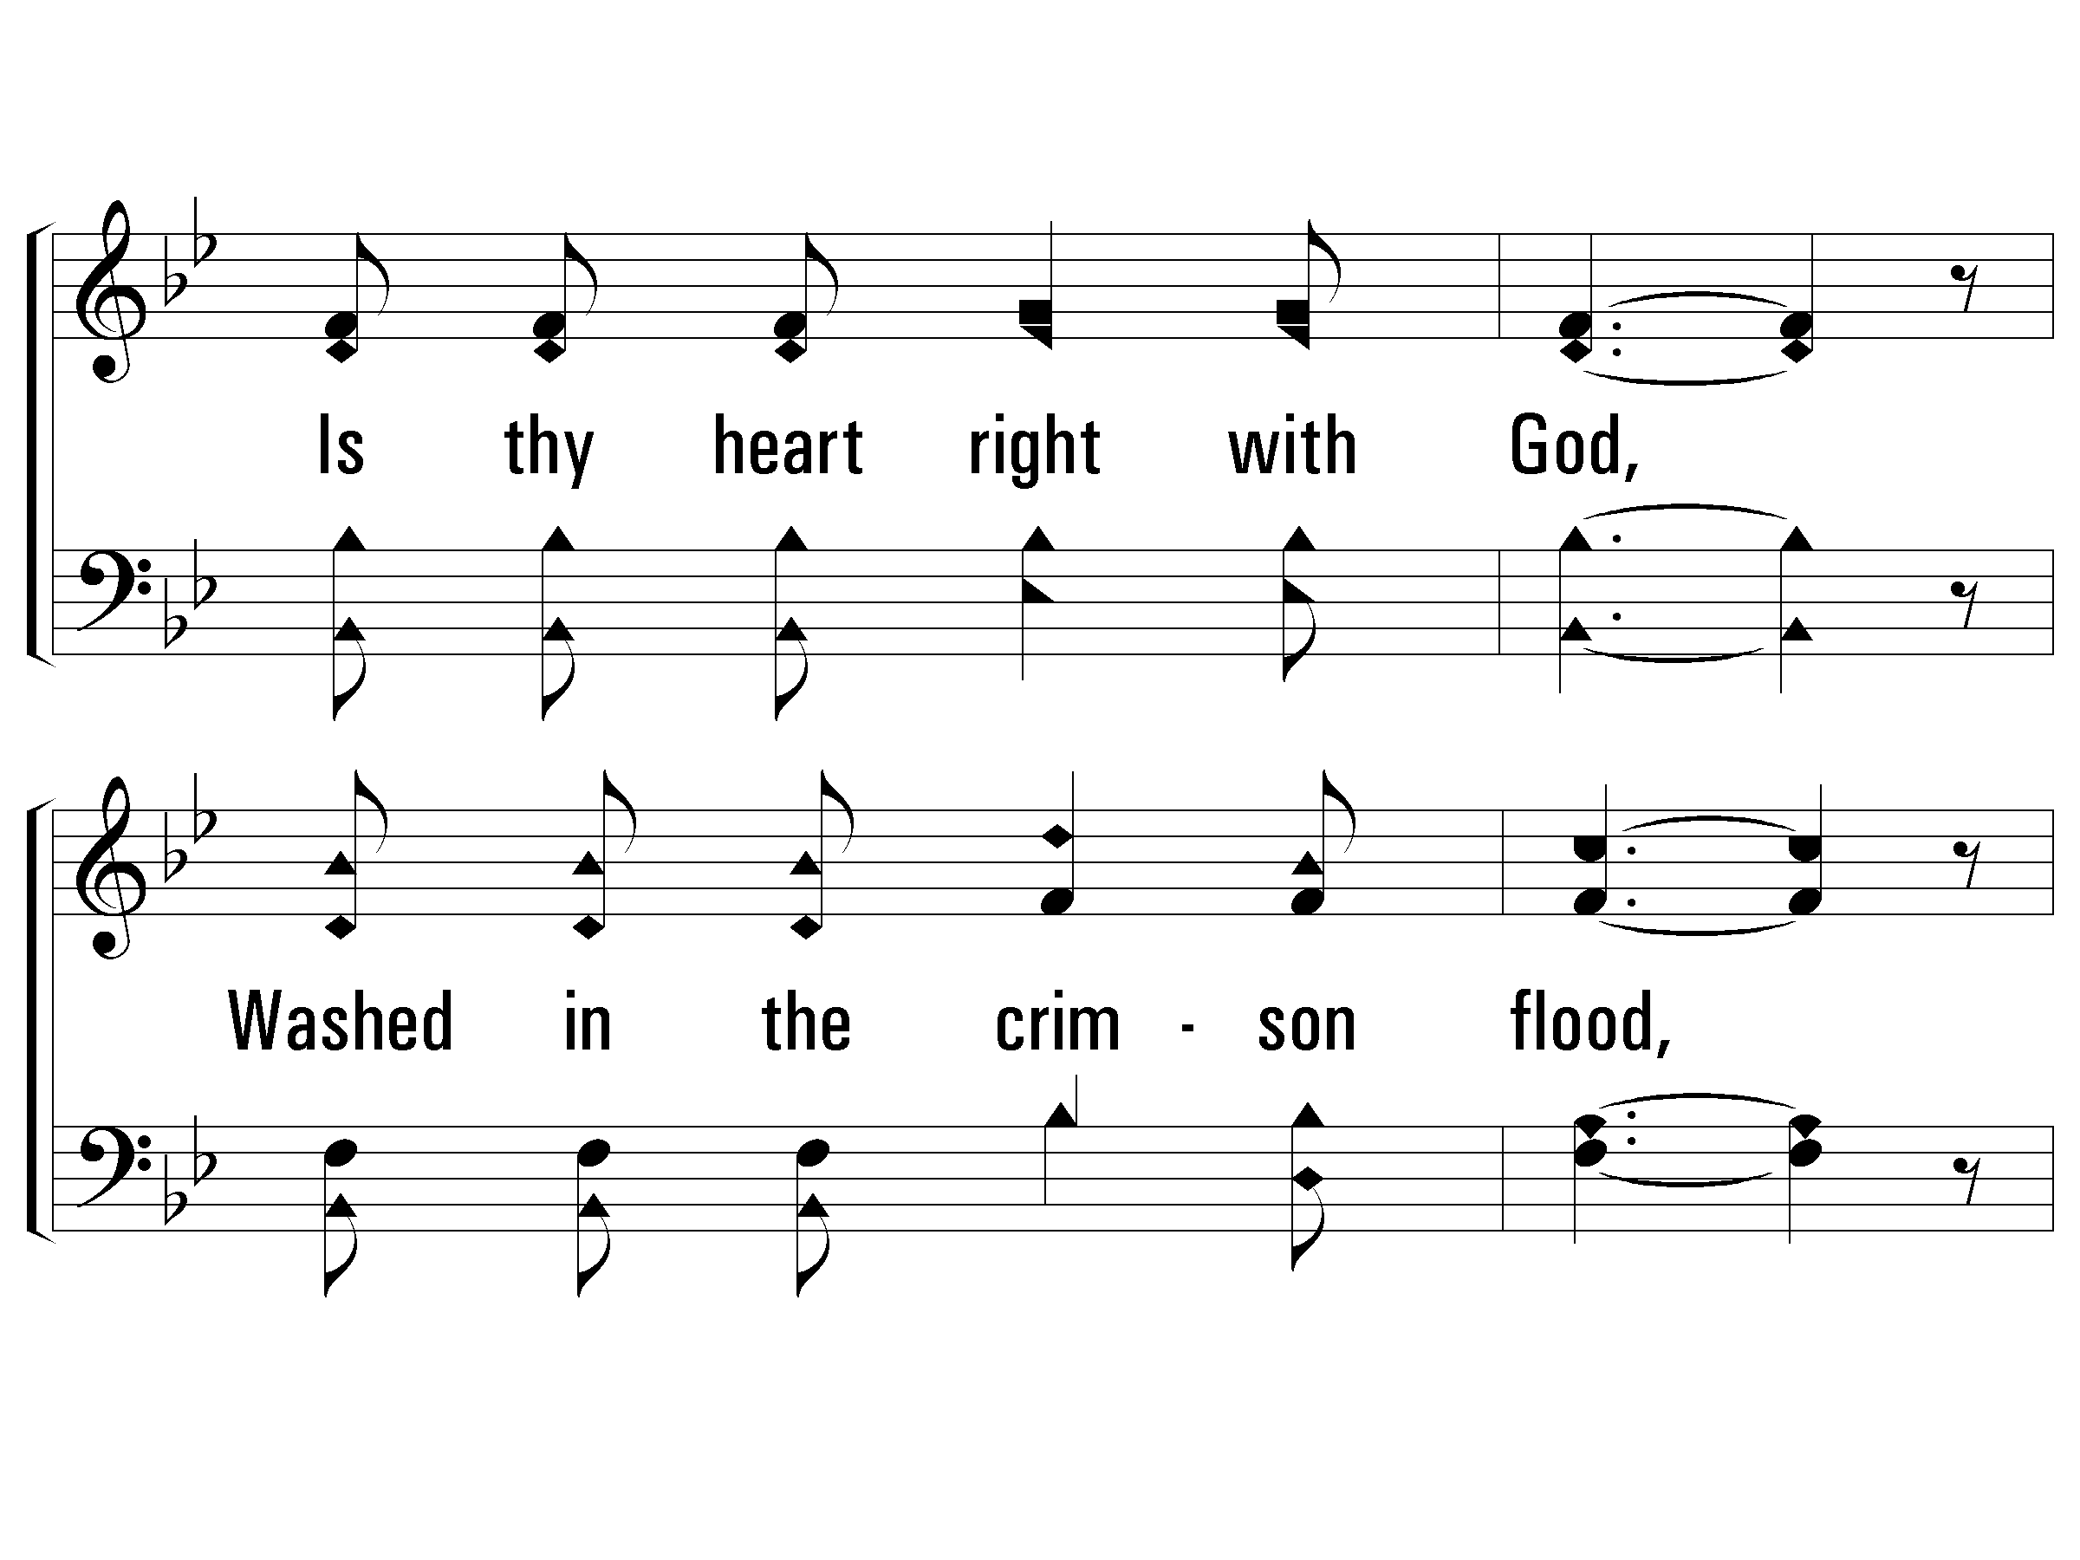
c – Is Thy Heart Right With God?
Is thy heart right with God,
Washed in the crimson flood,
Cleansed and made holy,
humble and lowly,
Right in the sight of God?
© 2002 The Paperless Hymnal™

Slide 38
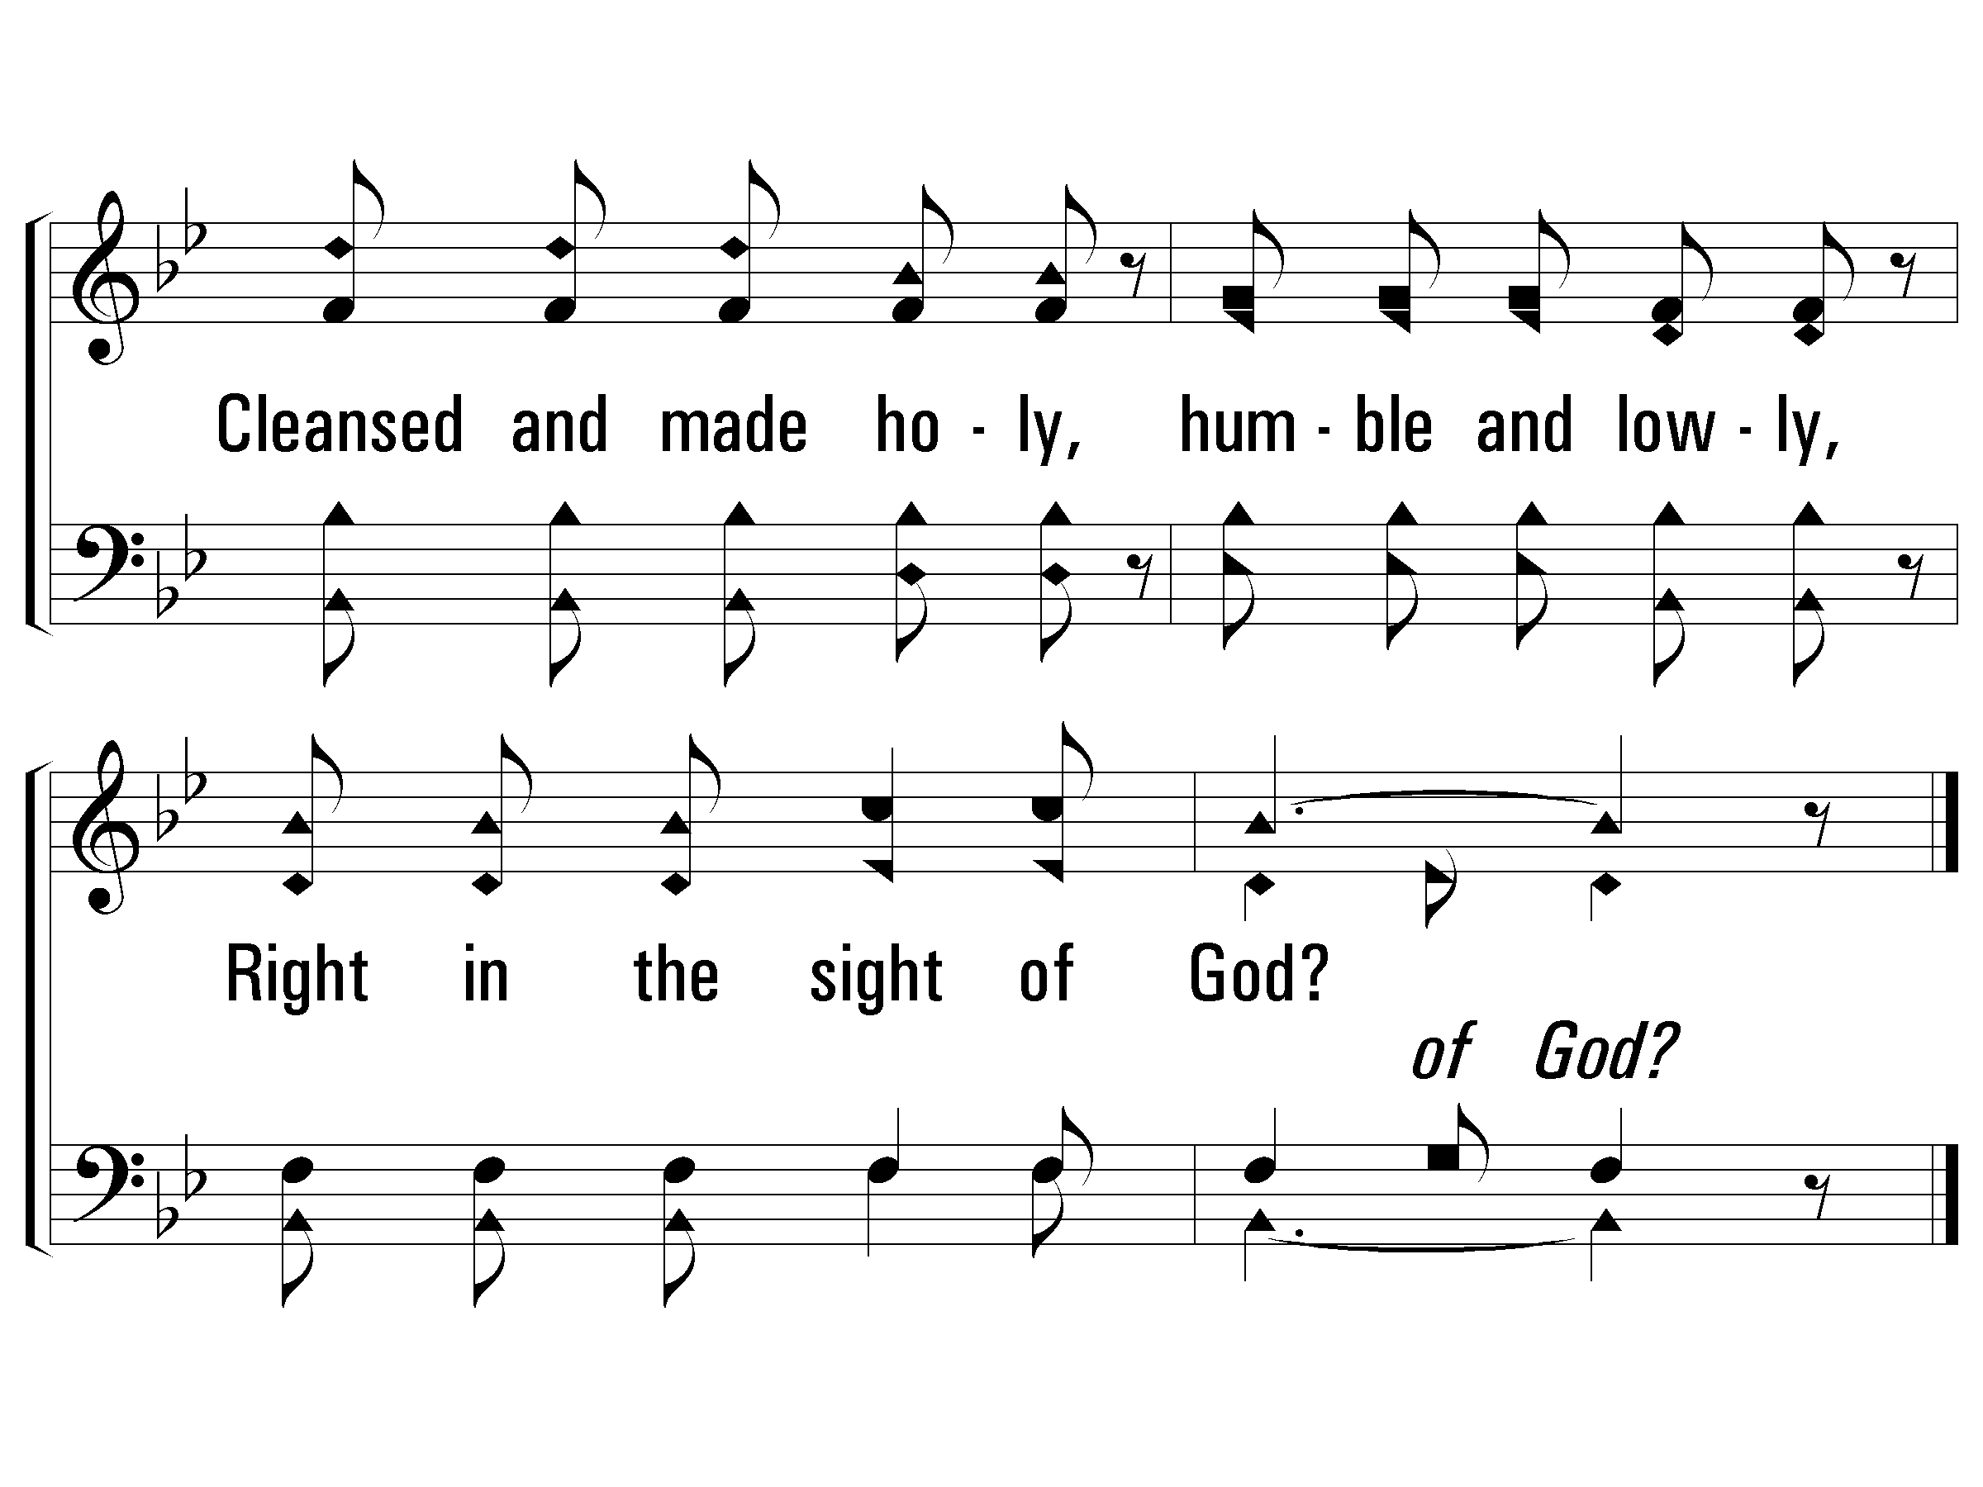
c – Is Thy Heart Right With God?
© 2002 The Paperless Hymnal™

Slide 39
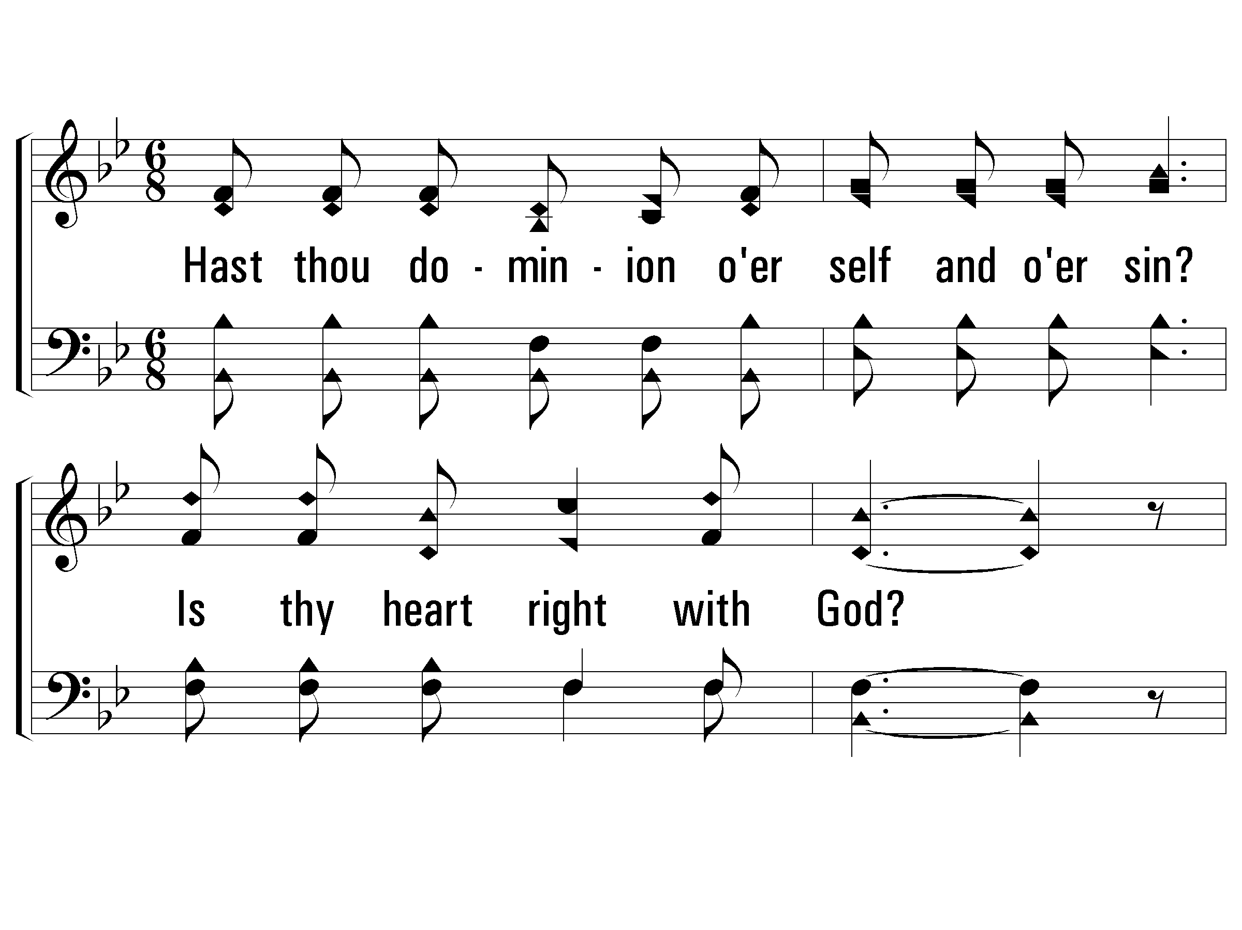
2 – Is Thy Heart Right With God?
2.
Hast thou dominion o'er self and o'er sin?
Is thy heart right with God?
Over all evil without and within?
Is thy heart right with God?
Words & Music: E. A. Hoffman
© 2002 The Paperless Hymnal™

Slide 40
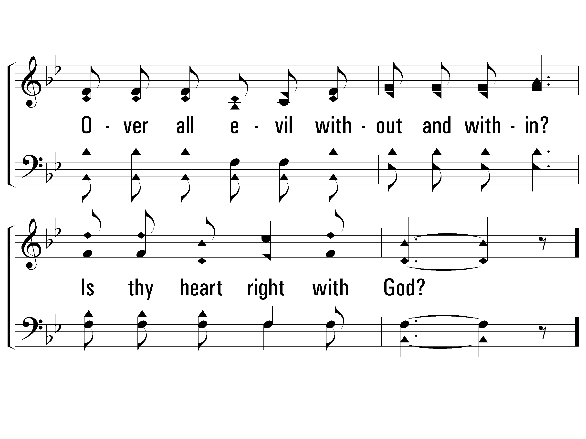
2 – Is Thy Heart Right With God?
© 2002 The Paperless Hymnal™

Slide 41
c – Is Thy Heart Right With God?
Is thy heart right with God,
Washed in the crimson flood,
Cleansed and made holy,
humble and lowly,
Right in the sight of God?
© 2002 The Paperless Hymnal™

Slide 42
c – Is Thy Heart Right With God?
© 2002 The Paperless Hymnal™

Slide 43
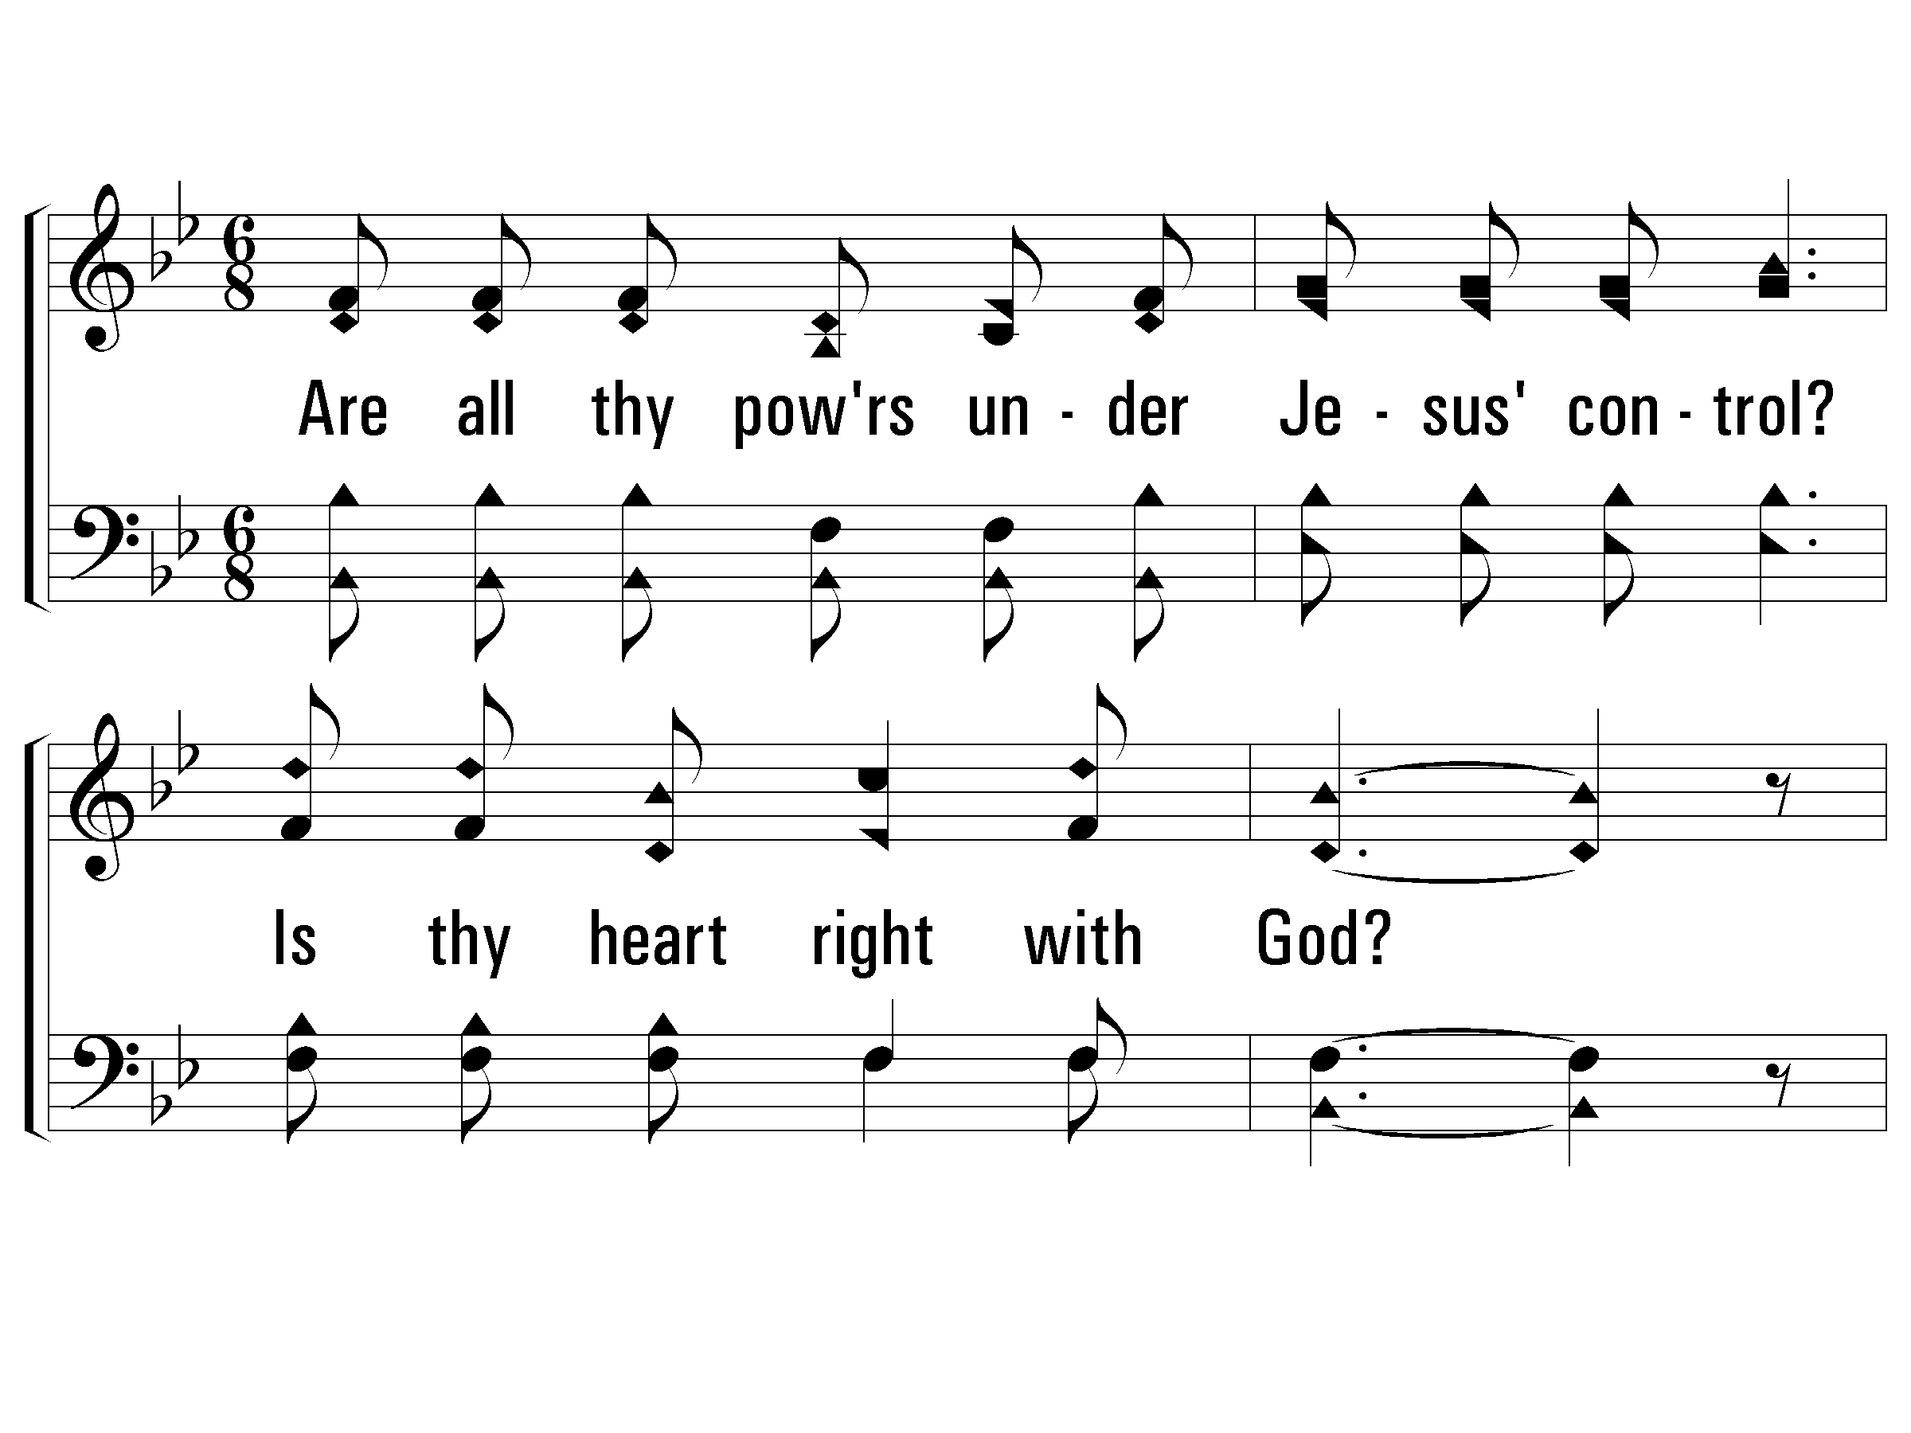
3 – Is Thy Heart Right With God?
3.
Are all thy powers under Jesus' control?
Is thy heart right with God?
Does He each moment abide in thy soul?
Is thy heart right with God?
Words & Music: E. A. Hoffman
© 2002 The Paperless Hymnal™

Slide 44
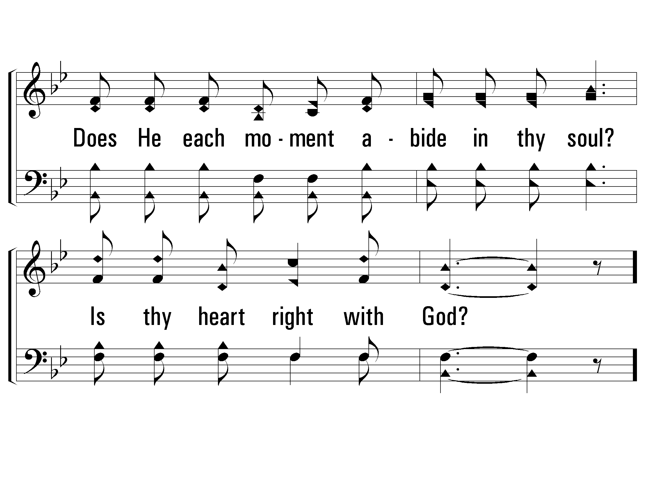
3 – Is Thy Heart Right With God?
© 2002 The Paperless Hymnal™

Slide 45
c – Is Thy Heart Right With God?
Is thy heart right with God,
Washed in the crimson flood,
Cleansed and made holy,
humble and lowly,
Right in the sight of God?
© 2002 The Paperless Hymnal™

Slide 46
c – Is Thy Heart Right With God?
© 2002 The Paperless Hymnal™

Slide 48
Is It For Me?
Page 336
All 4 verses

Slide 49
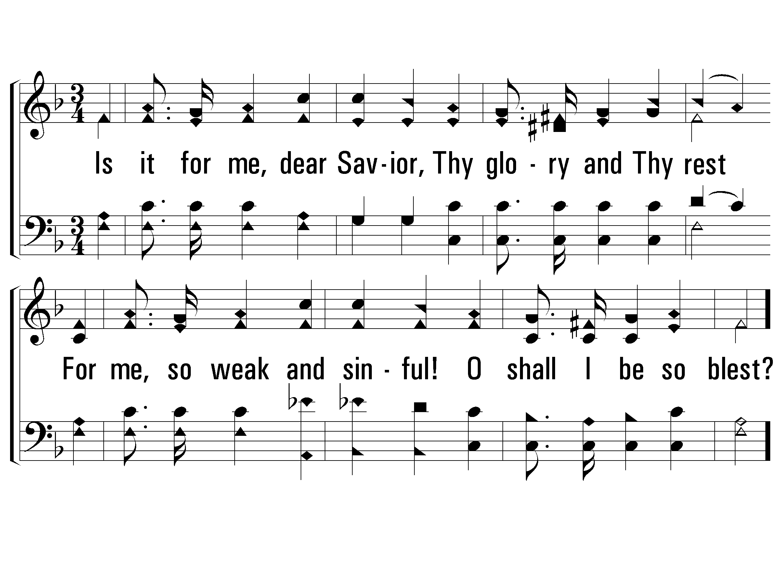
1 – Is It For Me?
1.
Is it for me, dear Savior,
Thy glory and Thy rest
For me, so weak and sinful!
O shall I be so blest?
Words: Frances R. Havergal
Music: Tullius C. O’Kane
© 2002 The Paperless Hymnal™

Slide 50
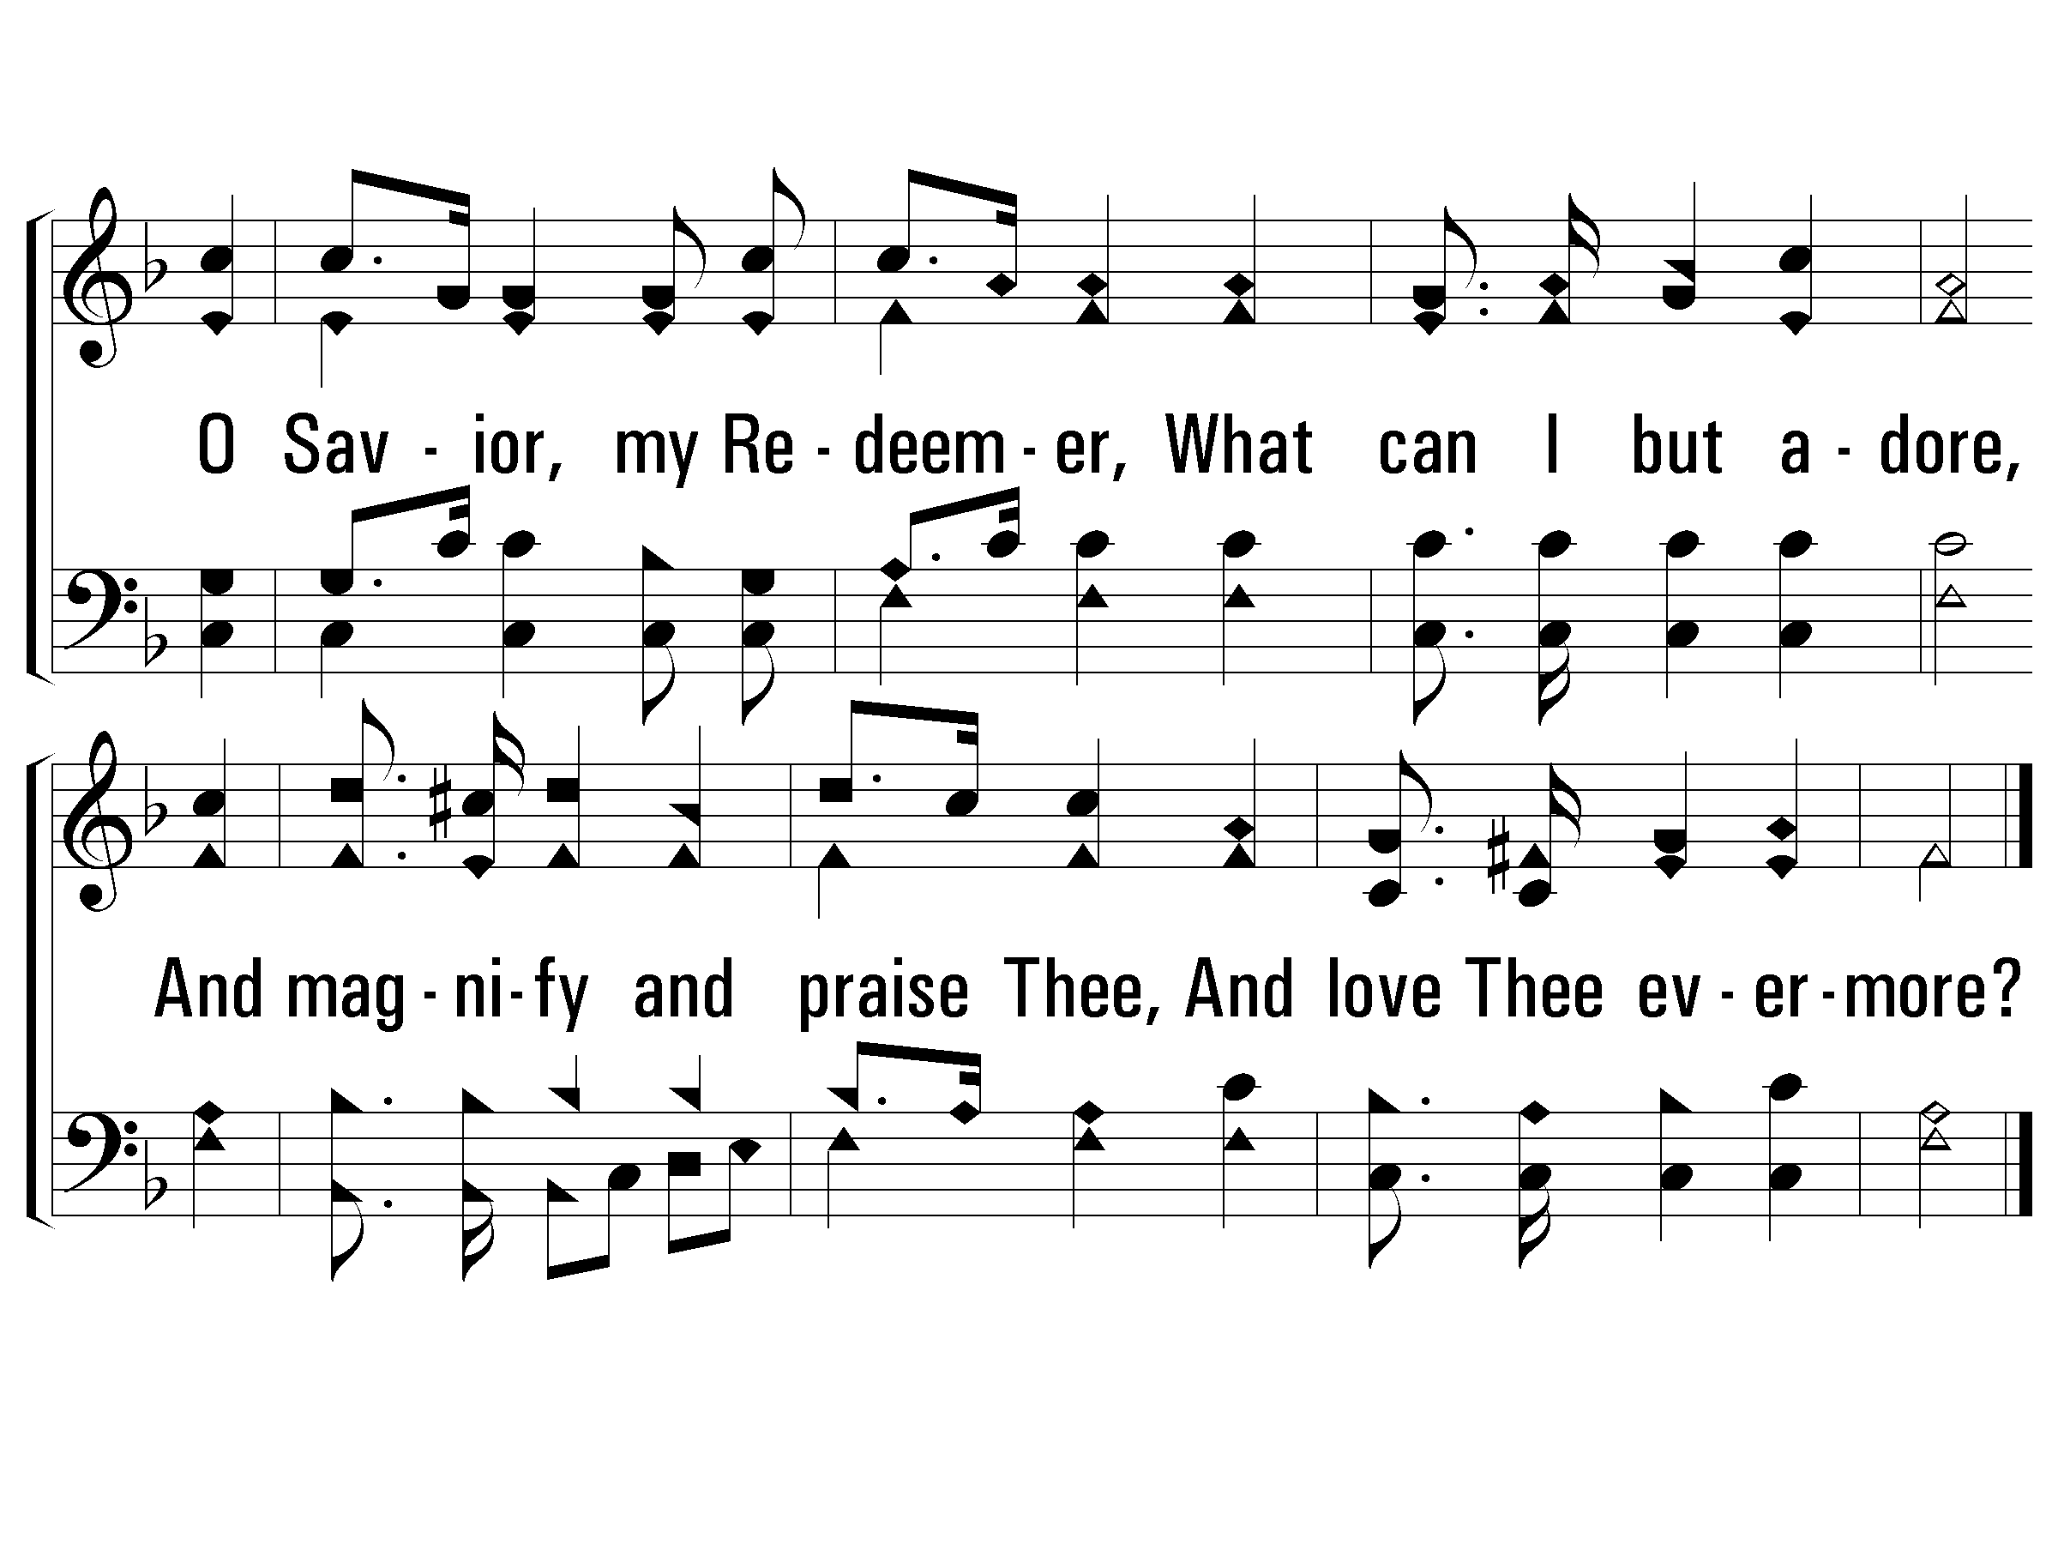
c – Is It For Me?
O Savior, my Redeemer,
What can I but adore,
And magnify and praise Thee,
And love Thee evermore?
© 2002 The Paperless Hymnal™

Slide 51
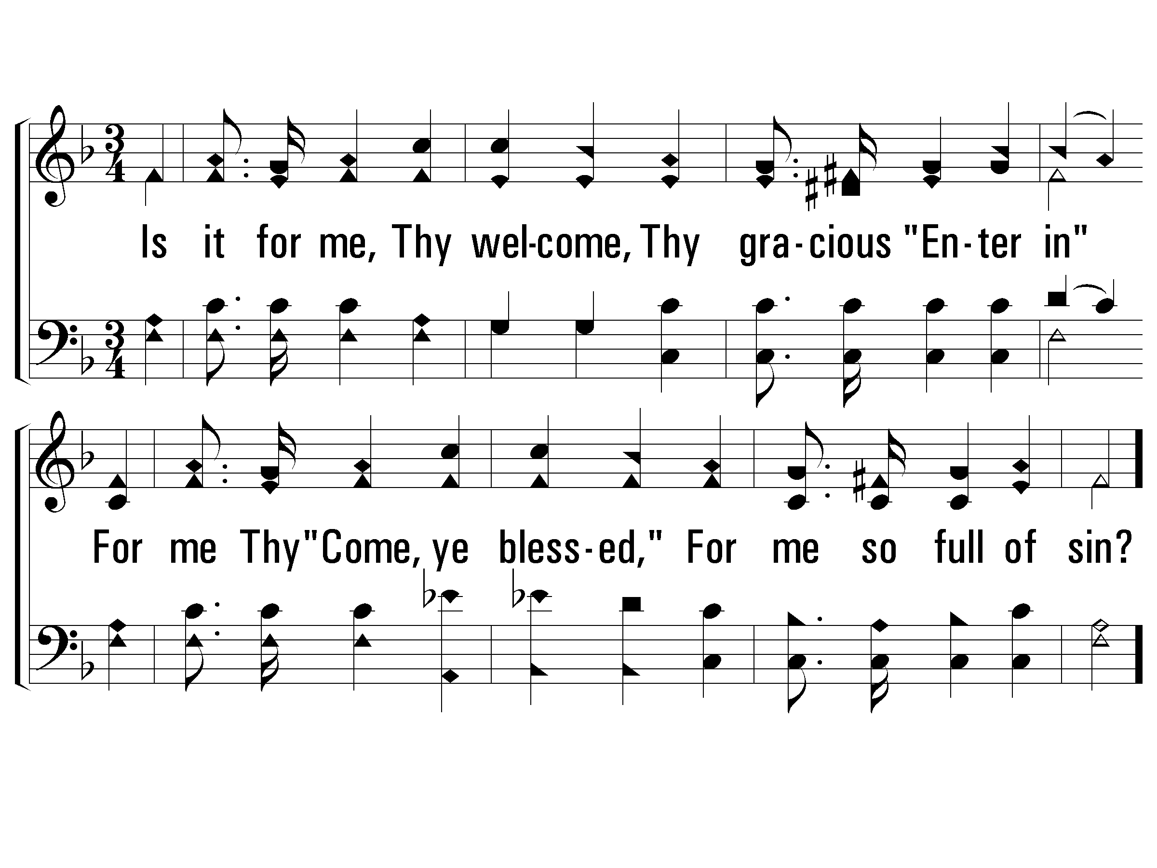
2 – Is It For Me?
2.
Is it for me, Thy welcome,
Thy gracious "Enter in"
For me Thy "Come, ye blessed,"
For me so full of sin?
Words: Frances R. Havergal
Music: Tullius C. O’Kane
© 2002 The Paperless Hymnal™

Slide 52
c – Is It For Me?
O Savior, my Redeemer,
What can I but adore,
And magnify and praise Thee,
And love Thee evermore?
© 2002 The Paperless Hymnal™

Slide 53
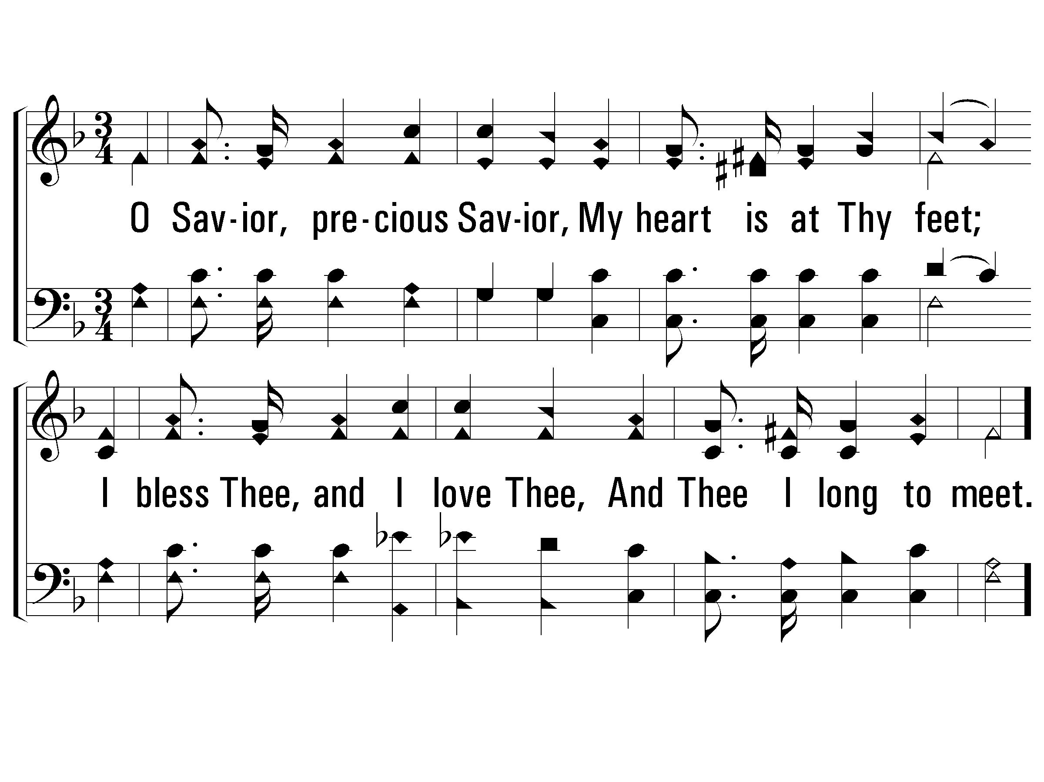
3 – Is It For Me?
3.
O Savior, precious Savior,
My heart is at Thy feet;
I bless Thee, and I love Thee,
And Thee I long to meet.
Words: Frances R. Havergal
Music: Tullius C. O’Kane
© 2002 The Paperless Hymnal™

Slide 54
c – Is It For Me?
O Savior, my Redeemer,
What can I but adore,
And magnify and praise Thee,
And love Thee evermore?
© 2002 The Paperless Hymnal™

Slide 55
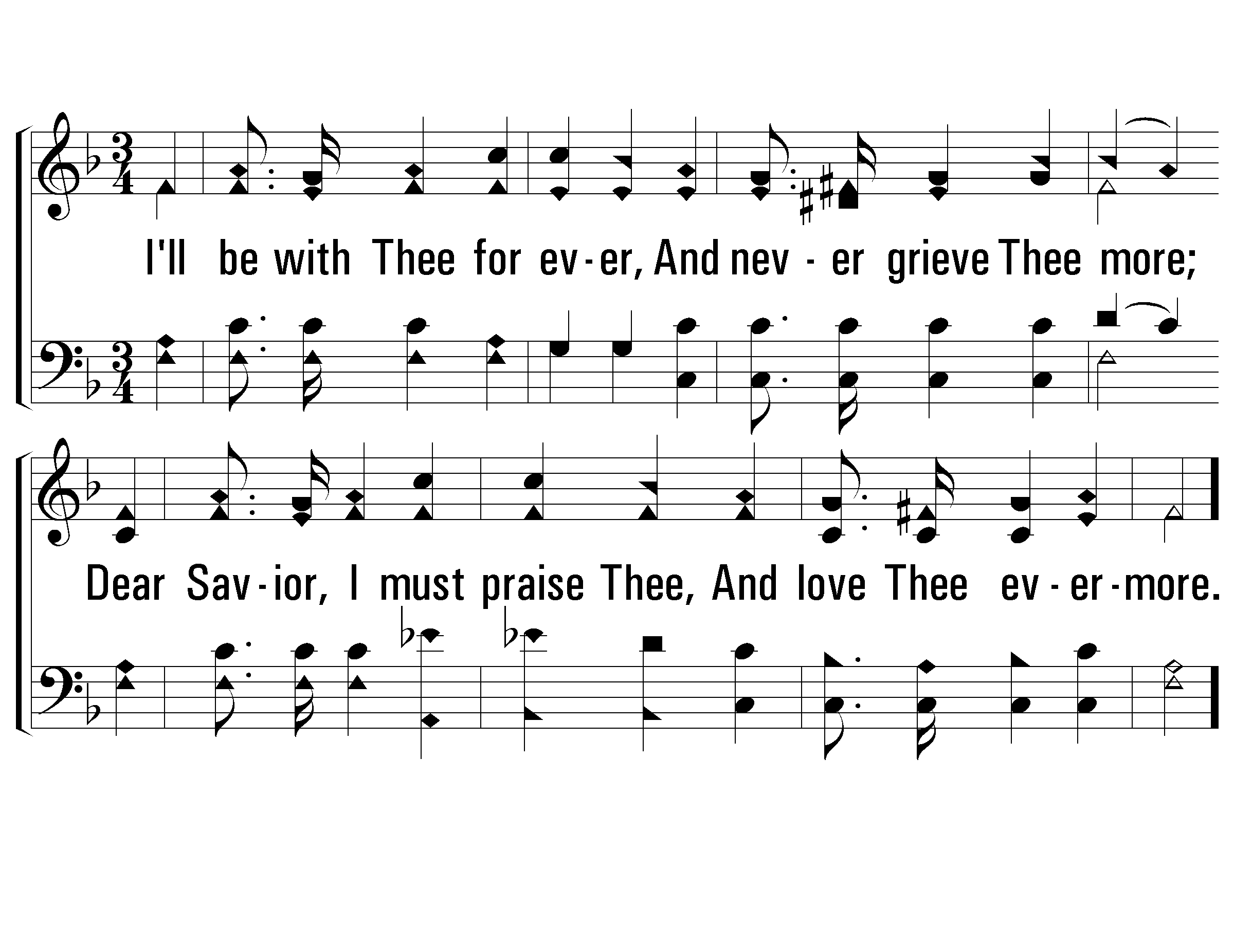
4 – Is It For Me?
4.
I'll be with Thee for ever,
And never grieve Thee more;
Dear Savior, I must praise Thee,
And love Thee evermore.
Words: Frances R. Havergal
Music: Tullius C. O’Kane
© 2002 The Paperless Hymnal™

Slide 56
c – Is It For Me?
O Savior, my Redeemer,
What can I but adore,
And magnify and praise Thee,
And love Thee evermore?
© 2002 The Paperless Hymnal™

