Slide 1

Welcome.
We are glad that you have come to worship with us.

Slide 2
O‘Neal church of Christ VBS 2018
Mercy

Slide 3
Mercy defined.
Matthew 5:7 Blessed are the merciful, For they shall obtain mercy.
1 : compassion or forgiveness shown toward someone whom it is within one's power to punish or harm.
2 : compassionate treatment of those in distress.

Slide 4
Luke 10:25-37
25 On one occasion an expert in the law stood up to test Jesus. “Teacher,” he asked, “what must I do to inherit eternal life?” 26 “What is written in the Law?” he replied. “How do you read it?” 27 He answered, “‘Love the Lord your God with all your heart and with all your soul and with all your strength and with all your mind’; and, ‘Love your neighbor as yourself.’” 28 “You have answered correctly,” Jesus replied. “Do this and you will live.”

Slide 5
It’s not just a story about helping others…
This lawyer asked the most important question that one can ask.
It was a question of eternal salvation…
In some cases, it has become a platform for judging how others are helping the “needy”.
This isn’t a story about a beggar…
Luke 10:25 On one occasion an expert in the law stood up to test Jesus. “Teacher,” he asked, “what must I do to inherit eternal life?”

Slide 6
Beggars in the Bible
Mark 10:46 Now they came to Jericho. As He went out of Jericho with His disciples and a great multitude, blind Bartimaeus, the son of Timaeus, sat by the road begging.
Acts 3:2 And a certain man lame from his mother’s womb was carried, whom they laid daily at the gate of the temple which is called Beautiful, to ask alms from those who entered the temple;
Luke 16:19 “There was a rich man who was dressed in purple and fine linen and lived in luxury every day. 20 At his gate was laid a beggar named Lazarus, covered with sores
Unfortunately, some people today are lazy and greedy rather than injured or needy.

Slide 7
So, Jesus answers him…
“What is written in the Law?”
Basic summation of the entire Old Law.
Deuteronomy 6:4 Hear, O Israel: The Lord our God, the Lord is one. 5 Love the Lord your God with all your heart and with all your soul and with all your strength.
Leviticus 19:18 “‘Do not seek revenge or bear a grudge against anyone among your people, but love your neighbor as yourself. I am the Lord.

Slide 8
Luke 10:25-37
29 But he wanted to justify himself, so he asked Jesus, “And who is my neighbor?”30 In reply Jesus said: “A man was going down from Jerusalem to Jericho, when he was attacked by robbers. They stripped him of his clothes, beat him and went away, leaving him half dead. 31 A priest happened to be going down the same road, and when he saw the man, he passed by on the other side. 32 So too, a Levite, when he came to the place and saw him, passed by on the other side.

Slide 9
“But he wanted to justify himself”…
By asking Jesus to define “neighbor”, the lawyer is trying to justify the ways in which he has fallen short of the law he just defined.
He’s forging excused absences for mercy…
And at times, I've done the same. Excuses are easy to make and those absences are easy to defend…

Slide 10
Defending the Priest
Maybe his “church work” got in the way.
If he became unclean, he had to undergo a 7 day cleansing. Num. 19:2-13; Ez. 44:24-27
“I can’t help him, I have to serve the Lord!”
Rules for Priests
Leviticus 21:1 The Lord said to Moses, “Speak to the priests, the sons of Aaron, and say to them: ‘A priest must not make himself ceremonially unclean for any of his people who die,

Slide 11
Defending the Priest
Maybe he worried what others would think.
“I'm protecting my reputation and someone else’s soul!”
1 Corinthians 15:33 Do not be deceived: “Evil company corrupts good habits.”
1 Corinthians 8:9 But beware lest somehow this liberty of yours become a stumbling block to those who are weak.

Slide 12
Defending the Priest
Maybe he was concerned for his own safety.
Many Jews believe this implies they should live by the law rather than die because of it.
In fact, modern Jewish faith allows some laws to be broken if doing so preserves life.
“He might kill me!”
Leviticus 18:5 Keep my decrees and laws, for the person who obeys them will live by them. I am the Lord.

Slide 13
Defending the Priest
Maybe he helped the last guy.
“Well, I have to stop somewhere. I can’t help everyone!”
Matthew 5:41 If anyone forces you to go one mile, go with them two miles. 42 Give to the one who asks you, and do not turn away from the one who wants to borrow from you.

Slide 14
Defending the Levite
The Levites were experts in the law.
Maybe he thought it was a scam/trick/lie.
“That money will be used for drugs!”
Nehemiah 8:7 The Levites—(abbreviated)—instructed the people in the Law while the people were standing there. 8 They read from the Book of the Law of God, making it clear and giving the meaning so that the people understood what was being read.

Slide 15
Defending the Levite
Maybe he thought there are programs (civil and social) that are in place to help.
“I pay my taxes and put my money in the collection plate on Sunday. I’ve done my part!”
Mark 12:17 Then Jesus said to them, “Give back to Caesar what is Caesar’s and to God what is God’s.”

Slide 16
Defending the Levite
Maybe he thought the guy was lazy.
“Get a job and quit being a burden to others!”
2 Thessalonians 3:10 For even when we were with you, we gave you this rule: “The one who is unwilling to work shall not eat.”

Slide 17
Defending the Levite
Maybe he thought the guy got what he deserved.
“You wouldn’t be here if you had made better choices!”
Proverbs 1:29 since they hated knowledge and did not choose to fear the Lord. 30 Since they would not accept my advice and spurned my rebuke, 31 they will eat the fruit of their ways and be filled with the fruit of their schemes.

Slide 18
Is this the heart of our excuses?…
“I'm better than you!” It’s what the Priest and Levite thought (even about the Samaritan).
Are any of these excuses acceptable?
Romans 12:3 For by the grace given me I say to every one of you: Do not think of yourself more highly than you ought,
16 Live in harmony with one another. Do not be proud, but be willing to associate with people of low position.
Matthew 5:42 Give to him who asks you, and from him who wants to borrow from you do not turn away.

Slide 19
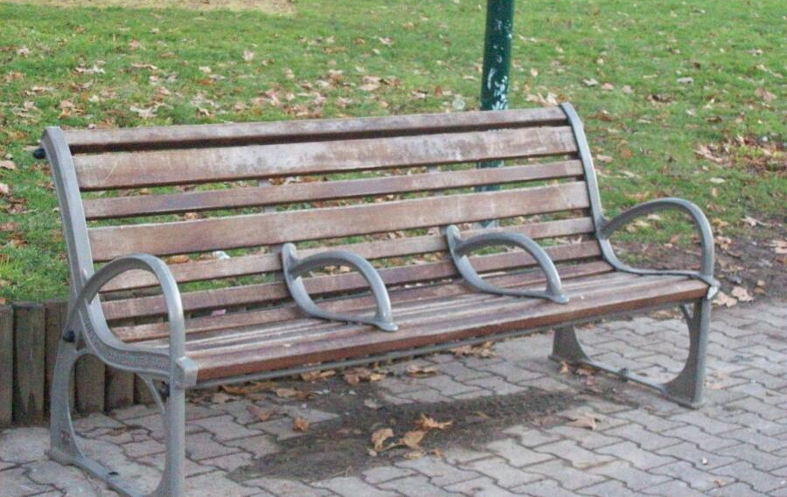
What does the world think of mercy?
Do everything for those in need.
Some do nothing for those in need.
While still others increase the burden.

Slide 20
Luke 10:25-37
33 But a Samaritan, as he traveled, came where the man was; and when he saw him, he took pity on him. 34 He went to him and bandaged his wounds, pouring on oil and wine. Then he put the man on his own donkey, brought him to an inn and took care of him. 35 The next day he took out two denarii and gave them to the innkeeper. ‘Look after him,’ he said, ‘and when I return, I will reimburse you for any extra expense you may have.’ 36 “Which of these three do you think was a neighbor to the man who fell into the hands of robbers?” 37 The expert in the law replied, “The one who had mercy on him.” Jesus told him, “Go and do likewise.”

Slide 21
“And when he saw him, he took pity on him.”…
The world is filled with hurting people, and people who truly care are few and far between.
Do our fast paced lives cause us to speed past ministry opportunities or do we stop?
People won’t care how much you know until they know how much you care.

Slide 22
Are we willing to invest?
Helping another doesn’t require we do some grand event. We don’t have to found a charity or build a building.
Kindness is shown just with a smile. Frank…
Mark 9:41 Truly I tell you, anyone who gives you a cup of water in my name because you belong to the Messiah will certainly not lose their reward.

Slide 23
“Then he put the man on his own donkey, …
brought him to an inn and took care of him.”
Are we willing to personally invest?
Time. Effort. Money. Resources. The Gospel.
Evangelism without empathy is ineffective…
Empathy without evangelism is POINTLESS!
1 Thessalonians 2:8 so we cared for you. Because we loved you so much, we were delighted to share with you not only the gospel of God but our lives as well.

Slide 24
Are we willing to see others?
Do we see the interests of the others?
Are we looking for loopholes?
Philippians 2:4 (NLT) Don’t look out only for your own interests, but take an interest in others, too.

Slide 25
Are we being good stewards?
Can we be trusted in all things?
All we have is from God!
Luke 16:9 (parable of the shrewd manager) Here’s the lesson: Use your worldly resources to benefit others and make friends. Then, when your possessions are gone, they will welcome you to an eternal home.
11 And if you are untrustworthy about worldly wealth, who will trust you with the true riches of heaven?

Slide 26
We will be judged on these things.
Matthew 25:31-46
Will we inherit the Kingdom ready for us!
34 “Then the King will say to those on his right, ‘Come, you who are blessed by my Father, inherit the Kingdom prepared for you from the creation of the world. 35 For I was hungry, and you fed me. I was thirsty, and you gave me a drink. I was a stranger, and you invited me into your home. 36 I was naked, and you gave me clothing. I was sick, and you cared for me. I was in prison, and you visited me.’

