Slide 2
World War II
1939 to 1945

Slide 3
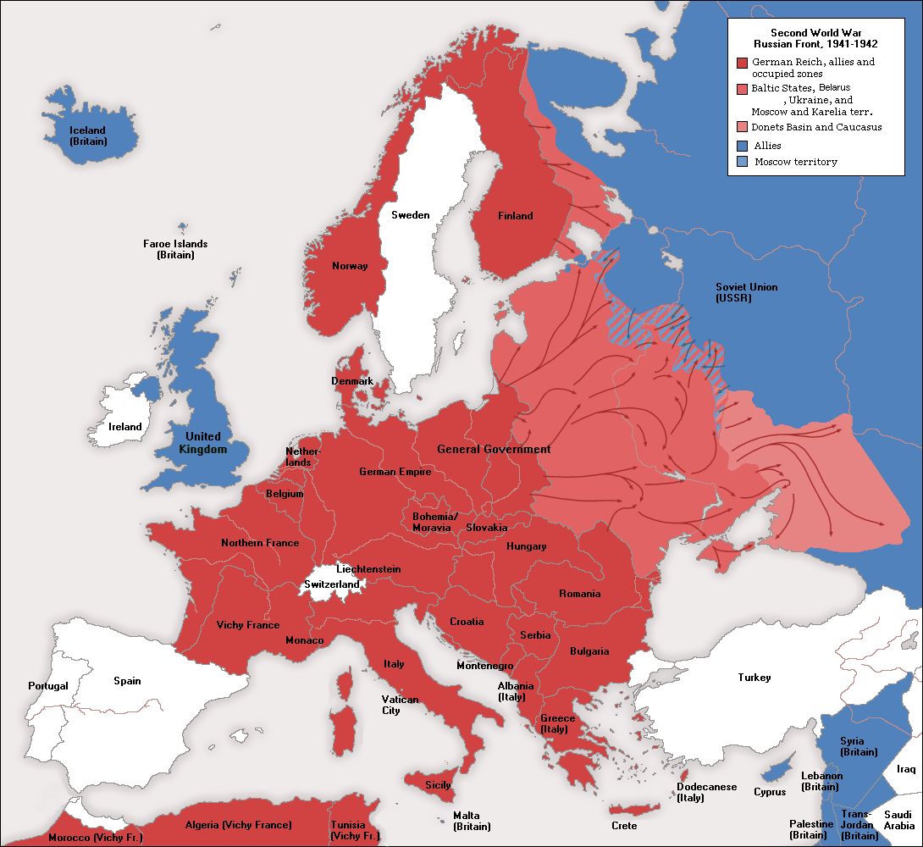
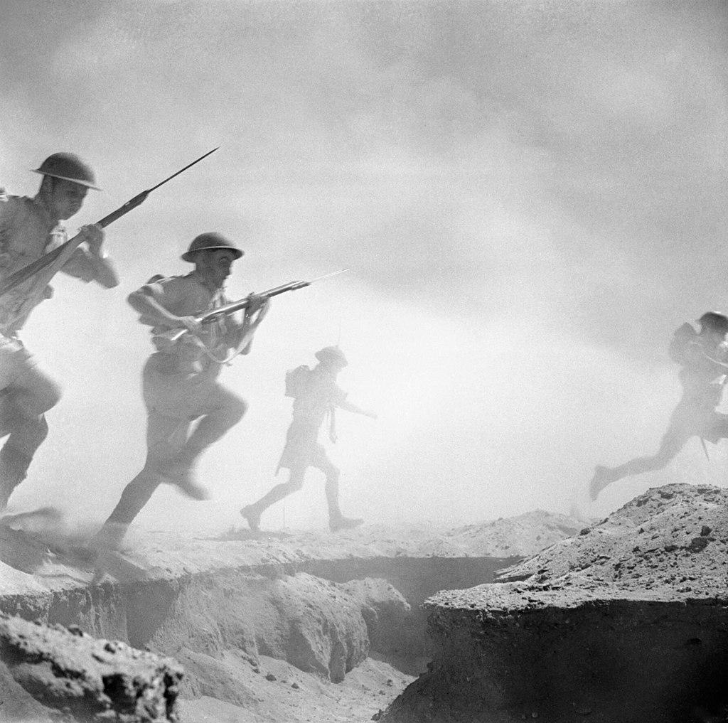
WORLD WAR II
THE SECOND BATTLE OF EL ALAMEIN : October 1942

Slide 4
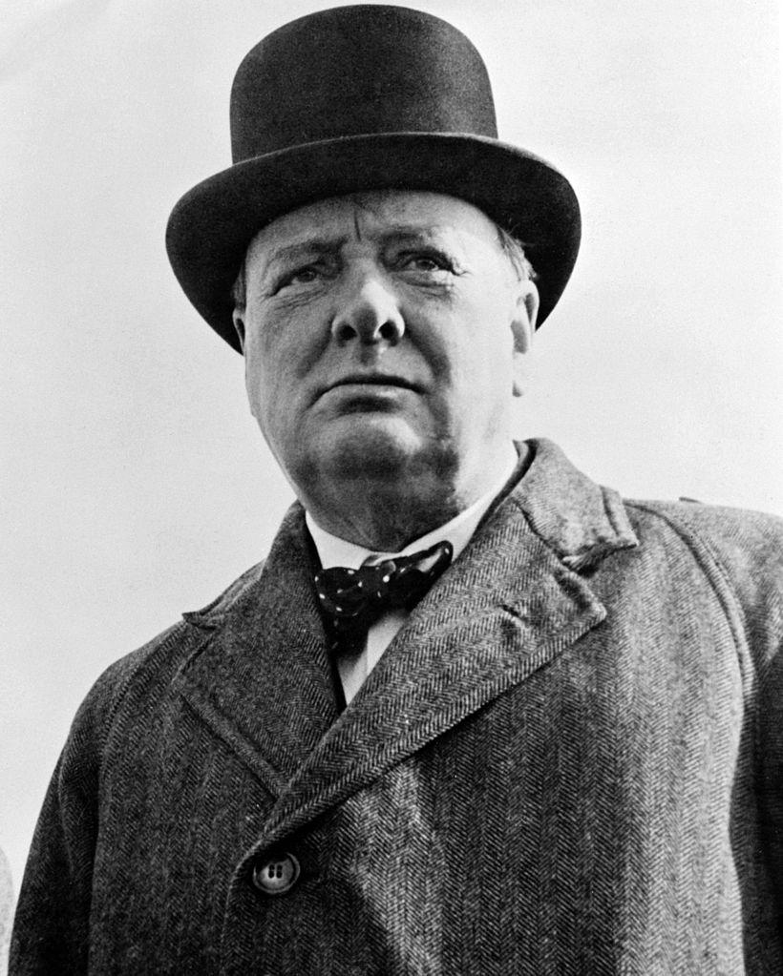
ENGLAND ALONE
Now this is not the end. It is not even the beginning of the end. But it is, perhaps, the end of the Beginning...
– Winston Churchill

Slide 5
WE NEEDED A VICTORY
Examining Bible characters who needed a victory

Slide 6
ELIJAH NEEDED A VICTORY
Now Ahab told Jezebel all that Elijah had done, and how he had killed all the prophets with the sword. Then Jezebel sent a messenger to Elijah, saying, “So may the gods do to me and even more, if I do not make your life as the life of one of them by tomorrow about this time.” And he was afraid and arose and ran for his life and came to Beersheba, which belongs to Judah, and left his servant there. But he himself went a day’s journey into the wilderness, and came and sat down under a juniper tree; and he requested for himself that he might die, and said, “It is enough; now, O Lord, take my life, for I am not better than my fathers.” I Kings 19:1-4

Slide 7
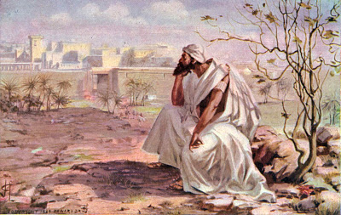
JONAH NEEDED A VICTORY
But it greatly displeased Jonah and he became angry. He prayed to the Lord and said, “Please Lord, was not this what I said while I was still in my own country? Therefore in order to forestall this I fled to Tarshish, for I knew that You are a gracious and compassionate God, slow to anger and abundant in lovingkindness, and one who relents concerning calamity. Therefore now, O Lord, please take my life from me, for death is better to me than life.”
Jonah 4:1-3

Slide 8
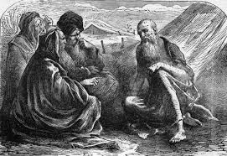
JOB NEEDED A VICTORY
Afterward Job opened his mouth and cursed the day of his birth. And Job said, "Let the day perish on which I was to be born,
And the night which said, ‘A boy is conceived.’
“May that day be darkness;
Let not God above care for it,
Nor light shine on it. Job 3:1-4

Slide 9
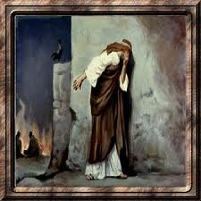
PETER NEEDED A VICTORY
But Peter said to Him, “Even though all may fall away because of You, I will never fall away.” Jesus said to him, “Truly I say to you that this very night, before a rooster crows, you will deny Me three times.” Peter *said to Him, “Even if I have to die with You, I will not deny You.” All the disciples said the same thing too. Matthew 26:33-35
And Peter remembered the word which Jesus had said, “Before a rooster crows, you will deny Me three times.” And he went out and wept bitterly. Matthew 26: 75

Slide 10
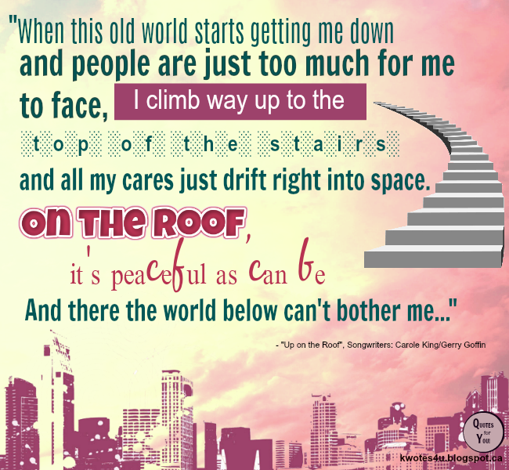

Slide 11
If we are honest we ALL NEED a victory from time to time.
We can all sympathize with these people in the Bible.

Slide 12
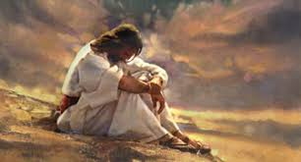
We can understand how Elijah felt all alone. Because we have felt alone
“It is enough; now, O Lord, take my life, for I am not better than my fathers.” I Kings 18:4

Slide 13
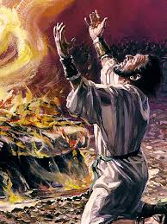
But Elijah was NOT alone
The Lord said to him, “Go, return on your way to the wilderness of Damascus, and when you have arrived, you shall anoint Hazael king over Aram; and Jehu the son of Nimshi you shall anoint king over Israel; and Elisha the son of Shaphat of Abel-meholah you shall anoint as prophet in your place. It shall come about, the one who escapes from the sword of Hazael, Jehu shall put to death, and the one who escapes from the sword of Jehu, Elisha shall put to death. Yet I will leave 7,000 in Israel, all the knees that have not bowed to Baal and every mouth that has not kissed him.” I Kings 19:15-18

Slide 14
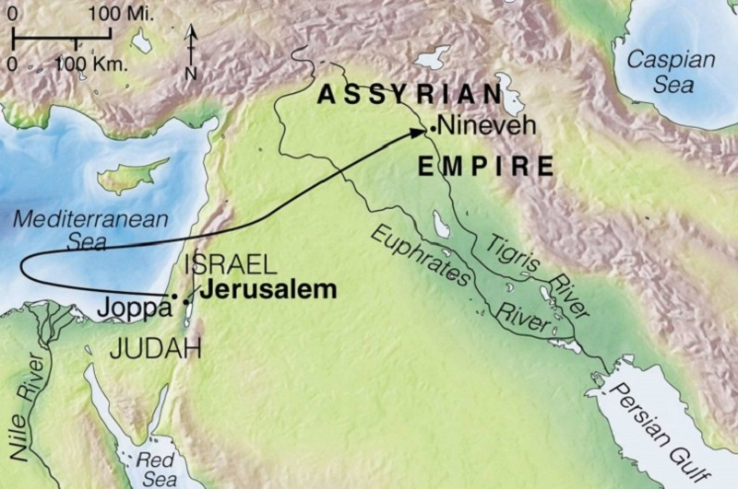
We can understand why Jonah became angry.
But it greatly displeased Jonah and he became angry. He prayed to the Lord and said, “Please Lord, was not this what I said while I was still in my own country? Jonah 4:1

Slide 15
“You have heard that it was said, ‘You shall love your neighbor and hate your enemy.’ But I say to you, love your enemies and pray for those who persecute you, so that you may be sons of your Father who is in heaven; for He causes His sun to rise on the evil and the good, and sends rain on the righteous and the unrighteous. ...
Matthew 5:43-45

Slide 16
We can understand why Job wished he was never born.
Afterward Job opened his mouth and cursed the day of his birth. And Job said, "Let the day perish on which I was to be born, Job 3:1

Slide 17
At times we have all thought this.
For You formed my inward parts; You wove me in my mother’s womb.
I will give thanks to You, for I am fearfully and wonderfully made; Wonderful are Your works, And my soul knows it very well. My frame was not hidden from You, When I was made in secret, And skillfully wrought in the depths of the earth; Your eyes have seen my unformed substance. And in Your book were all written The days that were ordained for me, When as yet there was not one of them.
Psalm 139: 13-16

Slide 19
THE LORD ALMIGHTY HAS A PLAN FOR ME AND I PRAISE HIM THAT I WAS BORN!
The Lord blessed the latter days of Job more than his beginning; Job 42:12
After this, Job lived 140 years, and saw his sons and his grandsons, four generations. And Job died, an old man and full of days. Job 42:16-17

Slide 20
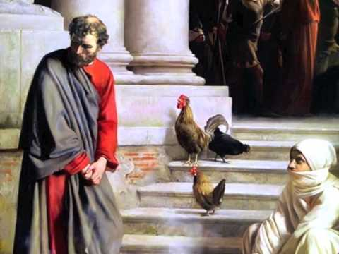
We can understand why Peter wept bitterly. Because we know regret
.... And immediately a rooster crowed. And Peter remembered the word which Jesus had said, “Before a rooster crows, you will deny Me three times.” And he went out and wept bitterly. Matthew 26:74-75

Slide 21
We all carry regrets that we should let go.
But now apart from the Law the righteousness of God has been manifested, being witnessed by the Law and the Prophets, even the righteousness of God through faith in Jesus Christ for all those who believe; for there is no distinction; for all have sinned and fall short of the glory of God, being justified as a gift by His grace through the redemption which is in Christ Jesus; whom God displayed publicly as a propitiation in His blood through faith. This was to demonstrate His righteousness, because in the forbearance of God He passed over the sins previously committed; Romans 3:21-25

Slide 22
If we are honest we ALL NEED a victory from time to time.
We can all sympathize with these people in the Bible.

Slide 23
We often forget that
“The Battle Belongs to the Lord”
“When you go out to battle against your enemies and see horses and chariots and people more numerous than you, do not be afraid of them; for the Lord your God, who brought you up from the land of Egypt, is with you. When you are approaching the battle, the priest shall come near and speak to the people. He shall say to them, ‘Hear, O Israel, you are approaching the battle against your enemies today. Do not be fainthearted. Do not be afraid, or panic, or tremble before them, for the Lord your God is the one who goes with you, to fight for you against your enemies, to save you.’ Deuteronomy 20: 1-4

Slide 24
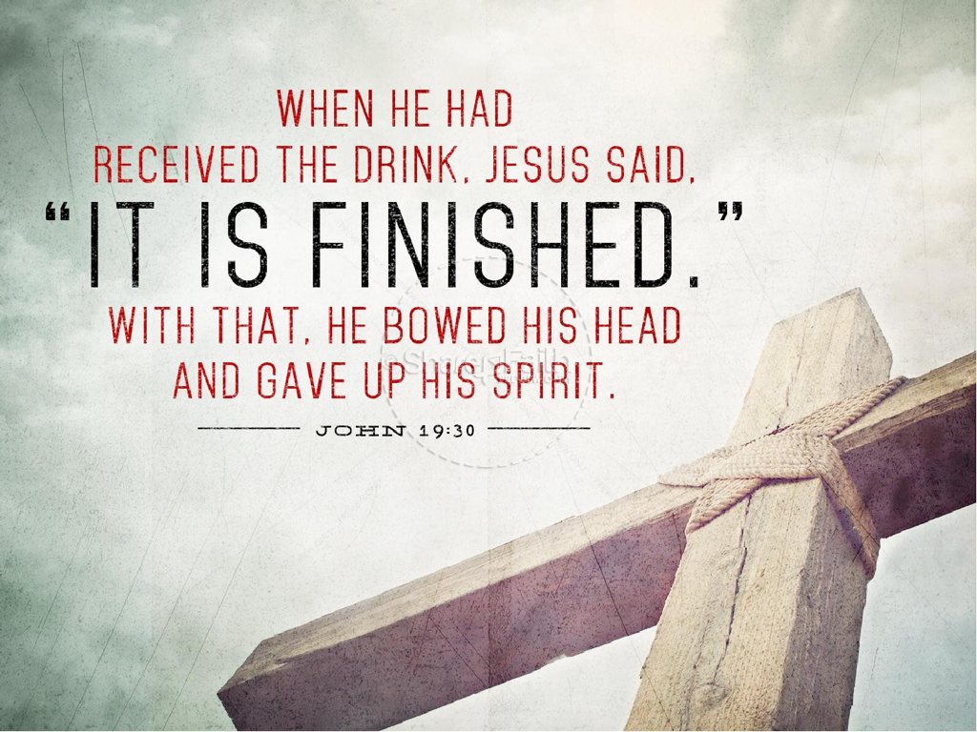
It is finished,
The battle is over
It is finished,
There’ll be no more war
It is finished,
The end of the conflict
It is finished,
And Jesus is Lord.

Slide 25


