Slide 1
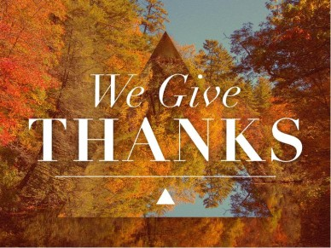
God Is So Good!!

Slide 2
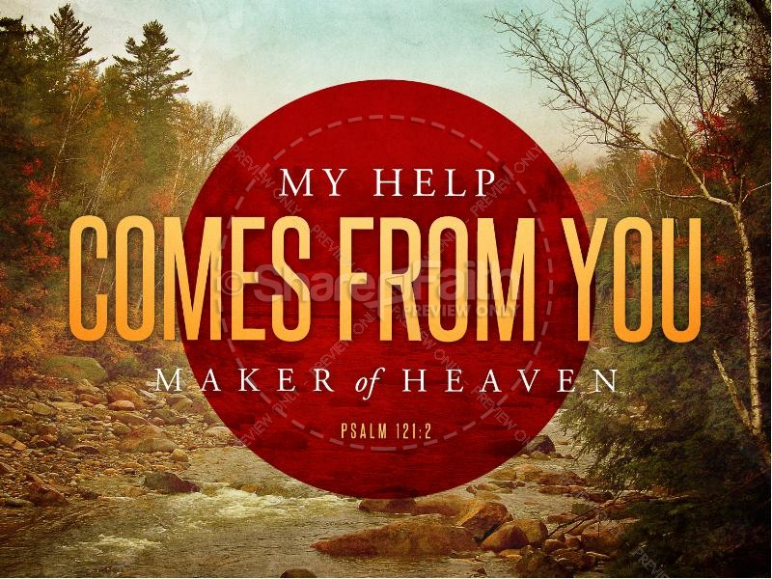
God’s People at O’Neal
2 My help cometh from the Lord, which made heaven and
earth.

Slide 3
O Give Thanks Unto the Lord God
Psalm 100:1-5

Slide 4
We will never forget!!
Our brothers and sisters who have
Left us.
We shall press onward, looking forward
To meeting the Lord with all
His saints.

Slide 5
1 Make a joyful noise unto the Lord, all ye lands.
² Serve the Lord with gladness: come before his presence with singing.
³ Know ye that the Lord he is God: it is he that hath made us, and not we ourselves; we are his people, and the sheep of his pasture.
⁴ Enter into his gates with thanksgiving, and into his courts with praise: be thankful unto him, and bless his name.
⁵ For the Lord is good; his mercy is everlasting; and his truth endureth to all generations.

Slide 6
1 Chronicles 16:34
O give thanks unto the Lord;
for he is good;
for his mercy endureth for ever.

Slide 7
Psalm 18:49
Therefore will I give thanks unto thee, O Lord, among the heathen, and sing praises unto thy name

Slide 8
Psalm 92:1
It is a good thing to give thanks unto the Lord, and to sing praises unto thy name, O Most High:

Slide 9
Psalm 30:12
To the end that my glory may sing praise to thee,
and not be silent. O Lord my God,
I will give thanks unto thee for ever

Slide 10
Psalm 105:1
O give thanks unto the Lord;
call upon his name:
make known his deeds among the people.

Slide 11
Psalm 106:47
Save us, O Lord our God, and gather us from
among the heathen, to give thanks unto
thy holy name, and to triumph in thy praise.

Slide 12
Psalm 136:1
O give thanks unto the Lord;
for he is good:
for his mercy endureth for ever.

Slide 13
1 Thessalonians 5:18 In every thing give thanks:
for this is the will of God in
Christ Jesus concerning you.

Slide 14
Isa. 55:6-11
⁶ Seek ye the Lord while he may be found, call ye upon him while he is near:
⁷ Let the wicked forsake his way, and the unrighteous man his thoughts: and let him return unto the Lord, and he will have mercy upon him; and to our God, for he will abundantly pardon.

Slide 15
⁸ For my thoughts are not your thoughts, neither are your ways my ways, saith the Lord.
⁹ For as the heavens are higher than the earth, so are my ways higher than your ways, and my thoughts than your thoughts.
¹⁰ For as the rain cometh down, and the snow from heaven, and returneth not thither, but watereth the earth, and maketh it bring forth and bud, that it may give seed to the sower, and bread to the eater:
¹¹ So shall my word be that goeth forth out of my mouth: it shall not return unto me void, but it shall accomplish that which I please, and it shall prosper in the thing whereto I sent it

Slide 16
1. Give God thanks for the glorious invitation
To be forgiven Isa. 55:6-7

Slide 17
2. Give God thanks for the Glorious Ways of God.
Isa. 55:8-9

Slide 18
3. Give God thanks for the
glorious
Operation of the word of God. Isa. 55:10-11

Slide 19
1. Give God thanks for the glorious invitation
To be forgiven Isa. 55:6-7

Slide 20
Isa. 55:6-11
⁶ Seek ye the Lord while he may be found, call ye upon him while he is near:
⁷ Let the wicked forsake his way, and the unrighteous man his thoughts: and let him return unto the Lord, and he will have mercy upon him; and to our God, for he will abundantly pardon.

Slide 21
2. Give God thanks for the Glorious Ways of God.
Isa. 55:8-9

Slide 22
The Great Difference between God and Man
Thoughts
My Thoughts
Your Thoughts
Ways
My Ways
Your Ways

Slide 23
Demonstration of God’s Goodness
For as the rain cometh down,
And the snow from heaven,
And returneth not again
But Watereth the earth
That it may bring forth seed to the sower
And bread to the eater

Slide 24
3. Give God thanks for the
glorious
Operation of the word of God. Isa. 55:10-11

Slide 25
So…shall my word be that goeth forth out of my mouth
The word that goeth forth out of God’s mouth….
Don’t Add it, don’t take away from it.
Prov. 30:5-6
Rev. 22:18-19
2 John 9
Matt. 4:4

Slide 26
It shall prosper in the thing that I sent it.
There is never a time when it does not do what He says it will do.
Ill. 2 Tim. 4:2-4
Jude 3

Slide 27
Guaranteed promise:
1. It shall accomplish that which I please
God’s truth is astonishing…what it can do.
Ill. Make you free. John 8:32; no longer a
slave. Rom. 6:16-18..
God be thanked, you were the servants of sin, but have obeyed from the heart that form of doctrine delivered unto you. Being then made free from sin, you became the servants of righteousness.

Slide 28
For The power in God’s word…we give thanks

Slide 29
For The grace given us in Jesus Christ…we give God thanks

Slide 30
With Jesus, we have so much to be thankful for every day..
Jesus is: alpha and omega,
the beginning and the end,
the first and the last,
the one who was and is and evermore shall be
He is the master of the mighty,
He is the hero of the heroes,
He is the rose of Sharon and the Lily of the Valley,
He is the bright and the morning star.
Some day he will descend from heaven with a shout and with the voice of the arch angel.. ... Acts 1:9-11

Slide 31
For The circumstances that we have in Jesus, makes us humble with thanks

Slide 32
For The outcome of our lives…We give God thanks

Slide 33
For The people who God has given us to touch our lives, we give God thanks..
Paul was so thankful for Timothy (Phil.2:20)
The Philippians (church who sent once and
again unto his necessities) Phil. 1:5; Phil. 4:15-17
David reminds us of those ‘precious’ to God and us
Psalm 116:15
.. The Thessalonians are given the assurance that “God
Will bring them with His Son”… I Thess. 4:16

Slide 34
Today we give thanks to God for all those who have lived among us and are gone…
We remember them.

Slide 35
Above all,
We stand with assurance of hope that God will bring
Them with His Son Jesus Christ
We shall see our loved ones again.
They shall not come back to us,
But we shall go to them… As David said about his son that
Had died. (2 Sam. 12:23 “..Can I bring him back again?
I shall go to him, but he shall not return to me.”)

Slide 36
Are you in Christ Jesus?
Husbands,
Wives,
Children
Grandchildren
Great grandchildren
Parents

Slide 37
O Give Thanks Unto the Lord God
Isa 55:6-11

