Slide 1
What Defiles a Man?
Notes:
One Sunday a man sat through a church service and then on the way home he fussed about the sermon, he griped about the traffic, he complained about the heat, and he made a big fuss about how late the lunch meal was served. Then he bowed and prayed, giving God thanks for the food.
His son was watching him all the way through this post-church experience. Just as they were beginning to pass the food he said, “﻿Daddy, did God hear you when we left the church and you started fussin’ about the sermon and about the traffic and about the heat?﻿”
The father blushed and said, “﻿Well, yes, son, He heard me.﻿”
﻿Well, Daddy, did God hear you when you just prayed for this food right now?﻿”
And he says, “﻿Well, yes, son, He … He … He heard me.﻿”
“﻿Well, Daddy, which one did God believe?﻿”
That little story showcases a problem that afflicts far too many church people. Too often what we claim to be and what we really are is miles apart.
We call this condition “hypocrisy”.

Slide 2
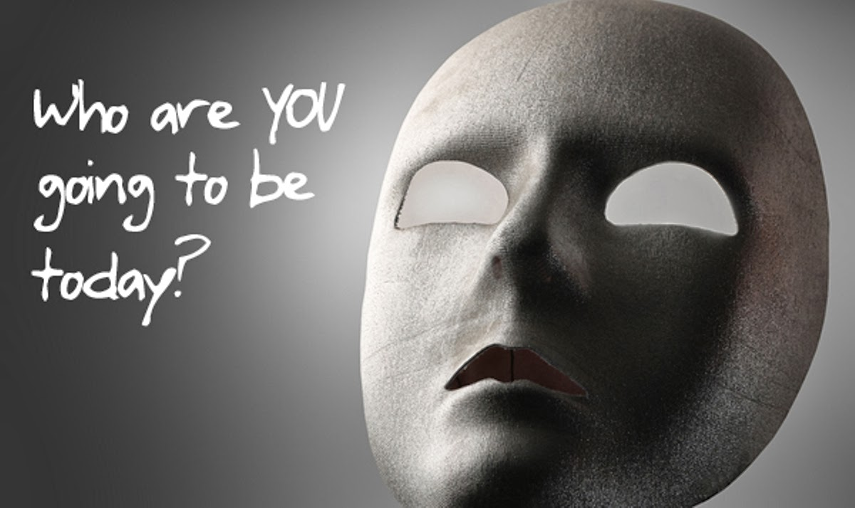
Hypocrisy
Notes:
This word comes to us from the ancient Greek language. It was used to describe actors in a play. Ancient actors would carry different masks in their hands as they acted. The masks were attached to sticks and could be held before the face as needed. A smiling mask suggested humor, a frowning mask suggested sadness, etc. These actors were called the “hypocritos”. This word means “one who wears a mask”.
We use the word today to refer to people who pretend to be one thing when they are actually something else.
People who pretend to be your friend while stabbing you in the back are hypocrites.
People who live one way at church and another way at home are hypocrites.
People who attempt to do wicked things under the radar while acting like all is well are hypocrites.
Now, there should be no people like that in the church, but sadly, there are some in every congregation.

Slide 3
Mark 7
¹ Then came together unto him the Pharisees, and certain of the scribes, which came from Jerusalem.
² And when they saw some of his disciples eat bread with defiled, that is to say, with unwashen, hands, they found fault.
³ For the Pharisees, and all the Jews, except they wash their hands oft, eat not, holding the tradition of the elders.
Notes:
Some people claim there are too many hypocrites in the church.
That’s just an excuse people use for not coming to church.
Think about this…..“If a hypocrite is standing between you and God, the hypocrite is closer to God than you are.”
Hypocrites are nothing new! In this passage, Jesus encountered a whole group of hypocrites.

Slide 4
Mark 7
⁴ And when they come from the market, except they wash, they eat not. And many other things there be, which they have received to hold, as the washing of cups, and pots, brasen vessels, and of tables.
⁵ Then the Pharisees and scribes asked him, Why walk not thy disciples according to the tradition of the elders, but eat bread with unwashen hands?

Slide 5

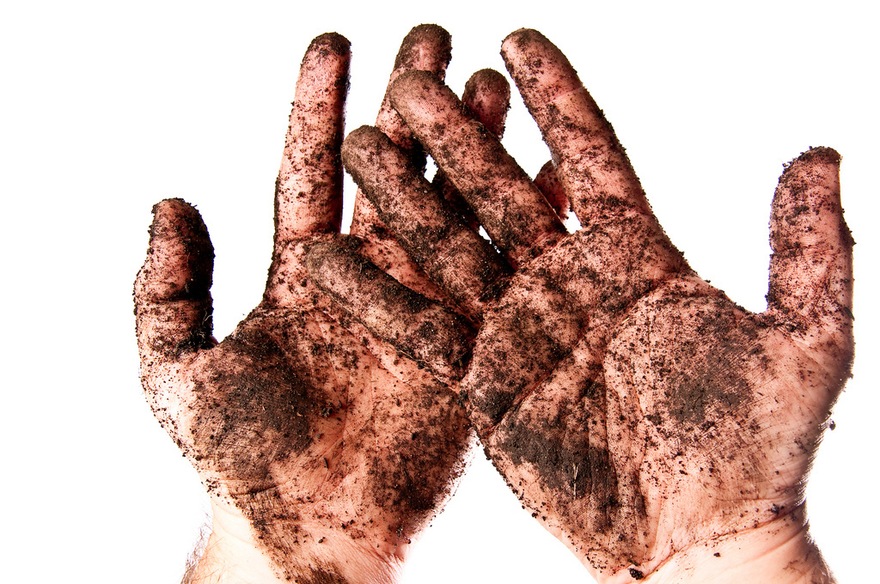
What’s the problem?
Notes:
These men see the disciples of Jesus eating food without washing their hands and they are offended. They attack Jesus over this issue, but He turns the tables on them. They think the issue is one of clean hands, but Jesus shows them that the issue is really about clean hearts.
This text has something to say to us today. We still have those people who are more concerned about clean hands than they are about clean hearts.
Jesus is going to teach us that the inside of a person should match the outside of that person. He is going to teach us that what we are in our heart is what we really are! He is going to teach us that hypocrisy has no place in our lives.
Let’s watch Jesus as He reveals these religious hypocrites for what they are.

Slide 6
Jesus Responds
⁶ He answered and said unto them, Well hath Esaias prophesied of you hypocrites, as it is written,
This people honoureth me with their lips, but their heart is far from me.
Notes:
God doesn’t want lip service, He wants heart service!!

Slide 7
Jesus Responds
⁷ Howbeit in vain do they worship me, teaching for doctrines the commandments of men.
⁸ For laying aside the commandment of God, ye hold the tradition of men, as the washing of pots and cups: and many other such like things ye do.

Slide 8
Jesus Responds
¹³ Making the word of God of none effect through your tradition, which ye have delivered: and many such like things do ye.
Notes:
Keeping your traditions has made the word of God ineffective.

Slide 9
Listen to Jesus
¹⁴ And when he had called all the people unto him, he said unto them, Hearken unto me every one of you, and understand:

Slide 10
Listen to Jesus
¹⁵ There is nothing from without a man, that entering into him can defile him: but the things which come out of him, those are they that defile the man.
¹⁶ If any man have ears to hear, let him hear.

Slide 11
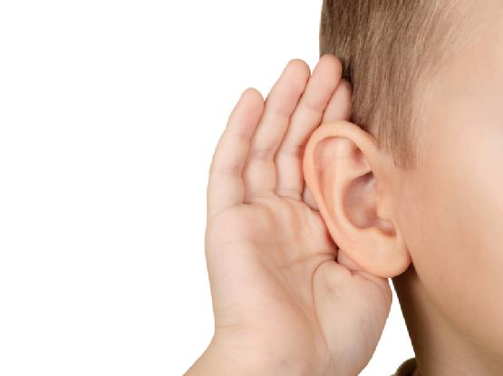
Listen to Instruction
Proverbs 1:8
⁸ My son, hear the instruction of thy father, and forsake not the law of thy mother:
Notes:
As children of God, we must listen to His instruction. The wise man says….
Do we like to listen to instruction? Especially our parents?

Slide 12
Proverbs 4:20-22
²⁰ My son, attend to my words; incline thine ear unto my sayings.
²¹ Let them not depart from thine eyes; keep them in the midst of thine heart.
²² For they are life unto those that find them, and health to all their flesh.

Slide 13

Proverbs 4:23
²³ Keep thy heart with all diligence; for out of it are the issues of life.
Notes:
Keep it!
Guard it!
Protect it!
WHY? For out of it are the issues of life.
The key to man is his heart. Who holds the key? Whatever captures the heart (mind) captures the man!

Slide 14
Hold Fast
Job 27:6
My righteousness I hold fast, and will not let it go: my heart shall not reproach me so long as I live.
Proverbs 4:13
Take fast hold of instruction; let her not go: keep her; for she is thy life.
Notes:
That’s why it’s so important to hold fast to the truth!

Slide 15
Hold Fast
1 Thessalonians 5:21
Prove all things; hold fast that which is good.
2 Thessalonians 2:15
Therefore, brethren, stand fast, and hold the traditions which ye have been taught, whether by word, or our epistle.
Notes:
That’s why it’s so important to hold fast to the truth!

Slide 16
Hold Fast
2 Timothy 1:13
Hold fast the form of sound words, which thou hast heard of me, in faith and love which is in Christ Jesus.
Titus 1:9
Holding fast the faithful word as he hath been taught, that he may be able by sound doctrine both to exhort and to convince the gainsayers.
Notes:
That’s why it’s so important to hold fast to the truth!

Slide 17
Hold Fast
Hebrews 3:6
But Christ as a son over his own house; whose house are we, if we hold fast the confidence and the rejoicing of the hope firm unto the end.
Hebrews 10:23
Let us hold fast the profession of our faith without wavering; (for he is faithful that promised;)
Notes:
That’s why it’s so important to hold fast to the truth!

Slide 18
Proverbs 4:23
²³ Keep thy heart with all diligence; for out of it are the issues of life.
Notes:
Keep it!
Guard it!
Protect it!
WHY? For out of it are the issues of life.
The key to man is his heart. Who holds the key? Whatever captures the heart (mind) captures the man!

Slide 19

Proverbs 4:24-25
²⁴ Put away from thee a froward mouth, and perverse lips put far from thee.
²⁵ Let thine eyes look right on, and let thine eyelids look straight before thee.
Notes:
Froward mouth=deceitful mouth

Slide 20

Proverbs 4:26-27
²⁶ Ponder the path of thy feet, and let all thy ways be established.
²⁷ Turn not to the right hand nor to the left: remove thy foot from evil.

Slide 21
What Defiles a Man?
¹⁸ And he saith unto them, Are ye so without understanding also? Do ye not perceive, that whatsoever thing from without entereth into the man, it cannot defile him;
¹⁹ Because it entereth not into his heart, but into the belly, and goeth out into the draught, purging all meats?

Slide 22

Jesus Answers
²⁰ And he said, That which cometh out of the man, that defileth the man.
What comes out of your heart?
Notes:
What defiles a man?
Jesus answers.
Jesus reveals that spiritual defilement is always the result of a defiled heart.
Every sin we commit, whether it is a sin of the body or of the mind, has its birth in our heart. We do the things we do because of defilement within.

Slide 23
What happens if I don’t guard my heart?
Notes:
Sin reigns!
Satan reigns!
When Satan controls your heart, look at what happens….

Slide 24
What Comes Out of the Heart?
²¹ For from within, out of the heart of men, proceed evil thoughts, adulteries, fornications, murders,
²² Thefts, covetousness, wickedness, deceit, lasciviousness, an evil eye, blasphemy, pride, foolishness:
²³ All these evil things come from within, and defile the man.
Notes:
Every person in this room in capable of every sin in the list we just covered, and more. In fact, some here today are guilty of some of these things and you know it. There are defiled hearts in this room and they need to be cleansed.
If that is to happen, there must be acceptance of the truth of your condition and there must be repentance of your sins. If these things are in your heart today, you are spiritually defiled dirty and in deep trouble today.
Evil Thoughts – This is the root of all that follows. When an evil heart conjures up evil intentions, the evil person will carry them out.
Adulteries – Illicit sexual activity by married persons.
Fornications – Any sexual immorality. The origin of sexual sin in not in the body, it is the result of a defiled heart!
Murders – The taking of another’s life. By the way, you are guilty of murder if you have hatred in your heart toward another person, 1 John 3:15.
Thefts – Taking that which belongs to another for your own use.
Covetousness – An insatiable craving for that which belongs to another.
Wickedness – This word means “malice” and it is deliberate acts of meanness!
Deceit – This word refers to cunning maneuvers designed to ensnare someone for one’s personal advantage. It is the idea of someone trying to work undercover to bring someone else down. Sneaky, deceptive people fall into this category.
Lasciviousness – This word refers to unrestrained, shameless behavior. It is an attitude that says, “I will do as I please and I do not care what anyone thinks about it!”
An Evil Eye – This is a Hebrew expression that speaks of envy and jealousy. It looks at the blessings of another and desires them for itself. It is envious when others prosper.
Blasphemy – injurious or defaming speech directed at either God or man. Gossip and curing fall into this category.
Pride –It’s the attitude that says, “Look at me, see what I have done. No one is a good or as great as I am.” This is the opposite of humility.
Foolishness – This word refers to those who are morally and spiritually desensitized. They cannot see their sins; neither can they sense the Lord working in and around them. They do not know God and there is no desire to know Him.
If these things abide in your heart, then you are spiritual defiled.

Slide 25
What Comes Out of the Heart?
Galatians 5:19-21
¹⁹ Now the works of the flesh are manifest, which are these; Adultery, fornication, uncleanness, lasciviousness,
²⁰ Idolatry, witchcraft, hatred, variance, emulations, wrath, strife, seditions, heresies,
²¹ Envyings, murders, drunkenness, revellings, and such like: of the which I tell you before, as I have also told you in time past, that they which do such things shall not inherit the kingdom of God.

Slide 26
1 Corinthians 6:9-11
⁹ Know ye not that the unrighteous shall not inherit the kingdom of God? Be not deceived: neither fornicators, nor idolaters, nor adulterers, nor effeminate, nor abusers of themselves with mankind,
¹⁰ Nor thieves, nor covetous, nor drunkards, nor revilers, nor extortioners, shall inherit the kingdom of God.
¹¹ And such were some of you: but ye are washed, but ye are sanctified, but ye are justified in the name of the Lord Jesus, and by the Spirit of our God.

Slide 27
Acknowledge Him
Proverbs 3:5-6
⁵ Trust in the Lord with all thine heart; and lean not unto thine own understanding.
⁶ In all thy ways acknowledge him, and he shall direct thy paths.
Notes:
Why do people treat each other so badly? Why do spouses break their wedding vows? Why do people act out in violence and hatred toward others? Why do racism and hate crimes still exist in our world? Why are people filled with greed? Why do we give in to our desires? Why does our temptation see too hard to escape?
If we aren’t acknowledging God in our life, then he isn’t the driver of our life. In Prov. 3:5-6…

Slide 28
Galatians 6:22-25
²² But the fruit of the Spirit is love, joy, peace, longsuffering, gentleness, goodness, faith,
²³ Meekness, temperance: against such there is no law.
²⁴ And they that are Christ's have crucified the flesh with the affections and lusts.
²⁵ If we live in the Spirit, let us also walk in the Spirit.

Slide 29
1 John 1:6-7, 9
⁶ If we say that we have fellowship with him, and walk in darkness, we lie, and do not the truth:
⁷ But if we walk in the light, as he is in the light, we have fellowship one with another, and the blood of Jesus Christ his Son cleanseth us from all sin.
⁹ If we confess our sins, he is faithful and just to forgive us our sins, and to cleanse us from all unrighteousness.

Slide 30
If our greatest need had been more information, God would have sent us a teacher.
If our greatest need had been technology, God would’ve sent us a scientist.
If our greatest need had been more money, God would’ve sent us an economist.
If our greatest need had been pleasure, God would have sent us an entertainer.

Slide 31
But our greatest need was freedom from sin, so God sent us what we needed: A Savior.

Slide 32


