Slide 1
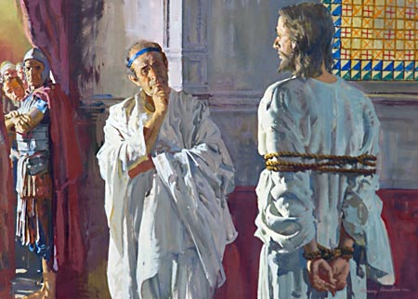
What shall I do then with Jesus…?
Matthew 27:22
Notes:
Our lesson tonight comes from Matthew 27 starting in verse 1.
It’s morning. A group of men gathered together…not for morning coffee, but to plot the death of Jesus.
Read V. 11-14
Then read 15-22.

Slide 2
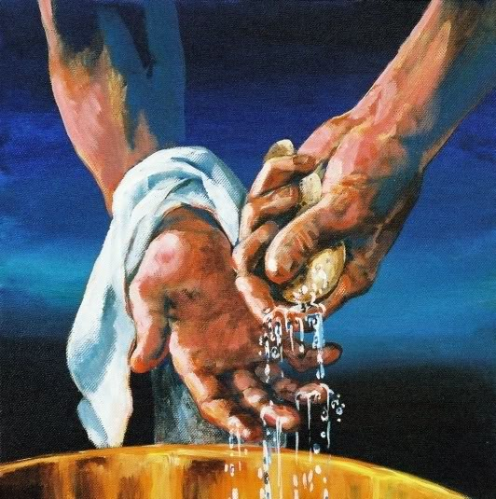
Pilate’s Answer
Avoidance
Notes:
In verse 22, we hear the t of the people as they all say, “Let Him be crucified.”
verdic
Vs. 23, Pilate tries again to ask the people, “What evil has he done?” , but all they would say was “Let Him be crucified.”
Pontius Pilate was a man trained and commissioned by Rome to act as a judge. If there was a dispute and a decision was to be made, he was the man. In cases like these he was the judge, prosecutor, and defense attorney.
He had the right questions for the people and the ability to answer it; but he failed to release Jesus.
In vs. 24, he washes his hands of Jesus. Here Pilate gives Jesus his answer…I’m just going to avoid you.

Slide 3
What Will You Do with Jesus?
Notes:
The question Pilate asked is still a great question for us to consider tonight!
Pilate’s answer was inadequate. The Jewish leaders were irresponsible and the mob was irrational.
Is our response to the question any different sometimes?
Is our answer sometimes inadequate, irresponsible or irrational?

Slide 4
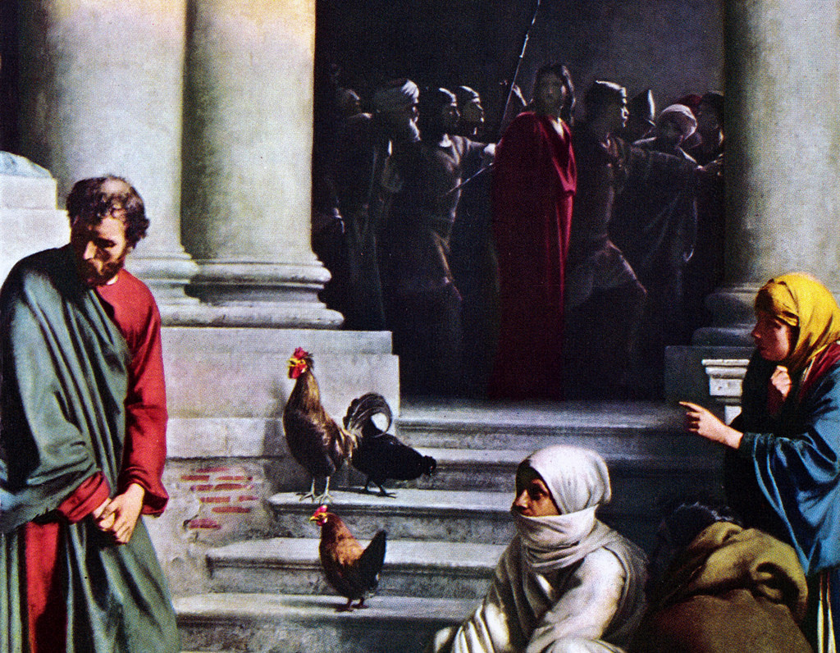
Peter’s Answer
Denial
Notes:
We see many examples in the Bible of people’s answer to What Will You Do With Jesus?
In Matthew 26, we see Peter’s answer.
Starting in Matthew 26:69-75

Slide 5
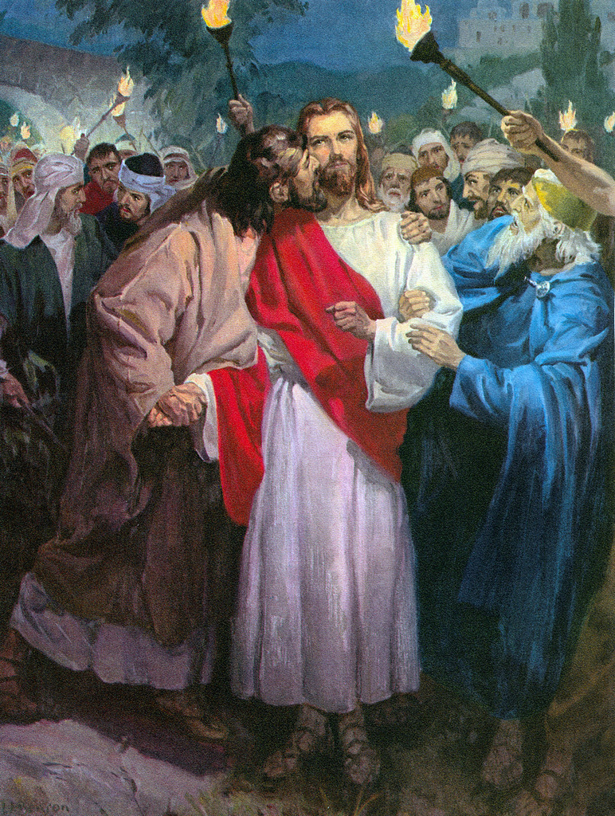
Judas’ Answer
Betrayal
Notes:
In Matthew 27, we see Judas’ answer.
Starting in Matthew 27:3-5

Slide 6
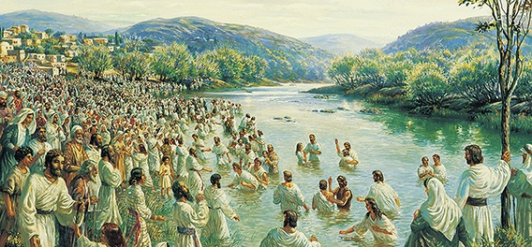
Answer on Day of Pentecost
Acceptance
Notes:
In Acts 2, we see the men of Judea and Jerusalem’s answer Peter.
In Acts 2:36-41
36 Therefore let all the house of Israel know assuredly, that God hath made the same Jesus, whom ye have crucified, both Lord and Christ.
37 Now when they heard this, they were pricked in their heart, and said unto Peter and to the rest of the apostles, Men and brethren, what shall we do?
38 Then Peter said unto them, Repent, and be baptized every one of you in the name of Jesus Christ for the remission of sins, and ye shall receive the gift of the Holy Ghost.
39 For the promise is unto you, and to your children, and to all that are afar off, even as many as the Lord our God shall call.
40 And with many other words did he testify and exhort, saying, Save yourselves from this untoward generation.
41 Then they that gladly received his word were baptized: and the same day there were added unto them about three thousand souls.

Slide 7
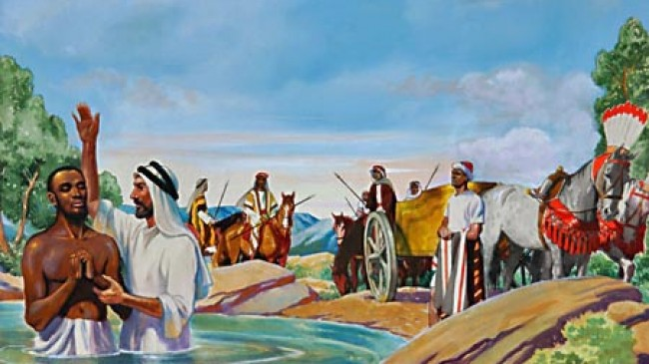
Eunuch’s Answer
Obedience
Notes:
In Acts 8, we see the Eunuch’s answer to Philip’s teacher of Jesus:
35 Then Philip opened his mouth, and began at the same scripture, and preached unto him Jesus.
36 And as they went on their way, they came unto a certain water: and the eunuch said, See, here is water; what doth hinder me to be baptized?
37 And Philip said, If thou believest with all thine heart, thou mayest. And he answered and said, I believe that Jesus Christ is the Son of God.
38 And he commanded the chariot to stand still: and they went down both into the water, both Philip and the eunuch; and he baptized him.

Slide 8
Our Answer
Avoidance
Denial
Betrayal
Acceptance
Obedience
Notes:
Are we any different?
How often do we avoid or try to escape what we know we should do?
How often do we deny Christ by not standing up for Him in our lives?
How often do we betray Him with giving into our weaknesses?
Have we accepted our sins and understand that we need a Savior?
Have we obeyed His teachings and are faithfully living them?

Slide 9
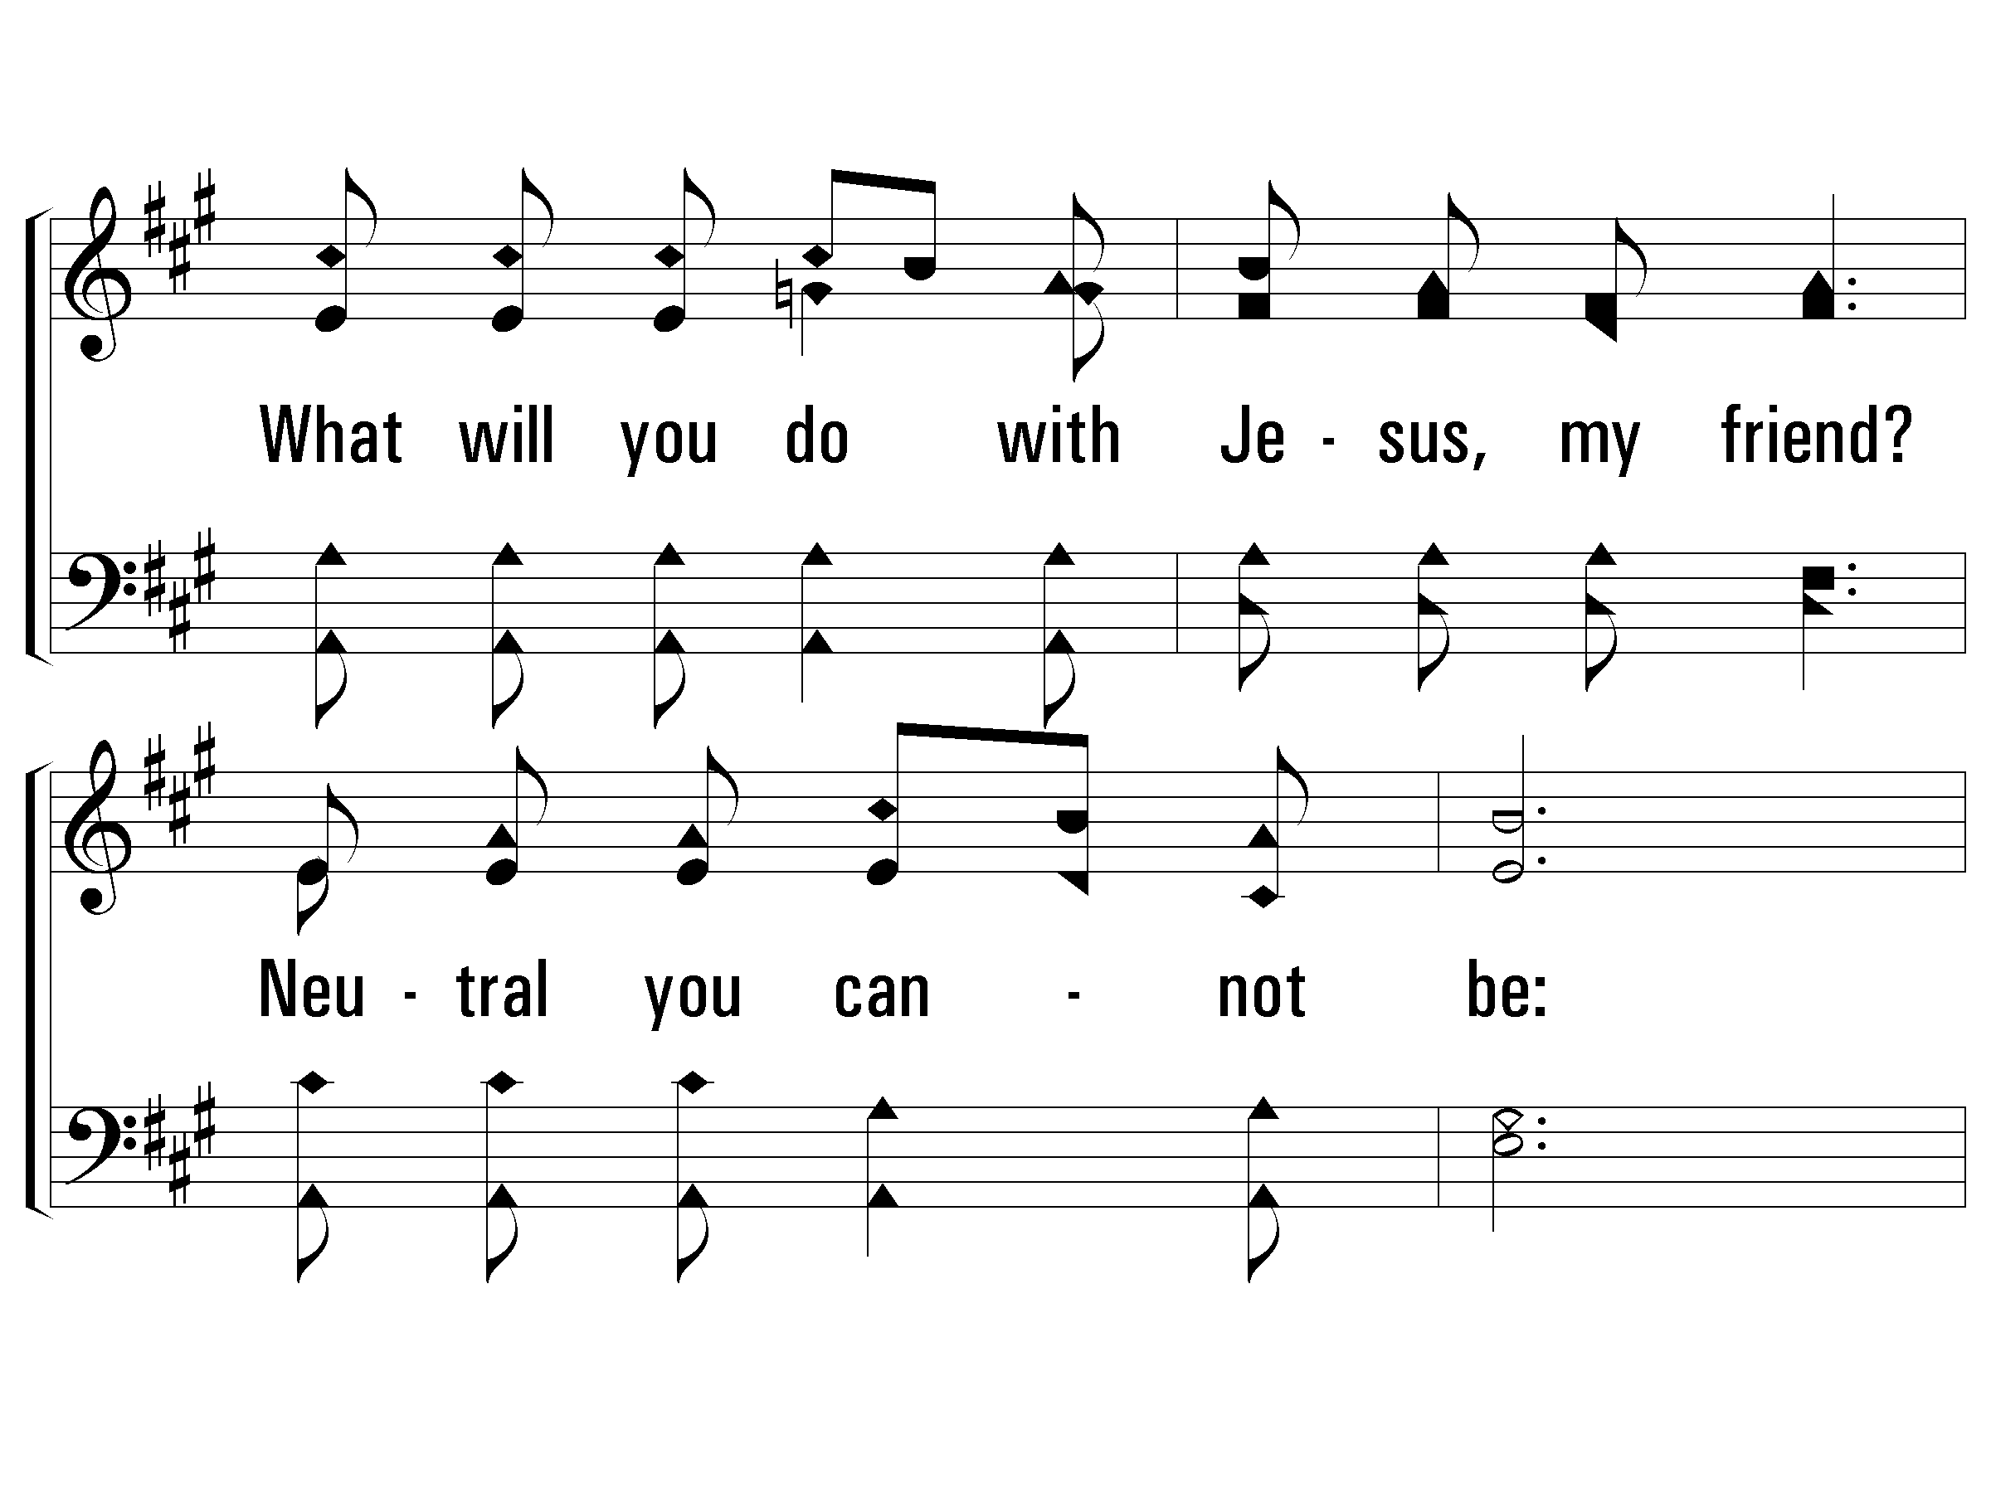
c – What Will You Do With Jesus?
740
What will you do with Jesus, my friend?
Neutral you cannot be:
Some day your heart will be asking,
O friend,
"What will He do with me?"
© 2004 The Paperless Hymnal™
Notes:
You can’t sit on the fence.

Slide 10

Notes:
Trying to make a decision about becoming a Christian?
Get off the fence.
Trying to make a decision about serving Christ with all your heart, soul and mind?
Get off the fence.
Trying to decide whether living one more day in sin is worth it?
Get off the fence.
Stop putting off what we know we need to do!

Slide 11
Is Jesus Lord?
Ephesians 1:19-21
And what is the exceeding greatness of his power to us-ward who believe, according to the working of his mighty power,
Which he wrought in Christ, when he raised him from the dead, and set him at his own right hand in the heavenly places,
Far above all principality, and power, and might, and dominion, and every name that is named, not only in this world, but also in that which is to come:
Notes:
Ephesians 1:19-23

Slide 12
Is Jesus Lord?
Ephesians 1:22-23
And hath put all things under his feet, and gave him to be the head over all things to the church,
Which is his body, the fulness of him that filleth all in all.
Notes:
Ephesians 1:19-23

Slide 13
Is Jesus Lord?
Acts 10:36
Then Peter opened his mouth, and said, Of a truth I perceive that God is no respecter of persons:
But in every nation he that feareth him, and worketh righteousness, is accepted with him.
The word which God sent unto the children of Israel, preaching peace by Jesus Christ: (he is Lord of all:)
Notes:
Ephesians 1:19-23

Slide 14


Slide 15
Is Jesus Your Lord?
Matthew 6:24
No man can serve two masters: for either he will hate the one, and love the other; or else he will hold to the one, and despise the other. Ye cannot serve God and mammon.

Slide 16
Is Jesus Your Lord?
Romans 6:16-18
Know ye not, that to whom ye yield yourselves servants to obey, his servants ye are to whom ye obey; whether of sin unto death, or of obedience unto righteousness?
But God be thanked, that ye were the servants of sin, but ye have obeyed from the heart that form of doctrine which was delivered you.
Being then made free from sin, ye became the servants of righteousness.

Slide 17
Is Jesus Your Lord?
Romans 6:19-21
I speak after the manner of men because of the infirmity of your flesh: for as ye have yielded your members servants to uncleanness and to iniquity unto iniquity; even so now yield your members servants to righteousness unto holiness.
For when ye were the servants of sin, ye were free from righteousness.
What fruit had ye then in those things whereof ye are now ashamed? for the end of those things is death.

Slide 18
Is Jesus Your Lord?
Romans 6:22-23
But now being made free from sin, and become servants to God, ye have your fruit unto holiness, and the end everlasting life.
For the wages of sin is death; but the gift of God is eternal life through Jesus Christ our Lord.

Slide 19
c – What Will You Do With Jesus?
740
What will you do with Jesus, my friend?
Neutral you cannot be:
Some day your heart will be asking,
O friend,
"What will He do with me?"
© 2004 The Paperless Hymnal™
Notes:
You can’t sit on the fence.

Slide 20
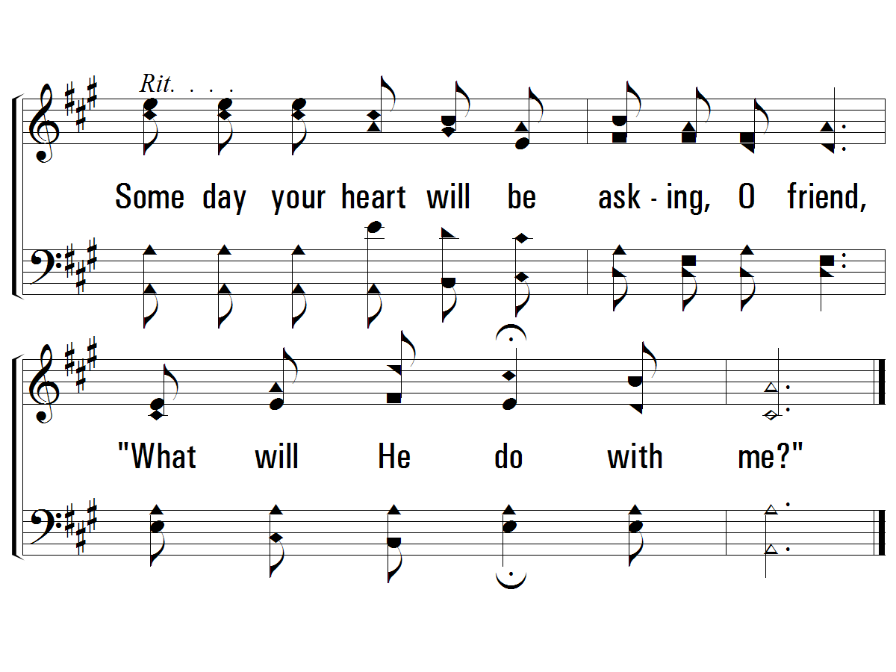
c – What Will You Do With Jesus?
740
© 2004 The Paperless Hymnal™

Slide 21
What Will You Do with Jesus?
Notes:
Will you become His child by being born again through baptism or keep avoiding Him?
Will you confess His name and put Him on or keep denying Him as the Lord of your life?
Will you put off your sin and confess your faults or keep betraying Him?
Tonight, won’t you answer Jesus as we stand and sing.

