Slide 1

Why Do You Go to Church?
Notes:
Tonight, I want to ask you a question:
Why Do You Go to Church?
Not why should you go, but personally,
Why Do You Go to Church?

Slide 2

10 Possible Reasons
To enjoy the community of your brothers and sisters in Christ.
To use your talents.
To discover your purpose.
To find connections with others.
To worship.
Notes:
What are reasons the world gives?
www.ibelieve.com website

Slide 3
10 Possible Reasons
To learn the Word.
To participate in missions.
To practice generosity.
To create lifelong friendships.
To enjoy food.

Slide 4
My Kids’ Responses
Addie Mae: I go to church because I’m a Christian, Jesus died on the cross for the forgiveness of my sins, and to learn more about Him.
Noah: I go to church to praise God and to go to Sunday school.
Mattilea: Because the parents go.

Slide 5

Benefits of Going to Church
Guidance from social support
Good influence
Promotes accountability and routine
Discipline
Teaches morals and good manners
Acceptance
Self identity/esteem
Promotes charity
Inspiration/Motiviation
Reduces stress
Notes:
Guidance from social support: Going to a place of worship gives you a sense of community—like having a second family that can share your life’s problems and fun times. Support through the best and worst of times.
Good influence: Helps you to lead a better spiritual life—great support system
Promotes accountability and routine- Gives you a sense of routine—helps you account for everyday responsibilities.
Discipline: Helps you make good life choices.
Teaches morals and good manners: We are encouraged to think and act with goodwill. Provide mankind with outstanding citizens with set morals and manners.
Acceptance: Helps you feel socially accepted.
Self identity/esteem: Promotes individual growth—reflect upon one’s actions, thoughts
Promotes charity: People become selfless.
Inspiration/Motivation: The world becomes overstimulating, but going to church can be an excellent way to draw on inspiration and motivation to improve one’s lifestyle
Reduces stress: The time spent focusing and clearing your thoughts leads to a drastic reduction in stress levels.

Slide 6
Why Aren’t You Going to Church?
Notes:
I recently had a conversation with a relative of mine asking them Why aren’t you going to church?

Slide 7
ANSWER
Because of all those hypocrites.
I had to…..
I will when….
Notes:
That’s like saying you won’t go to the doctor because you are sick.
A hospital is a sanctuary for sick people. Inside, the people do not aim for more sickness, but more cures.

Slide 8
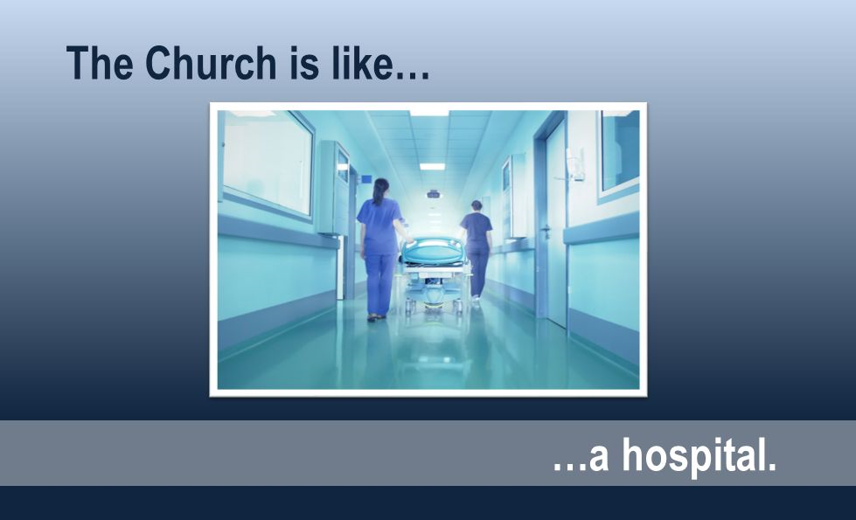
Notes:
The Church will always be full of sinners inside, like a hospital.

Slide 9

We are all sick with sin, so we go to church to be healed.
Notes:
Satan uses people and circumstances to disappoint Christians to pull them away from the very people God would use to bless, train, and encourage them at church.

Slide 10

The church is not a MUSEUM for good people. It’s a HOSPITAL for the broken.

Slide 11


Slide 12
Mark 2:17
When Jesus heard it, He said to them, “Those who are well have no need of a physician, but those who are sick. I did not come to call the righteous, but sinners, to repentance.”
Notes:
“The people who go to church don’t go because they think they’re perfect but because they – we – know ourselves to be in need of Christ’s forgiveness and look forward to being renewed by our time in worship.”

Slide 13
Who needs a physician?
Only the sick?
Only the saved?

Slide 14
Why Should You Go to Church?

Slide 15
Because it is commanded
Hebrews 10:24
²⁴ And let us consider one another to provoke unto love and to good works:
²⁵ Not forsaking the assembling of ourselves together, as the manner of some is; but exhorting one another: and so much the more, as ye see the day approaching.
Notes:
What was God thinking? Commanding us to go to worship. There’s a reason He wants us to go to church.
We need to realize that God wants us to attend regularly. He wants you and me—His people—to encourage each other—to kindle love among each other and to stimulate others to do good works.

Slide 16
Because Iron Sharpens Iron
Proverbs 27:17
¹⁷ As iron sharpens iron, so a man sharpens the countenance of his friend.
Notes:
Meeting regularly with other believers is a source of encouragement and strength. But know this: when iron rubs against iron, not only does it become sharper, it also causes sparks!
When you live in community with other Christians you will get bumped. And what spills out of you is what’s in your heart. God uses our interactions with others to show us the areas He would have us repent and turn to reflect more the image of His Son. Working alongside Christians in a church fellowship is a wonderful way to grow your love for God and for others. And it is also God’s way of showing you areas He wants to mature your walk with Christ.
If you’ve stopped attending church because people hurt you, didn’t measure up to your expectations, or are hypocritical, know that the enemy has you right where he wants you. Satan’s tactic is to divide and conquer. If he can pull you from the flock, you are vulnerable to his deceptions and attacks. Satan will use your lack of love for God’s people to quench your love for God.

Slide 17
To learn more about His Word
Hebrews 4:12
¹² For the word of God is quick, and powerful, and sharper than any two-edged sword, piercing even to the dividing asunder of soul and spirit, and of the joints and marrow, and is a discerner of the thoughts and intents of the heart.

Slide 18
The Word of God…
Penetrates hearts and transforms lives
Calls sinners to repentance
Encourages the downtrodden
Inspires the Lord’s servants to love and serve Christ
Lights the way God would have you go

Slide 19
Preach the Word
2 Timothy 4:2-4
² Preach the word; be instant in season, out of season; reprove, rebuke, exhort with all long suffering and doctrine.
³ For the time will come when they will not endure sound doctrine; but after their own lusts shall they heap to themselves teachers, having itching ears;
⁴ And they shall turn away their ears from the truth, and shall be turned unto fables.

Slide 20
To worship and praise God
John 4:24
²⁴ God is Spirit, and those who worship Him must worship in spirit and truth.”
Singing praises to Him.
Praying to Him.
Thanking Him.
Remembering Him.

Slide 21
To partake in the Lord’s Supper
Acts 20:7
⁷ And upon the first day of the week, when the disciples came together to break bread, Paul preached unto them, ready to depart on the morrow; and continued his speech until midnight.

Slide 22
The Forward Vision of God
Adam and Eve
Sinned
Spiritual death occurred
Yearly Sacrifice- no forgiveness, just appeasement
UNTIL the Lifesaver came
Jesus died
NOW we have the Lord’s Supper
Remember His sacrifice
Notes:
When you think about the Providence of God—when you examine His forward vision….

Slide 23
The Forward Vision of God
When remembering, we LOOK to Jesus
Reflect
Make Correction
Take of it worthily
HOW WONDERFUL!

Slide 24
Where else would you rather be?
Notes:
Than to be in the house of the Lord with brothers and sisters in Christ who aren’t perfect, but who are coming to the one who is perfect.

Slide 25
Captivity of Activity
Notes:
Maybe you don’t have issues with anyone at church; you’re just really busy on weekends doing other things––good things. Attending your kid’s soccer games, going on family getaways, and fixing stuff around the house are all “good things” but if they regularly take you away from church attendance, you would do well to realize you’re choosing the captivity of activity over what God says is more important.
Going to church is not about getting your attendance gold star, nor is it about gaining God’s favor for the week because you assembled together with His people.
Church is not a place to go, rather it is a living body where God wants you to become a part––for your good and His glory.

Slide 26
Tonight, are you here….
For a well check-up?
Or to be healed?
Notes:
God’s word, no matter how simple or difficult, will always be good for the soul. It will always be beneficial. It will always make us whole.
His word is living and it moves us to action.
How wonderful it is to love each other, forgive each other, worship with each other as we all walk toward our journey home!

