Slide 1


Slide 2
Working For the Master
I Cor. 15:58; Sign in front of building:
Wanted: Jesus Christ wants workers now!

Slide 3
Matt. 20:1-16 For the kingdom of heaven is like unto a man that is an householder, which went out early in the morning to hire labourers into his vineyard.
² And when he had agreed with the labourers for a penny a day, he sent them into his vineyard.
³ And he went out about the third hour, and saw others standing idle in the marketplace,
⁴ And said unto them; Go ye also into the vineyard, and whatsoever is right I will give you. And they went their way

Slide 4
⁵ Again he went out about the sixth and ninth hour, and did likewise.
⁶ And about the eleventh hour he went out, and found others standing idle, and saith unto them, Why stand ye here all the day idle?
⁷ They say unto him, Because no man hath hired us. He saith unto them, Go ye also into the vineyard; and whatsoever is right, that shall ye receive.
⁸ So when even was come, the lord of the vineyard saith unto his steward, Call the labourers, and give them their hire, beginning from the last unto the first.

Slide 5
⁹ And when they came that were hired about the eleventh hour, they received every man a penny.
¹⁰ But when the first came, they supposed that they should have received more; and they likewise received every man a penny.
¹¹ And when they had received it, they murmured against the goodman of the house,
¹² Saying, These last have wrought but one hour, and thou hast made them equal unto us, which have borne the burden and heat of the day.

Slide 6
¹³ But he answered one of them, and said, Friend, I do thee no wrong: didst not thou agree with me for a penny?
¹⁴ Take that thine is, and go thy way: I will give unto this last, even as unto thee.
¹⁵ Is it not lawful for me to do what I will with mine own? Is thine eye evil, because I am good?
¹⁶ So the last shall be first, and the first last: for many be called, but few chosen.

Slide 7
Jesus’ work is for everyone…. (Matt. 11:28-30)
“Come unto me, all ye that labor..”
Men
Women
Young people
Fathers
Mothers
Sons
Daughters
Grandchildren
Great Grandchildren

Slide 8
But does the Lord want us to work?
Jesus says:
1. “Go” work in my vineyard today! Matt. 20:1-16
2. James tells us James 2:24 “Ye see then, how
That by works a man is justified , and not by faith only”

Slide 9
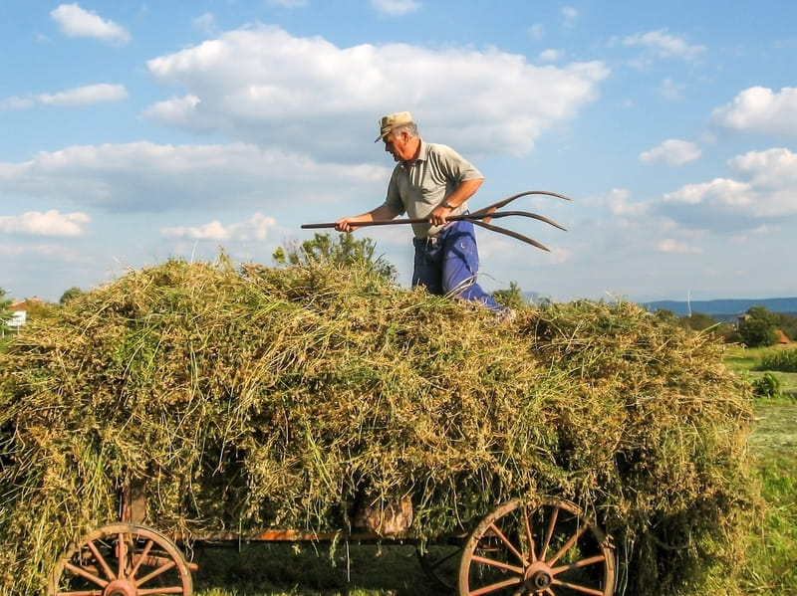

Slide 10
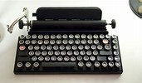

Slide 11


Slide 12
1 Corinthians 3:9 - For we are labourers together with God: ye are God's husbandry, [ye are] God's building
Philippians 2:12-16 - Wherefore, my beloved, as ye have always obeyed, not as in my presence only, but now much more in my absence, work out your own salvation with fear and trembling.
2 Timothy 2:15 - Study to shew thyself approved unto God, a workman that needeth not to be ashamed, rightly dividing the word of truth.

Slide 13
2 Corinthians 6:1-3 ..Again, we work with him…
6 We then, as workers together with him, beseech you also that ye receive not the grace of God in vain.
² (For he saith, I have heard thee in a time accepted, and in the day of salvation have I succoured thee: behold, now is the accepted time; behold, now is the day of salvation.)
³ Giving no offence in any thing, that the ministry be not blamed:
Reason: for ye serve the Lord Christ..
And whatsoever ye do, do it heartily, as to the Lord, and not unto men; Knowing that of the Lord ye shall receive the reward of the inheritance: for ye serve the Lord Christ. Colossians 3:23-24

Slide 14
And whatsoever ye do in word or deed, do all in the name of the Lord Jesus, giving thanks to God and the Father by him.Colossians 3:17 What? Do all in the name of the
Lord Jesus…
And let the beauty of the Lord our God be upon us: and establish thou the work of our hands upon us; yea, the work of our hands establish thou it.Psalm 90:17
And who is he that will harm you, if ye be followers of that which is good?1 Peter 3:13 When you are working
Together with God, no one can harm you!!!

Slide 15
God furnishes us directions to His good works!
All scripture is given by inspiration of God, and is profitable for doctrine, for reproof, for correction, for instruction in righteousness: That the man of God may be perfect, thoroughly furnished unto all good works.2 Timothy 3:16-17

Slide 16
Believing in Jesus is a work of God!
John 6:29 Jesus answered and said unto them, This is the work of God, that ye believe on him whom he hath sent. ... [35] And Jesus said unto them, I am the bread of life: he that cometh to me shall never hunger; and he that believeth on me shall never thirst
When we die, no more work that we can do!
John 9:4 “I must work the works of him that sent me, while it is day: the night cometh, when no man can work

Slide 17
God wants us to ‘always abound in the work of the Lord!
1 Corinthians 15:58 - Therefore, my beloved brethren, be ye stedfast, unmoveable, always abounding in the work of the Lord, forasmuch as ye know that your labour is not in vain in the Lord.

Slide 18
Our Lord’s work is for every time in our lives.
1. Early hours of the day Go to work!
2. 3rd. Hour of the day New ones: Go to work
Others…keep working
3. 6th o’clock in the day New ones: Go to work
Others…keep working
4. 9th o’clock in the day..New ones: Go to work
Others…keep working
5. 11th o’clock in the day: New ones: Go to work
Others…keep working.

Slide 19
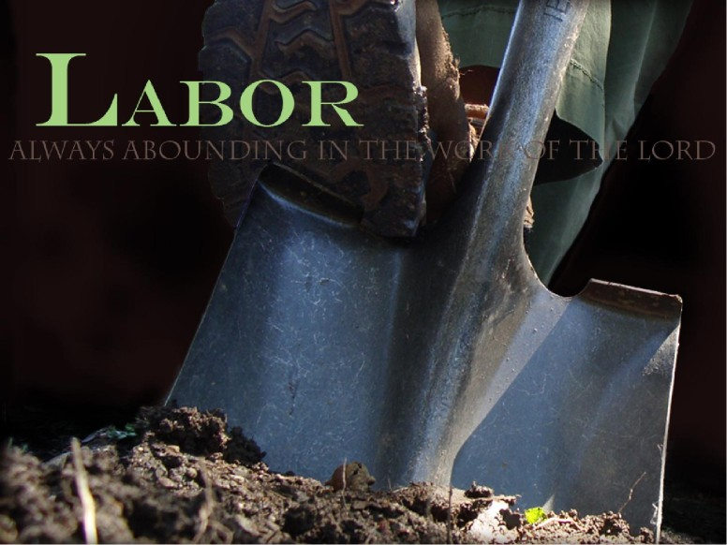
Working For the Master

Slide 20
I Cor. 15:58
⁵⁸ Therefore, my beloved brethren, be ye stedfast, unmoveable, always abounding in the work of the Lord, forasmuch as ye know that your labour is not in vain in the Lord

Slide 21
I Challenged you on April 8, 2018 to be a Worker For the Lord?
How much have you accomplished?

Slide 22


Slide 23
Let’s Grow Together!
2 Pet.3:18 ¹⁸ But grow in grace, and in the knowledge of our Lord and Saviour Jesus Christ. To him be glory both now and for ever. Amen

Slide 24


Slide 25
Let’s make sure we are on the right road,
<Matt.7:13-14
Doing the right work Matt. 7:21-23
And keep up the work to the end of our lives.
2 Tim.4:7-8 ;Luke 9:62

Slide 26


Slide 27
1 Peter 4:10 ¹⁰ As every man hath received the gift, even so minister the same one to another, as good stewards of the manifold grace of God.

Slide 28

God’s People at O’Neal church of Christ

Slide 29
ABOUNDING IN THE WORK OF THE LORD
1 Corinthians 15:57, 58
: The Christian life is a life filled with work for the Master –
1 Cor. 3:9. ⁹ For we are labourers together with God: ye are God's husbandry, ye are God's building.
Remember what is involved in the “Master’s work”?
1. The greatest privileges,(No greater privilege than to save a
Soul from death.James 5:19-20; cf. Matt. 16:26
2. The huge responsibilities ..Matt.5:16
3. The untold worth and rewards God gives for our doing it..
I Tim.4:16

Slide 30
The admonition of Paul is addressed to “My beloved brethren."
1. It is not addressed to elders only.
a. Although they must set the example - 1 Pet. 5:3.
2. It is not addressed to deacons only.
a. Though the word deacon means "servant" - Acts 6:1-3.
3. It is not addressed to preachers only.
a. Though he has a work to do - 2 Tim. 2:15; 4:5.
It is addressed to ‘my beloved brethren”..

Slide 31
The N. T. teaches that every Christian must be a worker.
1. The parable of the talents : Everyone of us given
Some talents. Matthew 25:14-30
a. Even if we only have one talent, we have a work to do.
2. The church of the Bible is pictured as a body - Rom. 12:5.
a. As with the physical body, each member of the spiritual body of Christ has a function - 1 Cor. 12:12-21.
What you can do as a Christian, do it!

Slide 32
2. There will always be work in the church for
People like :
a Paul I Cor. 11:1 be ye followers of me…
a Timothy; No man likeminded as he Phil.2:20
a Lois and Eunice 2 Tim.1:5
a Dorcas; Acts 9:36 ff

Slide 33
Always Abounding..
It has been said: The religion of Christ is the religion of always.
1. Always let your speech be with grace - Col. 4:6.
2. Always rejoice in the Lord - Phil. 4:4.
3. Always obey - Phil. 2:12.
4. Always be ready to give an answer - 1 Pet. 3:15.
5. To work always means to
"Be instant ( urgent )in season, out of season" - 2 Tim. 4:2.
Always means youth plus aged - Lk. 9:62.

Slide 34
Christian service must be abounding service.
1. Abounding service is willing service.
Consider the eleventh hour men - Mt. 20:1-16.
2. Abounding service is fervent service - Rom. 12:11. ¹¹ Not slothful in business; fervent in spirit; serving the Lord
“ The idea of being heated to a boil.” Zeal,“Red Hot” in the Master’s work. Titus 2:14 ‘a Peculiar people, zealous of good works.”
3. Abounding service is heart service.- Eph. 6:6.
Not with eyeservice, as menpleasers; but as the servants of Christ, doing the will of God from the heart;
4. Abounding service is -. 1st place service Mt.6:33

Slide 35
AND THE REASON FOR ALWAYS ABOUNDING IN THE
WORK OF THE LORD!
A. The final resurrection.
1. The "Wherefore" connects with the preceding verses.
A. The entire chapter is a discussion of the resurrection and immortality.
2. Paul's point is, in view of the fact that there will be a life beyond this one, work - Rev. 14:13.
A. The future life is reason for all to abound in the work of the Lord. Matt.25:34
B. The final judgment. 2 Cor. 5:10

Slide 36
Abounding in the work of the Lord means happiness here and heaven hereafter.
A. We need to examine our Christian service and ask ourselves individually, "Am I abounding in the Lord's work?"
1. Remember, the question isn't, "Am I occasionally doing the Lord's work" but, "Am I abounding in it?“
2. Let us remember, "the night cometh, when no man can work" – John 9:4.
I Cor. 15:58

