Slide 1

Psalm 100
WORKING MEMBERS
with THANKSGIVING

Slide 2
Psalm 100 NASB
1 Shout joyfully to the Lord, all the earth.
2 Serve the Lord with gladness; Come before Him with joyful singing.
3 Know that the Lord Himself is God; It is He who has made us, and not we ourselves; We are His people and the sheep of His pasture.
4 Enter His gates with thanksgiving And His courts with praise. Give thanks to Him, bless His name.
5 For the Lord is good; His lovingkindness is everlasting And His faithfulness to all generations.

Slide 3
Singing praises to God
Ephesians 5:19 speaking to one another in psalms and hymns and spiritual songs, singing and making melody with your heart to the Lord;
Colossians 3:16 Let the word of Christ richly dwell within you, with all wisdom teaching and admonishing one another with psalms and hymns and spiritual songs, singing with thankfulness in your hearts to God.
SINGING WITH THANKSGIVING!
The melody in our hearts is rooted in thankfulness!

Slide 4
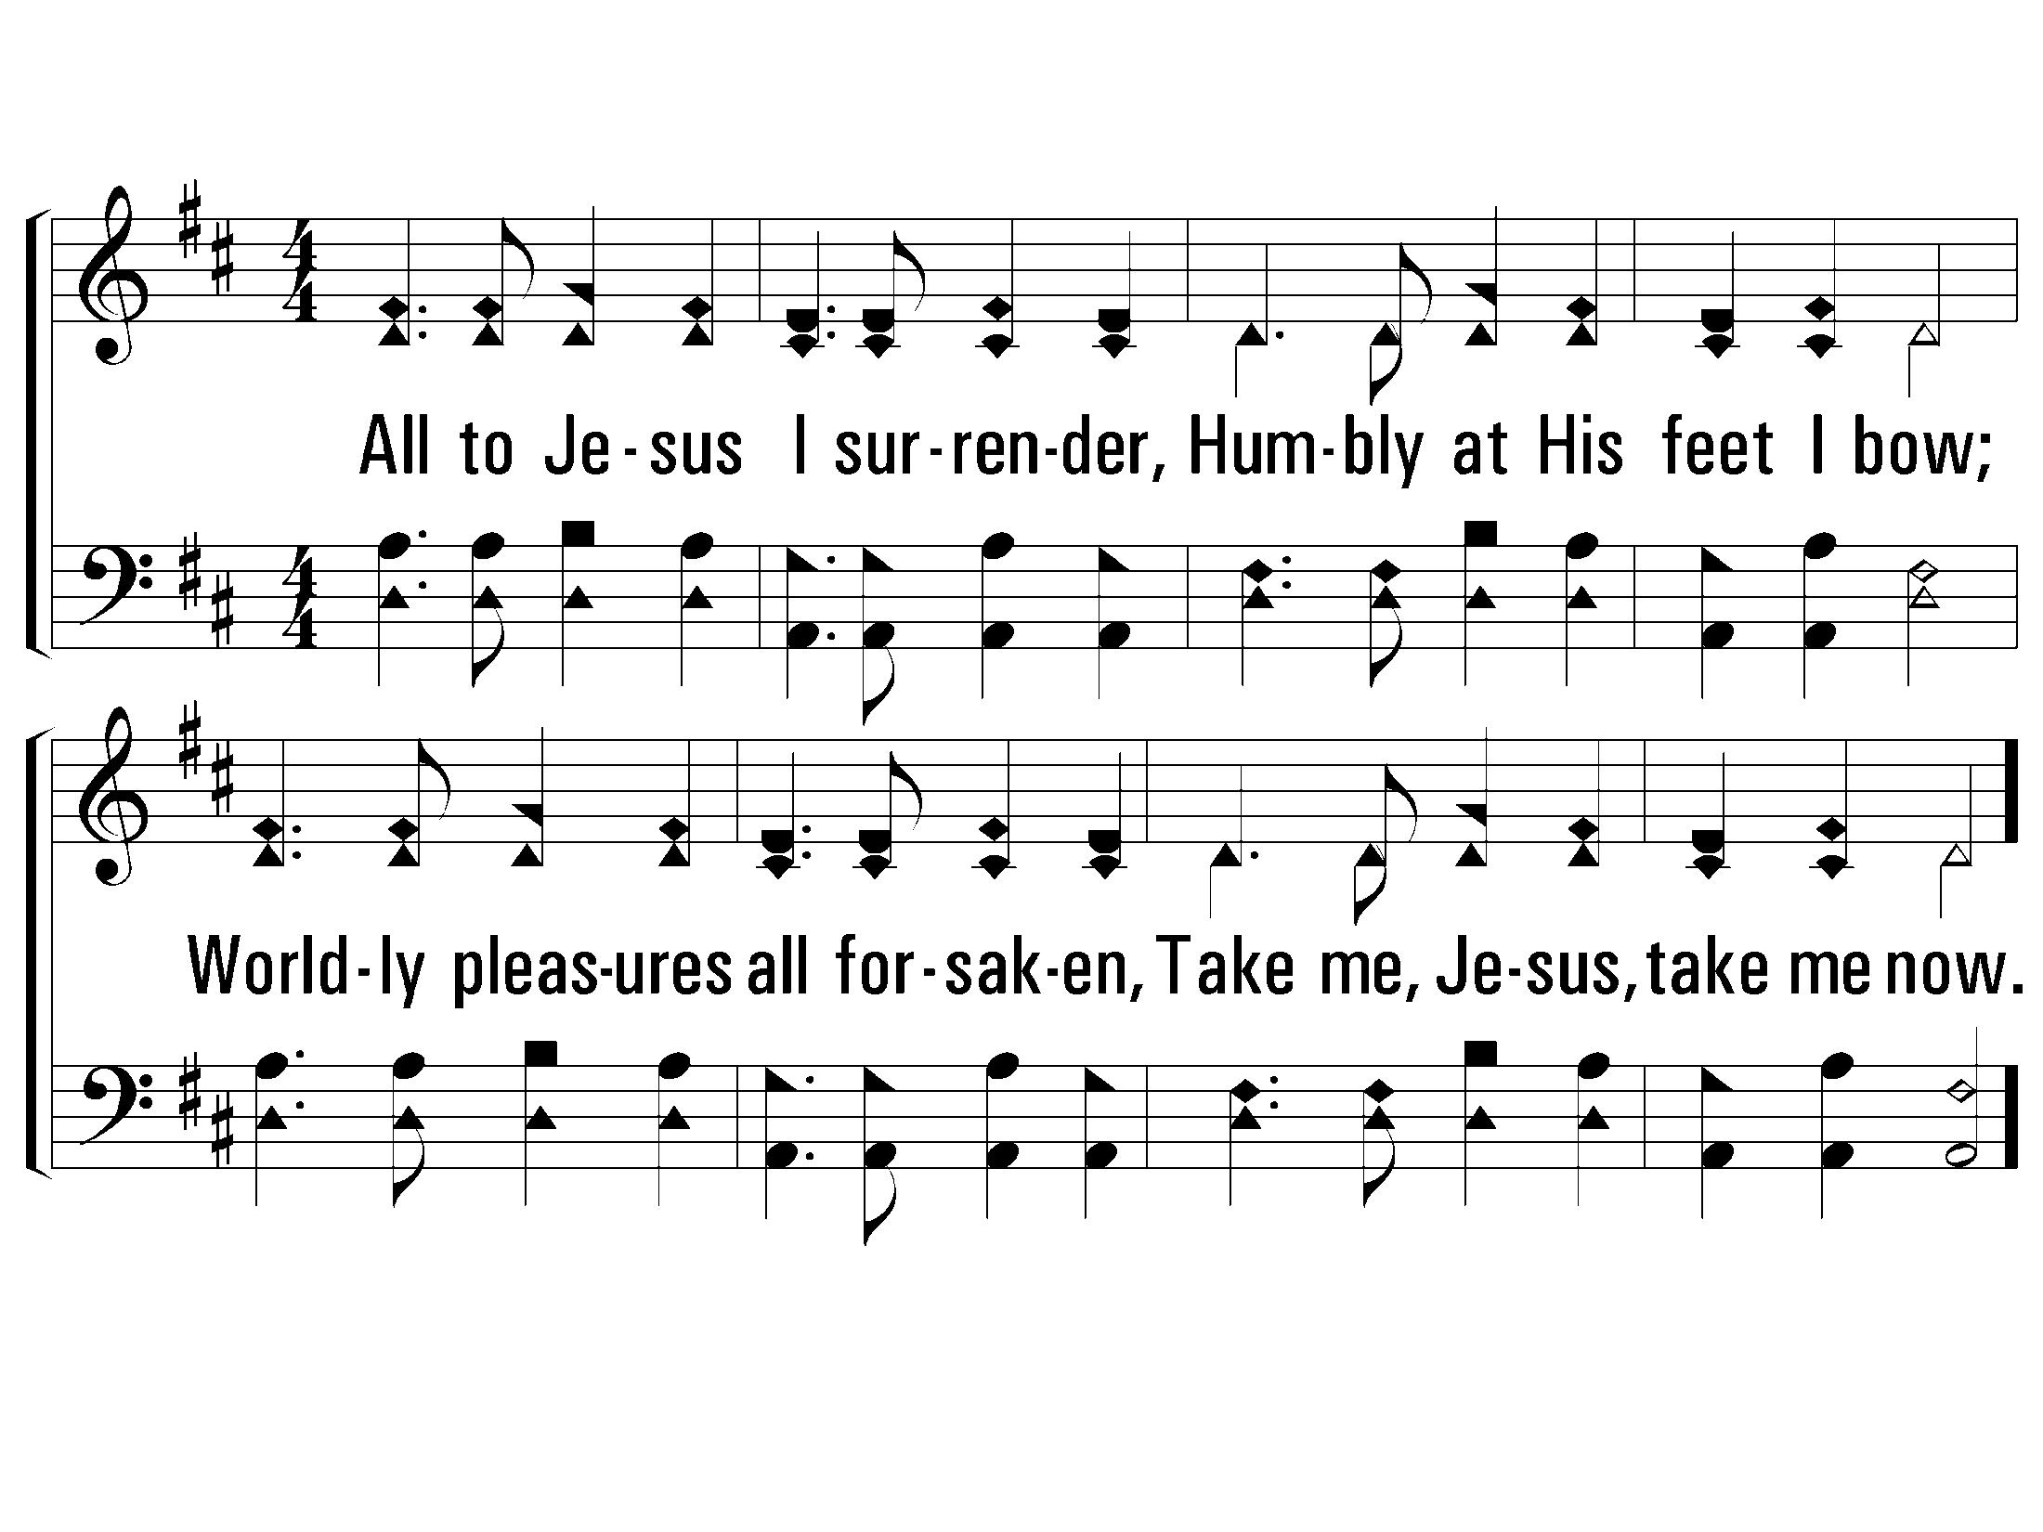
2 - All to Jesus I Surrender
29
2.
All to Jesus I surrender,
Humbly at His feet I bow;
Worldly pleasures all forsaken,
Take me, Jesus, take me now.
Words by: J. W. Van De Venter
Music by: W. S. Weeden
© 2001 The Paperless Hymnal™

Slide 5
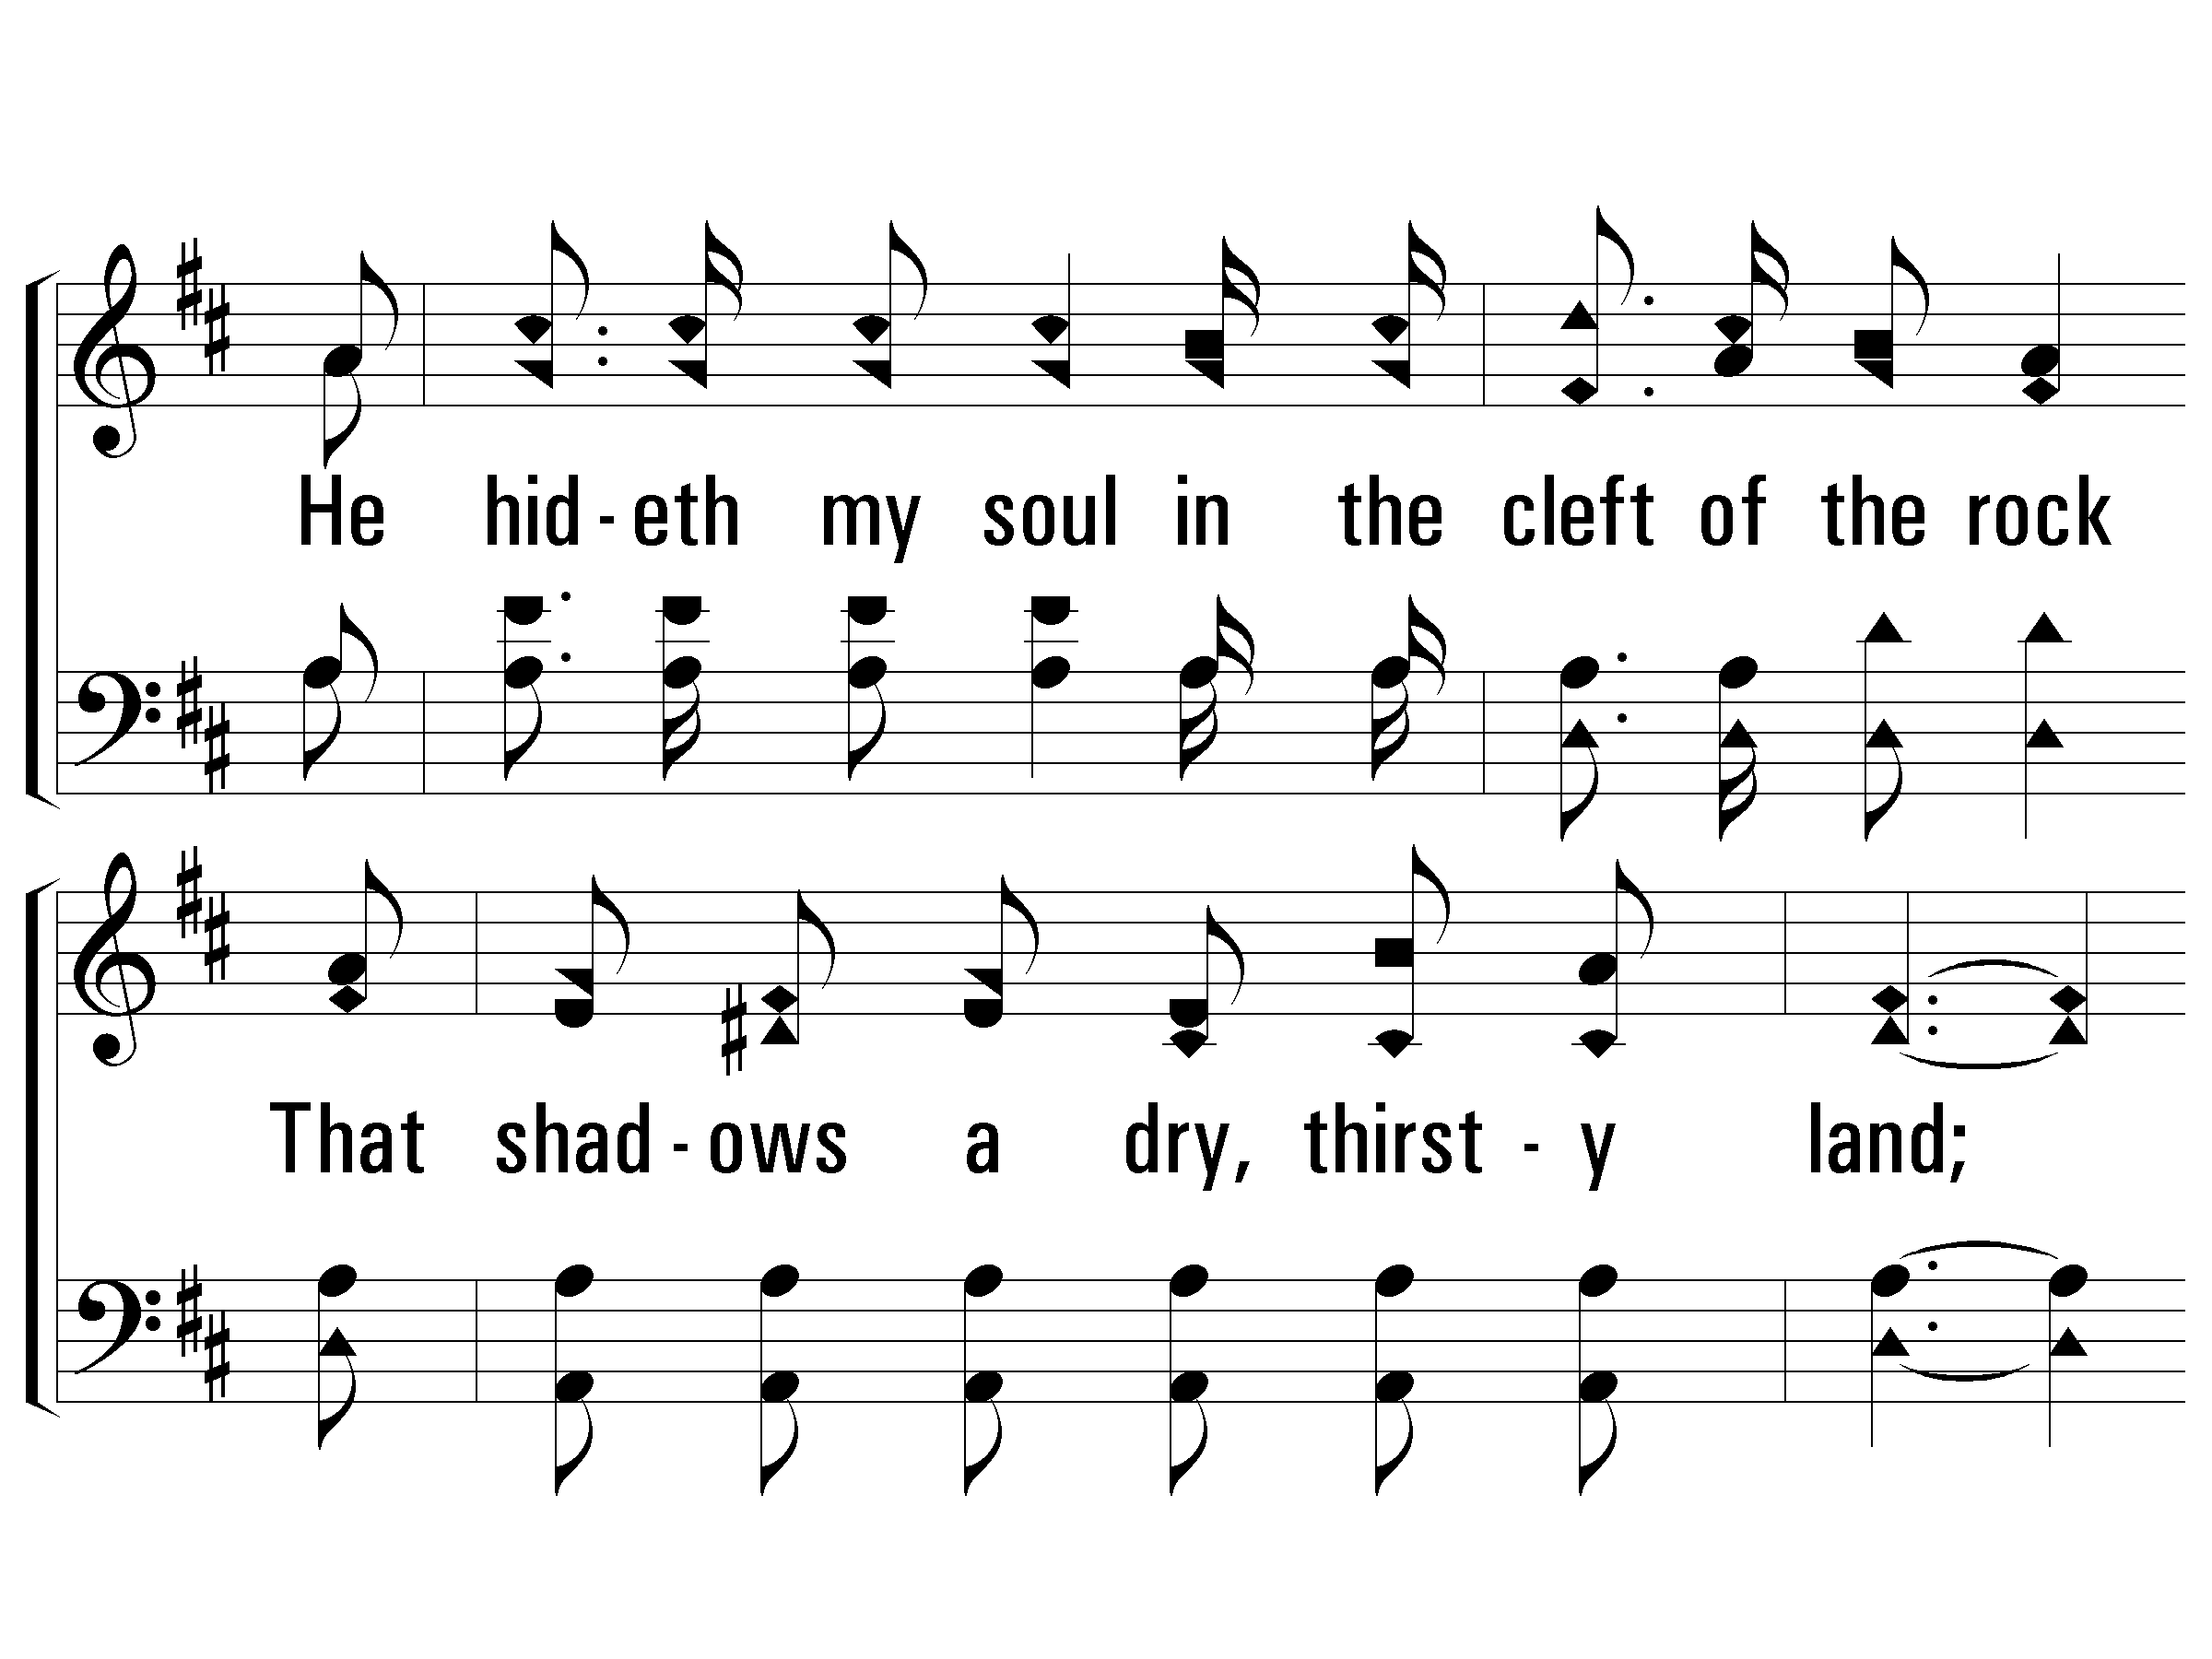
c - A Wonderful Savior
He hideth my soul in the cleft of the rock
That shadows a dry, thirsty land;
He hideth my life in the depths of His love,
And covers me there with His hand,
And covers me there with His hand.
© 2001 The Paperless Hymnal™

Slide 6
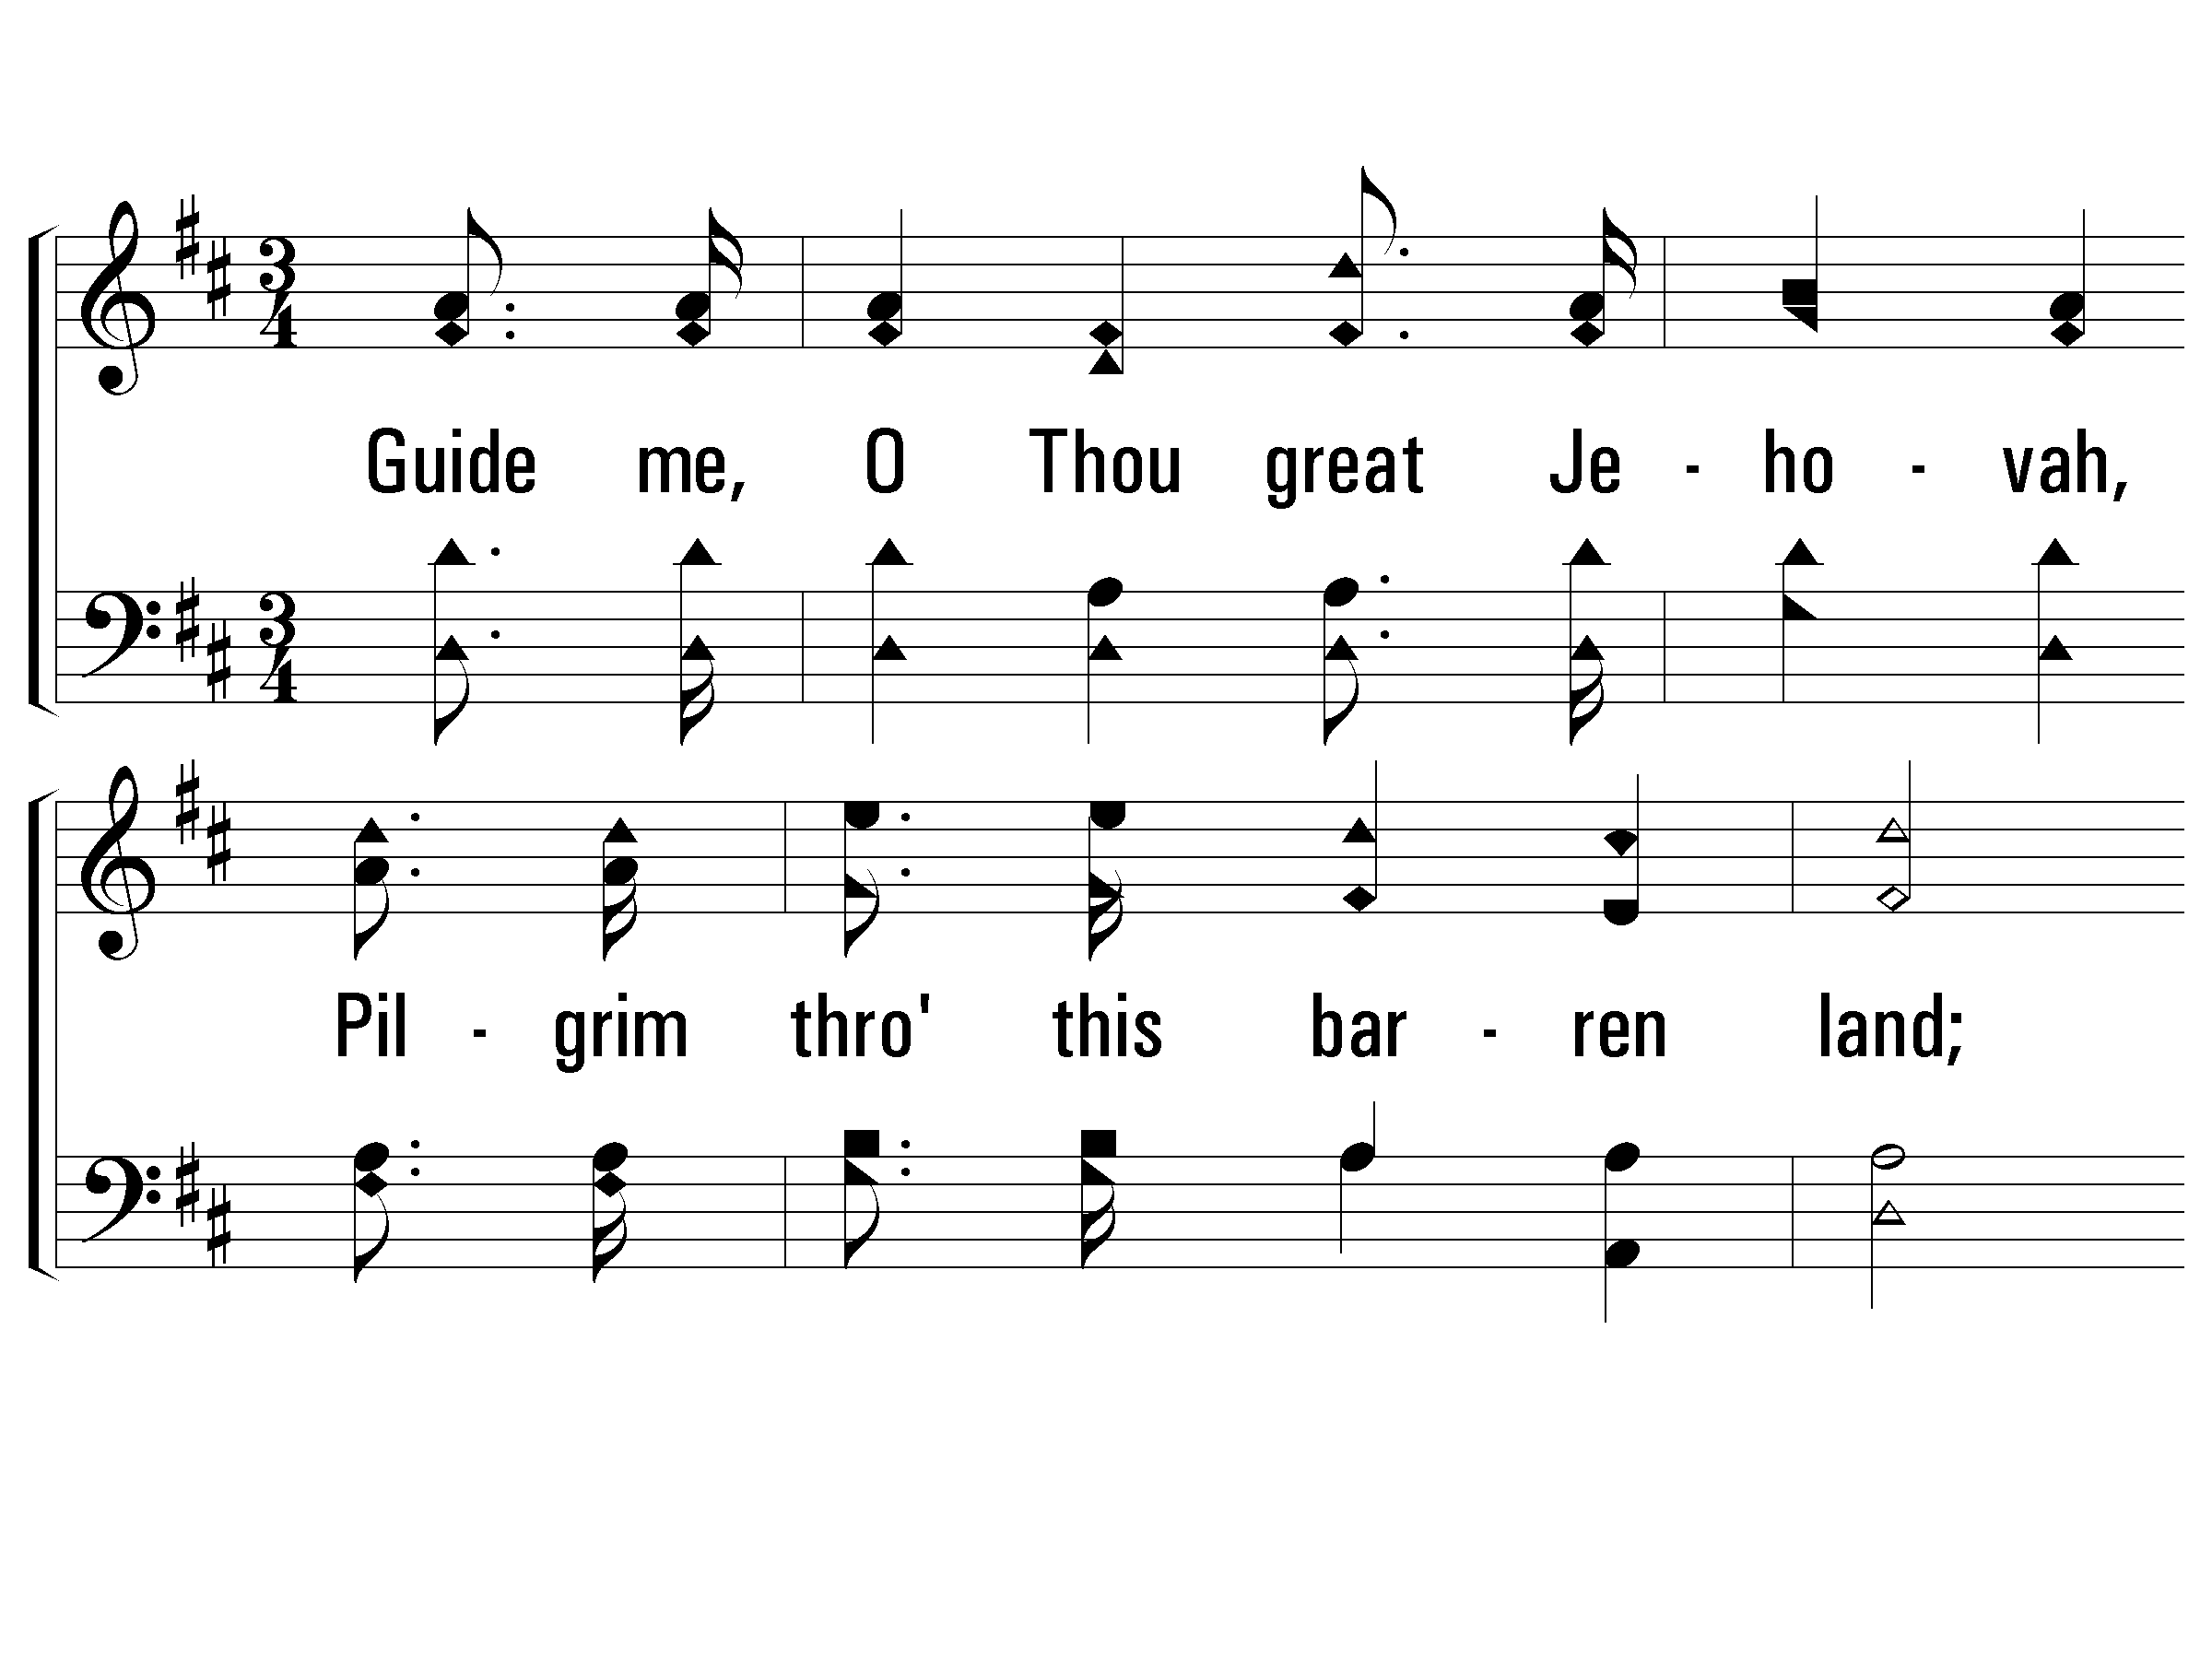
1 - Guide Me, O Thou Great Jehovah
1.
Guide me, O Thou great Jehovah,
Pilgrim through this barren land;
I am weak, but Thou art mighty,
Hold me with Thy powerful hand;
Bread of heaven,
Feed me till I want no more:
Bread of heaven,
Feed me till I want no more.
Words: William Williams
Music: Thomas Hastings
© 2001 The Paperless Hymnal™

Slide 7
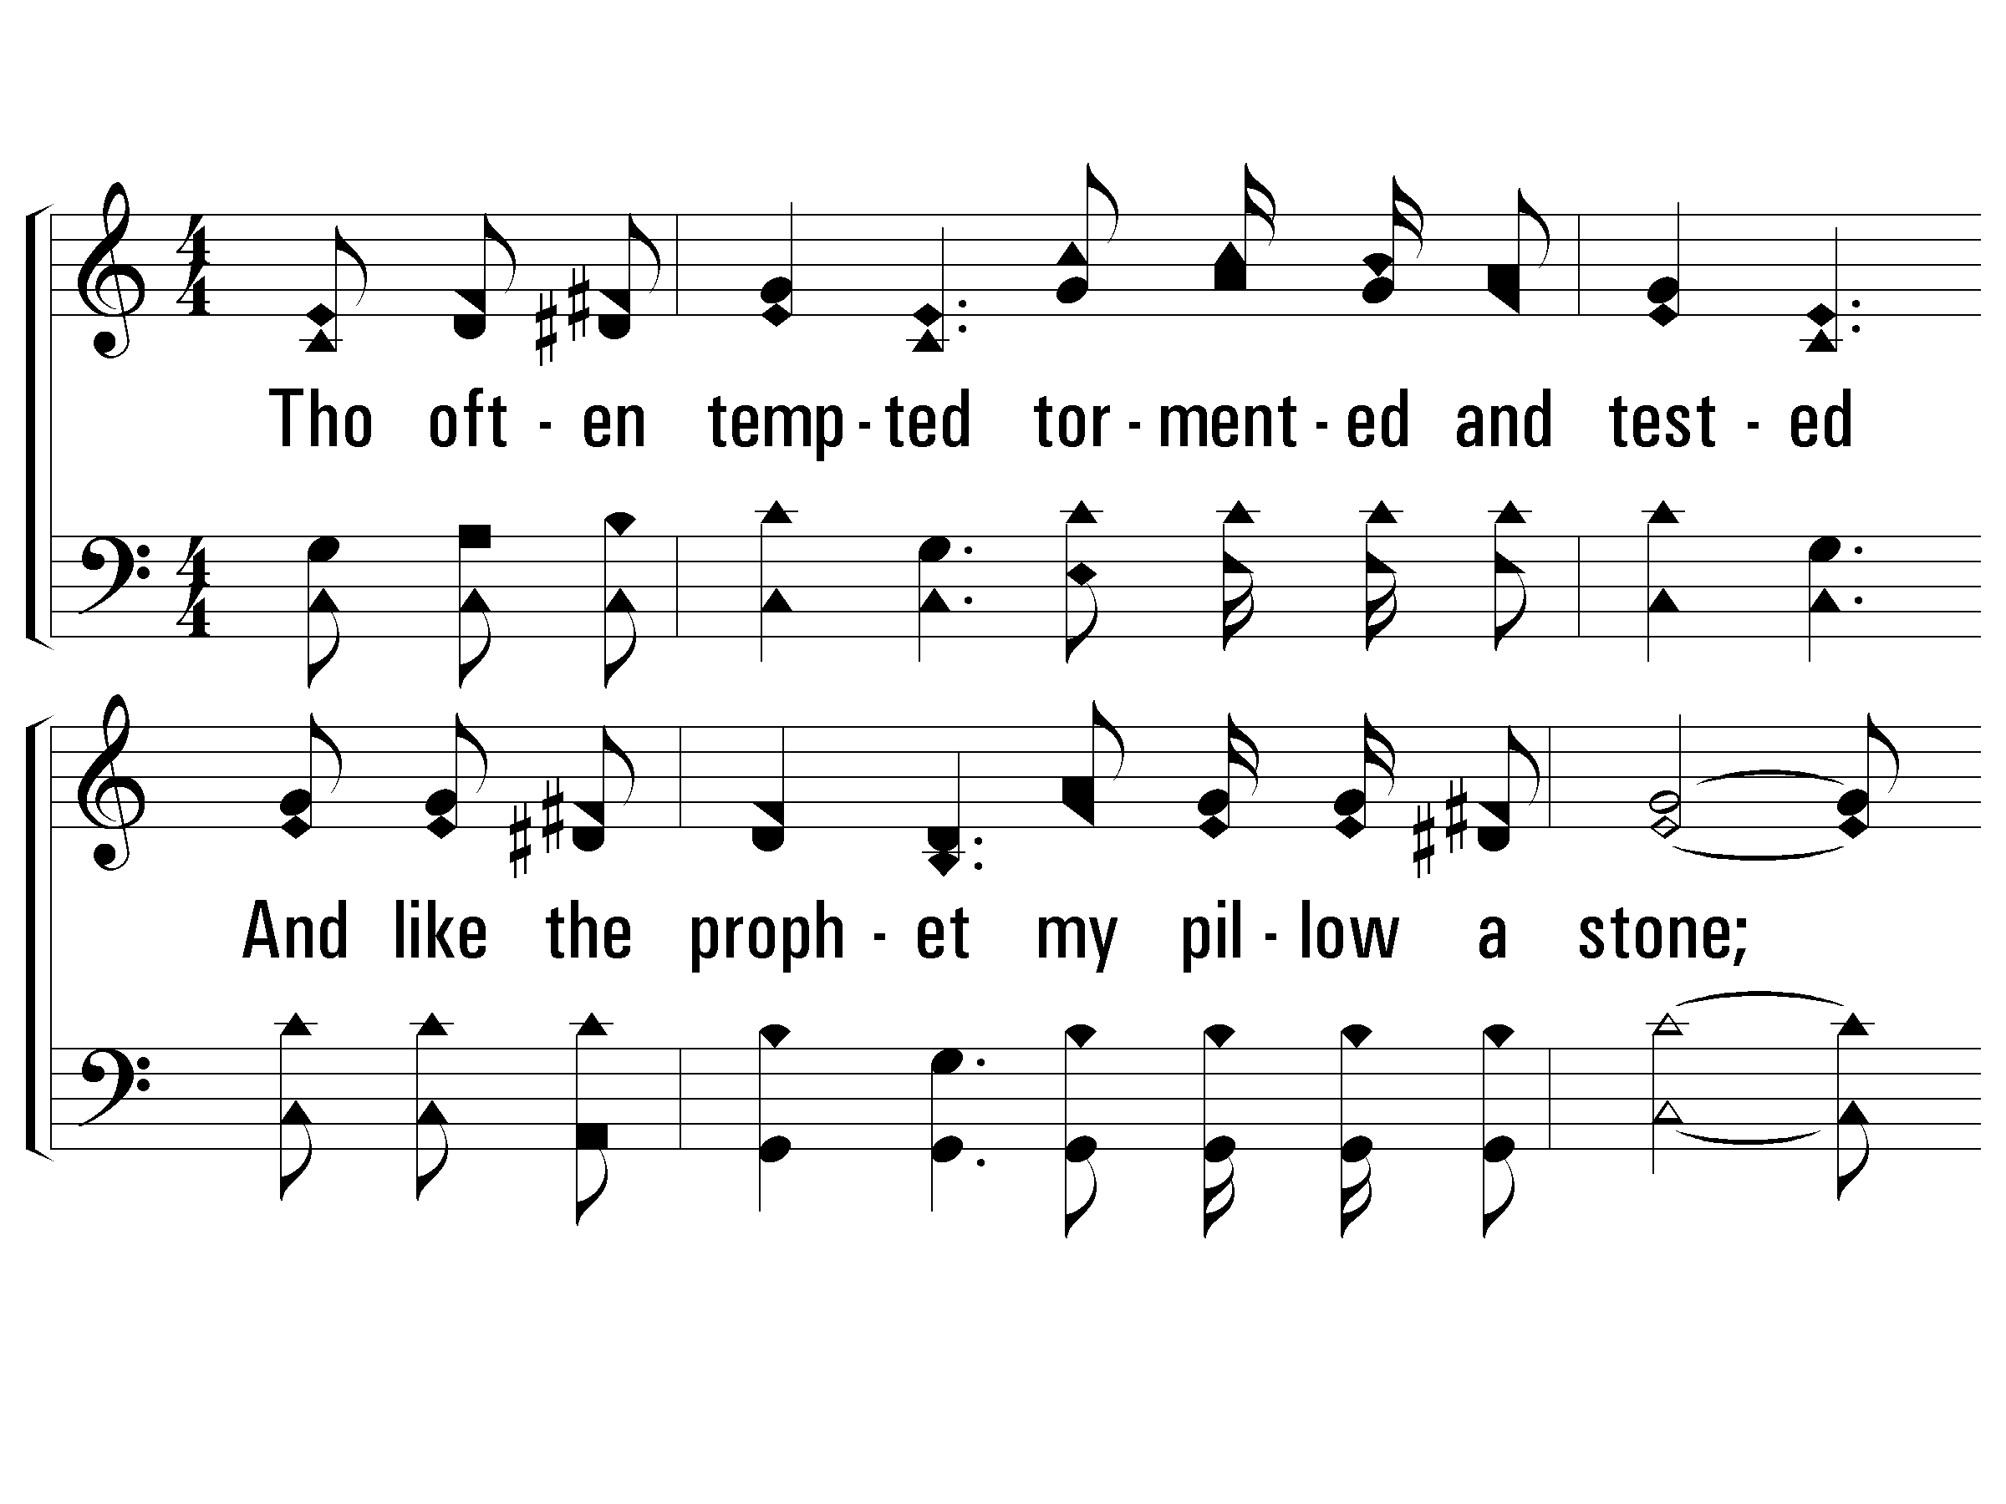
2 – Mansion Over the Hilltop
2.
Though often tempted tormented and tested
And like the prophet my pillow a stone;
And though I find here no permanent dwelling,
I know He'll give me a mansion my own.
Words and Music by: Ira Stanphill
Copyright © 1949 by Singspiration Music(ASCAP)(admin. By Brentwood-Benson Music Publishing, Inc.)
All Rights reserved. Used by permission.
© 2001 The Paperless Hymnal™

Slide 8
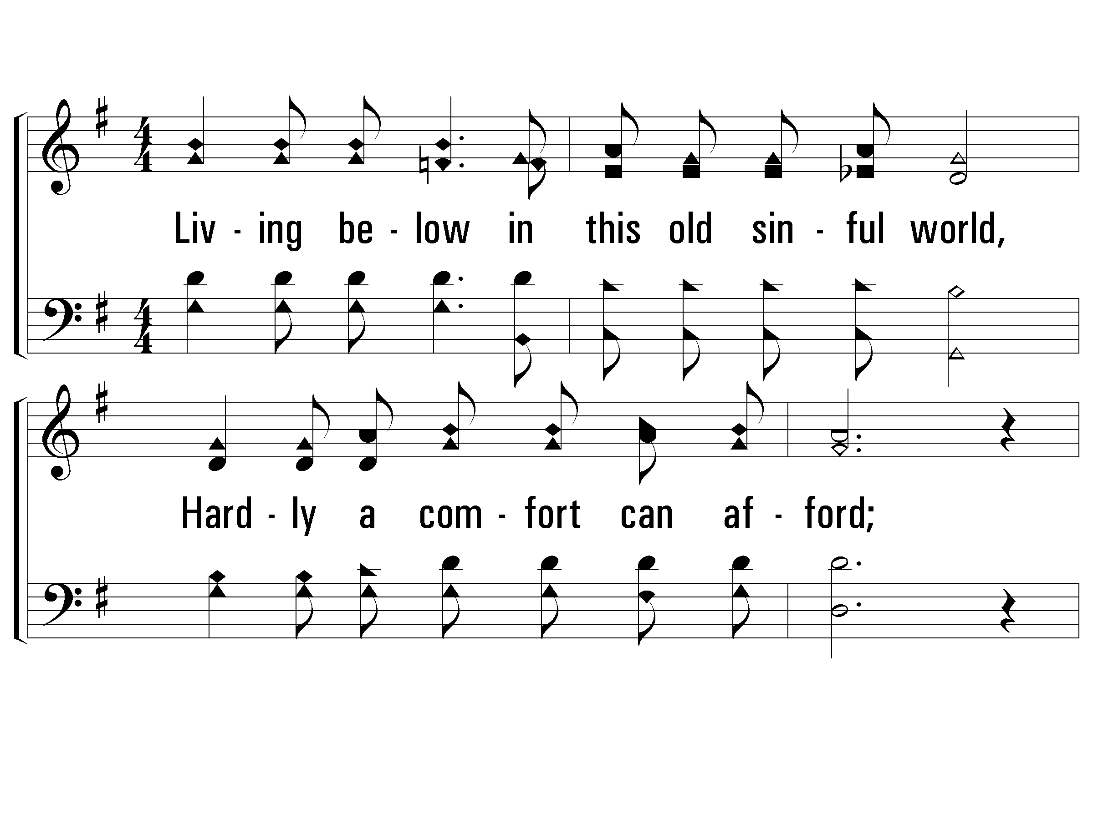
1 - Where Could I Go?
1.
Living below in this old sinful world,
Hardly a comfort can afford;
Striving alone to face temptations sore,
Where could I go but to the Lord?
Words and Music by: J. B. Coats
Copyright © 1968 by Stamps-Baxter Music(BMI)(admin. by Brentwood-Benson Music Publishing, Inc.)
All Rights reserved. Used by permission
© 2001 The Paperless Hymnal™

Slide 9
Singing praises to God
SINGING WITH THANKSGIVING!
Do we have just the basic necessities of life?
Food
Clothing
Shelter
Hardly a comfort can afford?
Hardly a comfort withheld. We’ve been richly blessed!

Slide 10
Giving back to God
1 Corinthians 16:1 Now concerning the collection for the saints, as I directed the churches of Galatia, so do you also. 2 On the first day of every week each one of you is to put aside and save, as he may prosper, so that no collections be made when I come.
Easy to Read Version – “as you can from what you are blessed with.”

Slide 11
Giving back to God
Considering how blessed we are…
Could you give an extra dollar?
250 people x 1 dollar = $250 a week
$250 a week x 52 weeks = $13,000
Aid in preaching the gospel!
Phil.1:3 I thank my God in all my remembrance of you, always offering prayer with joy in my every prayer for you all, in view of your participation in the gospel from the first day until now.
Philippians 4:16 for even in Thessalonica you sent a gift more than once for my needs.

Slide 12
Giving back to God
2 Corinthians 9:7 Each one must do just as he has purposed in his heart, not grudgingly or under compulsion, for God loves a cheerful giver.
When we consider all that our God has done for us, we want to share the blessings!

Slide 13
Inspiring each other
CARD / CALL / VISIT – matt. 25:34-40; 2 Tim. 1:16 Onesiphorus often refreshed me, he eagerly searched for me and found me.
PRAYER – phil. 4:6; James 5:13-18 vs.16 – pray for one another, that you may be healed.
EXHORT – Hebrews 3:13;10:25 exhort (encourage) one another daily
RESTORE THE WAYWARD –
Galatians 6:1 Brethren, even if anyone is caught in any trespass, you who are spiritual, restore such a one in a spirit of gentleness; each one looking to yourself, so that you too will not be tempted.

Slide 14
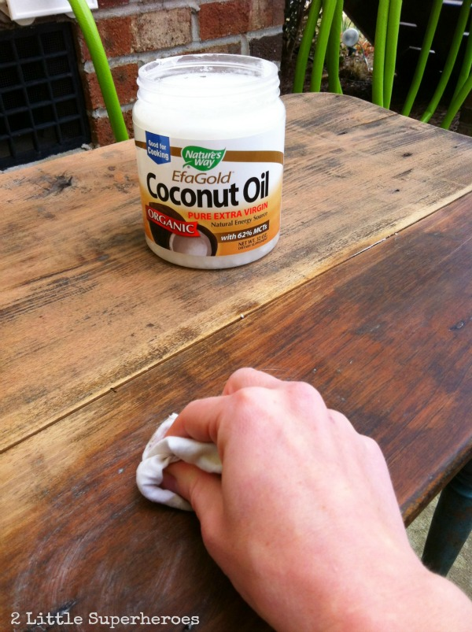

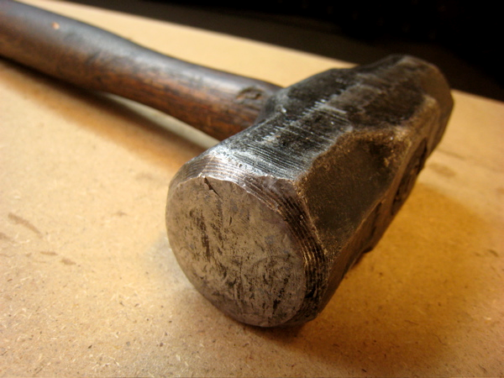
Restoration done right

Slide 15
Hospitable to each other
How did 1st century Christians stick together?
They hosted, and they attended.
They enjoyed the pleasures of each others company!
Acts 2:46 Day by day continuing with one mind in the temple, and breaking bread from house to house, they were taking their meals together with gladness and sincerity of heart, 47 praising God and having favor with all the people. And the Lord was adding to their number day by day those who were being saved.

Slide 16
Hospitable to each other
Heb 3:13 “encourage one another day after day”
May God be glorified in all that we do!
1 Peter 4:9 NIV Offer hospitality to one another without grumbling. 10 Each of you should use whatever gift you have received to serve others, as faithful stewards of God’s grace in its various forms.

Slide 17
Teaching the Lost
Matthew 28:19 Go therefore and make disciples of all the nations, baptizing them in the name of the Father and the Son and the Holy Spirit, 20 teaching them to observe all that I commanded you; and lo, I am with you always, even to the end of the age.”
Teaching can be done any many ways
Classes, one on one conversation (Acts 8 – Philip and the Eunuch) , training up children (Proverbs 22:6) , letters (epistles), bulletin article, being an example (Matt. 5:16), even singing (Col. 3)
What experience can you share that might help someone?

Slide 18
PERSONAL WORK

Slide 19
Invite someone to church
TAKE ADVANTAGE OF THE OPPORTUNITIES THAT YOU GET.
LOOK TO CREATE AN OPPORTUNITY.

Slide 20
USE YOUR TALENTS
Matt. 25:14-30 – the parable of the talents
What if every member did only what you do? How strong would this church be?
Add to your abilities! Get out of your comfort zone.
Let’s work together as members so that we may be a stronger body.

