Slide 2
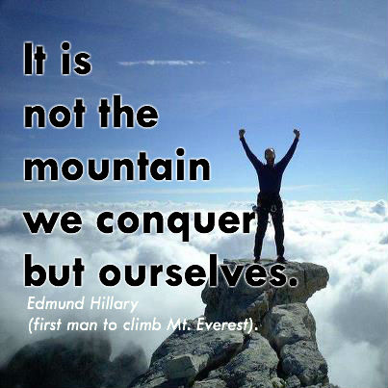
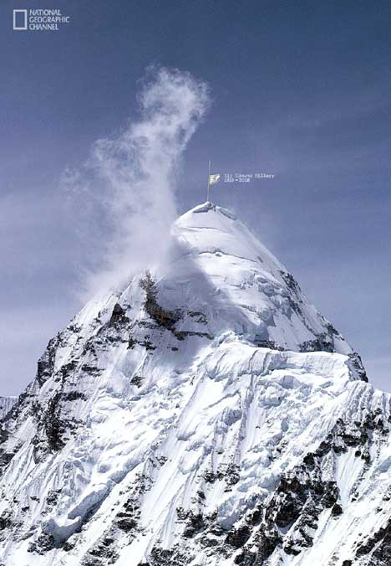
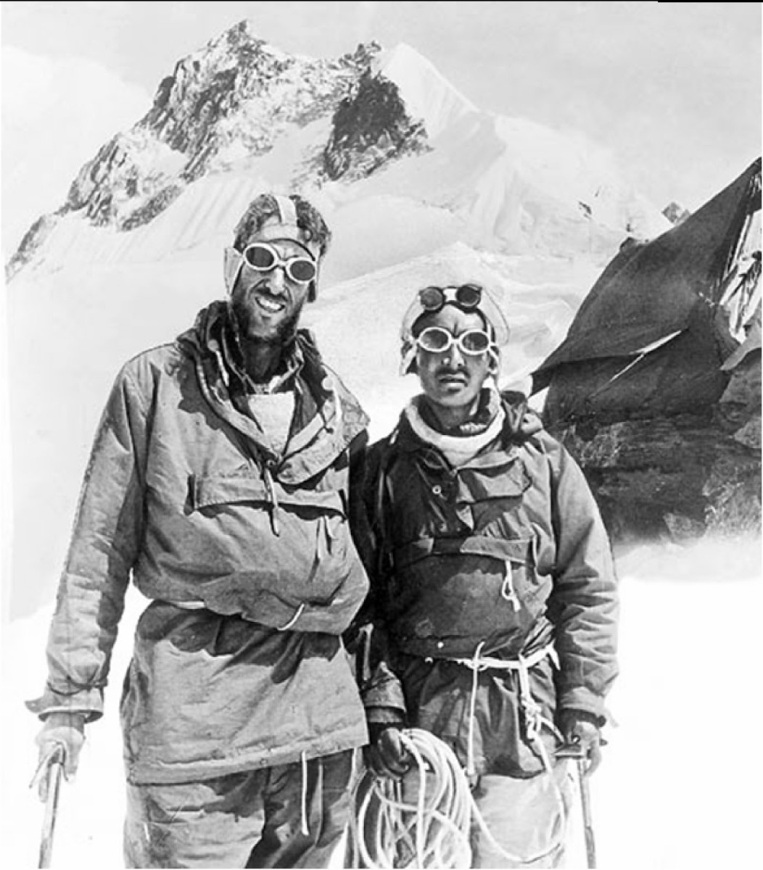

Slide 3
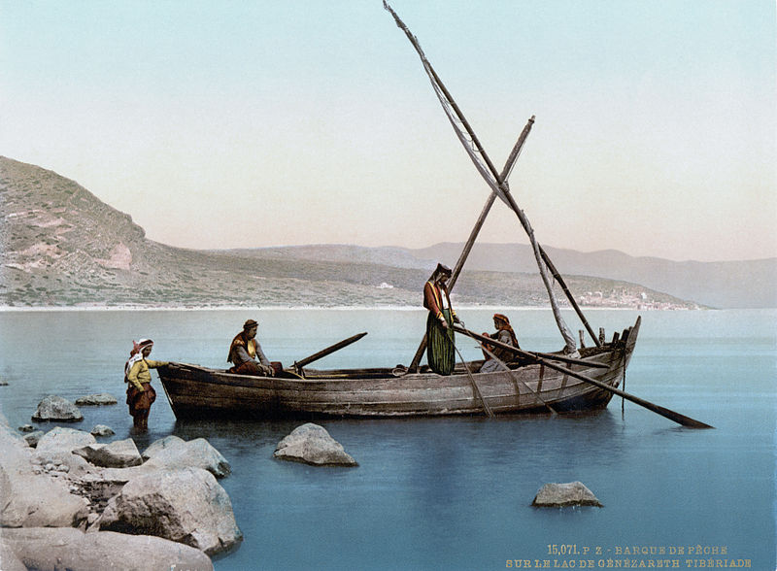
Learning to conquer ourselves.
Matthew 14:26-31

Slide 4
Look beneath the surface of this story
When the disciples saw Him walking on the sea, they were terrified, and said, “It is a ghost!” And they cried out in fear. But immediately Jesus spoke to them, saying, “Take courage, it is I; do not be afraid.”Peter said to Him, “Lord, if it is You, command me to come to You on the water.” And He said, “Come!” And Peter got out of the boat, and walked on the water and came toward Jesus. But seeing the wind, he became frightened, and beginning to sink, he cried out, “Lord, save me!” Immediately Jesus stretched out His hand and took hold of him, and said to him, “You of little faith, why did you doubt?” Matthew 14:26-31

Slide 5
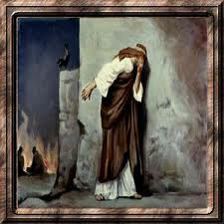
Peter lost faith
“You of little faith, why did you doubt?”
Matthew 14: 31

Slide 6
What or who did Peter lose faith in?
And Peter got out of the boat, and walked on the water and came toward Jesus. But seeing the wind, he became frightened, and beginning to sink, he cried out, “Lord, save me!” Immediately Jesus stretched out His hand and took hold of him, and said to him, “You of little faith, why did you doubt?” Matthew 14:26-31

Slide 7
Peter lost faith in himself
He lost faith in what he was capable of and what he could do.

Slide 8
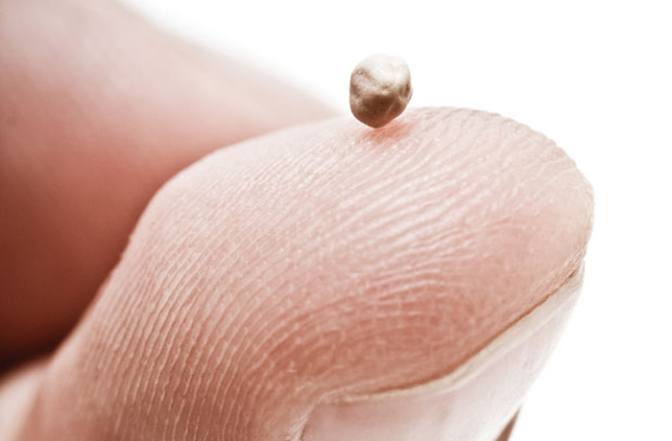
Mustard seed faith
And He said to them, “Because of the littleness of your faith; for truly I say to you, if you have faith the size of a mustard seed, you will say to this mountain, ‘Move from here to there,’ and it will move; and nothing will be impossible to you.
Matthew 17:20

Slide 9
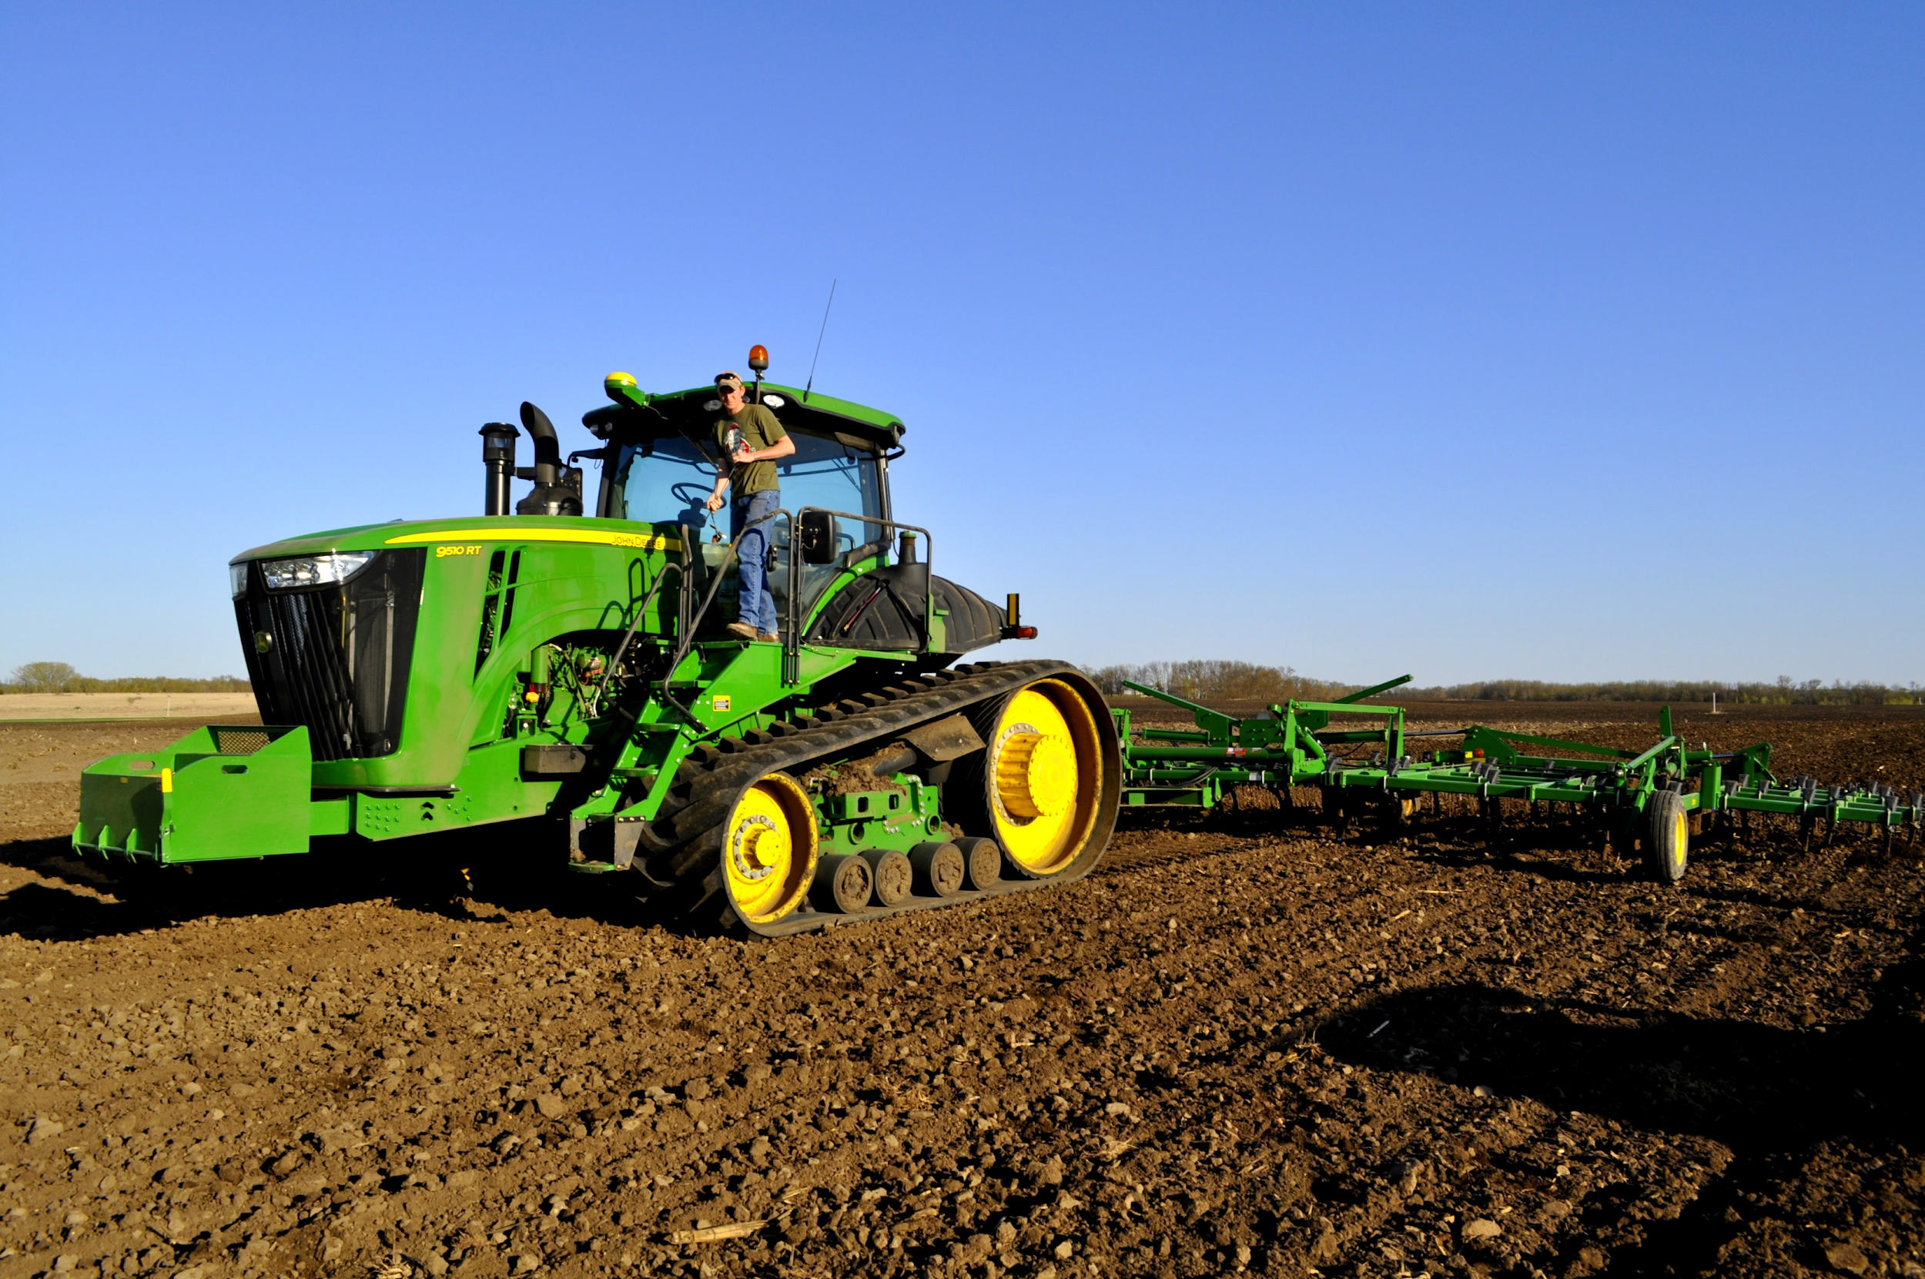
How can we cultivate this kind of faith?

Slide 10

Realize what you are worth.
For you have been bought with a price: therefore glorify God in your body. I Cor. 6:20
For God so loved the world, that He gave His only begotten Son, that whoever believes in Him shall not perish, but have eternal life. John 3:16
But God, being rich in mercy, because of His great love with which He loved us, even when we were dead in our transgressions, made us alive together with Christ (by grace you have been saved), and raised us up with Him, and seated us with Him in the heavenly places in Christ Jesus, so that in the ages to come He might show the surpassing riches of His grace in kindness toward us in Christ Jesus. For by grace you have been saved through faith; and that not of yourselves, it is the gift of God … Ephesians 2:4-8

Slide 11
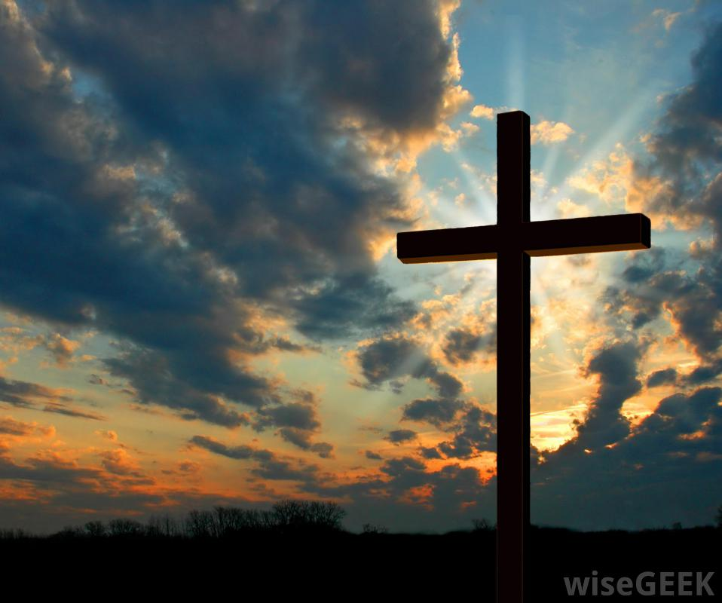
Realize that you have a purpose!
For You formed my inward parts; You wove me in my mother’s womb.
I will give thanks to You, for I am fearfully and wonderfully made; Wonderful are Your works, And my soul knows it very well.
My frame was not hidden from You. When I was made in secret, And skillfully wrought in the depths of the earth; Your eyes have seen my unformed substance;
And in Your book were all written, The days that were ordained for me,
When as yet there was not one of them. Psalm 139:13-16

Slide 12
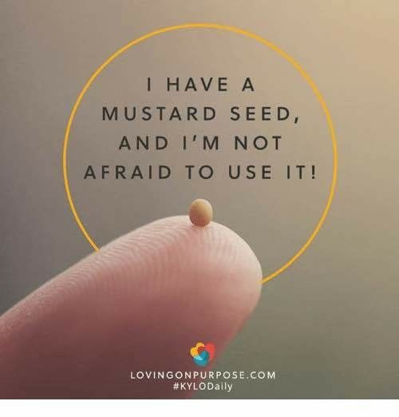
Realize that we are meant to grow!
The Kingdom of Heaven is like a mustard seed, which, when sown upon the soil, though it is the least of all the seeds that are upon the soil, yet when it is sown, it grows up and becomes larger than all the garden plants and forms large branches; so that even the birds of the air can nest under its shade.” Mark 4:31-32

Slide 13

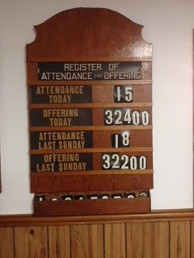
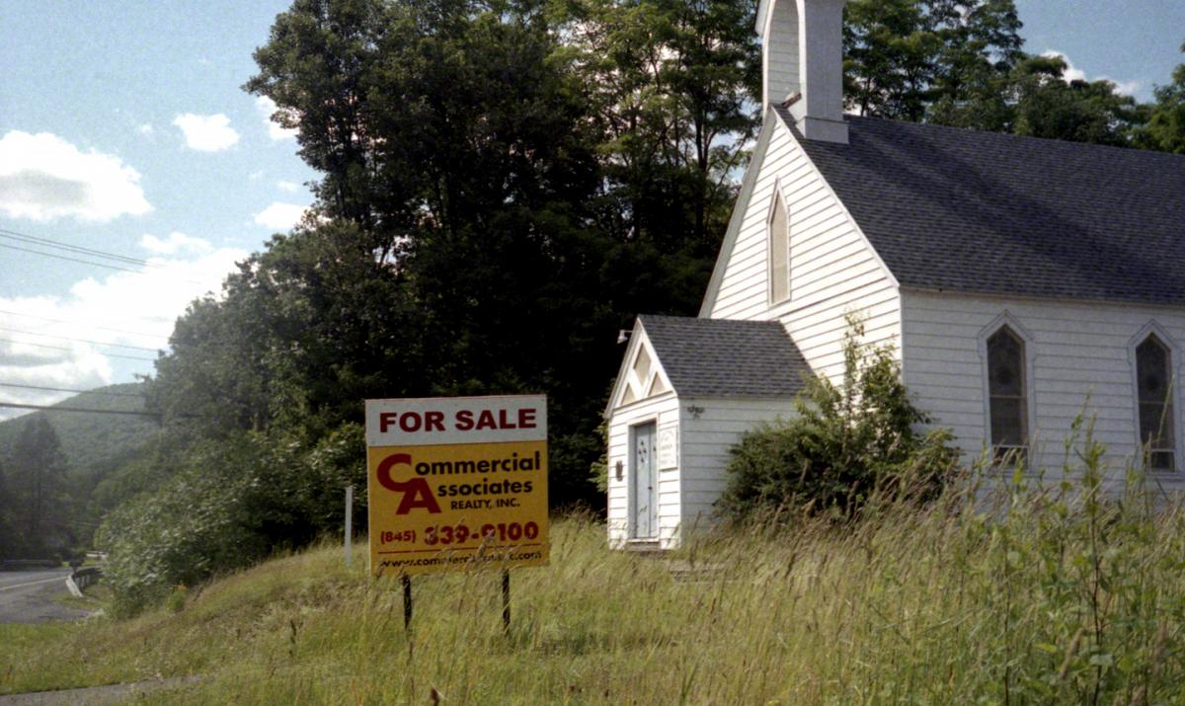
500 less...

Slide 14
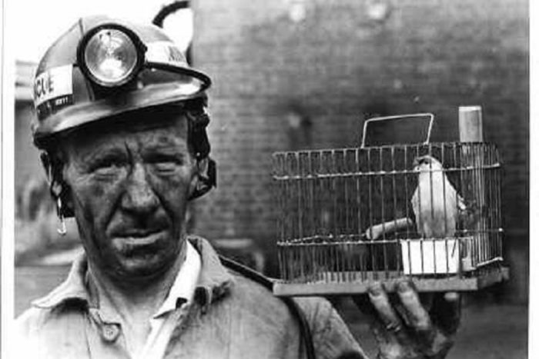
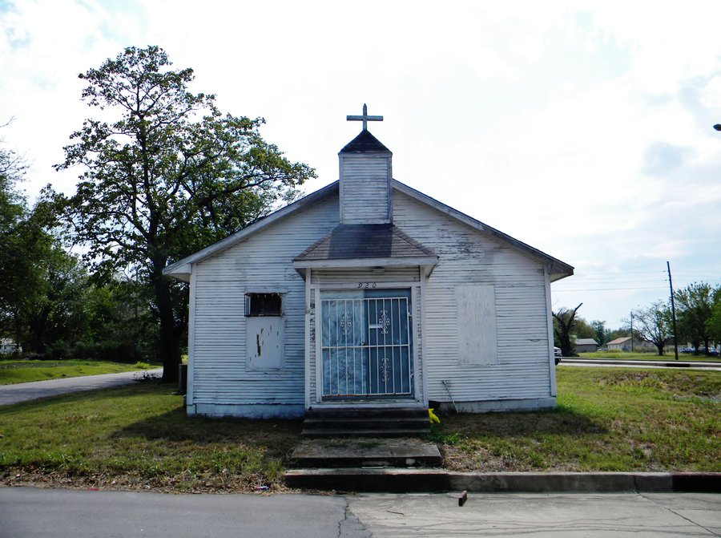
Are the canaries dying?

Slide 15
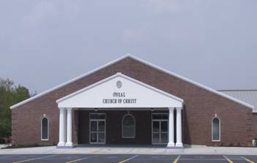
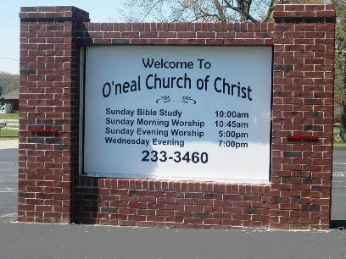
O’Neal Church of Christ...

Slide 16
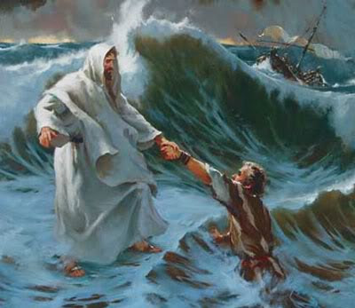
Why do we doubt?
But seeing the wind, he became frightened, and beginning to sink, he cried out, “Lord, save me!” Immediately Jesus stretched out His hand and took hold of him, and said to him, “You of little faith, why did you doubt?” Matthew 24:31
Simon Peter then, having a sword, drew it and struck the high priest’s slave, and cut off his right ear; and the slave’s name was Malchus. John 18:10
The Lord turned and looked at Peter. And Peter remembered the word of the Lord, how He had told him, “Before a rooster crows today, you will deny Me three times.” Luke 21:61

Slide 17
We doubt because we don’t understand.
But you are a chosen race, a royal priesthood, a holy nation, a people for his own possession, that you may proclaim the excellencies of him who called you out of darkness into his marvelous light. I Peter 2:9

Slide 18
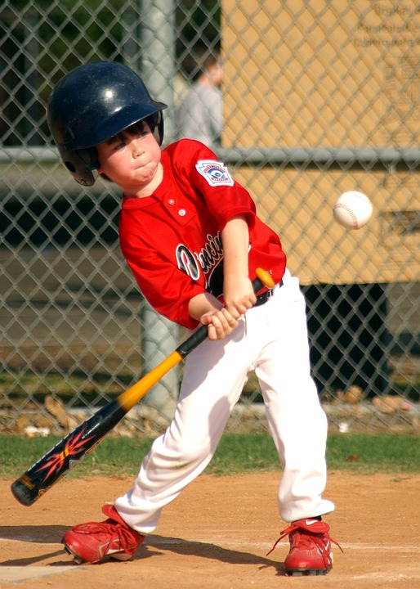
We have a mustard seed!
And He said to them, “Because of the littleness of your faith; for truly I say to you, if you have faith the size of a mustard seed, you will say to this mountain, ‘Move from here to there,’ and it will move; and nothing will be impossible to you.
Matthew 17:20

