Slide 1
Welcome.
We are glad that you have come to worship with us.

Slide 2
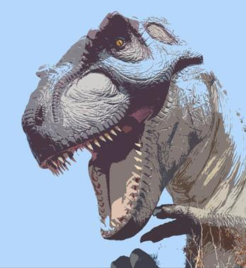
“What about Dinosaurs?”

Slide 3

Today’s sermon…
Church’s choice!
The Queen of Sheeba
A study on Modesty
What about Dinosaurs?
13%
24%
63%

Slide 4
introduction
Why does this question matter?
Satan is attacking the foundation of the Bible by discrediting God’s creation in Genesis 1.
Psalm 11:3 If the foundations are destroyed, What can the righteous do?”
3

Slide 5
introduction
Genesis 1:1 In the beginning God created the heavens and the earth.
If a person can be turned against the first 5 words of the Bible, then the rest won’t matter to them.
If we can’t trust the historical and scientific parts of the Bible, why would we have faith in the parts related to salvation and eternity?
4

Slide 6
introduction
This is the basis for Jesus’ warning…
John 5:46 For if you believed Moses, you would believe Me, for he wrote about Me. 47 But if you do not believe his writings, how will you believe My words?”
If the Bible is wrong in this area, then it is not the Word of God and we can ignore everything else it says.
5

Slide 7

How the BIBLE answers
JURASSIC MYTHS

Slide 8
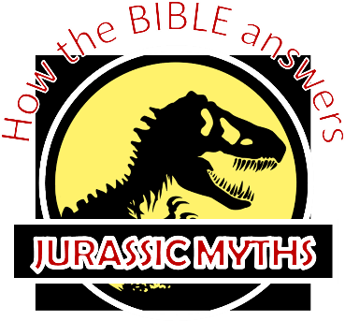
Myth # 1
Dinosaurs aren’t mentioned in the Bible.
Claim – if God created dinosaurs, why aren’t they mentioned in the Bible.

Slide 9
“What about dinosaurs? Dinosaurs aren’t mentioned in the Bible.”
I certainly do believe that dinosaurs “once roamed the earth.” Archeologists have discovered many fossils and bones that are on display in museums today.
So why are they not mentioned in the bible?
This question might be a little silly. I could ask…“If God created rolly pollies & kangaroos, why aren’t they mentioned in the Bible?”
8

Slide 10
“What about dinosaurs? Dinosaurs aren’t mentioned in the Bible.”
The term “dinosaur” wasn’t even used until 1841.
At the time of creation, Adam named the animals.
Some of these were called Dragons.
Genesis 2:19 Out of the ground the Lord God formed every beast of the field and every bird of the sky, and brought them to the man to see what he would call them; and whatever the man called a living creature, that was its name.
21x in KJV OT. Numerous cultures possess ancient stories about “dragons” that resemble what we call dinosaurs.
9

Slide 11
Myth # 1
Dinosaurs aren’t mentioned in the Bible.
Outcome – a basic word study and Bible research would suggest dinosaur-like animals are mentioned in the Bible

Slide 12
Myth # 2
Man did not and could not have lived at the same time as dinosaurs.
Claim – Dinosaurs lived millions of years ago and died before man came to exist.

Slide 13
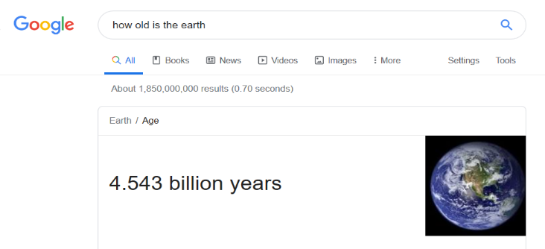
Man did not and could not have lived at the same time as dinosaurs.
How old is the earth?
There are 63,000 searches/second on Google.
12

Slide 14
Dinosaurs lived millions of years ago, and the earth is billions of years old.
The Bible not only tells us the future destiny of the universe, but it also tells the history of the universe.
Using the years and genealogies given, there was 4004 years from Creation to Christ.
We live about 2020 years after Christ.
The earth is 6000+ years old.
So did dinosaurs live with man or millions of years before?
Well, much of what we know about dinosaurs is based on fossils…
13

Slide 15
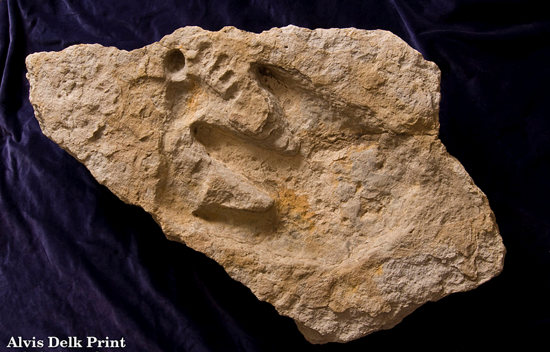

In 2000, amateur archaeologist Alvis Delk was working near Glen Rose, Texas and discovered a fossil having both human and dinosaur footprints.

Slide 16
Man did not and could not have lived at the same time as dinosaurs.
God created man & animals (dinosaurs) on day 6.
Dinosaurs weren’t created to kill man.
Man was created to rule the earth.
Genesis 1:24 Then God said, “Let the earth bring forth living creatures after their kind: cattle and creeping things and beasts of the earth after their kind”; and it was so.
Genesis 1:28 God blessed them; and God said to them, “Be fruitful and multiply, and fill the earth, and subdue it; and rule over the fish of the sea and over the birds of the sky and over every living thing that moves on the earth.”
15

Slide 17
Man did not and could not have lived at the same time as dinosaurs.
Other verses say the same…
Psalm 8:4 What is man that You take thought of him, And the son of man that You care for him? 5 Yet You have made him a little lower than God, And You crown him with glory and majesty! 6 You make him to rule over the works of Your hands; You have put all things under his feet, 7 All sheep and oxen, And also the beasts of the field,
James 3:7 For every species of beasts and birds, of reptiles and creatures of the sea, is tamed and has been tamed by the human race. 8a But no one can tame the tongue;
16

Slide 18
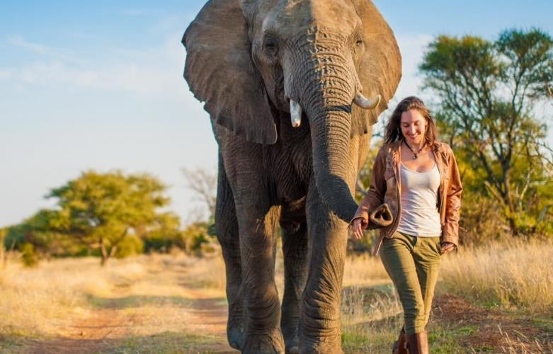


Slide 19
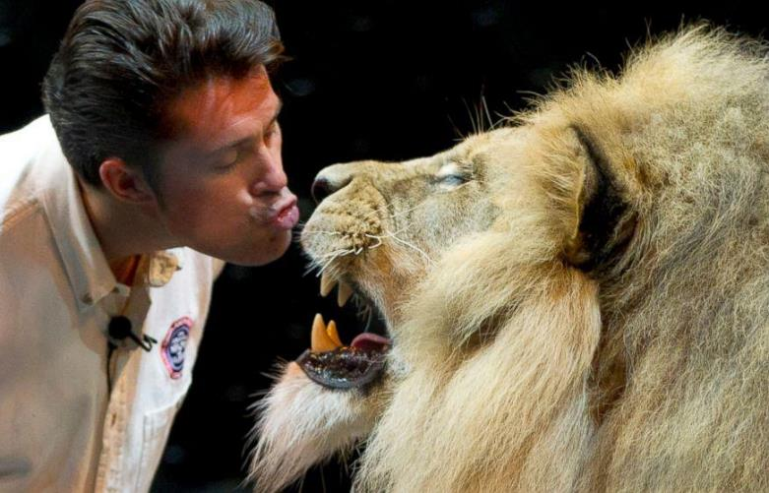
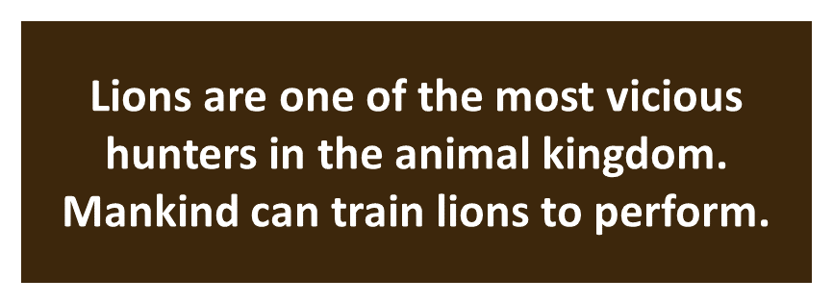
18

Slide 20
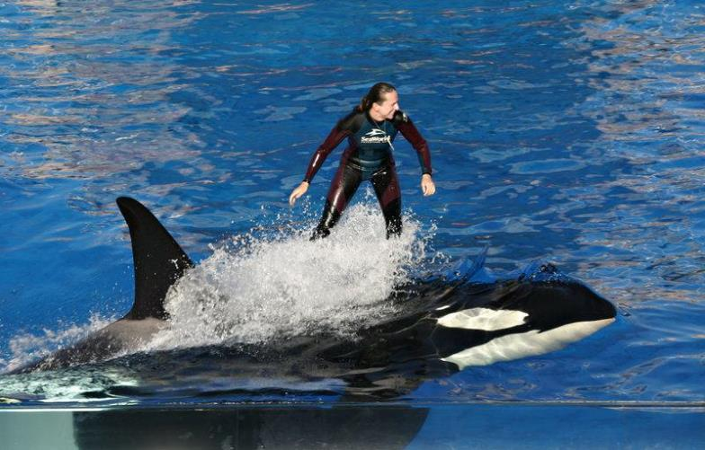


Slide 21
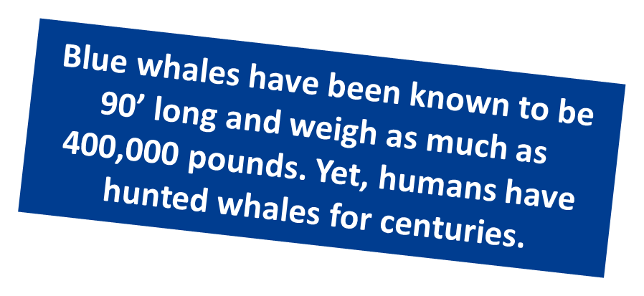
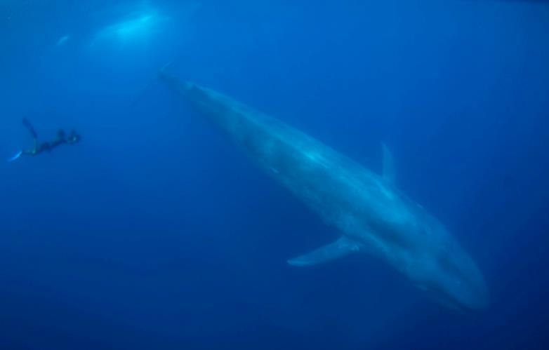
20

Slide 22
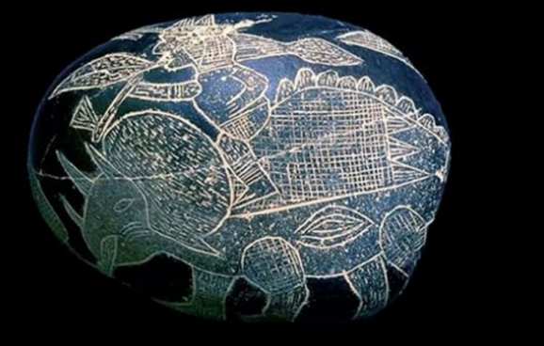
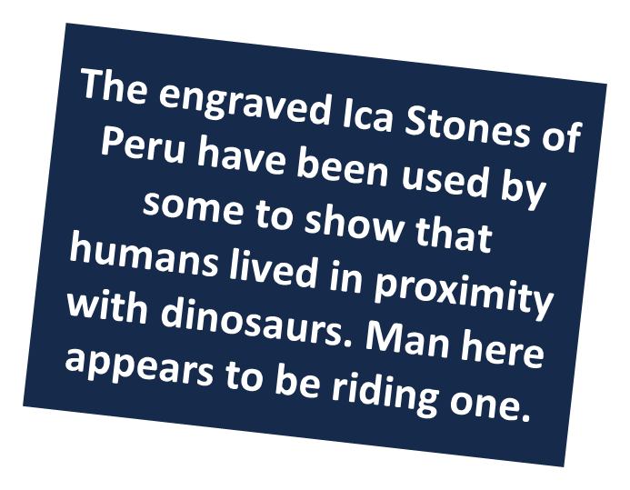
Man did not and could not have lived at the same time as dinosaurs.
If Man can tame elephants, lions and killer whales...
What makes dinosaurs any different?
21

Slide 23
Myth # 2
Man did not and could not have lived at the same time as dinosaurs.
Outcome – Science, history, common sense and the Bible all seem to agree that man could and did live at the same time as dinosaurs.

Slide 24
Myth # 3
The creatures described in Job weren’t real animals.
In a book titled The Genesis Question, the author ridicules the descriptions of Behemoth and Leviathan and supposes these animals could not have existed.

Slide 25
The creatures described in Job weren’t real animals.
God’s Power Shown in Creatures
Job 40:15-24 Behemoth (giant mammal)
Objection offered – No animal could have bones like bronze.
Job 40:15 “Behold now, Behemoth, which I made as well as you; He eats grass like an ox.
Job 40:17 “He bends his tail like a cedar; The sinews of his thighs are knit together. 18 “His bones are tubes of bronze; His limbs are like bars of iron. 19 “He is the first of the ways of God; Let his maker bring near his sword.
24

Slide 26
The creatures described in Job weren’t real animals.
Job 41:1-34 Leviathan (large sea-creature)
Job 41:1 “Can you draw out Leviathan with a fishhook? Or press down his tongue with a cord?
Job 41:8 “Lay your hand on him; Remember the battle; you will not do it again!
Job 41:21 “His breath kindles coals, And a flame goes forth from his mouth.
Objection offered – No animal could blow fire.
25

Slide 27
The creatures described in Job weren’t real animals.
Job obviously knew what God was talking about.
Job didn’t object or say to God, “I don’t know what you're talking about!”
Job 42:6 “Therefore I retract, And I repent in dust and ashes.”
But, to further defend the Scriptures, let’s consider some of the animals still in existence today…
26

Slide 28
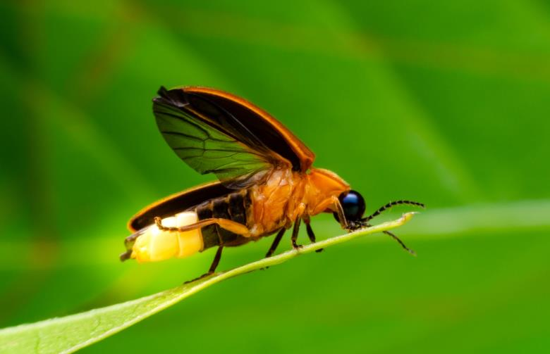

27

Slide 29
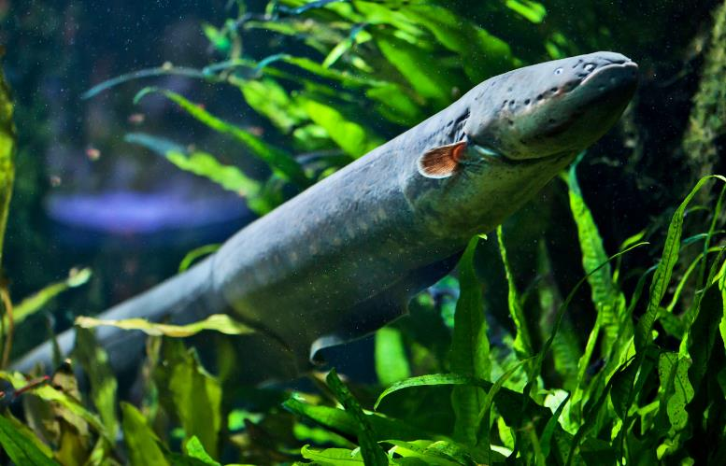

28

Slide 30
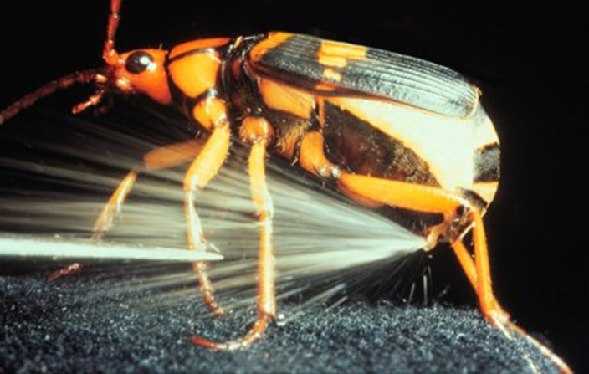

29

Slide 31
The creatures described in Job weren’t real animals.
When we consider what other animals can do, is it difficult to accept that certain “dinosaurs” were capable of releasing fumes that might ignite.
Remember the question the Lord asked Abraham…
Genesis 18:14 Is anything too difficult for the Lord? At the appointed time I will return to you, at this time next year, and Sarah will have a son.”
30

Slide 32
Myth # 3
The creatures described in Job weren’t real animals.
Outcome – How could anyone possibly know all the details of an extinct animal?

Slide 33
Myth # 4
Dinosaurs became extinct when an asteroid hit the earth.
Claim – The most popular "disaster theory" for the extinction of the dinosaurs is that the Earth was hit by an asteroid or a comet 65 million years ago. - Google

Slide 34
Dinosaurs became extinct when an asteroid hit the earth.
When we see the bones of dinosaurs, we should be reminded that death was not a part of God’s original creation.
Romans 5:12 Therefore, just as through one man sin entered into the world, and death through sin, and so death spread to all men, because all sinned—
1 Corinthians 15:21 For since by a man came death, by a man also came the resurrection of the dead. 22 For as in Adam all die, so also in Christ all will be made alive.
33

Slide 35
Dinosaurs became extinct when an asteroid hit the earth.
It wasn’t an asteroid... or a flood… that caused dinosaurs to become extinct.
Genesis 6:19 And of every living thing of all flesh, you shall bring two of every kind into the ark, to keep them alive with you; they shall be male and female.
Genesis 6:22 Thus Noah did; according to all that God had commanded him, so he did.
34

Slide 36
Dinosaurs became extinct when an asteroid hit the earth.
Post-Flood, things changed between man & animals.
Genesis 9:2 The fear of you and the terror of you will be on every beast of the earth and on every bird of the sky; with everything that creeps on the ground, and all the fish of the sea, into your hand they are given. 3 Every moving thing that is alive shall be food for you; I give all to you, as I gave the green plant. (compare to Genesis 1:29-30)
After the flood, even for man, the world became a harsher place. See life expectancies in the Bible.
35

Slide 37
Dinosaurs became extinct when an asteroid hit the earth.
Other animals became extinct too.
Isaiah 30:6 The oracle concerning the beasts of the Negev. Through a land of distress and anguish, From where come lioness and lion, viper and flying serpent, They carry their riches on the backs of young donkeys And their treasures on camels’ humps, To a people who cannot profit them;
Job 39:9 “Will the wild ox consent to serve you, Or will he spend the night at your manger? 10 “Can you bind the wild ox in a furrow with ropes, Or will he harrow the valleys after you? (footnotes in some say “ox – antelope”)
36

Slide 38
Dinosaurs became extinct when an asteroid hit the earth.
Job 39:9 KJV Will the unicorn be willing to serve thee, or abide by thy crib? 10 Canst thou bind the unicorn with his band in the furrow? or will he harrow the valleys after thee?
Though likely not the fantasy animal of books and movies, the Bible is clearly describing a real animal.
And it’s an animal that also died…
Isaiah 34:7 KJV And the unicorns shall come down with them, and the bullocks with the bulls; and their land shall be soaked with blood, and their dust made fat with fatness.
37

Slide 39
Dinosaurs became extinct when an asteroid hit the earth.
Just like Leviathan died…
And became food for other animals.
Isaiah 27:1 In that day the Lord will punish Leviathan the fleeing serpent, With His fierce and great and mighty sword, Even Leviathan the twisted serpent; And He will kill the dragon who lives in the sea.
Psalm 74:14 You crushed the heads of Leviathan; You gave him as food for the creatures of the wilderness.
38

Slide 40
Myth # 4
Dinosaurs became extinct when an asteroid hit the earth.
Outcome – Post-Flood changes, lack of food, competition in the animal kingdom, and man’s activities have caused many types of animals to become extinct.

Slide 41
conclusion
We could continue… more could be said.
What you believe about the book of Genesis will determine how you react to the rest of the Bible.
2 Timothy 3:16 All Scripture is given by inspiration of God, and is profitable for doctrine, for reproof, for correction, for instruction in righteousness, 17 that the man of God may be complete, thoroughly equipped for every good work.
When a sincere heart takes an honest question to the Bible, God has provided answers.
40

Slide 42
conclusion
If evolution is true, you are an accident, there is no purpose to life, and we are accountable to no one.
If the Bible is true, you’re a unique creation of God, you have a purpose and a destiny, and we are accountable to God because he made us.
Ecclesiastes 12:13 The conclusion, when all has been heard, is: fear God and keep His commandments, because this applies to every person.
41

