Slide 1

Sunday’s sermons…
Church’s choice!
The Spiritual Shrugs
Resentment
Do I know enough to become a Christian?
A journey through the Red Sea
13%
60%
2%
25%

Slide 2
RESENTMENT…
L
10
2 Samuel 15-17

Slide 3
What is Resentment?
While the word “resentment” does not appear in the KJV, NKJV, or NASB, it’s effects are clearly seen throughout text.
Resentment BEGINS as the most passive reaction to anger…
But left unchecked, continued resentment can grow into bitterness, hostility, and the desire to lash back.
N
4

Slide 4
What is Resentment?
Resentment is having ill feelings towards a person or event that we see as unfair.
How old is the problem of resentment?
As old as the story of Cain and Abel.
Genesis 4:4 And the Lord respected Abel and his offering, 5 but He did not respect Cain and his offering. And Cain was very angry, and his countenance fell.
O
20

Slide 5
Resentment…
Was the fall of Ahithophel.
N
12
Who was Ahithophel?
He was one of David’s best counselors.
1 Chronicles 27:33 Ahithophel was counselor to the king (David) and Hushai the Archite was the king’s friend.
2 Samuel 16:23 The advice of Ahithophel, which he gave in those days, was as if one inquired of the word of God; so was all the advice of Ahithophel regarded by both David and Absalom.

Slide 6
Resentment…
The fall of Ahithophel.
H
16
When Absalom conspired to steal the throne, he calls for Ahithophel to join him…
And he did!
2 Samuel 15:12 And Absalom sent for Ahithophel the Gilonite, David’s counselor, from his city Giloh, while he was offering the sacrifices. And the conspiracy was strong, for the people increased continually with Absalom.
2 Samuel 15:31 Now someone told David, saying, “Ahithophel is among the conspirators with Absalom.”

Slide 7
Resentment…
The fall of Ahithophel.
L
25
Ahithophel’s endorsement surely validated Absalom’s reign in the eyes of the people.
But why would Ahithophel abandon David? Didn’t he already have status and power and influence? Wasn’t he David’s friend? What more does he want?!
2 Samuel 15:12 And Absalom sent for Ahithophel the Gilonite, David’s counselor, from his city Giloh, while he was offering the sacrifices. And the conspiracy was strong, for the people increased continually with Absalom.

Slide 8
Resentment…
The fall of Ahithophel.
S
2
2 verses help us understand his motives…
David’s mighty men are listed in 2 Sam. 23.
The other verse is in 2 Sam. 11. Remember when David saw a woman bathing…
2 Samuel 23:34 Eliphelet the son of Ahasbai, the son of the Maacathite, Eliam the son of Ahithophel the Gilonite,
2 Samuel 11:3 So David sent and inquired about the woman. And one said, “Is this not Bathsheba, the daughter of Eliam, the wife of Uriah the Hittite?”

Slide 9
Resentment…
The fall of Ahithophel.
This story of Ahithophel begins to become pretty clear. Bathsheba was his granddaughter.
He had watched years ago as David murdered her husband and had taken her for himself. David brought violence, destruction and shame into his family…
And now it’s time for payback!
E
11

Slide 10
Resentment…
Can FEEL justified.
Resentment is NEVER justified.
But it can FEEL justified.
The sin of one person can cause resentment in another person.
N
5
Proverbs 12:4 An excellent wife is the crown of her husband, But she who shames him is like rottenness in his bones.

Slide 11
Resentment…
Can build up for years.
E
18
Absalom was the 3rd child born to David while he was reigning in Hebron…
2 Samuel 3:2 Sons were born to David at Hebron: his firstborn was Amnon, by Ahinoam the Jezreelitess; 3 and his second, Chileab, by Abigail the widow of Nabal the Carmelite; and the third, Absalom the son of Maacah,
2 Samuel 5:4 David was thirty years old when he became king, and he reigned forty years. 5 At Hebron he reigned over Judah seven years and six months, and in Jerusalem he reigned thirty-three years over all Israel and Judah.

Slide 12
Resentment…
Can build up for years.
Absalom would’ve been less than 7 years old when David moves to Jerusalem.
Soon after moving, David sees Bathsheba.
By the time Ahithophel supports Absalom’s rebellion, Absalom is now a grown man.
Ahithophel’s resentment likely grew over several years!
It happened to the prodigal’s brother also…
T
17

Slide 13
Luke 15:25-30
25 “Now his older son was in the field. And as he came and drew near to the house, he heard music and dancing.
26 So he called one of the servants and asked what these things meant.
27 And he said to him, ‘Your brother has come, and because he has received him safe and sound, your father has killed the fatted calf.’
28 “But he was angry and would not go in. Therefore his father came out and pleaded with him.

Slide 14
Luke 15:25-30
29 So he answered and said to his father, ‘Lo, these many years I have been serving you; I never transgressed your commandment at any time; and yet you never gave me a young goat, that I might make merry with my friends.
30 But as soon as this son of yours came, who has devoured your livelihood with harlots, you killed the fatted calf for him.’
T
21

Slide 15
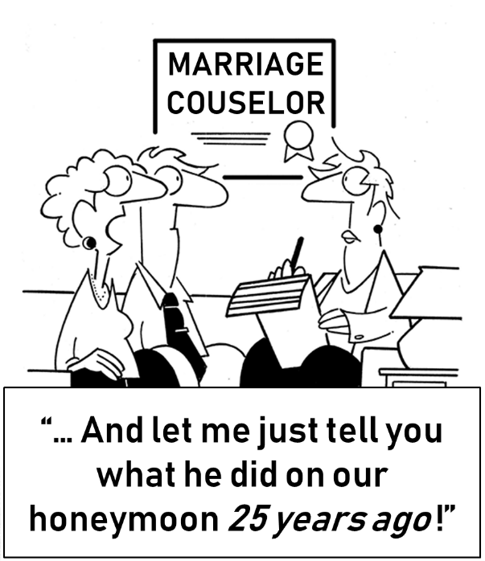
Resentment…
Can build up for years.
Some have trouble letting go of the past…
Resentment can remain for a lifetime.
T
22

Slide 16
Resentment…
Ruins relationships.
U
24
Even the closest of relationships.
Psalm 41:9 Even my close friend in whom I trusted, Who ate my bread, Has lifted up his heel against me.
Psalm 55:12 For it is not an enemy who reproaches me, Then I could bear it; Nor is it one who hates me who has exalted himself against me, Then I could hide myself from him. 13 But it is you, a man my equal, My companion and my familiar friend; 14 We who had sweet fellowship together Walked in the house of God in the throng.

Slide 17
Resentment…
Ruins relationships.
F
23
It can ruin the marriage relationship.
Think she’s resentful? Had he changed her?
1 Samuel 25:3 (now the man’s name was Nabal, and his wife’s name was Abigail. And the woman was intelligent and beautiful in appearance, but the man was harsh and evil in his dealings, and he was a Calebite)
1 Samuel 25:25 Please do not let my lord pay attention to this worthless man, Nabal, for as his name is, so is he. Nabal is his name and folly is with him; but I your maidservant did not see the young men of my lord whom you sent.

Slide 18
Resentment…
Changes a person.
Ahithophel was extremely smart. Why would he want to put himself in direct conflict with David, a king and warrior?
2 Samuel 15:33 David said to him (Hushai), “If you pass over with me, then you will be a burden to me. 34 But if you return to the city, and say to Absalom, ‘I will be your servant, O king; as I have been your father’s servant in time past, so I will now be your servant,’ then you can thwart the counsel of Ahithophel for me.
E
1

Slide 19
Resentment…
Changes a person.
C
9
Resentment made a very smart person act very foolishly.
Resentment makes a kind person turn mean, a compassionate person turn cold, and a happy person turn bitter.
Is it hard to recognize a bitter person? No.
Proverbs 14:10 The heart knows its own bitterness, And a stranger does not share its joy.

Slide 20
Resentment…
Can grow more destructive.
Ahithophel wants revenge.
The first advice he gives Absalom is to “steal” David’s wives!
Wonder where he got that idea?!
2 Samuel 16:20 Then Absalom said to Ahithophel, “Give your advice. What shall we do?” 21 Ahithophel said to Absalom, “Go in to your father’s concubines, whom he has left to keep the house; then all Israel will hear that you have made yourself odious to your father. The hands of all who are with you will also be strengthened.”
A
13

Slide 21
Resentment…
Can grow more destructive.
But even when Absalom takes David’s wives, that doesn’t satisfy Ahithophel’s resentment.
It wasn’t enough to embarrass David in front of the entire kingdom, Ahithophel wants him dead!
2 Samuel 17:1 Furthermore, Ahithophel said to Absalom, “Please let me choose 12,000 men that I may arise and pursue David tonight. 2 I will come upon him while he is weary and exhausted and terrify him, so that all the people who are with him will flee. Then I will strike down the king alone,
A
6

Slide 22
Resentment…
Can grow more destructive.
Sin (Satan) is eager to control us.
In the next verse, he kills his brother!
Genesis 4:4 NLT Abel also brought a gift—the best portions of the firstborn lambs from his flock. The Lord accepted Abel and his gift, 5 but he did not accept Cain and his gift. This made Cain very angry, and he looked dejected. 6 “Why are you so angry?” the Lord asked Cain. “Why do you look so dejected? 7 You will be accepted if you do what is right. But if you refuse to do what is right, then watch out! Sin is crouching at the door, eager to control you. But you must subdue it and be its master.”
B
3

Slide 23
Resentment…
Hurts the one who has it most.
“Resentment is like drinking poison and waiting on the other person to die.”
What was the end for Ahithophel?
2 Samuel 17:23 NKJV Now when Ahithophel saw that his advice was not followed, he saddled a donkey, and arose and went home to his house, to his city. Then he put his household in order, and hanged himself, and died; and he was buried in his father’s tomb.
R
14

Slide 24
Resentment…
Hurts the one who has it most.
He couldn’t see a possibility that David could forgive him.
Maybe because he couldn’t forgive David.
And if we can’t forgive, then we really shouldn’t expect forgiveness either.
I
15
Matthew 6:15 But if you do not forgive others, then your Father will not forgive your transgressions.

Slide 25
Resentment…
Hurts the one who has it most.
D
8
Job’s friend Eliphaz warned…
No matter how much you nurse a grudge, it won’t get better.
Job 5:2 NLT Surely resentment destroys the fool, and jealousy kills the simple.
Proverbs 19:11 GNT If you are sensible, you will control your temper. When someone wrongs you, it is a great virtue to ignore it.

Slide 26
Conclusion
You are the only person you can change.
And… ONLY YOU CAN CHANGE YOU.
Resentment can be a lifetime wasted with regret and anger… a lifetime burdened.
Don’t carry the unnecessary weight.
Proverbs 27:3 NLT A stone is heavy and sand is weighty, but the resentment caused by a fool is even heavier.
K
7

Slide 27
Conclusion
Puzzle Answer
Are we willing to be the Lord’s servants?
Resentment is a corrosive emotion that has no place in the Christian life. How can we who have been given so much have resentment in our hearts?
We have to let it go. We have to forgive.
2 Timothy 2:24 (NIV) And the Lord’s servant must not be quarrelsome but must be kind to everyone, able to teach, not resentful.

