Slide 1
Welcome.
We are glad that you have come to worship with us!
O’Neal church of Christ

Slide 2
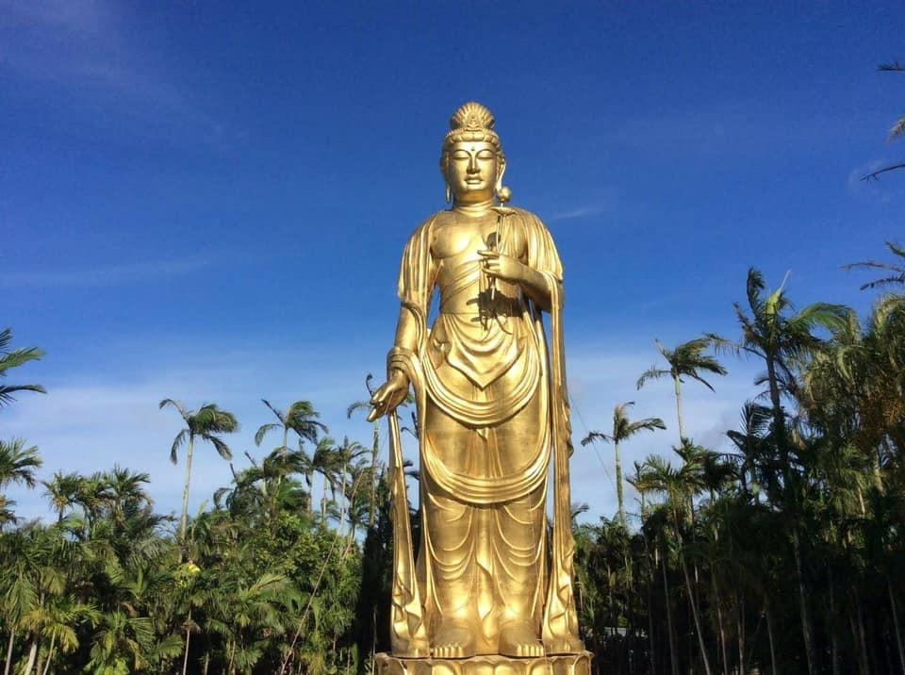
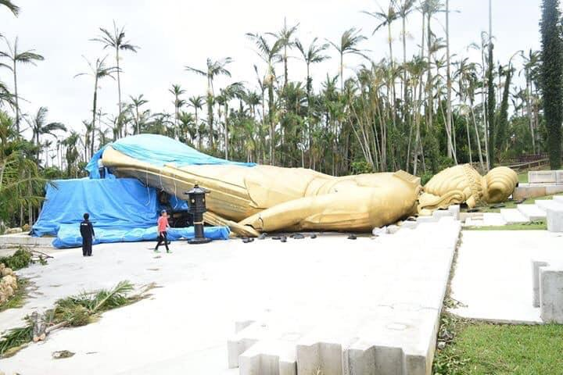
I believe in the God that can calm a storm rather than one that crumbles in a storm.

Slide 3
Idolatry
R
4
The first of the ten commandments
Exodus 20:3 “You shall have no other gods before Me.”

Slide 4
Idolatry
S
2
God warned Israel about serving foreign gods.
Deuteronomy 8:19 It shall come about if you ever forget the Lord your God and go after other gods and serve them and worship them, I testify against you today that you will surely perish. 20 Like the nations that the Lord makes to perish before you, so you shall perish; because you would not listen to the voice of the Lord your God.

Slide 5
Idolatry
I
11
God destroyed these nations because of their wickedness.
Deuteronomy 9:4 “Do not say in your heart when the Lord your God has driven them out before you, ‘Because of my righteousness the Lord has brought me in to possess this land,’ but it is because of the wickedness of these nations that the Lord is dispossessing them before you.

Slide 6
Idolatry
Their idolatry was an abomination, and even included child sacrifice.
Deuteronomy 12:31 You shall not worship the Lord your God in that way; for every abomination to the Lord which He hates they have done to their gods; for they burn even their sons and daughters in the fire to their gods.
I
6

Slide 7
Idolatry
Idolatry was a stonable offense under the law of Moses.
Deuteronomy 17:2 “If there is found among you, within any of your gates which the Lord your God gives you, a man or a woman who has been wicked in the sight of the Lord your God, in transgressing His covenant, 3 who has gone and served other gods and worshiped them,
5 then you shall bring out to your gates that man or woman who has committed that wicked thing, and shall stone to death that man or woman with stones.

Slide 8
Idolatry
O
1
And Israel’s idolatry finally caused God to divide the kingdom.
1 Kings 11:31 Behold, I will tear the kingdom out of the hand of Solomon and give you ten tribes 33 because they have forsaken Me, and have worshiped Ashtoreth the goddess of the Sidonians, Chemosh the god of Moab, and Milcom the god of the sons of Ammon; and they have not walked in My ways, doing what is right in My sight and observing My statutes and My ordinances, as his father David did.

Slide 9
Idolatry
V
23
Paul told the Corinthians to stay away from idolaters.
1 Corinthians 10:14 Therefore, my beloved, flee from idolatry.
1 Corinthians 5:11 NASB But actually, I wrote to you not to associate with any so-called brother if he is an immoral person, or covetous, or an idolater, or a reviler, or a drunkard, or a swindler—not even to eat with such a one.

Slide 10
Idolatry
M
22
No Idolater will receive an eternal inheritance!
Galatians 5:19 Now the works of the flesh are evident, which are: adultery, fornication, uncleanness, lewdness, 20 idolatry, sorcery, hatred, contentions, jealousies, outbursts of wrath, selfish ambitions, dissensions, heresies, 21 envy, murders, drunkenness, revelries, and the like; of which I tell you beforehand, just as I also told you in time past, that those who practice such things will not inherit the kingdom of God.

Slide 11
idolatry
Surely we can all see that
God hates idolatry.
I
9

Slide 12
1 Samuel 15 NASB
10 Then the word of the Lord came to Samuel, saying, 11 “I regret that I have made Saul king, for he has turned back from following Me and has not carried out My commands.” And Samuel was distressed and cried out to the Lord all night.

Slide 13
1 Samuel 15 NKJV
12 So when Samuel rose early in the morning to meet Saul, it was told Samuel, saying, “Saul went to Carmel, and indeed, he set up a monument for himself; and he has gone on around, passed by, and gone down to Gilgal.” 13 Then Samuel went to Saul, and Saul said to him, “Blessed are you of the Lord! I have performed the commandment of the Lord.” 14 But Samuel said, “What then is this bleating of the sheep in my ears, and the lowing of the oxen which I hear?”

Slide 14
1 Samuel 15 NKJV
15 And Saul said, “They have brought them from the Amalekites; for the people spared the best of the sheep and the oxen, to sacrifice to the Lord your God; and the rest we have utterly destroyed.” 16 Then Samuel said to Saul, “Be quiet! And I will tell you what the Lord said to me last night.” And he said to him, “Speak on.” 17 So Samuel said, “When you were little in your own eyes, were you not head of the tribes of Israel? And did not the Lord anoint you king over Israel?

Slide 15
1 Samuel 15 NKJV
18 Now the Lord sent you on a mission, and said, ‘Go, and utterly destroy the sinners, the Amalekites, and fight against them until they are consumed.’ 19 Why then did you not obey the voice of the Lord? Why did you swoop down on the spoil, and do evil in the sight of the Lord?” 20 And Saul said to Samuel, “But I have obeyed the voice of the Lord, and gone on the mission on which the Lord sent me, and brought back Agag king of Amalek; I have utterly destroyed the Amalekites.

Slide 16
1 Samuel 15 NKJV
21 But the people took of the plunder, sheep and oxen, the best of the things which should have been utterly destroyed, to sacrifice to the Lord your God in Gilgal.” 22 So Samuel said: “Has the Lord as great delight in burnt offerings and sacrifices, As in obeying the voice of the Lord? Behold, to obey is better than sacrifice, And to heed than the fat of rams. 23 For rebellion is as the sin of witchcraft, And stubbornness is as iniquity and idolatry. Because you have rejected the word of the Lord, He also has rejected you from being king.”

Slide 17
Stubbornness
Another sin that is as idolatry…
1 Samuel 15:23 NKJV For rebellion is as the sin of witchcraft, And stubbornness is as iniquity and idolatry. Because you have rejected the word of the Lord, He also has rejected you from being king.”
G
20

Slide 18
Stubbornness
O
24
The punishment under the law of Moses was the same as Idolatry.
Deuteronomy 21:18 “If a man has a stubborn and rebellious son who will not obey the voice of his father or the voice of his mother, and who, when they have chastened him, will not heed them, 21 Then all the men of his city shall stone him to death with stones; so you shall put away the evil from among you, and all Israel shall hear and fear.

Slide 19
Stubbornness
Stubbornness is as iniquity…
What is iniquity?
1 Samuel 15:23 NKJV For rebellion is as the sin of witchcraft, And stubbornness is as iniquity and idolatry. Because you have rejected the word of the Lord, He also has rejected you from being king.”
S
12

Slide 20
Synonyms for sin
D
8
Defining sin.
1 John 3:4 Whoever commits sin also commits lawlessness, and sin is lawlessness.
Mark 11:26 But if you do not forgive, neither will your Father in heaven forgive your trespasses.”
Psalm 32:5 I acknowledged my sin to You, And my iniquity I have not hidden. I said, “I will confess my transgressions to the Lord,” And You forgave the iniquity of my sin. Selah

Slide 21
Synonyms for sin
F
10
Trespasses – cross a boundary
Transgressions – to go beyond
Iniquity – wickedness
Micah 2:1 Woe to those who scheme iniquity, Who work out evil on their beds! When morning comes, they do it, For it is in the power of their hands.
premeditated sin.

Slide 22
1 Samuel 15 NASB
21 But the people took of the plunder, sheep and oxen, the best of the things which should have been utterly destroyed, to sacrifice to the Lord your God in Gilgal.” 22 So Samuel said: “Has the Lord as great delight in burnt offerings and sacrifices, As in obeying the voice of the Lord? Behold, to obey is better than sacrifice, And to heed than the fat of rams. 23 For rebellion is as the sin of witchcraft, And stubbornness is as iniquity and idolatry. Because you have rejected the word of the Lord, He also has rejected you from being king.”

Slide 23
the biggest problem I've had with stubbornness IS…
I haven’t viewed stubbornness the same way God views stubbornness.
N
16

Slide 24
What does stubbornness do?
Praises itself – vs 12

Slide 25
Stubbornness praises itself.
I
25
Saul was proud of “his” success.
1 Samuel 15:12 So when Samuel rose early in the morning to meet Saul, it was told Samuel, saying, “Saul went to Carmel, and indeed, he set up a monument for himself; and he has gone on around, passed by, and gone down to Gilgal.” 13 Then Samuel went to Saul, and Saul said to him, “Blessed are you of the Lord! I have performed the commandment of the Lord.”

Slide 26
Stubbornness praises itself.
D
13
Stubbornness boasts.
Stubbornness is wise in its opinion.
Proverbs 27:2 Let another man praise you, and not your own mouth; A stranger, and not your own lips.
Romans 12:16 Be of the same mind toward one another. Do not set your mind on high things, but associate with the humble. Do not be wise in your own opinion.

Slide 27
Stubbornness praises itself.
A
17
It thinks it has the only answer.
We all know some stuff.
We can all learn from each other.
1 Corinthians 8:1 Now concerning things offered to idols: We know that we all have knowledge. Knowledge puffs up, but love edifies. 2 And if anyone thinks that he knows anything, he knows nothing yet as he ought to know.

Slide 28
What does stubbornness do?
Praises itself – vs 12
Shifts blame – vs 15

Slide 29
Stubbornness shifts blame.
M
3
Saul said it wasn't his fault.
It’s easier to assign blame than to admit failure.
1 Samuel 15:15 And Saul said, “They have brought them from the Amalekites; for the people spared the best of the sheep and the oxen, to sacrifice to the Lord your God; and the rest we have utterly destroyed.”
21 But the people took some of the spoil,

Slide 30
Stubbornness shifts blame.
Excuse making is easy.
“I was going to ______ today, but the kids ______.”
Proverbs 26:13 The sluggard says, “There is a lion in the road! A lion is in the open square!”.
O
14

Slide 31
What does stubbornness do?
Praises itself – vs 12
Shifts blame – vs 15
Ignores authority – vs 19

Slide 32
Stubbornness ignores authority.
Saul ignored God and His prophet.
Saul did what he wanted to do.
1 Samuel 15:19 Why then did you not obey the voice of the Lord? Why did you swoop down on the spoil, and do evil in the sight of the Lord?”
B
5

Slide 33
Stubbornness ignores authority.
W
7
Stubbornness walks in it’s own way and does what it wants to do.
It follows its own stubborn heart.
Psalm 81:11 “But My people would not heed My voice, And Israel would have none of Me. 12 So I gave them over to their own stubborn heart, To walk in their own counsels. 13 “Oh, that My people would listen to Me, That Israel would walk in My ways!

Slide 34
Stubbornness ignores authority.
Psalm 32:8 I will instruct you and teach you in the way you should go; I will guide you with My eye. 9 Do not be like the horse or like the mule, Which have no understanding, Which must be harnessed with bit and bridle, Else they will not come near you.
“They're stubborn as a mule.”
But there's a difference between horses and mules…
E
21
Self will.

Slide 35
What does stubbornness do?
Praises itself – verse 12
Shifts blame – verse 15
Ignores authority – verse 19
Is unyielding – verse 20

Slide 36
Stubbornness is unyielding.
L
19
Saul just couldn’t see that he had done anything wrong.
1 Samuel 15:20 And Saul said to Samuel, “But I have obeyed the voice of the Lord, and gone on the mission on which the Lord sent me, and brought back Agag king of Amalek; I have utterly destroyed the Amalekites.
Proverbs 12:15 The way of a fool is right in his own eyes, But he who heeds counsel is wise.

Slide 37
Stubbornness is unyielding.
Y
18
Isaiah 48:4 NLT For I know how stubborn and obstinate you are. Your necks are as unbending as iron. Your heads are as hard as bronze.
Isaiah 64:8 NLT And yet, O Lord, you are our Father. We are the clay, and you are the potter. We all are formed by your hand.
Am I iron or clay in the Potter’s Hands?

Slide 38
conclusion
Puzzle Answer
Wisdom from above is yielding.
Are we willing to yield, that is, to listen to and be obedient to God?
James 3:17 But the wisdom that is from above is first pure, then peaceable, gentle, willing to yield, full of mercy and good fruits, without partiality and without hypocrisy.

Slide 39
Goals for Growth
Read Psalm 25 (guidance).
Pray for Godly wisdom.
Listen.

Slide 40
conclusion
Some idolaters repented.
1 Corinthians 6:9 Do you not know that the unrighteous will not inherit the kingdom of God? Do not be deceived. Neither fornicators, nor idolaters, nor adulterers, nor homosexuals, nor sodomites, 10 nor thieves, nor covetous, nor drunkards, nor revilers, nor extortioners will inherit the kingdom of God. 11 And such were some of you. But you were washed, but you were sanctified, but you were justified in the name of the Lord Jesus and by the Spirit of our God.

