Slide 2
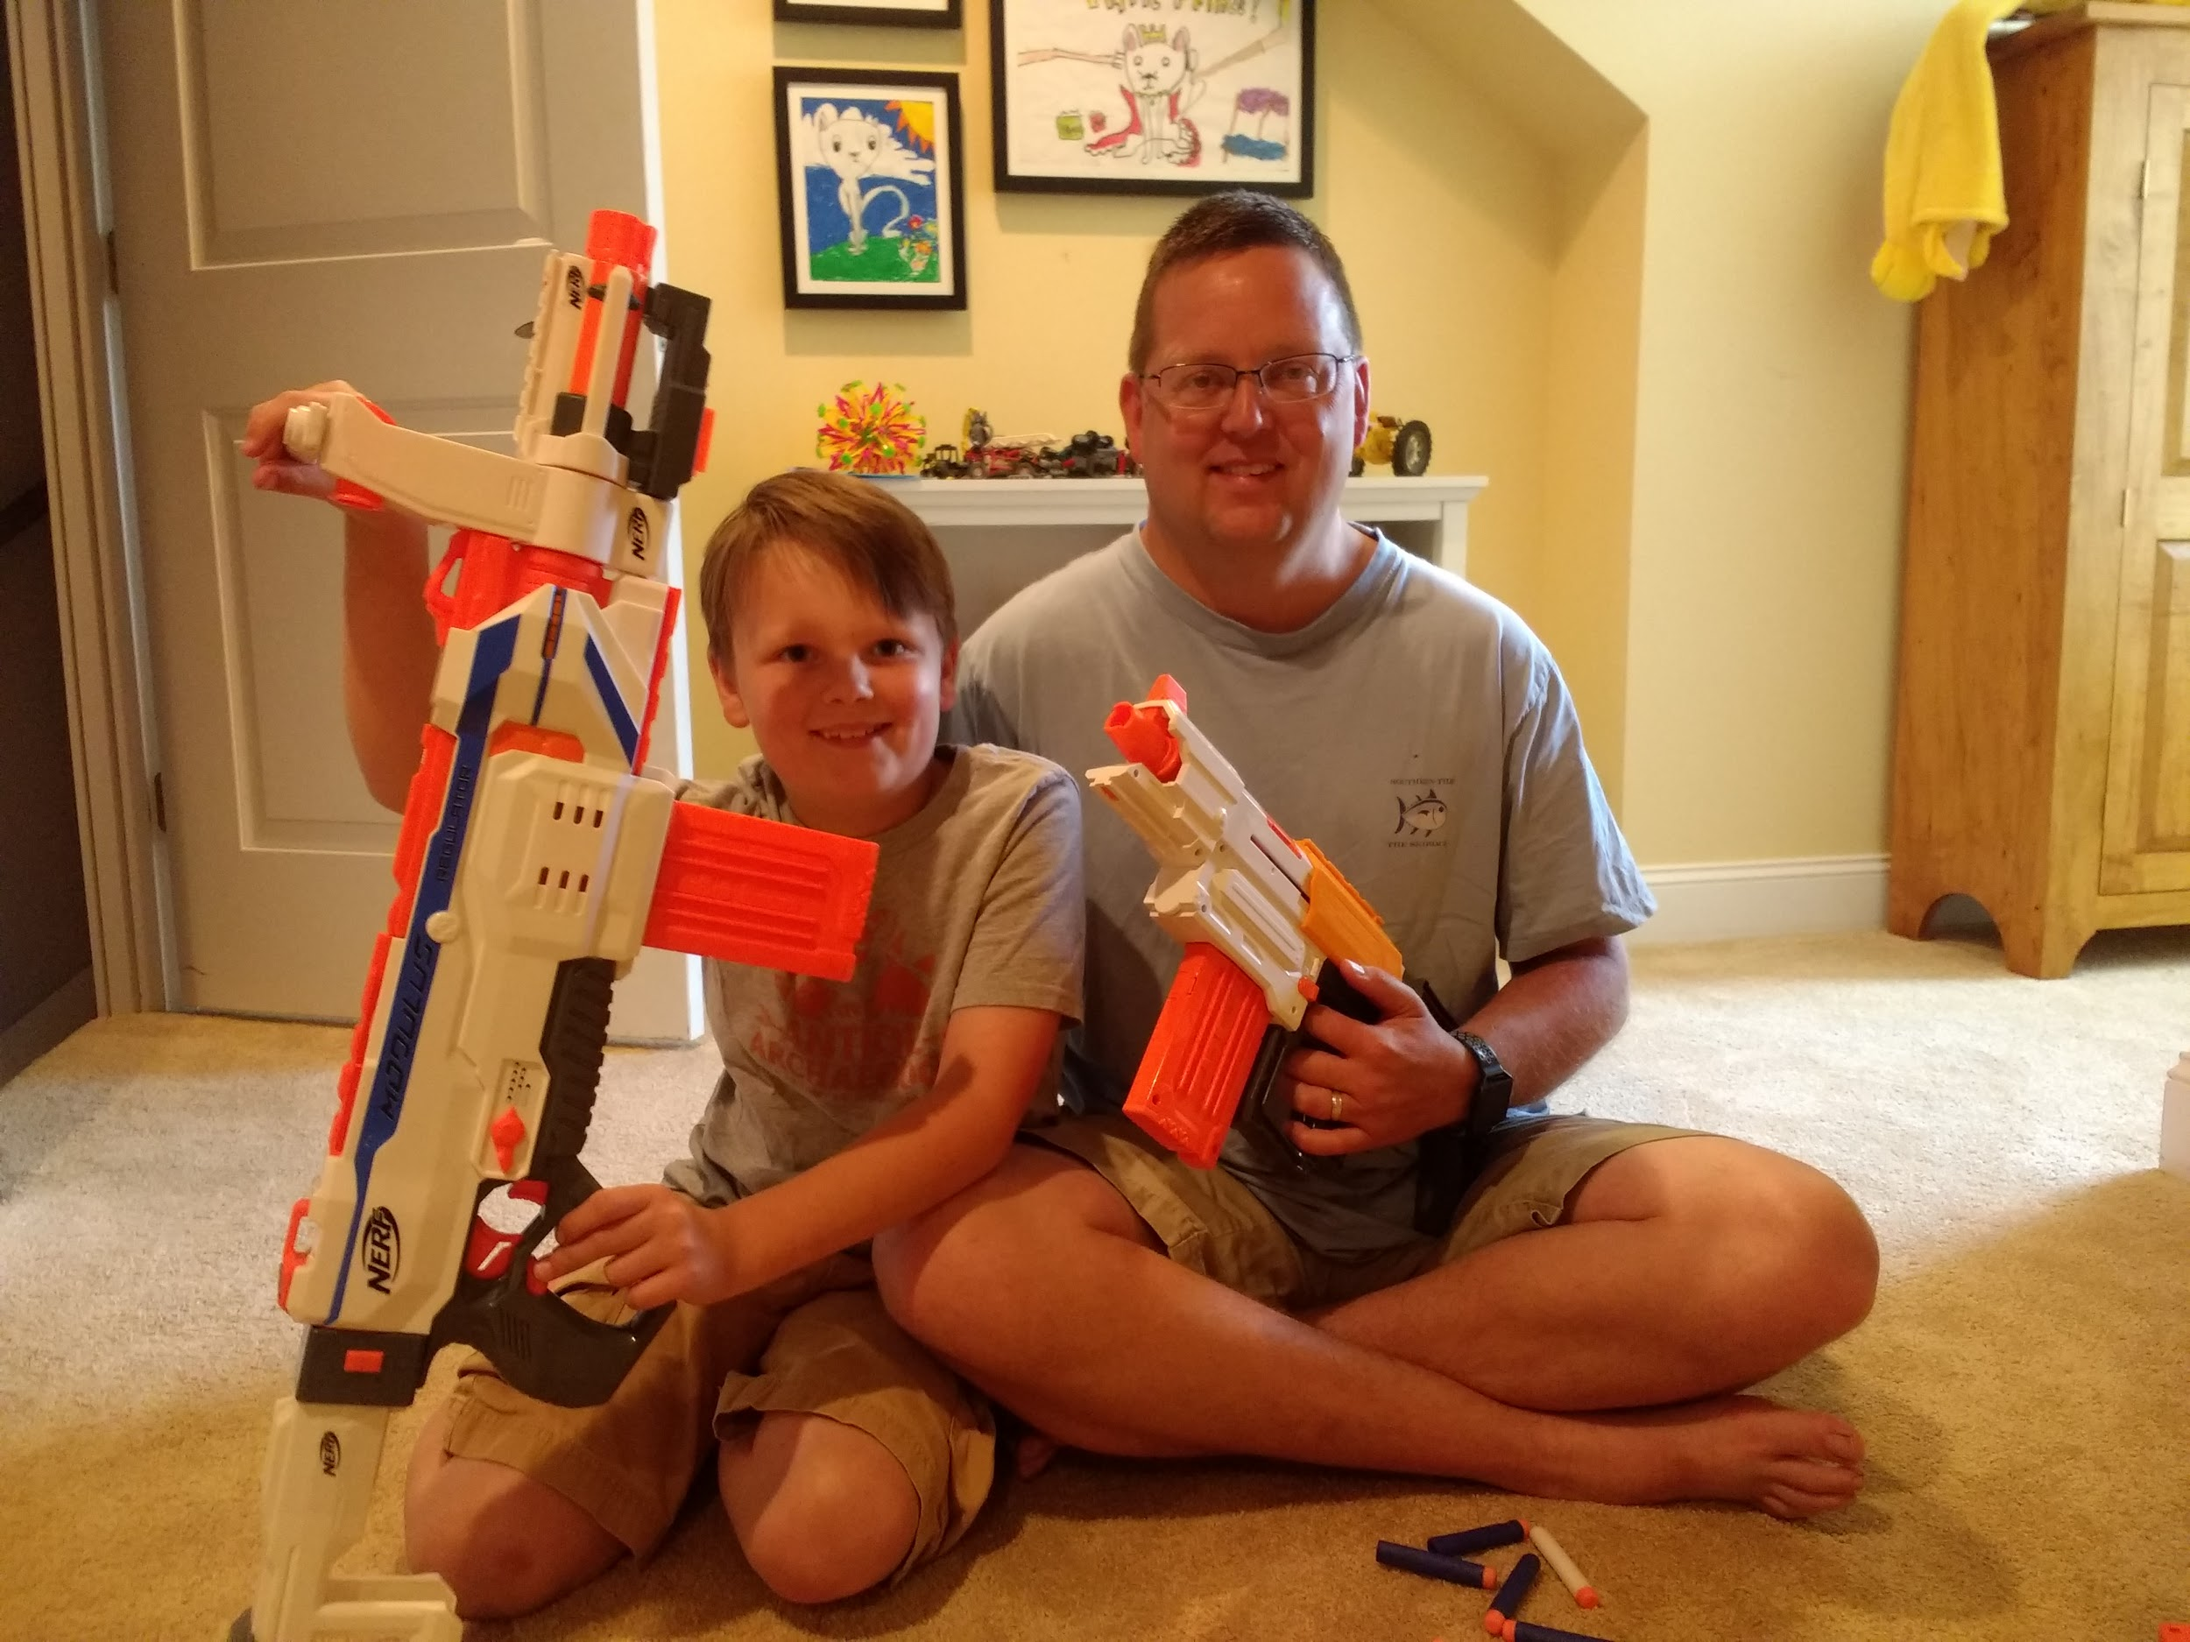

Slide 3
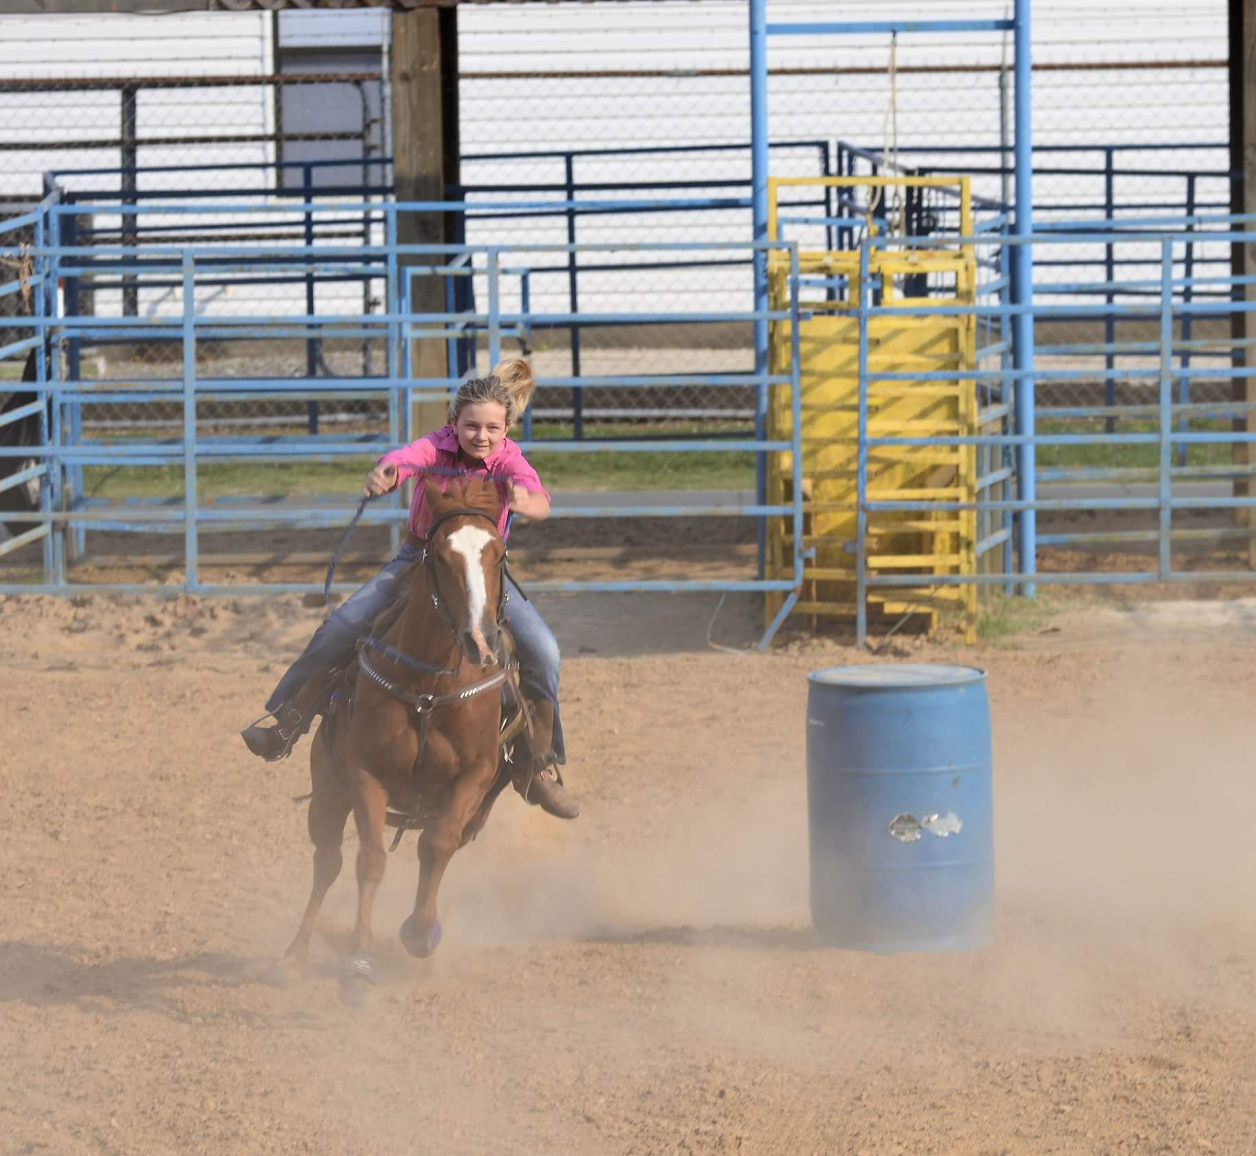

Slide 4
The night before
Abraham
Jesus
Darius
Mary Magdalene
Notes:
4

Slide 5
Abraham’s night before
Now it came about after these things, that God tested Abraham, and said to him, “Abraham!” And he said, “Here I am.” He said, “Take now your son, your only son, whom you love, Isaac, and go to the land of Moriah, and offer him there as a burnt offering on one of the mountains of which I will tell you.” So Abraham rose early in the morning and saddled his donkey, and took two of his young men with him and Isaac his son; and he split wood for the burnt offering, and arose and went to the place of which God had told him. Genesis 22:1-3
Notes:
5

Slide 6
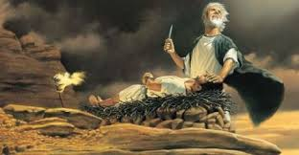

Slide 7
Can we imagine that night before?
What was that night before like?
What would we do in that situation?
How would we feel?
Notes:
7

Slide 8
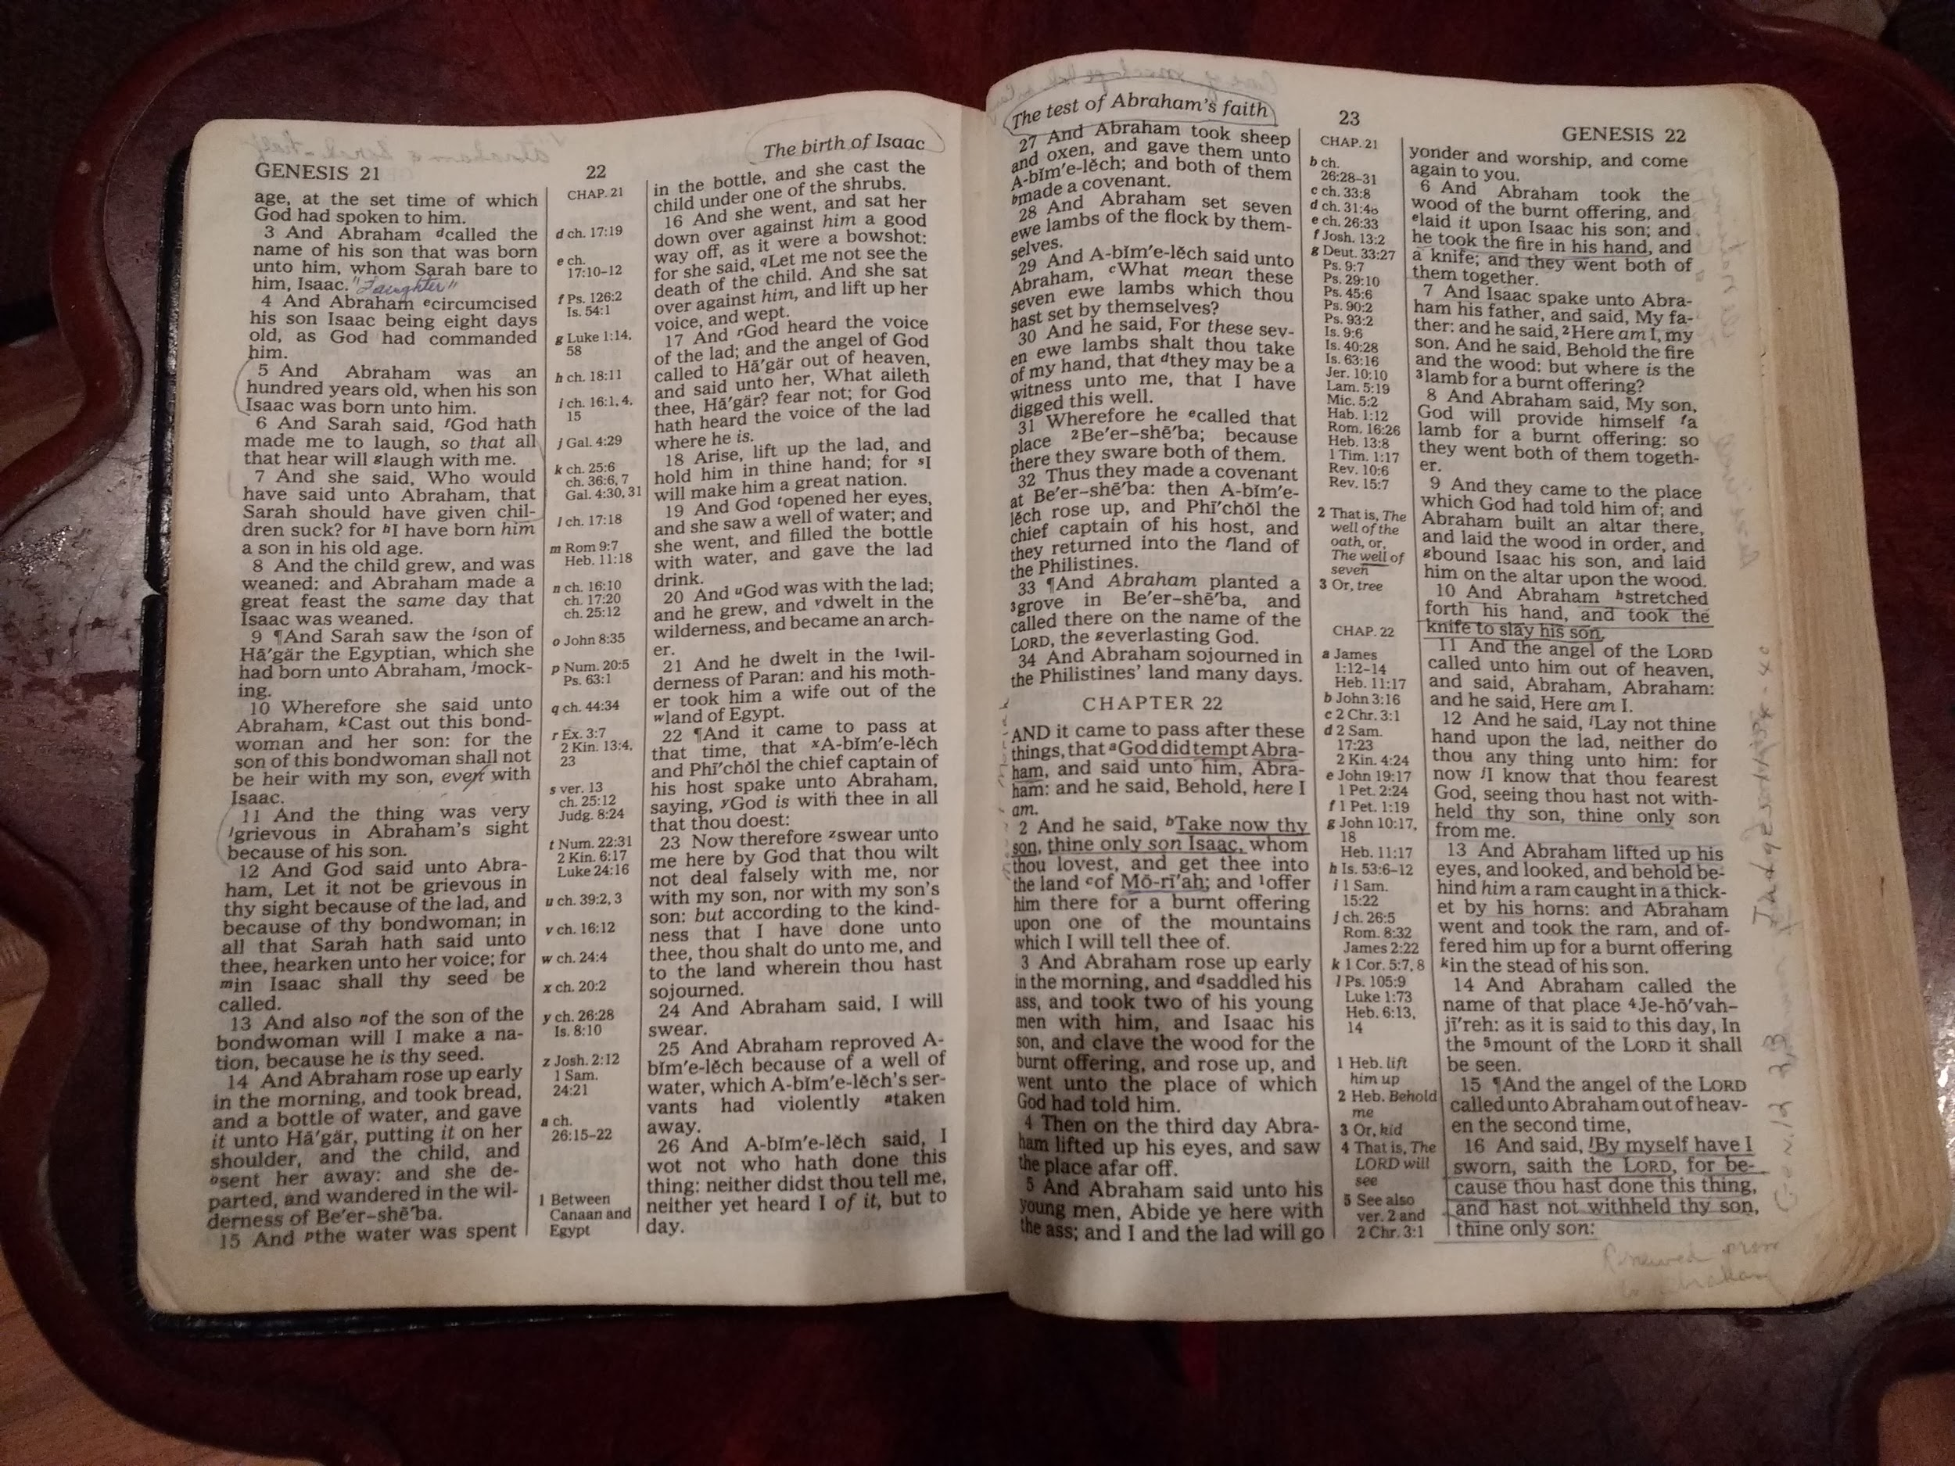
Have we ever had a similar night before?

Slide 9
Read it again… Genesis 22:1-3
Now it came about after these things, that God tested Abraham, and said to him, “Abraham!” And he said, “Here I am.” He said, “Take now your son, your only son, whom you love, Isaac, and go to the land of Moriah, and offer him there as a burnt offering on one of the mountains of which I will tell you.” So Abraham rose early in the morning and saddled his donkey, and took two of his young men with him and Isaac his son; and he split wood for the burnt offering, and arose and went to the place of which God had told him.

Slide 10
Genesis 22:4-7
On the third day Abraham raised his eyes and saw the place from a distance. Abraham said to his young men, “Stay here with the donkey, and I and the lad will go over there; and we will worship and return to you.” Abraham took the wood of the burnt offering and laid it on Isaac his son, and he took in his hand the fire and the knife. So the two of them walked on together. Isaac spoke to Abraham his father and said, “My father!” And he said, “Here I am, my son.” And he said, “Behold, the fire and the wood, but where is the lamb for the burnt offering?”

Slide 11
Verse 8 to 12
Abraham said, “God will provide for Himself the lamb for the burnt offering, my son.” So the two of them walked on together. Then they came to the place of which God had told him; and Abraham built the altar there and arranged the wood, and bound his son Isaac and laid him on the altar, on top of the wood. Abraham stretched out his hand and took the knife to slay his son. But the angel of the Lord called to him from heaven and said, “Abraham, Abraham!” And he said, “Here I am.” He said, “Do not stretch out your hand against the lad, …

Slide 12
Why is that shadow written?
Maybe so that we could better relate to God’s night before.
Notes:
12

Slide 13
Jesus’ night before
Then Jesus came with them to a place called Gethsemane, and said to His disciples, “Sit here while I go over there and pray.” And He took with Him Peter and the two sons of Zebedee, and began to be grieved and distressed. Then He *said to them, “My soul is deeply grieved, to the point of death; remain here and keep watch with Me.” And He went a little beyond them, and fell on His face and prayed, saying, “My Father, if it is possible, let this cup pass from Me; yet not as I will, but as You will.” Matthew 26: 36-39
Notes:
13

Slide 14
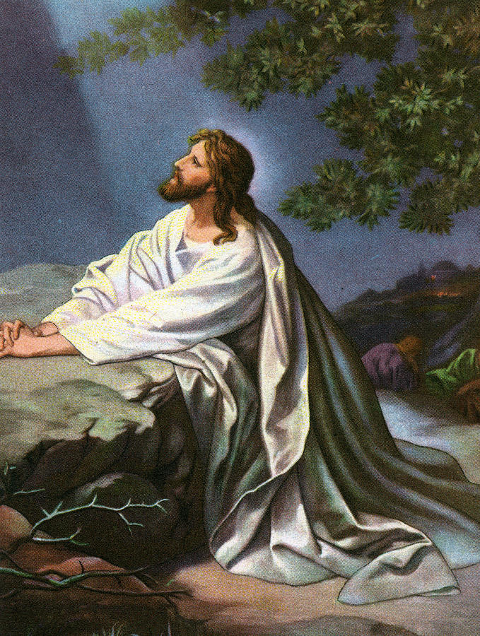
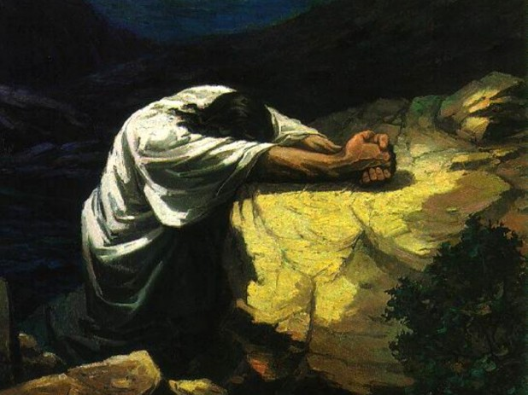

Slide 15
Jesus night before
And He went a little beyond them, and fell on His face and prayed,... Matthew 26
And being in agony He was praying very fervently; and His sweat became like drops of blood, falling down upon the ground. Luke 22:44
Why was Jesus in agony?
Do not fear those who kill the body but are unable to kill the soul; but rather fear Him who is able to destroy both soul and body in hell. Matthew 10:28
Notes:
15

Slide 16
Jesus was in agony because He knew He would carry our sorrows and grief!
About the ninth hour Jesus cried out with a loud voice, saying, “ELI, ELI, LAMA SABACHTHANI?” that is, “MY GOD, MY GOD, WHY HAVE YOU FORSAKEN ME?” Matthew 27:46
Notes:
16

Slide 17
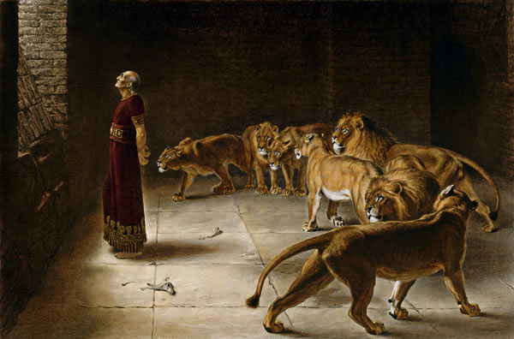
Darius’ night before
Then the king went off to his palace and spent the night fasting, and no entertainment was brought before him; and his sleep fled from him. Then the king arose at dawn, at the break of day, and went in haste to the lions’ den. When he had come near the den to Daniel, he cried out with a troubled voice. The king spoke and said to Daniel, “Daniel, servant of the living God, has your God, whom you constantly serve, been able to deliver you from the lions?” Daniel 6:18-20

Slide 18
Mary’s night before
When the Sabbath was over, Mary Magdalene, and Mary the mother of James, and Salome, bought spices, so that they might come and anoint Him. Very early on the first day of the week, they came to the tomb when the sun had risen. They were saying to one another, “Who will roll away the stone for us from the entrance of the tomb?” Mark 16:1-3
Notes:
18

Slide 19
They were not going to celebrate but to see their loved one. But they were separated by a stone!
Notes:
19

Slide 20
The Creaky Stair
What if…

Slide 21
Your night before
This could be your night before.
The night before your soul is required.
But God said to him, ‘You fool! This very night your soul is required of you; and now who will own what you have prepared? Luke 12:20
Notes:
21

Slide 22
July 16th and September 20th

